Slide 1
FE Developers 2022

Slide 2
Content
Data Share : Survive the Winter
2021~2022 FE Trends
React 18 detailed
Web3 Stack intro
Rust intro

Slide 3
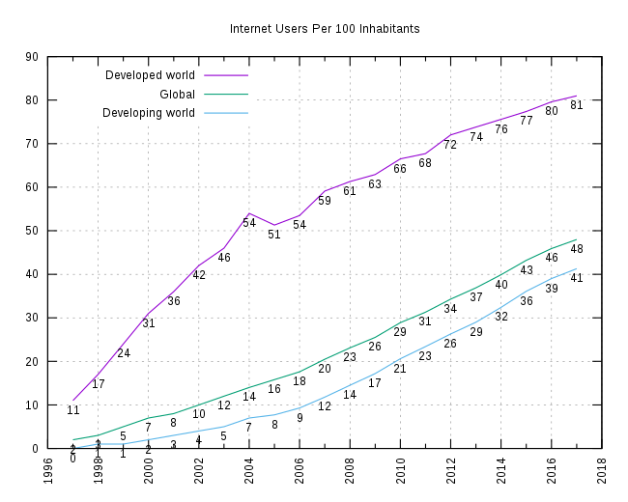
Internet Users Per 100 Inhabitants

Slide 4
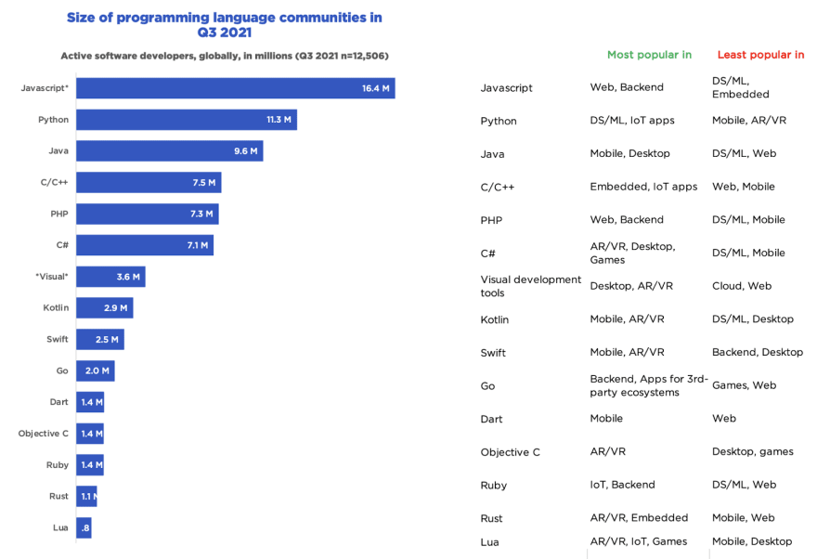
JavaScript's' adoption

Slide 5
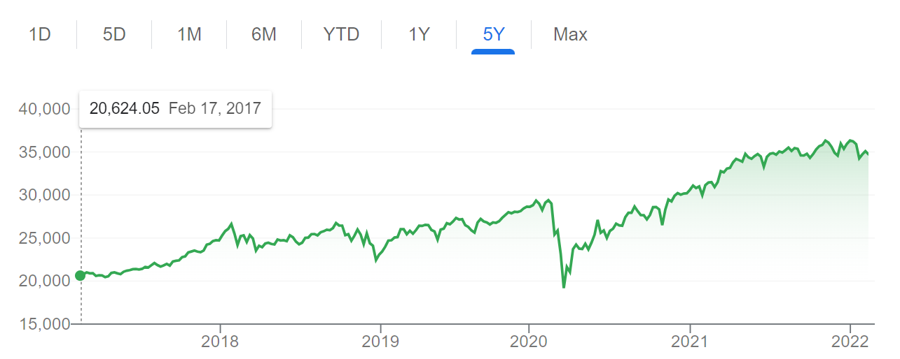
Dow Jones Industrial Market Index

Slide 6
我的 2021 ~ 2022计划
大形势： Long(看多) / Short(看空） ?
2014年转前端的Story… TL;DR.
前端 React 18/Vue 3/Es Build/Web Worker/D3/Web Assembly
Web3 + Meta solidity / unity / truffle / remix / Ethereum / File Coin
架构 Builder / Codeless / DDD
语言 Rust / Solidity
基础 AP Courses / White papers / Decentralized Algorithms and Apps

Slide 7
React 18
Link: https://github.com/reactwg/react-18
Out-of-box(开箱即用的) improvements
Concurrent（并发） Features
Concurrent vs Parallel ?
Server Components(服务端组件) & build-in(内置) Cache

Slide 8
React 18 SSR In Depth

Slide 9
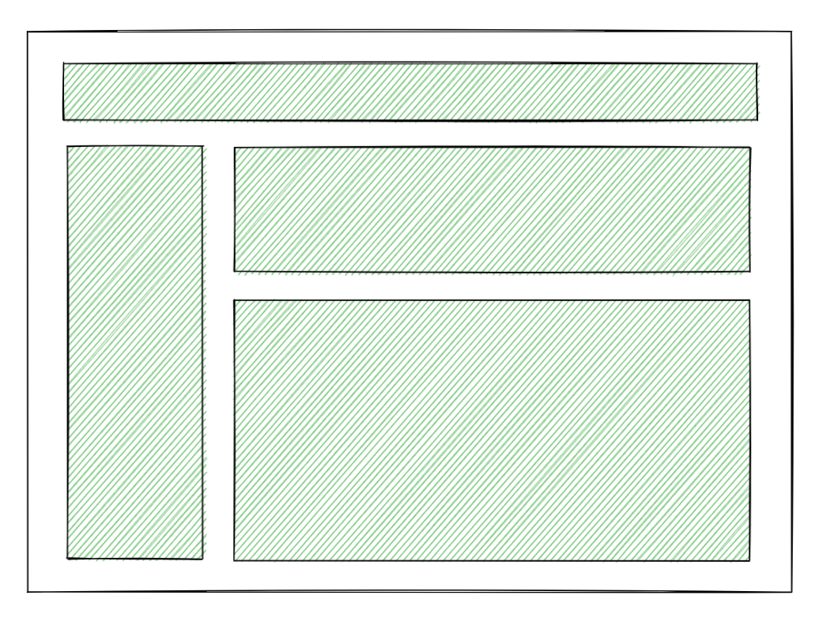
React 18 SSR Achitecture

Slide 10
React 18 SSR Example

Slide 11

Without SSR

Slide 12
SSR Problems
Fetch everything before display
Load everything before hydrate(水合)
Hydrate everything before interact
How to solve ?

Slide 13
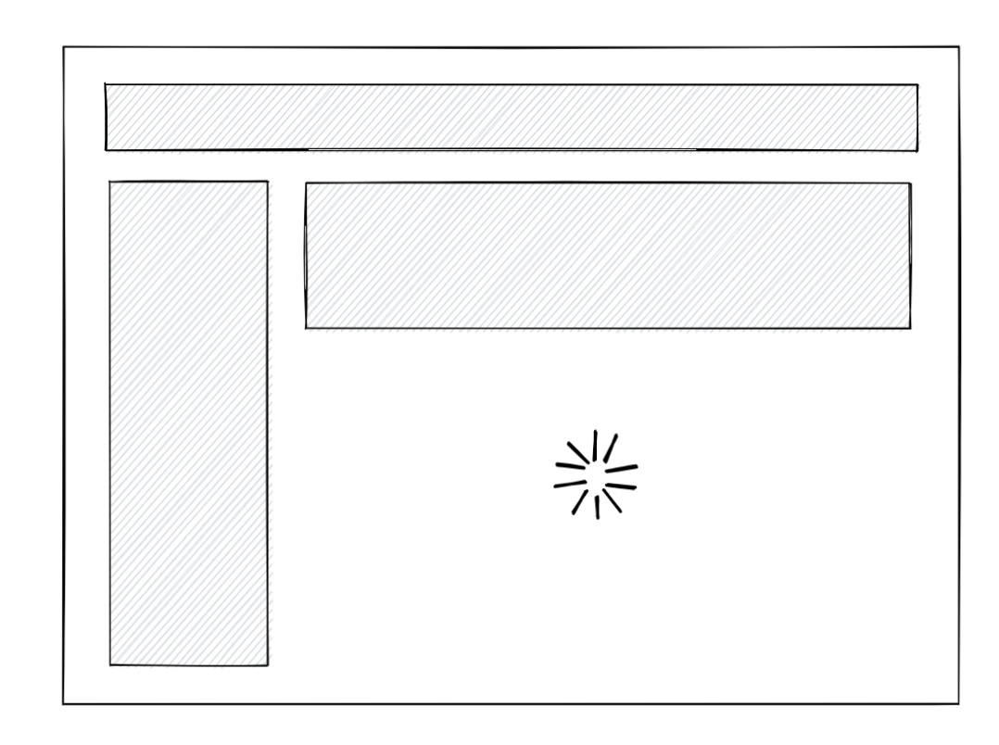
Streaming HTML and Selective Hydration
<Layout>
<NavBar />
<Sidebar />
<RightPane>
<Post />
<Suspense fallback={<Spinner />}>
<Comments />
</Suspense>
</RightPane>
</Layout>

Slide 14
React 18 Concurrent Features

Slide 15
startTransition
import { startTransition } from 'react';
// Urgent（紧急的）: Show what was typed
setInputValue(input);
// Mark any state updates inside as transitions
startTransition(() => {
// Transition: Show the results
setSearchQuery(input);
});

Slide 16
Control group #1
setInputValue(input);
setTimeout(() => {
setSearchQuery(input);
}, 200);

Slide 17
Control group #2
// Show what you typed
setInputValue(input);
// Show the results
setTimeout(debounce(() => {
setSearchQuery(input);
}, 300ms), 0);

Slide 18
Concurrent Transition
----- urgent updates ------------------
\--- transition updates ----/
UI Universe
Parallel Universe
Merge Back

Slide 19
Think Deeper
再给出1个必须用useTransition的场景？

Slide 20
Server Components
https://reactjs.org/blog/2020/12/21/data-fetching-with-react-server-components.html

Slide 21
Web3 Stack 押注未来的前端工作机会

Slide 22

What is Web3?
Everything related to Decentralized Application.

Slide 23
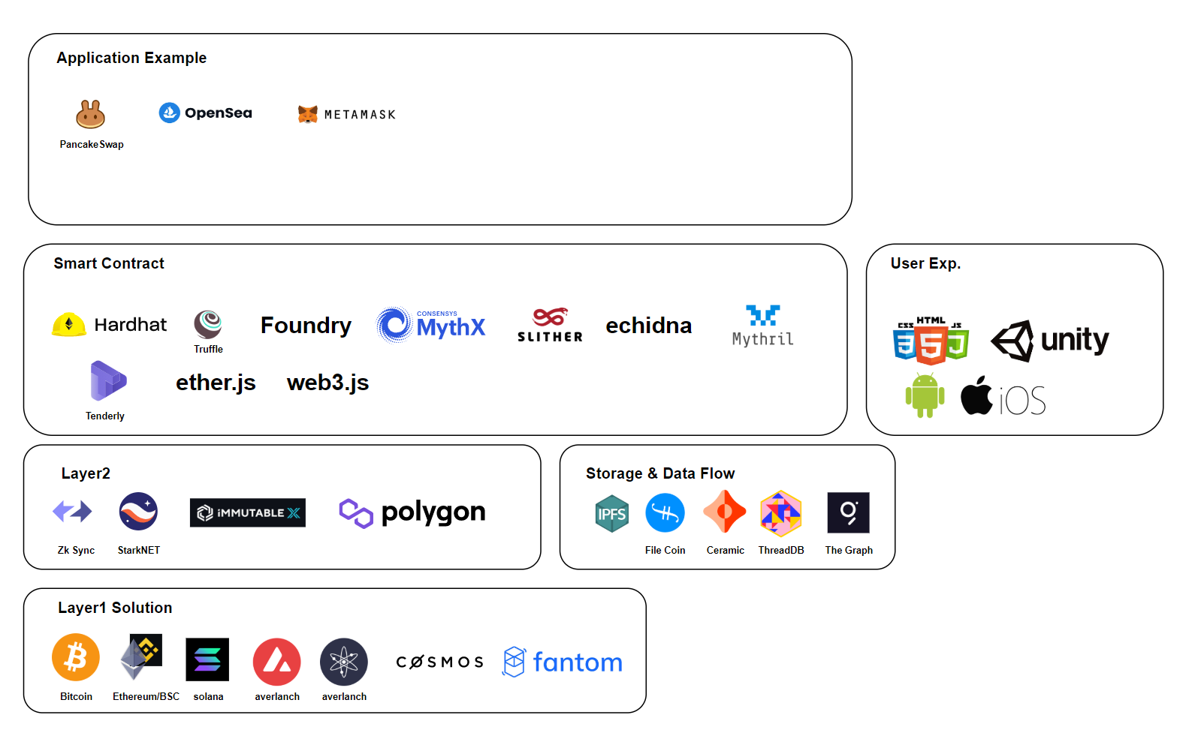

Slide 24
The State of Web Assembly 2021~2022 押注未来的前端工作机会

Slide 25
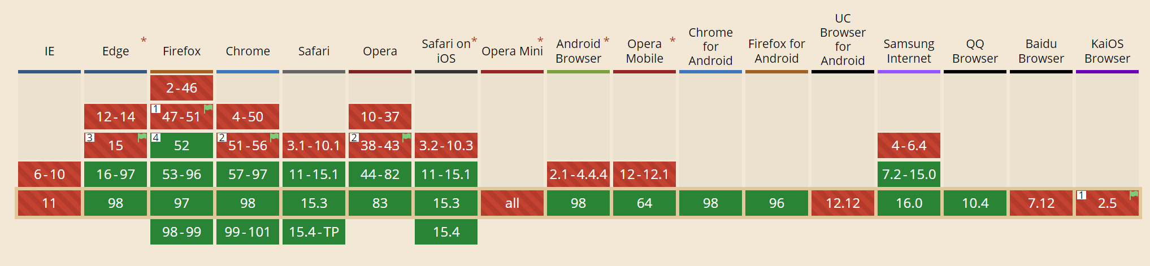
Browser Support

Slide 26
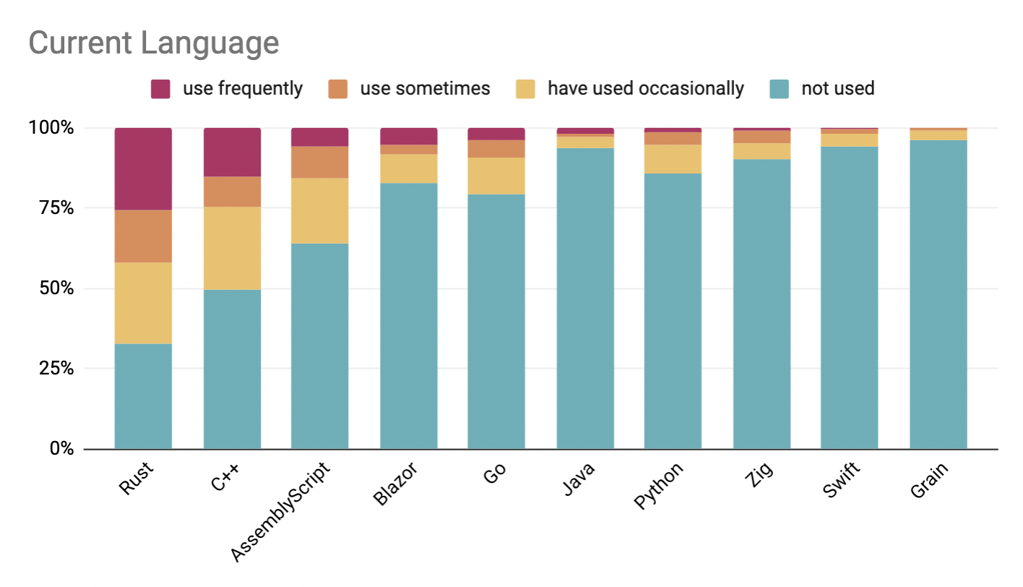
Usage

Slide 27
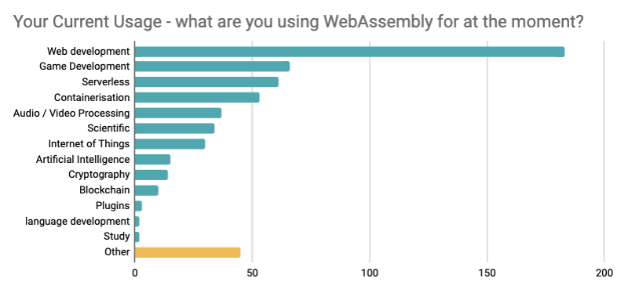
Web Assembly Applications

Slide 28
Stream Compilation
var importObject = { imports: { imported_func: arg => console.log(arg) } };
WebAssembly.compileStreaming(fetch('simple.wasm'))
.then(module => WebAssembly.instantiate(module, importObject))
.then(instance => instance.exports.exported_func());
详细链接

Slide 29
Memory Performance
Bulk Memory Operations : Support large scale memory copy
More: Webassembly Text format
Up to 4GB of memory ( V8 upgrade , 2g -> 4g )
Exception Handling : Break control flow when an exception is thrown.

Slide 30
Safe Upgrades : Support for the COOP and COEP
COOP：Cross Origin Opener Policy
COEP：Cross Origin Embedder Policy
more spectre: https://www.w3.org/TR/post-spectre-webdev/

Slide 31
Rust Programmer 押注未来的前端工作机会

Slide 32
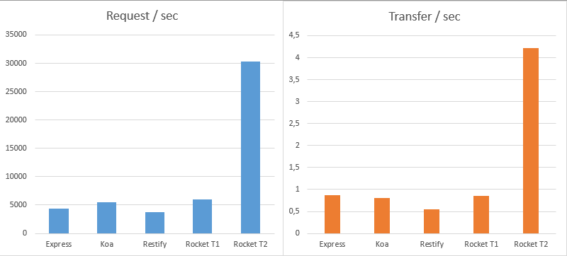
Fast
原文：https://medium.com/@lholznagel/comparing-nodejs-and-rust-http-frameworks-response-times-5738dfa1843d

Slide 33
Supercharge Javascript
Web Assembly Support https://rustwasm.github.io/docs/book/
Cargo

