Slide 1
“Inference of Population Structure using Dense Haplotype Data”
Written by Lawson, Hellenthal, Myers, and Falush (2012)
Presented by Seth Temple

Slide 2
Process
Phase data
“Paint chromosomes” to calculate coancestry matrix
Use coancestry matrix to infer populations
Principal Components Analysis (PCA)
Eigenstrat, Price et al (2006)
fineSTRUCTURE
structure
ADMIXTURE (2009)
(Optional) Visualize with a tree diagram

Slide 3
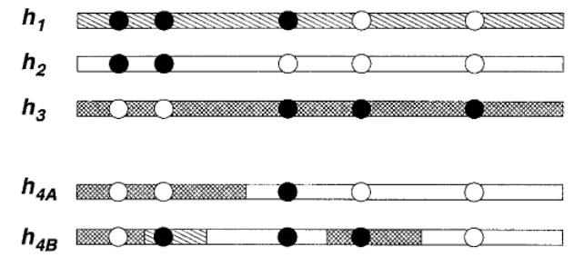
Li and Stephens (2003)
Hidden Markov Model (HMM) to describe genealogical process

Slide 4
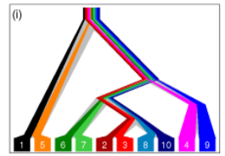
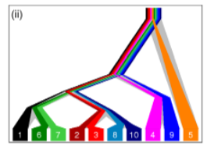
ChromoPainter
HMM like Li and Stephens (2003), but without ordering haplotypes

Slide 5
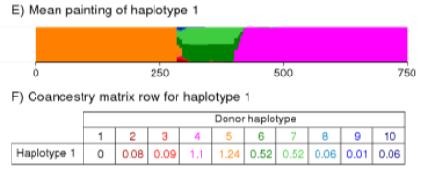
Coancestry Matrix
x_{ij} is the expected number of chunks inferred from donor j to haplotype i
Parameter rho used to consider linked vs unlinked loci

Slide 6
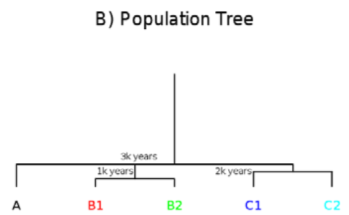
Simulation Study

Slide 7
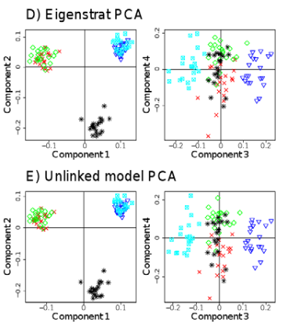
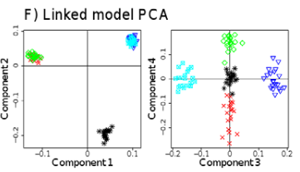
Simulation Study: PCA

Slide 8
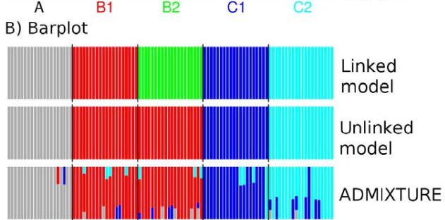
Simulation Study: Model-based Approaches

Slide 9
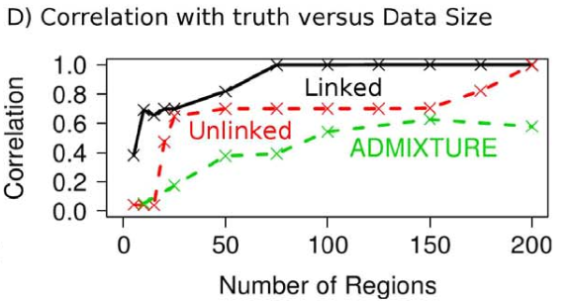
Simulation Study: Model-based Approaches
“using linkage information will therefore be expected to allow clear identification of more subtle structure than is detectable otherwise”

Slide 10
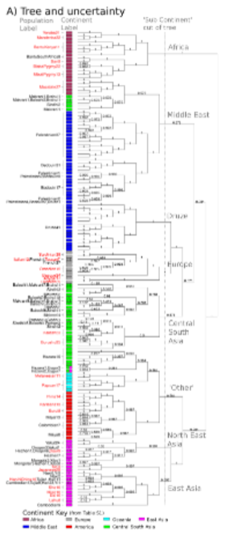
K > 10 Populations
structure-like methods struggle for large K
Dirichlet Process prior and reversible-jump MCMC
Ad hoc tree building on the left
226 populations inferred from 938 individuals

Slide 11
Takeaways
LD baked into coancestry matrix enables fine grained population inference using dense data
Previous approaches could only handle K < 10
Adapted existing PCA and model-based approaches for coancestry matrix input
Admixture not addressed yet in the software

