Slide 1

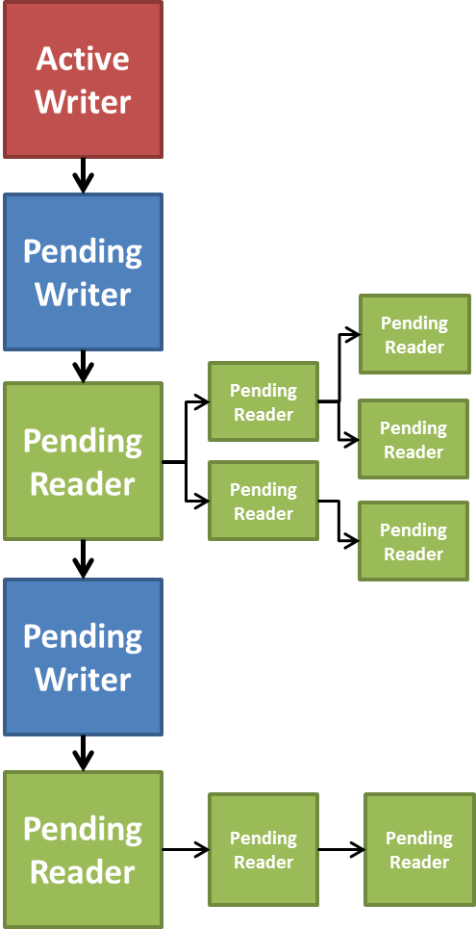
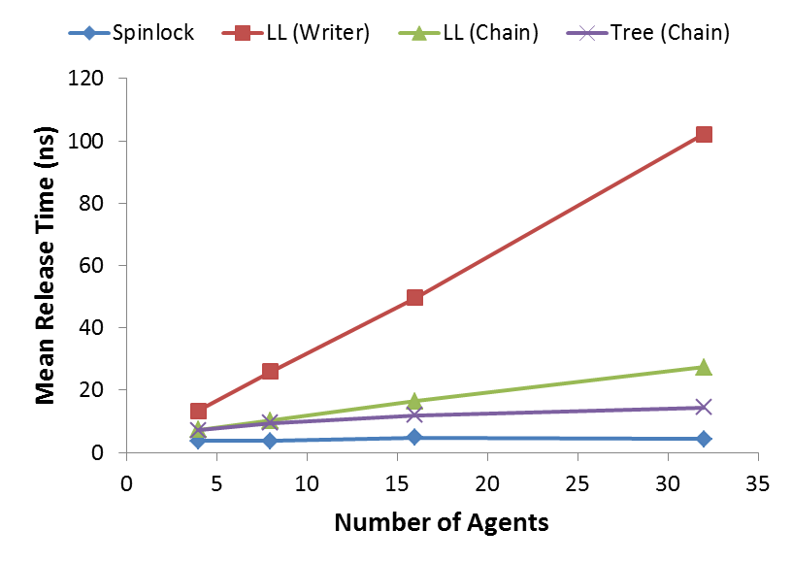
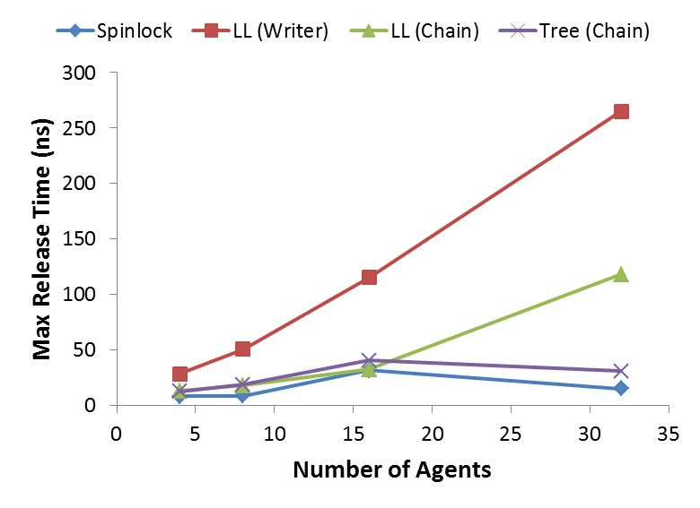
Improving the Readers-Writer Lock
Stephen Twigg
Readers-Writer Locks
Handling Writer -> Readers
Handling Readers -> Writer
A readers-writer lock is a synchronization construct that allows either multiple parallel readers or a singular writer at a time
  Granted priority between readers and writers highly dependent on desired application
Valid flags form a simple variant of this lock type.
  Setting invalid to switch from readable to writeable state is non-trivial to do safely without interrupting active readers.
  Spinlocks on remote data results in highly inefficient communication and presents network saturation risk.
Database applications allowing multiple parallel read-only transactions of modifiable data must use this lock.
  Common implementations use reader counters, wakeup queues, and standard locks to allow arbitrary state transitions with bounded overall communication.
To control network communication, waiting readers spinlock on local sentinels.
Upon being forced to wait, reader inserts pointer to their sentinel into some lock data structure
Linked List
Inspired by queue system from Mellor-Crummley.
If new list entry stored in reader’s memory, entries are statically allocable.
Releasing writer may follow linked list or readers can chain alerts.
Binary Tree
Inspired by common methods for implementing collectives.
Binary representation of readers counter as insertion path keeps tree balanced.
Release done by readers chaining alerts.
Directory Scheme
Inspired by cache coherence protocols.
Size of directory can be optimized according to expected contention.
Reverts to naïve spinlock when directory overflows
Granting writers full priority trivial
  Increment data age upon write.
  Readers discard if data too young or
  ages during transaction
Non-interruptible readers requires tracking.
  Decrementing readers count, ideally with
  atomics, is classical method.
  Collapsing data structure tempting but
  non-trivial for trees.
  Copying data amongst readers allows for
  immediate writing.
Propose using queues again but with readers
aggregated into singular queue entry.
  Aggregate object hosted by first reader,
  which acquires the write lock for all readers.
  Write lock released by last reader once all reading complete.
  Allows for use of most writer -> readers structures.
Priority controlled by data structure construction rules
  Fair priority always appends to tail, generating new readers aggregate object as needed.
  Writer priority allows writers to insert ahead of a readers aggregate.
  Reader priority adds reader to first available readers aggregate.
Survey of Current Methods
Mellor-Crummley and Scott present multiple implementations. One method assigns each possible reader a reading ticket and each possible writer a writing ticket. Upon acquiring a ticket, the agents note the highest number of each ticket type outstanding. Readers progress when all former writing tickets have completed. Writers progress when all former writing and reading tickets have completed. Upon completion, the agents increment the ticket counter for their respective request type.
Their alternative method removes the need to spinlock on remote data by building a queue of requestors. Upon completion of a write, all readers at the head up to the next writer are awakened. Once all readers have completed , the writer at the head are awakened. Optionally, priority can granted to readers or writers by using separate queues for readers and writers and controlling admission to the currently active queue.
Kenney and Hsiah present similar methods wherein, for a single readers-writer lock, each process in the system has a standard lock. Readers must only acquire and then release their own lock. Writers must acquire and then release all locks.
Comparison of Methods
 | Spinlock | Directory* | LL (Writer) | LL (Chain) | Binary Tree
Memory
Locks? | no | yes* | yes | yes | yes
Writer | O(1) | O(d) | O(2) | O(2) | O(3)
Reader | 0 | O(1) | O(2) | O(2) | O(2)
Remote MemOps.
Writes (W) | 0 | min(c,d) | 2c | 1 | 2
Reads (W) | 0 | 0 | c | 0 | 0
Writes (R) | 0 | 1 | 1 | 2 | 4
Reads (R) | Unbounded | O(c+d) | O(c) | O(c) | O(2log₂(c))
Theor. Perf.
Release (W) | O(1) | O(d) | O(c) | O(1) | O(1)
Receipt Delay (R) | O(c)† | O(c) | O(c) | O(c) | O(log₂(c))
Conclusions and Extensions
Binary tree structure superior in overall performance for handling the writer -> readers transitions
  Nearly matches release time of spinlocks in tests while still maintaining efficient network communication.
  Best scaling for both memory and latency metrics.
Hardware, kernel cache coherency protocols advise use of autotuning
  Likely provide scheme comparable to limited directory, thus efficient to spinlock when have small number of concurrent readers.
  Revert to full scheme for highly contentious locks to avoid thrashing the directory.
Use of reader aggregate objects allows for fine-tuning the performance of writer -> readers transition.
  Use of write queue disguises the readers-writer lock as a simple standard mutex lock.
  Using atomic operations and reader counters should provide reasonable performance while allowing absolving readers of any lock maintenance responsibility after release.
Splitting the Lock
Previous methods already provide functionality, optionally parameterizing the prioritization of readers versus writers
Performance not as well considered.
  Memory footprints of various methods not cataloged.
  Not all methods avoid spinlocking on remote data.
  Writer -> readers release of particular concern since forms a particularly optimizable bottleneck in certain programs
All current methods use combined handler for writer -> readers, readers -> writer transitions
  However, orthogonality exists in how to handle these transitions.
  Writer -> writer transition is uninteresting and resolved by methods for contentious standard locks (e.g. using a queue).
d = max. directory size, c = # of current pending readers, W = Writer, R = Reader
Non-unary scalars in O notation included to better emphasize relative differences.
* Entries that overflow directory revert to spinlock behavior. These entries do not need to use the lock.
† O(c) due to hardware/software backend is expected; however, O(1) likely seen due to significant overhead.
Release measurements taken using NERSC Hopper cluster with each process on a separate node over 32 trials coded in UPC. Timing data slightly inaccurate due to clock synchronization issues.

