Slide 1


Mining Movement Patterns For
Predicting Next Locations
Meng Chen

Slide 2

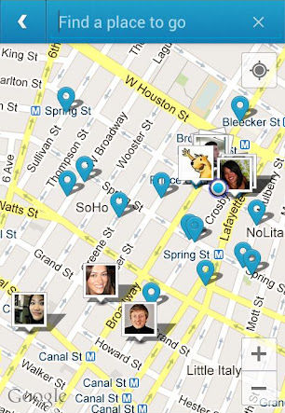
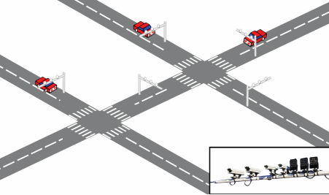





Introduction
Location data
  check-in data
  the vehicle passage records
Trajectory
  a sequence of locations ordered by time-stamps
  e.g.,

Slide 3


Motivation
Targeted advertising
predict next location in advance
push information
Route recommendation
predict the drivers' next locations
recommend more reasonable routes

Slide 4
Overview
Training data
  the historical trajectories
Markov model
  Global Markov Model
  Personal Markov Model
  NLPMM: a combined model
Time factor
  cluster the time periods
  build a separate model for each cluster

Slide 5
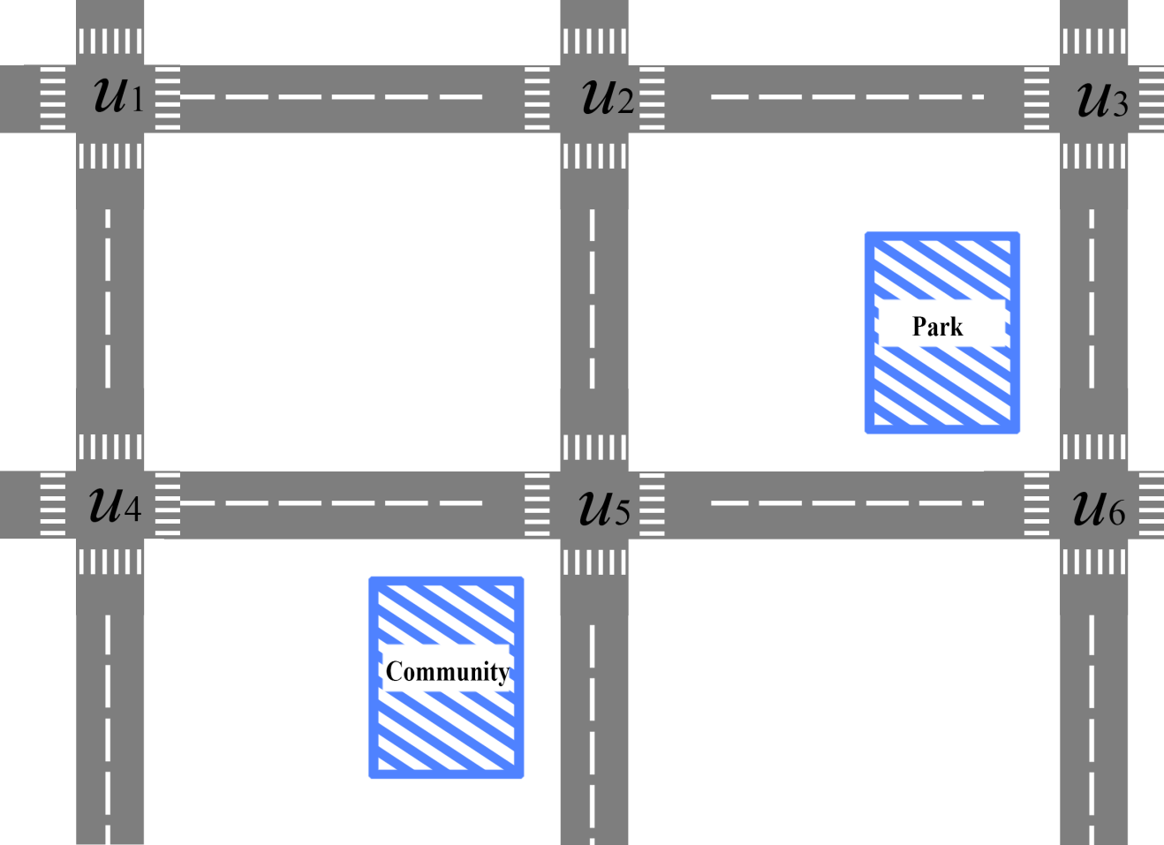





Global Markov Model
They all choose the route, so do I.

Slide 6

Global Markov Model
Order-N GMM
Variable-order GMM
Training data
training
training
Order-0
1
2
3
4
2
1
3
4
2
3
4
1
3
4
1
2
3
Order-N

Slide 7
Global Markov Model
Order-1 GMM
Training data
2
0.5
1
2
3
4
1
0.5
3
2
1
3
4
0.25
1
2
3
4
2
3
0.75
1
3
4
1
2
3
3
4
1.0

Slide 8
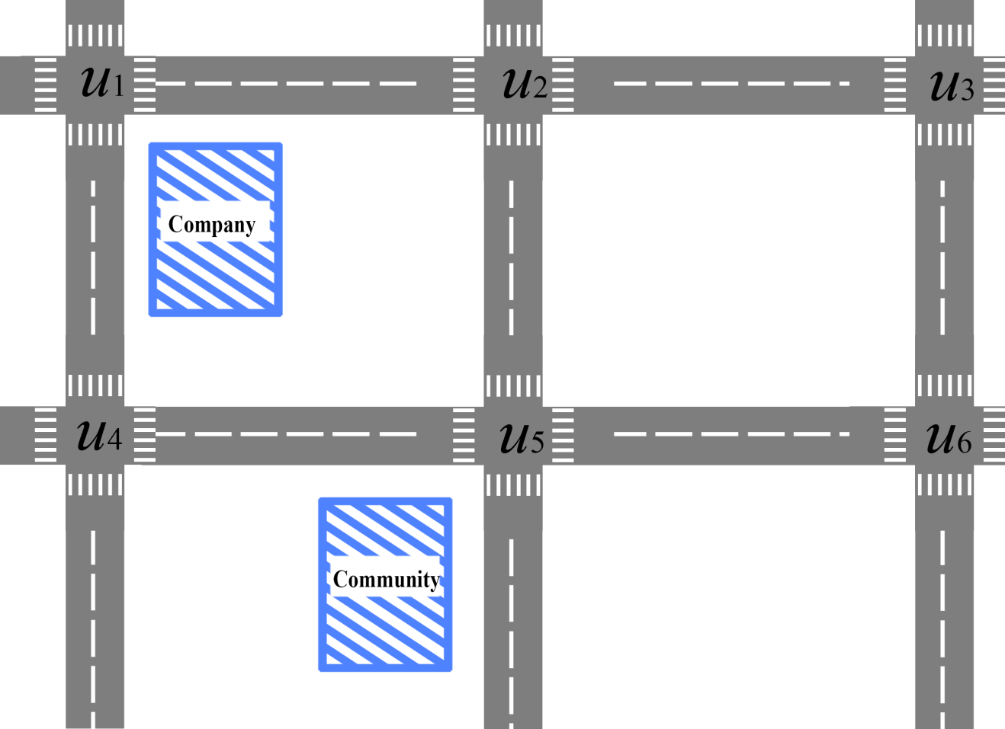
Personal Markov Model
I am familiar with the route, repeating…

Slide 9
Personal Markov Model
Variable-order PMM
Order-N PMM
training
Training data
Order-0
training
1
2
3
4
2
1
3
4
Order-N

Slide 10

Predicting next location
7
2
3
4
Test data
Order-N
Order-2
Order-1
Order-0
2
0.5
.
.
.
1
2
3
1.0
1
0.24
1
0.5
Variable-order NLPMM
2
3
4
1.0
3
2
0.24
1.0
1
0.25
3
0.28
1
3
4
2
2
1
3
1.0
0.75
4
0.24
3
3
4
1.0

Slide 11
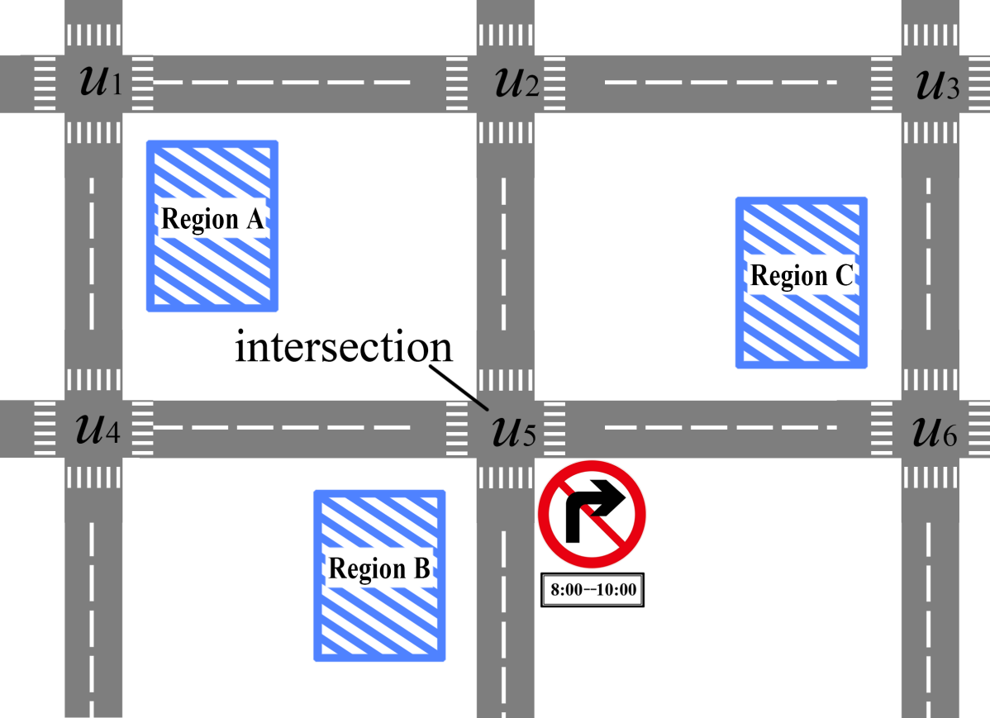

Time Factor

Slide 12

Time Factor

Slide 13


Time Binning
Training data
Time
0: 00
1
2
3
4
Bin 1
2
1
3
4
Bin 2
2
3
4
1
3
4
Bin 3
…
1
2
3
Bin m
24: 00
Train m independent models, each for a different time bin, using the trajectories falling in each bin.

Slide 14

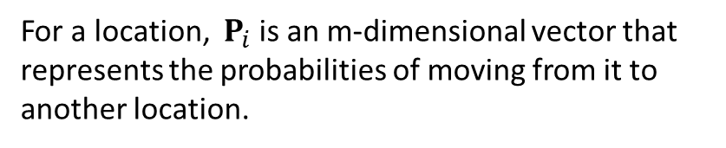
Distribution Clustering
Bin 1
Bin 2
Bin 3
Bin 4
Bin 5
Bin 6
Cluster 1
Cluster 2
Cluster 3

Slide 15
Distribution Clustering
Training:
train a separate NLPMM for each cluster with the trajectories in it.
Testing:
determine the cluster that the trajectory belongs to.
predict next location with the corresponding model.

Slide 16
Overview
A
Object-clustered Markov model
computing the spatial locality matrix
clustering objects
Markov modeling
next location prediction
B
Trajectory-clustered Markov model
trajectory clustering
Markov modeling
next location prediction
C
Object Trajectory Markov Model
logistic regression

Slide 17
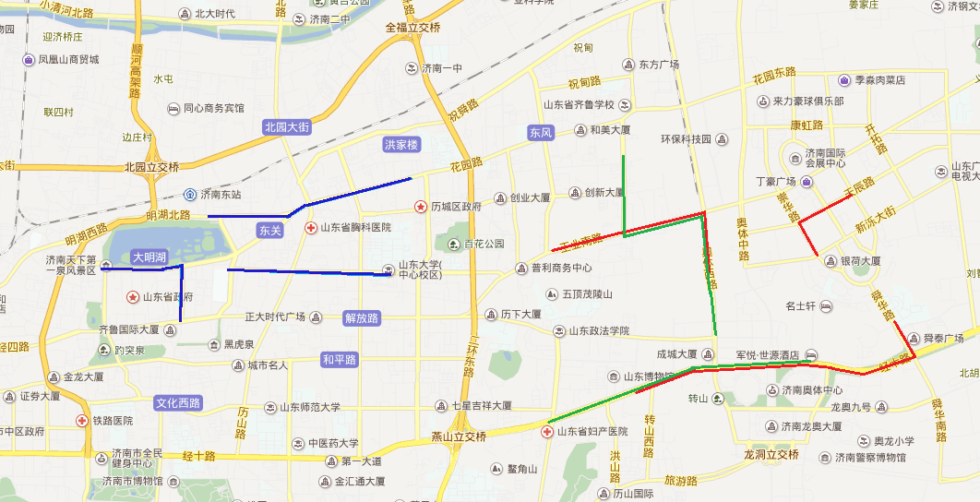
Computing the Spatial Locality Matrix
user A
user B
user C

Slide 18
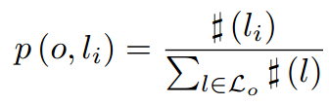
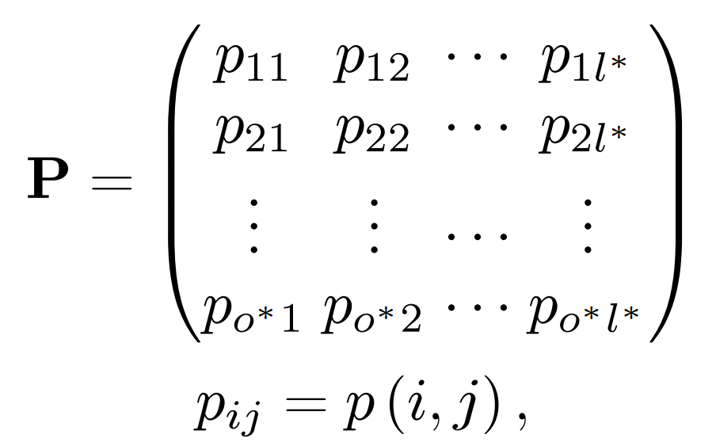
Computing the Spatial Locality Matrix
global location probability

Slide 19
Clustering Objects
1
2
3
4
5
6
Kullback-Leibler divergence
Cosine similarity
Cluster 1
Cluster 2
Cluster 3

Slide 20

Markov Modeling
Order-m MM
Variable-order MM
Trajectories in one cluster
training
training
Order-0
1
2
3
4
2
1
3
4
2
3
4
1
3
4
1
2
3
Order-m
Introduction Related Work Object-MM Tra-MM Experiments Conclusion

Slide 21
Markov Modeling
Order-1 MM
Trajectories in one cluster
2
0.5
1
2
3
4
1
0.5
3
2
1
3
4
0.25
1
2
3
4
2
3
0.75
1
3
4
1
2
3
3
4
1.0
Introduction Related Work Object-MM Tra-MM Experiments Conclusion

Slide 22
Next Location Prediction
7
2
3
4
Test data
Order-m
Order-2
Order-1
Order-0
2
0.5
cluster 1
.
.
.
1
2
3
1.0
1
0.24
1
0.5
Variable-order MM
2
3
4
1.0
3
2
0.24
1.0
1
0.25
3
0.28
1
3
4
2
2
1
3
1.0
0.75
4
0.24
3
3
4
1.0
Introduction Related Work Object-MM Tra-MM Experiments Conclusion

Slide 23
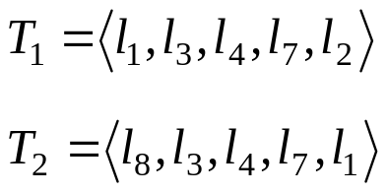
Trajectory Clustering
Methods based on collective patterns
  build a Markov model using the trajectories of all objects
  make predictions at too coarse a granularity
  not considering the inherent similarity between trajectories
Distance measures
  Euclidean distance
  Dynamic Time Warping

Slide 24
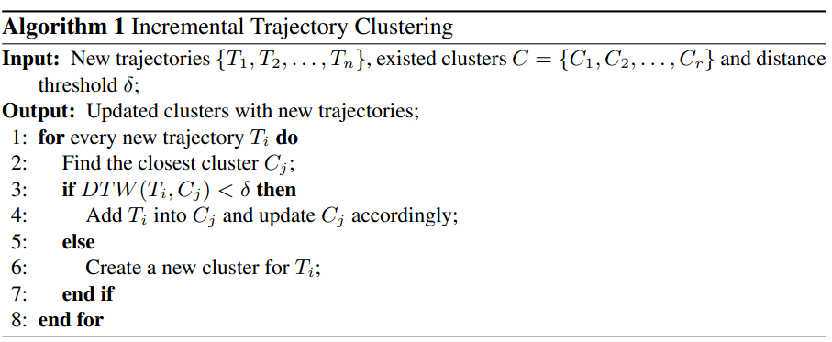
Trajectory Clustering
Traditional clustering algorithms
  developed for static and small datasets
  not suitable for large-scale trajectories and real-time
  stream data

Slide 25
Markov Modeling
Markov Modeling
  train a variable-order Markov model for each cluster
Next Location Prediction
  find its closest cluster for a trajectory
  choose the corresponding model of the cluster
  predict next location

Slide 26
数据挖掘之我见
道or术
  一招鲜吃遍天
第一层
  模型了解，工具会用
第二层
  调参数，应用特定数据
第三层
  新模型

Slide 27
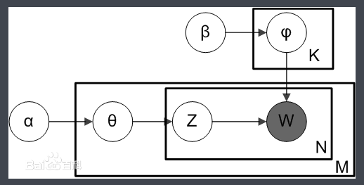
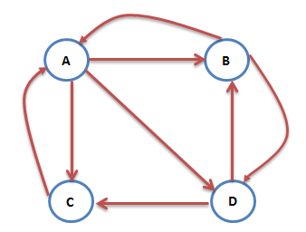
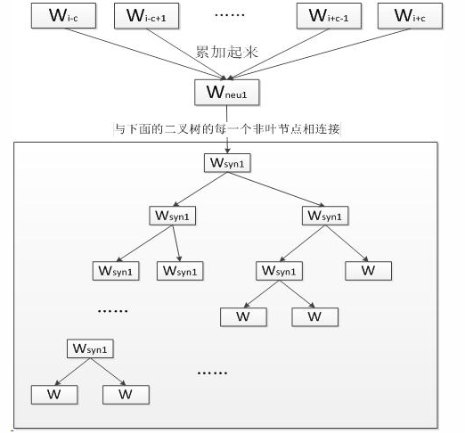
数据挖掘之我见
简约而不简单
简约而不简单
简约而不简单

Slide 28
推荐内容
数学之美
机器学习实战
python入门
分布式数据挖掘

Slide 29

WE ARE JUST ON THE WAY
THANK YOU.
Meng Chen
chenmeng114@hotmail.com

