Slide 1
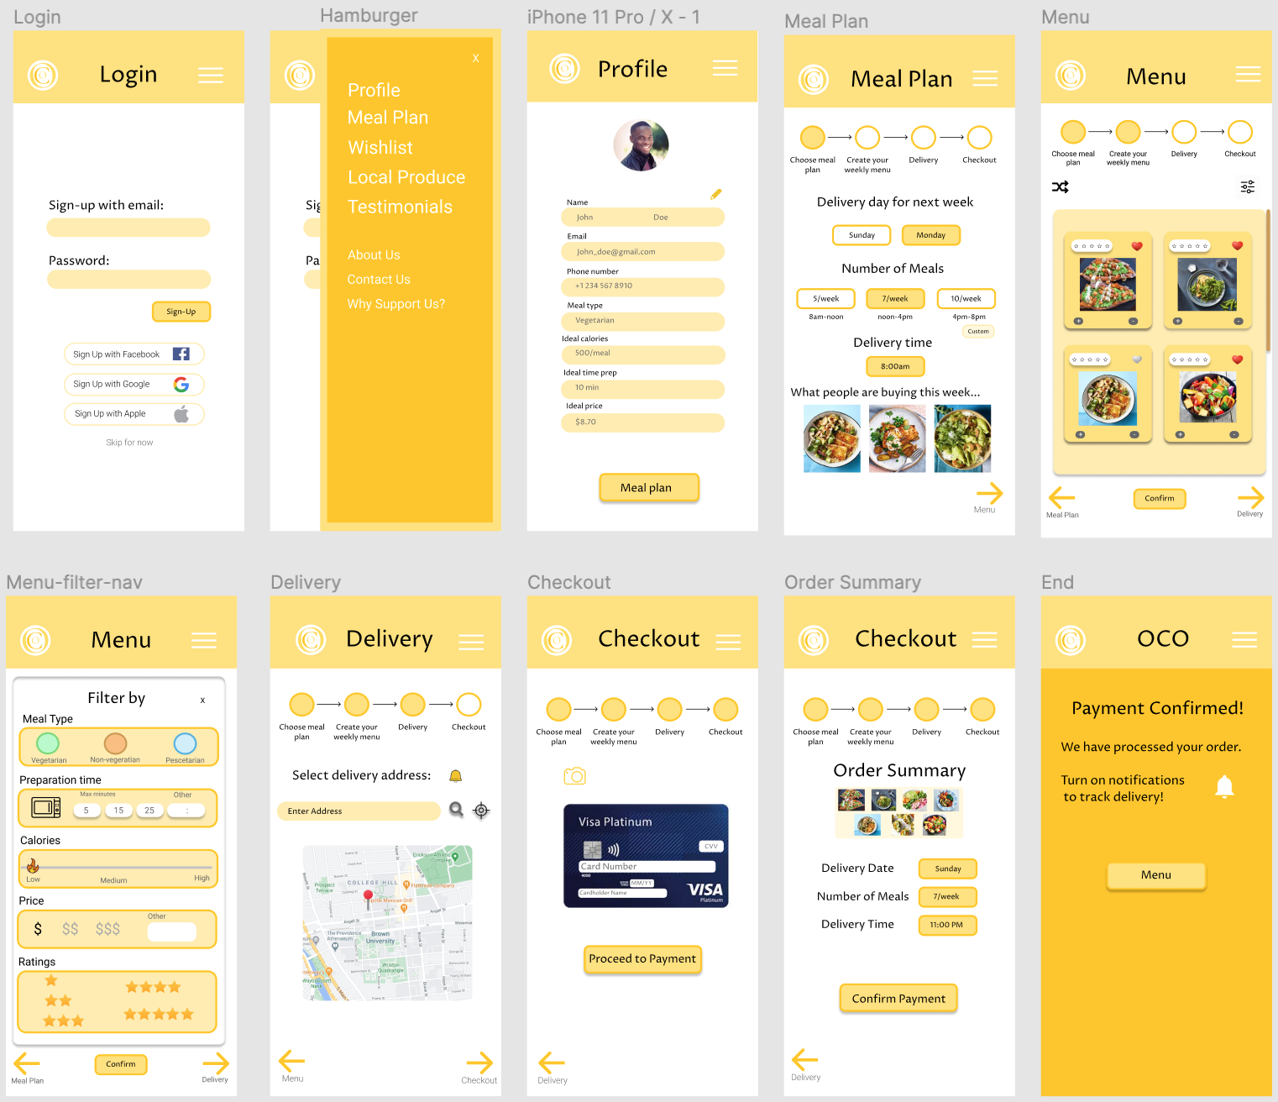
Users reported they wish the app give them some context about its goals / functions before asking them to sign-up
Most people didn’t seem to understand what the four images are (meals I’m getting for the week? choices?)
Hamburger menu seems to be hiding some of the main features -> maybe create a nav bar with an easy access to profile, menu
Users got confused because the ‘skip’ button took them the to profile page -> we need to hook them up before taking them to the profile page
Common critique saying there’s too much information in the profile page, it’s overwhelming
Before getting to the meal plan page where the user needs to make a lot of choices, the app needs to show how it works, options, etc.

