Slide 1


From Clicks to Rides: Analysing Metrocar’s User Funnel
Presented By : Sayantan Dutt (DA – July 2024 Cohort)

Slide 2
Objectives
Analyse the customer funnel of Metrocar, a ride sharing app
Identify areas for improvement and optimization

Slide 3
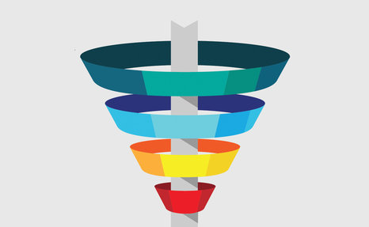
Metrocar’s User Funnel
App Downloaded
User Signup
Ride Requested
Ride Accepted
Ride Completed
Transaction Completed
Review Completed

Slide 4
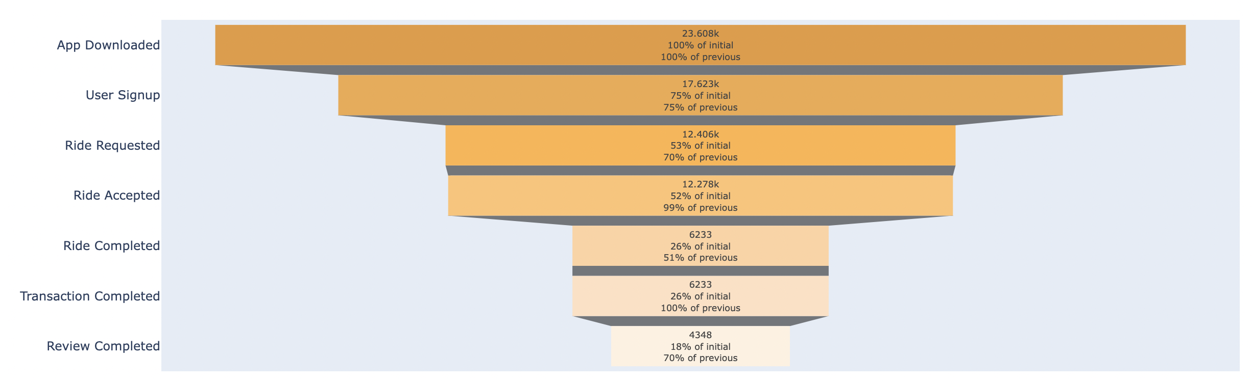
Funnel Analysis
App Downloaded → User Signed Up: 25% drop off
Probable Reason: Signup process may be lengthy or lacks incentives.
Recommendation: Simplify signup, offer discounts, and introduce referral incentives.
User Signed Up → Ride Requested : 30% drop off
Probable Reason: Users may not fully understand how easy it is to request a ride.
Recommendation: Advertise ease of use and offer discounts on the first few rides.
Ride Requested → Ride Accepted : 1% drop off
Probable Reason: Drivers may need better app training.
Recommendation: Enhance driver training for smoother acceptance.
Ride Accepted → Ride Completed : 49% drop off
Probable Reason: Long wait times or high non-peak pricing deter users.
Recommendation: Reduce wait times and optimize non-peak pricing.
Payment Completion (Some declined payments): 0%drop off
Probable Reason: Some payments may be declined due to limited options or technical issues.
Recommendation: Simplify payment, add options, and offer first-time discounts.
Ride Completed → Review Submitted : 30% drop off
Probable Reason: Users may forget or lack motivation to leave a review.
Recommendation: Send follow-up reminders via email or calls.
49%
Notes:
Upper Funnel:
Simplify sign up process – so that users can easily sign up
Offer discounts and coupons for first time users – so that users are attracted to incentives and sign up more
Introduce referal incentives – so that users can spread the word and attract more sign ups for incentioves.
Middle Funnel:

Slide 5
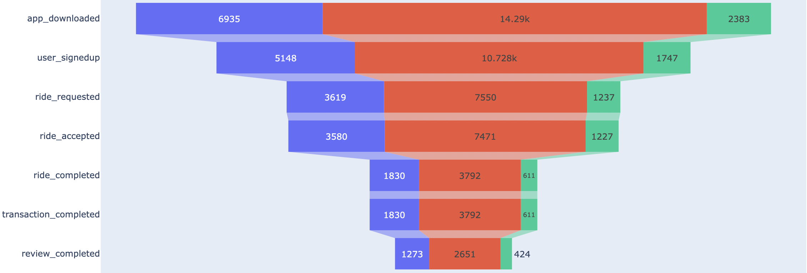
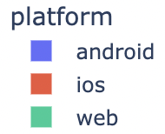
Platform Analysis
Key Insights:
iOS leads with the highest number of app downloads (14,290) compared to Android (6,935) and Web (2,383).
Web usage is significantly lower, indicating limited adoption.
Android has potential for growth but needs optimization to attract more users.
Recommendations:
Prioritize iOS Users: Increase iOS marketing and refine app usability to capitalize on strong engagement.
Optimize Android Experience: Shift budget from Web to Android to improve usability, drive adoption, and enhance funnel performance.
Reduce Investment in Web: Minimize Web investment due to its smaller and less impactful user base.
Notes:
Upper Funnel:
Simplify sign up process – so that users can easily sign up
Offer discounts and coupons for first time users – so that users are attracted to incentives and sign up more
Introduce referal incentives – so that users can spread the word and attract more sign ups for incentioves.
Middle Funnel:

Slide 6
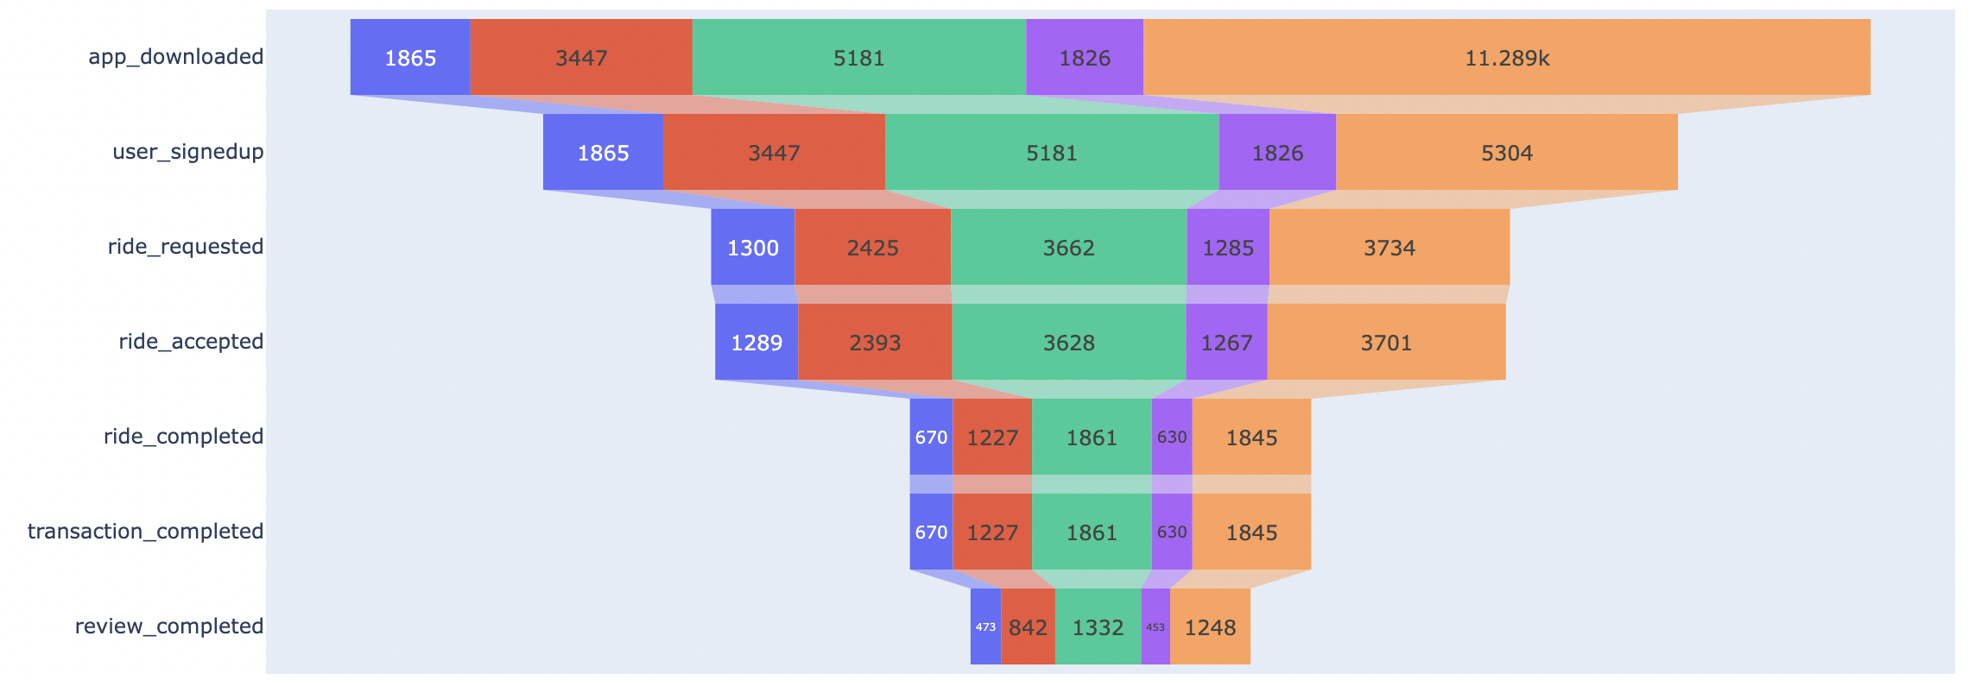
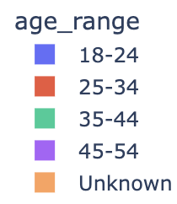
Age Range Analysis
Key Insights:
The 35-44 and 25-34 age groups dominate app downloads and signups but show a 50% drop-off from Ride Accepted → Ride Completed.
Ride cancellations are highest among these groups, with an average wait time of 12 minutes before cancellation.
11K users have not disclosed their age, limiting the scope of detailed demographic analysis.
Recommendations:
Improve Driver Availability: Reduce wait times between ride requests and pickups to minimize cancellations.
Expand Fleet: Increase the number of cabs available, especially during peak hours, to address high demand.
Offer Ride Incentives: Introduce discounts or rewards for completed rides to encourage retention of these 2 age groups.
Notes:
Upper Funnel:
Simplify sign up process – so that users can easily sign up
Offer discounts and coupons for first time users – so that users are attracted to incentives and sign up more
Introduce referal incentives – so that users can spread the word and attract more sign ups for incentioves.
Middle Funnel:

Slide 7
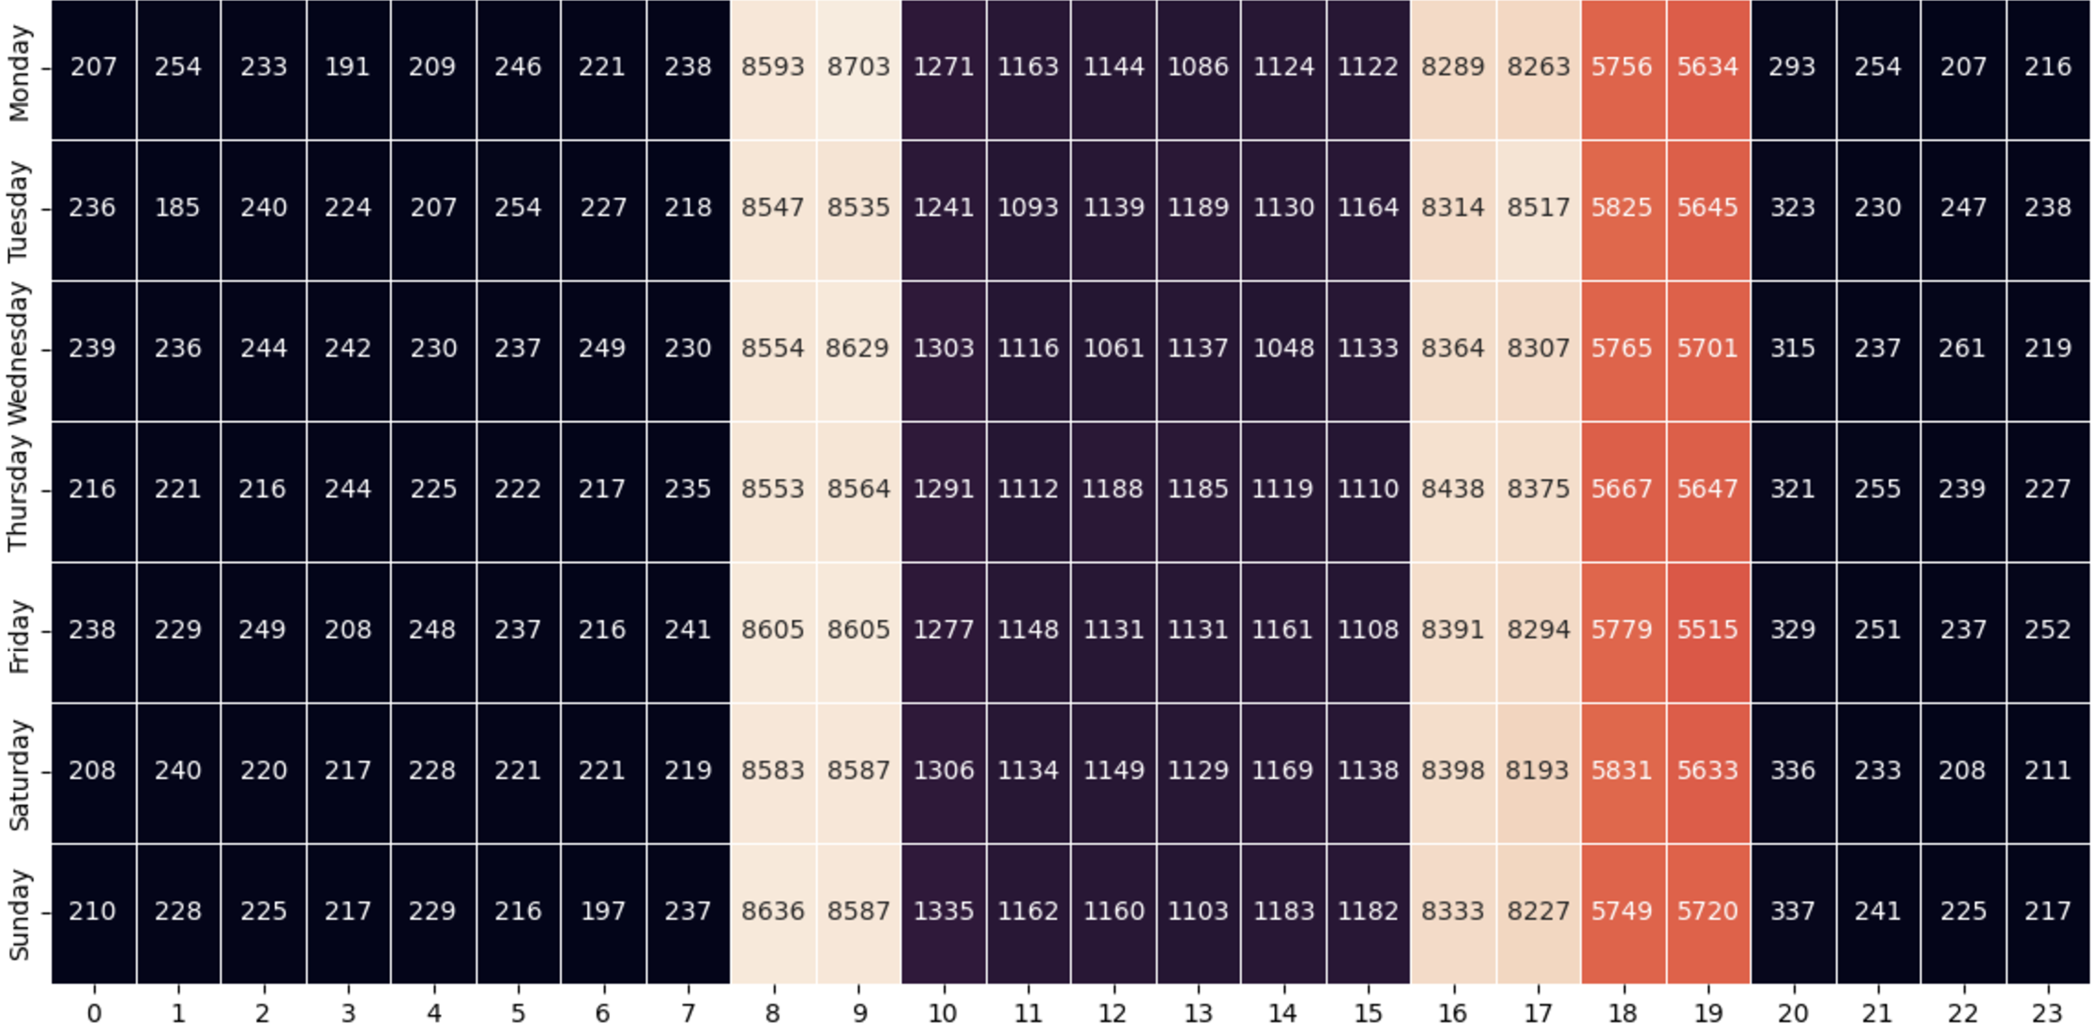
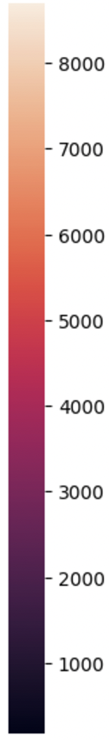
Surge pricing
Key Insights:
Peak Ride Requests: Notable surges occur between 8–9 AM and 4–7 PM on all days, including weekends.
Off-Peak Hours: Lower ride requests during other times, with no significant weekend variations.
Recommendations:
Apply Surge Pricing: Implement dynamic pricing during peak hours (8–9 AM, 4–7 PM) to maximize revenue.
Encourage Off-Peak Rides: Offer discounts or promotions during non-peak hours to boost demand.
This strategy balances revenue optimization during surges and increased ride volume during quieter periods.
Notes:
Upper Funnel:
Simplify sign up process – so that users can easily sign up
Offer discounts and coupons for first time users – so that users are attracted to incentives and sign up more
Introduce referal incentives – so that users can spread the word and attract more sign ups for incentioves.
Middle Funnel:

Slide 8
Links
Dataset:
Notebook:
https://colab.research.google.com/drive/1Cy-SGoKMPuevFLM6A_CQPHGXib4n78yZ?usp=sharing
Notes:
Upper Funnel:
Simplify sign up process – so that users can easily sign up
Offer discounts and coupons for first time users – so that users are attracted to incentives and sign up more
Introduce referal incentives – so that users can spread the word and attract more sign ups for incentioves.
Middle Funnel:

