Slide 1

UltraMart
Sheri Dutter
June 1, 2021

Slide 2
Goal and Objective.”
The company’s goal is to maintain slow, but sure, sales growth over the last year.
The primary business objective is to monitor YTD sales performance based on store type and region/segments. Ensuring there is a YTD sales increase over last year.
Each store segment has a target to exceed $500 in sales per sq foot per store.

Slide 3
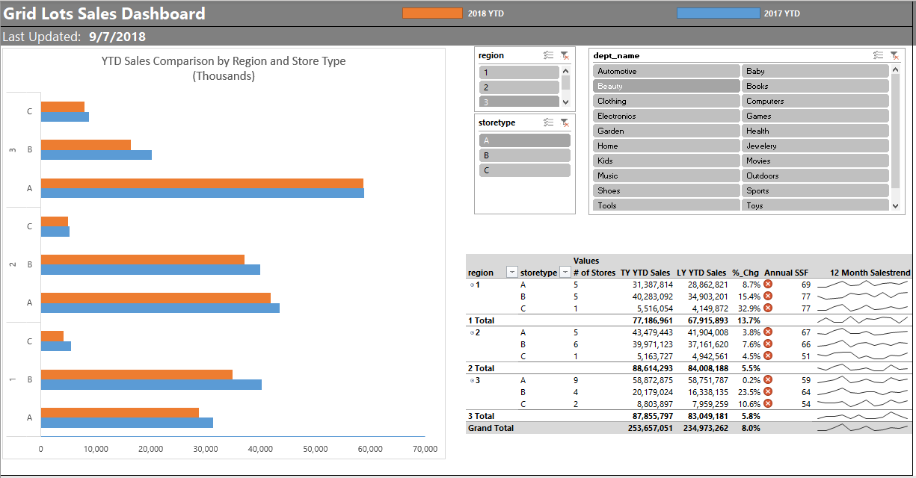

Slide 4
YTD Sales Comparison by Region and Store Type
(Thousands)
YoY sales have increased for all regions and store types.
Region 1 had the highest total YoY increase with store type C having the highest increase of 33%.
Region 2 had the smallest total YoY increase at 5%.
Region 3 had a 6% increase even though they have the most stores in the region. Store type A should be watched since they had less than 1% increase.

Slide 5
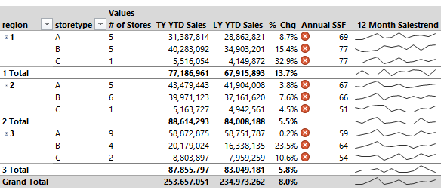
YTD Sales Comparison by Region and Store Type
(Thousands)
Total YoY sales increased by 8% largely due to a nearly 14% YoY sales increase in Region 1. Regions 2 and 3 sales should be watch to see how they continue to perform.

Slide 6
Appendix

Slide 7
Supporting Data
All data supporting the YoY metrics in this presentation can be found at the link below. If there are any questions, please let me know.
https://drive.google.com/file/d/1qA-DxyEH9jrKq6HpiVdSppAevBY0l4Vz/view?usp=sharing

