Slide 1
Are you ready to Hack-a-Doc?

Slide 2
Setup your tools
Bring your laptop with the following:
Setup Git and VS Code with your GitHub account
Install the following VS Code extensions
MS Learn Authoring Pack
Uninstall the templates and validation extensions
Reflow Markdown (marvhen)
"reflowMarkdown.preferredLineLength": 100
"editor.rulers": [1, 2, 3, 4, 5, 76, 80, 90, 100],
Fork and Clone MicrosoftDocs/windows-powershell-docs
git remote add upstream https://github.com/MicrosoftDocs/windows-powershell-docs

Slide 3
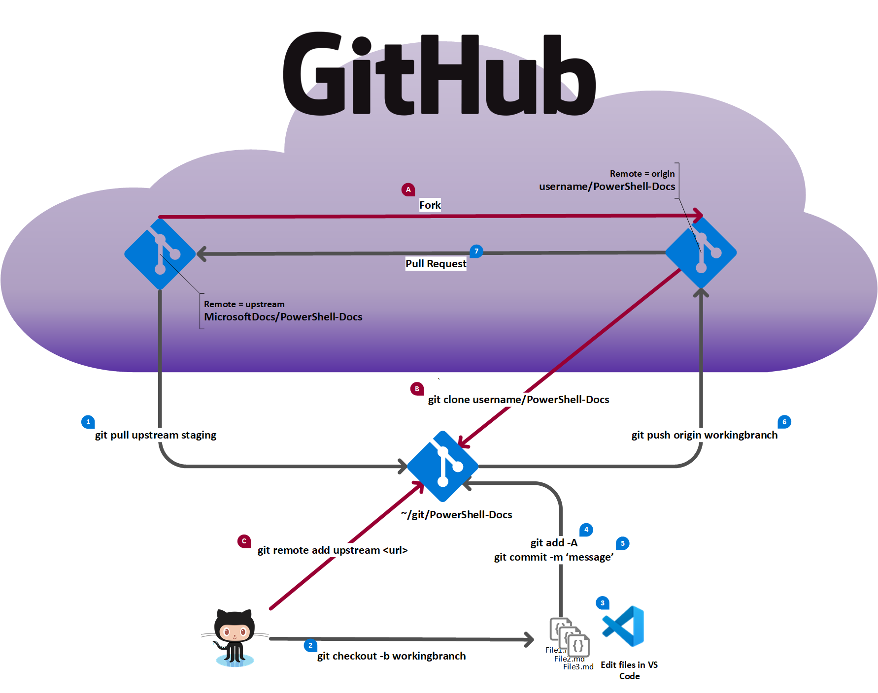
One-time steps
Fork the base repo
Clone your fork
Add an upstream pointer to the base
Normal workflow
Pull default branch from base repo
Create a working branch
Edit your files
Add your changes to Git
Commit your changes
Push the working branch to your fork
Create a pull request from your fork to the base repo

Slide 4
Documentarian modules
Documentarian - Collection of general purpose functions for working with Markdown documents.
Documentarian.MicrosoftDocs - Collection of tools for working with Microsoft Docs content.
Documentarian.ModuleAuthor - Collection of tools for creating and documenting PowerShell modules.
Documentarian.Vale - Collection of tools for installing and using the Vale prose linter.
https://www.powershellgallery.com/packages?q=documentarian

