Slide 1
Spiceworld 2024 Mastering PowerShell
Level Up Your IT Game

Slide 2

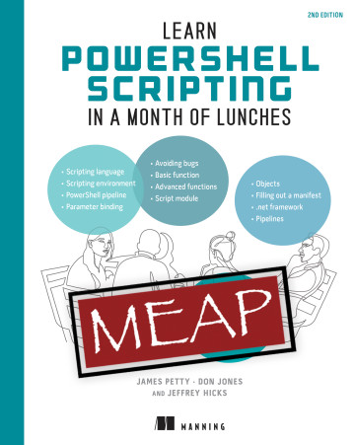

James Petty
@psjamesp
Github.com/psjamesp

Slide 3
Sean Wheeler
Microsoft
Principal Content Developer
https://sdwheeler.github.io/seanonit/docs
https://github.com/psjamesp/SW24-PowerShellIntro

