Slide 1

2025
PowerShell Toolmaking
Create shareable tools that other people will want to use.

Slide 2
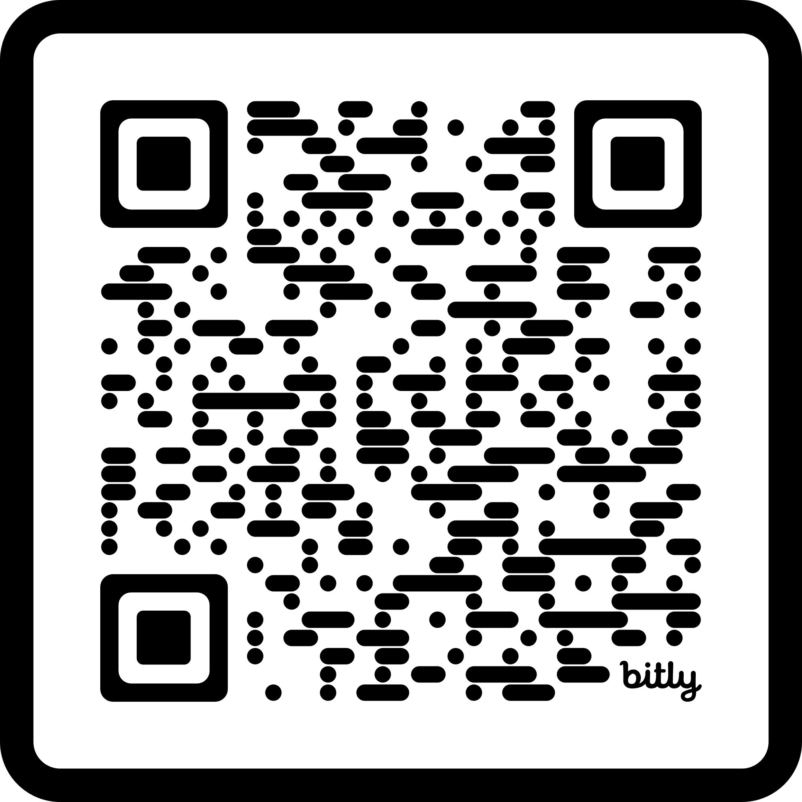
PowerShell Toolmaking
Download the PDF to follow along
Use the QR Code or
Go to https://seanonit.org/docs
Find the PowerShell Toolmaking link under Public Speaking

Slide 3


Sean Wheeler
Principal Content Developer, Microsoft
As the lead Content Developer for PowerShell, I create and maintain the core PowerShell documentation, developer guides, and command reference.
I’m an avid supporter of the PowerShell community. I am a frequent speaker at PowerShell user groups and conferences.
In my career, I’ve created and delivered numerous scripting, debugging, and troubleshooting workshops for internal and external customers.

Slide 4
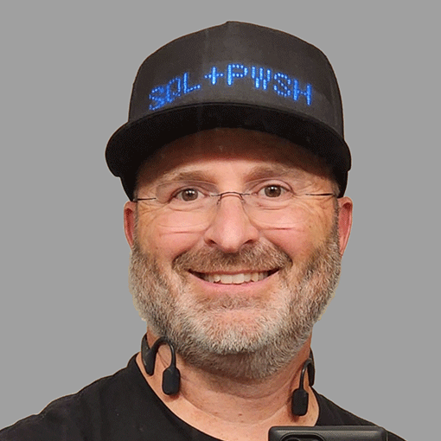

Steven Judd
Infrastructure Engineer, Tenstreet, LLC
As a Microsoft MVP for PowerShell, I have a passion for automation using PowerShell and DevOps Agile principles.
I have been working with Developers as the "Ops" of DevOps for more than 30 years, before I even knew what DevOps was. I developed a PowerShell training program to help people learn automation and accelerate their career.
I spend my free time learning more about PowerShell and other technologies and hanging out in the PowerShell Discord.

Slide 5
Goals & Expectations
Goals
Quick review of the fundamentals
Turn one-liners and scripts into advanced functions
Anatomy of a function
Pipelining, validation, tab completion
Create user documentation using Comment-based help
Package functions into structured modules
Public vs. Private functions
Multi-file vs. monolithic
Command design principles
Publish modules to a shareable PSRepository
Expectations
Some experience writing PowerShell scripts
VS Code with PowerShell extension
PowerShell 7 (or 5.1)

Slide 6
PowerShell fundamentals
Execution policy overview
Security feature – not a security boundary
Windows-only
Command types and their precedence
Alias
Function
Cmdlet
External executable files
Scripts & functions
Purpose
Batch scripts vs. tools
Scriptblocks
Profiles and dot-sourcing
Variable scopes
Global
Local
Script
Private

Slide 7
Scopes
Global scope
Script scope 1
Script scope 2
Function scope 1
Function scope 4
Function scope 2
Function scope 5
Function scope 3

Slide 8
Anatomy of a function
Scriptblocks vs. functions vs. filters vs. scripts
Scriptblock labels
begin, process, end, clean
Default is end
Advanced functions
[CmdletBinding()] and [Parameter()] attributes
Parameter validation
Pipeline input
Parameter sets
Argument completion

Slide 9
Coding style
Variables
Use Pascal Case for variables defined as parameters
Use Camel Case for variables defined in the code
Use single quotes for non-expanding text and double quotes for expanding text
$var1 = 'this is some text'
$var2 = "Profile path: $PROFILE"
Keep your line length below 120 characters
Use the natural line continuation characters
Use splatting
Use the Join operator
Use switch statements rather than complex if/elseif/else
See The Unofficial PowerShell Best Practices and Style Guide

Slide 10
Comment-based help
Why?
Quick overview of Help system
Syntax and pitfalls
location in code
comment styling - `#` vs `<# #>`
markup and formatting
Singletons, multiline, single instance

Slide 11
Module design
Structure
Module manifest
Public vs private functions
Monolithic vs multiple files
Templating (Plaster or Stucco)
Other resources
Help file
Format files (intermediate)
Type files (advanced)
Other data files (as needed)

Slide 12
Command design
Commands are single purpose
CRUD operations
Use approved verbs and consistent nouns
New/Get/Set/Update/Remove/Add
Parameter naming for the pipeline
Error handling
Write-Error vs throw
Try/catch/finally
$ErrorActionPreference
ShouldProcess - WhatIf/Confirm

Slide 13
Publishing modules
PowerShellGet vs. PSResourceGet module
Publishing to a repository
PowerShellGallery
Private repositories

Slide 14
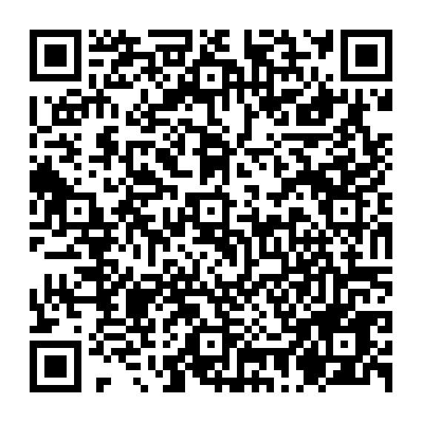
Thanks for coming!

