Slide 1

PowerShell Toolmaking
Create shareable tools that other people want to use.
Sean Wheeler
Principal Content Developer
Microsoft
Steven Judd, MVP
Sr Principal Consultant
Novus Consulting
Level: Intermediate

Slide 2
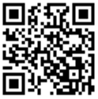
Your feedback is very important to us
Use the QR code or search for “Converge360 Events” in your app store
Find this session on the Agenda tab in the App
Click “Session Evaluation”
Thank you!

Slide 3


Sean Wheeler
Principal Content Developer, Microsoft
As the lead Content Developer for PowerShell, I create and maintain the core PowerShell documentation, developer guides, and command reference.
I’m an avid supporter of the PowerShell community. I am a frequent speaker at PowerShell user groups and conferences.
In my career, I’ve created and delivered numerous scripting, debugging, and troubleshooting workshops for internal and external customers.

Slide 4
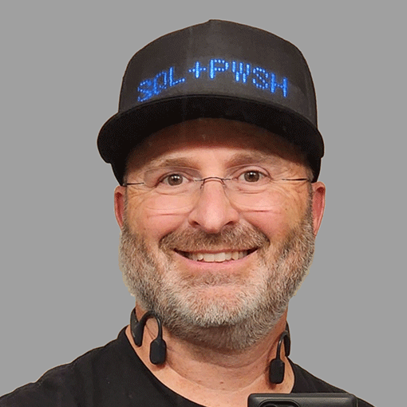

Steven Judd
Sr. Principal Consultant, Novus Consulting
As a Microsoft MVP for PowerShell, I have a passion for automation using PowerShell and DevOps Agile principles.
I have been working with Developers as the "Ops" of DevOps for more than 30 years, before I even knew what DevOps was. I developed a PowerShell training program to help people learn automation and accelerate their career.
I spend my free time learning more about PowerShell and other technologies and hanging out in the PowerShell Discord.

Slide 5
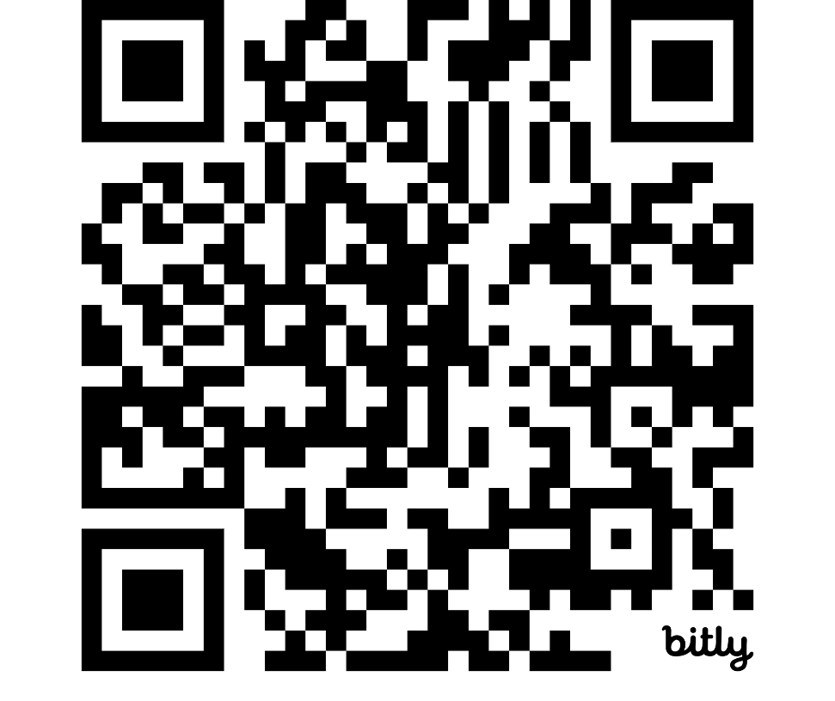
PowerShell Lab materials
Download the Zip file and extract it to a folder on your system.
https://bit.ly/THOL01-TM2026

Slide 6
Agenda
FIVE-PART AGENDA
EXPECTATIONS
01
FOUNDATIONAL TOPICS
Stuff you should already know
Three prerequisites
02
BEYOND THE BASICS
Scopes, Advanced functions, pipelining, command design
01
Some experience with PowerShell scripts
03
ENHANCING USABILITY
Parameter validation, argument completion, help documentation
02
VS Code & PowerShell extension
04
STRUCTURING MODULES
Layout, templating, packaging, publishing
03
PowerShell 7 (or 5.1)
05
ADVANCED TOPIC
Error handling & Pester tests

Slide 7
PowerShell fundamentals
Execution policy
Security feature – not a security boundary
Windows-only
Command types and precedence
Alias
Function
Cmdlet
External executable files
Scripts & functions
Purpose
Batch scripts vs. tools
Scriptblocks
Profiles and dot-sourcing
Variable scopes
Global
Local
Script
Private

Slide 8
Scopes
Global scope
Script scope 1
Script scope 2
Function scope 1
Function scope 4
Function scope 2
Function scope 5
Function scope 3

Slide 9
Advanced functions
Function-level attributes
[CmdletBinding()]
[OutputType()]
Parameter-level attributes
[Parameter()]
Pipeline input
Parameter sets
[Alias()]
Validation attributes
Argument completion attributes

Slide 10
Command design
Scripts do lots of things
Designed for large end-to-end solution
Not easily reusable for another purpose
Functions do single tasks
Composable into scripts for creating solutions
Easily reusable to compose different solutions
Packaged into modules

Slide 11

Enhancing Usability
Parameter Validation
Ensures inputs are correct and within expected formats, reducing errors and improving reliability.
Argument Completion
Assists users in filling in arguments quickly and accurately, streamlining the interaction process.
Help Documentation
Provides comprehensive guides and references to support users in understanding features and functionalities.

Slide 12
Lab 02
Exercise 1-3
Stretch goal – add tab completion to GetWifiPwd.ps1
Lunch 12:30-1:30

Slide 13
Structure & Consistency
Four moves turn consistent code into a publishable module.
01
02
03
04
CODE
STRUCTURE
BUILD
SHARE
Coding style
Module design
Templating tools
Publishing modules
Naming & quoting Readable formatting
Structure & access Supporting resources
Automated structure Consistent output
Repository choice Repeatable publishing
READABLE → STRUCTURED → REPEATABLE → SHAREABLE

Slide 14
Coding style
VARIABLE NAMES
PascalCase for parameters
camelCase inside the function
QUOTING
Single quotes for literal text
Double quotes when expanding variables
READABILITY
Keep lines under 120 characters
Use natural breaks, splatting, and -join
Prefer switch over complex if / elseif / else
Use OBTS with cuddled else
PowerShell Best Practices & Style Guide →
CONSISTENT BY DESIGN
≤ 120
param([string] $ProfilePath)
$options = @{
Path = $ProfilePath
ErrorAction = 'Stop'
}
switch (Test-Path @options) {
$true { "Profile: $ProfilePath" }
$false { 'Not found' }
}
Same rules. Every function.

Slide 15
Module design
CORE STRUCTURE
SUPPORTING RESOURCES
01
Module manifest
Help files
Format files (intermediate)
02
Public vs private functions
Type files (advanced)
03
Monolithic vs multiple files
Other data files (as needed)

Slide 16
Templating tools
Templates
Create structure automatically
Flexible
Ensure consistency
Repeatable automation
Tools
Plaster/Stucco
Sampler
InvokeBuild

Slide 17
Publishing modules
PSResourceGet module
How to package and publish a module
Supports multiple repository types
Create private repositories

Slide 18
Advanced topics
Error handling
Try/catch/finally
Preference settings
Testing with Pester
DSL for describing tests
Test-driven design
Mocking
Build validation

Slide 19
Your feedback is very important to us
Use the QR code or search for “Converge360 Events” in your app store
Find this session on the Agenda tab in the App
Click “Session Evaluation”
Thank you!

