Slide 1


The State of the Shell
April 2022
Jeffrey Snover, Jason Helmick, Sydney Smith
PowerShell Team, Microsoft
PowerShell Summit NA

Slide 2


Jeffrey Snover
Technical Fellow, CTO
Inventor of PowerShell

Slide 3

Jason Helmick
PowerShell PM

Slide 4

Sydney Smith
PowerShell PM

Slide 5



Slide 6
Agenda
Today the world is a messy place
The world has always been a messy place
In the past, PowerShell helped by simplifying automation
PowerShell continues to help by simplifying automation
A lot of life improving stuff has shipped the last three years…
And you’ve solved problems with it…
PowerShell is as relevant than ever (because pandemics are messy)
And new features can help with shifting problems

Slide 7
We Missed You!

Slide 8

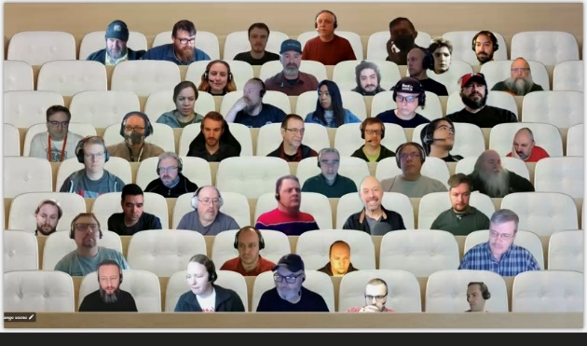



Notes:
Nice to see you all….. But let me tell you the last few years have been hard, they have challenged us in new ways and today the world is a messy place and things are moving fast

Slide 9

Every time I take a step …
Too many distributions
Too many breaking changes
Too many dissimilar services
Too many interfaces
Too many management tools
Too many changing requirements
Notes:
And all the while the tech and technical requirements for me to do my job are moving fast…“For someone working in modern operations there are too many dissimilar services, too many interfaces, too many management tools-- This is an old problem” – Michael…and every time I take a step it feels like I take a rake to the face….anyways I am having this one issue just today where I need to (start to set up demo)

Slide 10
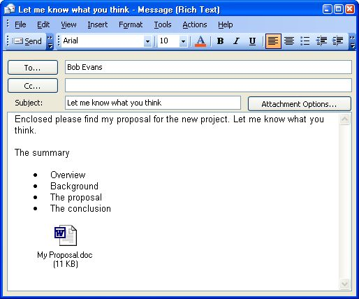






This is an old problem
Notes:
J: Well Sydney, these problems aren’t so new…. We had the internet and new forms of communication like email and smart phones, we had the launch of the cloud…
Actually, these isn’t new, we had the invention of the internet, needed news way to comminate, email and such….new tech.

Slide 11
“Learn PowerShell and we’ll do everything we can to make it the best investment you’ve ever made.” – Jeffrey Snover
It isn’t just a promise.
It’s the continuous effort, engaging with the community, to grow and extend PowerShell to serve the needs of operations.

Slide 12
What we’ve been thinking…

Slide 13
Monad Manifesto
“Monad leverages the .NET Common Runtime to provide a powerful, consistent, intuitive, extensible and useful set of tools that drive down costs of administration and make the life of non-programmers a lot easier”
http://www.jsnover.com/Docs/MonadManifesto.pdf

Slide 14
Improve the lives of folks working on operations by simplifying automation.
Notes:
That sounds awfully familiar to the way our team is thinking about PowerShell today…

Slide 15
Improve the lives of folks working on operations by simplifying automation.
We have genuine empathy for our users.
The world is continuously changing.
PowerShell should relieve this frustration.

Slide 16
Improve the lives of folks working on operations by simplifying automation.
PowerShell users solve diverse problems. PowerShell is for everyone who does operations. PowerShell is all about the users and the problems they solve.

Slide 17
Improve the lives of folks working on operations by simplifying automation.
PowerShell relieves fear over unfamiliar technology because the process of discovery and learning new types of automation is consistent with the past.
PowerShell continues to evolve with its community.

Slide 18




Improve the lives of people working on operations by simplifying automation.
Welcome diverse new uses/users
Reduce friction for users adopting new technologies
Build on legacy of customer trust
Engineer for Agility
PowerShell should make you more valuable over time (Sacred vow)
The world is a messy place
When you do impactful work at scale, mistakes matter
The world changes quickly, and the challenges are immediate.
We invest in enabling diverse new uses of PowerShell
We invest in reducing friction for users as they adopt new technologies
We invest in ensuring PowerShell is trustworthy
We build our engineering processes for agility.
Notes:
Speak briefly to what we mean by these themes:
Welcome new uses:
“Learn PowerShell and we’ll do everything we can to make it the best investment you’ve ever made.” – Jeffery
PowerShell should be available wherever you want to automate– PowerShell is for all types of people
PowerShell is "glue language" which is to make it easy to use within a messy world (REST, native commands, .NET APIs, Linux, Windows, etc...)
Enable day one success
The PowerShell community is welcoming, diverse, and encouraging to all PowerShell users
Reduce Friction
A consistent experience over time makes PowerShell easier to remember and easier to learn
The latest technology needs to accessible for PowerShell users, which means that PowerShell users need to be able to access the latest version of PowerShell
-Shipping new features and fixing bugs is fun– but focus on security and compliance make PowerShell dependable
Behind the scenes work that is critical to success for PowerShell users
Community contributions
Friction free inovation ( htorwing rocks at us for not being in Windows – shiping in windows has an incredible overhead and tax....and is paid in the reduction of features.

Slide 19
What we’ve been up to…

Slide 20
What we have been up to the last 3 years
Welcome diverse new uses of PowerShell
PowerShell in Azure Functions
ForEach–Object –Parallel
Improvements in Windows/Linux Container images
PowerShell support for notebooks
Visual Studio Code for PowerShell 7
Console Gui tools (ConsoleGridView)
PowerShell user group videos
Additional distro support for PowerShell
98 active GitHub projects
New ErrorView
New operators (ternary, pipeline chain, null conditional)
ANSI colors with $PSStyle
Reduce friction for users adopting new technologies
Cloud Shell Enhancements
PSSA compatibility rules
DSC Resource Kit
Cloud Shell support for Exchange Online
Out-GridView for PS7
ISE Mode for Visual Studio Code
PowerShellGet 3.0 (previews)
PowerShellGetCompat module (preview)
Crescendo
PlatyPS
Predictors
WindowsCompat layer
Shipping w/ .NET release cadence
Microsoft Update support
Build on legacy of user trust
PowerShell Gallery accessibility work
PowerShell release improvements
PowerShell editor service release improvements
Improved testing for PowerShell extension for Visual Studio Code
SecretManagement
SecretStore
Executive Order Requirements (+ many more compliance reviews/requirements)
PowerShell Gallery (and PowerShellGet) TLS changes
Monthly community call
SSH based remoting
Engineered for Agility
60 releases of PowerShell (preview and stable) since May 2019
Notes:
So here is what we have been up to during the pandemic

Slide 21


Danny Maertens
PowerShell PM

Slide 22
What you have been up to…

Slide 23
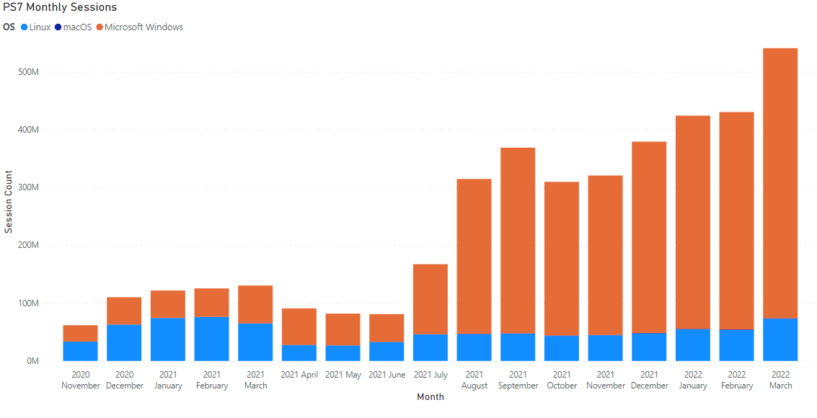
What you have been up to

Slide 24
What you have been up to

Slide 25
What you have been up to

Slide 26
What you have been up to
16 Trillion Cmdlets ran in 2021
Over 3 billion downloads from the PowerShell Gallery since spring 2019
Over 400 million unique instances of PowerShell 7 in 2021
64% on linux
Over 2.5 billion starts of PowerShell 7 in 2021
Over 350,000 monthly users of the PowerShell extension for VSCode
Over 10% on macOS
Notes:
What is interesting to highlight??

Slide 27
What we are working on
Welcome diverse new uses of PowerShell
Additional Azure Mariner support
PowerShell 7 in Windows exploration
macOS Notarization support
More Windows ARM64 support
Crescendo
OpenSSH for Windows
Predictive Intellisense
CompleterPredictor
ANSI coloring
Reduce friction for users adopting new technologies
Move PowerShell to .NET 7
Making it easier to find out what’s new in PowerShell
Custom ConnectionInfo
Local SessionConfiguration support
Module Isolation
PlatyPS 2
PowerShell extension for Visual Studio Code stability and performance improvements
PowerShellGet 3.0
PSDesiredStateConfiguration 3.0
Build on legacy of user trust
AMSI and WDAC enhancements
Continued work on executive order requirements
Compliance commitments
PowerShell Gallery scale improvements
Engineered for Agility
Working groups/supporting open source
Continued investments in test and release infrastructure
https://devblogs.microsoft.com/powershell/
https://aka.ms/PSYouTube
Notes:
Looking forward we are continuing to work to improve the lives of folks working on operations by investing in these areas
J: This is all exciting to look forward, but I have a problem I need to solve today! Mind if we jump on our machines and work this out?

Slide 28
PowerShell + Community
We solve problems and build solutions

Slide 29

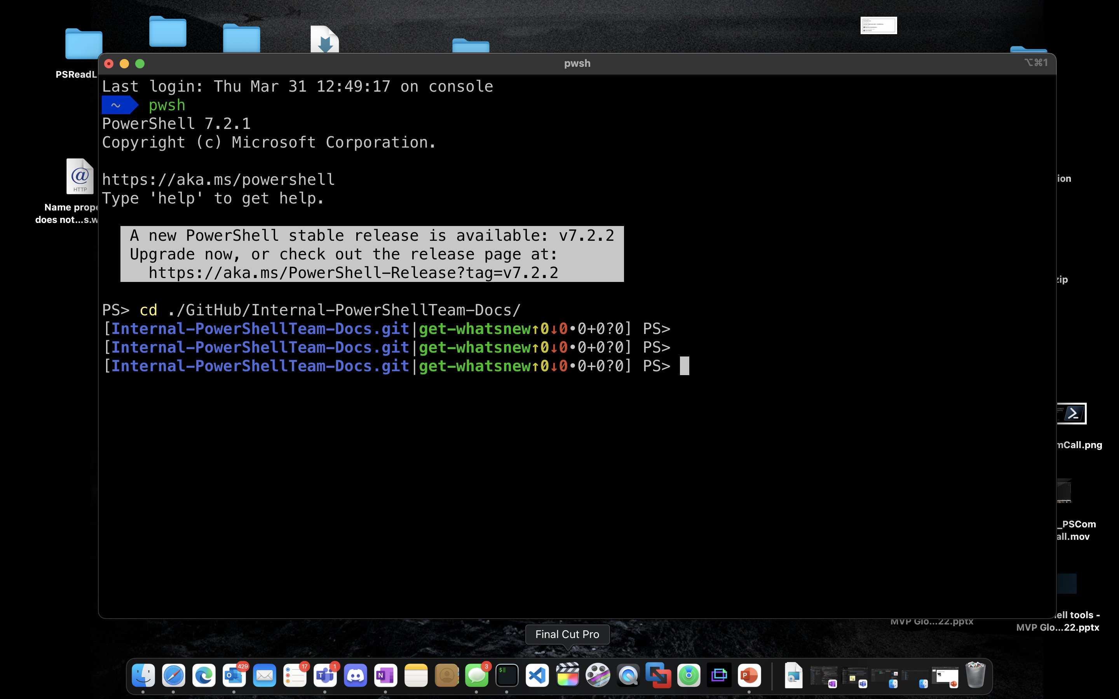

Working cross-platform
VM’s
Mac/Windows
Jason’s mac
Scenario:
Bob needs to change the firewall settings on hundreds of computers. He has worked with `netsh.exe`
in the past, but has had problems trying to automate its complexity. Bob wants to know if PowerShell
can help.
Turn this: netsh advfirewall set allprofiles state off
Into this: Set-Winfirewall -off
Features you will see…
Crescendo
SecretManagement
OpenSSH
Predictive Intellisense
Visual Studio Code (+ PowerShell extension)

Slide 30

Thank you!

Slide 31
Oh wait…..One more thing
PowerShell Completion Predictor for PSReadLine Predictive IntelliSense
https://github.com/PowerShell/CompletionPredictor
Unix Tab Completions - PowerShell parameter completers for native commands on Linux and macOS.
https://github.com/PowerShell/UnixCompleters
Get-WhatsNew - Cmdlet that provides information about changes and new features
https://github.com/PowerShell/whatsnew
DSC v3 beta1 – A Platform that enables writing configuration as code
https://github.com/PowerShell/psdesiredstateconfiguration

Slide 32

Thank you!
Enjoy the conference!
Get PowerShell: https://aka.ms/Get-PowerShell
Stay in Touch!
PowerShell GitHub
www.github.com/powershell
PS Community Call – 3rd Thursday of every month
www.aka.ms/joinPSCall
PowerShell Team Blog
https://devblogs.microsoft.com/powershell
PowerShell Team Twitter
https://twitter.com/PowerShell_Team
Add Danny/Tooling session.

