Slide 1

PowerShell 7 & beyond!
Jason Helmick & Sean Wheeler
Microsoft
Level: Beginner

Slide 2

Your feedback is very important to us
Use the QR code or search for “Converge360 Events” in your app store
Find this session on the Agenda tab in the App
Click “Session Evaluation”
Thank you!

Slide 3
PowerShell 7 & beyond!
◄ OUTATIME · EST. 2006 ►
Agenda
01
02
03
THE PAST
THE PRESENT
THE FUTURE
History of PowerShell releases
Where things stand today
Where we're headed next

Slide 4



Slide 5
TIMELINE UP TO TODAY
◄ OUTATIME · EST. 2006 ►
v1.0 – optional on Windows Server 2008
v6.0 - first cross-plat
Nov-2006
Jan-2018
Installable on Windows
v5.1 – last version on Windows
v7.6 – latest LTS
Jan-2017
Mar-2026
Installable on Windows

Slide 6

The future of PowerShell on Windows
ACCELERATE TO 88 MPH
Where we're going, you won’t need to install PowerShell!
LAST TIME DEPARTED
PRESENT TIME
DESTINATION TIME
JAN 2017
AUG 2026
NOV 2027
Notes:
November 2006 - PowerShell 1.0 released
January 2017 – WMF 5.1 released with PowerShell 5.1
November 2027 – PowerShell 7 ships preinstalled on Windows Server 2028

Slide 7
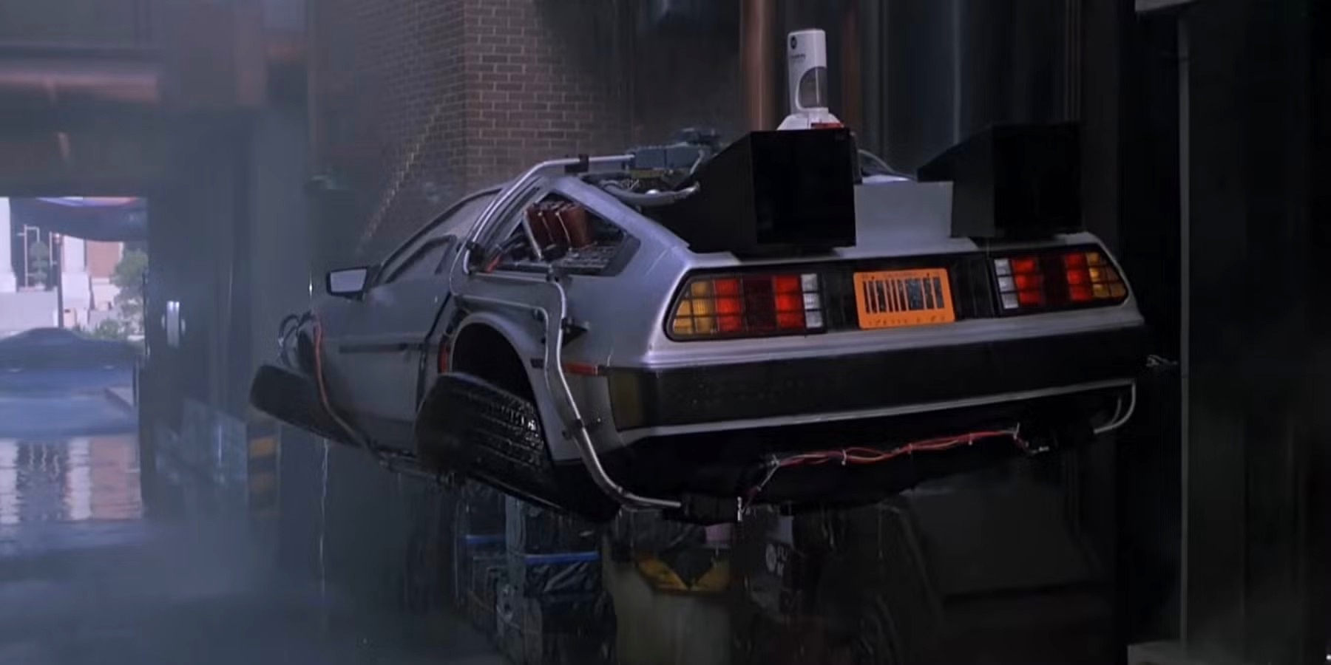
BACK TO THE FUTURE
ACCELERATE TO 88 MPH
v7 on Windows Server 2028
v5.1 not installed by default
v5.1 becomes optional component (installed)
Nov-2027
v7 on Windows client
v5.1 removed from Windows
Tied to client release
At least 3-years away

Slide 8

This is how WE get to 88 mph
FLUX CAPACITOR
MSIX is the future for Microsoft
The promise - parity with MSI
Multiple teams working on the promise (Windows, SCCM, Intune, and more)
Serviced via the Store
Your feedback it important

Slide 9
This is how YOU get to 88 mph
FLUX CAPACITOR
Discovery Tools
AI-assisted migration
Docs
Demo script – WMI to CIM

Slide 10
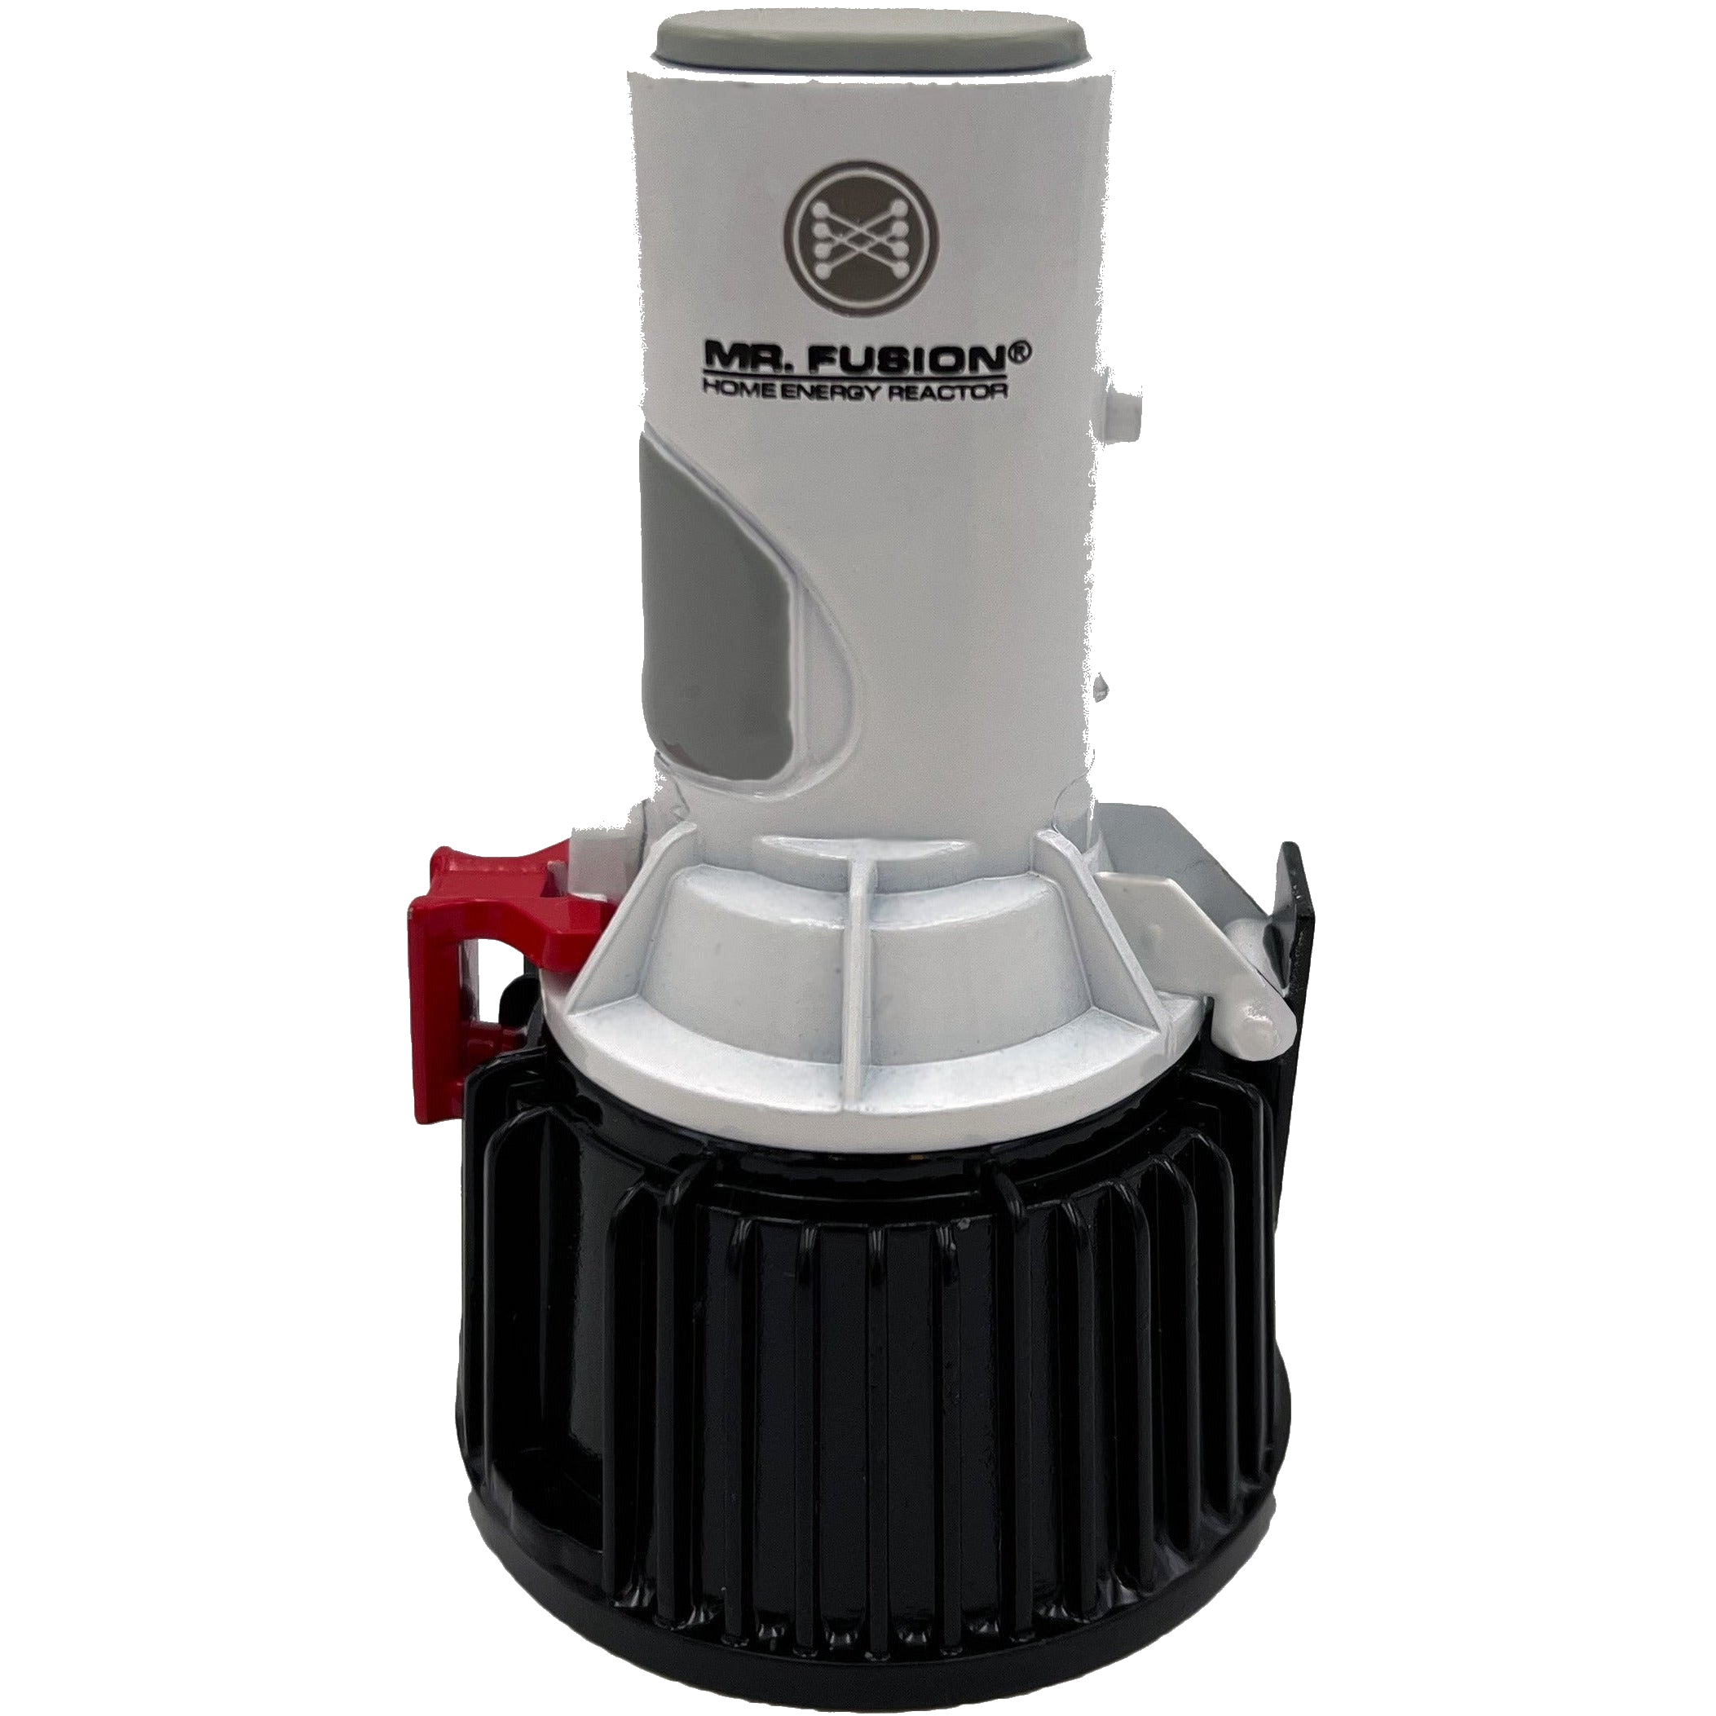
MR. FUSION
Where else are we going?
VS Code extension & PSScriptAnalyzer
Enable ISE-mode
PSResourceGet & PowerShell Gallery
MAR support
Faster
PlatyPS
DSC v3
OpenSSH

Slide 11

Resources
MR. FUSION
Documentation
Differences between Windows PowerShell 5.1 and PowerShell 7.x
Migrating from Windows PowerShell 5.1 to PowerShell 7
More to come
PSScriptAnalyzer compatibility rules
UseCompatibleCmdlets
UseCompatibleCommands
UseCompatibleSyntax
UseCompatibleTypes

Slide 12
Your feedback is very important to us
Use the QR code or search for “Converge360 Events” in your app store
Find this session on the Agenda tab in the App
Click “Session Evaluation”
Thank you!

Slide 13
This is how WE get to 88 mph
FLUX CAPACITOR
First key point — replace with your content.
Second key point — keep it to one line each.
Third key point supporting the section theme.
Fourth point — add or remove rows as needed.
88
MPH
Swap in your headline metric — the number the audience should remember.

Slide 14

SECTION TITLE
GOES HERE
SECTION 01
A one-line description of what this section is about.

Slide 15
CONTENT LAYOUT
FLUX CAPACITOR
First key point — replace with your content.
Second key point — keep it to one line each.
Third key point supporting the section theme.
Fourth point — add or remove rows as needed.
88
MPH
Swap in your headline metric — the number the audience should remember.

Slide 16
TO BE
CONTINUED
◄ ROADS? WHERE WE'RE GOING... ►
your.name@company.com · @handle · company.com
DESTINATION TIME
PRESENT TIME
LAST TIME DEPARTED
OCT 26 1985
JUL 09 2026
NOV 05 1955

