Slide 1

Get more from your tooling
Turning command-line tools into cmdlets using Crescendo

Slide 2


Presenters
Jim Truher
Sr. Software Engineer
An original PowerShell developer
Sean Wheeler
Sr. Content Developer
Lead Writer for PowerShell

Slide 3
My 5 Steps to creating a Module
Getting started reading the blogs
Choose the native command - VSSAdmin.exe on Windows
Create the output parsers
Create the cmdlet configuration file
Export the configuration to a module
DEMO TIME!

Slide 4
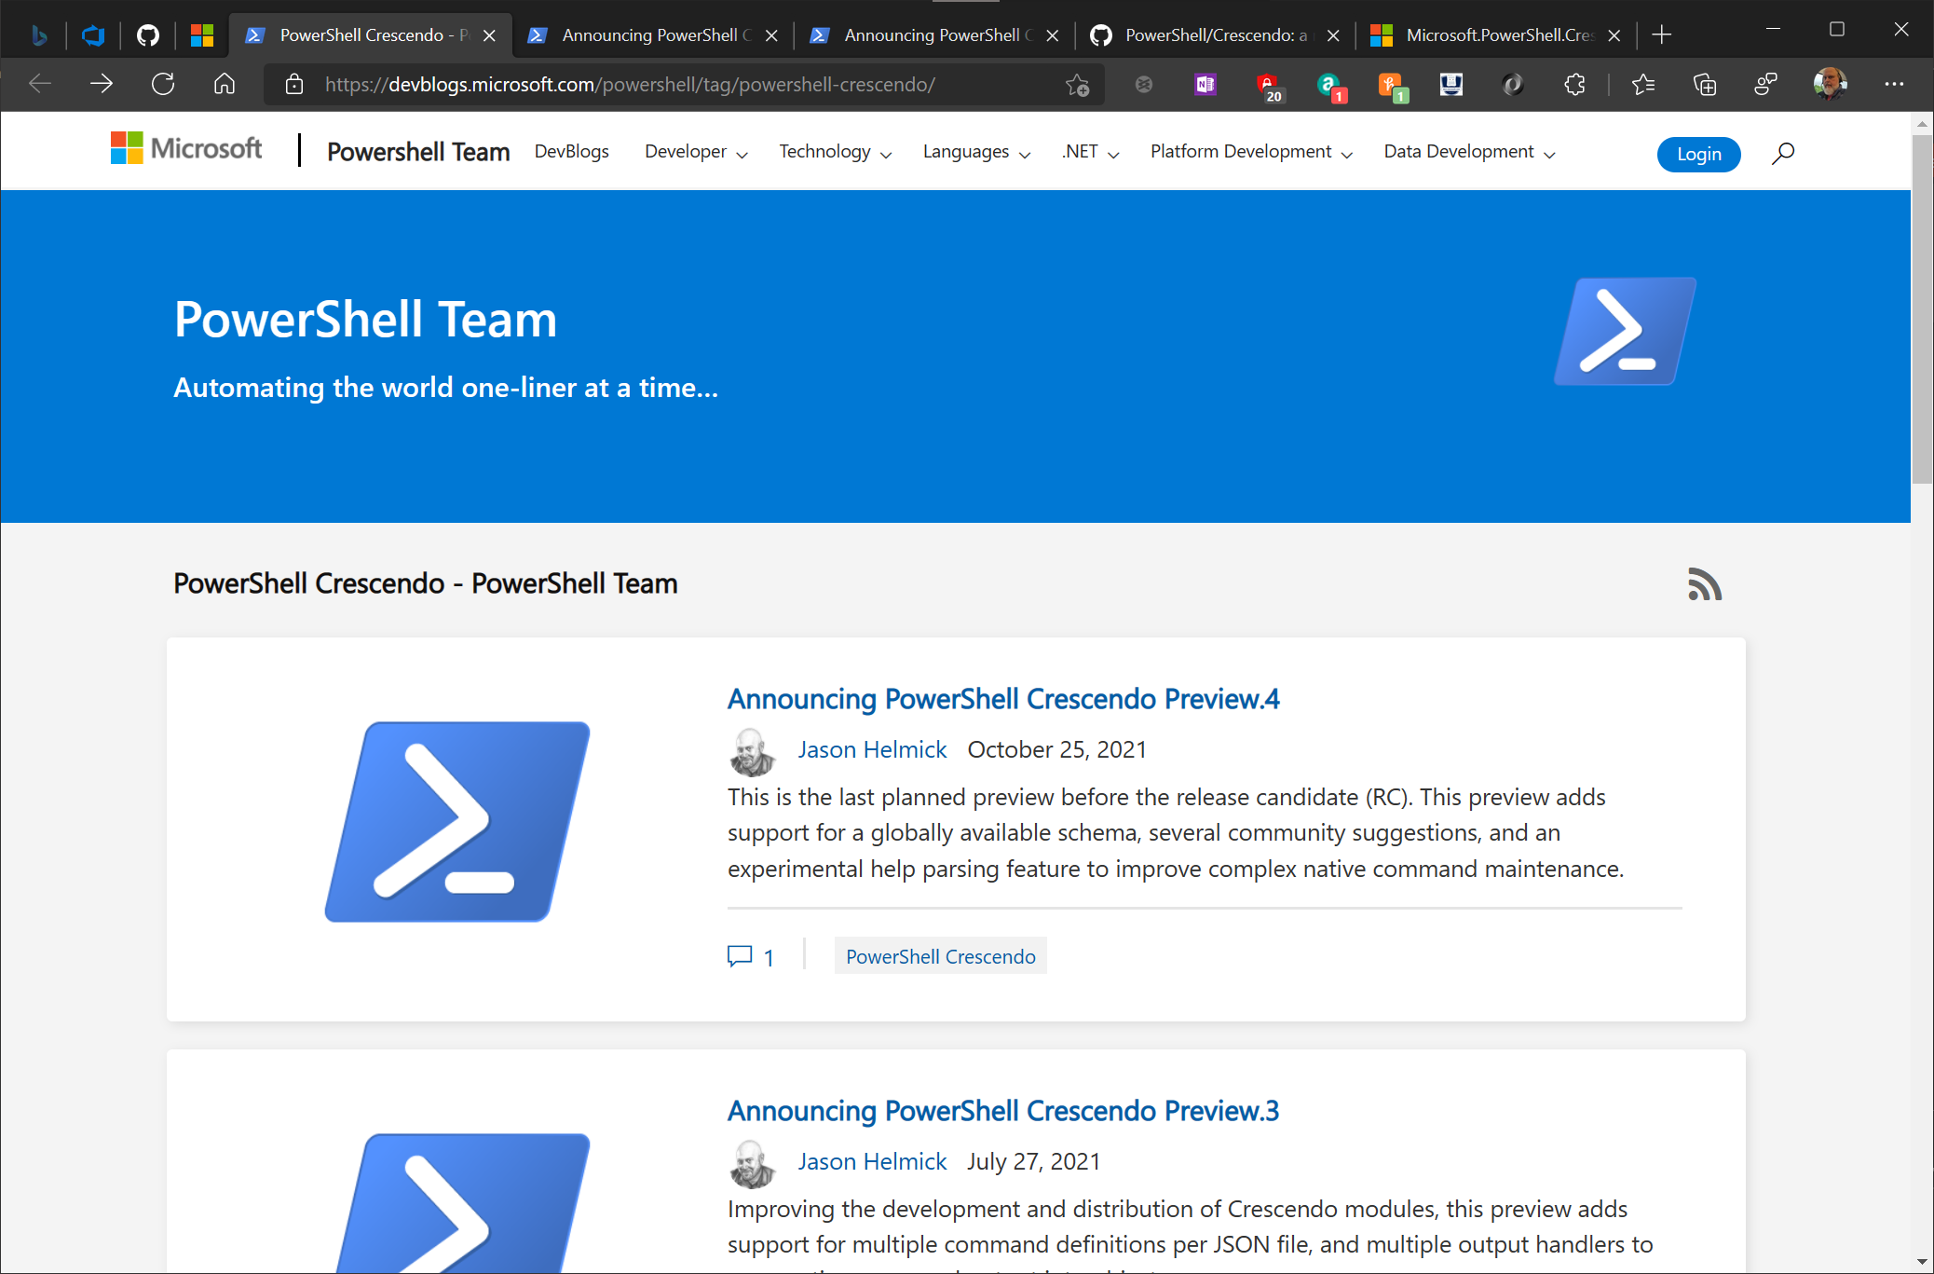
Step 1 – Read the blogs!

Slide 5
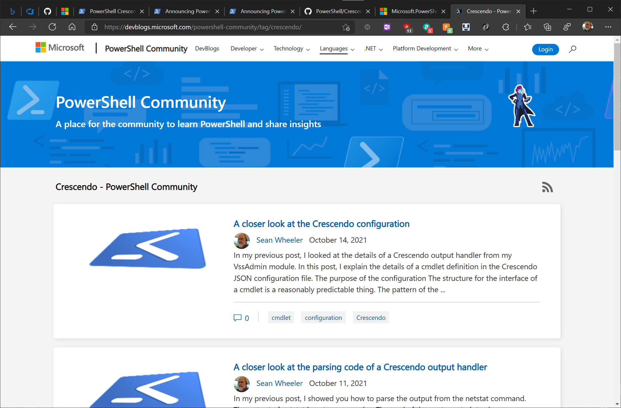
Step 1 – Read the blogs!

Slide 6
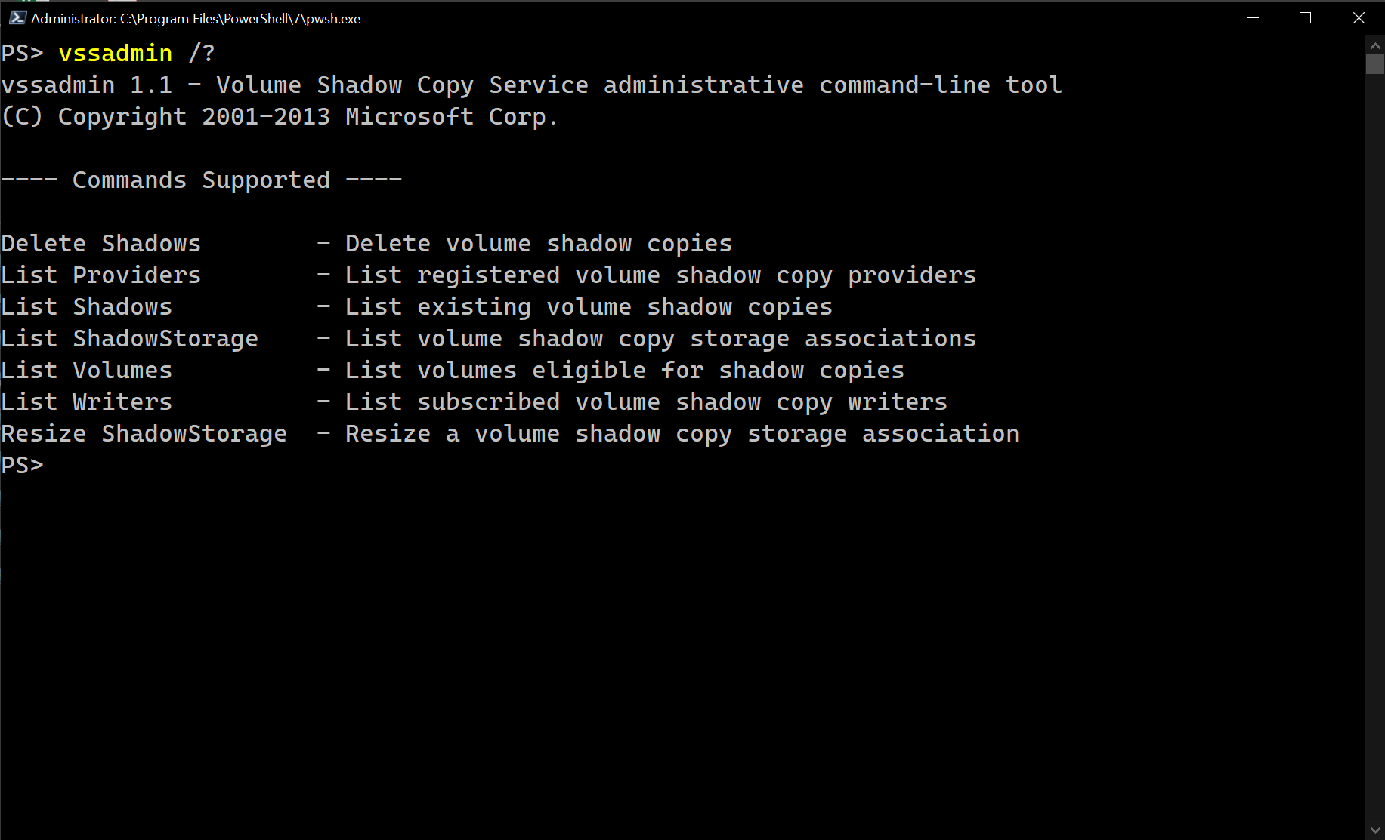
Step 2 - Choose the native command
Start with the help
Collect output samples
Notes:
Start with the help for each subcommand
Get sample output for each subcommand
Analyze the output to determine which bits of information are important to you
Look for patterns that make it easy to identify which line of data you are working with
Look for natural delimiters that separate labels from data in the output
VSSAdmin is a good choice
It has decent documentation
The output is structured well

Slide 7
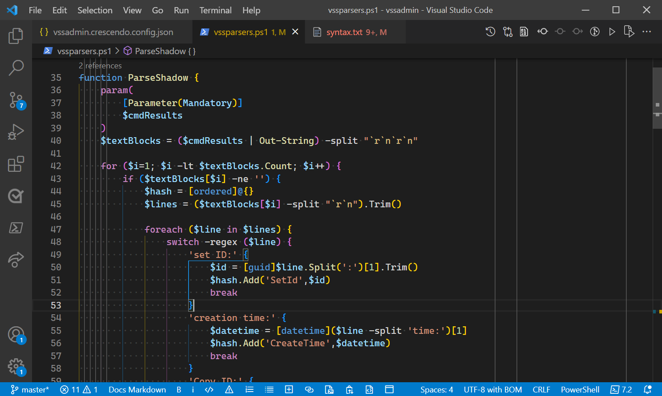
Step 3 - Create the output parsers
This is the hard part
Lots of tools available - Split(), Trim(), Replace(), regular expressions (with -match and switch), etc.
Parsers must be discoverable by Get-Command
Notes:
Crescendo doesn’t make this part any easier, but it does allow you to focus on parsing the output
I started with the parsing functions because I was more comfortable writing PowerShell than JSON
I captured the output of each subcommand into a text file that I could easily use as input to my parsing function
Let’s step through an example for parsing the output from vssadmin list shadows
Here is the output of the native command
Notice how the labels and data are presented
Set breakpoints on first line and Original Volume line
Step through first line
Notice that I convert the string to a GUID object
Remove break point and run until next breakpoint
See how the line is subdivided into multiple property values
Remove all breakpoints and show the output as objects
Switch to terminal and show the verbose output
Jim, what is I am having trouble? How can I see what native command is actually being run?

Slide 8
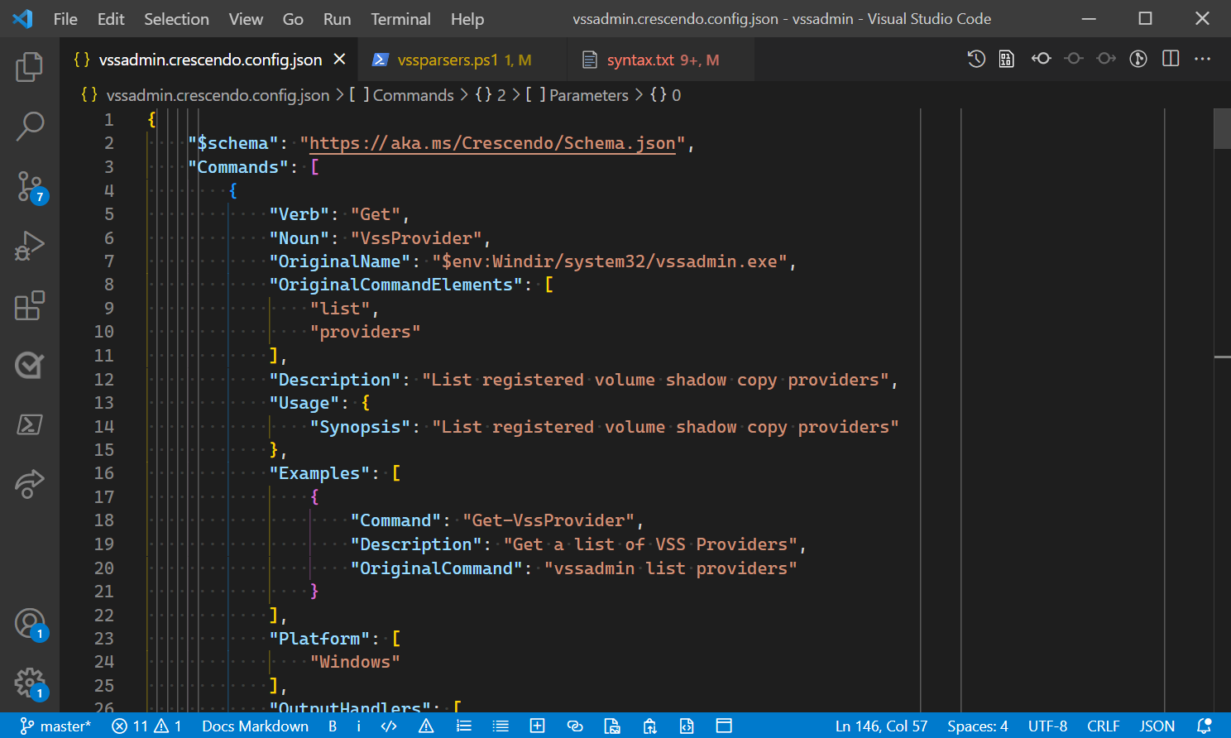
Step 4 - Create a cmdlet configuration
JSON schema helps with IntelliSense in VS Code and tooltips for help
Notes:
I implement all but one subcommand. Let’s add that to the configuration file now.
See how the JSON schema validation helps us with the authoring process.
Note the information shown in the Problems pane of VS Code.
Hover over a property to see a description.
Let’s look at the finished example for Get-VssShadow
This command has multiple parameters and parameter sets
Get-Command Get-VssShadow –Syntax
Run Get-VssShadow | Select OriginalVolume
See the different property options that show up as help
Get-Help -Full Get-VssShadow
Let’s look at the OutputHandlers
Jim – tell us about the other types
Why would you use one over the other?
Let’s look at some other properties
What is NoGap? Jim – how does Crescendo construct the native command line
See that MaxSize has validation
Jim – what is Platform used for?

Slide 9
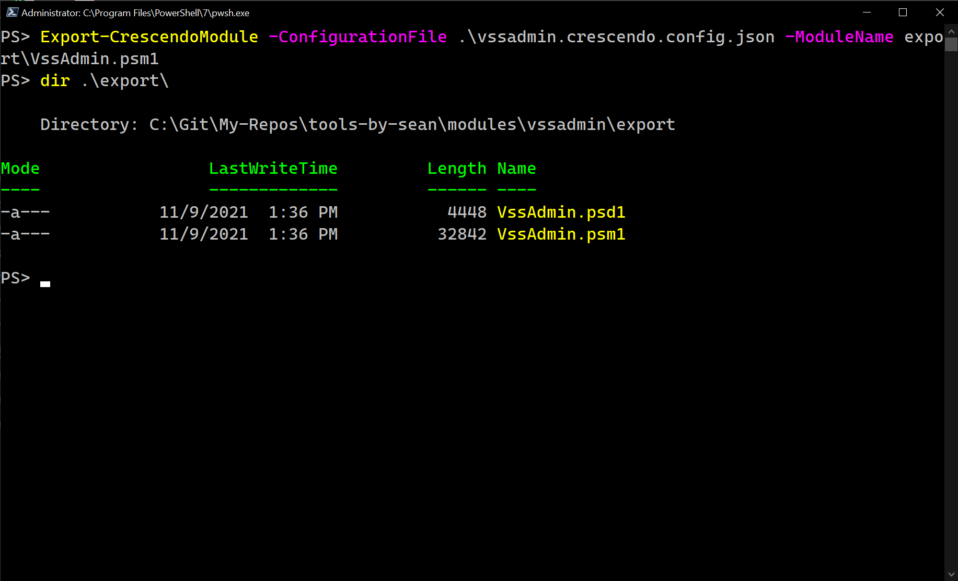
Step 5 - Export the configuration to a module
Crescendo creates the module files
The end-user does not need Crescendo
Notes:
Delete the module from the export folder
Export the module
Switch to PS 5.1 – show that VSSAdmin and Crescendo are not loaded
Import VSSAdmin and run some commands

Slide 10
What’s next
New features in Preview 4
Helper cmdlets
Experimental Help parsers
Improved documentation
GA targeted for early 2022

Slide 11
Get Started
Get Crescendo
https://www.powershellgallery.com/packages/Microsoft.PowerShell.Crescendo
Give us feedback
https://github.com/PowerShell/Crescendo
Crescendo Documentation
https://docs.microsoft.com/powershell/module/microsoft.powershell.crescendo/

Slide 12
Resources
Crescendo announcements - https://devblogs.microsoft.com/powershell/tag/powershell-crescendo/
Sean’s 4-part blog series - https://devblogs.microsoft.com/powershell-community/tag/crescendo/
Sean’s VSSAdmin examples - https://github.com/sdwheeler/tools-by-sean/tree/master/modules/vssadmin

