Slide 1
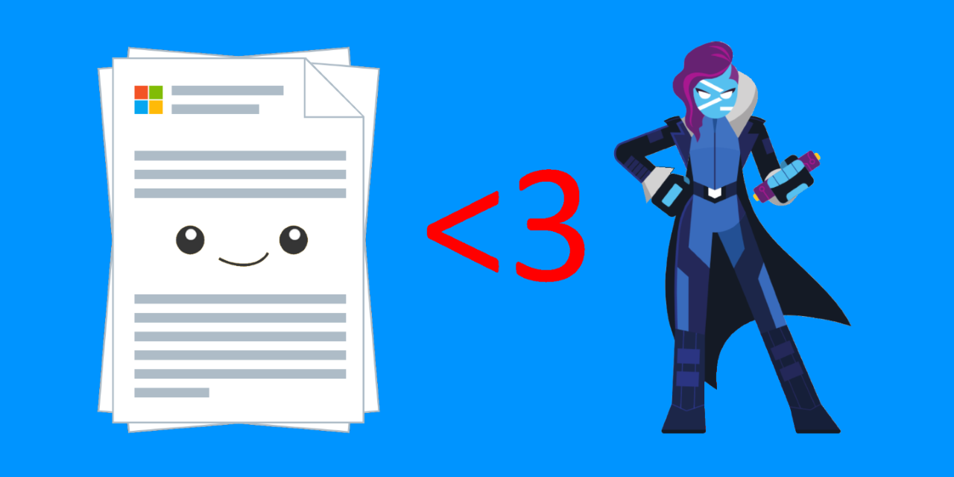
Contribute to Docs like a Microsoft Insider
Presented by the Guys who write the docs

Slide 2




Sean Wheeler
sean.wheeler@microsoft.com
Mike F. Robbins
mike.robbins@microsoft.com
Lead Writer for PowerShell
sdwheeler – @swsamwa
Lead Writer for Azure PowerShell
Former PowerShell MVP
@mikefrobbins – GitHub & Twitter

Slide 3
Why Contribute?
Easier than contributing to the PowerShell source code
Improve the documentation for everyone
Recognition in the community
Easy way to learn about GitHub and Markdown
Notes:
Show the community updates and Hall of Fame

Slide 4
Getting Started
Create a GitHub account
Setup Git and VS Code (with extensions)
Read the contributor docs
Docs Contributor Guide
PowerShell-specific Contributor Guide
Markdown reference for docs.microsoft.com
Using the Microsoft Doc Authoring Pack
Notes:
Show the contributor docs
Show the setup guides

Slide 5
Make a simple change
See https://docs.microsoft.com/en-us/contribute/
Click the Edit icon on the page
Use the GitHub web interface to edit
Good for small changes to a single file
Use the full workflow for complex changes and multiple files
Notes:
DEMO

Slide 6
PowerShell-Docs structure
Reference vs. conceptual content
Version management
How the TOC works
Published M-F at 3pm PST
Notes:
Show repo structure in relation to Docs site
Conceptual above the line
Reference below the line (no TOC file)
Show the structure of the TOC file
Other special formats (yaml files) – prefer you file issue rather than PRs
FAQs
Hub & landing pages

Slide 7
Azure-DOCS-PowerShell structure
Two repositories
Azure PowerShell source code – Azure/azure-powershell
Docs repository – MicrosoftDocs/azure-docs-powershell
Edit button points to Source repo for cmdlet reference
Must make changes in both repositories to see update in Docs
Published M-F at 10am and 3pm PST
Azure PowerShell release schedule

Slide 8
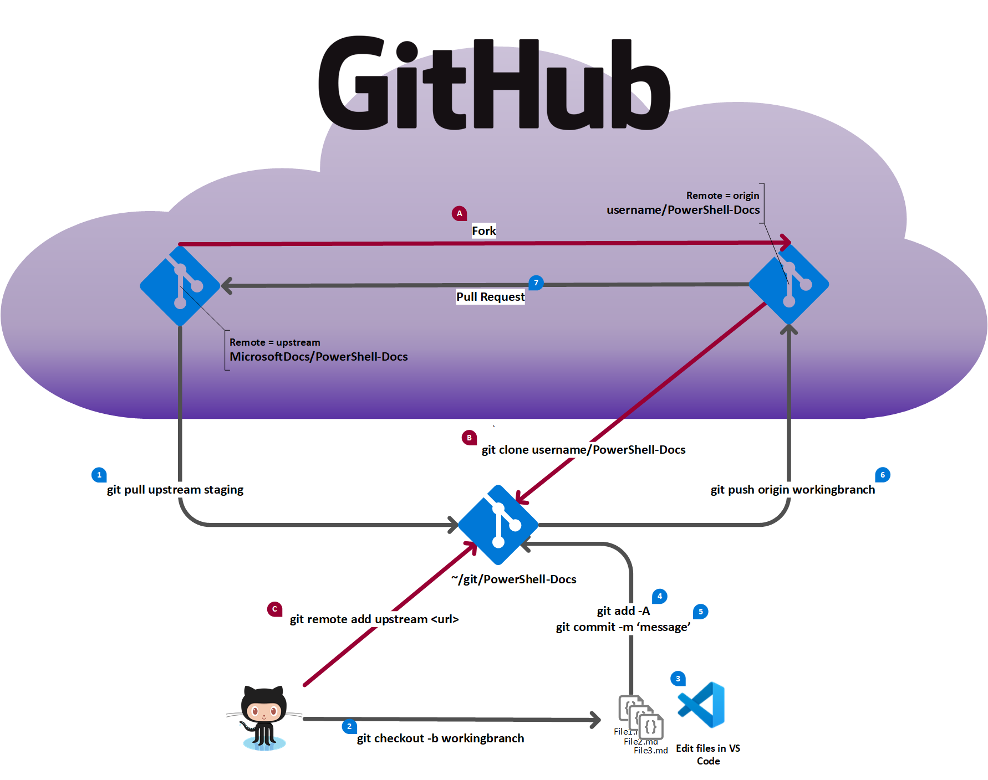
One-time steps
Fork the base repo
Clone your fork
Add an upstream pointer to the base
Normal workflow
Pull default branch from base repo
Create a working branch
Edit your files
Add your changes to Git
Commit your changes
Push the working branch to your fork
Create a pull request from your fork to the base repo

Slide 9
Full GitHub workflow
Demo
Notes:
Full workflow
Cmdlet reference schema
Dealing with the error message - Add files via upload - add two PowerShell topics. by jweston-1 · Pull Request #2912 · MicrosoftDocs/windows-powershell-docs (github.com)
PR Quality
Fix warnings and errors
MS-only tools - build reports and previews
Show in PR comments
VS Code, markdown, and extensions
Docs Authoring Pack
Reflow – why the 100-character limit?

Slide 10
Authoring tools and extensions
Demo
Notes:
VS Code, markdown, and extensions
Docs Authoring Pack
Reflow – why the 100-character limit?
PowerShell best practices
Code styling for docs
Don’t use continuation characters – use splatting
Code fences - powershell vs. azurepowershell-interactive
No aliases - Use proper Pascal Case
No prompts unless documenting the prompt behavior

Slide 11
Bonus - Another Way to Contribute
PowerShell Community Blog
GitHub Source - https://github.com/PowerShell/Community-Blog
Blog site - https://devblogs.microsoft.com/powershell-community/
Great way to start writing and get free code and content reviews

Slide 12
Key takeaways
Read the contributor & style guides
Docs Contributor Guide
PowerShell-specific Contributor Guide
Microsoft Style Guide
The process is the same for contributing to any docs.microsoft.com content
Only difference would be content-specific styling
PowerShell content is everywhere – Azure, Office, Windows, SQL, etc.

Slide 13
Resources & Links
Tools
Visual Studio Code – https://code.visualstudio.com
Beyond Compare – https://www.scootersoftware.com/download.php
Markdown resources
Markdown reference
CommonMark Specification

Slide 14
Thanks for coming

