Slide 1

Getting started with Crescendo

Slide 2
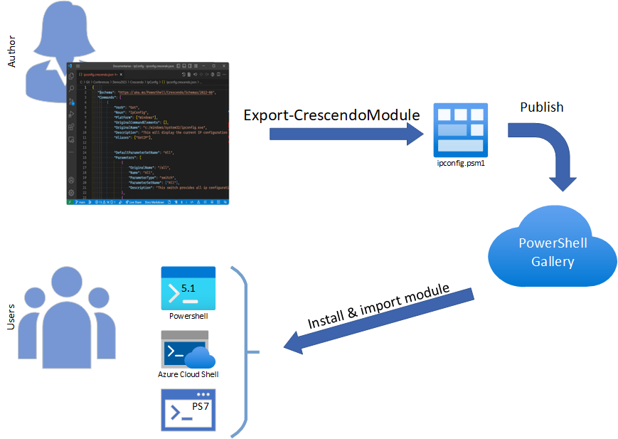
What is PowerShell Crescendo?
PowerShell Crescendo is a framework for creating PowerShell cmdlets that amplify command-line tools, regardless of platform.
Goal
Create a PowerShell experience for native command-line tools.
Notes:
Don’t edit the generated module – update the config and rebuild it instead

Slide 3
How to choose the tool to amplify
Good candidates
The original tool is difficult to use.
The command-line tool output is difficult to use in automation.
The command-line tool doesn't provide adequate help.
Bad candidates
Equivalent cmdlets already exist
There may be better ways (APIs, etc.)
The output is trivial – not useful as an object
Optimize your investment by focusing on what you need

Slide 4
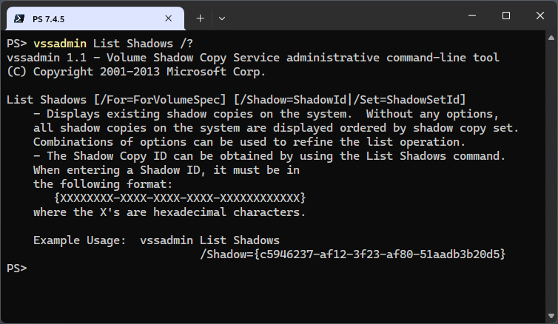
Research the tool's syntax and output
Start with command-line help and documentation
Note the command-line parameters and their syntax
Capture example output for parsing
See how the output is laid out to inform the parsing requirements

Slide 5



Create a Crescendo cmdlet definition
Cmdlet method | JSON authoring
Create base objects then add properties to the object Export the object to JSON | Schema enables IntelliSense in VS Code Separates cmdlet interface definition from parsing code Difficult to write PowerShell code in JSON | The goal is to create a JSON configuration file

Slide 6
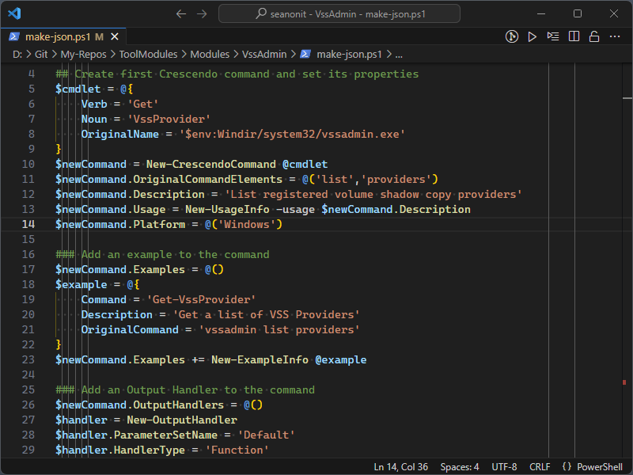
Create Crescendo objects
Crescendo cmdlets create Crescendo objects that can be serialized to a JSON
New-CrescendoCommand
New-ExampleInfo
New-OutputHandler
New-ParameterInfo
New-UsageInfo

Slide 7
Author JSON in VS Code
Crescendo includes a JSON schema file that enables IntelliSense in Visual Studio Code and ensures that the JSON file is correctly structured.

Slide 8

Build and publish the module
Export-CrescendoModule
NoClobber option
Prepare your module for distribution
Include any files that the end-user needs
Edit PSD1 file as necessary (Version, HelpUri, Compatibility, etc.)
See requirements for PSGallery
Finding Crescendo modules

Slide 9
Types output handlers
ByPass
Inline
Good for short/simple handlers – short one-liners
Separate script files for each parser
Easier for testing
Script files get packaged with module (external to PSM1)
Separate functions
Functions must be loaded in session when you export the module
Functions included in the PSM1
Pass output through unaltered
Embedded in JSON

Slide 10
Advanced features
Handle error output
Transform argument values
Create parameters not mapped to the native command
Support elevation

