Slide 1
IDS 517 HW-7
Submitted By:
Shubham dwivedi
660328503
sdwive4@uic.edu

Slide 2
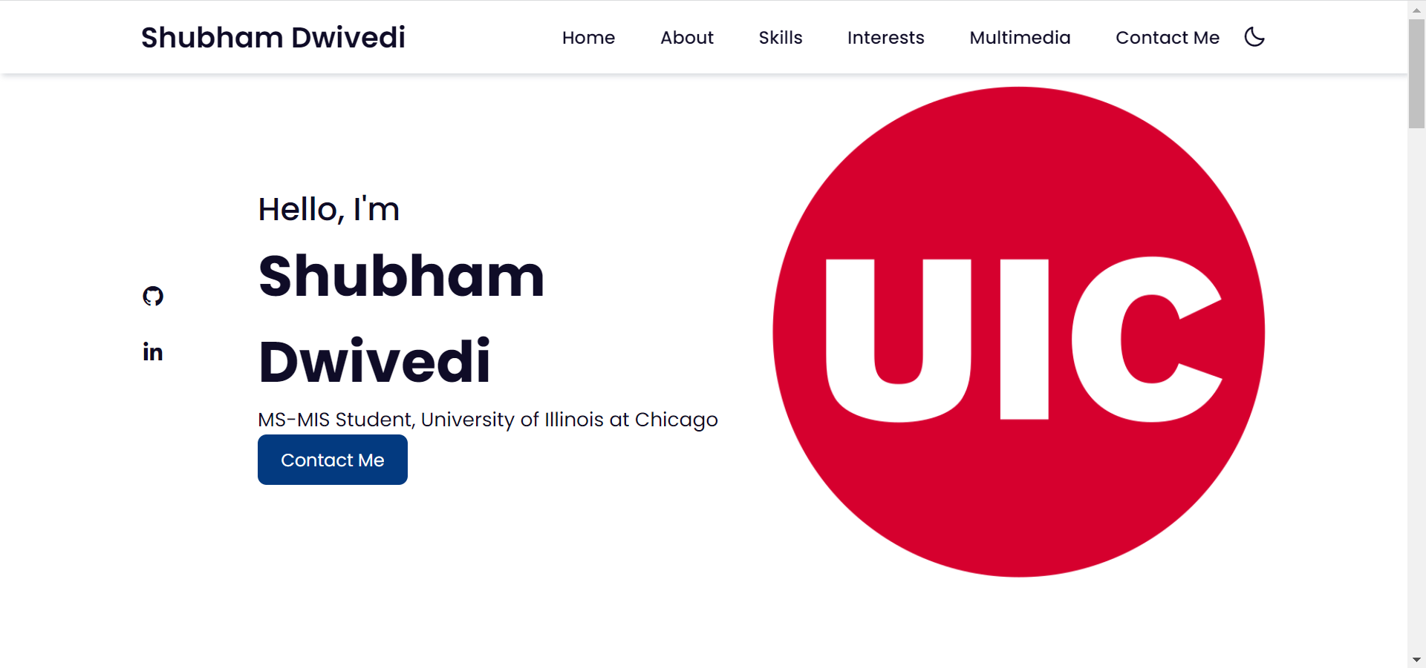
Home page

Slide 3
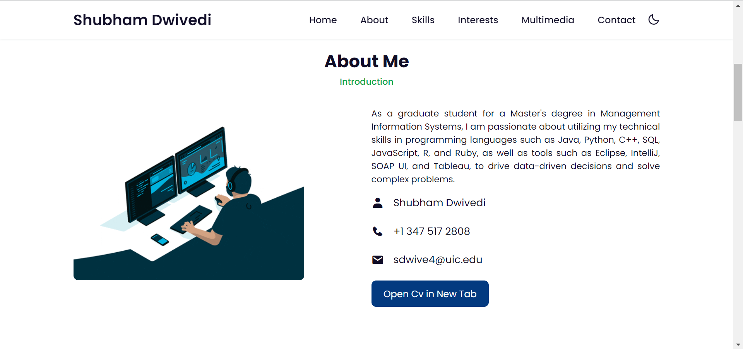
About Me section

Slide 4
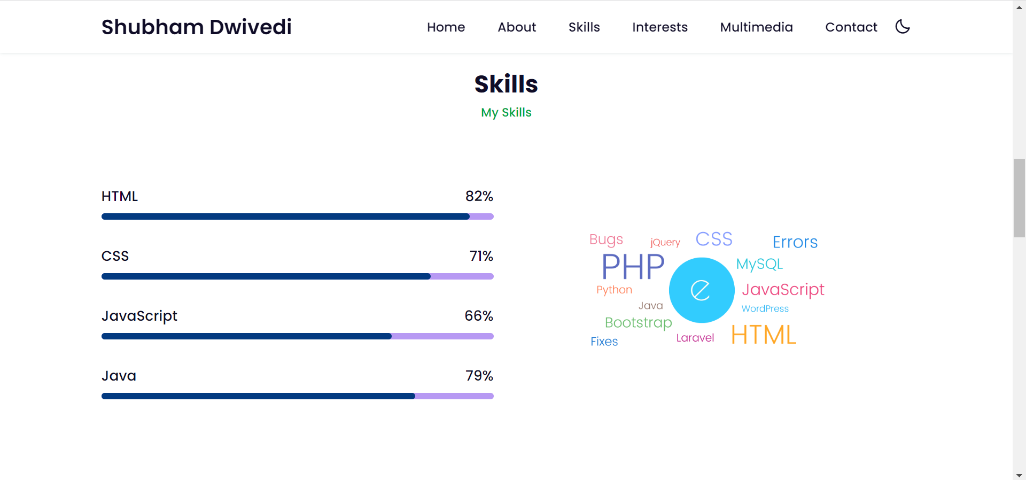
Skills section

Slide 5
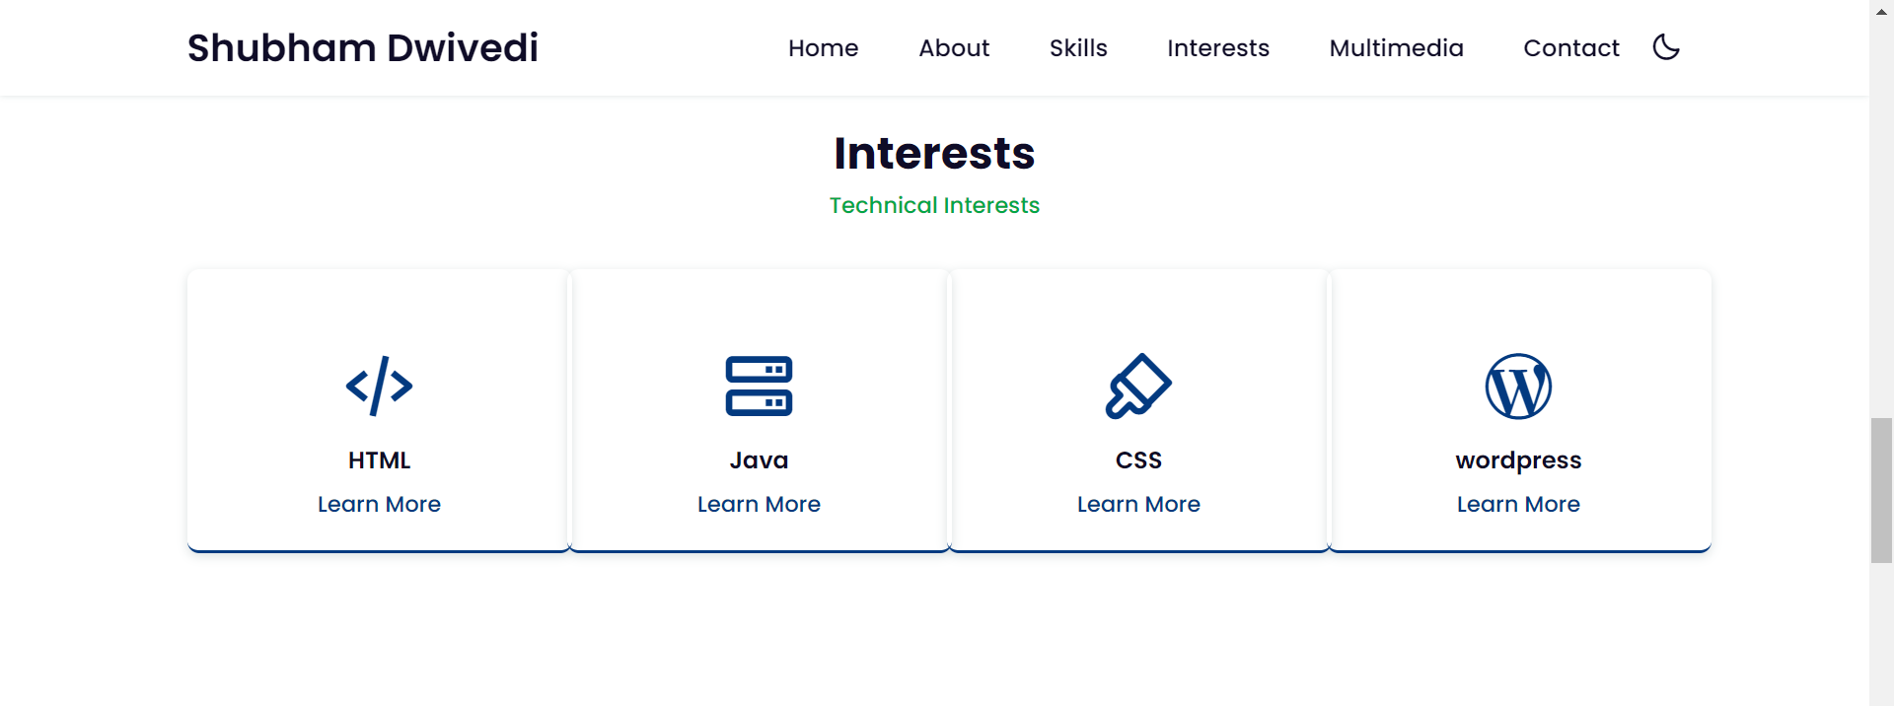
Interests section

Slide 6
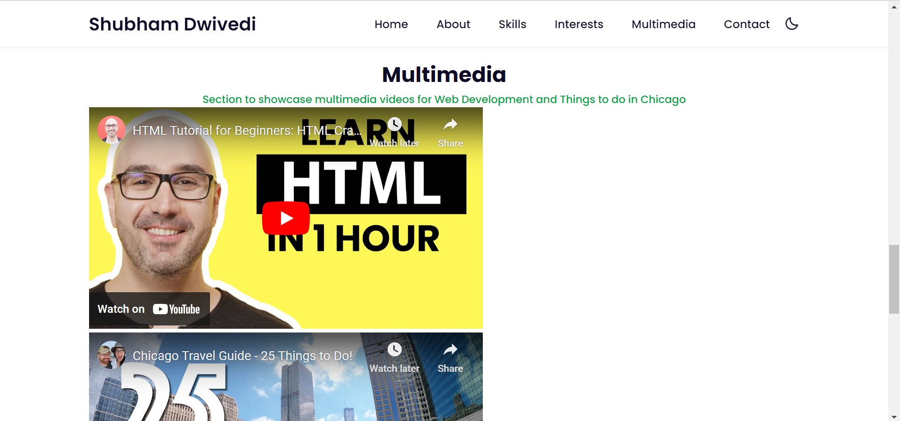
Multimedia section

Slide 7
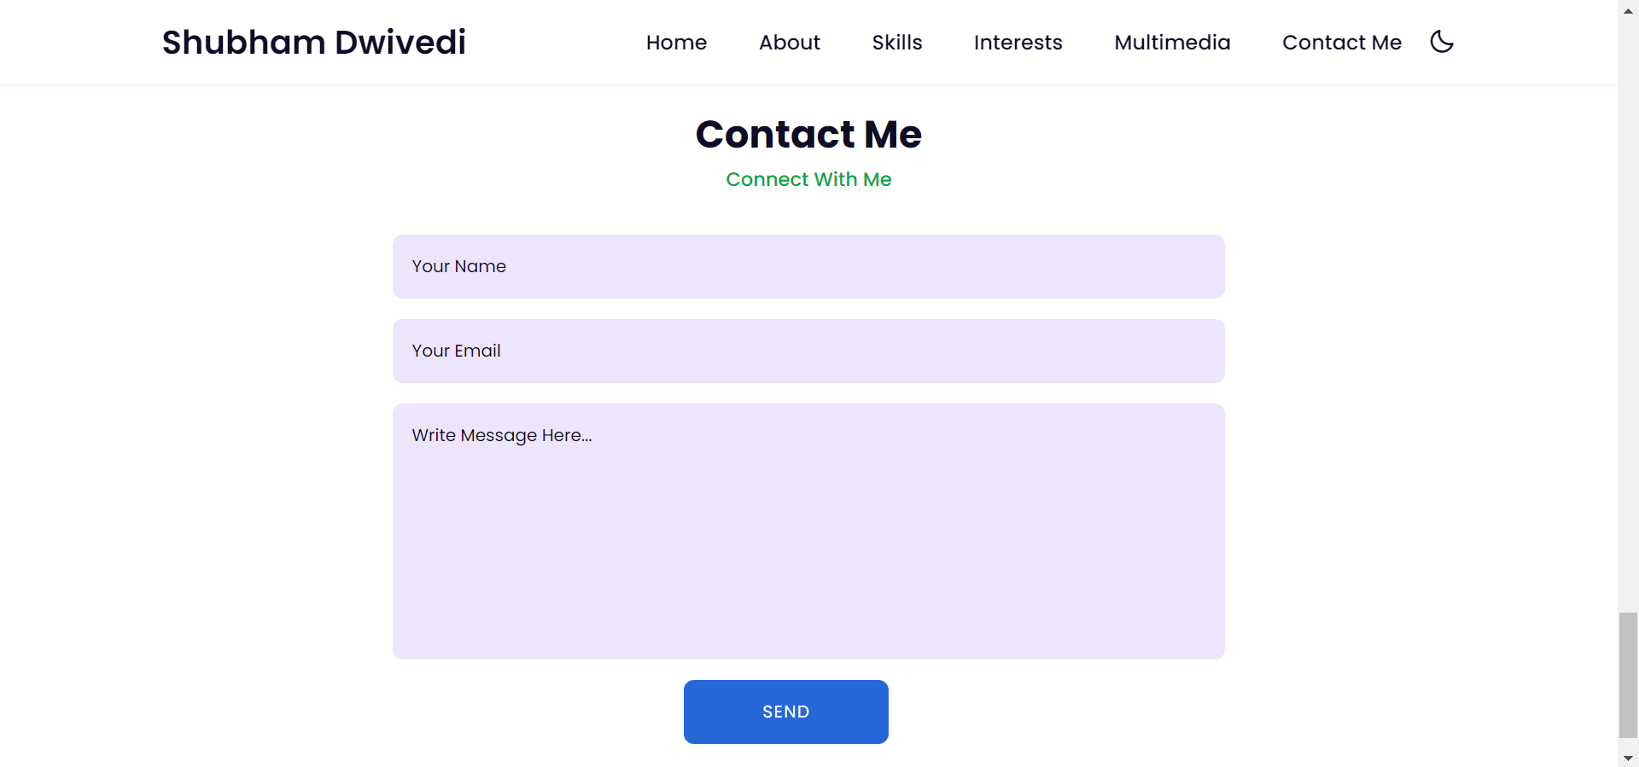
Contact me section

Slide 8
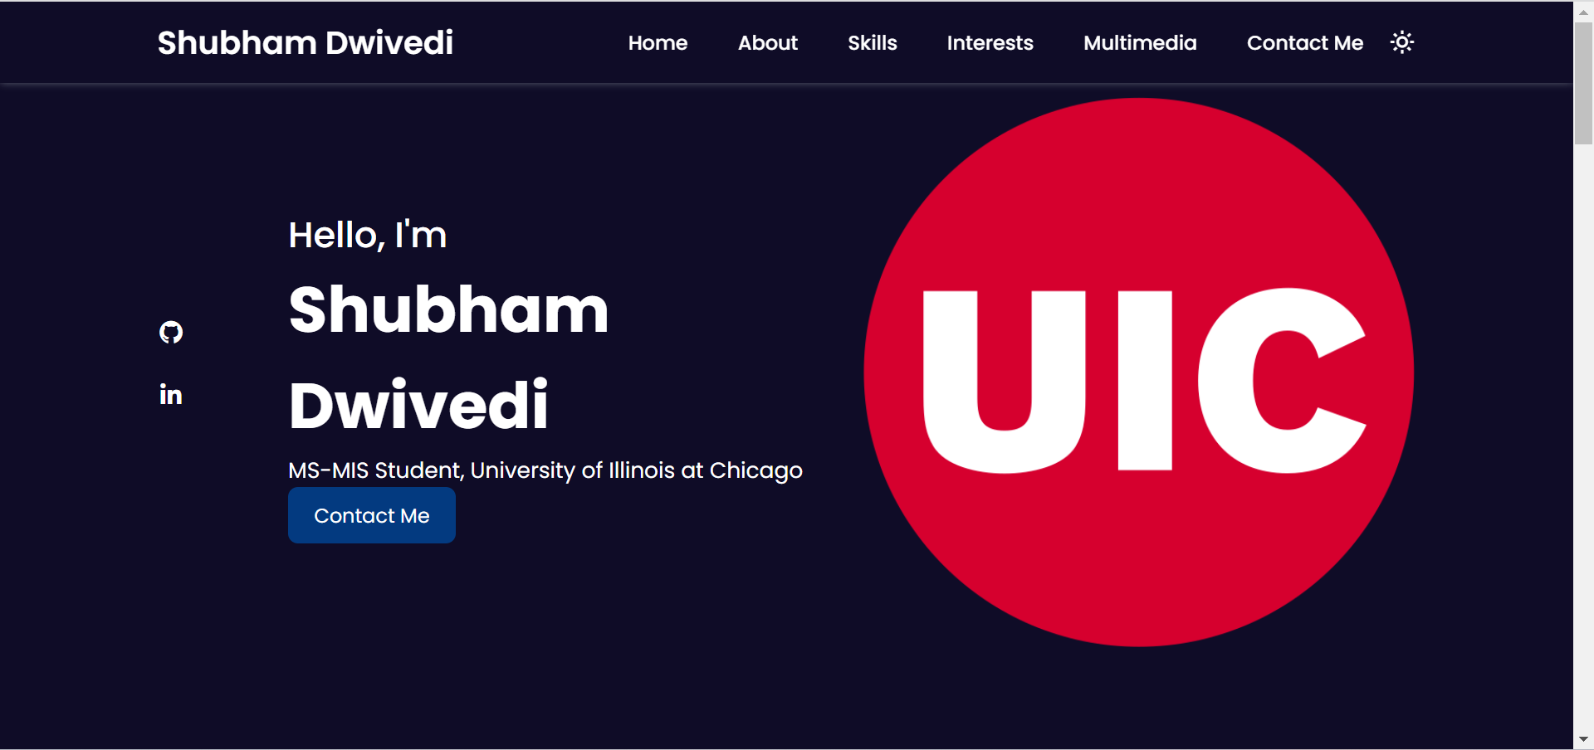
Dark mode

Slide 9
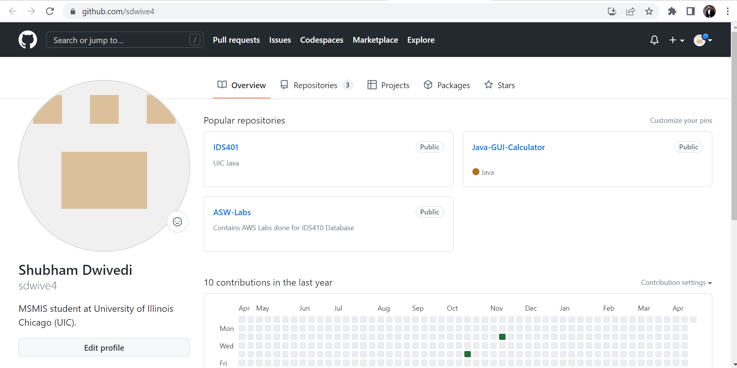
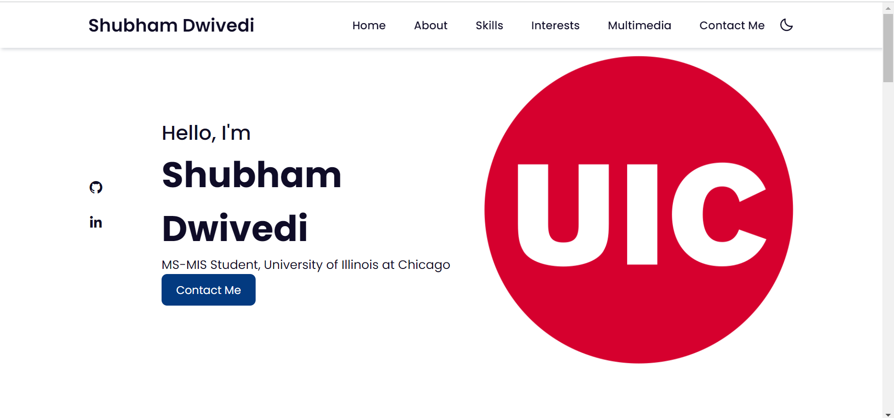
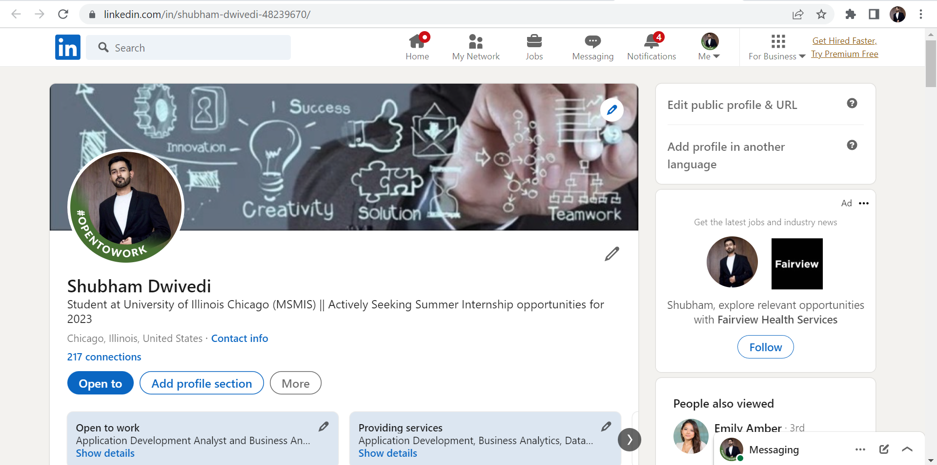
Github and linkedin profiles added (hyperlinks to external website)

Slide 10
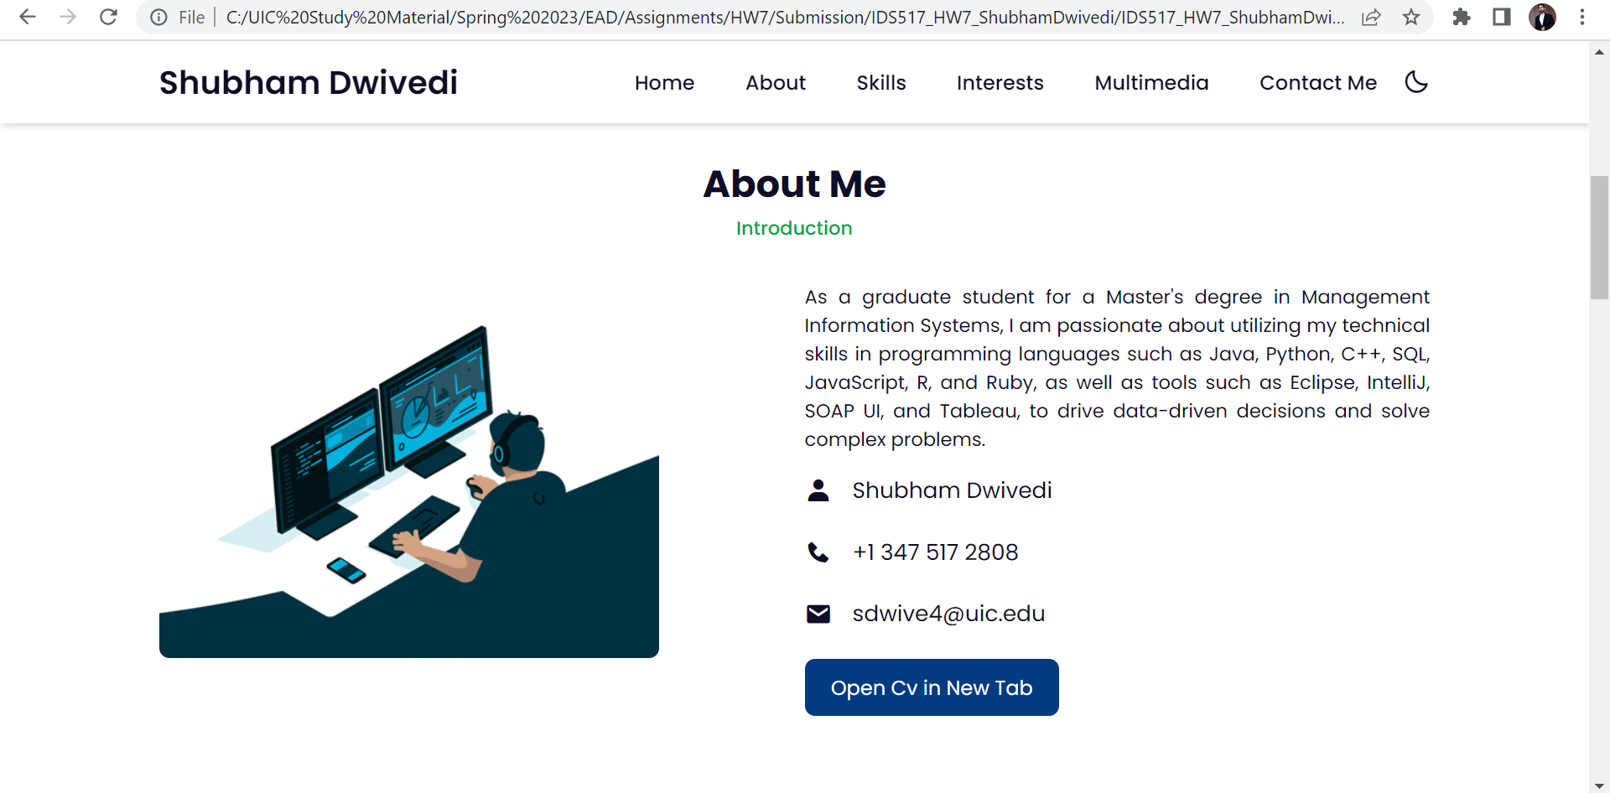

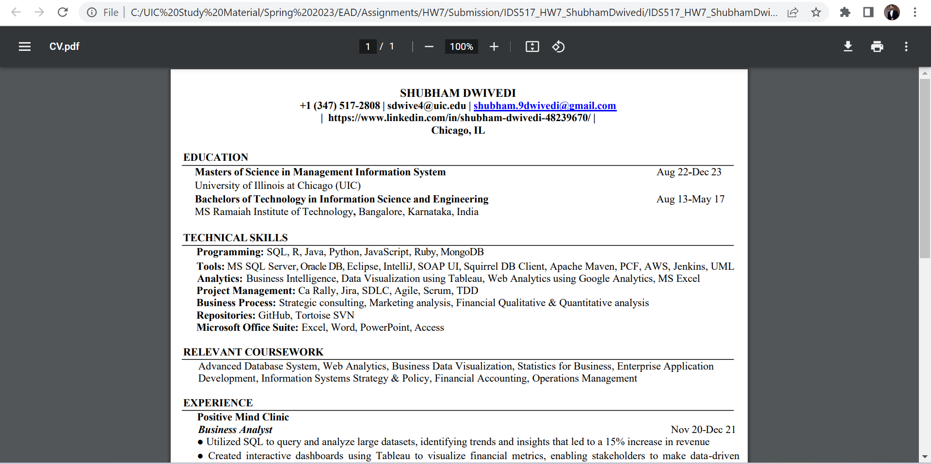
Resume file download by clicking on button
Code Used:
Explanation: This code creates a hyperlink to a PDF file named "CV.pdf" with the text "Open Cv in New Tab" displayed on it, which, when clicked, will open the file in a new browser tab or window.

Slide 11
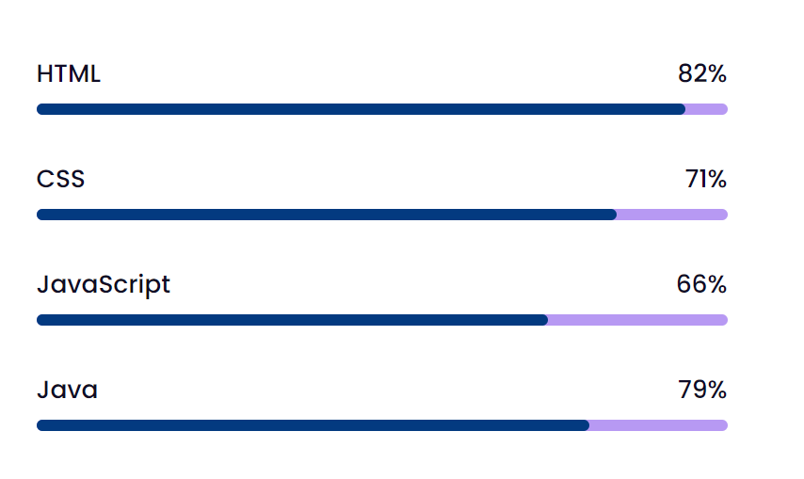
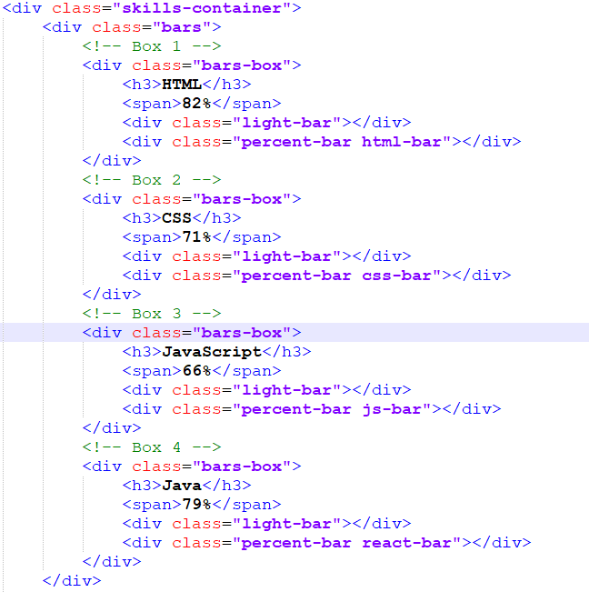
Percentage bar added
Code Explanation: This is a section of HTML code that creates four boxes displaying the proficiency percentage of a person in HTML, CSS, JavaScript, and Java using a progress bar.

Slide 12
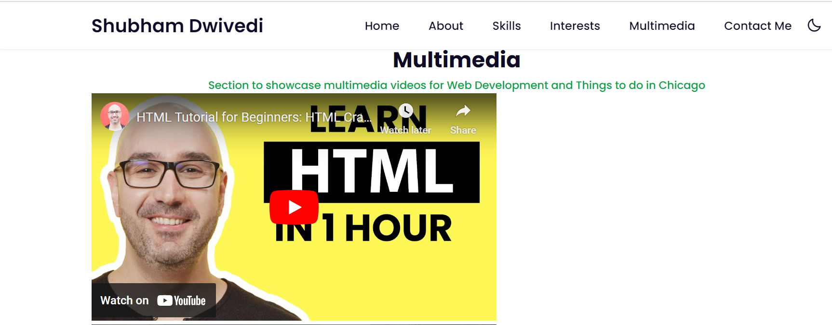
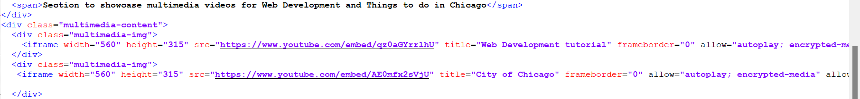
Adding videos to the webpage
The code uses iframe elements to embed YouTube videos on the webpage, specifying the video URL and dimensions using attributes. The allow attribute enables autoplay and encrypted media playback, while the title and allowfullscreen attributes provide a title and allow fullscreen mode, respectively.

Slide 13

Using gif multimedia feature
Added a .Gif (video).
Code:
Explanation: By adding ".gif" in the "src" attribute of the "img" tag, you specify that the image to be displayed is in GIF format.

Slide 14
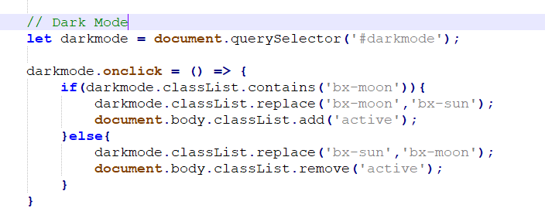
Added dark mode using java script
Code in html:
Code in Javascript:
Explanation: The code adds a dark mode toggle functionality that switches between bx-moon and bx-sun icons and toggles the active class on document.body. This enables users to switch between light and dark modes on the page.

Slide 15
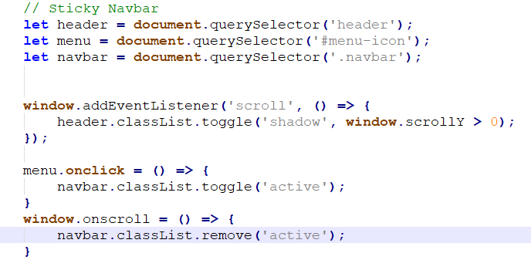
Responsive & Sticky navbar in javascript
Explanation: Sticky Navbar: The code adds a shadow to the header element on scroll, creating a sticky effect, and removes it when the user scrolls back to the top.
Responsive Navbar: The code toggles the active class on the .navbar element when the user clicks on the #menu-icon, showing or hiding the menu items. It also removes the active class on scroll, ensuring that the menu items are hidden when the user scrolls down the page.

Slide 16
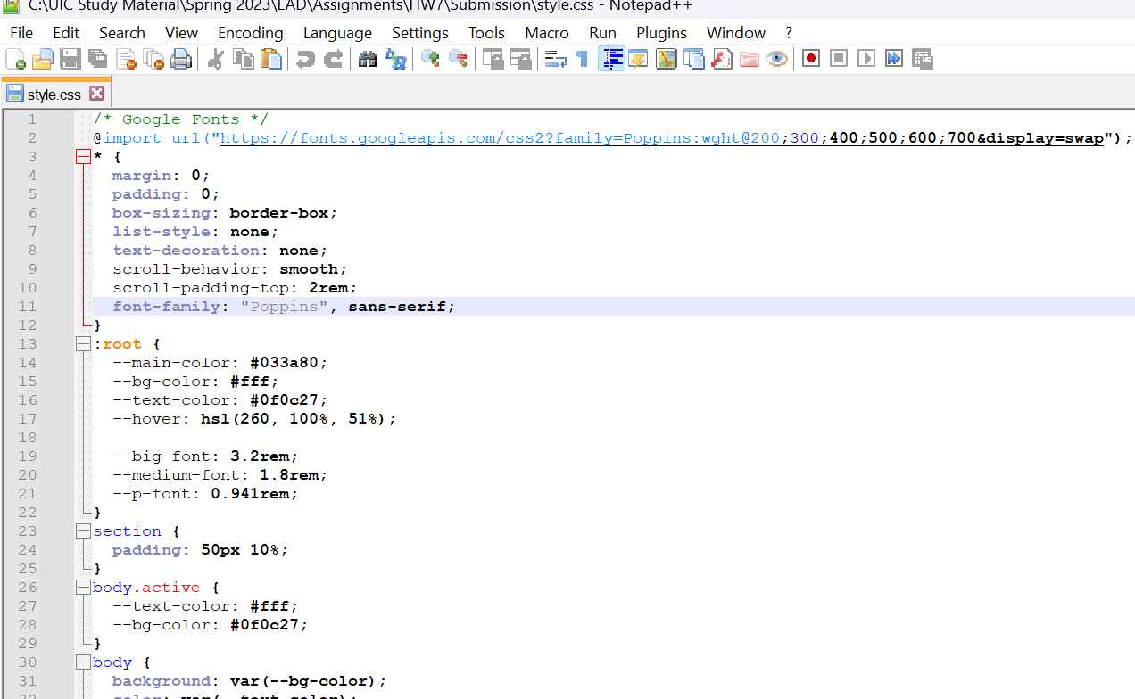
Used google fonts for css

Slide 17

Thank you

