Slide 1
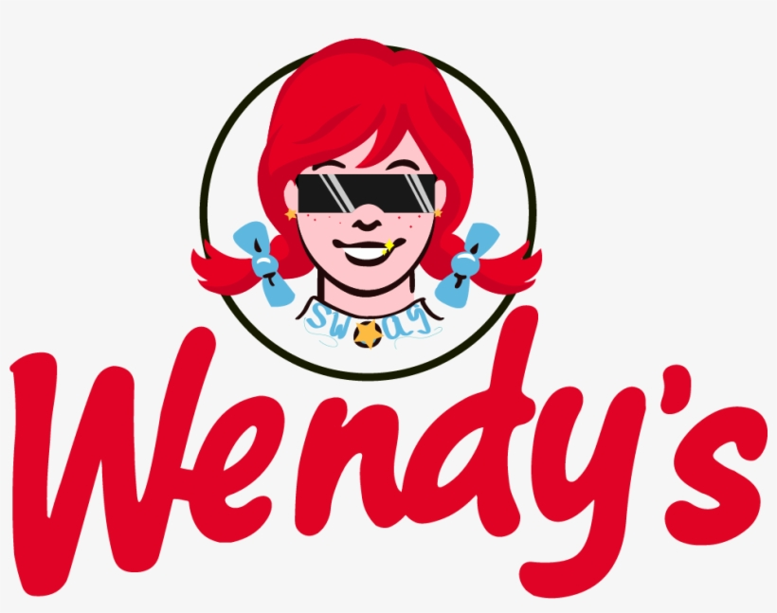
Presented By:
Shubham Dwivedi
Vamshidhar Nandineni
Nunayon Avoseh
Apeksha Suram

Slide 2
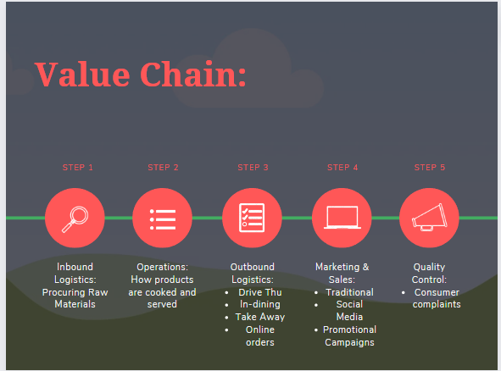

Slide 3
Wendy's Social Media Campaign
Positives
Free Marketing Platform
Increased followers base
Personalised replies to most of the tweets
Less promotion and more interaction
Appropriate number of posts
Distinct Identity
Negatives
Won’t be able to address every complain
Risk of fake complains
Huge volume of complains can highlight company’s shortcomings
Changes of controversies and defamation
Primarily focused on twitter

Slide 4

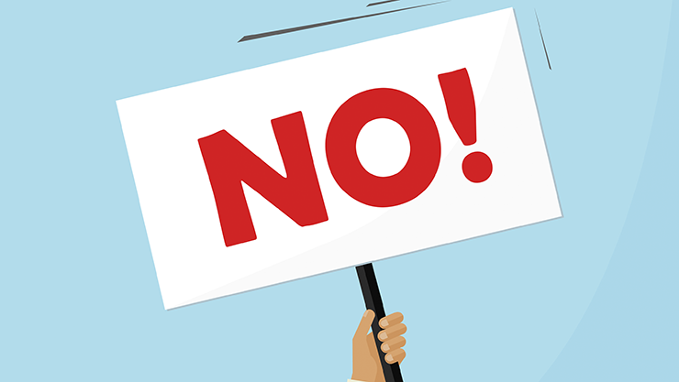



Can Twitter campaign be replicated in other platforms?
Different social media platforms contain different kinds of audience and platform orientation
Better for addressing text based complaints, brand oriented platform
For interpersonal relationships, friendship oriented platform
Less communication oriented, Image/video sharing platform
Communications are done in a professional tone
Verdict: Each platform will require a different campaign strategy

Slide 5
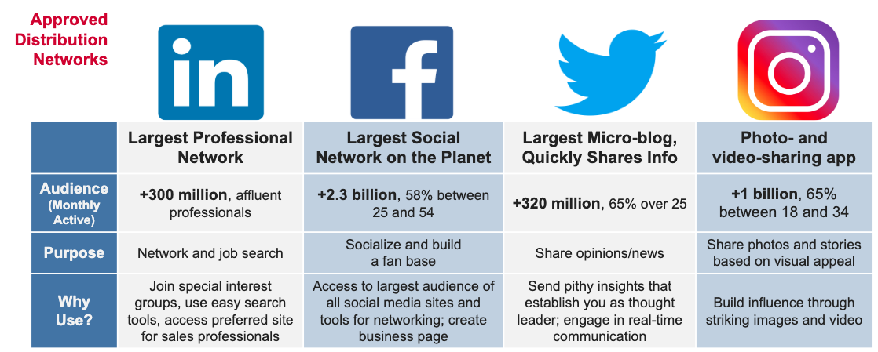

Slide 6
Means of Sales
SALES
ONLINE
OFFLINE
DELIVERY PARTNER
APPLICATION
DRIVE-THRU
DINE-IN

Slide 7
Wendy’s Primary Customer Base
People looking for quick, affordable meals
These include teenagers and young adults
Is Twitter campaign reaching the intended customer base?
Yes | No
Twitter has a good number of teenages and young adults With Wendy's adoption of witty and sparky humor, the number of followers grew over time. | A Lot of twitter users are affluent and use it for intellectual conversations
Verdict: Twitter helps wendy's to reach a large chunk of their customer base
However, for better reach they should target other platforms like Instagram and Tiktok

Slide 8
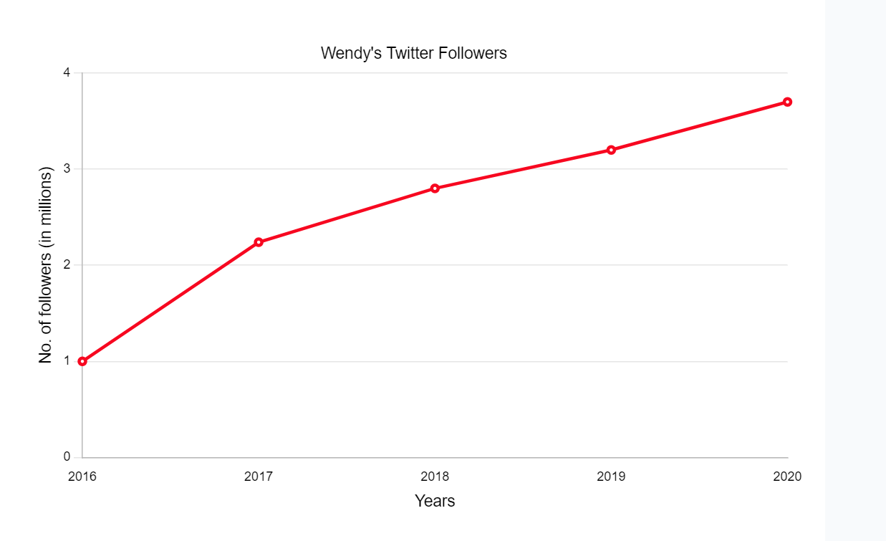
3.2
3.7
2.8
2.24
Graph 1: Wendy’s Twitter followers over the years

Slide 9
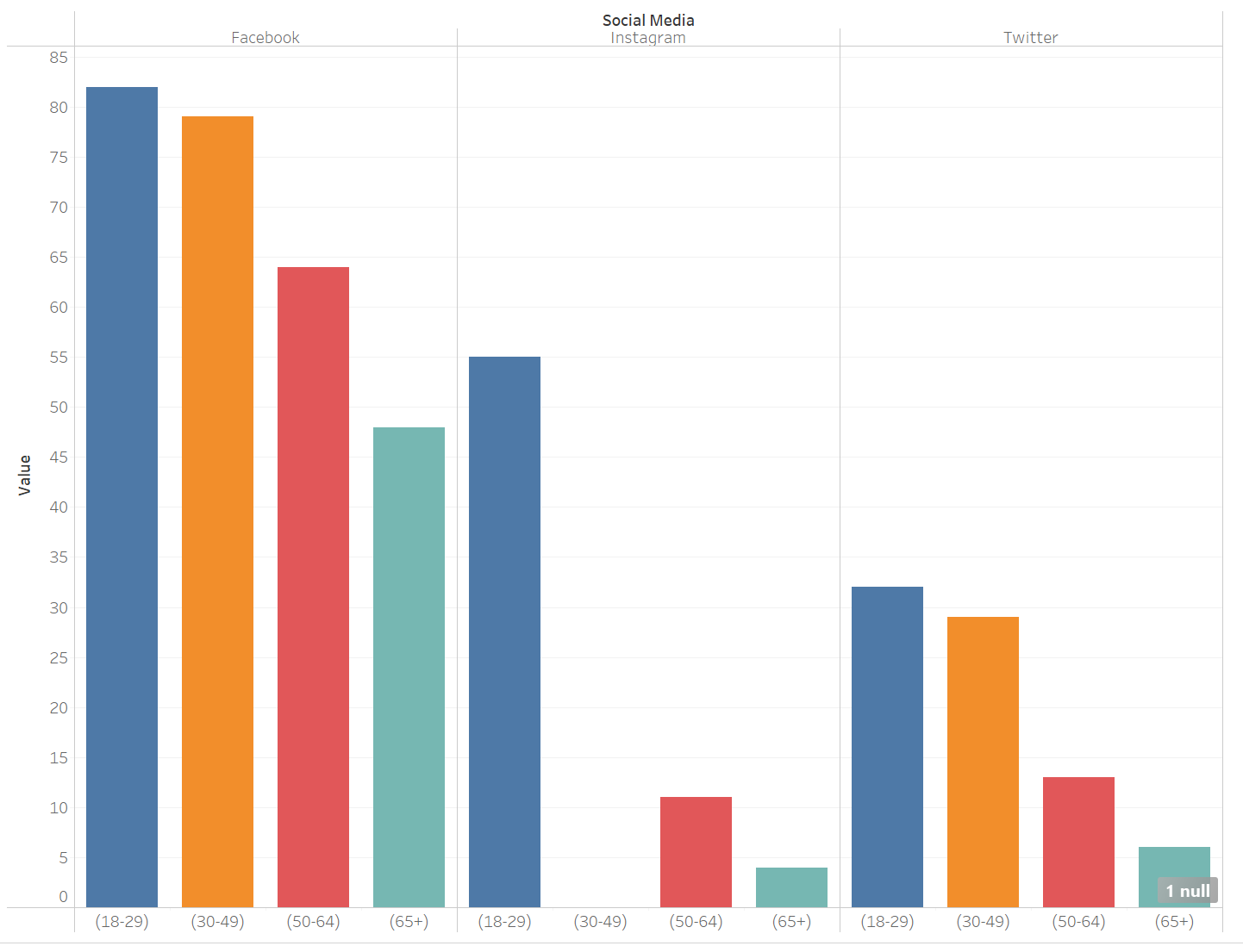
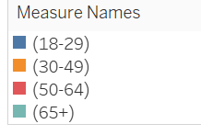
Graph 2: Age-related comparisons of social media platforms

Slide 10
Sample Strategy
Let's offer a coupon link available exclusively on Twitter that creates a special 16-digit number that can be used to make purchases both online and in-person
Deal : 3 sandwiches are offered for $5.
Assume that out of 3.7 million followers, 1.5 million click the link
Let’s say 50,000 people made purchase, then
Conversion rate = no.of purchases/ no.of clicks = 50,000/1.5M = 3.33%
We can estimate how many users on Twitter are making sales using this type of approach
Benefits:
Estimation of Twitter conversion rate
New Customers
Reach increases
Demographic details

Slide 11
Impact of Wendy’s Twitter Campaign
Large no of followers -> increases brand awareness & visibility -> potentially increases sales (but not guaranteed)
The average amount spent per person per visit at Wendy’s in United States is $7.36
The average conversion rate per social media advertisement is around 1-2%
Let's take an average value of 1.5%
Wendy’s has 3.7 Million followers on Twitter.
3.7 Million * 1.5% = 55,500 members
An average retention rate of a fast food chain is 30% -> 55,500*0.3 = 16,650
An average person visits a fast food restaurant every year is 50
So the revenue generated over one year = 16,650*50*$7.36 = $6.1M
Salary paid for 1 Manager = $44k
For 3 Managers = 3*44k = $132k
Profit = 6.1M - 132k = $5.9M

Slide 12
Cost Benefit Analysis
High Benefit
Social Media Influencers
Instagram/Tiktok
Challenges
App Notifications
Hire More Social Media
Managers
Area Based Promotion
Low Cost
High Cost
Product Promotion
Posts
Celebrity Brand Ambassador
Low Benefit

Slide 13
Thank You!

