Slide 1

EcoTrack
Spencer Yates
&
Andrey Owen

Slide 2

ECOTrack’s Purpose
EcoTrack is a comprehensive sustainability and eco-consciousness app designed to empower users to make environmentally-friendly choices in their daily lives. It provides a wealth of information, tools, and resources to assist individuals in reducing their carbon footprint and living more sustainably.
The app uses a sql database for the purpose of community sharing with plant care, users being able to comment and share their thoughts on posts they create about their plants and their care process for them.
The app is used when users may need information about how to take care of plants. They could be a first-time plant owner and want to get insight from others regarding how to take care of them.

Slide 3
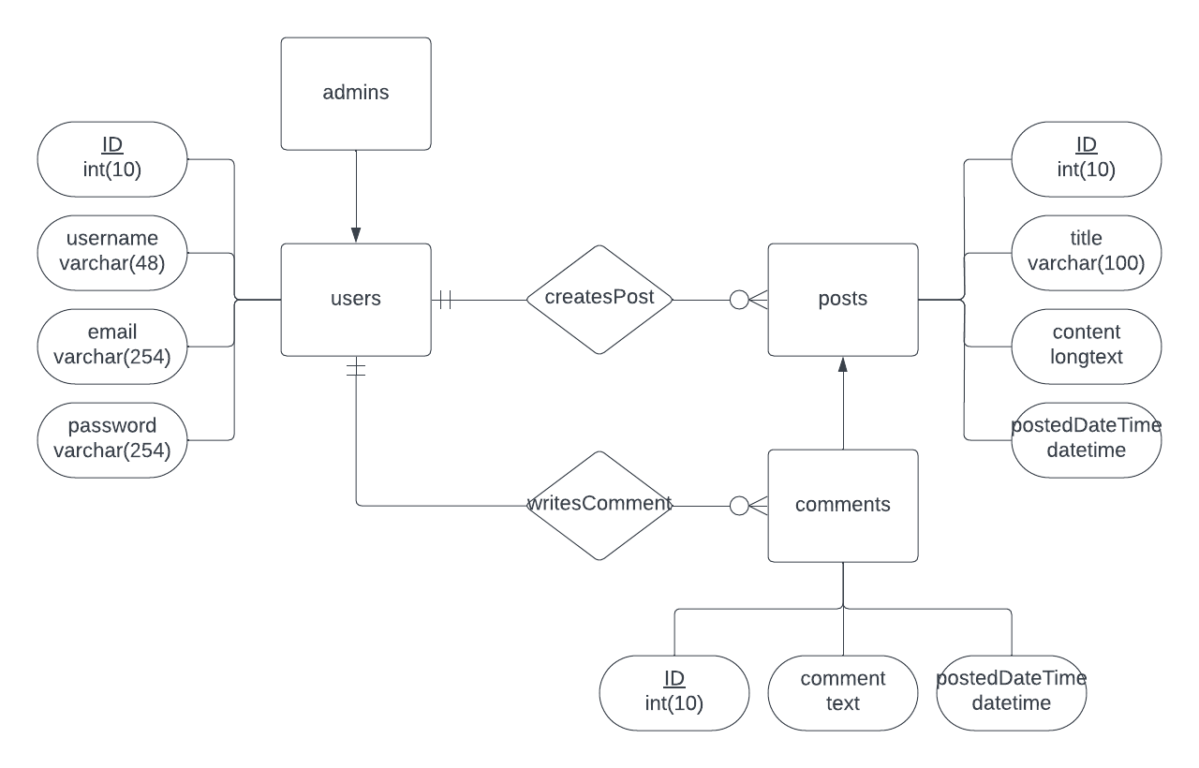
ERD Diagram for EcoTrack

Slide 4
Contributions
Spencer Yates:
Designed website and layout,
Polished SQL Database
Added User Posts, User Comments
Finalized Site for Completion
Created Second Iteration ERD
Implemented Admin
Andrey Owen
Created Original ERD Diagram
Created EcoTrack App Idea
Polished Theming

