Slide 1

Chapter 4 Message Authentication
Stefan Dziembowski www.crypto.edu.pl/Dziembowski University of Warsaw

Slide 2
Secure communication
 | encryption | authentication
private key | private key encryption | private key authentication
public key | public key encryption | signatures
1
2
3
4

Slide 3
Plan
Introduction to Message Authentication Codes (MACs).
Constructions of MACs
Authenticated encryption
Outlook

Slide 4



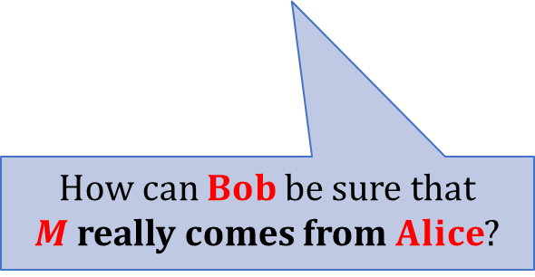
Message Authentication
Integrity:
$$M$$
$$Alice$$
interferes with the transmission
(modifies the message, or inserts a new one)
$$Bob$$
How can $Bob$be sure that $M$ really comes from $Alice$?

Slide 5


Sometimes more important than secrecy!
transfer $\$1000$ to Bob
transfer $\$1000$to Eve
Alice
Bank
Of course: usually we want both secrecy and integrity.

Slide 6
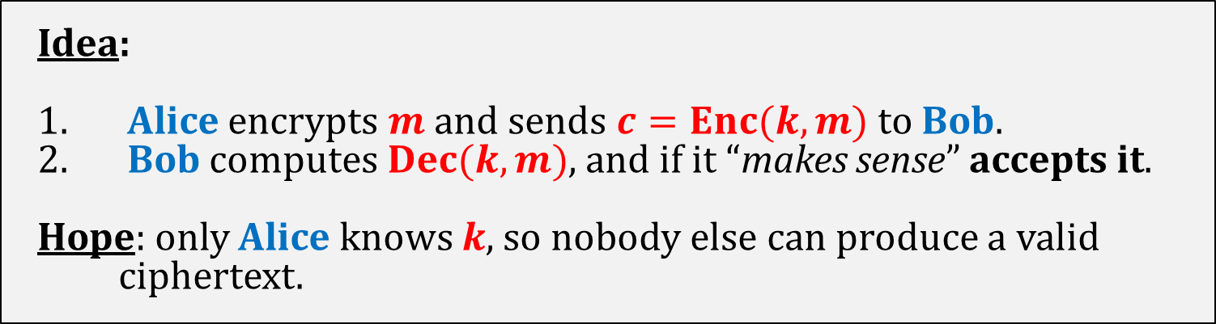




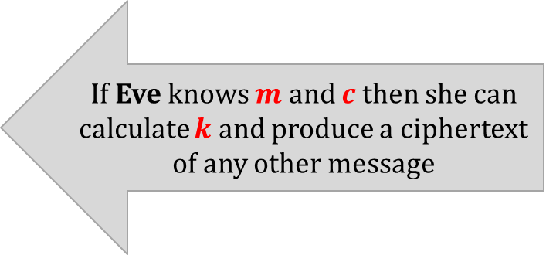
Does encryption guarantee message integrity?
Idea:
Alice encrypts $m$ and sends $c=Enc(k,m)$to Bob.
Bob computes $Dec(k,m)$, and if it “makes sense” accepts it.
Hope: only Alice knows $k$, so nobody else can produce a valid ciphertext.
This doesn’t work!
Example: one-time pad.
plaintext $m$
transfer $\$1000$ to $Bob$
If Eve knows $m$ and $c$ then she can calculate $k$ and produce a ciphertext of any other message
key $k$
xor
ciphertext $c$

Slide 7
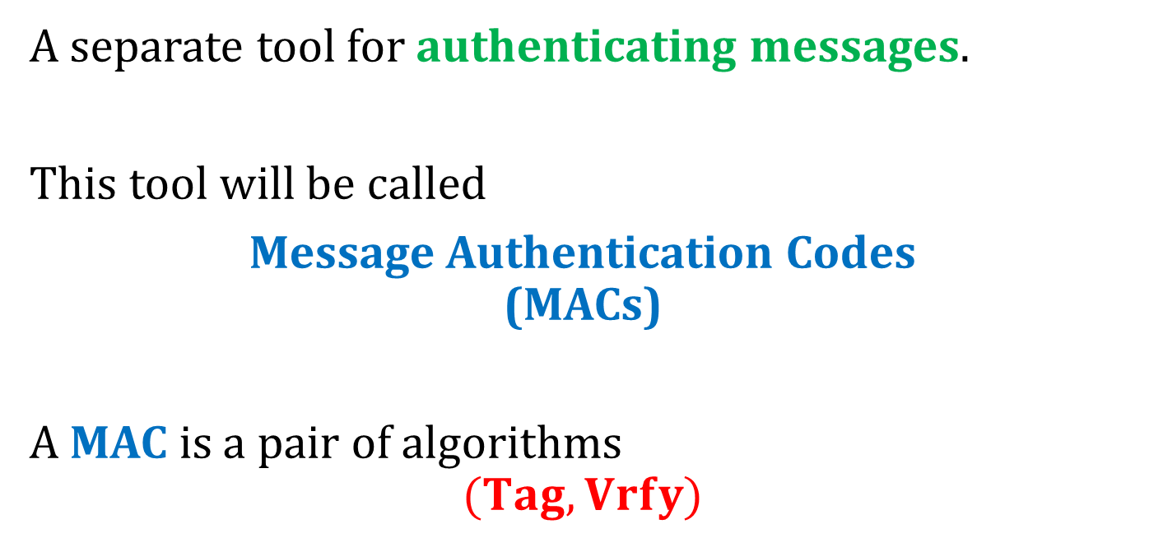
What do we need?
A separate tool for authenticating messages.
This tool will be called
Message Authentication Codes (MACs)
A MAC is a pair of algorithms
$$(Tag,Vrfy)$$
“tagging” algorithm
“verification algorithm”

Slide 8
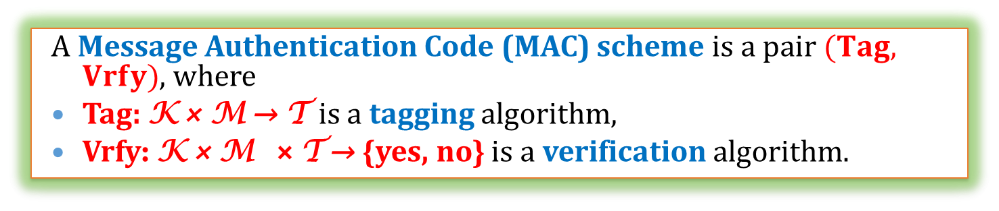
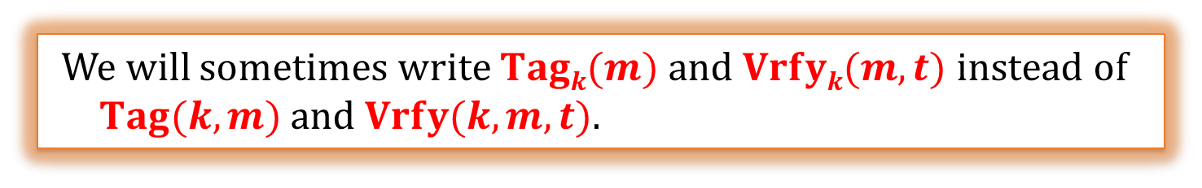
A mathematical view
K – key space
M – plaintext space
T - set of tags
A Message Authentication Code (MAC) scheme is a pair $(Tag, Vrfy)$, where
Tag: K × M → T is a tagging algorithm,
Vrfy: K × M × T → {yes, no} is a verification algorithm.
We will sometimes write $Tagk(m)$and $Vrfyk(m,t)$instead of $Tag(k,m)$and $Vrfy(k,m,t)$.

Slide 9
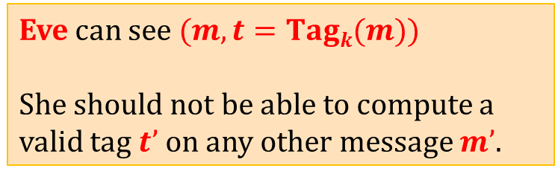
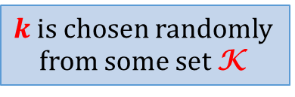
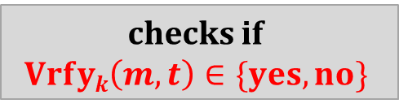





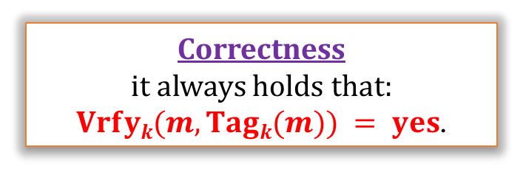
Message Authentication Codes
Eve can see $(m, t=Tagk(m))$
She should not be able to compute a valid tag $t’$on any other message $m’$.
$$(m, t=Tagk(m))$$
checks if $$Vrfyk\left(m,t\right)∈\{yes,no\}$$
$$m$$
$$Alice$$
Bob
$$k$$
$$k$$
$k$ is chosen randomly from some set K
Correctness
it always holds that: $Vrfyk(m,Tagk(m)) = yes$.

Slide 10
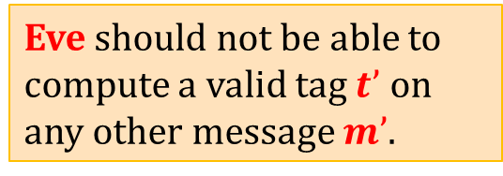









Message authentication – multiple messages
$$m1$$
$$t1 =Tagk(m1)$$
$$m2$$
$$t2 =Tagk(m2)$$
. . .
. . .
$$Alice$$
Bob
$$mw$$
$$t_{w} =Tagk(m_{w})$$
$$k$$
$$k$$
Eve should not be able to compute a valid tag $t’$ on any other message $m’$.

Slide 11
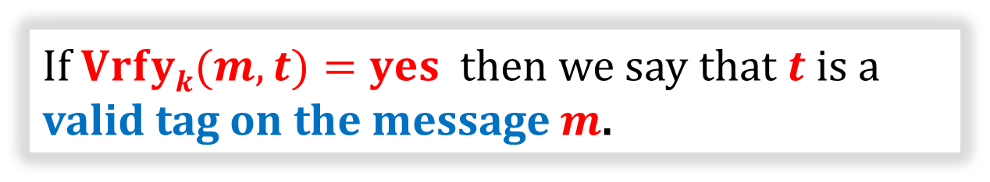
Conventions
If $Vrfyk(m,t)=yes$ then we say that $t$ is a valid tag on the message $m$.
If Tag is deterministic, then Vrfy just computes Tag and compares the result.
In this case we do not need to define Vrfy explicitly.

Slide 12
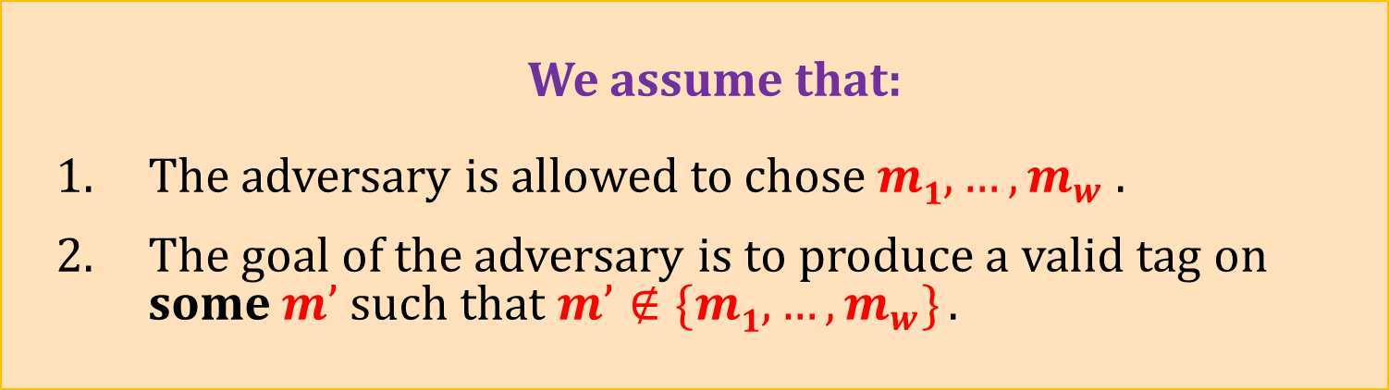
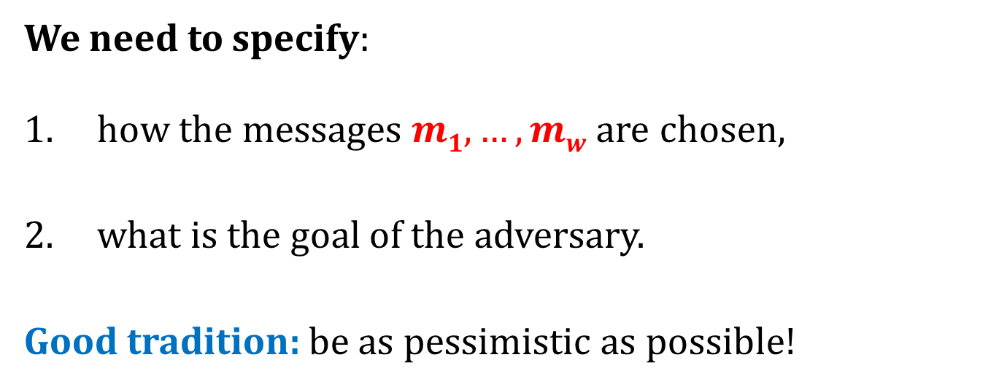
How to define security?
We need to specify:
how the messages $m1,…,mw$are chosen,
what is the goal of the adversary.
Good tradition: be as pessimistic as possible!
We assume that:
The adversary is allowed to chose $m1,…,m_{w}$ .
The goal of the adversary is to produce a valid tag on some $m’$ such that $m’∉\{m1,…,m_{w}\}$.

Slide 13



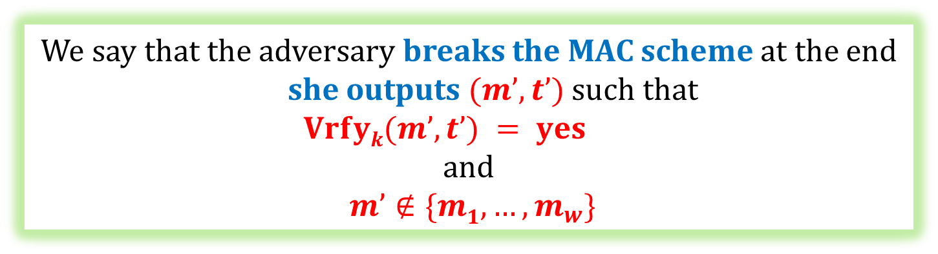
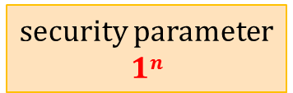


security parameter
$$1n$$
selects a random $k∈\{0,1\}n$
$$m1$$
adversary
$$(m1, t=Tagk(m1))$$
oracle
. . .
$$mw$$
$$(m_{w}, t=Tagk(m_{w}))$$
We say that the adversary breaks the MAC scheme at the end she outputs $(m’,t’)$such that
$$Vrfyk(m’,t’) = yes$$
and
$m’∉\{m1,…,m_{w}\}$

Slide 14

The security definition
We say that $(Tag,Vrfy)$is secure if
$$∀$$
P(A breaks it) is negligible (in n)
polynomial-time adversary A

Slide 15

Aren’t we too paranoid?
Maybe it would be enough to require that:
the adversary succeds only if he forges a message that “makes sense”.
(e.g.: forging a message that consists of random noise should not count)
Bad idea:
hard to define,
is application-dependent.

Slide 16


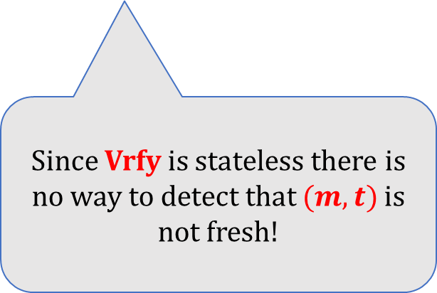



Warning: MACs do not offer protection against the “replay attacks”.
$$(m, t)$$
$$Alice$$
$$Bob$$
$$(m, t)$$
$$(m, t)$$
Since Vrfy is stateless there is no way to detect that $(m,t)$is not fresh!
$$(m, t)$$
. . .
This problem has to be solved by the higher-level application
(methods: time-stamping, nonces...).

Slide 17
Constructing a MAC
There exist MACs that are secure even if the adversary is infinitely-powerful. These constructions are not practical.
MACs can be constructed from the block-ciphers. We will now discuss to constructions:
simple (and not practical),
a little bit more complicated (and practical) – a CBC-MAC
MACs can also be constructed from the hash functions (NMAC, HMAC).

Slide 18
Plan
Introduction to Message Authentication Codes (MACs).
Constructions of MACs
Constructions from block ciphers
Constructions from hash functions
Authenticated encryption
Outlook

Slide 19
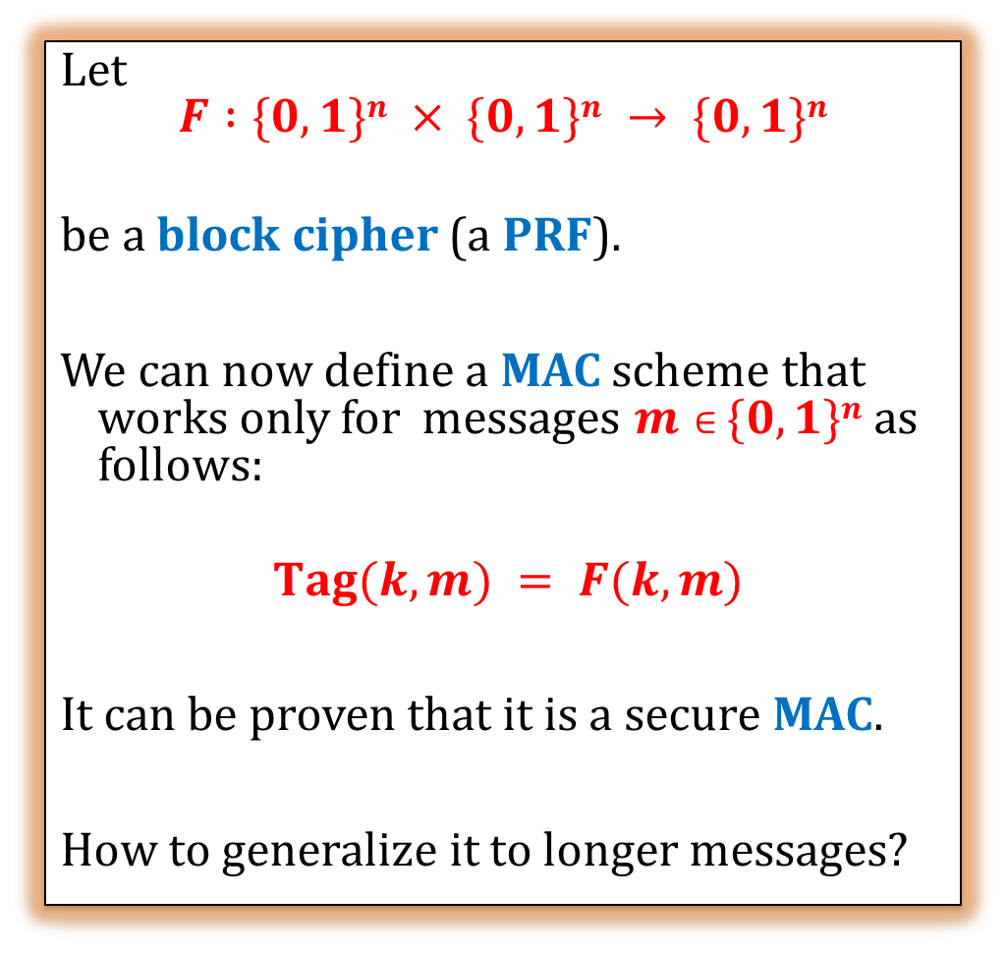



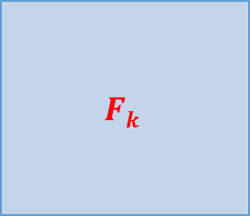
A simple construction from a block cipher
Let
$$F :\{0,1\}n × \{0,1\}n → \{0,1\}n$$
be a block cipher (a PRF).
We can now define a MAC scheme that works only for messages $m∈\{0,1\}n$as follows:
$Tag(k,m) = F(k,m)$
It can be proven that it is a secure MAC.
How to generalize it to longer messages?
$$F(k,m)$$
$$k$$
$$Fk$$
$$m$$

Slide 20

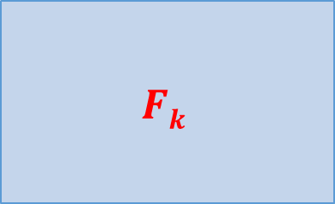




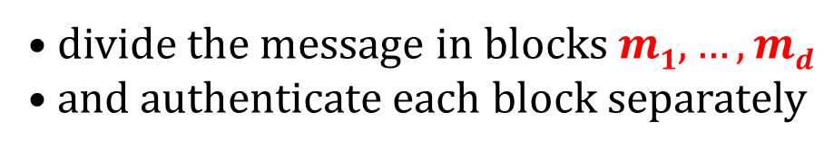
Idea 1
divide the message in blocks $m1,…,md$
and authenticate each block separately
$$F(k,m1)$$
$$F(k,m_{d})$$
$$Fk$$
$$Fk$$
. . .
$$m1$$
$$md$$
This doesn’t work!

Slide 21




What goes wrong?
$$m:$$
$$t = Tagk(m):$$
perm
$$m’ = perm(m):$$
$$t’ = perm(t):$$
Then t’ is a valid tag on $m’$.

Slide 22

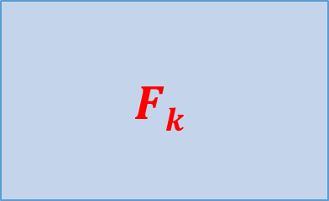








Idea 2
Add a counter to each block.
$$F(k,x1)$$
$$F(k,x_{d})$$
$$Fk$$
$$Fk$$
. . .
$$m1$$
$$1$$
$$md$$
$$d$$
$$x1$$
$$xd$$
This doesn’t work either!

Slide 23







$$mi$$
$$i$$
$$xi$$
$$m:$$
$$t = Tagk(m):$$
$m’$= a prefix of $m$:
$t’$= a prefix of $t$:
Then $t’$is a valid tag on $m’$.

Slide 24









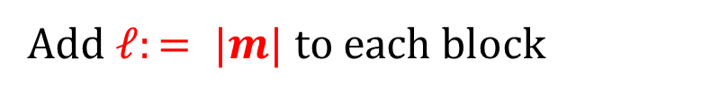

Idea 3
Add $ℓ:= |m|$to each block
$$F(k,x1)$$
$$F(k,x_{d})$$
$$Fk$$
$$Fk$$
. . .
$$m1$$
$$ℓ$$
$$1$$
$$md$$
$$ℓ$$
$$d$$
$$x1$$
$$xd$$
This doesn’t work either!

Slide 25











$$m1$$
$$ℓ$$
$$1$$
$$xi$$
What goes wrong?
$m$:
$m’$:
$$t = Tagk(m):$$
$$t’=Tagk(m’):$$
$m’’=$first half from $m$ $||$second half from $m’$
$t’’ =$first half from $t$ $||$ second half from $t’$
Then$t’’$is a valid tag on $m’’$.

Slide 26


Idea 4
Add a fresh random value to each block!
$$F(k,x1)$$
$$F(k,x_{d})$$
$$Fk$$
$$Fk$$
. . .
m₁
r
l
1
m_{d}
r
l
d
$$x_{1}$$
$$xd$$
This works!

Slide 27




























$$Tagk(m)$$
$$r$$
$$F(k,x1)$$
$$F(k,x2)$$
$$F(k,x_{d})$$
$$Fk$$
$$Fk$$
$$Fk$$
. . .
$$r$$
$$ℓ$$
$$1$$
$$m1$$
$$r$$
$$ℓ$$
$$2$$
$$m2$$
. . .
r
$$ℓ$$
$$d$$
$$md$$
$$x1$$
$$x2$$
$$xd$$
$r$ is chosen randomly
. . .
$$m1$$
$$m2$$
$$md$$
$$m$$
$$000$$
$n$ – block length
$$ℓ$$
$$|mi|=n/4$$
pad with zeroes if needed

Slide 28
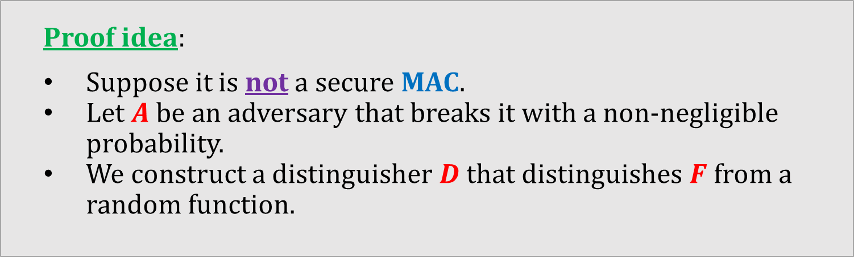
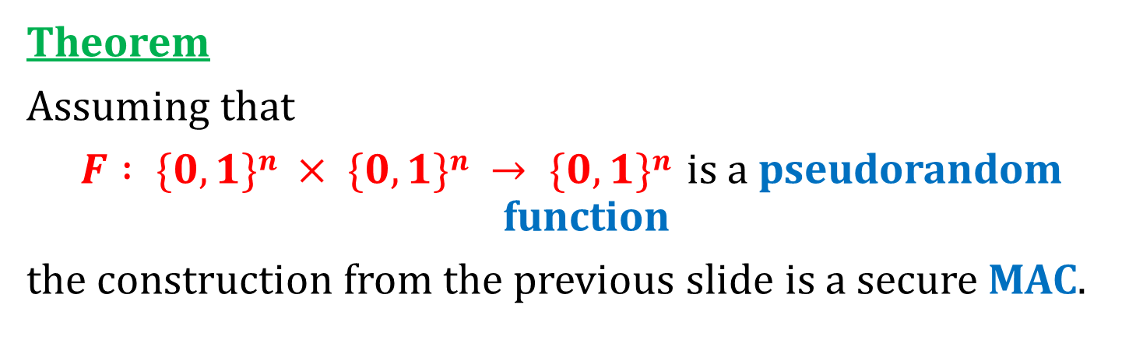
This construction can be proven secure
Theorem
Assuming that
$F : \{0,1\}n × \{0,1\}n → \{0,1\}n$is a pseudorandom function
the construction from the previous slide is a secure MAC.
Proof idea:
Suppose it is not a secure MAC.
Let $A$ be an adversary that breaks it with a non-negligible probability.
We construct a distinguisher $D$ that distinguishes $F$ from a random function.

Slide 29
A new member of “Minicrypt”
one-way functions
exist
this can be proven
this we already knew
computationally-secure
MACs exist
PRPs/PRFs
exist
this we have just shown

Slide 30
Our construction is not practical
Problem:
The tag is 4 times longer than the message...
We can do much better!

Slide 31





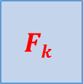



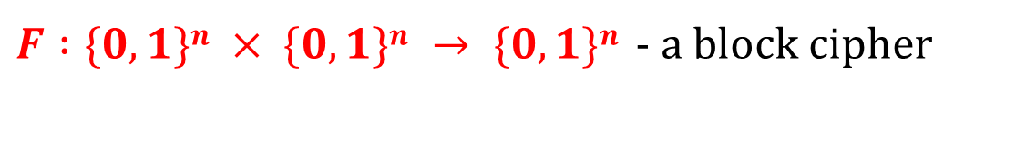


CBC-MAC
$F :\{0,1\}n × \{0,1\}n → \{0,1\}n$- a block cipher
T$agk(m)$
$$Fk$$
$$Fk$$
$$Fk$$
$$Fk$$
$$Fk$$
$$|m|$$
$$m1$$
$$m2$$
$$m3$$
$$. . .$$
$$md$$
$$m$$
$$0000$$
pad with zeroes if needed
Other variants exist!

Slide 32






$$Tagk(m)$$
$$Fk$$
$$Fk$$
$$Fk$$
$$Fk$$
$$Fk$$
. . .
$$|m|$$
$$m1$$
$$m2$$
$$m3$$
$$md$$
Why is this needed?
Suppose we do not prepend $|m|$...

Slide 33
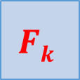





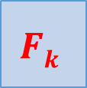




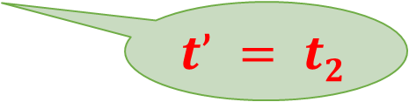

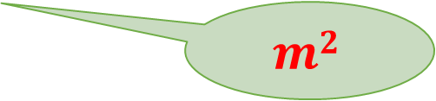
$$t1=Tagk(m1)$$
$$t2=Tagk(m2)$$
the adversary chooses:
$$Fk$$
$$Fk$$
$$m1$$
$$m2$$
$$t’=Tagk(m’)$$
$$t1$$
$$t’ = t2$$
$$Fk$$
$$Fk$$
now she can compute:
$$m2$$
$$m1$$
$$m2⊕t1$$
$$m’$$

Slide 34
Plan
Introduction to Message Authentication Codes (MACs).
Constructions of MACs
Constructions from block ciphers
Constructions from hash functions
Authenticated encryption
Outlook

Slide 35
Some practitioners don’t like the CBC-MAC
They prefer to use the hash functions for authentication.
Why?
hash functions tend to be a bit more efficient
no export regulations (important in the past)

Slide 36

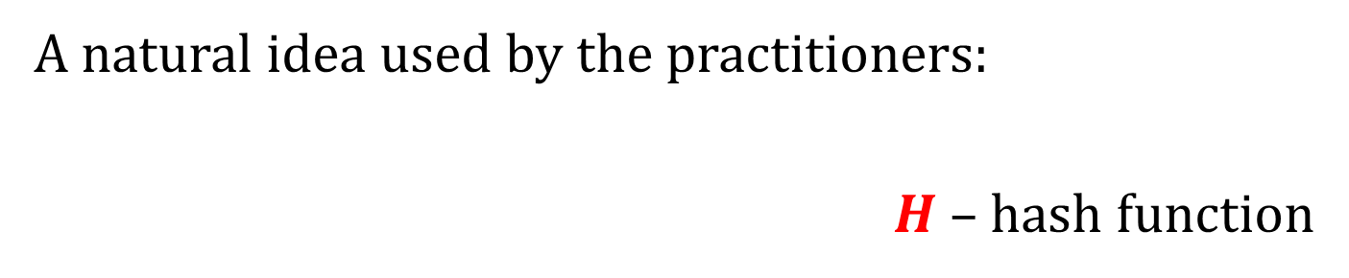
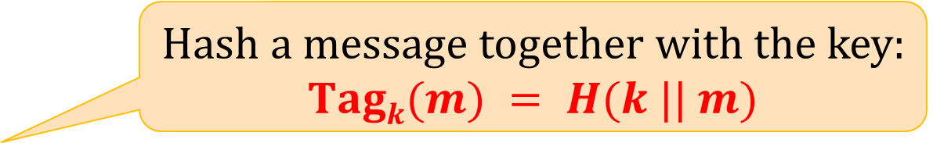
How to use hash functions for authentication?
A natural idea used by the practitioners:
$H$– hash function
Hash a message together with the key:
$$Tagk(m) = H(k || m)$$
this is not secure!

Slide 37

















Message extension attack: Suppose H was constructed using the MD-transform
she can fabricate this
Tag$k(m||t)$
she can see this
$$Tagk(m)$$
$$t + L$$
$$Tagk(m)$$
$$t$$
$$z_{3}$$
$$t$$
$$z3$$
$$m$$
$$z2$$
$$m$$
$$z2$$
$$k$$
$$IV$$
$$k$$
$$IV$$
$$L$$

Slide 38
Still, used in practice in the past
For example in SSL v.2:
The MAC-DATA is computed as follows:
MAC-DATA = HASH[SECRET, ACTUAL-DATA, PADDING-DATA, SEQUENCE-NUMBER]

Slide 39
A better idea
M. Bellare, R. Canetti, and H. Krawczyk (1996):
NMAC (Nested MAC)
HMAC (Hash based MAC)
have some “provable properties”
They both use the Merkle-Damgård transform.
Again, let $h:\{0,1\}2L → \{0,1\}L$be a compression function.

Slide 40












NMAC
$$m$$
$$0000$$
$$m1$$
$$mB$$
$$m_{B+1}≔|m|$$
$$k1$$
. . .
$$h$$
$$h$$
$$h$$
$$k2$$
$$h$$
NMA${C }_{k_{1},k_{2}}$

Slide 41





What can be proven
Suppose that
$h$is collision-resistant
the following function is a secure MAC:
Then NMAC is a secure MAC.
$$m$$
$$k2$$
$$h$$
$$Ta{g_{k}}_{2}(m)$$

Slide 42
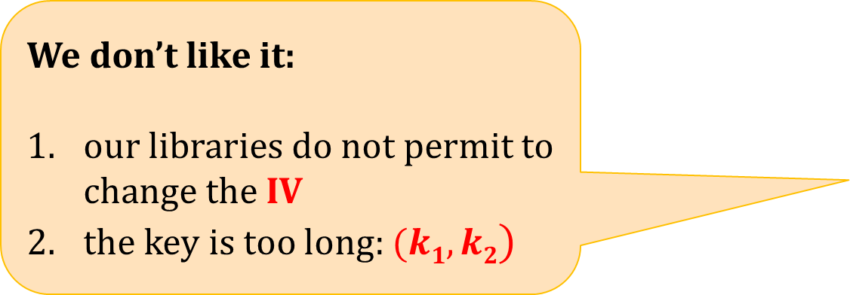
We don’t like it:
our libraries do not permit to change the IV
the key is too long: $(k1,k2)$
HMAC is the solution!

Slide 43



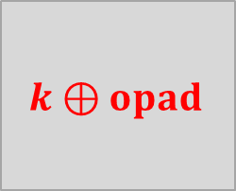






HMAC
$$k⊕ipad$$
$$m1$$
$$m_{B+1}:= |m|$$
ipad = 0x36 repeated
opad = 0x5C repeated
IV
. . .
$$h$$
$$h$$
$$h$$
IV
$$h$$
$$h$$
$$HMACk (m)$$
$$k⊕opad$$

Slide 44
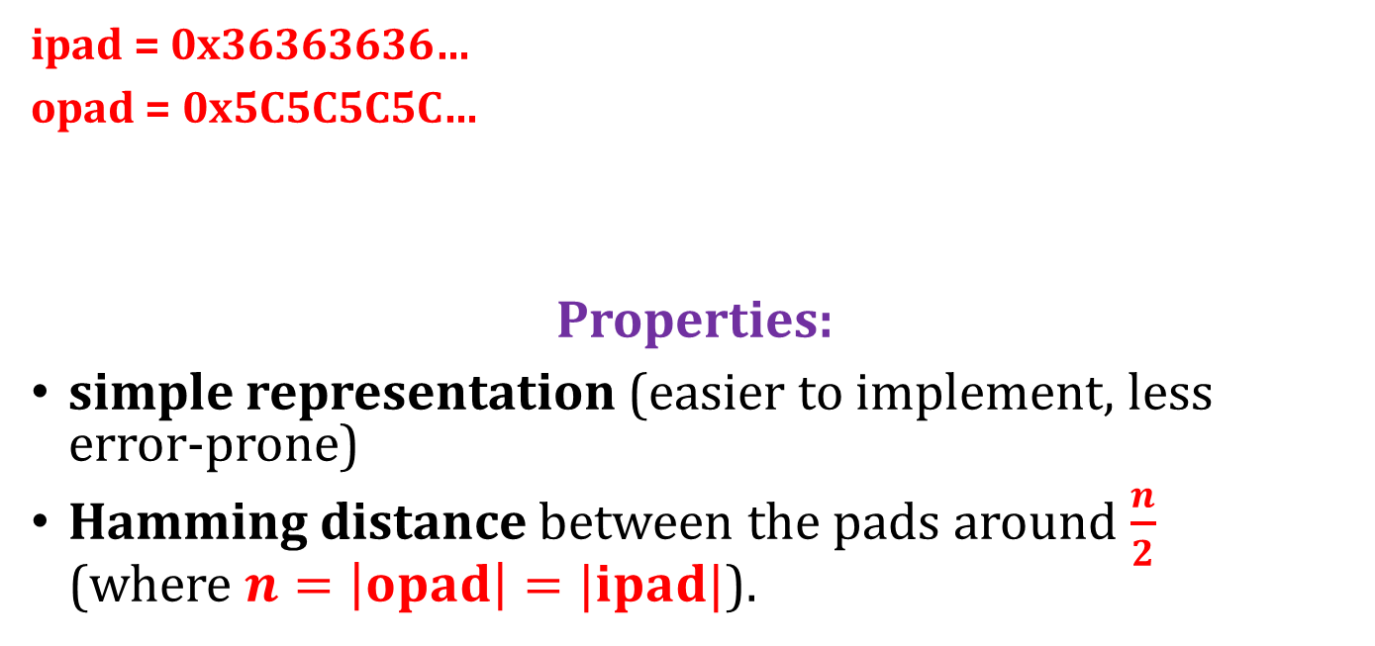
Why such a choice for ipad and opad?
in binary:
0 | 1 | 0 | 1 | 1 | 1 | 0 | 0 | 0 | 1 | 0 | 1 | 1 | 1 | 0 | 0
ipad = 0x36363636…
opad = 0x5C5C5C5C…
Properties:
simple representation (easier to implement, less error-prone)
Hamming distance between the pads around $\frac{n}{2}$ (where $n=\left|opad\right|=|ipad|$).
0 | 0 | 1 | 1 | 0 | 1 | 1 | 0 | 0 | 0 | 1 | 1 | 0 | 1 | 1 | 0

Slide 45
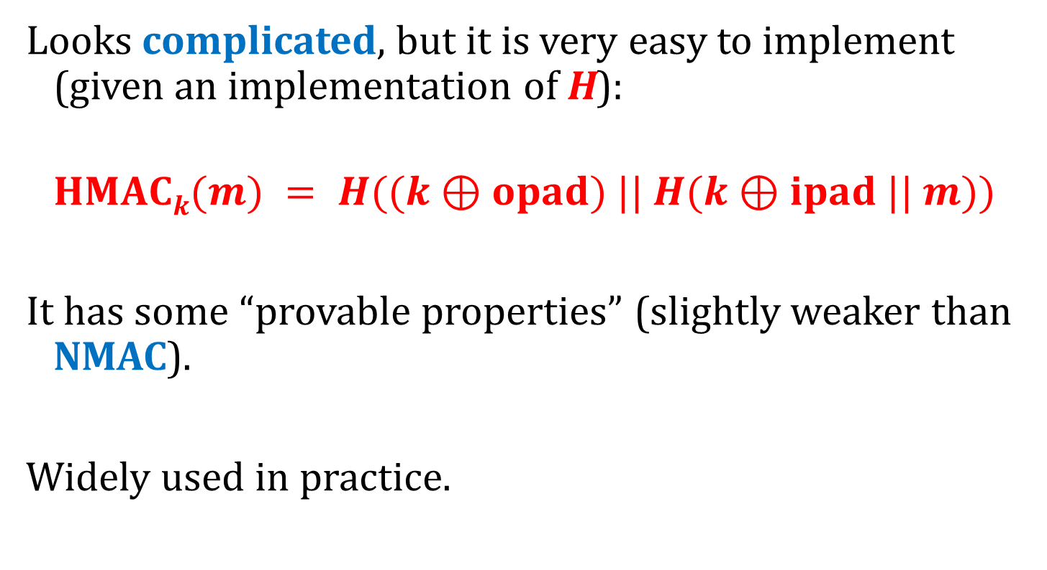
HMAC – the properties
Looks complicated, but it is very easy to implement (given an implementation of H):
$$HMACk(m) = H((k⊕opad) || H(k⊕ipad || m))$$
It has some “provable properties” (slightly weaker than NMAC).
Widely used in practice.

Slide 46
Plan
Introduction to Message Authentication Codes (MACs).
Constructions of MACs
Authenticated encryption
Outlook

Slide 47
What is needed to establish secure channels?
In practice one needs both
encryption
and
authentication.
This can be achieved as follows:
combine encryption with authentication
or
design “authenticated encryption” from scratch.

Slide 48

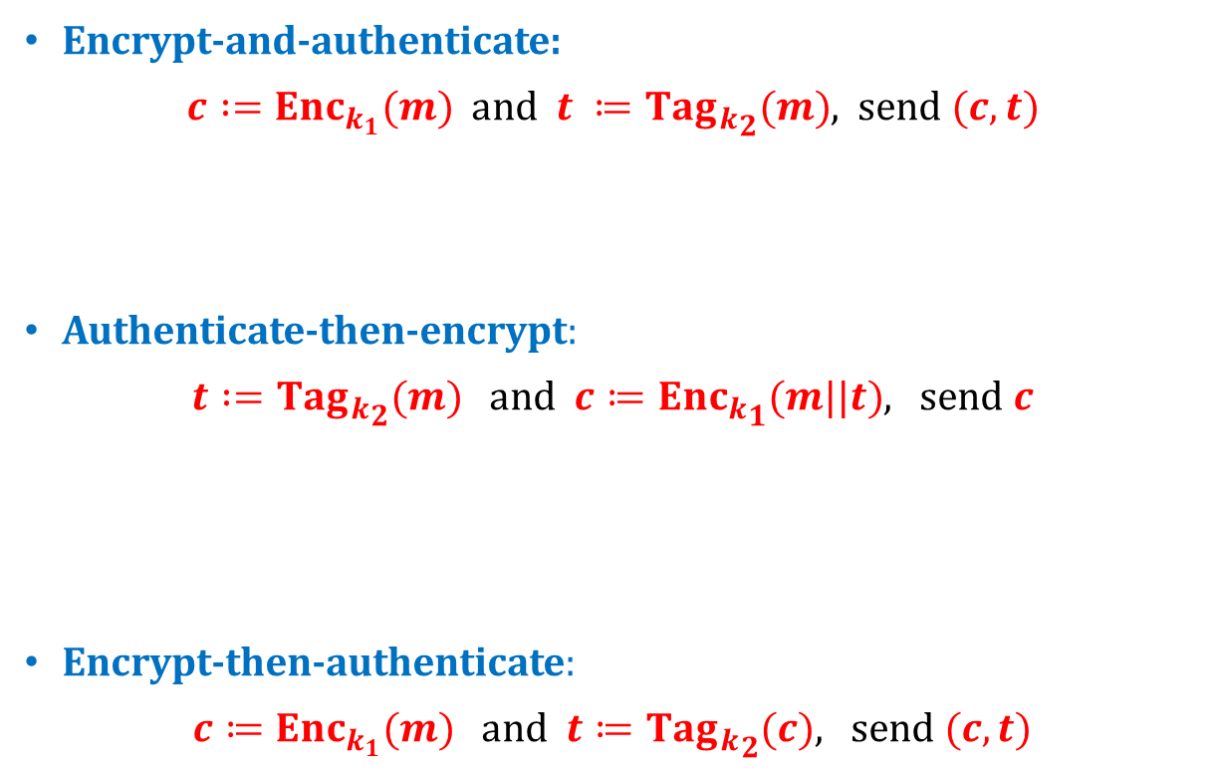








Authentication + encryption, options:
Encrypt-and-authenticate:
$c :={Enc}_{k_{1}}(m)$ and $t ≔Ta{g_{k}}_{2}(m)$, send $(c,t)$
Authenticate-then-encrypt:
$t :=Ta{g_{k}}_{2}(m)$and $c≔En{c_{k}}_{1}(m||t)$, send $c$
Encrypt-then-authenticate:
$c≔Enc_{k_{1}}(m)$ and $t≔Ta{g_{k}}_{2}(c)$, send $(c,t)$
wrong
$$c :=Enc_{k_{1}}(m)$$
$$m$$
$$t≔Ta{g_{k}}_{2}(m)$$
better
$$c≔En{c_{k}}_{1}(m||t)$$
$$m$$
$$t ≔Ta{g_{k}}_{2}(m)$$
the best
$$t≔Ta{g_{k}}_{2}(c)$$
$$m$$
$$c≔Enc_{k_{1}}(m)$$

Slide 49
By the way…
Never use the same key for encryption and authentication.
Actually:
Never use the same key in two different applications (or two different instantiations of the same application).

Slide 50
Authenticated encryption
A popular method: Galois/Counter Mode.
A competition for a new authenticated encryption scheme:
CAESAR: Competition for Authenticated Encryption: Security, Applicability, and Robustness
not formally organized by any institution, supported by a grant from NIST webpage: competitions.cr.yp.to/caesar.html

Slide 51
Caesar competition winners
Announced Feb 2019:
Final portfolio for use case 1 (Lightweight applications): Ascon, ACORN
Final portfolio for use case 2 (High-performance applications): AEGIS-128, OCB

Slide 52
Plan
Introduction to Message Authentication Codes (MACs).
Constructions of MACs
Authenticated encryption
Outlook

Slide 53
Outlook
cryptography
“information-theoretic”,
“unconditional”
“computational”
one time pad,
quantum cryptography,
...
based on 2 simultanious assumptions:
some problems are computationally difficult
our understanding of what “computational difficulty” means is correct.

Slide 54
Symmetric cryptography
symmetric cryptography
encryption
authentication
(and hash functions)

Slide 55
The basic information-theoretic tool
xor (one-time pad)

Slide 56
Basic tools from the computational cryptography
one-way functions
pseudorandom generators
pseudorandom functions/permutations
hash functions

Slide 57
A method for proving security: reductions
minicrypt
P ≠ NP
hash functions
one-way functions
pseudorandom generators
pseudorandom functions/permutations
computationally-secure authentication
in general the picture is much more complicated!
computationally-secure encryption

Slide 58
©2025 by Stefan Dziembowski. Permission to make digital or hard copies of part or all of this material is currently granted without fee provided that copies are made only for personal or classroom use, are not distributed for profit or commercial advantage, and that new copies bear this notice and the full citation.

