Slide 1

Chapter 3 Hash Functions
Stefan Dziembowski www.crypto.edu.pl/Dziembowski University of Warsaw

Slide 2
Secure communication
 | encryption | authentication
private key | private key encryption | private key authentication
public key | public key encryption | signatures
1
2
3
4
we will discus this on the next lecture, but first, we talk about the hash functions

Slide 3
Plan
Introduction and definitions
Hash function design paradigms
Other uses of hash functions
Real-life constructions

Slide 4


Hash functions
short $H(m)$
a hash function
$$H:{\left\{0,1\right\}}^{∗}→ \{0,1\}L$$
long $m$

Slide 5

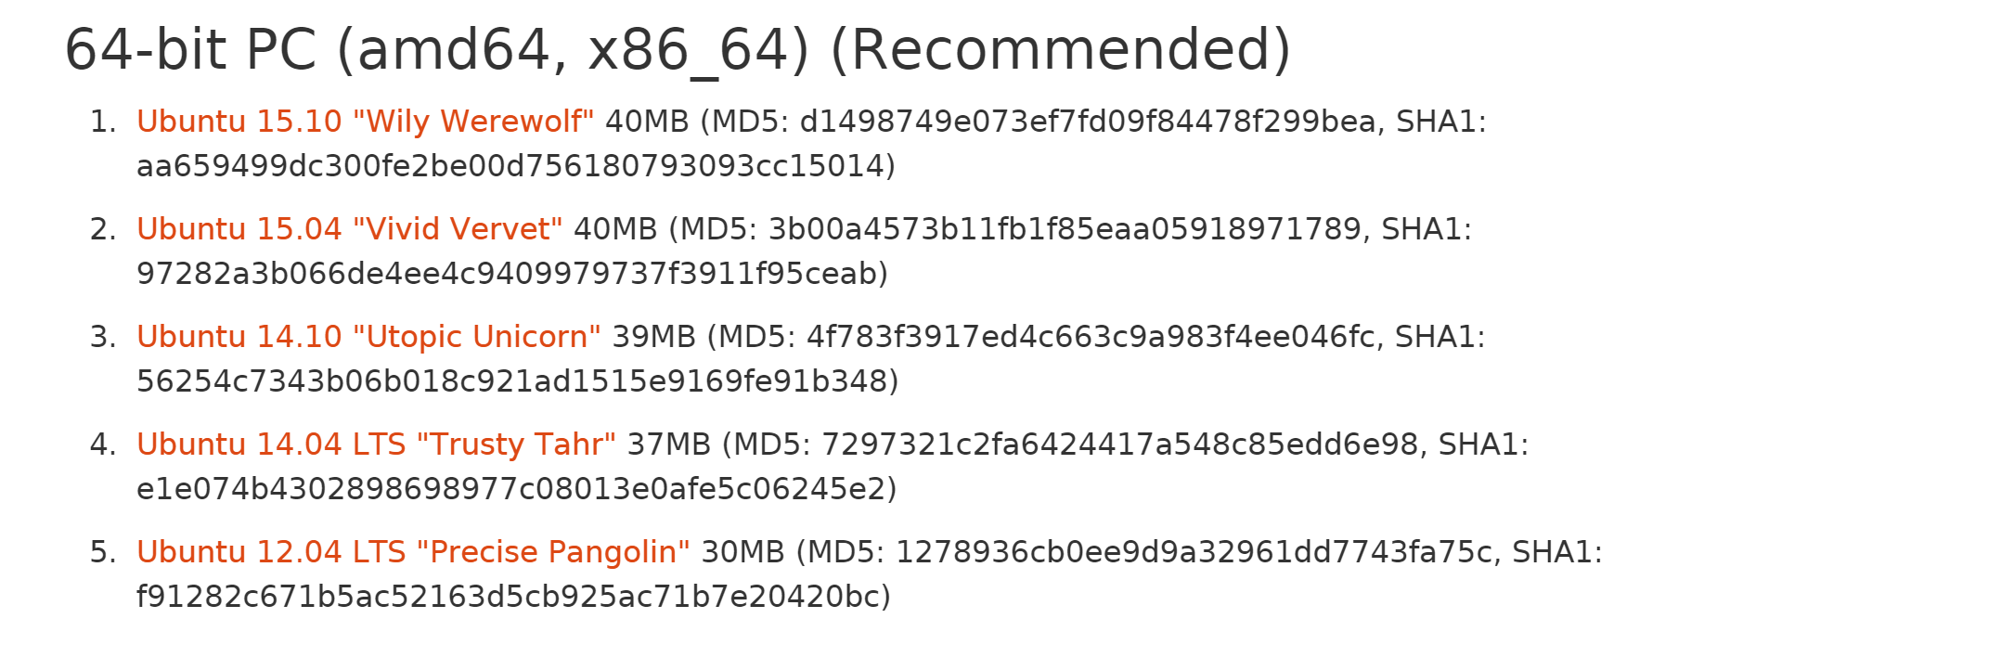

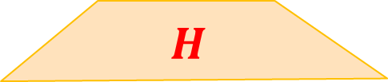

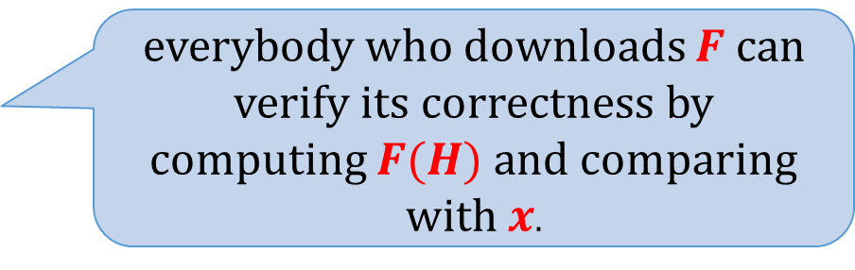
Example of an application: file fingerprinting
“fingerprint”
(publish this through a secure channel)
$$x= H(F)$$
$$H$$
everybody who downloads $F$ can verify its correctness by computing $F(H)$ and comparing with $x$.
large file $F$
Example (ubuntu.com):

Slide 6
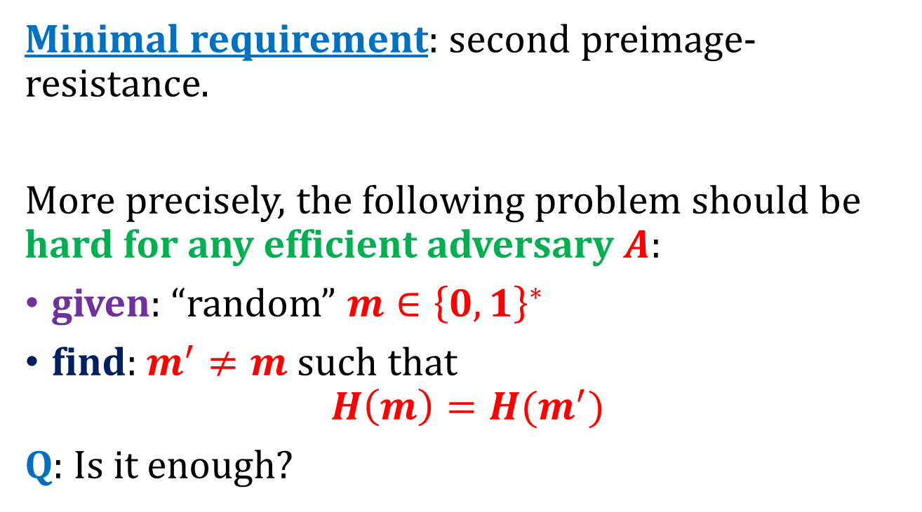
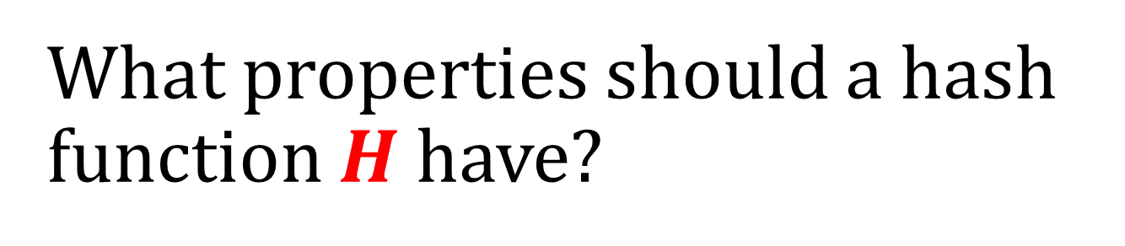
What properties should a hash function $H$have?
Minimal requirement: second preimage-resistance.
More precisely, the following problem should be hard for any efficient adversary $A$:
given: “random” $m∈{\left\{0,1\right\}}^{∗}$
find: $m^{′}≠m$such that
$$H\left(m\right)=H(m^{′})$$
Q: Is it enough?

Slide 7
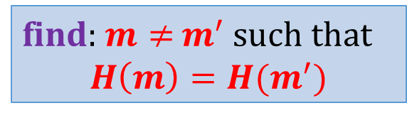
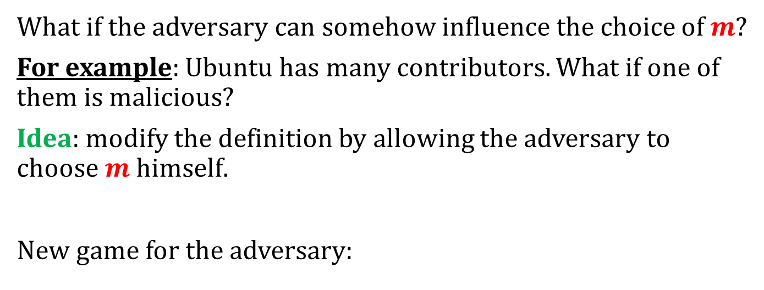
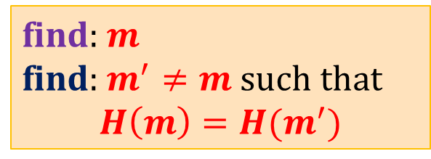

Second preimage resistance may be in many cases be too weak
What if the adversary can somehow influence the choice of $m$?
For example: Ubuntu has many contributors. What if one of them is malicious?
Idea: modify the definition by allowing the adversary to choose $m$ himself.
New game for the adversary:
if this problem is hard then a function is called “collision-resistant”
find: $m$
find: $m^{′}≠m$ such that
$$H\left(m\right)=H(m^{′})$$
$$⇔$$
find: $m≠$ $m^{′}$ such that
$$H\left(m\right)=H(m^{′})$$

Slide 8



Collision-resistant hash functions
short $H(m)$
a hash function
$$H:{\left\{0,1\right\}}^{∗} → \{0,1\}L$$
long $m$
a “collision”
Requirement: it should be hard to find a pair $(m,m’)$such that $m≠m′$and $H(m)=H(m’)$

Slide 9


Collisions always exist
domain
$$m$$
range
$$m’$$
Since the domain is larger than the range the collisions must exist.

Slide 10
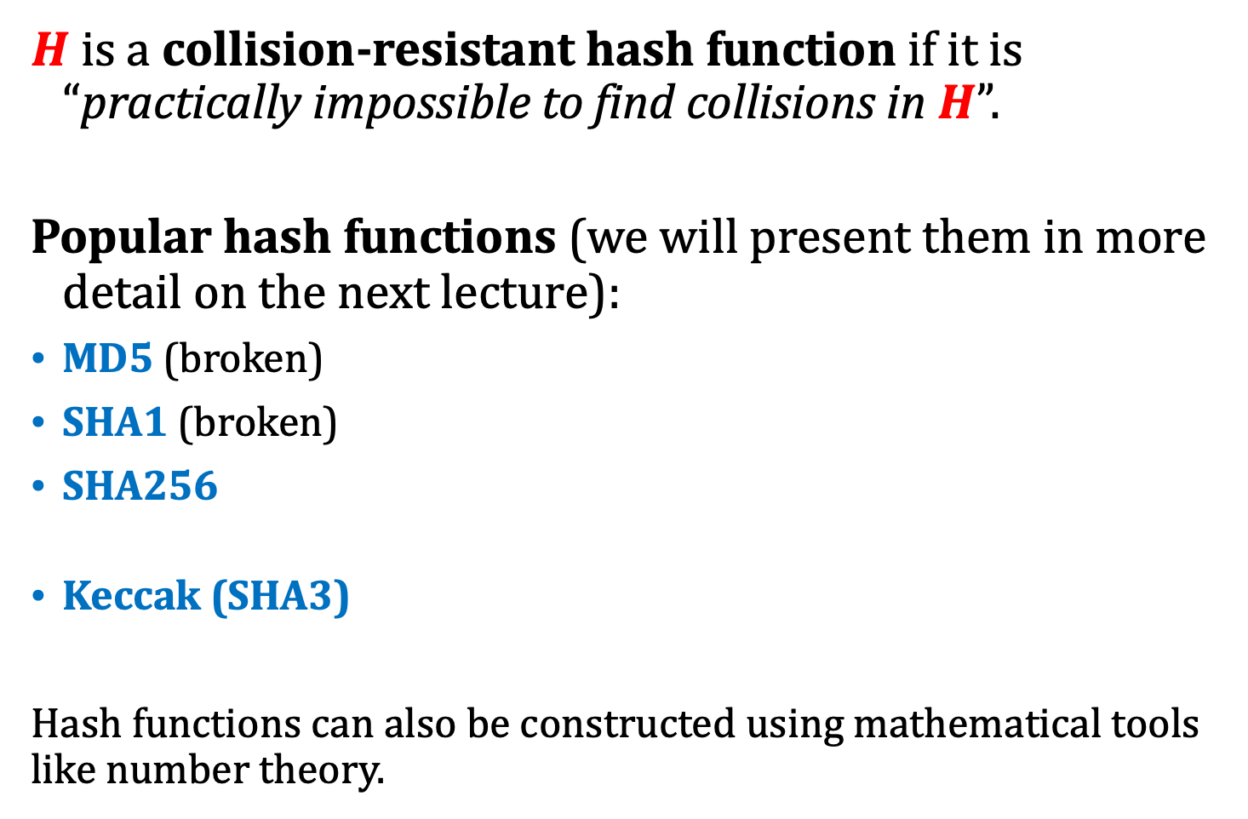
“Practical definition”
$H$ is a collision-resistant hash function if it is “practically impossible to find collisions in $H$”.
Popular hash functions (we will present them in more detail on the next lecture):
MD5 (broken)
SHA1 (broken)
SHA256
Keccak (SHA3)
Hash functions can also be constructed using mathematical tools like number theory.
based on the Merkle-Damgård transformation
based on the sponge construction

Slide 11
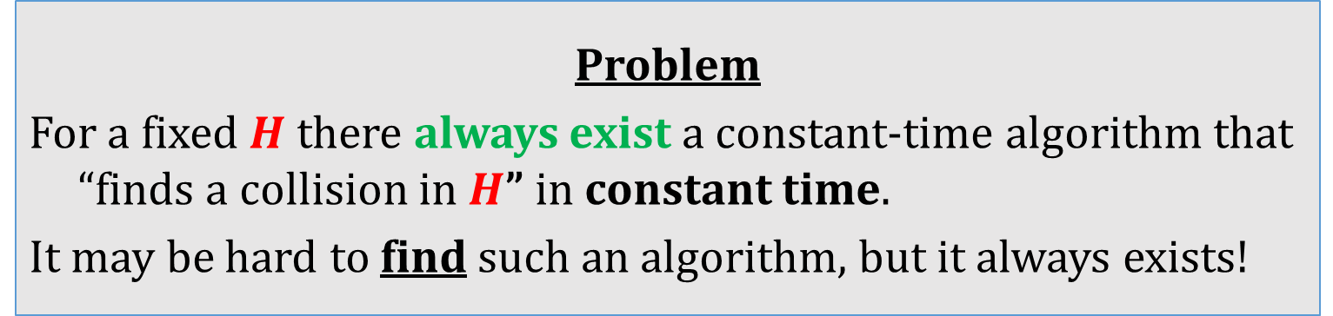
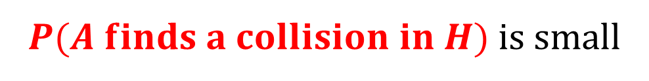
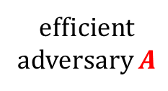

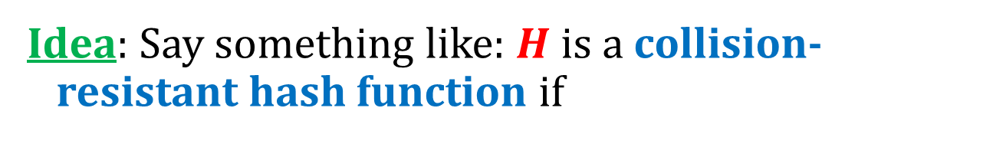
How to formally define “collision resistance”?
Idea: Say something like: $H$ is a collision-resistant hash function if
$$∀$$
$P(A finds a collision in H)$is small
efficient adversary $A$
Problem
For a fixed $H$ there always exist a constant-time algorithm that “finds a collision in $H$” in constant time.
It may be hard to find such an algorithm, but it always exists!

Slide 12

Solution
When we prove theorems we will always consider
families of hash functions
indexed by a key $s$:
$${\left\{H^{s}\right\}}_{s∈keys }$$

Slide 13




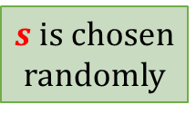

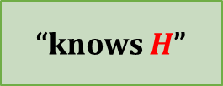
informal description:
“knows $H$”
a protocol
$$H$$
$$H$$
$$H$$
formal model:
$s$ is chosen
randomly
a protocol
$$s$$
$$Hs$$
$$Hs$$
$$Hs$$

Slide 14
informal description:
“knows $H$”
a protocol
$$H$$
$$H$$
H
$$H$$
real-life implementation (example):
“knows SHA3”
a protocol
SHA3
SHA3
SHA3

Slide 15
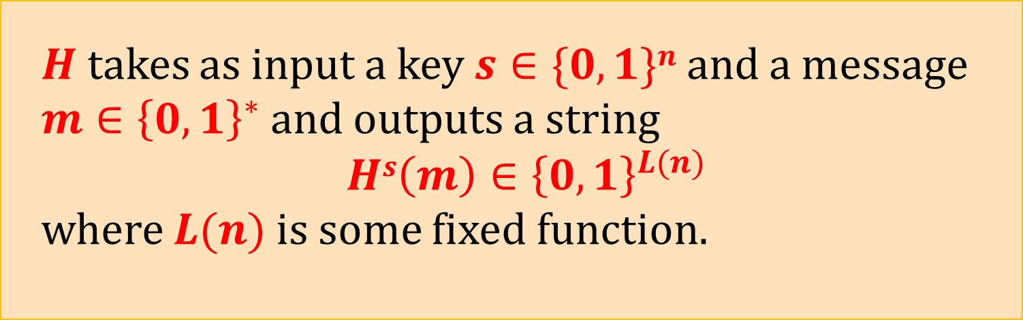
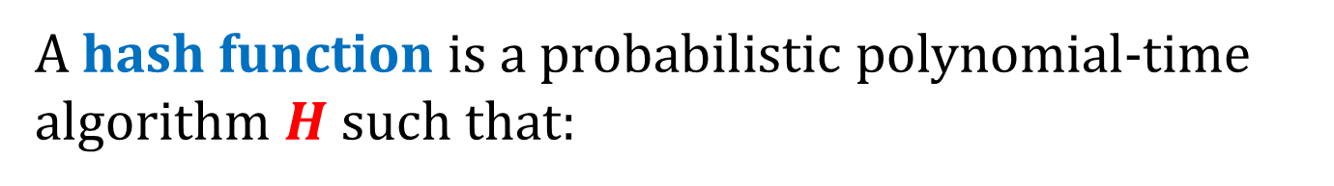
Hash functions – the functional definition
A hash function is a probabilistic polynomial-time algorithm $H$ such that:
$H$ takes as input a key $s∈\{0,1\}n$and a message $m∈{\left\{0,1\right\}}^{∗}$and outputs a string
$$Hs\left(m\right)∈{\left\{0,1\right\}}^{L(n)}$$
where $L(n)$is some fixed function.

Slide 16


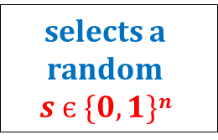

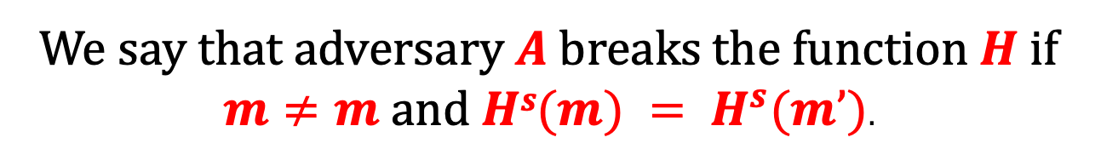
Hash functions – the security definition [1/2]
$$1n$$
selects a random
$$s є \{0,1\}n$$
$$s$$
outputs $(m,m’)$
We say that adversary $A$breaks the function $H$ if $m≠m$ and $Hs(m) = H^{s}(m’)$.

Slide 17


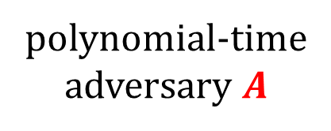

Hash functions – the security definition [2/2]
$H$ is a collision-resistant hash function if
$$∀$$
$P(A breaks H)$is negligible
polynomial-time adversary $A$

Slide 18
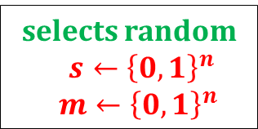

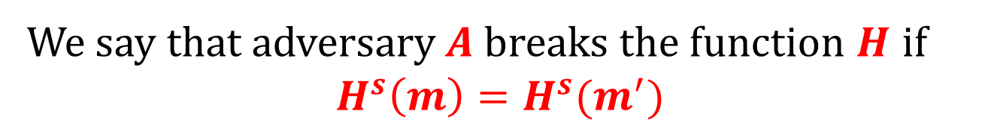

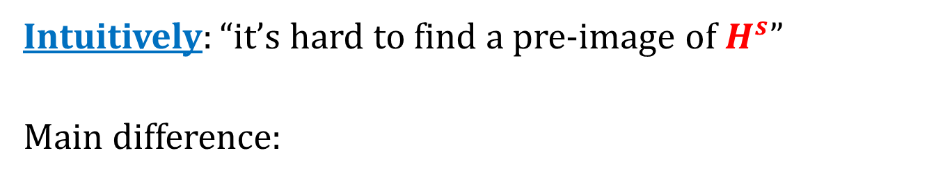

A weaker requirement: pre-image resistance
Intuitively: “it’s hard to find a pre-image of $H^{s}$”
Main difference:
$$1n$$
selects random
$s←{\left\{0,1\right\}}^{n}$
$m←{\left\{0,1\right\}}^{n}$
$$s,H^{s}(m)$$
outputs $m^{′}$
We say that adversary A breaks the function $H$ if
$$H^{s}\left(m\right)=H^{s}(m^{′})$$

Slide 19

Yet another requirement: second pre-image resistance
Intuitively: “it’s hard to find a second pre-image of $H^{s}$”
$$1^{n}$$
selects random
$s←{\left\{0,1\right\}}^{n}$
$m←{\left\{0,1\right\}}^{n}$
$$s,m$$
outputs $m^{′}$
We say that adversary A breaks the function $H$ if $m^{′}≠m$ and $H^{s}\left(m\right)=H^{s}(m^{′})$

Slide 20

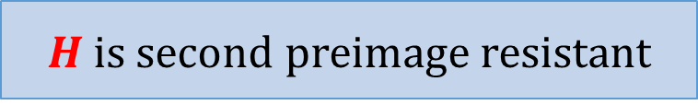

Fact
The following implications hold:
$H$ is collision resistant
$H$ is second preimage resistant
$H$ is pre-image resistant

Slide 21
Do collision-resilient hash functions belong to minicrypt?
collision-resilient hash functions exist
?
easy exercise
open problem
one-way functions
exist
[D. Simon: Finding Collisions on a One-Way Street: Can Secure Hash Functions Be Based on General Assumptions? 1998]:
there is no “black-box reduction”.

Slide 22
Plan
Introduction and definitions
Hash function design paradigms
Merkle-Damgård transform
Sponge construction
Other uses of hash functions
Real-life constructions

Slide 23





A common method for constructing hash functions
Construct a “fixed-input-length” collision-resistant hash function Call it: a collision-resistant compression function.
Use it to construct a hash function.
$$L$$
$$h(m)$$
$$h:{\left\{0,1\right\}}^{2⋅L} → \{0,1\}L$$
$$m$$
$$2·L$$

Slide 24











An idea
pad with zeroes
if needed
$$t$$
$$m$$
$$0000$$
$$m1$$
$$m2$$
. . .
$$mB$$
$$mi∈\{0,1\}L$$
. . .
$$IV$$
$$h$$
$$h$$
$$h$$
$$H(m)$$
can be arbitrary
This doesn’t work...

Slide 25










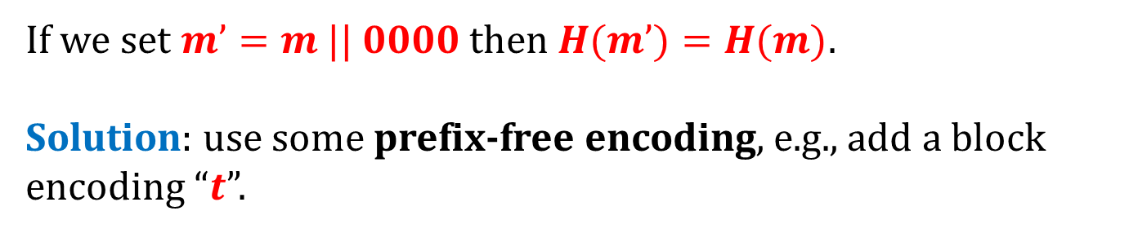

Why is it wrong?
$$t$$
$$m$$
$$0000$$
$$m1$$
$$m2$$
. . .
$$mB$$
If we set $m’=m || 0000$then $H(m’)=H(m)$.
Solution: use some prefix-free encoding, e.g., add a block encoding “$t$”.
$$t$$
$$m’$$
$$0000$$
$$m_{1}^{′}$$
$$m_{2}^{′}$$
. . .
$$m_{B}^{′}$$
$$m_{B+1}^{′}=t$$

Slide 26














Merkle-Damgård transform
given $h :\{0,1\}2L → \{0,1\}L$ we construct $H:{\left\{0,1\right\}}^{∗}→\{0,1\}L$
doesn’t need to be know in advance
(nice!)
$$t$$
$$m$$
$$0000$$
$$m1$$
$$m2$$
$$mB$$
$$m_{B+1}=t$$
$$mi∈\{0,1\} L$$
. . .
$$IV$$
$$h$$
$$h$$
$$h$$
$$h$$
$$H(m)$$

Slide 27
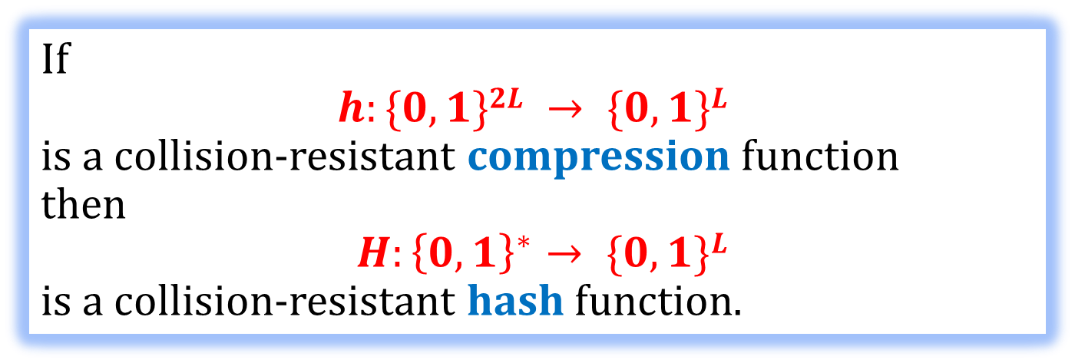
This construction is secure
We would like to prove the following:
Theorem
If
$$h:\{0,1\}2L → \{0,1\}L$$
is a collision-resistant compression function
then
$H:{\left\{0,1\right\}}^{∗}→ \{0,1\}L$
is a collision-resistant hash function.
But wait….
It doesn’t make sense…

Slide 28
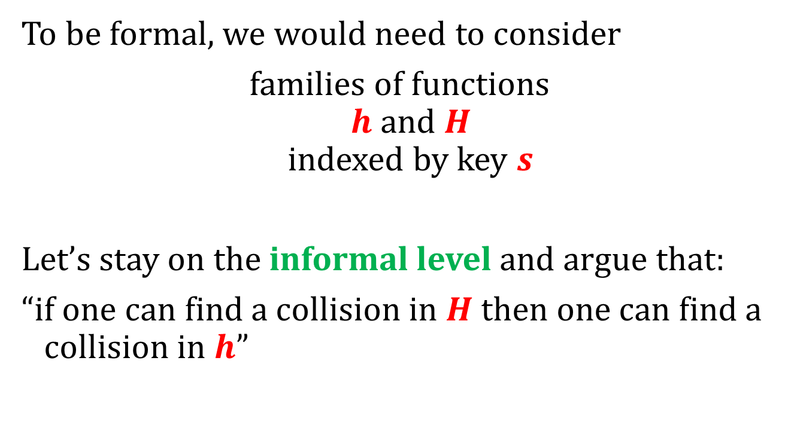
What to do?
To be formal, we would need to consider
families of functions $h$ and $H$ indexed by key $s$
Let’s stay on the informal level and argue that:
“if one can find a collision in $H$then one can find a collision in $h$”

Slide 29

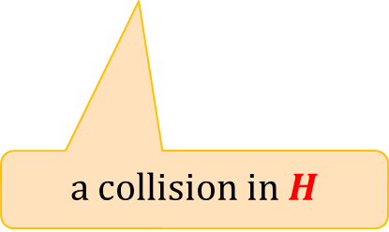



$a$ breaks $h$
$$(m,m’)$$
$A$ breaks $H$
a collision in $H$
outputs a collision $(x,y)$in $h$

Slide 30
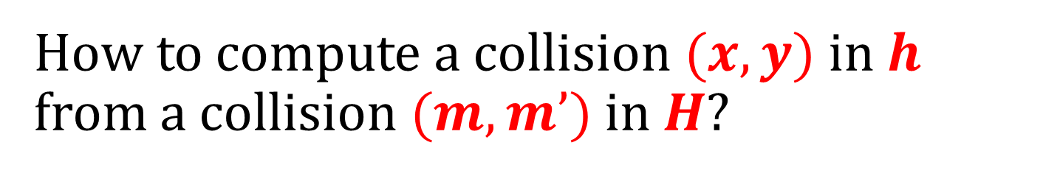

How to compute a collision $(x,y)$in $h$ from a collision $(m,m’)$in $H$?
We consider two cases:
$|m| = |m’|$
$|m| ≠ |m’|$

Slide 31












Case 1: $|m|=|m’|$
$$t$$
$$m$$
$$0000$$
$$m1$$
$$m2$$
$$mB$$
$$m_{B+1}=t$$
$$t$$
$$m’$$
$$0000$$
$$m_{1}^{′}$$
$$m_{2}^{′}$$
$$m_{B}^{′}$$
$$m_{B+1}^{′}=t$$

Slide 32







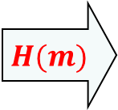





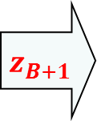


$$|m|=|m’|$$
Some notation:
$$m$$
$$0000$$
$$m1$$
$$m2$$
$$mB$$
$$m_{B+1}=t$$
. . .
$$IV$$
$$h$$
$$h$$
$$h$$
$$h$$
$$z1$$
$$z2$$
$$z3$$
$$zB$$
$$z_{B+1}$$
$$H(m)$$

Slide 33



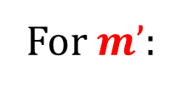



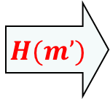





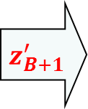

$$|m|=|m’|$$
For $m’$:
$$m’$$
$$0000$$
$$m_{1}^{′}$$
$$m_{2}^{′}$$
$$m_{B}^{′}$$
$$m_{B+1}^{′}=t$$
. . .
$$IV$$
$$h$$
$$h$$
$$h$$
$$h$$
$$z_{1}^{′}$$
$$z_{2}^{′}$$
$$z_{3}^{′}$$
$$z_{B}^{′}$$
$$z_{B+1}^{′}$$
$$H(m’)$$

Slide 34






















$$z_{B+2}=H(m)$$
equal
$$z_{B+2}^{′}=H(m^{′})$$
$$m_{B+1}$$
$$z_{B+1}$$
$$m_{B+1}^{′}$$
$$z_{B+1}^{′}$$
$$m_{B}$$
$$zB$$
$$m_{B}^{′}$$
$$z_{B}^{′}$$
$$. . .$$
$$. . .$$
$$z3$$
$$z_{3}^{′}$$
$$m2$$
$$z2$$
not equal
$$m_{2}^{′}$$
$$z_{2}^{′}$$
$$m1$$
$$z_{1}=IV$$
$$m_{1}^{′}$$
$$z_{1}^{′}=IV$$

Slide 35
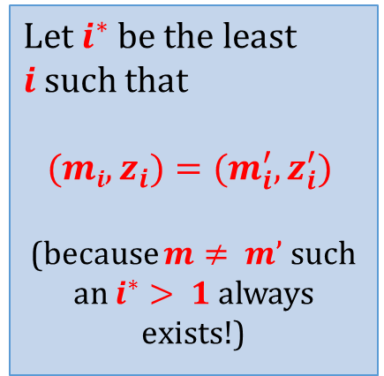
$$z_{B+2}=H(m)$$
equal
$$z_{B+2}^{′}=H(m^{′})$$
$$m_{B+1}$$
$$z_{B+1}$$
$$m_{B+1}^{′}$$
$$z_{B+1}^{′}$$
Let $i^{∗}$be the least $i$such that
$$(mi,z_{i})=(m_{i}^{′},z_{i}^{′})$$
(because $m≠ m’$such an $i^{∗}> 1$always exists!)
$$m_{B}$$
$$zB$$
$$m_{B}^{′}$$
$$z_{B}^{′}$$
$$. . .$$
$$. . .$$
$$z3$$
$$z_{3}^{′}$$
$$m2$$
$$z2$$
$$m_{2}^{′}$$
$$z_{2}^{′}$$
$$m1$$
$$z_{1}=IV$$
$$m_{1}^{′}$$
$$z_{1}^{′}=IV$$

Slide 36








So, we have found a collision!
$$z_{i^{∗}}$$
equal
$$z_{i^{∗}}^{′}$$
$$h$$
$$h$$
$$m_{i^{∗}−1}$$
$$z_{i^{∗}−1}$$
not equal
$$m_{i^{∗}−1}^{′}$$
$$z_{i^{∗}−1}^{′}$$

Slide 37







Case 2: $|m|≠|m’|$
$$H(m)$$
equal
$$H(m’)$$
$$m_{B+1}$$
$$z_{B+1}$$
$$m_{B^{′}+1}^{′}$$
$$z_{B^{′}+1}^{′}$$
. . .
. . .
the last block encodes the length on the message so these values cannot be equal!
So, again we have found a collision!

Slide 38
Plan
Introduction and definitions
Hash function design paradigms
Merkle-Damgård transform
Sponge construction
Other uses of hash functions
Real-life constructions

Slide 39







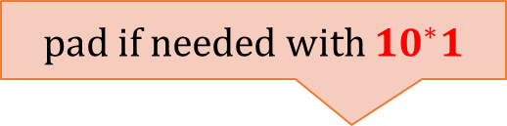




Sponge construction
main parameters:
$c$ – “capacity”
$r$ – “rate”
$b≔c+r$ – “state width”
main ingredient:
a function $f:{\left\{0,1\right\}}^{r+c}→{\left\{0,1\right\}}^{r+c}$
first step: input processing:
$$r$$
$$f$$
$$c$$
pad if needed with $10^{∗}1$
$$m$$
1$00…01$
divide $m$ as:
$$p_{0}$$
$$p_{1}$$
$$p_{ℓ}$$
$$r$$
$$r$$
$$r$$

Slide 40





















Second step
truncate if needed note: “unlimited” length
“output”
$$…$$
$$…$$
$$p_{0}$$
$$p_{1}$$
$$p_{ℓ}$$
$$z_{0}$$
$$z_{1}$$
$$f$$
$$f$$
$$f$$
$$f$$
$$f$$
$$r$$
$$⊕$$
$$⊕$$
$$⊕$$
$$(0,…,0)$$
$$…$$
$$…$$
$$c$$
$$(0,…,0)$$
“absorbing”
“squeezing”

Slide 41
Plan
Introduction and definitions
Hash function design paradigms
Other uses of hash functions
Merkle trees
Practical randomness extraction and the random oracle model
Password storage and Proofs of Work
Real-life constructions

Slide 42



Consider again file fingerprinting
$$x= H(F)$$
$$H$$
large file $F$

Slide 43





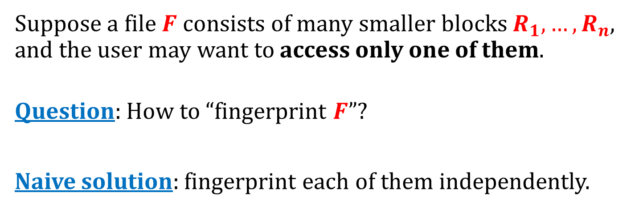






Fingerprinting large files
Suppose a file $F$ consists of many smaller blocks $R_{1},…,R_{n}$, and the user may want to access only one of them.
Question: How to “fingerprint $F$”?
Naive solution: fingerprint each of them independently.
H
H
H
H
H
H
H
H
$$R_{1}$$
$$R_{2}$$
$$R_{3}$$
$$R_{4}$$
$$R_{5}$$
$$R_{6}$$
$$R_{7}$$
$$R_{8}$$

Slide 44






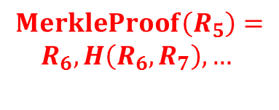



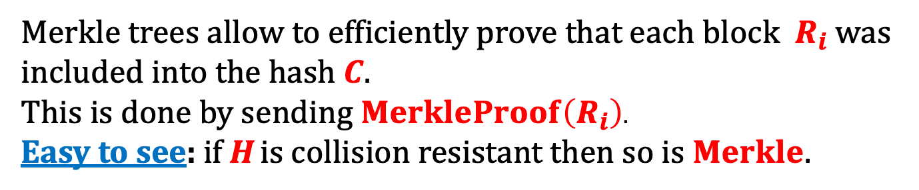




Better solution: construct a Merkle tree:
$$MerkleProof\left(R_{5}\right)=$$
$$R_{6},H\left(R_{6},R_{7}\right),…$$
$$Merkle(R_{1},…,R_{8})$$
C
$$H(R_{1},R_{2})$$
$$H(R_{3},R_{4})$$
$$H(R_{5},R_{6})$$
$$H(R_{7},R_{8})$$
$$R_{1}$$
$$R_{2}$$
$$R_{3}$$
$$R_{4}$$
$$R_{5}$$
$$R_{6}$$
$$R_{7}$$
$$R_{8}$$
Merkle trees allow to efficiently prove that each block $R_{i}$ was included into the hash $C$.
This is done by sending $MerkleProof\left(R_{i}\right)$.
Easy to see: if H is collision resistant then so is $Merkle$.

Slide 45
File sharing
BitTorrent, Gnutella, Gnutella2, and Direct Connect P2P... - a variant of the idea from the previous slides:
files in the peer-to-peer networks are identified by their hashes
each file consists of “pieces”
the users download the pieces from each other.
some of them use Merkle trees.

Slide 46
Plan
Introduction and definitions
Hash function design paradigms
Other uses of hash functions
Merkle trees
Practical randomness extraction and the random oracle model
Password storage and Proofs of Work
Real-life constructions

Slide 47
How the outputs of hash functions look in real life?
SHA3 “Wydział Matematyki, Informatyki i Mechaniki” 016372eff8b4c4068ebd56dc8fcb59374c5dc7b27107a24903339fa28301d586
SHA3 “Wydział Matematyki, Informtyki i Mechaniki” b2094ca714e7da9546d4b31c0a3c6ae8180b239f244a9eb7f5085989fc27806f
SHA3 “Wydział Matematyki Informatyki i Mechaniki” 1ee4ab789fbee41cd17c839f01ebb2227d56ebfe79cbfbe3984055d1184369b6
Observation: the outputs on different inputs are “unrelated” and “completely random”.
we will formalize this property in a moment

Slide 48
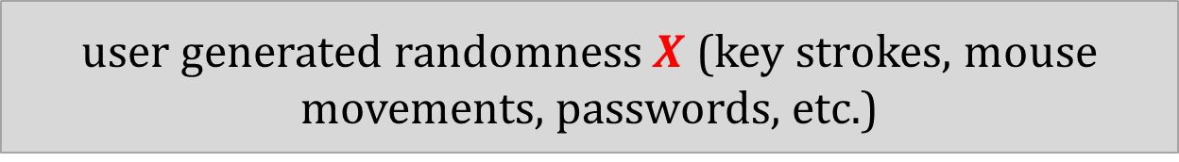

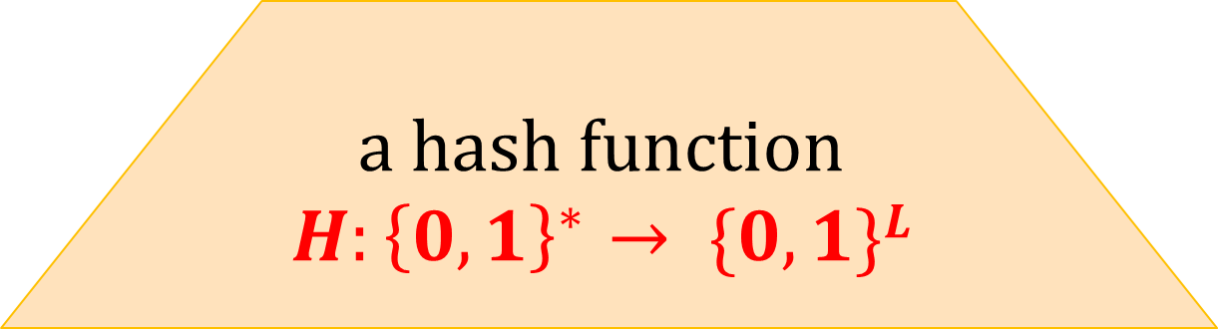
Example of how this property is used: deriving “uniformly random keys” from “non-uniform randomness"
shorter “uniformly random” $H(m)$
a hash function
$$H:{\left\{0,1\right\}}^{∗}→ \{0,1\}L$$
user generated randomness $X$ (key strokes, mouse movements, passwords, etc.)

Slide 49

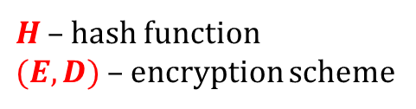


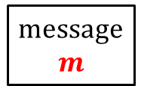

Example: password-based encryption
$H$ – hash function
$(E,D)$– encryption scheme
message $$m$$
$$c = E(H(π),m)$$
$$m = D(H(π),c)$$
Alice
Bob
shared password $π$
shared password $π$
Informally:
The only thing that Eve can do is to examine all possible passwords .
Warning:
there exist much better solutions for this problem

Slide 50




Random oracle model
[Fiat, Shamir: How to Prove Yourself: Practical Solutions to Identification and Signature Problems. 1986]
[Bellare, Rogaway: Random Oracles are Practical: A Paradigm for Designing Efficient Protocols, 1993]
Idea: model the hash function as a random oracle.
$$x$$
$$H(x)$$
a completely random function
$$H:{\left\{0,1\right\}}^{∗}→\{0,1\}L$$

Slide 51
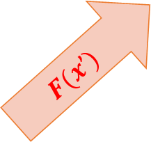
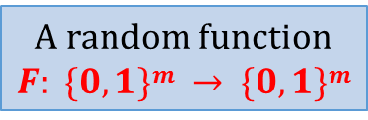
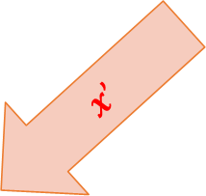
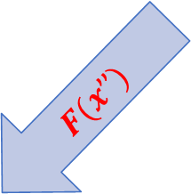
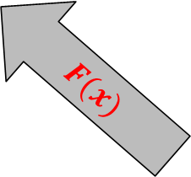
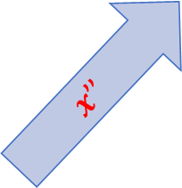

Remember the pseudorandom functions?
$$x$$
$$x’$$
$$F(x)$$
$$F(x’)$$
A random function
$F: \{0,1\}m → \{0,1\}m$
$$x’’$$
$$F(x’’)$$
Crucial difference:
Also the adversary can query the oracle

Slide 52




informal description:
“knows $H$”
a protocol
$$H$$
formal model:
Every call to $H$ is replaced with a query to the oracle.
$$H : \{0,{1\}}^{∗} → \{0,1\}L$$
a protocol
also the adversary is allowed to query the oracle.

Slide 53



How would we use it in the proof?
shorter “uniformly random” $H(X)$
a hash function
$$H:{\left\{0,1\right\}}^{∗}→ \{0,1\}L$$
user generated randomness $X$
As long as the adversary never queried the oracle on $X$ the value $H(X)$ “looks completely random to him”.

Slide 54
Criticism of the Random Oracle Model
[Canetti, Goldreich, Halevi: The random oracle methodology, revisited. 1998]
There exists a signature scheme that is
secure in ROM
but
is not secure if the random oracle is replaced with any real hash function.
This example is very artificial. No “realistic” example of this type is know.

Slide 55
Terminology
Model without the random oracles:
“plain model”
“cryptographic model”
Random Oracle Model is also called:
the “Random Oracle Heuristic”.
Common view: a proof in ROM is better than nothing.

Slide 56
Plan
Introduction and definitions
Hash function design paradigms
Other uses of hash functions
Merkle trees
Practical randomness extraction and the random oracle model
Password storage and Proofs of Work
Real-life constructions

Slide 57


Password storage
Simple idea: instead of storing user’s passwords $π$ in plaintext store their hashes.
Better: “salted hashes” $(s,H\left(s,π\right))$
advantages:
makes “precomputation attacks” harder [exercise]
if two users have the same password then the stored values are different.

Slide 58




Proofs of work
Introduced by Dwork and Naor [Crypto 1992] as a countermeasure against spam.
Basic idea: Force users to do some computational work: solve a moderately difficult “puzzle” (checking correctness of the solution has to be fast).
I want to send you an email
computes $s$ – “a solution for $x$”
(this takes $10$seconds)
solve a puzzle $x$first
verifies if $s$ is a solution for $x$
(this takes a few milliseconds)
$$s$$
ok

Slide 59




A simple hash-based PoW
H – a hash function whose computation takes time TIME(H)
random x
s
Prover
Verifier
finds s such that
$H(s,x)$ starts with n zeros (in binary)
checks if
$H(s,x)$ starts with n zeros
salt
“hardness parameter
(in ROM) takes expected time 2^{n} $⋅$ TIME(H)
takes time TIME(H)
This PoW is used in Bitcoin.

Slide 60

Problem
Computing typical hash functions is much faster when done in parallel and in hardware (this can give advantage to a powerful adversary).
For example “Bitcoin mining” is done almost entirely on ASICs
Notes:
See: Joel Alwen and Vladimir Serbinenko High Parallel Complexity Graphs and Memory-Hard Functions

Slide 61

Idea for a solution
Design hash functions whose computation needs to lot of memory, so it’s hard to implement it efficiently in hardware
Example: scrypt hash function introduced in:
Colin Percival, Stronger Key Derivation via Sequential Memory-Hard Functions, 2009.
Used in Litecoin
Has one practical drawback: it’s access pattern is data-dependent (hence: it reveals the input).
bad for the side-channel resilience
Notes:
See: Joel Alwen and Vladimir Serbinenko High Parallel Complexity Graphs and Memory-Hard Functions

Slide 62
Password Hashing Competition
announced in 2013
run by an independent panel of experts
website: password-hashing.net
winner (2015): Argon2 (by Biryukov, Dinu, and Khovratovic)
broken (together with several other competition finalists) by
Alwen, Gaži, Kamath, Klein, Osang, Pietrzak, Reyzin, Rolínek, Rybár: On the Memory-Hardness of Data-Independent Password-Hashing Functions, Aug 2016
Several improvements to Argon2 (e.g.: “Argon2i 1.3”) broken

Slide 63
Plan
Introduction and definitions
Hash function design paradigms
Other uses of hash functions
Real-life constructions

Slide 64

Fact
There exists a generic attack on any hash function
$$H:{\left\{0,1\right\}}^{∗}→{\left\{0,1\right\}}^{n}$$
that finds a collision with probability $\frac{1}{2}$ and works in time and space
$O\left(2^{\frac{n}{2}}\right)$.
It’s called a birthday attack and we will discuss it during the exercises.
Consequence: to achieve “$m$ bits of security” one needs to set $n=2⋅m.$

Slide 65
MD5 (Message-Digest Algorithm 5)
based on the Merkle-Damgard paradigm
output length: 128 bits,
designed by Rivest in 1991,
in 1996, Dobbertin found collisions in the compressing function of MD5,
in 2004 a group of Chinese mathematicians designed a method for finding collisions in MD5,

Slide 66


June 2005: researchers at the Bochum University produce 2 postscript documents with the same MD5 hash
both hash to
a25f7f0b 29ee0b39 68c86073 533a4b9
This is done by exploiting the redundancy in postscript.

Slide 67
Colliding certificates
2005 and 2006: A. Lenstra, X. Wang, and B. de Weger found X.509 certificates with different public keys and the same MD5 hash.
(we will discuss the X.509 certificates later)
Two certificates for different names (“Arjen K. Lenstra” and “Marc Stevens”) and different public keys.

Slide 68

Flame malware
attack on the Microsoft Windows Update Mechanism exploiting MD5 collision

Slide 69

SHA-1 (Secure Hash Algorithm)
based on the Merkle-Damgard paradigm
output length: 160 bits,
designed in 1993 by the NSA,
in 2005 Xiaoyun Wang, Andrew Yao and Frances Yao presented an attack that runs in time $263$.
Oct 2015: [Stevens, Karpman, and Peyrin: Freestart collision on full SHA-1] a collision in the compression function in 2⁵⁷ SHA-1 evaluations.
Feb 2017: [Stevens, Bursztein, Karpman, Albertini , Markov] a collision in full SHA-1
Improved in [Leurent and Peyrin 2020]

Slide 70

The collision that was found in 2015

Slide 71

Hardware used in [Stevens, Karpman, and Peyrin: Freestart collision on full SHA-1]:
“We have computed the SHA-1 freestart collision on Kraken, our 64-GPU cluster. More precisely Kraken is composed of 16 nodes, each node being made of simple, cheap and widely available hardware: 4 GTX-970 GPUs, 1 Haswell i5-4460 processor and 16GB of RAM.”

Slide 72


Reaction of the industry

Slide 73

The attack from 2017

Slide 74


Two colliding pdf files:

Slide 75

An unexpected victim of this attack

Slide 76
A new hash algorithm: SHA-3
Selected by the National Institute of Standards and Technology (NIST) in an open competition.
5 finalists: BLAKE, Grøstl, JH, Keccak, Skein.
Winner (2012): Keccak.

Slide 77
Keccak is the new standard
Designers: Guido Bertoni, Joan Daemen, Michaël Peeters, and Gilles Van Assche.
NIST standard from 2015 (selected in an open competition).
Now called SHA-3 (Secure Hash Algorithm 3).
Based on the sponge construction. Example of recommended parameters:
Instance | Output size d | Rate r = block size | Capacity c
SHA3-224 | 224 | 1152 | 448
SHA3-256 | 256 | 1088 | 512
SHA3-384 | 384 | 832 | 768
SHA3-512 | 512 | 576 | 1024

Slide 78
©2025 by Stefan Dziembowski. Permission to make digital or hard copies of part or all of this material is currently granted without fee provided that copies are made only for personal or classroom use, are not distributed for profit or commercial advantage, and that new copies bear this notice and the full citation.

