Slide 1

Chapter 7 Public-Key Encryption
Stefan Dziembowski www.crypto.edu.pl/Dziembowski University of Warsaw

Slide 2
Plan
Problems with the “handbook RSA”
Definition of the IND-CPA security
RSA encryption
Rabin encryption
ElGamal encryption
Homomorphic encryption and Paillier cryptosystem
The KEM/DEM paradigm
IND-CCA security
Practical considerations
Theoretical overview

Slide 3
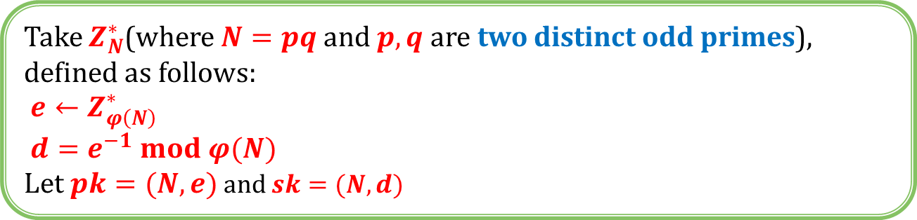
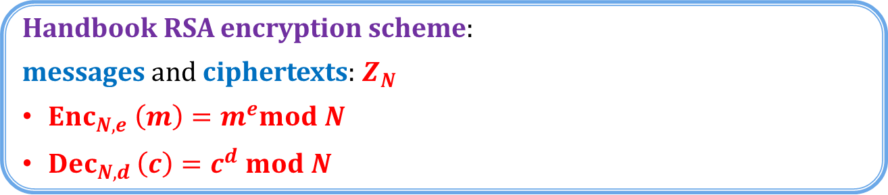
“Handbook RSA” encryption
Take $Z_{N}^{∗}$(where $N=pq$ and $p,q$ are two distinct odd primes), defined as follows:
$e←Z_{φ\left(N\right)}^{∗}$
$d=e^{−1} mod φ(N)$
Let $pk=(N,e)$ and $sk=(N,d)$
Handbook RSA encryption scheme:
messages and ciphertexts: $Z_{N}$
$Enc_{N,e} \left(m\right)=m^{e}mod N$
$Dec_{N,d }\left(c\right)=c^{d} mod N$
Is it secure?

Slide 4
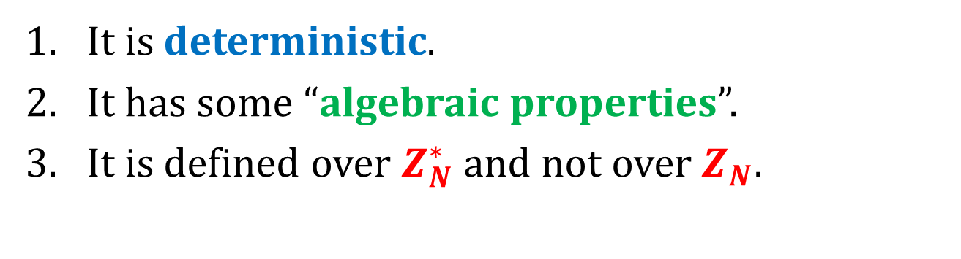
Issues with the “handbook RSA”
It is deterministic.
It has some “algebraic properties”.
It is defined over $Z_{N}^{∗}$ and not over $Z_{N}$.
this is not really a problem (exercise)

Slide 5
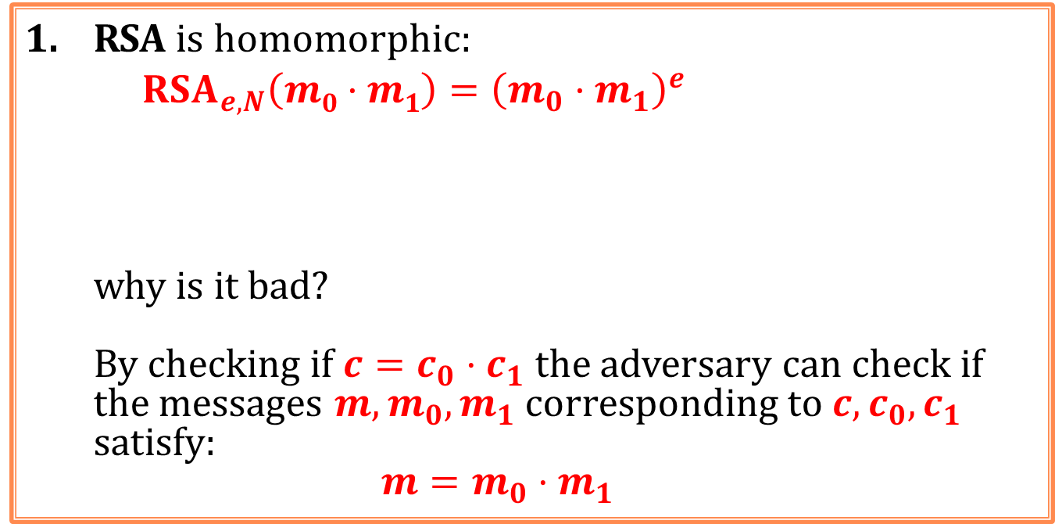


Algebraic properties of RSA
RSA is homomorphic:
$$RSA_{e,N}\left(m0·m1\right)={\left(m_{0}·m_{1}\right)}^{e}$$
why is it bad?
By checking if ${c=c}_{0}⋅c_{1}$ the adversary can check if the messages $m,m_{0},m_{1}$ corresponding to $c,c_{0},c_{1}$ satisfy:
$$m=m_{0}⋅m_{1}$$
$=m_{0}^{e}⋅m_{1}^{e}$
$$=RSA_{e,N}\left(m0\right)⋅RSA_{e,N}\left(m_{1}\right)$$
The Jacobi symbol leaks.

Slide 6
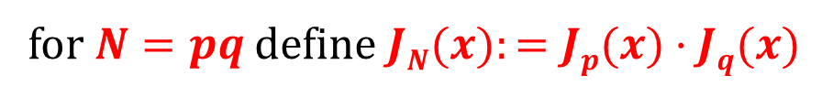





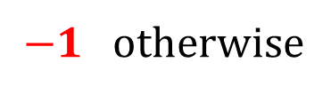

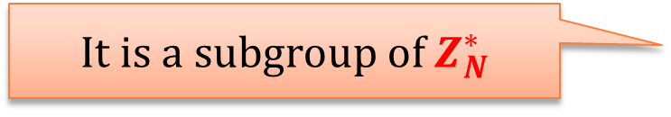
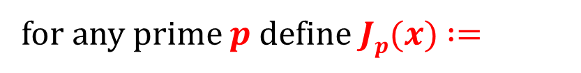

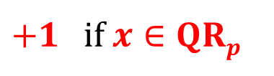
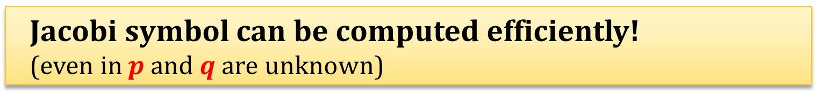
Jacobi Symbol (from the Chapter 6)
$+1$ if $x∈QRp$
for any prime $p$ define $Jp(x)$ $:=$
$−1$otherwise
for $N=pq$ define $JN(x):=Jp(x)·Jq(x)$
$$QR_{p}$$
$$mod p$$
$$JN(x) :=$$
+1 | -1
-1 | +1
$$QR_{q}$$
$$QR_{N}$$
$$mod q$$
It is a subgroup of $Z_{N}^{∗}$
$$Z_{N}^{+}:= \{x∈Z_{N}^{∗}: J_{N}(x)=+1\}$$
Jacobi symbol can be computed efficiently! (even in $p$ and $q$ are unknown)

Slide 7
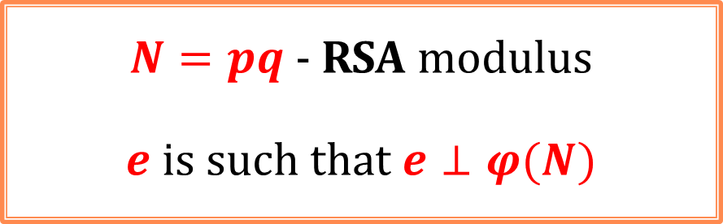
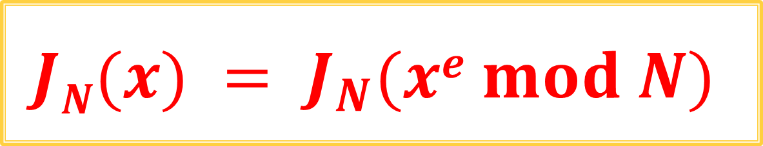
Fact: the RSA function “preserves” the Jacobi symbol
$N=pq$- RSA modulus
$e$ is such that $e⊥φ(N)$
$$JN(x) = J_{N}(xe mod N)$$

Slide 8



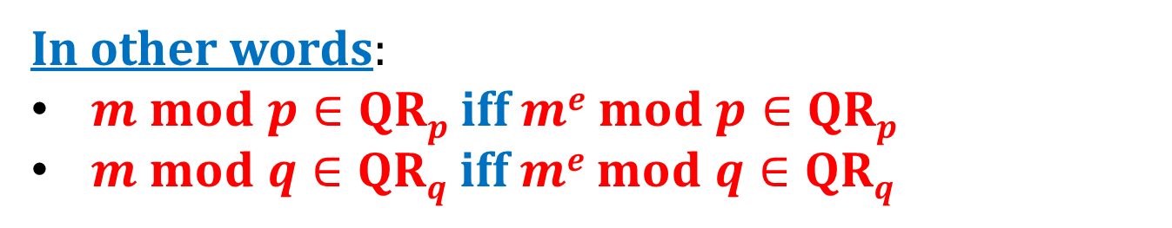
Actually, something even stronger holds:
$RSA_{N,e}$ is a permutation on each “quarter” of $Z_{N}^{∗}$
$$QRp$$
$$QRp$$
$$QRp$$
In other words:
$m mod p∈QRp$iff $me mod p∈QRp$
$m mod q∈QRq$iff $me mod q∈QRq$

Slide 9

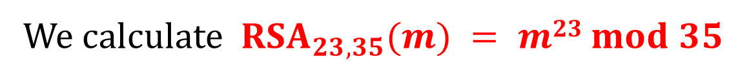
Example $Z_{35}^{∗}$
We calculate $RSA_{23,35}(m) = m23 mod 35$
QR₇
mod 7
QR₅
 | 1 | 2 | 4 | 3 | 5 | 6
1 | 1 | 16 | 11 | 31 | 26 | 6
4 | 29 | 9 | 4 | 24 | 19 | 34
2 | 22 | 2 | 32 | 17 | 12 | 27
3 | 8 | 23 | 18 | 3 | 33 | 13
 | 1 | 4 | 2 | 5 | 3 | 6
1 | 1 | 11 | 16 | 26 | 31 | 6
4 | 29 | 4 | 9 | 19 | 24 | 34
3 | 8 | 18 | 23 | 33 | 3 | 13
2 | 22 | 32 | 2 | 12 | 17 | 27
mod 5

Slide 10
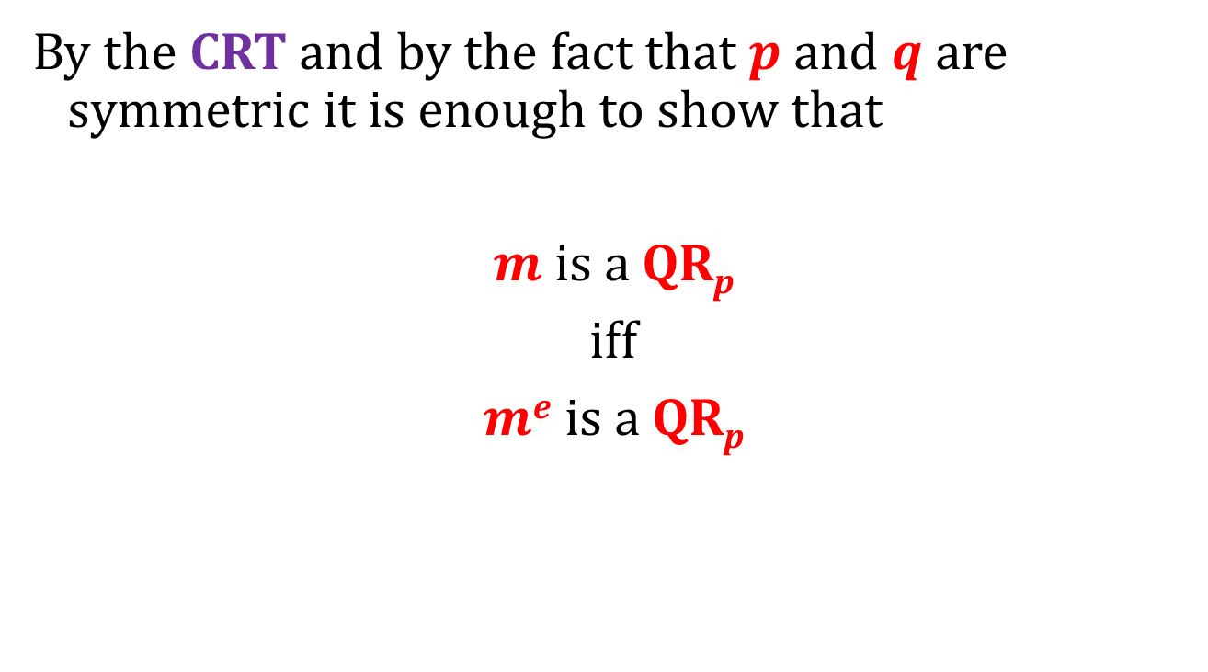
How to prove it?
By the CRT and by the fact that $p$ and $q$ are symmetric it is enough to show that
$m$ is a QR_{p}
iff
$me$ is a QR_{p}

Slide 11
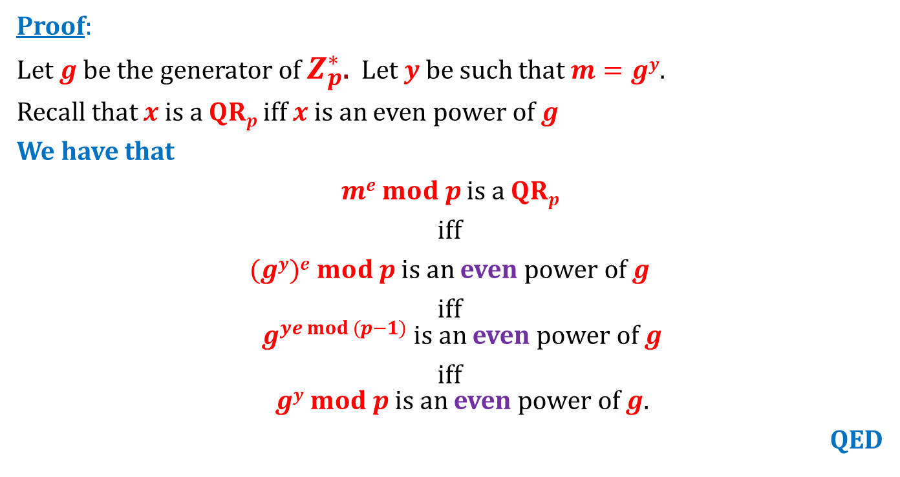

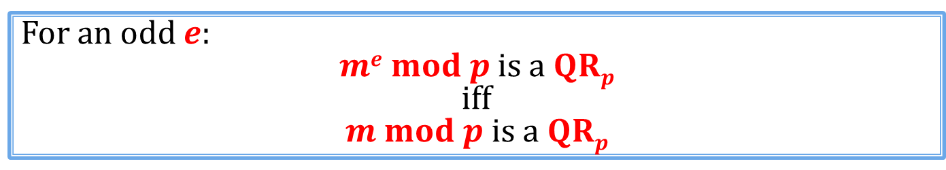
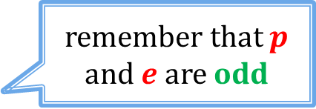
Fact
For an odd $e$:
$me mod p$ is a $QRp$ iff $m mod p$ is a $QRp$
Proof:
Let $g$ be the generator of $Z_{p}^{∗}$. Let $y$be such that $m=gy$.
Recall that $x$ is a $QRp$ iff $x$ is an even power of $g$
We have that
$me mod p$ is a $QRp$
iff
$(gy)e mod p$is an even power of $g$
iff $g^{ye mod (p−1)}$ is an even power of $g$
iff $gy mod p$is an even power of $g$.
QED
remember that $p$ and $e$ are odd
$$= m mod p$$

Slide 12
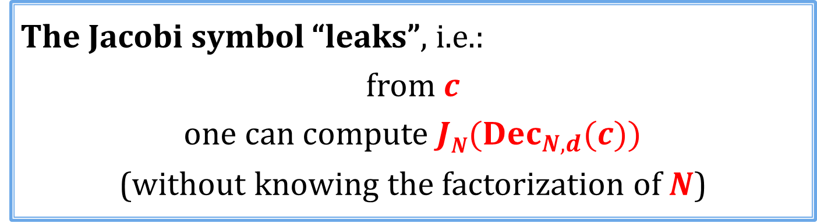
Conclusion
The Jacobi symbol “leaks”, i.e.:
from $c$
one can compute $JN(Dec_{N,d}(c))$
(without knowing the factorization of $N$)
Is it a big problem?
Depends on the application...

Slide 13
Plan for the next slides
Provide a formal security definition of public key encryption.
Modify RSA so that it is secure according to this definition.

Slide 14
Plan
Problems with the “handbook RSA”
Definition of the IND-CPA security
RSA encryption
Rabin encryption
ElGamal encryption
Homomorphic encryption and Paillier cryptosystem
The KEM/DEM paradigm
IND-CCA security
Practical considerations
Theoretical overview

Slide 15
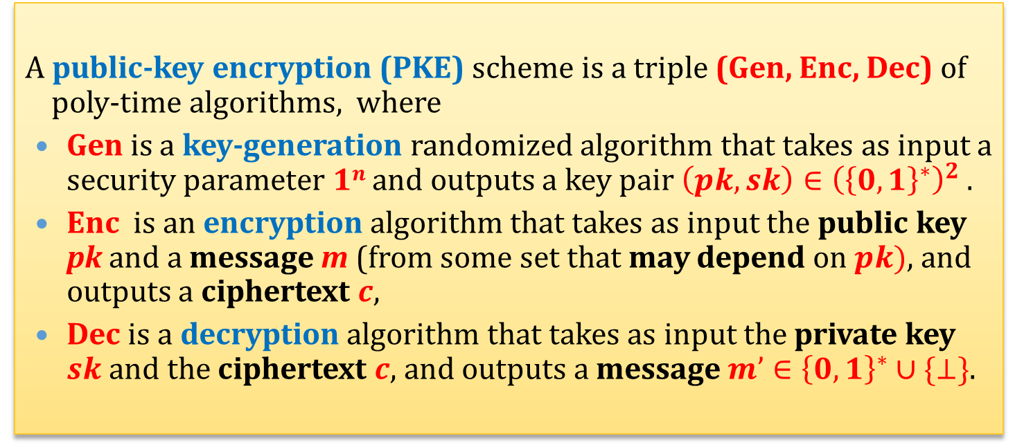
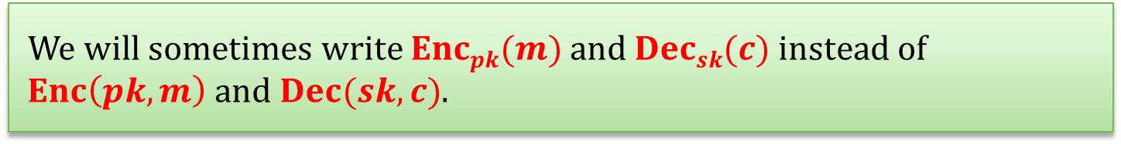
A mathematical view
A public-key encryption (PKE) scheme is a triple (Gen, Enc, Dec) of poly-time algorithms, where
Gen is a key-generation randomized algorithm that takes as input a security parameter $1n$and outputs a key pair $\left(pk,sk\right)∈{\left({\left\{0,1\right\}}^{∗}\right)}^{2}$.
Enc is an encryption algorithm that takes as input the public key pk and a message m (from some set that may depend on $pk)$, and outputs a ciphertext $c$,
Dec is a decryption algorithm that takes as input the private key $sk$ and the ciphertext $c$, and outputs a message $m’∈{\left\{0,1\right\}}^{∗}∪\{⊥\}$.
We will sometimes write $Encpk(m)$and $Decsk(c)$instead of $Enc\left(pk,m\right)$ and $Dec(sk,c)$.

Slide 16




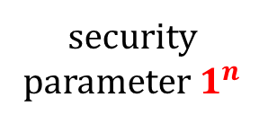


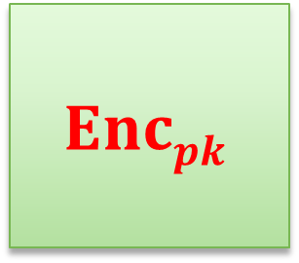


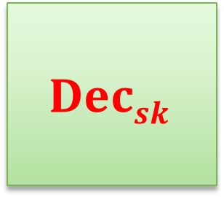
Pictorially
public key
secret key
security parameter $1^{n}$
$$Gen$$
$$(pk,sk)$$
$$m$$
$$c$$
$$Encpk$$
$$Decsk$$
$$pk$$
$$sk$$
$$Enc_{pk}(m)$$
$$Dec_{sk}(c)$$

Slide 17
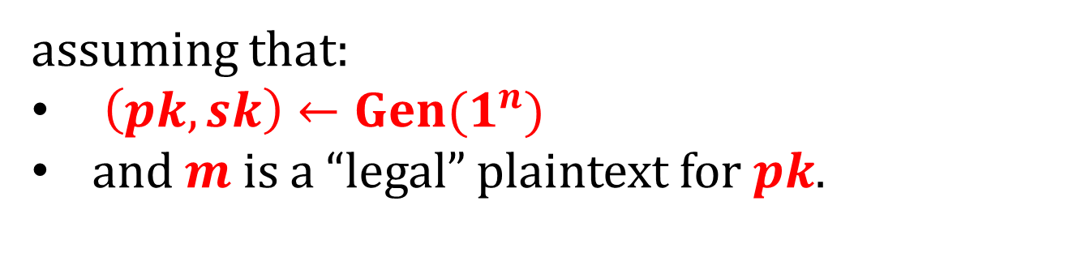
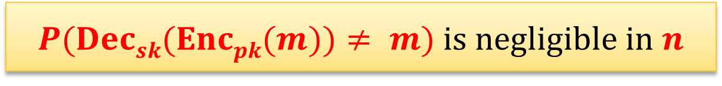
Correctness
We will require that it always holds that
$P(Decsk(Encpk(m))≠ m)$is negligible in $n$
assuming that:
$\left(pk,sk\right)←Gen(1^{n})$
and $m$ is a “legal” plaintext for $pk$.

Slide 18
The security definition
Remember the symmetric-key case?
We considered a chosen-plaintext attack.
How would it look in the case of the public-key encryption?

Slide 19



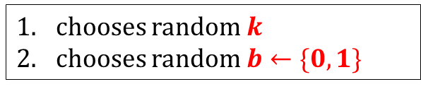



IND-CPA in the symmetric settings
security parameter
1^{n}
chooses random $k$
chooses random $b←\{0,1\}$
chooses $m_{1}^{′}$
$$m_{1}^{′}$$
c₁ = Enc(k,$m_{1}^{′}$)
oracle
. . .
chooses $m_{t}^{′}$
$$m_{t}^{′}$$
c_{t} = Enc(k,$m_{t}^{′}$)
challenge phase:
chooses m₀,m₁
m₀,m₁
c = Enc(k,m_{b})
the interaction continues . . .
has to guess b

Slide 20



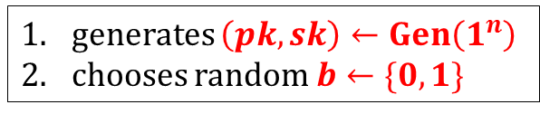

IND-CPA in the asymmetric settings
security parameter
1^{n}
generates $\left(pk,sk\right)←Gen\left(1^{n}\right)$
chooses random $b←\{0,1\}$
$$pk$$
chooses $m_{1}^{′}$
$$m_{1}^{′}$$
c₁ = Enc(pk,$m_{1}^{′}$)
oracle
. . .
This is not needed.
Why? Because if Eve knows $pk$ she can compute all these ciphertexts herself!
chooses $m_{t}^{′}$
$$m_{t}^{′}$$
c_{t} = Enc(pk,$m_{t}^{′}$)
challenge phase:
chooses m₀,m₁
m₀,m₁
c = Enc(pk,m_{b})
the interaction continues . . .
has to guess b

Slide 21


The game after simplifications
security parameter
1^{n}
generates $\left(pk,sk\right)←Gen\left(1^{n}\right)$
chooses random $b←\{0,1\}$
$$pk$$
oracle
challenge phase:
chooses m₀,m₁
m₀,m₁
c = Enc(pk,m_{b})
has to guess b

Slide 22
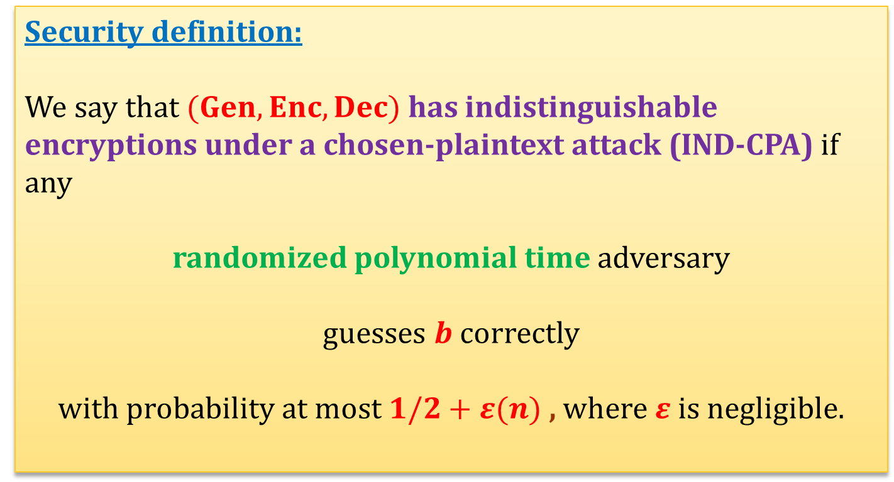
IND-CPA security
Alternative name: IND-CPA-secure
Security definition:
We say that $(Gen,Enc,Dec)$has indistinguishable encryptions under a chosen-plaintext attack (IND-CPA) if any
randomized polynomial time adversary
guesses $b$ correctly
with probability at most $1/2+ε(n)$ , where $ε$is negligible.

Slide 23
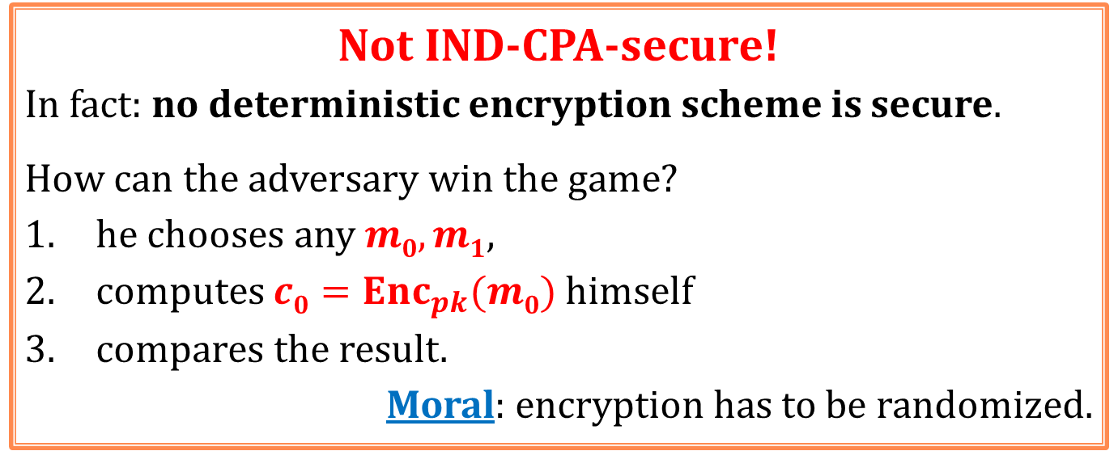
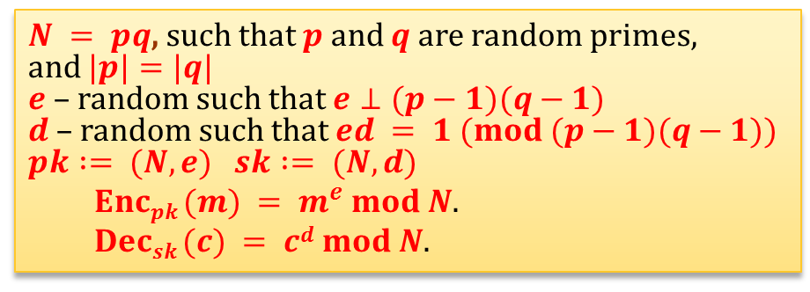
Is the “handbook RSA” IND-CPA-secure?
$N = pq$, such that $p$and $q$ are random primes,
and $|p|=|q|$
$e$ – random such that $e⊥(p−1)(q−1)$
$d$ – random such that $ed = 1 (mod (p−1)(q−1))$
$$pk := (N,e) sk := (N,d)$$
$Encpk (m) = m^{e} mod N$.
$Decsk (c) = cd mod N$.
Not IND-CPA-secure!
In fact: no deterministic encryption scheme is secure.
How can the adversary win the game?
he chooses any $m0,m1$,
computes $c0=Enc_{pk}(m0)$ himself
compares the result.
Moral: encryption has to be randomized.

Slide 24
Plan
Problems with the “handbook RSA”
Definition of the IND-CPA security
RSA encryption
theoretical construction
practical construction
Rabin encryption
ElGamal encryption
Homomorphic encryption and Paillier cryptosystem
The KEM/DEM paradigm
CCA security
Practical considerations
Theoretical overview

Slide 25

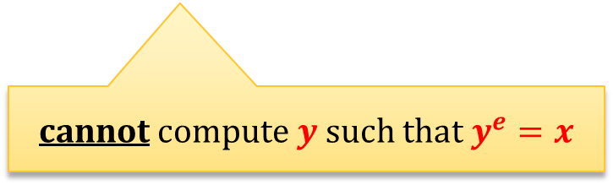


IND-CPA-secure encryption from the RSA assumption
We now show how to construct a provably secure encryption scheme whose security is based on the RSA assumption.
security parameter $1k$
poly-time adversary
choose:
$N=pq$where$p$and $q$ are random primes such that $|p| = |q| = k$
$x$ – a random element of $Z_{N}^{∗}$,
$e$ – a random element of $Z_{φ(N)}^{∗}$
$$(x,e,N)$$
cannot compute $y$ such that $y^{e}=x$

Slide 26
RSA hardcore bit
Question: does RSA have a bit that is for sure well-hidden?
Answer: if RSA assumption doesn’t hold, then: no.
But what if it holds?
Answer: yes – the least significant bit of the argument is hard to compute.

Slide 27

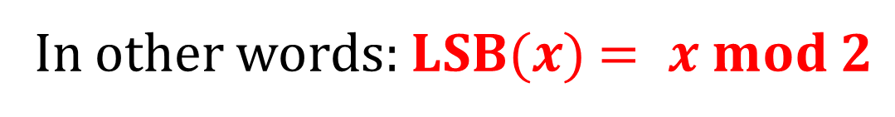
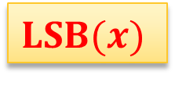

Notation
For an integer $x$we will write
$$LSB(x)$$
to denote the least significant bit of $x$.
$$LSB(x)$$
$x$:
In other words: $LSB(x)$ $= x mod 2$

Slide 28
Outline of the construction
We prove that the least significant bit is a hard to compute for RSA.
We show how to “encrypt using this bit”

Slide 29
Fact (informally)
LSB is the “hardest bit to compute” in RSA.
(it is called a “hard-core bit”).
More precisely:
If you can compute LSB then you can invert RSA.
Note:
In some sense it is a “dual” predicate to Jacobi symbol...

Slide 30


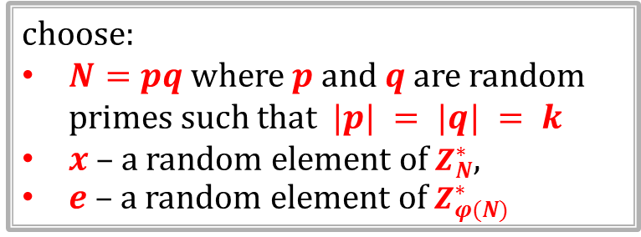
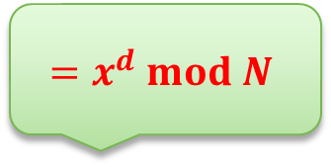

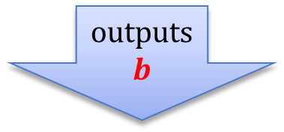
“LSB game”:
security parameter $1k$
choose:
$N=pq$where$p$and $q$ are random primes such that $|p| = |q| = k$
$x$ – a random element of $Z_{N}^{∗}$,
$e$ – a random element of $Z_{φ(N)}^{∗}$
$$(x,e,N)$$
outputs
$$b$$
$$=x^{d} mod N$$
The adversary wins if
$b$ is the least significant bit of $y={Enc}_{e,N}^{−1}(x)$

Slide 31
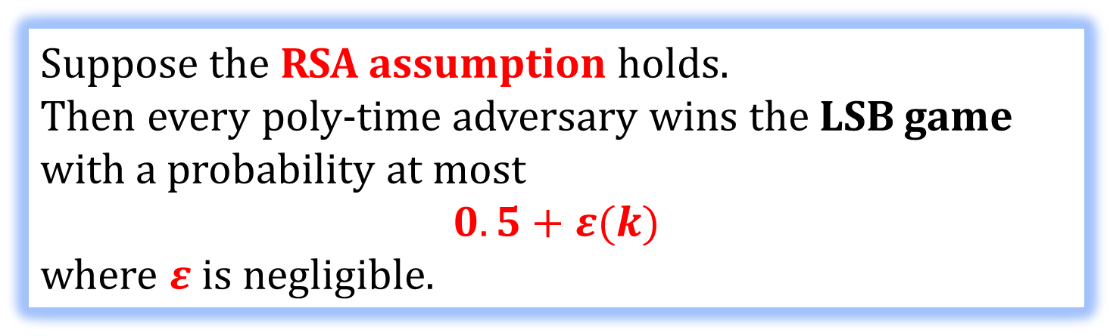
Theorem
Suppose the RSA assumption holds.
Then every poly-time adversary wins the LSB game with a probability at most
$$0.5+ε(k)$$
where $ε$is negligible.
W. Alexi, B. Chor, O. Goldreich, and C.P. Schnorr On the hardness of the least-signficant bits of the RSA and Rabin functions, 1984
In other words:
The least significant bit is a hard-core bit for RSA.

Slide 32
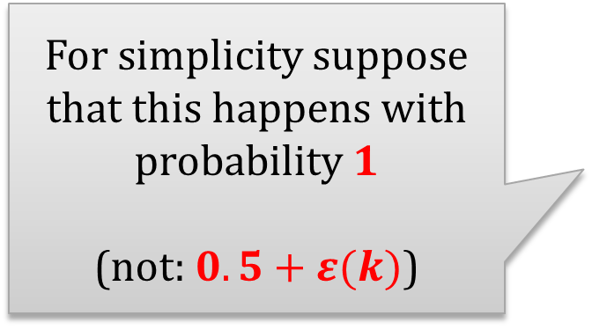
Proof strategy
Suppose we are given a poly-time adversary
that wins the LSB game.
We construct a poly-time adversary
that breaks the RSA assumption.
For simplicity suppose that this happens with probability 1
(not: $0.5+ε(k)$)

Slide 33
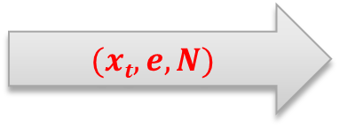
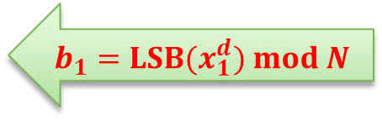

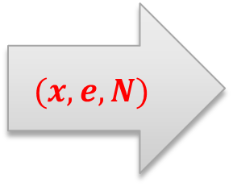
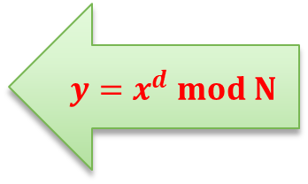
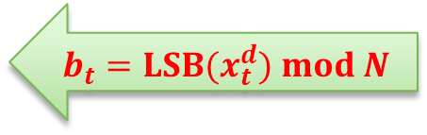
Outline of the construction
$$(x,e,N)$$
$$(x1,e,N)$$
$$b_{1}={LSB(x}_{1}^{d}) mod N$$
. . .
$$(xt,e,N)$$
$$y=x^{d} mod N$$
$$b_{t}={LSB(x}_{t}^{d}) mod N$$

Slide 34

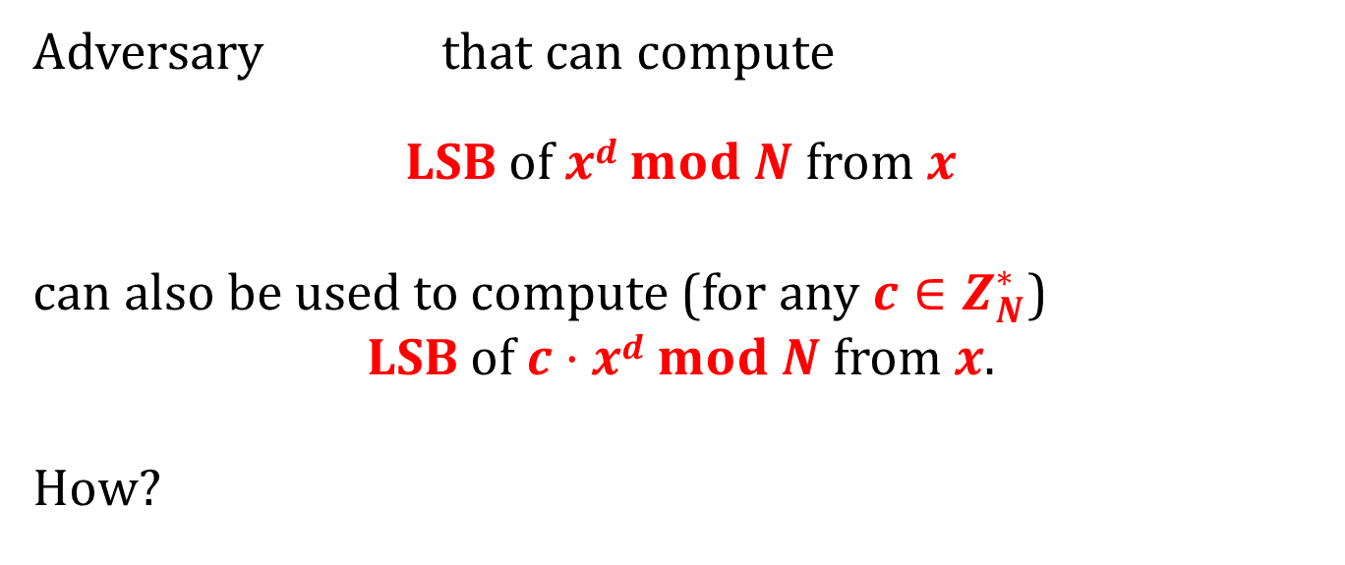
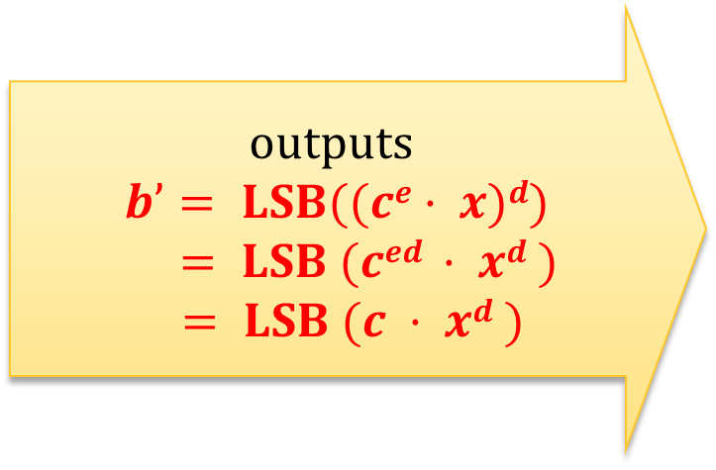
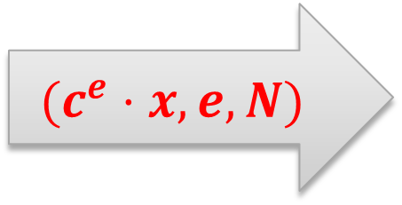
Observation
Adversary that can compute
LSB of $xd mod N$ from $x$
can also be used to compute (for any $c∈Z_{N}^{∗}$)
LSB of $c·xd mod N$ from $x$.
How?
outputs
$$b’= LSB((ce· x)d)$$
$= LSB (ced · xd )$
$= LSB (c · xd )$
$$(c^{e}⋅x,e,N)$$

Slide 35


The method
Let $y≔x^{d }mod N$
The adversary will use to compute:
$LSB(2y)$
$LSB(4y)$
$LSB(8y)$
Why is it useful?
. . .

Slide 36








Observation
$$y≤(N−1)/2$$
$$y>(N−1)/2$$
$$y$$
1 | . . . | N-1
$$2y$$
2 | . . . | 2N-2
1 | . . . | N-1
1 | . . . | N-1
Remember:
$N=pq$ is odd
$$2y mod N$$
$$= 2y$$
$$= 2y − N$$
even
odd
Moral: $y∈[1,…,(N−1)/2]$iff $2y mod N$is even

Slide 37










$$(N−1)/2$$
$$(N−1)/4$$
$$3(N−1)/4$$
$$y$$
1 | . . . | N-1
$$4y$$
4 | . . . | 4N-4
$$4y \\ mod N$$
1 | . . . | N-1
1 | . . . | N-1
1 | . . . | N-1
1 | . . . | N-1
$$= 4y$$
$$= 4y − N$$
$$= 4y – 2N$$
$$= 4y − 3N$$
even
odd
even
odd
Moral: $y∈\left[1,…,\frac{N−1}{4}\right]∪ \left[\frac{N}{2}+1,…,\frac{3\left(N−1\right)}{4}\right]$iff $4y mod N$is even

Slide 38











$$\frac{N−1}{8}$$
. . .
$$\frac{7\left(N−1\right)}{8}$$
$$y$$
 | . . .
$$8y$$
 | . . .
$$8y$$
$$mod N$$
$$= \\ 8y$$
$$=$$
$$8y−N$$
$$=$$
$$8y−2N$$
$$=$$
$$8y−7N$$
. . .
even
odd
even
odd
even
odd
even
odd
Moral: $y∈\left[1,…,\frac{N−1}{8}\right]∪ \left[\frac{2N}{8}+1,…,\frac{3\left(N−1\right)}{8}\right]$ $$∪ \left[\frac{4N}{8}+1,…,\frac{5\left(N−1\right)}{8}\right]∪ \left[\frac{6N}{8}+1,…,\frac{7\left(N−1\right)}{8}\right]$$
iff $8y mod N$is even

Slide 39






So we can use bisection
$$1$$
$$N−1$$
calculate
$$LSB(2y)$$
0
1
calculate
$$LSB(4·y)$$
0
1
calculate
$$LSB(8·y)$$
0
1
calculate
$$LSB(16·y)$$
QED
. . .

Slide 40

Why is it interesting?
We can encrypt one bit messages as follows:
$(N,e)$– public key
$(N,d)$– private key
$$Enc_{e,N }\left(b\right)=\left(LSB\left(y\right)⊕b,y^{e}\right)$$
(where $y←Z_{N}^{∗}$)
$Dec_{d,N }\left(c,x\right)=$ $LSB\left(x^{d}\right)⊕c$
This is secure under the RSA assumption

Slide 41
Lemma
Assume that the RSA assumption holds. Then the encryption scheme from the previous slide is IND-CPA-secure.
Proof: exercise

Slide 42

How to extend it to longer messages?
Encrypt bit-by-bit:
$$Enc_{e,N}\left(m_{1},…,m_{k}\right)=$$
$$\left((LSB\left(y_{1}\right)⊕m_{1},…,LSB\left(y_{k}\right)⊕m_{k}),(y_{1}^{e},…,y_{k}^{e})\right)$$
where $y_{1},…,y_{k}←Z_{N}^{∗}$
$$Dec_{d,N}({(c}_{1},…,c_{k}),{(x}_{1},…,x_{k}))=$$
$$\left({LSB(x}_{1}^{d})⊕c_{1}, …,{LSB(x}_{k}^{d})⊕c_{k}\right)$$

Slide 43
Conclusion
Advantage:
Security of this scheme is implied by the RSA assumption.
Disadvantage:
The ciphertext is much longer than the plaintext.
It is a rather theoretical construction!
the public-key encryption scheme that we just constructed is CPA- secure
RSA assumption holds

Slide 44
Plan
Problems with the “handbook RSA”
Definition of the IND-CPA security
RSA encryption
theoretical construction
practical construction
Rabin encryption
ElGamal encryption
Homomorphic encryption and Paillier cryptosystem
The KEM/DEM paradigm
CCA security
Practical considerations
Theoretical overview

Slide 45
Encoding (also called: “padding”)
Before encrypting a message we usually encode it (adding some randomness).
This has the following advantages:
it makes the encryption non-deterministic
it breaks the “algebraic properties” of encryption.

Slide 46




How is it done in real-life?
PKCS #1: RSA Encryption Standard Version 1.5:
public-key: $(N,e)$
$k$ := length on $N$ in bytes.
$D$ := length of the plaintext
requirement: $D≤k−11$.
$Enc\left(\left(N,e\right), m\right) := xe mod N$, where $x$ is equal to:
$k$ bytes
0x00 | 0x02 | r | 0x00 | m
$(k−D−3)$random non-zero bytes
$D$ bytes

Slide 47



How to encrypt?
$$m$$
$$Encoding(m) :=$$
0x00 | 0x02 | r | 0x00 | m
$Enc_{e,N}$
$$Enc_{e,N}(Encoding(m))$$

Slide 48



How to decrypt?
ciphertext $y$
De$c_{d,N}$
check if the format agrees....
0x00 | 0x02 | r | 0x00 | m
if not then output $⊥$
, otherwise
$$\text{output}$$
$$m$$

Slide 49

Example
If the adversary can calculate the Jacobi symbol of
most probably it doesn’t help him in learning any information about $m$...
0x00 | 0x02 | r | 0x00 | m

Slide 50
Security of the PKCS #1: RSA Encryption Standard Version 1.5 – security
It is believed to be IND-CPA-secure.
(as we will later learn: it’s not “CCA-secure”)

Slide 51
Plan
Problems with the “handbook RSA”
Definition of the IND-CPA security
RSA encryption
Rabin encryption
ElGamal encryption
Homomorphic encryption and Paillier cryptosystem
The KEM/DEM paradigm
CCA security
Practical considerations
Theoretical overview

Slide 52
The situation
question:
can we construct PKE based on the “factoring assumption”
Yes:
Rabin encryption
factoring RSA moduli is hard
???
RSA assumption holds
public-key encryption exists

Slide 53


Rabin encryption
Michael O. Rabin born Wrocław 1931
(in 1935 emigrated to Palestine)
One of the founding fathers of computer science.
introduced non-determinism
decidability of the monadic second order logic
efficient primality testing
oblivious transfer,
....
received Turing Award in 1976
introduced by Michael O. Rabin in 1979
based on squaring in $Z_{N}^{∗}$
security equivalent to factoring

Slide 54



On previous lectures we proven the following
Fact
Let $N$ be a random RSA modulus.
The problem of computing square roots (modulo $N$) of random elements in $QRN$ is poly-time equivalent to the problem of factoring $N$.
(1)
one can factor $N$ in poly-time
one can compute square roots modulo $N$
(2)

Slide 55

In other words
“squaring in $Z_{N}^{∗}$” is a one-way function (assuming the factoring RSA moduli is hard).
Define:
$$Rabin:Z_{N}^{∗}→Z_{N}^{∗}$$
as
$$Rabin\left(x\right)≔x^{2} mod N$$

Slide 56





A fact about squaring modulo $N=pq$?
$$Z_{N}^{∗}$$
$$Z_{N}^{∗}$$
$$RabinN(x) = x2 mod N$$
This function “glues”$4$elements together.

Slide 57





Example for $N=15$
$$Z_{15}^{∗}$$
$$x$$
0 | 1 | 2 | 3 | 4 | 5 | 6 | 7 | 8 | 9 | 10 | 11 | 12 | 13 | 14
$$x^{2}$$
0 | 1 | 4 | 3 | 1 | 5 | 6 | 4 | 4 | 9 | 10 | 1 | 12 | 4 | 1
$QR_{15}$:
1 | 4

Slide 58


How to base encryption on this?
Idea:
public key: $N=pq$
private key: $(p,q)$
encryption: $Enc_{N}\left(x\right)=x^{2}mod N$
decryption: $Dec_{\left(p,q\right)}\left(y\right)=\sqrt{y} mod N$
Problem: there are $4$ square roots.
Solution: “make the inversion unique”.
can be computed efficiently if one knows $p$ and $q$ (see Chapter 6)

Slide 59




How to do it?
An ad-hoc method: add an encoding (like in the “real RSA encryption”).
In such a way that only $1$ out of the $4$ square roots “make sense”.
$$Z_{N}^{∗}$$
$$Z_{N}^{∗}$$
In other words:
make the set of legal messages is “sparse”
$$f(x) = x2 mod N$$

Slide 60


Another approach
Such an$N$is called a “Blum integer”
Fact
Suppose $N=pq$ where
$$p=q=3 (mod 4)$$
Then the function
$$RabinN(x) = x2 mod N$$
is a permutation when restricted to $QR_{N}$
$$RabinN : QRN  QRN$$

Slide 61





How does it look?
$$Z_{N}^{∗}$$
$$Z_{N}^{∗}$$
$$RabinN(x) = x2 mod N$$
$$QRN$$
$$QRN$$

Slide 62

Rabin restricted to $QRN$ is a permutation
$$Z_{N}^{∗}$$
$$Z_{N}^{∗}$$
$$RabinN(x) = x2 mod N$$
$$QRN$$
$$QRN$$

Slide 63


Proof that $RabinN(x) = x2 mod N$ restricted to $QRN$ is a permutation
($N=pq$, where $p=q=3 mod 4$)
We prove that Rabin is injective, i.e. for every $x,y$ ∈ QR_{N} we have that
$x^{2}=y^{2}$ $⟹ x=y$
Observation: by CRT it is enough to show that
$x^{2}=y^{2}$ $⟹ x=y mod p$and
$x^{2}=y^{2}$ $⟹ x=y mod q$.
By symmetry it’s also enough to show it just for $p.$

Slide 64














Proof
Suppose we have $x,y$ ∈ QR_{N} such that
$x2=y2$mod N
$$x2=y2 mod p$$
Let $p=4k+$3, where $k∈N$
$$g4i=g4j mod p$$
Let $i,j∈N$ be such that
$x=g2i mod p$and
$y=g2j mod p$
where $g$is a generator of $Z_{p}^{∗}$ and
$$0≤j≤i<\frac{p−1}{2}$$
$$g^{4(i−j)}=1 mod p$$
$$p−1 | 4(i−j)$$
$$4k+2 | 4(i−j)$$
$$2k+1 | 2(i−j)$$
$$2k+1 | i−j$$
$$=\frac{4k+2}{2}$$
$$i = j$$
$$=2k+1$$
$$x=y mod p$$
QED

Slide 65




How to encrypt a one-bit message $b$?
Fact: the least significant bit is a hard-core bit for the Rabin permutation.
$N$ – public key
$(p,q)$– private key
$Enc_{N}(b) = (LSB\left(x\right)⊕b, RabinN(x))$,
where $x∈QRN$is random.
$$Dec_{p,q}\left(b^{′},y\right)=LSB\left(Rabin_{N}^{−1}\left(y\right)\right)⊕b^{′}$$
a Blum integer
$$RabinN (x) = x2 mod N$$
$$RabinN : QRN  QRN$$
this can be computed if one knows $p$ and $q$

Slide 66
Moral
factoring RSA moduli is hard
public-key encryption exists

Slide 67
Plan
Problems with the “handbook RSA”
Definition of the IND-CPA security
RSA encryption
Rabin encryption
ElGamal encryption
Homomorphic encryption and Paillier cryptosystem
The KEM/DEM paradigm
CCA security
Practical considerations
Theoretical overview

Slide 68


Remember the exponentiation modulo a prime?
$$x$$ | $$2x mod 11$$
0 | 1
1 | 2
2 | 4
3 | 8
4 | 5
5 | 10
6 | 9
7 | 7
8 | 3
9 | 6
1
2
3
4
5
6
7
8
9
10
$2$ is a generator of $Z_{11}^{∗}$

Slide 69



Discrete log
Function
$$f(x)=gx mod p$$
x | g^{x}
0 | 1
1 | 2
2 | 4
3 | 8
4 | 5
5 | 10
6 | 9
7 | 7
8 | 3
9 | 6
easy to compute
believed to be hard to compute for large $p$
$f^{−1}$ is also denoted $logg$
and called the discrete logarithm
Discrete log is hard in many other groups!

Slide 70
How to construct PKE based on the hardness of discrete log?
RSA was a trapdoor permutation, so the construction was quite easy...
In case of the discrete log, we just have a one-way function.
Diffie and Hellman constructed something weaker than PKE: a key exchange protocol (also called key agreement protocol).
We will now describe it. Then, we will show how to “convert it” into a PKE.

Slide 71
Plan
Problems with the “handbook RSA”
Definition of the IND-CPA security
RSA encryption
Rabin encryption
ElGamal encryption
a tool: Diffie-Hellman key exchange
ElGamal encryption
Homomorphic encryption and Paillier cryptosystem
The KEM/DEM paradigm
CCA security
Practical considerations
Theoretical overview

Slide 72



Key exchange
initially they share no secret
listens
Alice
Bob
key $k$
key $k$
Eve should have no information about $k$
We will formalize it later. Let’s first show the protocol.

Slide 73









The Diffie-Hellman Key exchange
$G$ – a group, where discrete log is believed to be hard
$q := |G|$
$g$ – a generator of $G$
$$x ← Zq$$
$$h1 = gx$$
$$y ← Zq$$
$$h2 = gy$$
Alice
Bob
output: $$kA=(h2)x$$
output: $$kB=(h1)y$$
equal to: $$gyx$$
equal to: $gxy$
equal!

Slide 74





Security of the Diffie-Hellman key exchange
$$G,g$$
$$h1 = gx$$
$$h2 = gy$$
knows
$gyx$ ?
Eve
Eve should have no information about $gyx$.

Slide 75


Is it secure?
If the discrete log in $G$ is easy then the DH key exchange is not secure.
(because the adversary can compute $x$ and $y$ from $gx$and $gy$)
If the discrete log in $G$ is hard, then...
it may also not be secure

Slide 76


Example for ${G=Z}_{p}^{∗}$
We use the facts that:
quadratic residues in $Z_{p}^{∗}$are even powers of the generator, and
testing membership in $QR_{p}$ is computationally easy (even for large $p$).

Slide 77










Suppose ${G=Z}_{p}^{∗}$
$x$ is even iff $h_{1}∈QR_{p}$
$$x ← Z_{p−1}$$
$$h1 = gx$$
$$y ← Z_{p−1}$$
$$h2 = gy$$
Alice
Bob
$y$ is even iff $h_{2}∈QR_{p}$
$gxy$ ?
Therefore:
$g^{xy}∈QR_{p}$ iff ($h_{1}∈QR_{p}$ or $h_{2}∈QR_{p}$)
So, Eve can compute some information about $gxy$ (namely: if it is a QR, or not).
$$=g^{xy mod p−1}$$

Slide 78

Solution (see Chapter 6)
Instead of working in $Z_{p}^{∗}$ work in its subgroup: $QR_{p}$
How to find a generator of $QR_{p}$?
A practical method: Choose $p$ that is a strong prime, which means that:
$p=2⋅q + 1$, with $q$prime.
Hence: $QR_{p}$ has a prime order ($q$).
Every element (except of $1$) of a group of a prime order is its generator!
Therefore: every element of $QR_{p}$ is a generator.

Slide 79







The DH Key exchange over QR group
Take a prime $p=2⋅q+1$, with $q$prime.
Take any $h∈Z_{p}^{∗}$ such that $h≠±1$ and let $g=h^{2}mod p$.
$$x ← Zq$$
$$h1 = gx$$
$$y ← Zq$$
$$h2 = gy$$
Alice
Bob
output: $$kA=(h2)x$$
output: $$kB=(h1)y$$

Slide 80
But is the partial information leakage really a problem?
We need to
formalize what we mean by secure key exchange,
identify the assumptions needed to prove the security.

Slide 81









interactive
probabilistic Turing machine $A$
interactive probabilistic
Turing machine $B$
“transcript” $T$: the sequence of exchanged messages:
Alice
Bob
key $k∈K$
some finite set
key $k∈K$
Informal definition: $(A,B)$is secure if no “efficient adversary” can distinguish $k$from random, given $T$, with a “non-negligible advantage”.
?
key $k$
$$T$$
random element of $K$

Slide 82











How to formalize it?
security parameter $1n$
$$T$$
$$A$$
$$B$$
key $k∈K$
may depend on $1^{n}$
key $k∈K$
We say $(A,B)$is secure a secure key-exchange protocol if: the output of $A$ and $B$ is always the same, and
$$∀$$
$$\left|P\left(M\left(1^{n},T,k\right)=1\right)−P\left(M\left(1^{n},T,r\right)=1\right)\right|≤negl(n)$$
poly-time $M$
$$r←K$$

Slide 83


How to make $G$ dependent on $1^{n}$?
In practice often a fixed group is used.
In theory we need to have a new group $G$ for every value of $1n$.
So, we need to define an algorithm that generates $G$ and its generator $g$.

Slide 84



Group generating algorithm $GenG$
$$(G,q,g)$$
description of a group $G$,
order $q$of $G$, and
a generator $g$ of $G$.
GenG
$$1n$$
poly-time randomized algorithm

Slide 85




Example of $GenG$
$$(Z_{p}^{∗},q,g)$$
where:
$p$– random prime such that $\left|p\right|=n$
$q=(p−1)/2$ – a prime
and $g=h^{2}mod p$, where $h←Z_{p}^{∗}∖\left\{−1,1\right\}$
$$Ge{nG}_{QR}$$
$$1n$$

Slide 86








How does the protocol look now?
security parameter $1n$
$$(G,g,q) ←GenG(1n)$$
$$x ←Zq$$
$$\left(G,g,q, \left(h1 =g^{x}\right)\right)$$
$$y ←Zq$$
$$h2 = gy$$
Alice
Bob
output: $$kA=(h2)x$$
output: $$kB=(h1)y$$
If such a key exchange protocol is secure, we say that: the Decisional Diffie-Hellman (DDH) problem is hard with respect to GenG)

Slide 87

Formally
Decisional Diffie-Hellman (DDH) problem is hard relative to GenG if for every poly-time algorithm $A$ we have that
$\left|P\left(A\left(G,q,g,g^{x},g^{y},g^{z}\right)=1\right)−P\left(A(G,q,g,g^{x},g^{y},g^{xy}\right)=1\right)|$ $$≤negl(n)$$
where
$$\left(G,q,g\right)←GenG\left(1^{n}\right)$$
and
$$x,y,z←Z_{q}$$

Slide 88

Examples
DDH is believed to be hard relative to $Ge{nG}_{QR}$
Other examples: elliptic curves

Slide 89


How does DDH compare to the discrete log assumption
DDH is hard relative to $GenG$
implies
discrete log is hard relative to $H$
The opposite implication is unknown in most of the cases

Slide 90
A problem
The protocols that we discussed are secure only against a passive adversary (that only eavesdrop).
What if the adversary is active?
She can launch a “man-in-the-middle attack”.

Slide 91



Man in the middle attack
I am Bob
I am Alice
Alice
Bob
key $k$
key $k$
key $k′$
key $k′$
A very realistic attack!
So, is this thing totally useless? No! (it is useful as a building block)

Slide 92
Plan
Problems with the “handbook RSA”
Definition of the IND-CPA security
RSA encryption
Rabin encryption
ElGamal encryption
a tool: Diffie-Hellman key exchange
ElGamal encryption
Homomorphic encryption and Paillier cryptosystem
The KEM/DEM paradigm
CCA security
Practical considerations
Theoretical overview

Slide 93

ElGamal encryption
ElGamal is another popular public-key encryption scheme.
Introduced in:
[Taher ElGamal "A Public key Cryptosystem and A Signature Scheme based on discrete Logarithms". IEEE Transactions on Information Theory. 1985]
Taher ElGamal
(1955– )
It is based on the Diffie-Hellman key-exchange.

Slide 94




First observation
Remember that the one-time pad scheme can be generalized to any group $G$?
K = M = C = $G$
$$Enc(k,m)=m·k$$
$$Dec(k,m)=m·k^{−1}$$
So, if $k$ is the key agreed in the DH key exchange, then Alice can send a message $M∈G$to Bob “encrypting it with $k$” by setting:$c :=m·k$
$$c :=m·k$$
Alice
Bob

Slide 95











How does it look now?
security parameter $1n$
$$(G,g,q) ←GenG(1n)$$
$$x ← Zq$$
$$y ← Zq$$
$$(G,g,q,h1)$$
$$h1=gx$$
plaintext $$m$$
$$h2=gy$$
Alice
Bob
$$c :=m·(h1)y$$
output: $$m’ := c·{\left(h2\right)}^{−x}$$
since $(h2)x = (h1)y$
we get: $m = m’$

Slide 96



The last two messages can be sent together
security parameter $1n$
$$(G,g,q) ←GenG(1n)$$
$$x ← Zq$$
$$y ← Zq$$
$$(G,g,q,h1)$$
$$h1=gx$$
plaintext $$m$$
$${(h}_{2},c)≔$$
$$\left(gy,m·\left(h1\right)y \right)$$
Alice
Bob
output: $$m’ := c·{\left(h2\right)}^{−x}$$

Slide 97


ElGamal encryption
key generation
encryption
private key
security parameter $1n$
public key
$$(G,g,q) ←GenG(1n)$$
$$x ← Zq$$
$$y ← Zq$$
$$(G,g,q,h1)$$
$$h1=gx$$
plaintext $$m$$
$${(h}_{2},c)≔$$
$$\left(gy,m·\left(h1\right)y \right)$$
Alice
Bob
output: $$m’ := c·{\left(h2\right)}^{−x}$$
ciphertext
decryption

Slide 98




ElGamal encryption
Let $GenG$ be such that DDH is hard with respect to $GenG$.
$Gen(1n)$ first runs GenG to obtain $G,g$ and $q$. Then, it chooses $x←Zq$and computes $h_{1} :=gx$.
The public key is $(G,g,q,h_{1})$.
The private key is $(G,g,q,x)$.
$Enc((G,g,q,h_{1}), m) := (m⋅h_{1}^{y}, gy)$ ,
where $m∈G$ and $y$is a random element of $Z_{q}$
(note: it is randomized by definition)
$$Dec\left(\left(G,g,q,x\right), \left(c1,h2\right)\right):= c1·h_{2}^{−x}$$

Slide 99





Correctness
$$h=gx$$
$$Enc((G,g,q,h), m)=(m · hy, gy)$$
$$Dec\left(\left(G,g,q,x\right), \left(c1,h2\right)\right)= c1·h_{2}^{−x}$$
$$= m · hy · {\left(gy\right)}^{−x}$$
$$= m · (gx)y{⋅\left(gy\right)}^{−x}$$
$$= m · gxy ·g^{−yx}$$
$$= m$$

Slide 100


ElGamal – implementation issues
Which group to choose?
E.g.: $QR_{p}$, where $p$ is a strong prime, i.e.: $q=\frac{p−1}{2}$ is also prime.
Plaintext space is a set of integers $\{1,…,q\}$.
How to map an integer $i∈\{1,…,q\}$to $QR_{p}$?
Just square:
$f(i) = i2 mod p$.
Why is it one-to-one?

Slide 101
Remember this picture (from previous lectures)?
$$f(x)= x2$$
$$Z_{11}^{∗}:$$
1
2
3
QR₁₁:
4
5
3
5
9
4
1
6
7
8
9
10

Slide 102

The mapping
So
$$f(i) = i2 mod p$$
is one-to-one (on $\{1,…,q\}$).
Is it also efficiently invertible?
Yes (see Chapter 6)

Slide 103
Plan
Problems with the “handbook RSA”
Definition of the IND-CPA security
RSA encryption
Rabin encryption
ElGamal encryption
Homomorphic encryption and Paillier cryptosystem
The KEM/DEM paradigm
CCA security
Practical considerations
Theoretical overview

Slide 104




ElGamal has an interesting property
homomorphism with respect to multiplication:
A “product of two ciphertexts” decrypts to a product of their corresponding messages.
$$Enc_{pk}\left(m\right)=\left(c,h\right),$$
$$Enc_{pk}\left(m′\right)=\left(c′,h′\right)$$
multiply
$$c⋅c^{′},h⋅h^{′}$$
decrypt
decrypt
multiply
$$m,m′$$
$$m⋅m′$$

Slide 105


Why?
public key: $(G,g,q,h)$
private key: $\left(G,g,q,x\right)$
$c≔Enc((G,g,q,h), m) :=(m⋅hy, gy)$, where $y←Z_{q}$
$c′≔Enc((G,g,q,h), m′) :=(m′⋅hy′, gy′)$, where $y′←Z_{q}$
product of $c$ and $c′$:
$$(m⋅m^{′}⋅h^{y}⋅h^{y^{′}},g^{y}⋅g^{y′})$$
$$=\left(m⋅m^{′}⋅h^{y+y^{′}},g^{y+y^{′}}\right)$$
this is an encryption of $m⋅m^{′}$ with randomness $y+y′$

Slide 106

Homomorphism – good or bad?
Sometimes homomorphism is a security weakness (think of the CCA security).
On the other hand: it can also be a plus.
One example: cloud computing

Slide 107









Example: outsourcing computation
has a large set
$$\left\{x_{1},…,x_{n}\right\}⊆QR_{p}$$
and wants to learn
$${x=x}_{1}⋅⋯⋅x_{n} mod p$$
generated a key pair
$$pk= \left({QR}_{p},g,q,h\right)$$
$$sk=(QR_{p},g,q,x)$$
$$p,$$
$$c_{1},…,c_{n}$$
for $i=1$ to $n$:
$$c_{i}≔Enc_{pk}(x_{i})$$
computes
$$c≔c_{1}⋅⋯⋅c_{n} mod p$$
$$c$$
computes the result as:
$$x≔Dec_{sk}\left(c\right)$$
Observe: the server doesn’t learn the $x_{i}$‘s!

Slide 108







This can be generalized!
The example on the previous slide was a bit artificial. But think about the following.
has some data $x_{1},…,x_{n}$and wants to learn
${x=f(x}_{1},…,x_{n})$ for some function $f$.
$$pk,$$
$$c_{1},…,c_{n}$$
for $i=1$ to $n$:
$$c_{i}≔Enc_{pk}(x_{i})$$
computes $c$from
$$c_{1},…,c_{n}$$
$$c$$
computes the result as:
$$x≔Dec_{sk}\left(c\right)$$
but how to do it for any $f$?

Slide 109

Fully homomorphic encryption (FHE)
Constructing encryption scheme that would allow “homomorphic computation” of any function $f$ was an open problem until 2009.
The first such construction was given in:
Craig Gentry. Fully Homomorphic Encryption Using Ideal Lattices. ACM Symposium on Theory of Computing (STOC), 2009.
Working towards construction of practical FHE is an active research area.

Slide 110
A natural (but much simpler) question
Can we construct an encryption scheme that is homomorphic with respect to addition?
Answer: Yes, Paillier cryptosystem
[Pascal Paillier "Public-Key Cryptosystems Based on Composite Degree Residuosity Classes". EUROCRYPT 1999]

Slide 111


Paillier cryptosystem works over $Z_{N^{2}}^{∗}$, where $N$ is an RSA modulus
Let $N≔pq$.
public key: $N$
private key: $(p,q)$
How does $Z_{N^{2}}^{∗}$ look like?
Fact:
$$φ\left(N^{2}\right)=p\left(p−1\right)⋅q\left(q−1\right)$$
$$=pq⋅\left(p−1\right)(q−1)$$
$$=N⋅φ(N)$$

Slide 112


Moreover
$Z_{N^{2}}^{∗}$ is isomorphic to $Z_{N}×Z_{N}^{∗}$ with the following isomorphism
$f:Z_{N}×Z_{N}^{∗}$ $→Z_{N^{2}}^{∗}$
$$f\left(a,b\right)={\left(1+N\right)}^{a}⋅b^{N} mod N^{2}$$
[proof: exercise]
If $x=f\left(a,b\right)$ then we will also write: $x↔\left(a,b\right)$

Slide 113

Another fact
Fact: for any integer $a$ we have that
$${\left(1+N\right)}^{a}=1+a⋅N \left(mod N^{2}\right)$$
Proof:
$${\left(1+N\right)}^{a}=1+\left({a \atop 1}\right)N^{1}+\left({a \atop 2}\right)N^{2}+⋯+\left({a \atop a}\right)N^{a}$$
$$=1+\left({a \atop 1}\right)N \left(mod N^{2}\right)$$
$=1+a⋅N \left(mod N^{2}\right)$
QED

Slide 114



A consequence of this fact
Fact: for any integer $a$ we have that
$${\left(1+N\right)}^{a}=1+a⋅N \left(mod N^{2}\right)$$
Consequence: order of $1+N$in $Z_{N^{2}}^{∗}$ is $N$.
why?
because:
for $0<a<N$ we have $1<1+a⋅N<N^{2}$
and $1+N⋅N=1 (mod N^{2})$

Slide 115










Structure of $Z_{N^{2}}^{∗}$
$$Z_{N}$$
$$Z_{N^{2} }^{∗}≅$$
$$0$$
$$. . .$$
$$N−1$$
$$1$$
$$Z_{N }^{∗}$$
$$. . .$$
$$N−1$$

Slide 116









Multiplication in $Z_{N^{2}}^{∗}$
$$Z_{N}$$
$$x$$
$$x′$$
$$x+x′$$
$$y$$
$$Z_{N }^{∗}$$
$$y′$$
$$y⋅y′$$

Slide 117


$N$th residues in $Z_{N^{2}}^{∗}$
A number $y∈Z_{N^{2}}^{∗}$ is called an $N$th residue modulo $N^{2}$ if there exists $x∈Z_{N^{2}}^{∗}$ such that
$$y=x^{N}mod N^{2}$$
How do the $N$th residues look like?

Slide 118


A form of every $N$th residue
Suppose $x↔(a,b)$.
Then
$$x^{N}↔(N⋅a mod N,b^{N} mod N)$$
$$=(0,b^{N}mod N)$$
So, every $N$th residue is of a form
$y↔(0,c)$
Is every element of this form an $N$th residue?
Yes!

Slide 119



A proof that every element $(0,c)$ is an $N$th residue
this is possible because
$$N⊥φ(N)$$
[exercise]
Take $y↔(0,c)$. Let $d=N^{−1} mod φ(N)$.
For an arbitrary $a∈Z_{N}$ let $x$ be such that
$$x↔\left(a,c^{d}\right)$$
We have:
$$x^{N}↔\left(Na mod N,c^{dN} mod N\right)$$
$$=\left(0,c^{dN mod φ\left(N\right)}\right)$$
$$=(0,c^{1})$$
$$=(0,c)$$
Observe: this also shows that every $N$th residue $y$ has exactly $N$ roots $\sqrt[N]{y}.$

Slide 120











The $N$th residues pictorially
$$Z_{N}$$
$$0$$
$$. . .$$
$$N−1$$
$$1$$
$$Z_{N^{2}}^{∗}$$
$$Z_{N }^{∗}$$
$$. . .$$
$$N−1$$
$N$th residues. Denote this set $Res\left(N^{2}\right)$

Slide 121











Also
The $N$th roots of every $(0,c)$ have a form $(a,c^{d})$:
$$Z_{N}$$
$$0$$
$$. . .$$
$$N−1$$
all $N$th roots of the same $N$th residue
$$1$$
$$Z_{N^{2}}^{∗}$$
$$Z_{N }^{∗}$$
$$. . .$$
$$N−1$$

Slide 122

Corollary
It’s easy to choose a random $N$th residue:
Just take a random element $x←Z_{N^{2}}^{∗}$ and compute $y=x^{N} mod N^{2}$.
Which problem is hard $Z_{N^{2}}^{∗}$ (if one doesn’t know $p$and $q$)?

Slide 123



Decisional composite residuosity (DCR) assumption
Informally:
It is hard to distinguish random element of $Res\left(N^{2}\right)$ from a random element of $Z_{N^{2}}^{∗}$.
?
$$Z_{N^{2}}^{∗}$$
$$Z_{N^{2}}^{∗}$$

Slide 124



How to encrypt?
Main idea: messages are elements $x↔\left(a,1\right)$ (for $a∈Z_{N}$)
$$Z_{N^{2}}^{∗}$$
To encrypt a message $m$multiply it by a random $r←Res(N^{2})$:
$$Enc_{N}\left(m\right)=m⋅r$$

Slide 125



Pictorially
ciphertexts of $m$
message $m$
$$Z_{N^{2}}^{∗}$$

Slide 126
Two questions
Is this secure?
How to decrypt?

Slide 127


Security follows from the DCR assumption
Proof (sketch):
Take the original scheme
$Enc_{N}\left(m\right)=m⋅r$ where $r←Res(N^{2})$
and modify it as follows:
$Enc_{N}\left(m\right)=m⋅r$ where $r←Z_{N^{2}}^{∗}$
Easy to see:
the modified scheme hides the message completely (it’s a “generalized one-time pad”)
if these two schemes can be distinguished then the DCR assumption is broken.

Slide 128



How to decrypt?
$Enc_{N}\left(m\right)=m⋅r$ where $r←Res(N^{2})$
Let’s view encryption as a function in $Z_{N}×Z_{N}^{∗}$:
$Enc_{N}\left(a,1\right)↔\left(a+0,1⋅b\right)$ where $b←Z_{N}^{∗}$
$$=\left(a,b\right)$$
Problem:
the receiver can only see $f(a,b)$.
How can he “extract” $a$from it?

Slide 129





Observation
$${\left(f\left(a,b\right)\right)}^{φ(N)}mod N^{2}↔(φ\left(N\right)⋅a mod N, b^{φ\left(N\right)} mod N)$$
$=(φ\left(N\right)⋅a mod N, 1)$
$↔f\left(φ\left(N\right)⋅a mod N,1\right)$
$={\left(1+N\right)}^{φ\left(N\right)⋅a mod N}⋅1^{N} mod N^{2}$
$={\left(1+N\right)}^{φ\left(N\right)⋅a mod N}$ $mod N^{2}$
$=1+(φ\left(N\right)⋅a mod N)⋅N mod N^{2}$
here we use the fact that
$${\left(1+N\right)}^{a}$$
$$=1+a⋅N \left(mod N^{2}\right)$$
$$<N^{2}$$
$$=1+(φ\left(N\right)⋅a mod N)⋅N$$
So:
$$φ\left(N\right)⋅a mod N=\frac{{\left(f\left(a,b\right)\right)}^{φ(N)}mod N^{2}−1}{N}$$

Slide 130


Continued:
denote it $z$
We got that
$$φ\left(N\right)⋅a mod N=\frac{{\left(f\left(a,b\right)\right)}^{φ(N)}mod N^{2}−1}{N}$$
Therefore
$$a=z⋅{\left(φ\left(N\right)\right)}^{−1} mod N$$

Slide 131



Paillier encryption
Key generation: let $N≔pq$ like in RSA
public key: $N$
private key: $(p,q)$
Encryption:
$Enc_{N}\left(m\right)={\left(1+N\right)}^{m}⋅r^{N} mod N^{2}$ where $r←Z_{N}^{∗}$
Decryption:
$Dec_{p,q}\left(c\right)=\frac{{(c}^{φ\left(N\right)} mod N^{2}) −1}{N}⋅φ{\left(N\right)}^{−1}mod N$

Slide 132

Why is this additively homomorphic?
$c=Enc_{N}\left(m\right)↔(m,r)$ where $r←Z_{N}^{∗}$
$c^{′}=Enc_{N}\left(m′\right)↔\left(m′,r^{′}\right)$where $r′←Z_{N}^{∗}$
We have:
$$c{⋅c}^{′}↔\left(m,r\right)⋅(m′,r′)$$
$$=(m+m^{′},r⋅r^{′})$$
$↔Enc_{N}\left(m+m′\right)$ with randomness $r⋅r^{′}$

Slide 133
Plan
Problems with the “handbook RSA”
Definition of the IND-CPA security
RSA encryption
Rabin encryption
ElGamal encryption
Homomorphic encryption and Paillier cryptosystem
The KEM/DEM paradigm
CCA security
Practical considerations
Theoretical overview

Slide 134
How to encrypt longer messages?
Two options:
divide the message in blocks and encrypt each block separately.
combine the public-key techniques with the private-key encryption.

Slide 135







Encrypting block-by-block
long message
$$M$$
note: this is randomized, so we don’t have the same problem as with the ECB mode
split into blocks
$$B_{1}$$ | $$…$$ | $$B_{n}$$
$$Enc_{pk}$$
$$…$$
$$Enc_{pk}$$
$$C_{1}$$ | $$…$$ | $$C_{n}$$
$$Dec_{sk}$$
$$…$$
$$Dec_{sk}$$
$$B_{1}$$ | $$…$$ | $$B_{n}$$

Slide 136

A problem with this solution
It’s rather inefficient (the number of public-key operations is proportional to $|M|$)
A more efficient solution:
KEM/DEM paradigm

Slide 137

Ingrediens
DEM – Data Encapsulation Mechanism
KEM – Key Encapsulation Mechanism consists of the following algorithms:
key generation algorithm $Gen$ – as in PKE,
encapsulation algorithm Encaps,
decapsulation algorithm Decaps.
= private key encryption

Slide 138











KEM:
public key
secret key
security parameter $1^{n}$
$$Gen$$
$$(pk,sk)$$
$$c$$
$$Encapspk$$
$$Decapssk$$
$$pk$$
$$sk$$
$$(c,k)$$
$$k$$
“ciphertext”
symmetric key $$k∈{\left\{0,1\right\}}^{ℓ(n)}$$

Slide 139










How to encrypt?
$Gen$ – as in KEM
$(Enc^{′},Dec^{′})$ – DEM
$$m$$
private key encryption
$$Encapspk$$
$$Enc_{k}^{′}$$
$$pk$$
$$k$$
$$c$$
$$c′$$
ciphertext
$$c$$
$$c′ =Enc_{k}^{′}\left(m\right)$$

Slide 140







How to decrypt?
$$c$$
$$c′$$
ciphertext
private-key decryption
$$Decapssk$$
$$Dec_{k}^{′}$$
$$sk$$
key decapsulation
$$k$$
$$m$$

Slide 141

One method to implement KEM
Hybrid encryption:
Take a public-key encryption scheme $(Gen,Enc,Dec)$.
Define $KEM$ as follows:
$Gen$ is the same
$Encaps_{pk}=$generate a random symmetric key $k$ and output
$$\left(Enc_{pk}\left(k\right),k\right)$$
$Decaps_{sk}$ = on input $c$ output $Dec_{sk}(c)$

Slide 142















Pictorially:
random $k$
$$Encapspk$$
$$pk$$
=
$$Encpk$$
$$pk$$
$$c,k$$
$$\left(Enc_{pk}\left(k\right),k\right)$$
$$c$$
$$c$$
De$capssk$
De$csk$
$$sk$$
=
$$sk$$
$$k$$
$$Dec_{sk}\left(c\right)$$
Other methods exist.

Slide 143
Consequences of these approaches
For longer messages the cost of encryption is dominated by the cost of symmetric operations.
Hence: the public-key operations (amortized over the length of the messages) are almost “for free”.

Slide 144
Plan
Problems with the “handbook RSA”
Definition of the IND-CPA security
RSA encryption
Rabin encryption
ElGamal encryption
Homomorphic encryption and Paillier cryptosystem
The KEM/DEM paradigm
CCA security
Definition of the CCA security
Constructions of CCA-secure symmetric encryption
Constructions of CCA-secure RSA encryption schemes
Practical considerations
Theoretical overview

Slide 145





Chosen-ciphertext attacks – motivation
Consider the following scenario:
$$c$$
has a key $k$
$c′$ that depends on $c$
if $c^{′}$ cannot be decrypted then send “error”
obtains some information about $c$

Slide 146


Another scenario
$$c$$
if $Dec_{sk}(c)$ = “alarm”
then announce “alarm” to everybody.

Slide 147





A more advanced example
$$Dec_{sk}\left(c\right)=$$
$$c$$
From: Alice@gmail.com
To: Bob@gmail.com
<some text>
$$(pk,sk)$$
$c′$ that depends on $c$
replies to Eve citing
<some text>
Eve
Bob
$$Dec_{sk}\left(c′\right)=$$
From: Eve@gmail.com
To: Bob@gmail.com
<some text>

Slide 148
Note
IND-CPA security does not imply that such attacks are impossible.
We need a stronger security definition.
This will be called:
chosen-ciphertext security (IND-CCA)
It can be defined both for the symmetric and asymmetric case.

Slide 149








Decryption oracle
To define the IND-CCA security we consider a decryption oracle.
$$c1$$
$$sk$$
$$Decsk(c1)$$
$$c2$$
convention:
$$Decsk\left(ci\right)≔ ⊥$$
if $c_{i}$ cannot be
decrypted
we call such a ciphertext “invalid”
$$Decsk(c2)$$
. . .
$$ck$$
$$Decsk(ck)$$

Slide 150





Decryption/encryption oracle
this will be used in the symmetric case
We assume that also IND-CPA is allowed.
Two types of queries:
Decrypt $ci$
$$Dec_{sk}\left(c_{i}\right)$$
$$(pk,sk)$$
Encrypt $mi$
$$Enc_{sk}\left(m_{i}\right)$$
this is called a IND-CCA-attack

Slide 151



IND-CCA security– the game in the symmetric case
generates $k←Gen\left(1^{n}\right)$
chooses random $b←\{0,1\}$
security parameter
1^{n}
IND-CCA-attack
decryption/encryption oracle
challenge phase:
chooses m₀,m₁
m₀,m₁
c = $Enc_{k}$(m_{b})
IND-CCA-attack
has to guess b
Here the adversary cannot ask for decryption of $c$.

Slide 152




IND-CCA security– the game in the asymmetric case
security parameter
1^{n}
generates $\left(pk,sk\right)←Gen\left(1^{n}\right)$
chooses random $b←\{0,1\}$
$$pk$$
decryption oracle
IND-CCA-attack
challenge phase:
chooses m₀,m₁
m₀,m₁
c = $Enc_{pk}$(m_{b})
$m_{0},m_{1}$have to be legal for $pk$
IND-CCA-attack
has to guess b
Here the adversary cannot ask for decryption of $c$.

Slide 153


IND-CCA security
Alternative name: IND-CCA-secure
Security definition (in the asymmetric case):
We say that $(Gen,Enc,Dec)$has indistinguishable encryptions under a chosen-ciphertext attack (IND-CCA) if any
randomized polynomial time adversary
guesses $b$ correctly
with probability at most $1/2+ε(n)$ , where $ε$is negligible.
In the symmetric case:$(Enc,Dec)$

Slide 154
Easy to see
IND-CCA security implies IND-CPA security
(because the adversary in the “IND-CCA game” is at least as powerful as the one in the “IND-CPA game”)
What about the implication in the other direction?

Slide 155





IND-CPA security does not imply the IND-CCA security
$$m0,m1$$
$$c=Enc(k,m_{b})$$
here ask about the “related” $c′$
IND-CCA-attack
Here Eve cannot ask for decryption of $c$.
Informally:
To win the game it is enough that Eve is computes some $c′$such that $Dec_{k}(c′)$is “related to” $Dec_{k}(c)$. (Why? Because then she is allowed to ask for it.)
For example: it is possible for any stream cipher!
if $c^{′}=c⊕(1,…,1)$ then$Dec_{k}\left(c^{′}\right)=Dec_{k}\left(c\right)⊕(1,…,1)$

Slide 156
How to construct IND-CCA-secure schemes?
in the symmetric case: easy
in the asymmetric case: usually harder (also: in this case the “IND-CCA attacks” are more realistic).

Slide 157
Plan
Problems with the “handbook RSA”
Definition of the IND-CPA security
RSA encryption
Rabin encryption
ElGamal encryption
Homomorphic encryption and Paillier cryptosystem
The KEM/DEM paradigm
IND-CCA security
Definition of the IND-CCA security
Constructions of IND-CCA-secure symmetric encryption
Constructions of IND-CCA-secure RSA encryption schemes
Practical considerations
Theoretical overview

Slide 158


Symmetric case
Simplest method: authenticate every ciphertext with a MAC.
Ingredients:
$(Enc,Dec)$ – a IND-CPA-secure symmetric encryption scheme
$\left(Tag,Vrfy\right)$ – a message authentication code that is strongly secure.
A MAC is strongly secure if the adversary cannot produce a valid tag $t′$ on a message $m$even if he saw a valid pair $(m,t)$ (where $t^{′}≠t$)

Slide 159


The method from previous lectures
encrypt-then-authenticate:
key: a pair $(k_{1},k_{2})$
to encrypt $m$ compute $c≔Enc_{k_{1}}(m)$ and $t≔Ta{g_{k}}_{2}(c)$, and output $(c,t)$
to decrypt $\left(c,t\right)$:
if $Vrfy_{k_{2}}\left(c,t\right)=no$ then output $⊥$ otherwise output $Dec_{k_{1}}(c)$

Slide 160


Why is this secure?
IND-CCA-attack
chooses m₀,m₁
m₀,m₁
c = $Enc_{k}$(m_{b})
IND-CCA-attack
The adversary cannot “produce himself” a valid ciphertext.
The only decryption queries Decrypt $c′$ on which he doesn’t get $⊥$ are such that he received $c′$ from the oracle before.
But he already knows the decryptions of such $c′$s.
So: the IND-CCA attack does not help him!

Slide 161
Plan
Problems with the “handbook RSA”
Definition of the IND-CPA security
RSA encryption
Rabin encryption
ElGamal encryption
Homomorphic encryption and Paillier cryptosystem
The KEM/DEM paradigm
IND-CCA security
Definition of the IND-CCA security
Constructions of IND-CCA-secure symmetric encryption
Constructions of IND-CCA-secure RSA encryption schemes
Practical considerations
Theoretical overview

Slide 162
PKCS #1 v.2 is not IND-CCA-secre
Bleichenbacher [1998] showed a “practical” chosen ciphertext attack on encoding proposed for the PKCS #1 v.2 standard.
[see also: Bleichenbacher, D., Kaliski B., Staddon J., "Recent results on PKCS #1: RSA encryption standard", RSA Laboratories' bulletin #7, ftp://ftp.rsasecurity.com/pub/pdfs/bulletn7.pdf ]
Why is Blaichenbacher’s attack practical?
Because it assumes that the adversary can get only one bit of information about the plaintext...

Slide 163









Bleichenbacher’s attack – the scenario
$$pk = (N,e)$$
$$sk=(N,d)$$
$$c$$
$$c1$$
computes
$$x=c_{1}^{d} mod N$$
and checks if $x$is a correct PKCS #1 v2 encoding
yes/no
. . .
Goal:
compute $cd mod N$
$$ck$$
yes/no
Bleichenbacher [1998]:
There exists a successful attack that requires $k=220$ questions for $|N|=1024$.

Slide 164






How to construct IND-CCA-secure encryption scheme from RSA?
Observation: MACs don’t help (at least directly).
Because in the asymmetric case the parties don’t share a key for a MAC.
$$P1$$

Slide 165



First attempt
Idea: take a symmetric-key IND-CCA-secure scheme $(Enc’,Dec’)$and use it in the KEM/DEM method.
$r$ is random from $Z_{N}^{∗}$
public key: $(N,e)$ private key: $(N,d)$
$$Enc((N,e),m) := (r^{e} mod N, Enc’(r,m))$$
$$Dec((N,d),(c0,c1)) := Dec’(c_{0}^{d} mod N, c1)$$

Slide 166


Problem
$$Enc((N,e),m) := (r^{e} mod N, Enc’(r,m))$$
$|N|$is normally much larger than the length of a key for symmetric encryption.
Typically $|N|=1024$and length of the symmetric key is $128$.
First idea: truncate.
But is it secure?
It may be the case that
RSA is hard to invert, but
$128$first bits are easy to compute...

Slide 167

Idea: instead of truncating – hash!
$t$ – length of the symmetric key
$H:{\left\{0,1\right\}}^{∗}→ \{0,1\}t$– a hash function
$$Enc((N,e),m) := (r^{e}mod N, Enc′(H(r),m))$$
$$Dec((N,d),(c0,c1)) ≔Dec′\left(H\left(c_{0}^{d}mod N\right), c1\right)$$
But can we prove anything about it?
depends...

Slide 168



Which properties should $H$ have?
If we just assume that $H$ is collision-resistant we cannot prove anything...
We have to assume that $H$ “outputs random values on different inputs”.
This can be formalized by modeling $H$ as random oracle.
Remember the Random Oracle Model?

Slide 169




Random oracle model
hash functions $≈$ random oracles
$$x$$
$$H(x)$$
a completely random function
$$H:{\left\{0,1\right\}}^{∗}→ \{0,1\}L$$

Slide 170




Security proof – the intuition
$H$ – a hash function $Enc((N,e),m) := (r^{e} mod N, Enc’(H(r), m))$
Why is this scheme secure in the random oracle model?
Because, as long as the adversary did not query the oracle on $r$, the value of $H(r)$ is completely random.
To learn $r$the adversary would need to compute it from $re mod N$, so he would need to invert RSA.
So (with a very high probability) from the point of view of the adversary $H(r)$ is random.
Therefore, the IND-CCA security of $(Enc,Dec)$follows from the IND-CCA security of $(Enc’,Dec’)$.

Slide 171

A drawback of this method
$$Enc((N,e),m) := (r^{e} mod N, Enc′(H(r), m))$$
The ciphertext is longer than $N$ even if the message is short.
Therefore in practice another method is used:
Optimal Asymmetric Encryption Padding (OAEP).

Slide 172
Optimal Asymmetric Encryption Padding (OAEP) – the history
Introduced in: [M. Bellare, P. Rogaway. Optimal Asymmetric Encryption -- How to encrypt with RSA. Eurocrypt '94]
An error in the security proof was spoted in [V. Shup. OAEP Reconsidered. Crypto ’01]
This error was repaired in [E. Fujisaki, T. Okamoto, D. Pointcheval, and J. Stern. RSA-OAEP is secure under the RSA assumption. Crypto ’01]
It is now a part of a PKCS#1 v. 2.0 standard.

Slide 173













OAEP
$N$ – RSA modulus
$ℓ,k_{1},k_{2}$– parameters such that
$ℓ+k_{1}+k_{2}≤⌊log_{2}N⌋$
hash functions:
$G:{\left\{0,1\right\}}^{k_{0}}→{\left\{0,1\right\}}^{ℓ+k_{1}},$
$H:{\left\{0,1\right\}}^{ℓ+k_{1}}→{\left\{0,1\right\}}^{k_{0}}$
$$OAEP(m) :=$$
$$ℓ$$
$$k_{1}$$
$$k_{0}$$
$$m$$
$$000…0$$
random $r$
$$G$$
$$H$$
$$X$$
$$Y$$

Slide 174







How to invert?
If$Z= 000…0$
then output $m$,
otherwise
output $⊥$.
$$m$$
$$Z$$
$$G$$
$$H$$
$$X$$
$$Y$$

Slide 175


RSA-OAEP
key pair like in the handbook RSA:
private key: $(N,d)$
public key: $(N,e)$
$$Enc\left(\left(N,e\right),m\right)≔(OAEP(m))e mod N$$
$Dec\left(\left(N,e\right),c\right)≔$ let $x≔c^{d} mod N$ if $x>2^{ℓ+k_{1}+k_{2}}$ then output $⊥$ otherwise output $OAEP^{−1}(x)$

Slide 176

Security of RSA-OAEP
Security of RSA-OAEP can be proven
if one models $H$ and $G$ as random oracles
assuming the RSA assumption holds.
We do not present the proof here.
We just mention some nice properties of this encoding.

Slide 177

Nice properties of OAEP (for the right choice of parameters)
it is invertible
but to invert you need to know $(X,Y)$completely
for every message $m$ the encoding
$$OAEP(m)$$
is uniformly random
It is hard to produce a valid $(X,Y)$“without knowing $m$ first”
good for the IND-CPA security
good for the IND-CCA security

Slide 178


OAEP is hard to invert if you don’t know $X$ and $Y$ completely.
Actually: $m$is completely hidden in such a case.
(assuming $G$ and $H$ are random oracles)

Slide 179
Why?
Look at the picture:
m
Z
G
H
X
Y

Slide 180



The encoding$OAEP\left(m\right)$ is uniformly random
Again look at the picture:
$$m$$
$$000…0$$
random $r$
G
H
X
Y

Slide 181

Why are these two properties useful for IND-CPA security?
The adversary obtains
$$Enc_{pk}\left(m_{b}\right)=x^{e} mod N$$
where $x=OAEP\left(m_{b}\right)$.
In order to get any information about $m_{b}$ needs to compute the entire value of $x$, where $x$ is uniformly random.
Hardness of this problem is equivalent to the RSA assumption.

Slide 182


It is hard to produce a valid $(X,Y)$“without knowing $m$ first”
requirement: $Z = 000…0$
m
Z
G
H
X
Y

Slide 183

This last property is useful for IND-CCA security
Why?
Informally:
Eve can produce valid ciphertexts only of those messages that she knows...
The only way to produce a valid ciphertext is to do the following:
choose $m$
compute $c ≔{\left(OAEP\left(m\right)\right)}^{e}mod N$.

Slide 184

Note
In “handbook RSA” this is not the case since every $c∈Z_{N}^{∗}$ is a valid ciphertext.
Also in the PKCS #1: RSA Encryption Standard Version 1.5 standard the probability of producing a valid ciphertext is noticeable.

Slide 185

An interesting attack on OAEP
J. Manger: A Chosen Ciphertext Attack on RSA Optimal Asymmetric Encryption Padding (OAEP) as Standardized in PKCS #1 v2.0. CRYPTO 2001
Based on the following fact:
the decryption algorithm outputs $⊥$ in two cases:
“$x>2^{ℓ+k_{1}+k_{2}}$”,
or $Z≠000…0$.
The attack exploits the fact that in the PKCS #1 v2.0 standard the error messages in these two cases were different and (1) was checked before (2).
Moral: implementation details matter!

Slide 186
Plan
Problems with the “handbook RSA”
Definition of the IND-CPA security
RSA encryption
Rabin encryption
ElGamal encryption
Homomorphic encryption and Paillier cryptosystem
The KEM/DEM paradigm
IND-CCA security
Practical considerations
Theoretical overview

Slide 187

ElGamal vs. RSA
In practice RSA and ElGamal (in $Z_{p}^{∗}$) have similar security for equivalent key lengths.
RSA is slightly more efficient
ElGamal has a ciphertext twice as long as the plaintext
But ElGamal can be generalized to other groups (e.g., the elliptic curves) where it is much more efficient!

Slide 188

NIST recommendations
bits of security | RSA modulus length | discrete log in order $q$subgroups of $Z_{p}^{∗}$ | discrete log in elliptic curves of order:
$$≤80$$ | 1024 | $$\left|p\right|=1024$$ $$\left|q\right|=160$$ | 160
112 | 2048 | $$\left|p\right|=2048$$ $$\left|q\right|=224$$ | 224
128 | 3072 | $$\left|p\right|=3072$$ $$\left|q\right|=256$$ | 256
192 | 7680 | $$\left|p\right|=7680$$ $$\left|q\right|=384$$ | 384
256 | 15360 | $$\left|p\right|=15360$$ $$\left|q\right|=512$$ | 512
[NIST Special Publication 800-57 Part 1 Revision 4 Recommendation for Key Management]

Slide 189

Quantum attacks
All the schemes presented so far can be broken by quantum computers using Shor’s algorithm.
[Peter W. Shor "Polynomial-Time Algorithms for Prime Factorization and Discrete Logarithms on a Quantum Computer“ 1995]
Peter Shor 1959—
There exists public-key encryption schemes that are believed to be secure against quantum computers (see post-quantum cryptography)

Slide 190
Plan
Problems with the “handbook RSA”
Definition of the IND-CPA security
RSA encryption
Rabin encryption
ElGamal encryption
Homomorphic encryption and Paillier cryptosystem
The KEM/DEM paradigm
IND-CCA security
Definition of the IND-CCA security
Constructions of IND-CCA-secure symmetric encryption
Constructions of IND-CCA-secure RSA encryption schemes
Practical considerations
Theoretical overview

Slide 191
A natural question
Is public-key encryption a member of Minicrypt?
Answer: NO (as far as we know).
More precisely: nobody knows how to construct PKE from one-way functions.
However, the following implication is known:
public-key encryption exists
trap-door permutations exist
This is proven using the hardcore predicates.

Slide 192

Hard-core predicates
Hard-core predicates are a generalization of hard-core bits.
Definition (informal)
$π:\{0,1\}n  \{0,1\}$is a hard core predicate for a trap-door permutation $f: \left\{0,1\right\}n→ \{0,1\}n$if it is hard to guess $π(f^{−1}(y))$from $y$ (with probability significantly better than $1/2$).

Slide 193

A fact
Does every trap-door permutation have a hard-core predicate?
Almost:
Suppose that$f$is a trap-door permutation.
It can be used to build a trap-door permutation $g$ that has a hard-core predicate.

Slide 194


How to encrypt with such an $g$?
Encryption for messages of length $1$:
public key: description of $g$
private key: trapdoor $t$ for $g$
$$Enc_{g}\left(b\right)=(π\left(x\right)⊕b,g\left(x\right))$$
where $x∈Z_{N}^{∗}$ is random.
$$Dec_{t}\left(b^{′},y\right)=π\left(g^{−1}\left(y\right)\right)⊕b′$$

Slide 195
The general picture
cryptomania
public-key encryption exists
trap-door permutations exist
???
one way functions exist
minicrypt

Slide 196
©2025 by Stefan Dziembowski. Permission to make digital or hard copies of part or all of this material is currently granted without fee provided that copies are made only for personal or classroom use, are not distributed for profit or commercial advantage, and that new copies bear this notice and the full citation.

