Slide 1

Chapter 8 Signature Schemes
Stefan Dziembowski www.crypto.edu.pl/Dziembowski University of Warsaw

Slide 2
Plan
The definition of secure signature schemes
Signatures based on RSA, “hash-and-sign”, “full-domain-hash”
Constructions based on discrete log
identification schemes
Schnorr signatures
DSA signatures
Theoretical constructions

Slide 3
Signature schemes
digital signature schemes
≈
MACs in the public-key setting

Slide 4
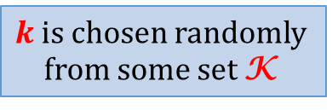
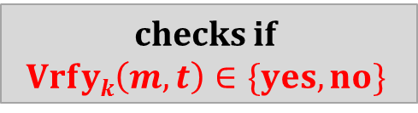





Message Authentication Codes
$$(m, t=Tagk(m))$$
checks if $$Vrfyk\left(m,t\right)∈\{yes,no\}$$
$$m$$
$$Alice$$
Bob
$$k$$
$$k$$
$k$ is chosen randomly from some set K

Slide 5

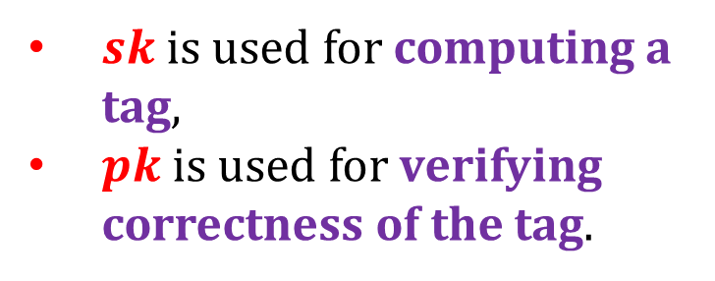

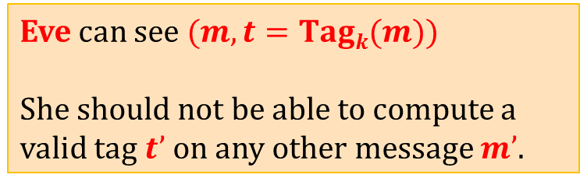



Signatures
this will be called “signatures”
Sign – the signing algorithm
$sk$is used for computing a tag,
$pk$is used for verifying correctness of the tag.
$$m$$
$$(m,t :=Tag(k,m))$$
$$Vrfy(k,m,t)$$
Alice
$$(m,t :=Sign(sk,m))$$
Bob
$$Vrfy(pk,m,t)$$
$$k$$
$$sk$$
$$k$$
$$pk$$
$$\left(pk,sk\right)←Gen\left(1^{n}\right)$$

Slide 6
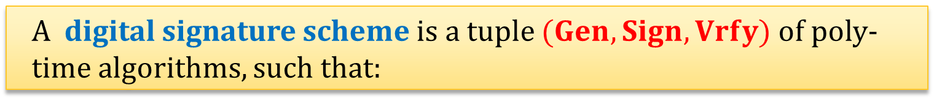
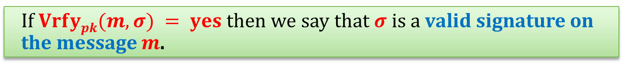
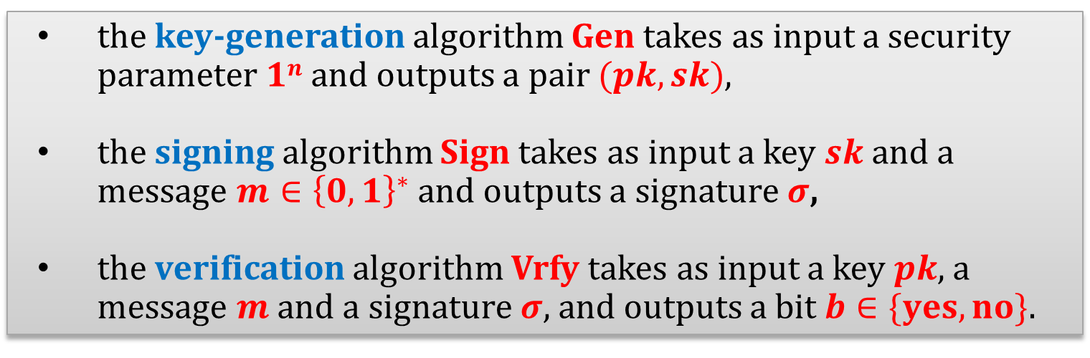
Digital Signature Schemes
A digital signature scheme is a tuple $(Gen,Sign,Vrfy)$of poly-time algorithms, such that:
the key-generation algorithm Gen takes as input a security parameter $1n$ and outputs a pair $(pk,sk)$,
the signing algorithm Sign takes as input a key $sk$ and a message $m∈{\left\{0,1\right\}}^{∗}$and outputs a signature $σ$,
the verification algorithm Vrfy takes as input a key $pk$, a message $m$ and a signature $σ$, and outputs a bit $b∈\{yes, no\}$.
If $Vrfypk(m,σ) = yes$then we say that $σ$ is a valid signature on the message $m$.

Slide 7
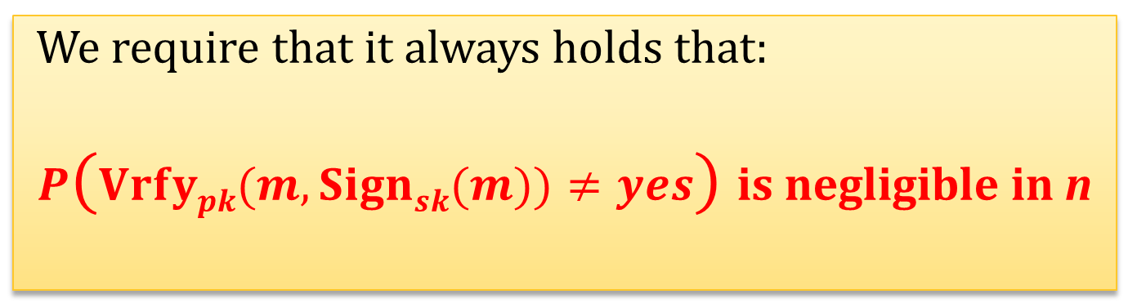
Correctness
We require that it always holds that:
$P(Vrfypk(m,Signsk(m))≠yes)$ is negligible in n
What remains is to define security.

Slide 8
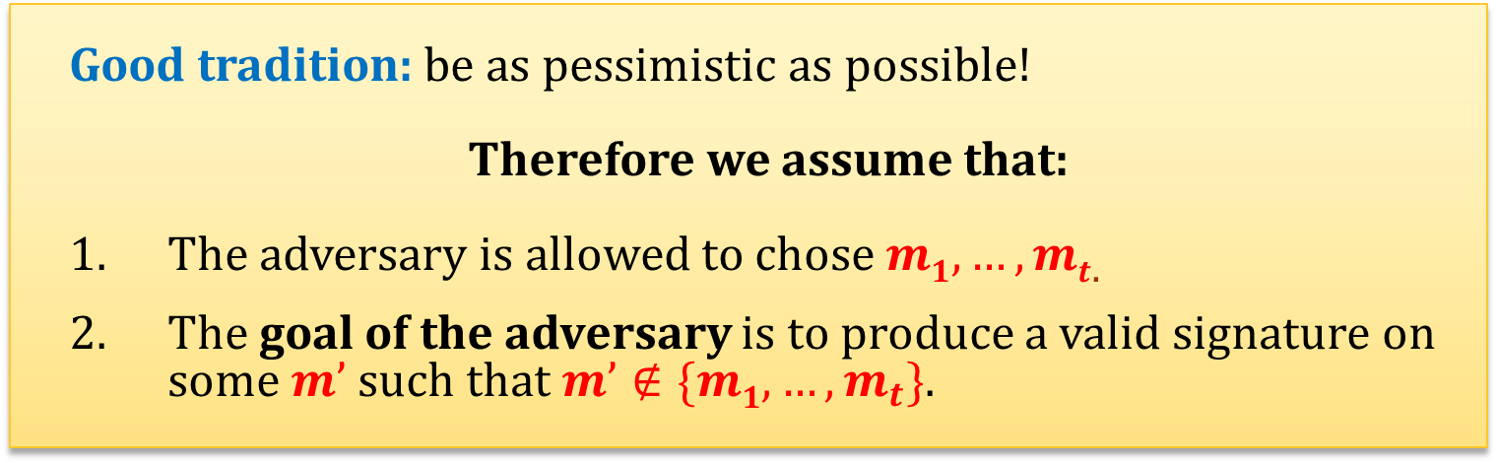
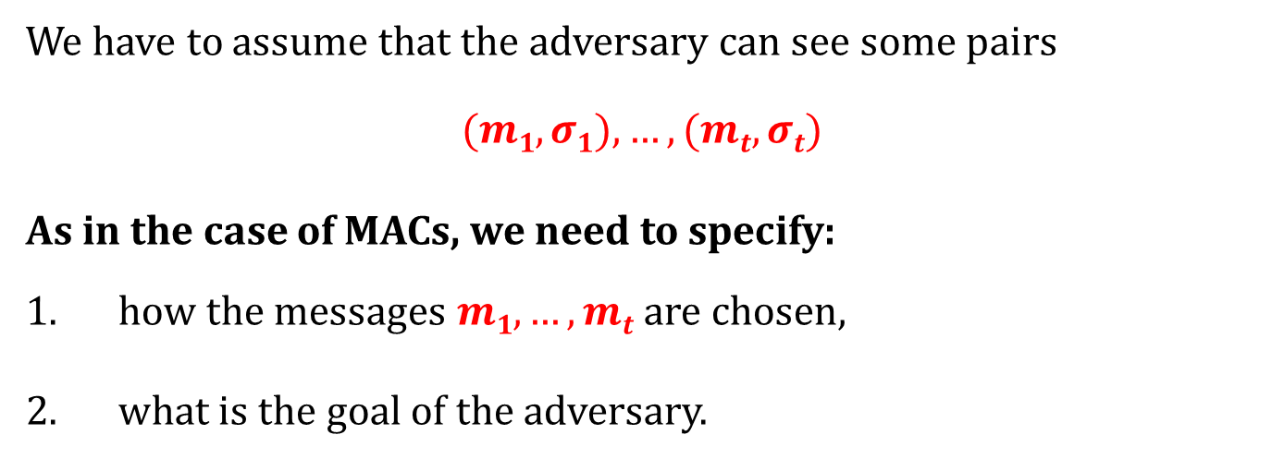
How to define security?
We have to assume that the adversary can see some pairs
$$(m1,σ1),…, (mt,σt)$$
As in the case of MACs, we need to specify:
how the messages $m1,…,mt$are chosen,
what is the goal of the adversary.
Good tradition: be as pessimistic as possible!
Therefore we assume that:
The adversary is allowed to chose $m1,…,mt$.
The goal of the adversary is to produce a valid signature on some $m’$ such that $m’∉\{m1,…,m_{t}\}$.

Slide 9






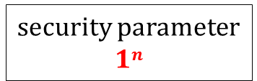
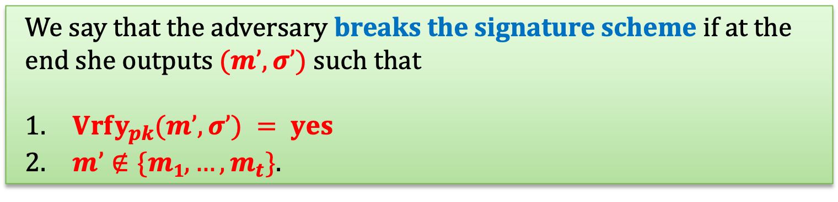

security parameter
$$1n$$
selects $\left(pk,sk\right)←Gen(1n)$
$$pk$$
adversary
$$m1$$
$$Signsk(m1)$$
oracle
$$. . .$$
$$mt$$
$$Sign_{sk}\left(m_{t}\right)$$
We say that the adversary breaks the signature scheme if at the end she outputs $(m’, σ’)$such that
$Vrfy_{pk}(m’, σ’) = yes$
$m’∉\{m1,…,m_{t}\}$.

Slide 10

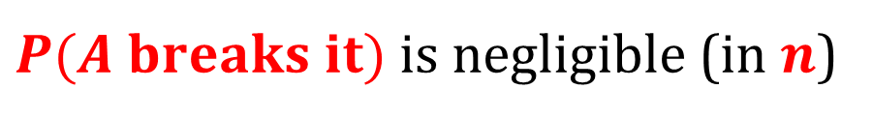
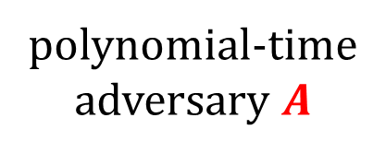

The security definition
sometimes we just say: unforgeable (if the context is clear)
We say that $(Gen,Sign,Vrfy)$is existentially unforgeable under an adaptive chosen-message attack if
$$∀$$
$P(A breaks it)$is negligible (in $n$)
polynomial-time adversary $A$

Slide 11
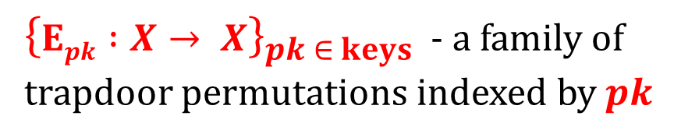
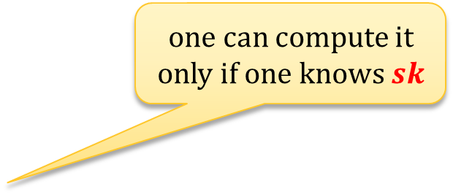


How to construct signature schemes?
Remember this idea?
${\left\{Epk :X→ X\right\}}_{pk ∈ keys }$ - a family of trapdoor permutations indexed by $pk$
one can compute it only if one knows $sk$
signing:
signatures
messages
$$σ≔Dsk(m)$$
verifying:
$$Epk(σ)$$
compare the result
We said: In general it’s not that simple.

Slide 12
In general it’s not that simple
Not every trapdoor permutation is OK.
example: the RSA function
There exist other ways to create signature schemes.
One can even construct a signature scheme from any one-way function. (this is a theoretical construction)

Slide 13
Plan
The definition of secure signature schemes
Signatures based on RSA, “hash-and-sign”, “full-domain-hash”
Constructions based on discrete log
identification schemes
Schnorr signatures
DSA signatures
Theoretical constructions

Slide 14
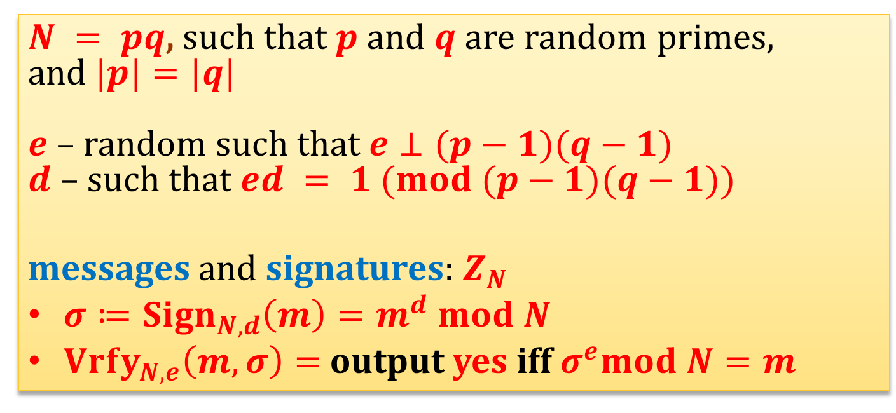
The “handbook RSA signatures”
$N = pq$, such that $p$and $q$ are random primes,
and $|p|=|q|$
$e$ – random such that $e⊥(p−1)(q−1)$
$d$ – such that $ed = 1 (mod (p−1)(q−1))$
messages and signatures: $Z_{N}$
$σ≔Sign_{N,d}\left(m\right)=m^{d} mod N$
$Vrfy_{N,e}\left(m,σ\right)=$output yes iff $σ^{e}mod N=m$

Slide 15
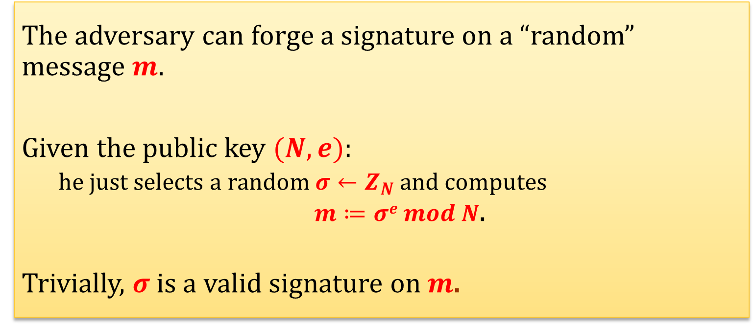
Problems with the “handbook RSA” [1/2]
“no-message attack”:
The adversary can forge a signature on a “random” message $m$.
Given the public key $(N,e)$:
he just selects a random $σ←Z_{N}$and computes
$m≔σe mod N$.
Trivially, $σ$ is a valid signature on $m$.

Slide 16


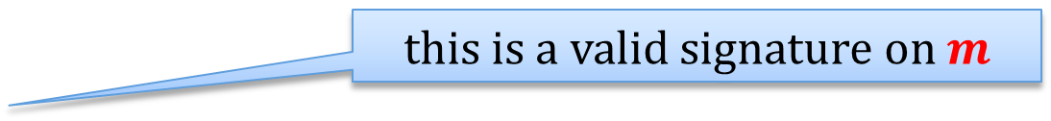

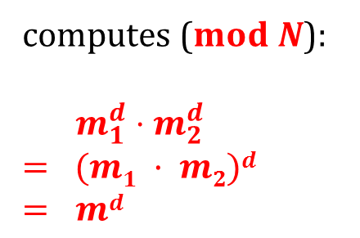


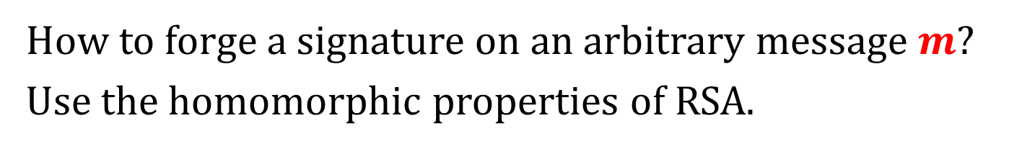
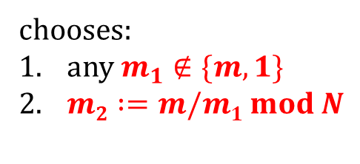
Problems with the “handbook RSA” [2/2]
How to forge a signature on an arbitrary message $m$?
Use the homomorphic properties of RSA.
$$(N,e)$$
adversary
$$m1$$
chooses:
any $m_{1}∉\{m,1\}$
$m2 :=m/m1 mod N$
$$Signsk(m1) = m_{1}^{d} mod N$$
oracle
$$m2$$
$$Signsk(m2) = m_{2}^{d} mod N$$
computes ($mod N$):
$$m_{1}^{d}⋅m_{2}^{d}$$
$$= (m1 · m2)d$$
$$= md$$
this is a valid signature on $m$

Slide 17
Is it a problem?
In many applications – probably not.
But we would like to have schemes that are not application-dependent...

Slide 18
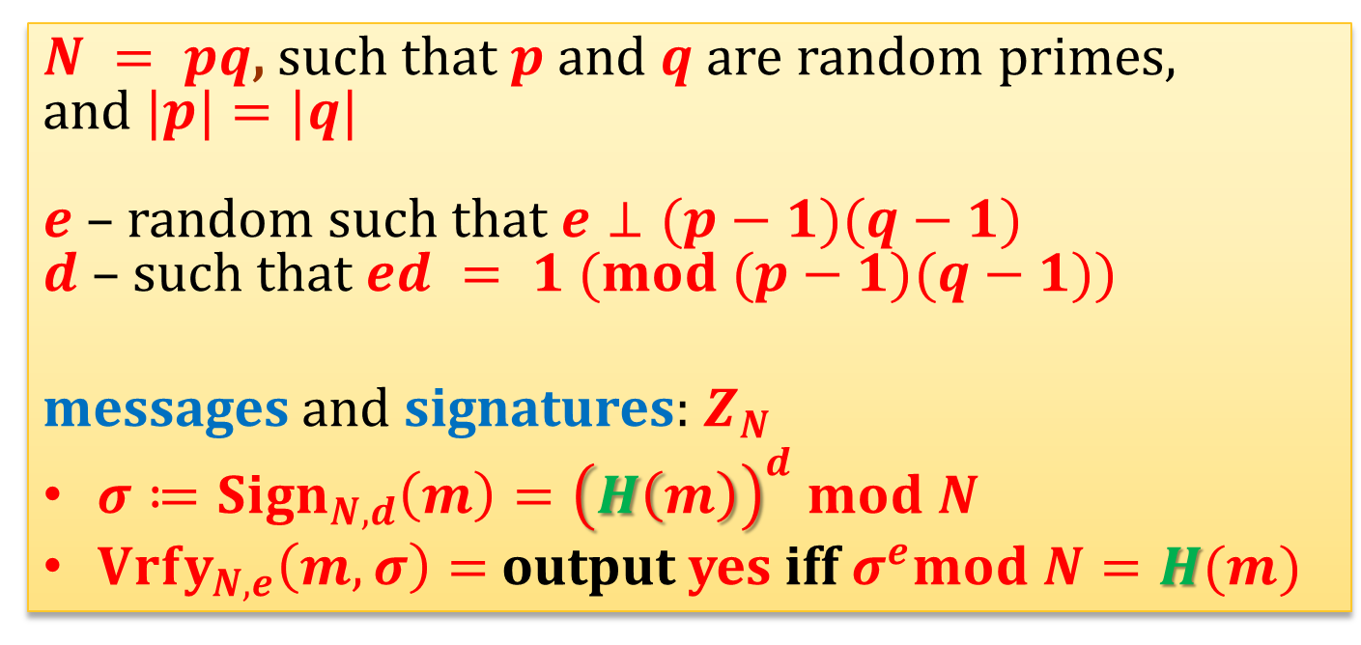
Solution
Before computing the RSA function – apply some function $H$.
$N = pq$, such that $p$and $q$ are random primes,
and $|p|=|q|$
$e$ – random such that $e⊥(p−1)(q−1)$
$d$ – such that $ed = 1 (mod (p−1)(q−1))$
messages and signatures: $Z_{N}$
$σ≔Sign_{N,d}\left(m\right)={\left(H\left(m\right)\right)}^{d} mod N$
$Vrfy_{N,e}\left(m,σ\right)=$output yes iff $σ^{e}mod N=H(m)$

Slide 19
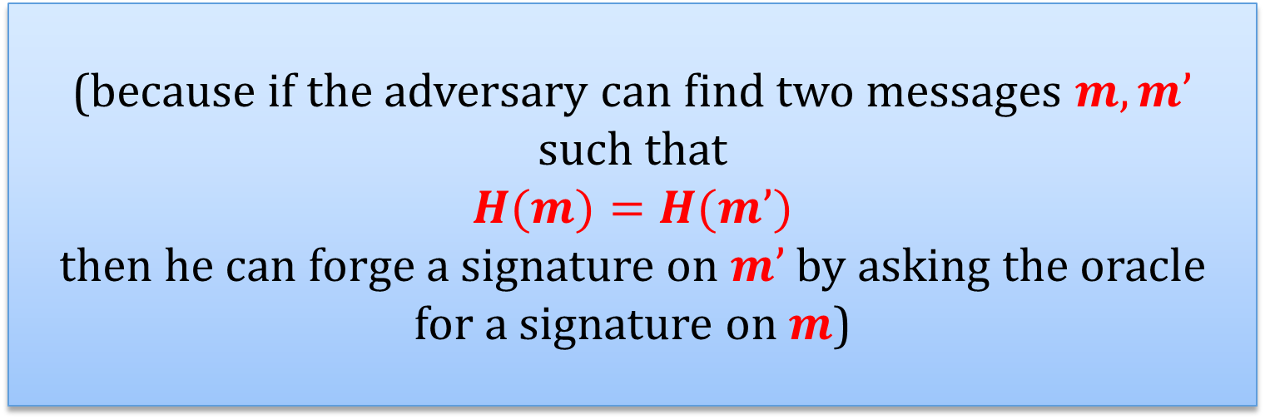
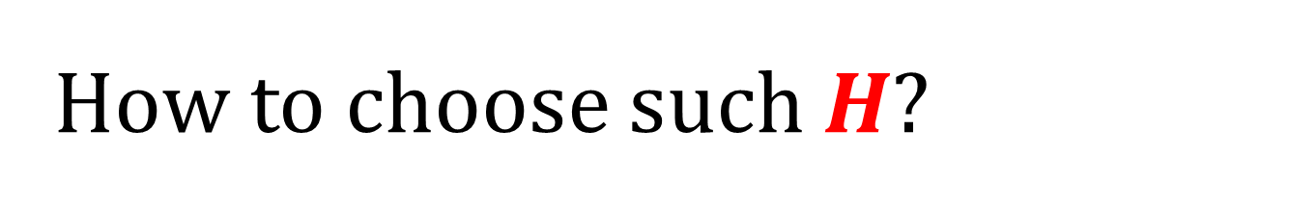
How to choose such $H$?
A minimal requirement:
it should be collision-resistant.
(because if the adversary can find two messages $m,m’$ such that
$$H(m)=H(m’)$$
then he can forge a signature on $m’$ by asking the oracle for a signature on $m$)

Slide 20
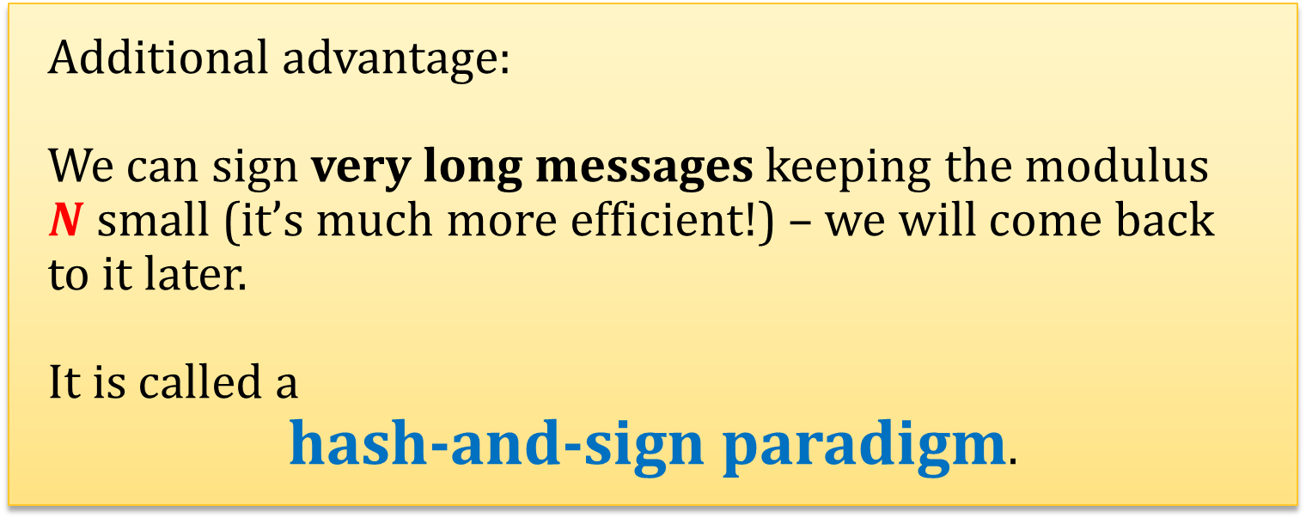
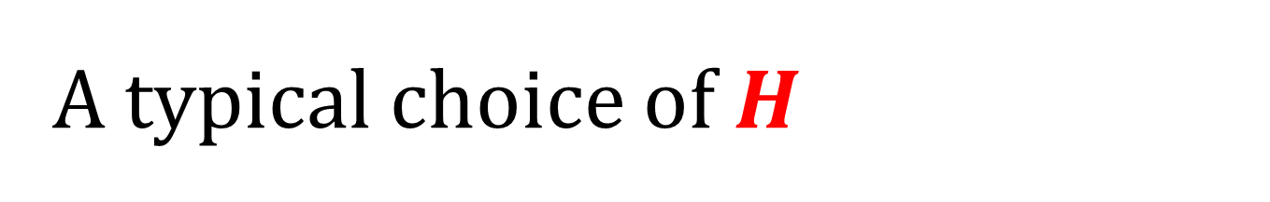
A typical choice of $H$
Usually $H$ is one of the popular hash functions.
Additional advantage:
We can sign very long messages keeping the modulus $N$ small (it’s much more efficient!) – we will come back to it later.
It is called a
hash-and-sign paradigm.

Slide 21

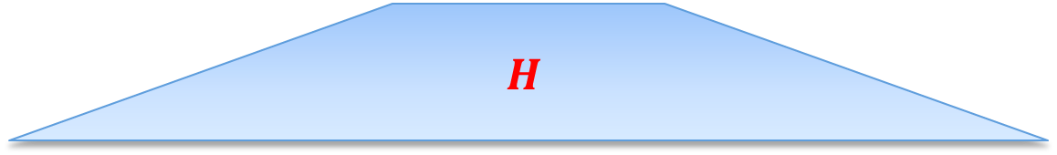

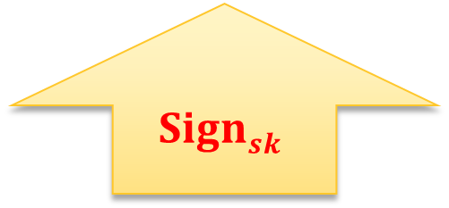
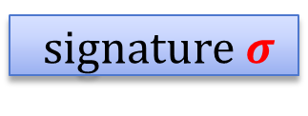

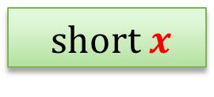


Hash-and-Sign [1/4]
1. $(Gen,Sign,Vrfy)$– a signature scheme “for short messages”
signature $σ$
$$yes / no$$
$$Signsk$$
$$Vrfypk$$
short $x$
$σ$
$$x$$
2. a hash function $H$
$$H(m)$$
$$H$$
$$m$$

Slide 22

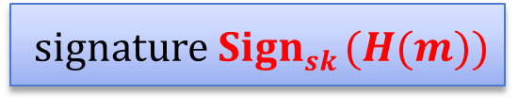

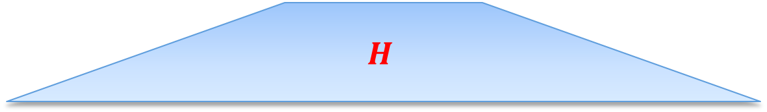

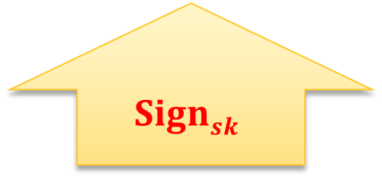
Hash-and-Sign [2/4]
How to sign a message $m$?
signature $Signsk (H(m))$
$$Signsk$$
$$H(m)$$
$$H$$
$$m$$

Slide 23


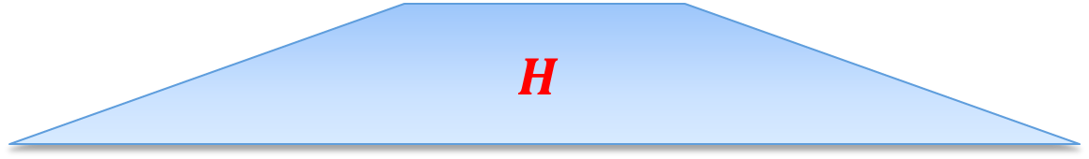

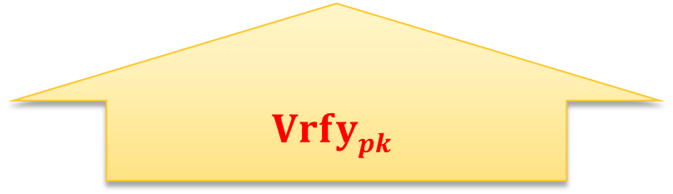
Hash-and-Sign [3/4]
How to verify?
yes / no
$$Vrfypk$$
$$σ$$
$$H(m)$$
$$H$$
$$m$$

Slide 24
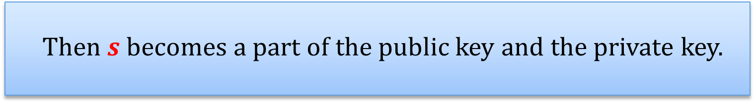
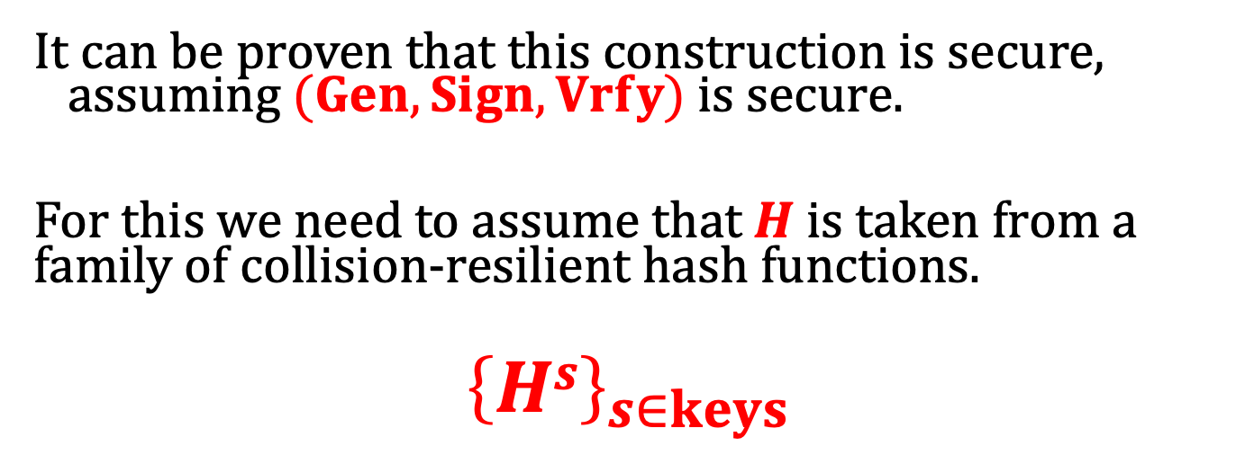
Hash-and-Sign [4/4]
It can be proven that this construction is secure, assuming $(Gen,Sign,Vrfy)$ is secure.
For this we need to assume that $H$ is taken from a family of collision-resilient hash functions.
$${\left\{Hs\right\}}_{s∈keys}$$
Then $s$becomes a part of the public key and the private key.

Slide 25
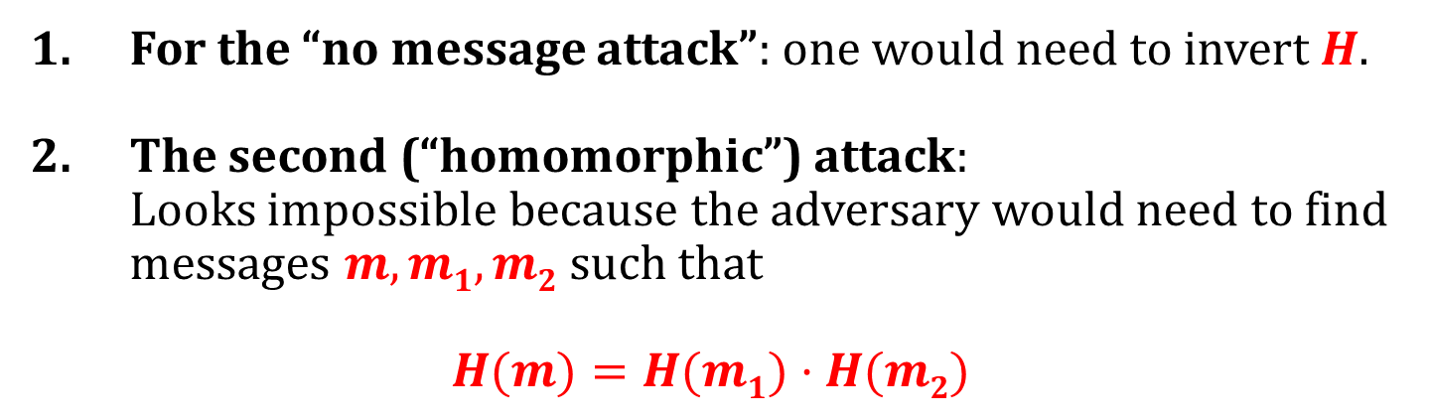
Can anything be proven about the “hashed RSA” scheme?
In the plain model - not really.
But at least the attacks described before “look infeasible”.
For the “no message attack”: one would need to invert $H$.
The second (“homomorphic”) attack: Looks impossible because the adversary would need to find messages $m,m1,m2$ such that
$$H(m)=H(m1)·H(m2)$$

Slide 26


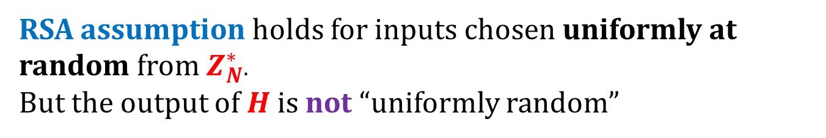

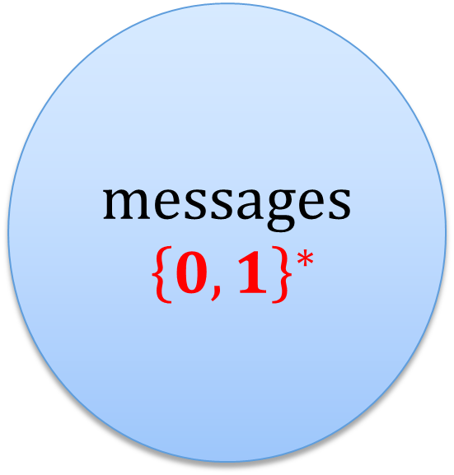
Why the security proof from the RSA assumption is impossible?
RSA assumption holds for inputs chosen uniformly at random from $Z_{N}^{∗}$.
But the output of $H$ is not “uniformly random”
messages
${\left\{0,1\right\}}^{∗}$
$$Z_{N}^{∗}$$
$$H:{\left\{0,1\right\}}^{∗}→Z_{N}^{∗}$$
$$H\left({\left\{0,1\right\}}^{∗}\right)$$

Slide 27
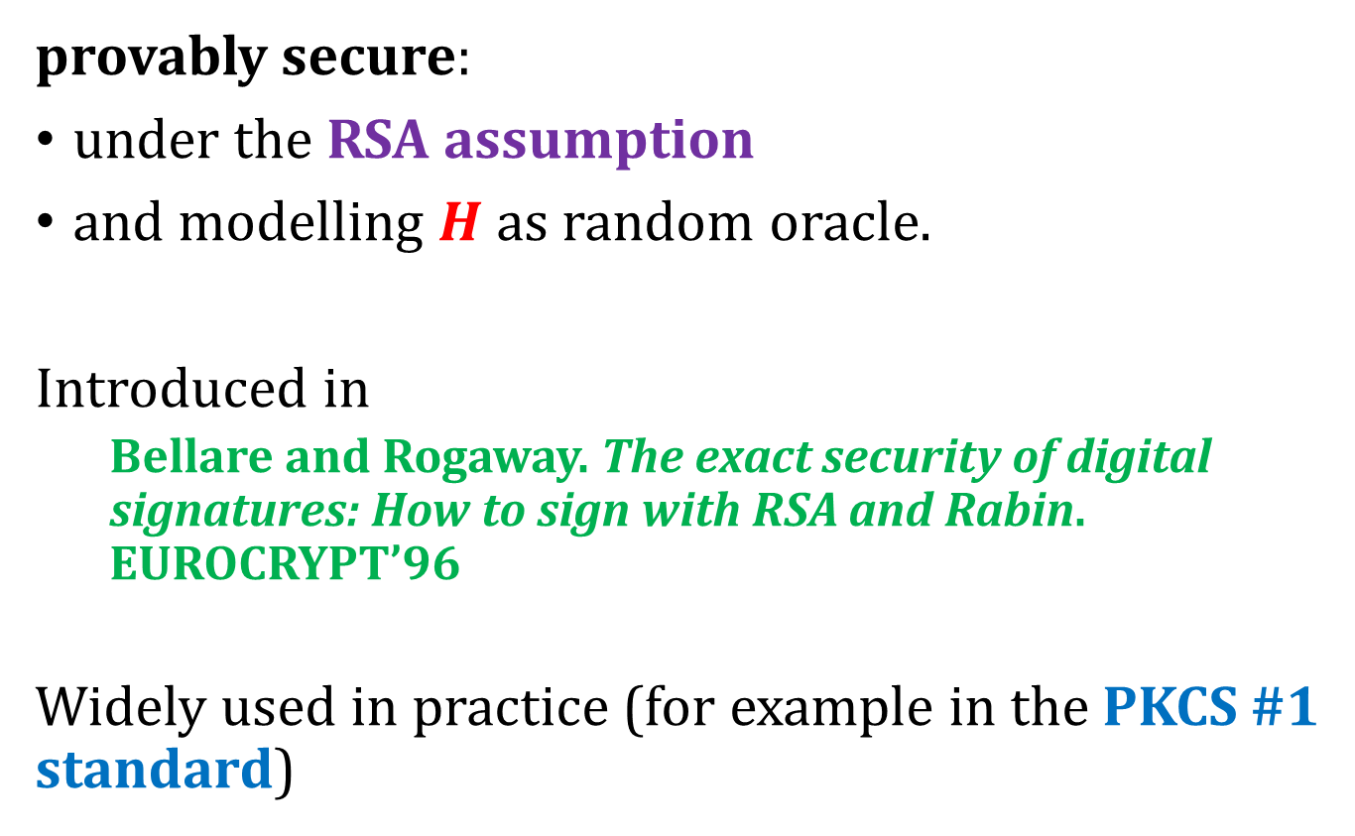
Solution: “Full Domain Hash” (FDH)
provably secure:
under the RSA assumption
and modelling $H$as random oracle.
Introduced in
Bellare and Rogaway. The exact security of digital signatures: How to sign with RSA and Rabin. EUROCRYPT’96
Widely used in practice (for example in the PKCS #1 standard)

Slide 28
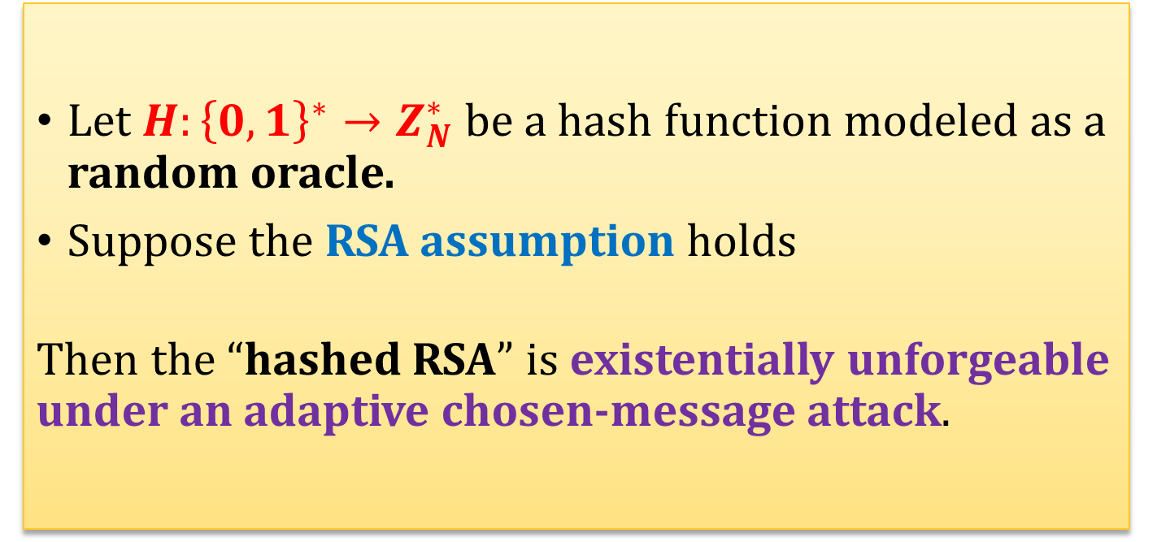
Fact (security of the Full Domain Hash)
Lemma (informal)
Let $H:{\left\{0,1\right\}}^{∗}→Z_{N}^{∗}$ be a hash function modeled as a random oracle.
Suppose the RSA assumption holds
Then the “hashed RSA” is existentially unforgeable under an adaptive chosen-message attack.

Slide 29




Remember the Random Oracle Model?
$$x$$
$$H(x)$$
a completely random function
$$H : {\left\{0,1\right\}}^{∗}→ \{0,1\}L$$

Slide 30
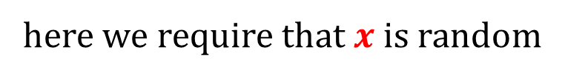
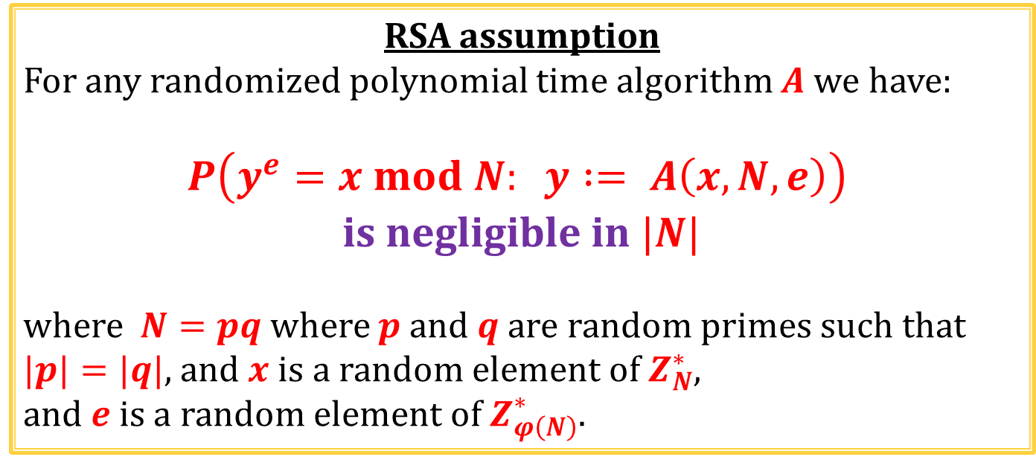
Why does it help?
RSA assumption
For any randomized polynomial time algorithm $A$ we have:
$$P\left(y^{e}=x mod N: y := A\left(x,N,e\right)\right)$$ is negligible in $|N|$
where $N=pq$where $p$ and $q$ are random primes such that $|p|=|q|$, and $x$ is a random element of $Z_{N}^{∗}$,
and $e$ is a random element of $Z_{φ\left(N\right)}^{∗}$.
here we require that $x$ is random

Slide 31
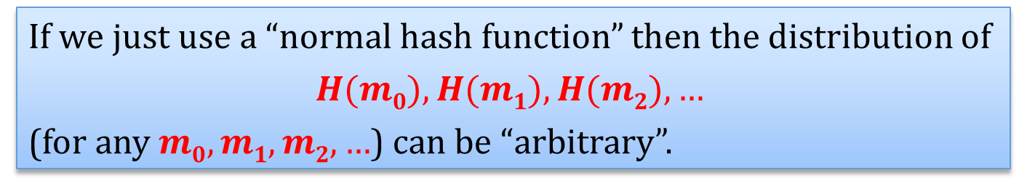
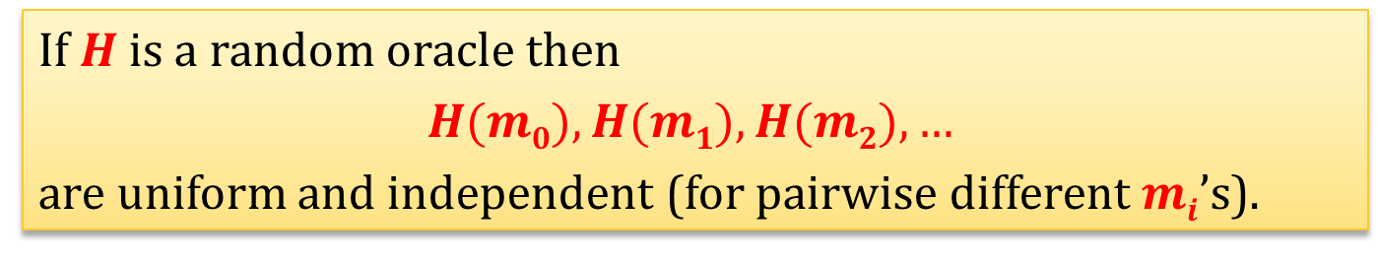
Intuition
If we just use a “normal hash function” then the distribution of
$$H(m0),H(m1),H(m2),…$$
(for any $m0,m1,m2,…$) can be “arbitrary”.
If $H$ is a random oracle then
$$H(m0),H(m1),H(m2),…$$
are uniform and independent (for pairwise different $mi$’s).
This helps a lot in the proof!

Slide 32
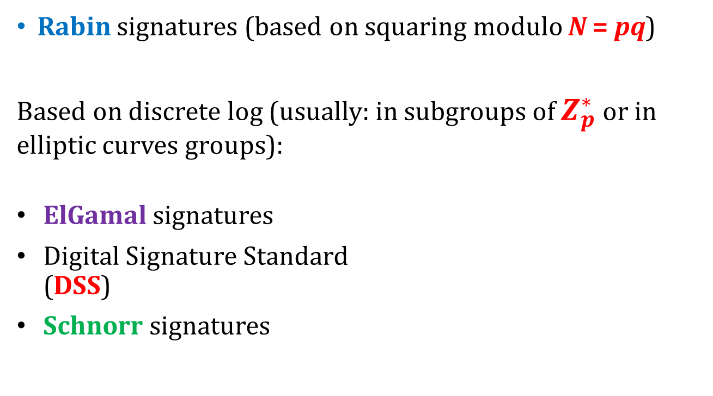
Other popular signature schemes
Rabin signatures (based on squaring modulo N = pq)
Based on discrete log (usually: in subgroups of $Z_{p}^{∗}$ or in elliptic curves groups):
ElGamal signatures
Digital Signature Standard (DSS)
Schnorr signatures
can be viewed as
identification schemes transformed using Fiat-Shamir transform.
we will explain it

Slide 33
Plan
The definition of secure signature schemes
Signatures based on RSA, “hash-and-sign”, “full-domain-hash”
Constructions based on discrete log
identification schemes
Schnorr signatures
DSA signatures
Theoretical constructions

Slide 34




Identification schemes
$\left(pk,sk\right)←Gen(1^{n})$– a (public key, private key) pair of prover
Everybody who knows $pk$ can verify the identity of the prover
$$pk$$
$$sk$$
prover
verifier
yes if he believes he is talking to the prover
verifier’s output:
no – otherwise

Slide 35
Definition
We do not define identification schemes formally.
Informally they have to satisfy the following:
[correctness] an honest prover should always convince the verifier
[security] no poly-time adversary should be able to impersonate the prover with non-negligible probability.

Slide 36




What is the attack model?
Let’s assume it’s rather weak:
“learning phase”:
transcript
$$T$$
$$sk$$
prover
verifier
the adversary learns as many transcripts $T_{1},T_{2},…$ as she wants
$$pk$$

Slide 37

Then he has to win in the following game
“challenge phase”:
the adversary does not know $sk$ but has access to transcripts
verifier
the adversary wins if the verifier outputs yes

Slide 38
Note
The adversary cannot talk to the prover during the learning phase.
The adversary cannot act as a man-in-the middle.
(these problems can be solved, but are not relevant today)
We will come back again to these protocols when we talk about zero-knowledge.

Slide 39


Schnorr identification scheme
Key generation similar to the one in ElGamal encryption
Let $GenG$ be such that discrete log is hard w. r. t. $GenG$.
$Gen(1n)$ first runs GenG to obtain $G,g$ and $q$ (assume $q$is prime). Then, it chooses $x←Zq$and computes $y:=gx$.
The public key is $(G,g,q,y)$.
The private key is $(G,g,q,x)$.

Slide 40










The protocol
$G$ – group, $q=|G|$
$g$ – generator
knows $x$
knows
$$y :=gx$$
prover
verifier
$$k←Z_{q}$$
$$I≔g^{k}$$
$$I$$
$$r←Z_{q}$$
$$r$$
$$s≔rx+k mod q$$
$$s$$
output yes iff
$$g^{s}⋅y^{−r}=I$$

Slide 41









Why is this protocol correct?
$$y :=gx$$
$$k←Z_{q}$$
$$I≔g^{k}$$
$$I$$
$$r←Z_{q}$$
$$r$$
$$s≔rx+k mod q$$
$$s$$
output yes iff
$$g^{s}⋅y^{−r}=I$$
$$g^{s}⋅y^{−r}=g^{rx+k}⋅{\left(g^{x}\right)}^{−r}$$
$$=g^{rx+k}⋅g^{−rx}$$
$$=g^{k}$$
$=I$

Slide 42





Security
First, suppose the adversary didn’t see any transcript. He has to win the following game.
verifier
$$I$$
$$r←Z_{q}$$
$$r$$
$$s$$
output yes iff
$$g^{s}⋅y^{−r}=I$$

Slide 43


Lemma
If discrete logarithm is hard with respect to $GenG$ then the probability that any poly-time adversary wins this game is negligible.
How to prove it?
We show that for every $I$there exists at most one $r∈Z_{q}$ such that the adversary can answer it correctly (if she cannot compute the discrete log).
(so: his probability of winning is at most $1/q$)

Slide 44


Proof by contradiction
Assume there exist $r_{0}$ and $r_{1}$ such that $r_{0}≠r_{1}$ and that the adversary knows answers
$s_{0}$ to $r_{0}$ and
$s_{1}$ to $r_{1}$
where
$g^{s_{0}}⋅y^{−r_{0}}=I=g^{s_{1}}⋅y^{−r_{1}}$.
But then
$$y^{r_{1}−r_{0}}=g^{s_{1}−s_{0}}$$
so
$$y=g^{\frac{{s_{1}−s}_{0}}{r_{1}−r_{0}}}$$
$$=log_{g}y$$
This finishes the proof of the lemma.

Slide 45

To finish the full security proof we need to show the following
Learning the transcripts
$(I,r,s)$
doesn’t help the adversary.
Q: Why is it true?
A: It turns out that the adversary can “simulate” such transcripts himself (just from $pk$).
We now explain it.

Slide 46

How do the transcripts look like?
$(I,r,s)$
where
$I=g^{k}$ where $k←Z_{q}$
$r←Z_{q}$
$s≔rx+k mod q$
We now show that:
the transcripts with exactly the same distribution can be sampled by the adversary himself!

Slide 47



How can the adversary do it?
first sample $r,s←Z_{q}$ and
then compute $I$as
$$I=g^{s}{⋅y}^{−r}$$
Why is the distribution the same?
this is computed
this is sampled
$${I≔g}^{k}$$
$$r$$
$$s$$
this is sampled
this is computed
such that
$$s≔rx+k mod q$$
It’s the same!

Slide 48



Therefore
transcript
$$T$$
$$sk$$
prover
verifier
access to the transcripts does not change anything!
$$pk$$

Slide 49

Note the difference
The adversary can produce tuples $(I,r,s)$ with the right distribution
if he “starts from $(r,s)$”
but he cannot do it
if he has to “start from $I$” and sampling $r$ is out of his control.

Slide 50
Conclusion
The Schnorr protocol is a secure identification scheme.
But how is this related to the signature schemes?
We now show how to transform any such identification scheme into a signature scheme.

Slide 51
Plan
The definition of secure signature schemes
Signatures based on RSA, “hash-and-sign”, “full-domain-hash”
Constructions based on discrete log
identification schemes
Schnorr signatures
DSA signatures
Theoretical constructions

Slide 52








Fiat-Shamir transform: main idea
Suppose we have an identification protocol of this form:
$$\left(pk,sk\right)←Gen(1^{n})$$
$$pk$$
$$sk$$
prover
$$I$$
verifier
technical assumption:
$I$ is “reasonably long”, say:
$\left|I\right|=Ω(n)$
random $r$
$$s≔P(I,r)$$
compute some value $V(r,s)$ from $r$ and $s$ and accept iff $V(r,s)=I$.

Slide 53









Create a signature scheme as follows
Let $H:{\left\{0,1\right\}}^{∗}→{\left\{0,1\right\}}^{|r|}$ be a hash function (modelled as a random oracle)
key pair generation – as in the authentication protocol
To sign a message $m$ the signing algorithm simulates the execution of the identification scheme:
the verifier is “simulated using $H$“
$$Sign(sk,m)$$
$$I$$
$$sk$$
$$r=H(I,m)$$
$$r$$
$$s$$
output $(r,s)$

Slide 54











How to verify?
$$Sign(sk,m)$$
$$I$$
$$sk$$
$$r=H(I,m)$$
$$r$$
$$s$$
output $(r,s)$
$$Vrfy(pk,m,\left(r,s\right))$$
Assuming $I$ is such that $\left(I,r,s\right)$ “is a correct transcript” check if $r$ was computed correctly. That is:
let $I=V(r,s)$
and check if $r=H\left(I,m\right)$
equivalent
check if
$$r=H\left(V(r,s),m\right)$$
output yes iff $r=H\left(I,m\right)$

Slide 55


More formally
$Gen$ – the same as in the identification scheme
$Sign\left(sk,m\right)=(r,s)$, computed by simulating the prover or random input as follows:
let $I$ be the “first message of the prover”
let $r≔H(I,m)$
let $s≔P\left(I,r\right)$ be the “second message of the prover” (after receiving $r$)
output $(r,s)$
$Vrfy(pk,m,\left(r,s\right))$:
output yes iff $r=H(V(r,s),m)$.

Slide 56
Why does it work?
Correctness is trivial – if the signer is honest then the verifier will always accept.
What about security?

Slide 57



Security
First look at the learning phase:
In the identification scheme the adversary learns $pk$ and can see many tuples of a form:
$(I,r,s)$
sampled as follows:
random $I$
random $r$
$s≔P(I,r)$
In the signature scheme the adversary learns $pk$ and can see many tuples of a form:
$(I,r,s)$
sampled as follows:
random $I$
$r≔H(I,m)$
$s≔P(I,r)$
difference
Note:
the adversary chooses $m$ but she cannot choose $I$, so by the properties of the random oracle: $r$ is completely random.
Moral:
these two experiments are identical!

Slide 58





Now look at the challenge phase
To break the authentication scheme the adversary has to
find $I$ such that
after learning random $r$
she can find $s$
such that:
$$V\left(r,s\right)=I$$
In the signature scheme the adversary has to find $(r,s)$ such that
$r=H(I,m)$,
where $I=V(r,s)$.
since $H$ is a random oracle
it’s the same!
She has to:
choose the value of $I$ first,
then she learns $r=H(I,m)$,
and she has to find $s$ such
$$V\left(r,s\right)=I$$
because if he chooses $r$ first she will not be able to find the right $I$ (remember that $I$ is long)

Slide 59
Using this method we can construct signature schemes
For example:
Schnorr’s identification scheme
Fiat-Shamir paradigm
Schnorr’s signature scheme

Slide 60




Schnorr’s signature scheme
$Gen(1n)$ run GenG to obtain $G,g$ and $q$ (assume $q$is prime). Then, choose $x←Zq$and computes $y:=gx$.
The public key $pk$is $(G,g,q,y)$.
The private key $sk$is $(G,g,q,x)$.
$$Sign\left(sk,m\right):$$
choose uniform $k←Z_{q}$ and let ${I≔g}^{k}$
compute $r≔H(I,m)$
compute $s≔rx+k mod q$
output $(r,s)$
$$Vrfy\left(pk,m,\left(r,s\right)\right):$$
output yes if $r=H\left(g^{s}⋅y^{−r},m\right) \text{.}$
By the way: It is important to check if the parameters $G$ and $g$ agree (“parameter validation”). (see “Windows CryptoAPI Spoofing Vulnerability” discovered in Jan 2020 by the NSA)

Slide 61
Plan
The definition of secure signature schemes
Signatures based on RSA, “hash-and-sign”, “full-domain-hash”
Constructions based on discrete log
identification schemes
Schnorr signatures
DSA signatures
Theoretical constructions

Slide 62
DSS signatures (also called DSA)
based on a paradigm similar to Schnorr’s signatures
can also be viewed as a variant of ElGamal signatures (1984)
DSS was covered by an (expired) U.S. Patent 5,231,668 (1991) granted to the US government (available worldwide royalty-free)
Schnorr claimed that his U.S. Patent 4,995,082 (1989) covered DSA – this claim is disputed, and anyway it expired in 2008.
very widely used in practice!
[we will present this scheme during the exercises]

Slide 63

Note
In Schnorr and DSS signatures it’s very important that the signer’s randomness is generated properly [exercise].
Failure to do so can have catastrophic effects:

Slide 64
Plan
The definition of secure signature schemes
Signatures based on RSA, “hash-and-sign”, “full-domain-hash”
Constructions based on discrete log
identification schemes
Schnorr signatures
DSA signatures
Theoretical constructions

Slide 65
Signatures schemes can be constructed from any one-way function
another member of minicrypt!
signature schemes exist
one way functions exist

Slide 66








One-time signatures (Leslie Lamport)
How to sign one bit?
$f$– a one way function
private key
public key
random $x_{0}$
$$f$$
$$y0=f(x0)$$
random $$x_{1}$$
$$f$$
$$y1=f(x1)$$
$$Sign\left(\left(x0,x1\right), b\right) = xb$$
$$Vrfy\left(\left(y0,y1\right), b,x\right) = yes iff f(x) = yb$$

Slide 67





Why is it secure?
To forge a signature on bit $b$ the adversary needs to calculate $xb$ from $yb$
$$xb$$
$$f$$
$$yb=f(xb)$$
This should be infeasible, since $f$ is one-way...

Slide 68

Constructing Digital Signatures from a One Way Function SRI International Technical Report CSL-98 (October 1979).
At a coffee house in Berkeley around 1975, Whitfield Diffie described a problem to me that he had been trying to solve: constructing a digital signature for a document. I immediately proposed a solution. Though not very practical--it required perhaps 64 bits of published key to sign a single bit--it was the first digital signature algorithm.
In 1978, Michael Rabin published a paper titled Digitalized Signatures containing a more practical scheme for generating digital signatures of documents. (I don't remember what other digital signature algorithms had already been proposed.) However, his solution had some drawbacks that limited its utility.
[...] I didn't feel that it added much to what Rabin had done. However, I've been told that this paper is cited in the cryptography literature and is considered significant, so perhaps I was wrong.
from: research.microsoft.com/en-us/um/people/lamport/
what about the RSA ???
Lamport

Slide 69







How to sign longer messages?
We show a one-time signature scheme (one public key can be used at most once).
$f$– one way function
$n$ – length of the message
private key $sk$:
public key $pk$:
$$x_{0,1}$$ | $$. . .$$ | $$x_{0,n}$$
$$x_{1,1}$$ | $$. . .$$ | $$x_{1,n}$$
$$y_{0,1}=f(x_{0,1})$$ | $$. . .$$ | $$y_{0,n}=f(x_{0,n})$$
$$y_{1,1}=f(x_{1,1})$$ | $$. . .$$ | $$y_{1,n}=f(x_{1,n})$$
all $xij$’s are random strings
$$SignLamport \left(sk,\left(m_{0},…,m_{n}\right)\right)≔\left(x_{m_{0}},…,x_{m_{n}}\right)$$
$$Vrfy_{Lamport}\left(pk,\left(m_{0},…,m_{n}\right),\left(x_{m_{0}},…,x_{m_{n}}\right)\right) ≔$$
check if $\left(f\left(xm0\right),…,f\left(xmn\right)\right) = \left(ym0,…,ymn\right)$

Slide 70



Example
$$n=6$$
$$m = (1,0,1,1,0,0)$$
private key:
$$x_{0,1}$$ | $$x_{0,2}$$ | $$x_{0,3}$$ | $$x_{0,4}$$ | $$x_{0,5}$$ | $$x_{0,6}$$
$$x_{1,1}$$ | $$x_{1,2}$$ | $$x_{1,3}$$ | $$x_{1,4}$$ | $$x_{1,5}$$ | $$x_{1,6}$$
public key:
$${f(x}_{0,1})$$ | $${f(x}_{0,2})$$ | $${f(x}_{0,3})$$ | $${f(x}_{0,4})$$ | $${f(x}_{0,5})$$ | $${f(x}_{0,6})$$
$${f(x}_{1,1})$$ | $${f(x}_{1,2})$$ | $${f(x}_{1,3})$$ | $${f(x}_{1,4})$$ | $${f(x}_{1,5})$$ | $${f(x}_{1,6})$$
signature:
$$x_{1,1}$$ | $$x_{0,2}$$ | $$x_{1,3}$$ | $$x_{1,4}$$ | $$x_{0,5}$$ | $$x_{0,6}$$

Slide 71



Why each key can be used at most once?
private key:
$$x_{0,1}$$ | $$x_{0,2}$$ | $$x_{0,3}$$ | $$x_{0,4}$$ | $$x_{0,5}$$ | $$x_{0,6}$$
$$x_{1,1}$$ | $$x_{1,2}$$ | $$x_{1,3}$$ | $$x_{1,4}$$ | $$x_{1,5}$$ | $$x_{1,6}$$
signature:
$$x_{1,1}$$ | $$x_{0,2}$$ | $$x_{1,3}$$ | $$x_{1,4}$$ | $$x_{0,5}$$ | $$x_{0,6}$$
knows
private key:
$$x_{0,1}$$ | $$x_{0,2}$$ | $$x_{0,3}$$ | $$x_{0,4}$$ | $$x_{0,5}$$ | $$x_{0,6}$$
$$x_{1,1}$$ | $$x_{1,2}$$ | $$x_{1,3}$$ | $$x_{1,4}$$ | $$x_{1,5}$$ | $$x_{1,6}$$
signature:
$$x_{1,1}$$ | $$x_{1,2}$$ | $$x_{1,3}$$ | $$x_{0,4}$$ | $$x_{1,5}$$ | $$x_{1,6}$$
private key:
$$x_{0,1}$$ | $$x_{0,2}$$ | $$x_{0,3}$$ | $$x_{0,4}$$ | $$x_{0,5}$$ | $$x_{0,6}$$
$$x_{1,1}$$ | $$x_{1,2}$$ | $$x_{1,3}$$ | $$x_{1,4}$$ | $$x_{1,5}$$ | $$x_{1,6}$$
can
calculate
signature:
$$x_{1,1}$$ | $$x_{0,2}$$ | $$x_{1,3}$$ | $$x_{0,4}$$ | $$x_{1,5}$$ | $$x_{1,6}$$

Slide 72
Problem
Signature is much longer than the message!
(and can be used only once)

Slide 73



How to sign long messages?
Use hash functions
$$SignLamport(sk,m)$$
Sign_{Lamport}
denote it:
$$SignHL$$
hash $H$
a long message $m$

Slide 74












Idea: to sign multiple messages use “certification”
$$SignHL(sk1,m1 || pk2)$$
$$m1$$
$$pk2$$
generate a new pair
$$(sk2,pk2)$$
$$SignHL(sk2,m2 || pk3)$$
$$m2$$
$$pk3$$
generate a new pair
$$(sk3,pk3)$$
$$SignHL(sk3,m3 || pk4)$$
generate a new pair
$$(sk4,pk4)$$
$$m3$$
$$pk4$$
. . .

Slide 75


















How to verify?
The signer needs to include the “certificate chain” in the signature.
$$Sign(sk1,m1) =$$
$$SignHL(sk1,m1 || pk2)$$
verify using $pk1$
$$Sign(sk1,m2) =$$
$$SignHL(sk1,m1 || pk2)$$
$$m1 || pk2$$
verify using $pk1$
$$SignHL(sk2,m2 || pk3)$$
verify using $pk2$
$$Sign(sk1,m3) =$$
$$SignHL(sk1,m1 || pk2)$$
$$m1 || pk2$$
verify using $pk1$
$$SignHL(sk2,m2 || pk3)$$
$$m2 || pk3$$
verify using $pk2$
$$SignHL(sk3,m3 || pk4)$$
verify using $pk3$

Slide 76
Problems
The length of the signature grows linearly
The signing algorithm needs to have a state (“memory”)

Slide 77



Solution to the first problem
Instead of a chain use a binary tree:
“certify each time two public keys”
$$SignHL(sk, pk 0 || pk1)$$
$$pk0$$
$$pk1$$

Slide 78









The tree:
$$(sk,,pk)$$
$$(sk0 ,pk0)$$
$$(sk1, pk1)$$
$$(sk00 ,pk00)$$
$$(sk01 ,pk01)$$
. . .
$$(sk10 ,pk10)$$
$$(sk11,pk11)$$
$$(sk000 ,pk000)$$
$$(sk011 ,pk011)$$

Slide 79






The details
now the “chain” has length
$$|m| = t$$
$$m = (m1,…,mt)$$
start at root
if $mi=0$ go LEFT
if $mi=1$ go RIGHT
$$m1$$
$$m2$$
. . .
$$mt$$
use the key in the LEAF to sign $m$

Slide 80




























The key pairs are generated on-fly
“old” public keys have to remembered and reused
$$(sk pk)$$
$$0$$
$$1$$
$$(sk1 pk1)$$
$$(sk0 pk0)$$
$$0$$
$$1$$
$$(sk00 pk00)$$
$$(sk01 pk01)$$
$$0$$
$$1$$
$$0$$
$$1$$
$$(sk010 pk010)$$
$$(sk011 pk011)$$
$$(sk010 pk010)$$
$$(sk011 pk011)$$
$$Sign(sk,(0,1,0)) =$$
$$SignHL(sk,pk0||pk1)$$
$$SignHL(sk0,pk00||pk01)$$
$$SignHL(sk01,pk010||pk011)$$
$$SignHL(sk010,(0,1,0))$$
$$Sign(sk,(0,0,0)) =$$
$$SignHL(sk,pk0||pk1)$$
$$SignHL(sk0,pk00||pk01)$$
$$SignHL(sk00,pk000||pk001)$$
$$SignHL(sk000,(0,0,0))$$

Slide 81












Why we have to remember the old keys?
Suppose we don’t:
$$(skw pk_{w})$$
$$(skw pk_{w})$$
$$0$$
$$1$$
$$0$$
$$1$$
$$(sk_{w0} pk_{w0})$$
$$(sk_{w1} pk_{w1})$$
$$(sk_{w0} pk_{w0})$$
$$(sk_{w1}^{′} pk_{w1}^{′})$$
$$SignHL(sk_{w},pk_{w0}||pk_{w1})$$
$$SignHL(sk_{w},pk_{w0}||pk_{w1}^{′})$$
so we signed two different messages with the same key!

Slide 82

Problem
The tree is constructed on-fly, so we need to remember the state.
A stupid solution:
generate the whole tree beforehand.
A better solution:
generate the whole tree pseudorandomly and just remember the seed.

Slide 83




Remember the pseudorandom functions (PRFs)?
$$x$$
$$Fk: \{0,1\}m → \{0,1\}m$$
$$Fk(x)$$
For a random key $k$ and any $x1,…,xt$the values $$Fk(x1),…, Fk(xt)$$
“look random”

Slide 84




Solution
Take some PRF $F$
private key: $(sk,k)$
$sk$ – a private key for hashed Lamport
$k$ – a key for PRF $F$
public key:
$pk$– a public key for hashed Lamport
$$skw := Fk(w)$$
node $w$

Slide 85
We have shown that
pseudorandom functions exist
one way functions exist
hash functions exist
and
and
signature schemes exist

Slide 86
But we know that
pseudorandom functions exist
one way functions exist
hash functions exist

Slide 87
Therefore we have shown that
hash functions exist
signature schemes exist

Slide 88
The proof that
one-way functions exist
signature schemes exist
is more complicated

Slide 89
©2025 by Stefan Dziembowski. Permission to make digital or hard copies of part or all of this material is currently granted without fee provided that copies are made only for personal or classroom use, are not distributed for profit or commercial advantage, and that new copies bear this notice and the full citation.

