Slide 1

Chapter 9 Commitment Schemes
Stefan Dziembowski www.crypto.edu.pl/Dziembowski University of Warsaw

Slide 2
Plan
Coin-flipping by telephone
Commitment schemes

Slide 3


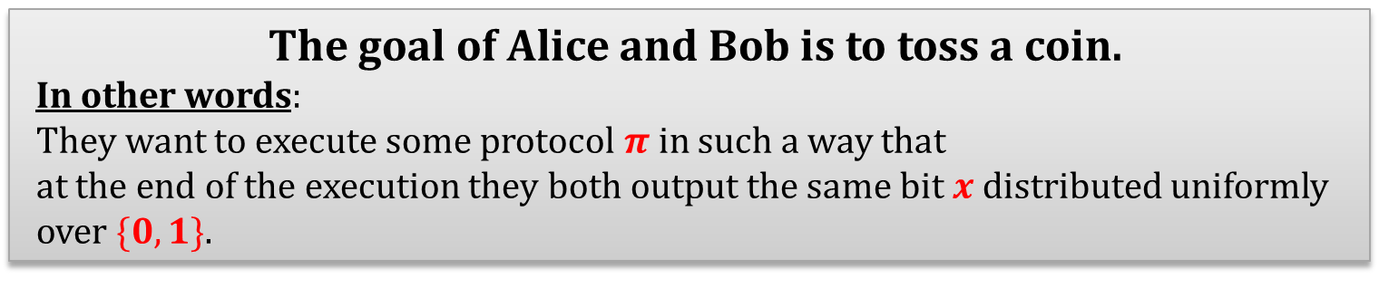
Coin-flipping by telephone [Blum’81]
privacy and authenticity is not a problem
Suppose Alice and Bob are connected by a secure internet link:
internet
$$x$$
$$x$$
The goal of Alice and Bob is to toss a coin.
In other words: They want to execute some protocol $π$ in such a way that at the end of the execution they both output the same bit$x$distributed uniformly over $\{0,1\}$.

Slide 4
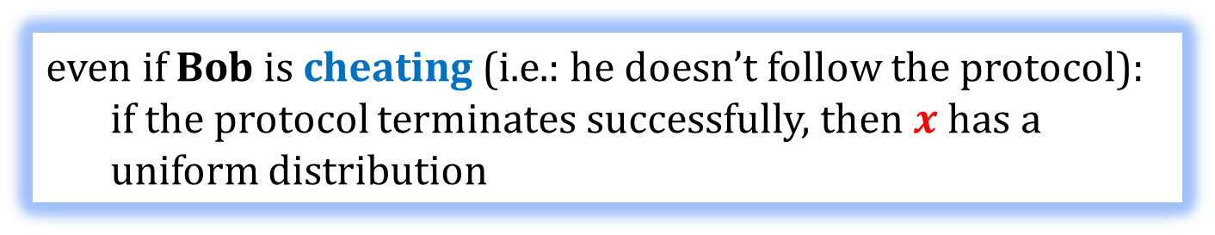


How to define security? [1/2]
Let us just stay at an informal level...
From the point of view of Alice:
internet
$$x$$
$$x$$
even if Bob is cheating (i.e.: he doesn’t follow the protocol):
if the protocol terminates successfully, then $x$ has a uniform distribution

Slide 5
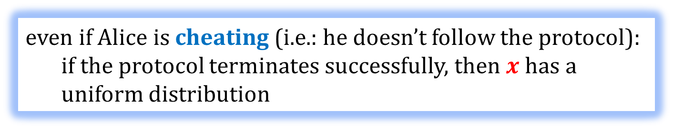


How to define security? [2/2]
The same holds from the point of view of Bob
internet
$$x$$
$$x$$
even if Alice is cheating (i.e.: he doesn’t follow the protocol):
if the protocol terminates successfully, then $x$ has a uniform distribution

Slide 6
Note the difference
Unlike what we saw on the previous lectures:
the enemy can be one of the parties
(not an external entity)
A cheating party is sometimes called a corrupted party, or a malicious party.
We will see many other examples of this later!

Slide 7

How to solve this problem?
Idea Remember the old game: rock-paper-scissors?

Slide 8




Alice
 | draw | Alice wins | Bob wins
 | Bob wins | draw | Alice wins
 | Alice wins | Bob wins | draw
Bob

Slide 9
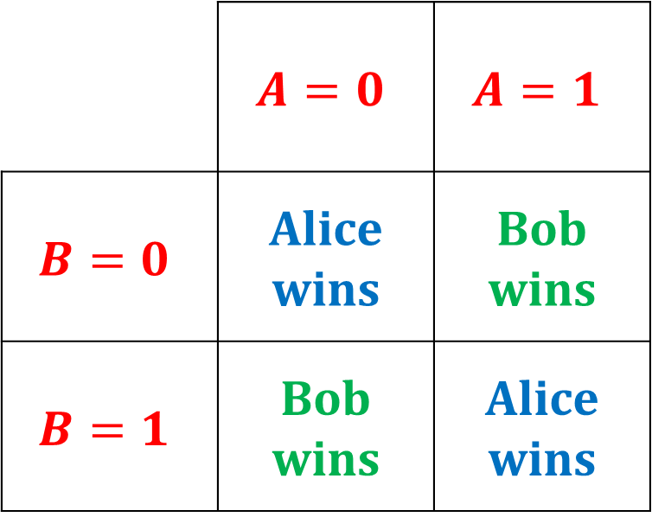
Let’s simplify this game
Alice
 | $$A=0$$ | $$A=1$$
$$B=0$$ | Alice wins | Bob wins
$$B=1$$ | Bob wins | Alice wins
Bob
In other words: Alice wins iff $A⊕B =0$.

Slide 10
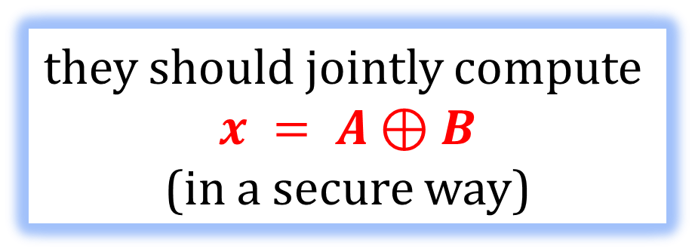
Another way to look at it
Alice
has an input A
Bob
has an input B
they should jointly compute
$$x = A⊕B$$
(in a secure way)

Slide 11
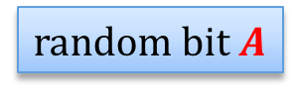
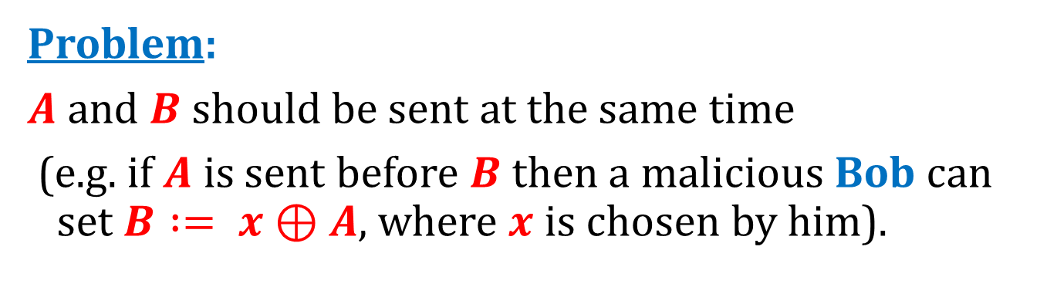
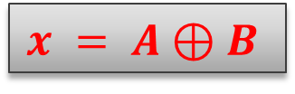
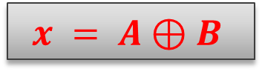
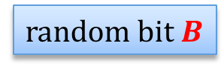
What to do?
random bit $A$
random bit $B$
$$x = A⊕B$$
$$x = A⊕B$$
Problem:
$A$ and $B$ should be sent at the same time
(e.g. if $A$ is sent before $B$ then a malicious Bob can set $B := x⊕A$, where $x$ is chosen by him).

Slide 12
How to prevent this?
Seems hard:
the internet is not synchronous...
A solution:
bit commitments

Slide 13
Plan
Coin-flipping by telephone
Commitment schemes
definition
construction based on QRA
construction based on discrete log
construction based on PRG

Slide 14
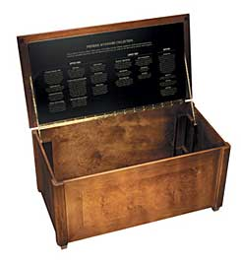
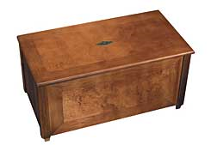



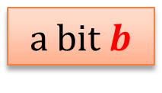
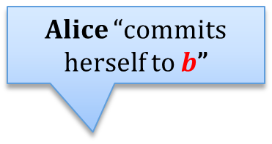
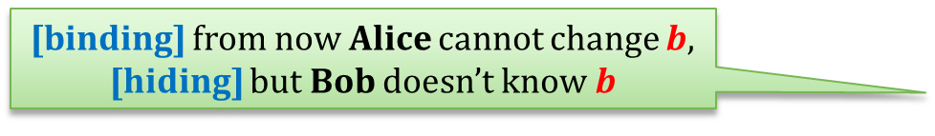

Commitment schemes – an intuition
a bit $b$
Alice “commits herself to $b$”
b
Alice sends a locked box to Bob
[binding] from now Alice cannot change $b$,
[hiding] but Bob doesn’t know $b$
Alice can later send the key to Bob
$$b$$
Alice “opens the commitment”

Slide 15
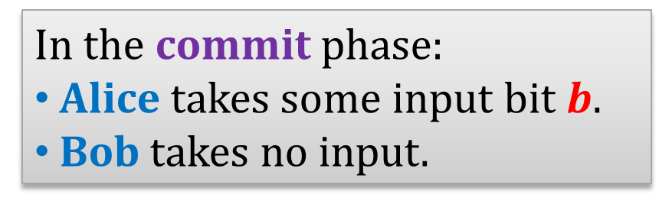
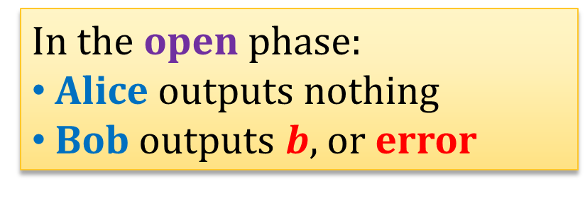
Commitment schemes – a functional definition
A commitment scheme is a protocol executed between Alice and Bob consisting of two phases: commit and open.
In the commit phase:
Alice takes some input bit $b$.
Bob takes no input.
In the open phase:
Alice outputs nothing
Bob outputs $b$, or error

Slide 16
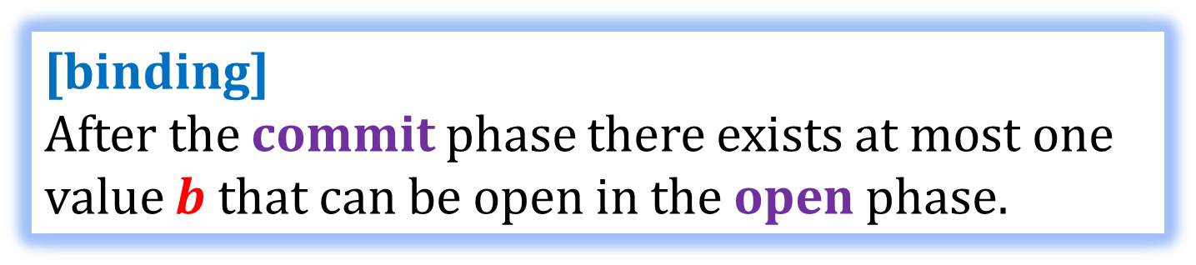
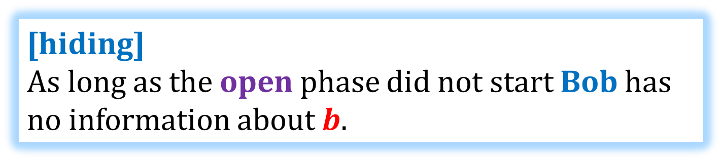
Security requirements - informally
[binding] After the commit phase there exists at most one value $b$ that can be open in the open phase.
[hiding] As long as the open phase did not start Bob has no information about $b$.

Slide 17
How to define security formally?
Not so trivial – remember that the parties can misbehave arbitrarily.
We do not present a complete definition here.
(The hiding property can be defined using the “indistinguishability” principle.)
The definition depends on some options.
What is the computational power of a cheating Alice?
What is the computational power of a cheating Bob?

Slide 18
The computational power of the adversary
If a cheating Alice can be infinitely powerful, we say that the protocol is unconditionally binding.
Otherwise it is computationally binding.
If a cheating Bob can be infinitely powerful, we say that the protocol is unconditionally hiding.
Otherwise it is computationally hiding.
Of course, to be formal we would need to introduce a security parameter...

Slide 19
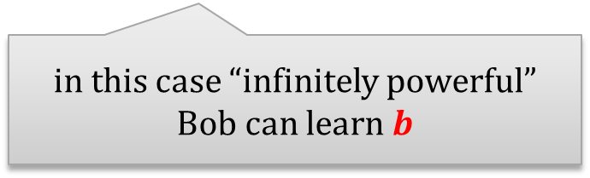
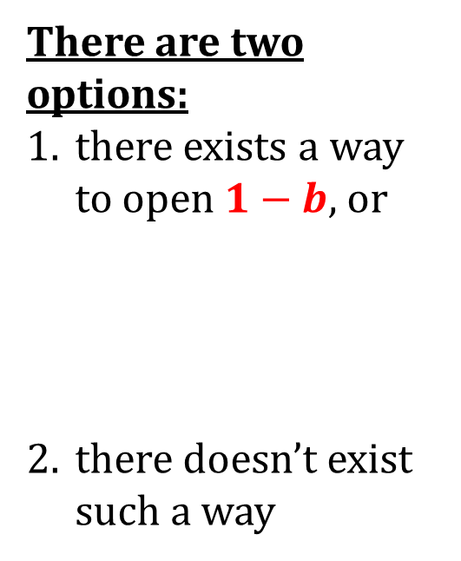

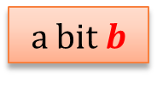
Unconditionally hiding and binding commitment schemes do not exist
There are two options:
there exists a way to open $1−b$, or
there doesn’t exist such a way
Proof (intuition)
a bit $b$
in this case “infinitely powerful” Alice can cheat
$$commit(b)$$
in this case “infinitely powerful” Bob can learn $b$

Slide 20
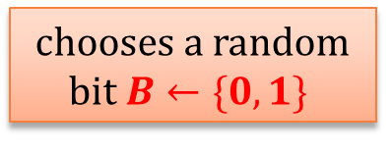


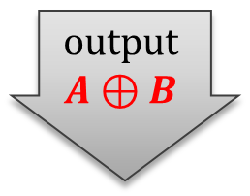
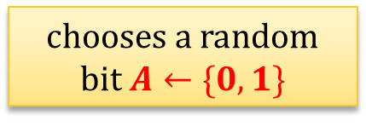
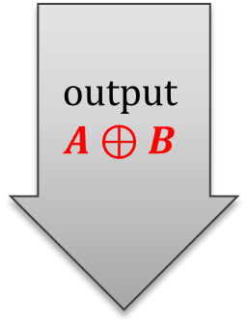

So, how does it solve the coin-flipping problem?
chooses a random
bit $A←\{0,1\}$
commits to $A$
chooses a random bit $B←\{0,1\}$
sends $B$
output $$A⊕B$$
opens $A$
output $$A⊕B$$

Slide 21
Problem
Alice can always refuse to send the last message.
This is unavoidable (there has to be the last message in the protocol).
But they can use a convention:
if Alice didn’t send the last message – she lost!

Slide 22
Plan
Coin-flipping by telephone
Commitment schemes
definition
construction based on QRA
construction based on discrete log
construction based on PRG

Slide 23

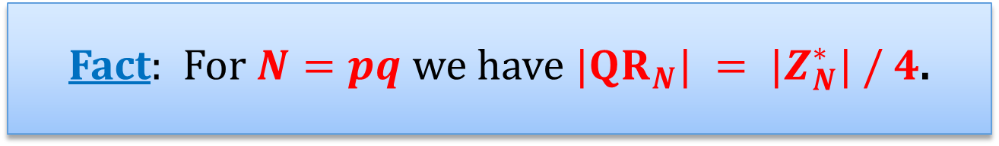






Remember quadratic residues modulo an RSA modulus?
$$QR_{N}=\{x^{2} mod N:x∈Z_{N}^{∗}\}$$
Fact: For $N=pq$ we have $|QR_{N}| = |Z_{N}^{∗}| / 4$.
$Z_{N}^{∗}$:
$$QR_{p}$$
$$mod p$$
$$QR_{q}$$
$$QR_{N}$$
$$mod q$$

Slide 24
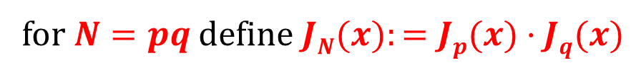





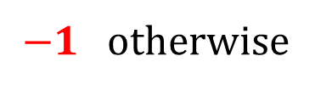

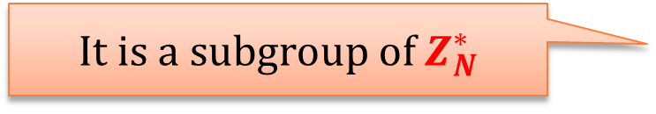
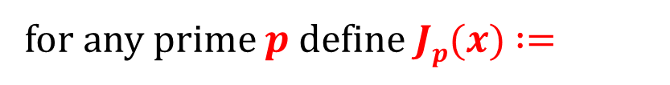

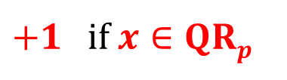
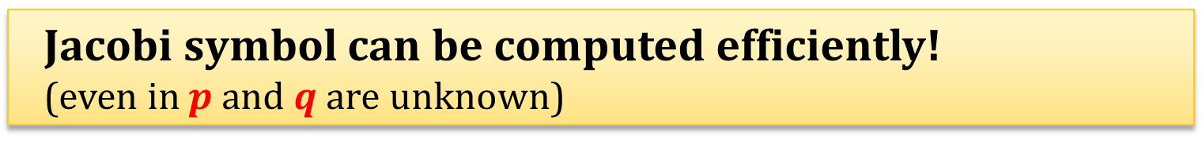
Jacobi Symbol
$+1$ if $x∈QRp$
for any prime $p$ define $Jp(x)$ $:=$
$−1$otherwise
for $N=pq$ define $JN(x):=Jp(x)·Jq(x)$
$$QR_{p}$$
$$mod p$$
$$JN(x) :=$$
+1 | -1
-1 | +1
$$QR_{q}$$
$$QR_{N}$$
$$mod q$$
It is a subgroup of $Z_{N}^{∗}$
$$Z_{N}^{+}:= \{x∈Z_{N}^{∗}: J_{N}(x)=+1\}$$
Jacobi symbol can be computed efficiently! (even in $p$ and $q$ are unknown)

Slide 25



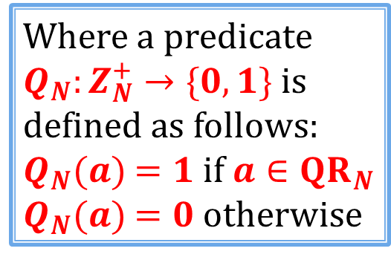
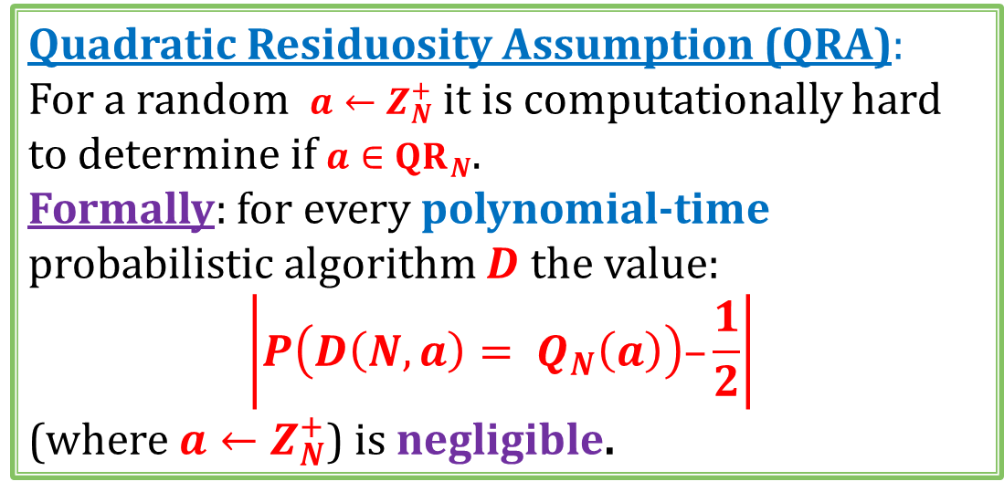



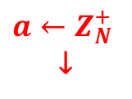
Quadratic Residuosity Assumption
$a←Z_{N}^{+}$
↓
?
$Z_{N}^{∗}$:
$$QR_{p}$$
$$Q{NR}_{p}$$
$$QR_{q}$$
$$QR_{N}$$
$$Q{NR}_{p}$$
Quadratic Residuosity Assumption (QRA):
For a random $a←Z_{N}^{+}$ it is computationally hard to determine if $a∈QR_{N}$.
Formally: for every polynomial-time probabilistic algorithm $D$ the value:
$$\left|P\left(D\left(N,a\right)= Q_{N}\left(a\right)\right)–\frac{1}{2}\right|$$
(where $a←Z_{N}^{+}$) is negligible.
Where a predicate $Q_{N}:Z_{N}^{+}→\{0,1\}$ is defined as follows:
$Q_{N}(a)$ $=1$if $a∈QR_{N}$
$Q_{N}(a)$ $=0$otherwise

Slide 26



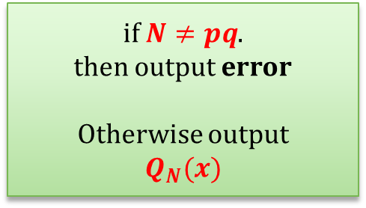
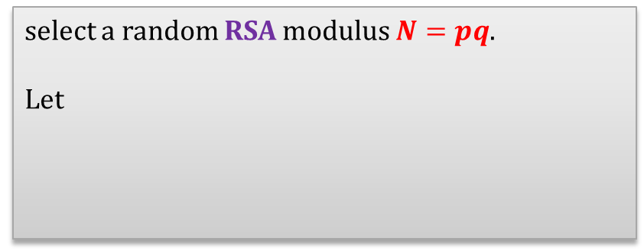
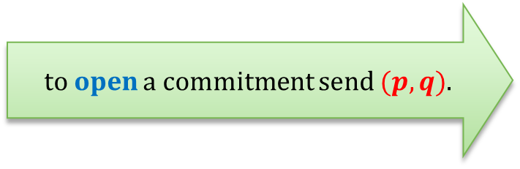

A construction based on QRA
a bit b
select a random RSA modulus $N=pq$.
Let
a random $QRN$ if $b =1$
$x$ :=
a random $Z_{N}^{+}∖QRN$if $b =0$
to commit to $b$sends$(N,x)$
to open a commitment send $(p,q)$.
if $N≠pq$.
then output error
Otherwise output
$$Q_{N}(x)$$

Slide 27
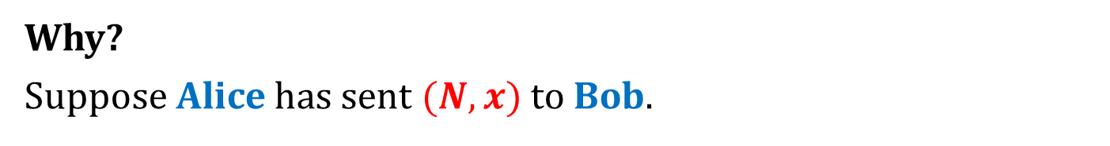
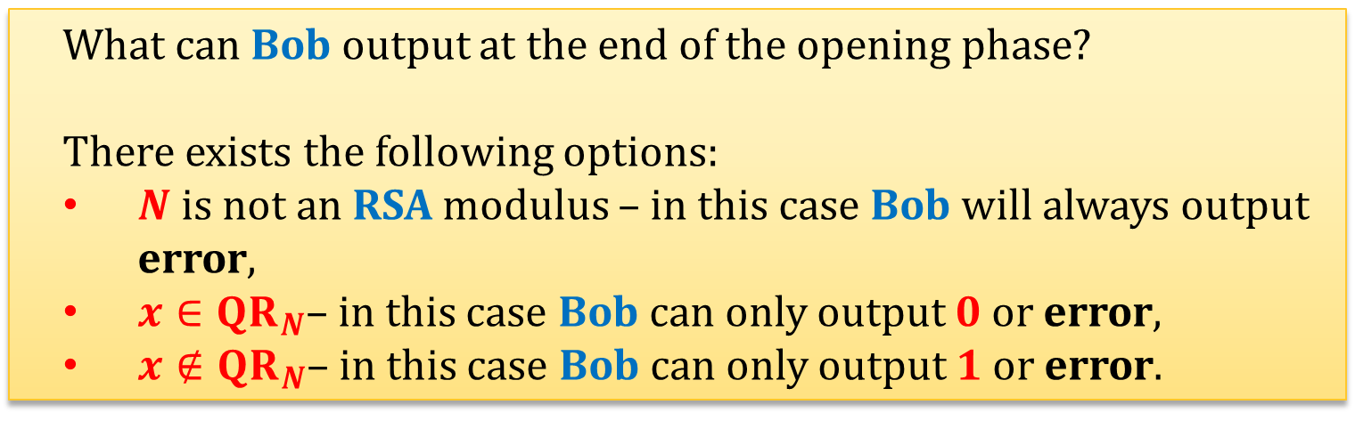
This commitment scheme is unconditionally binding
Why?
Suppose Alice has sent $(N,x)$to Bob.
What can Bob output at the end of the opening phase?
There exists the following options:
$N$ is not an RSA modulus – in this case Bob will always output error,
$x∈QR_{N}$– in this case Bob can only output $0$ or error,
$x∉QR_{N}$– in this case Bob can only output $1$ or error.

Slide 28
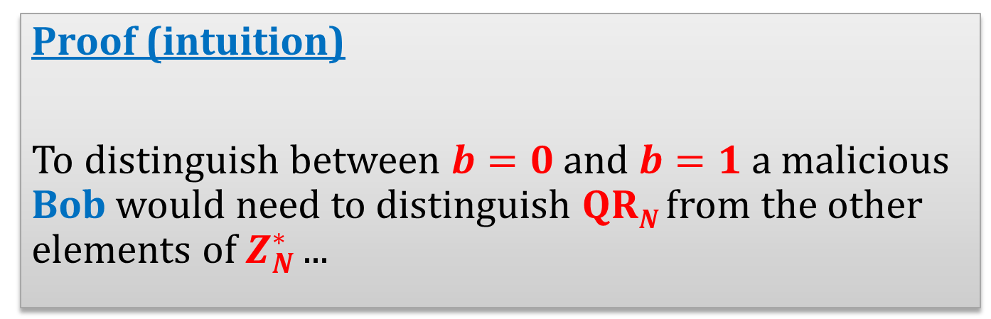
This commitment scheme is computationally hiding, assuming QRA holds
Proof (intuition)
To distinguish between $b=0$ and $b=1$ a malicious Bob would need to distinguish $QRN$ from the other elements of $Z_{N}^{∗}$ ...

Slide 29
Plan
Coin-flipping by telephone
Commitment schemes
definition
construction based on QRA
construction based on discrete log
construction based on PRG

Slide 30

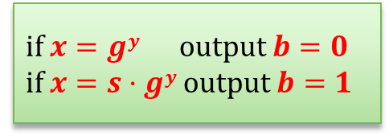




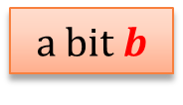
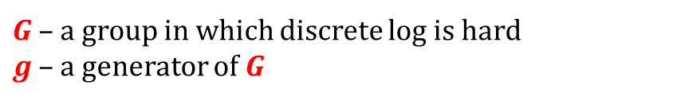



A construction based on discrete log
$G$ – a group in which discrete log is hard $g$ – a generator of $G$
a bit $b$
Select a random
$$y←Z_{|G|}$$
Let
Select $s$ – a random element of $G$
$$G,g,s$$
$gy$ if $b = 0$
$x$ :=
$s · gy$if $b = 1$
to commit to $b$send $x$
to open a commitment send $y$.
if $x=gy$ output $b=0$
if $x=s·gy$ output $b=1$

Slide 31
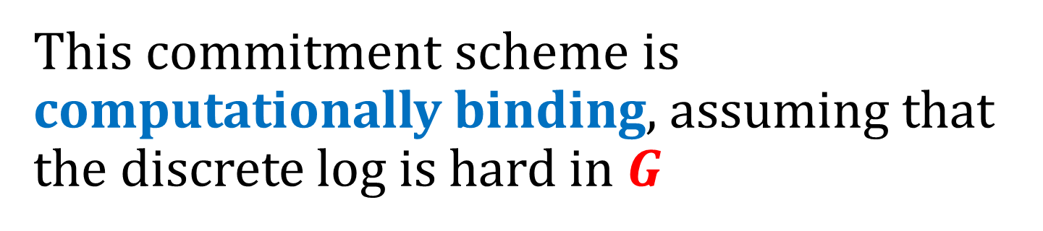
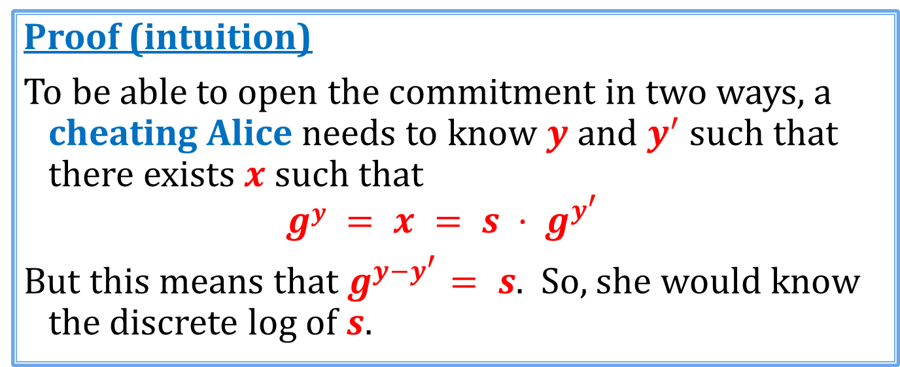
This commitment scheme is computationally binding, assuming that the discrete log is hard in $G$
Proof (intuition)
To be able to open the commitment in two ways, a cheating Alice needs to know $y$ and $y^{′}$ such that there exists $x$ such that
$$gy = x = s · g^{y^{′}}$$
But this means that $g^{y−y^{′}}= s$. So, she would know the discrete log of $s$.

Slide 32
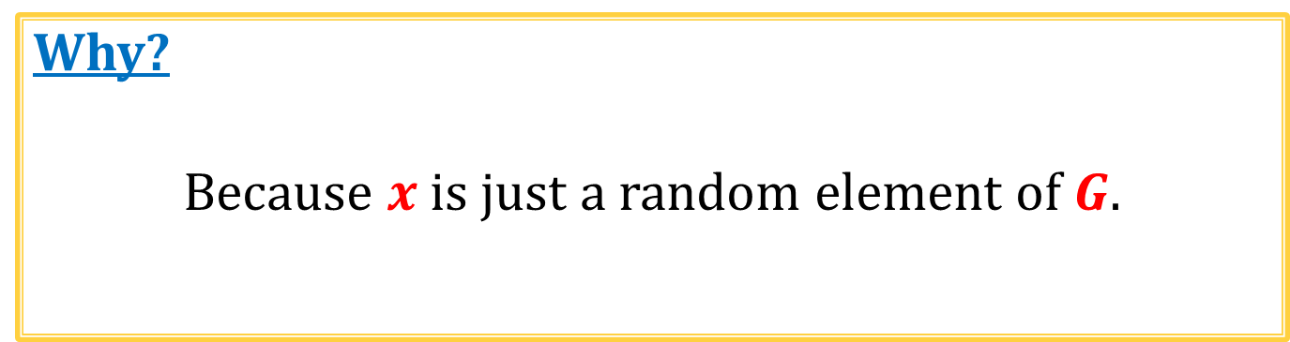
This commitment scheme is unconditionally hiding
Why?
Because $x$ is just a random element of $G$.

Slide 33
Plan
Coin-flipping by telephone
Commitment schemes
definition
construction based on QRA
construction based on discrete log
construction based on PRG

Slide 34

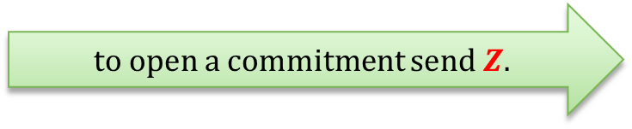









A construction based on PRGs [Naor’91]
$G:\{0,1\}L→\{0,1\}3L$a PRG
select a random string
$$X←{\left\{0,1\right\}}^{3L}$$
a bit $b$
$$X$$
select a random string
$$Z←{\left\{0,1\right\}}^{L}$$
and let
$G\left(Z\right)⊕X$if $b=0$
$Y$ :=
$G(Z)$ if $b=1$
to commit to $b$ send $Y$
to open a commitment send $Z$.
if $Y=G\left(Z\right)⊕X$output $b=0$
if $Y=G(Z)$ output $b=1$

Slide 35


This commitment scheme is unconditionally binding
Proof (intuition)
To be able to open the commitment in two ways, a cheating Alice needs to find $Z$ and $Z’$ such that there exists $Y$ such that:
$$G\left(Z\right)⊕X = Y = G(Z’)$$
This means that $G\left(Z\right)⊕G(Z’) = X$.
How many $X$’s have the property that
there exist $Z$ and $Z’$ such that $G\left(Z\right)⊕G(Z’) = X$?
By the counting argument: at most ${\left(2^{L}\right)}^{2}=2^{2L}$.
Therefore, the probability that a random $X∈{\left\{0,1\right\}}^{3L}$ has this property is at most
$\frac{2^{2L}}{2^{3L}}=2^{−L}$.
QED

Slide 36

This commitment scheme is computationally hiding, assuming G is a secure PRG
Why?
Obviously, if, instead of $G(Z)$ Alice uses a completely random string $R$, then the scheme is secure against a cheating Bob.
If a scheme behaved differently with $R$ and with $G(Z)$, then a cheating Bob could be used as a distinguisher for $G$.

Slide 37
Moral
one-way functions
exist
commitment schemes
exist
this can also be shown
Commitment schemes are a part of Minicrypt!

Slide 38

String commitment
How to commit to a longer string $x=(x_{1},…,x_{n})$?
Just commit to every $x_{i}$ separately.
To open the commitment, open each commitment to $x_{i}$.
(Bob accepts only if all the openings were ok)

Slide 39
©2026 by Stefan Dziembowski. Permission to make digital or hard copies of part or all of this material is currently granted without fee provided that copies are made only for personal or classroom use, are not distributed for profit or commercial advantage, and that new copies bear this notice and the full citation.

