Slide 1

Chapter 10 Interactive Proofs and Zero Knowledge
Stefan Dziembowski www.crypto.edu.pl/Dziembowski University of Warsaw

Slide 2
Plan
Interactive Proofs
Zero-Knowledge Proofs
Zero-Knowledge Proofs of Knowledge
Non-Interactive Zero-Knowledge
Applications

Slide 3

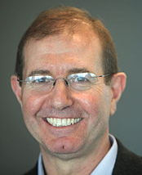
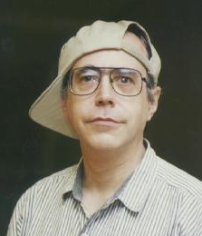
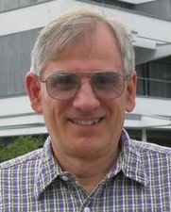
This field was started by
Turing Award in 2012
S. Goldwasser
S. Micali
C. Rackoff
[Shafi Goldwasser, Silvio Micali, Charles Rackoff: The Knowledge Complexity of Interactive Proof-Systems, STOC 1985, SIAM J. Comput. 1989]
see also:
[László Babai: Trading Group Theory for Randomness. STOC 1985]
László Babai

Slide 4
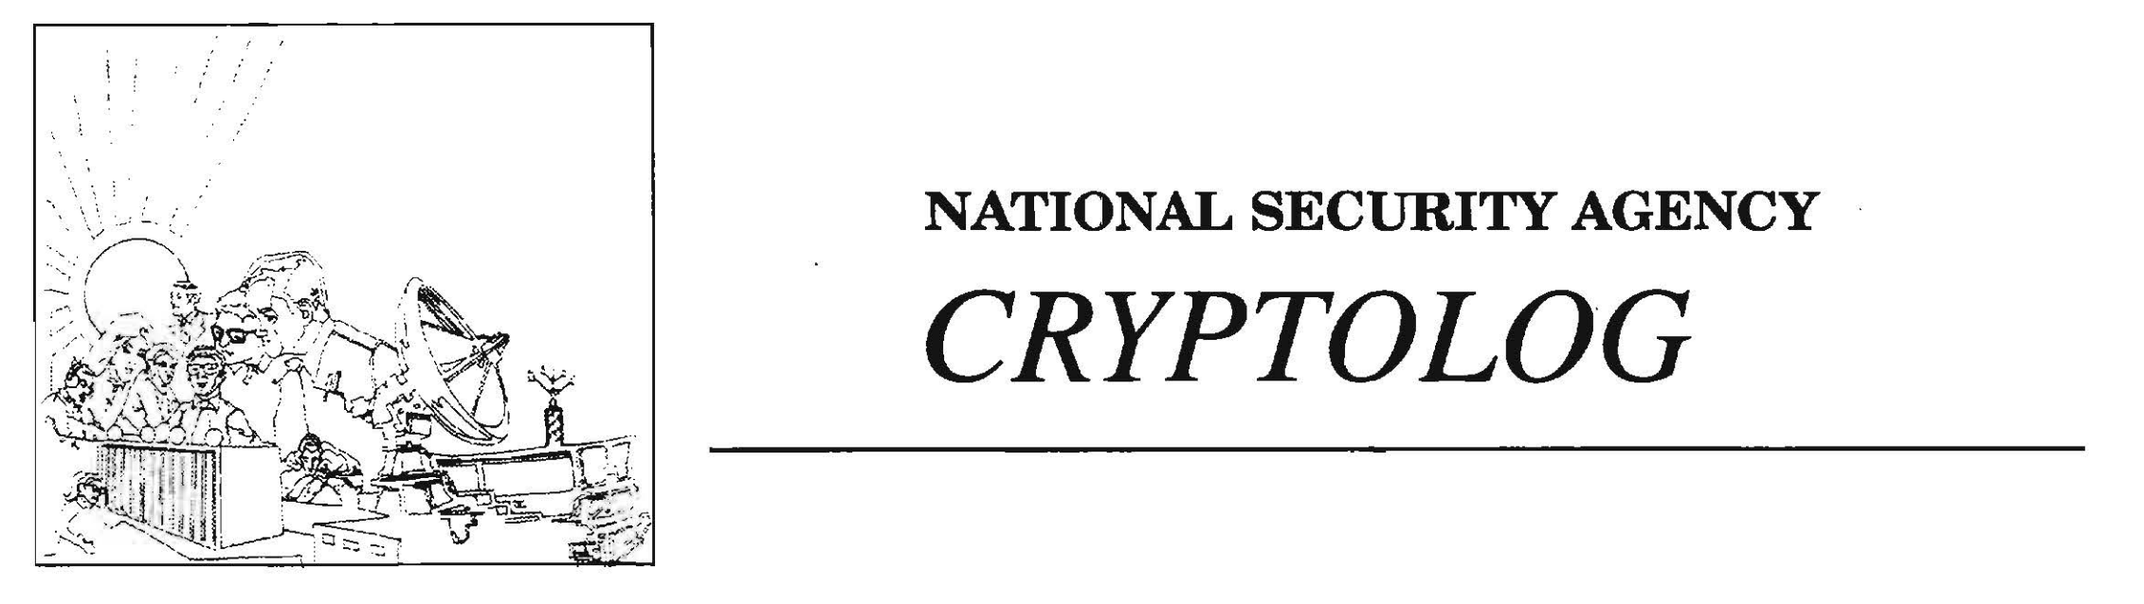
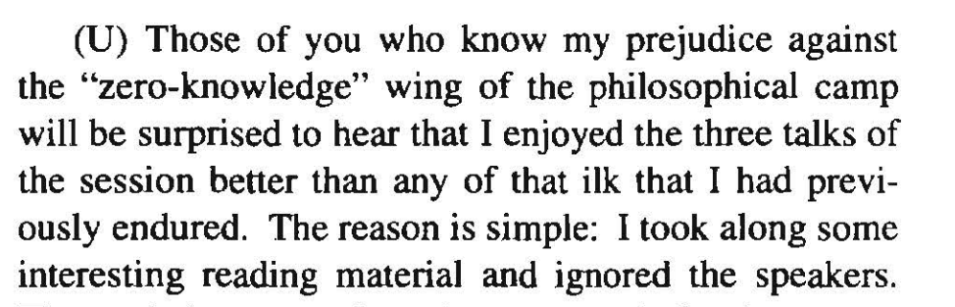
Initially treated as pure theory
A report from Eurocrypt’92:

Slide 5
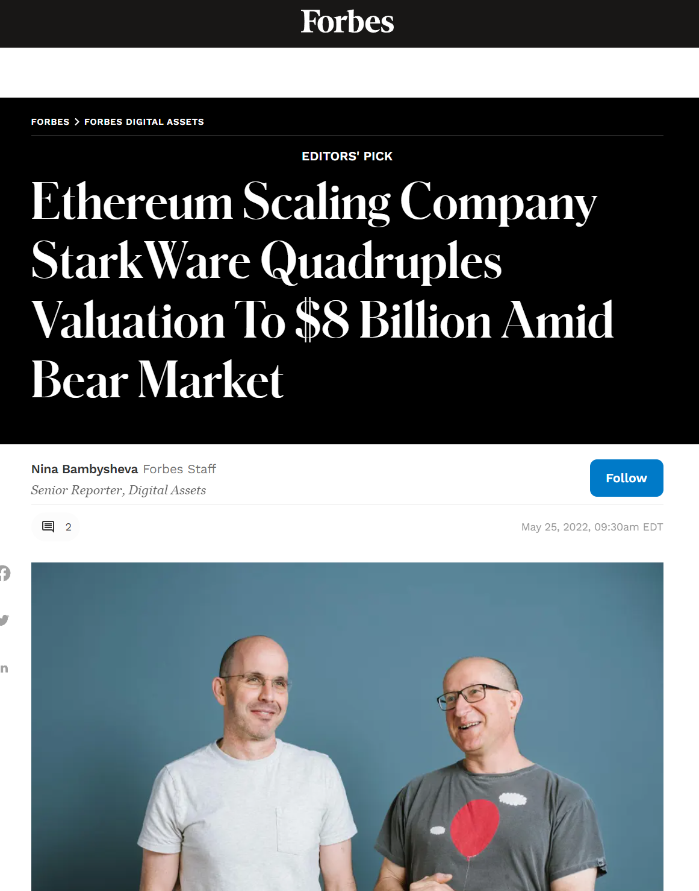
Nowadays: mainstream crypto

Slide 6

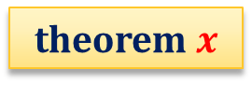

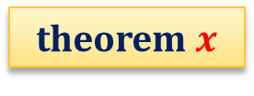
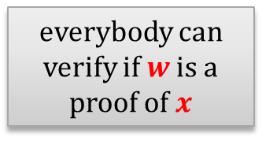
Proofs in mathematics
theorem $x$
theorem $x$
proof $w$
everybody can verify if $w$ is a proof of $x$
prover
Two main properties:
Completeness: true statement have a proof
Soundness: false statements don’t have a proof
Question: can we have a CS version of this notion?
First idea: extend it by adding “efficient” (poly-time) computation.

Slide 7
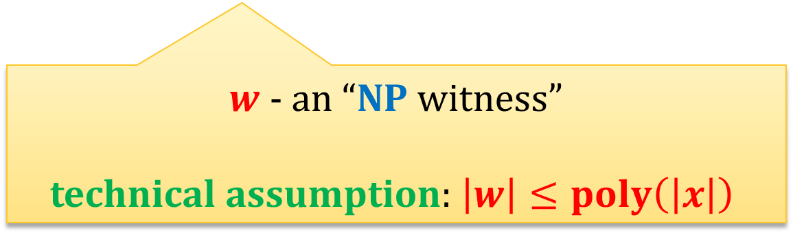


Recall the definition of NP
A language $L∈{\left\{0,1\right\}}^{∗}$ is in NP if there exists a poly-time computable relation $R$ such that
$$L=\left\{x:∃_{w} R\left(x,w\right)=true\right\}$$
$x$ – a “statement”
$w$ - an “NP witness”
technical assumption: $\left|w\right|≤poly\left(\left|x\right|\right)$

Slide 8





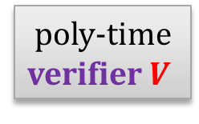
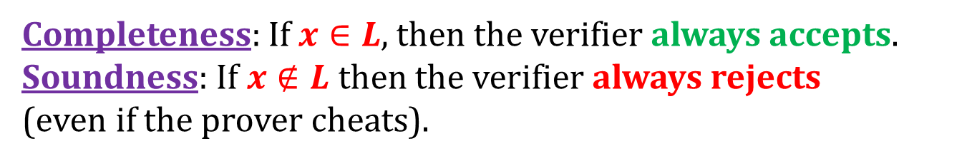

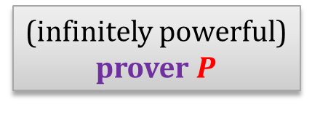

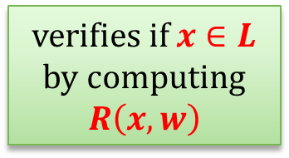

One way to look at the NP languages
$L$ – some language in NP defined by a poly-time computable relation $R$
$$x∉L$$
$$x∈L$$
$$x∉L$$
$$x∈L$$
accept
$$w$$
finds an
NP-witness $w$ for $x$
verifies if $x∈L$
by computing $R\left(x,w\right)$
reject
(infinitely powerful)
prover $P$
poly-time verifier $V$
Completeness: If $x∈L$, then the verifier always accepts.
Soundness: If $x∉L$ then the verifier always rejects (even if the prover cheats).

Slide 9
How to extend this further?
Add interaction and randomness
can interact
(infinitely powerful)
prover
poly-time verifier
can “toss coins”
Completeness and soundness may hold only with some probability.

Slide 10
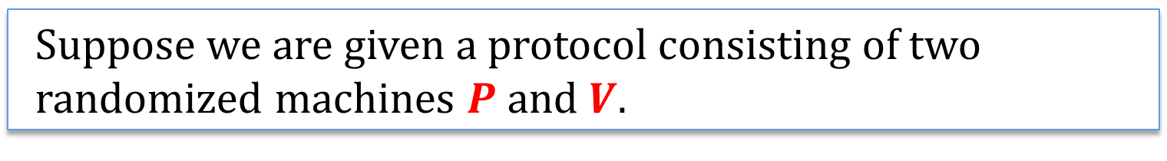
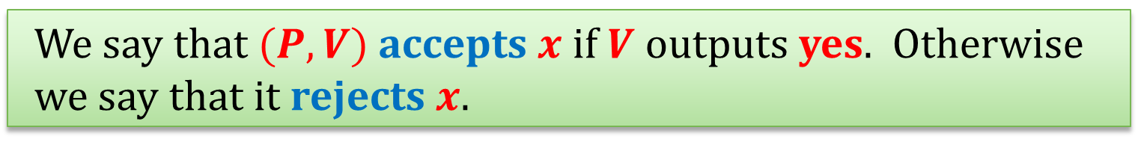
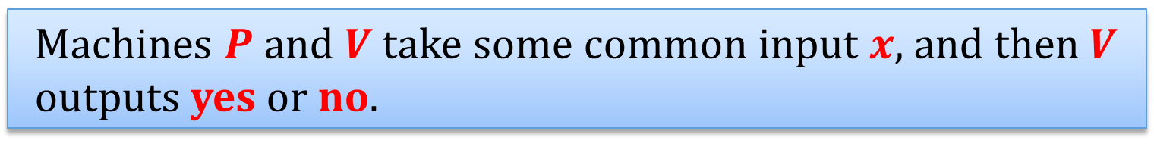
Notation
Suppose we are given a protocol consisting of two randomized machines $P$ and $V$.
Machines $P$ and $V$ take some common input $x$, and then $V$ outputs yes or no.
We say that $(P,V)$accepts $x$ if $V$ outputs yes. Otherwise we say that it rejects $x$.

Slide 11

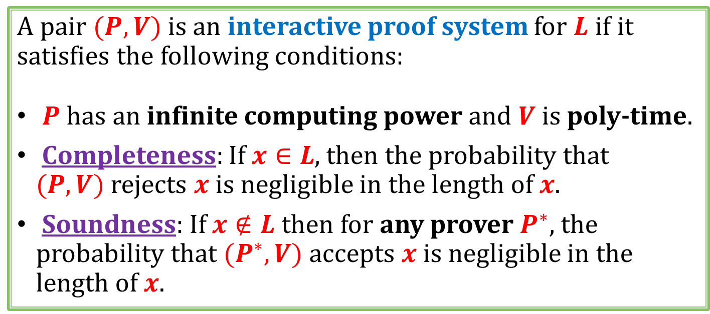
Interactive proofs
A pair $(P, V)$is an interactive proof system for $L$ if it satisfies the following conditions:
$P$ has an infinite computing power and $V$ is poly-time.
Completeness: If $x∈L$, then the probability that $(P, V)$rejects $x$ is negligible in the length of $x$.
Soundness: If $x∉L$ then for any prover $P^{∗}$, the probability that $(P^{∗},V)$ accepts $x$ is negligible in the length of $x$.
A class of languages that have such proofs is denoted IP.
Question: Where does IP it belong?
$$P^{∗}$$

Slide 12
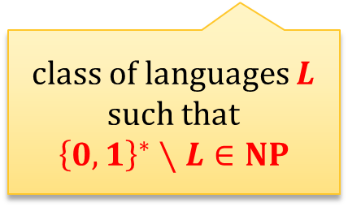
A diagram from complexity theory
in theory it is possible that all these classes are equal:
PSPACE
PSPACE
co-NP
NP
co-NP
NP
class of languages $L$ such that
$${\left\{0,1\right\}}^{∗}∖L∈NP$$
P
P
our assumption: they are different

Slide 13
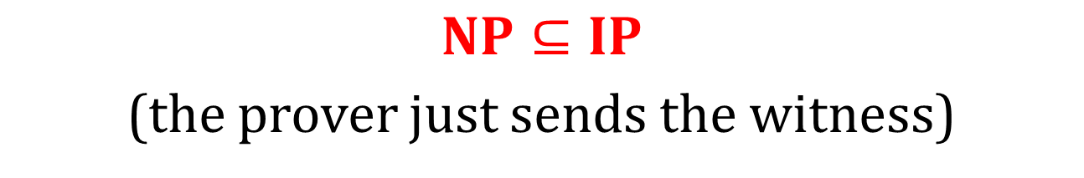
An obvious observation
$$NP⊆IP$$
(the prover just sends the witness)
P
IP
NP
graph non-isomorphism
We will now show that (probably) NP is a proper subset of IP.
This will be done by showing an interactive protocol for a language not known to be in NP.

Slide 14
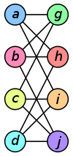
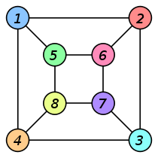
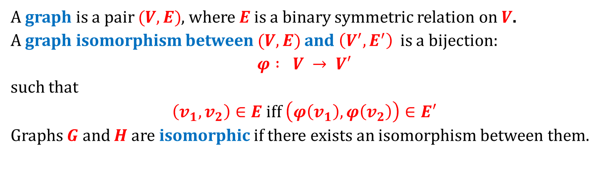
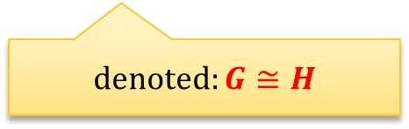

Graph isomorphism
A graph is a pair $(V,E)$, where $E$is a binary symmetric relation on $V$.
A graph isomorphism between $(V,E)$and $\left(V^{′},E^{′}\right)$is a bijection:
$φ : V → V′$
such that
$\left(v_{1},v_{2}\right)∈E$ iff $\left(φ\left(v_{1}\right),φ\left(v_{2}\right)\right)∈E′$
Graphs $G$ and $H$ are isomorphic if there exists an isomorphism between them.
denoted: $G≅H$
Example
isomorphism:
$$f(a)=1$$
f $\left(b\right)=6$
$$f(c)=8$$
$$f(d)=3$$
$$f(g)=5$$
$$f(h)=2$$
$$f(i)=4$$
$$f(j)=7$$
© Wikipedia

Slide 15
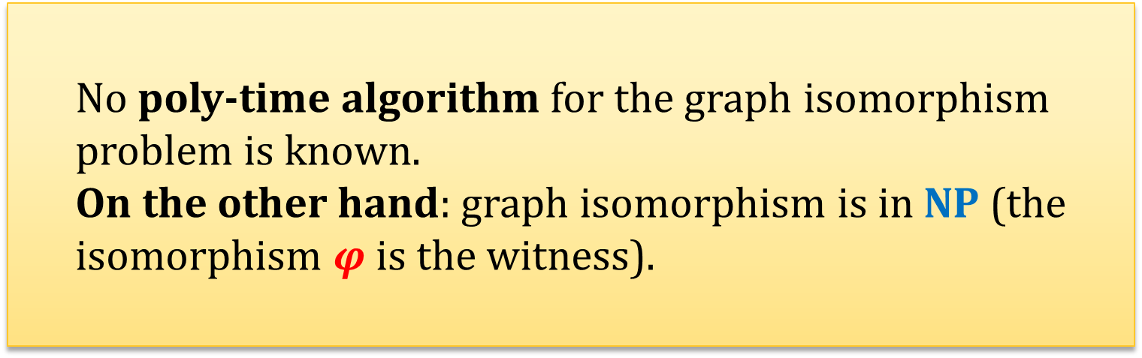
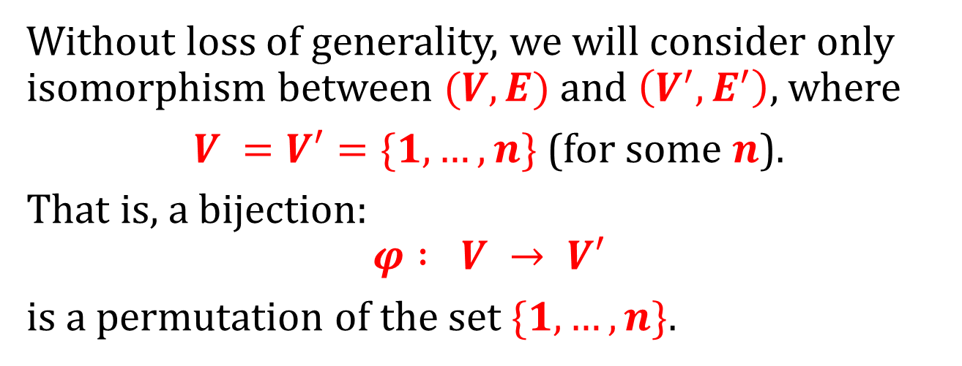
Hardness of graph isomorphism
Without loss of generality, we will consider only isomorphism between $(V,E)$and $\left(V^{′},E^{′}\right)$, where
$V =V′=\{1,…,n\}$(for some $n$).
That is, a bijection:
$$φ : V → V′$$
is a permutation of the set $\{1,…,n\}$.
No poly-time algorithm for the graph isomorphism problem is known.
On the other hand: graph isomorphism is in NP (the isomorphism $φ$ is the witness).

Slide 16
On our diagram
PSPACE
graph non-isomorphism
graph isomorphism
graph non-isomorphism
co-NP
NP
co-NP
P

Slide 17
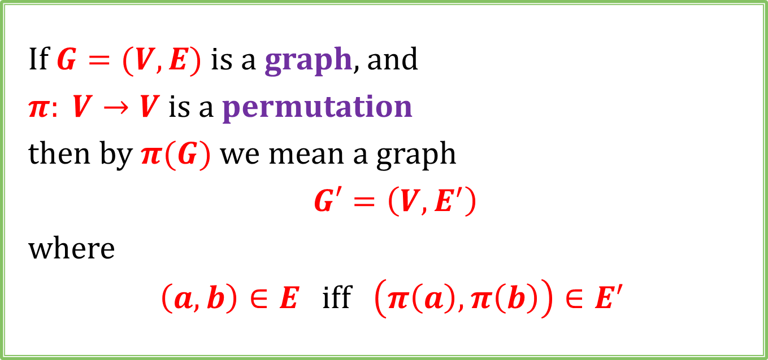
Notation
If $G=(V,E)$is a graph, and
$π: V→V$is a permutation
then by $π(G)$we mean a graph
$G′=\left(V,E^{′}\right)$
where
$\left(a,b\right)∈E$ iff $\left(π\left(a\right),π\left(b\right)\right)∈E^{′}$

Slide 18
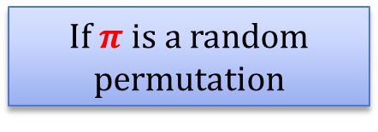

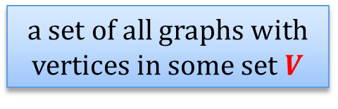
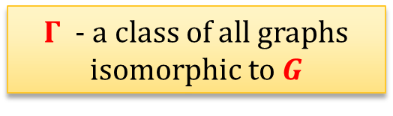

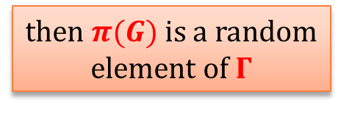

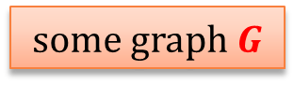
A fact
a set of all graphs with vertices in some set $V$
$Γ$ - a class of all graphs isomorphic to $G$
some graph $G$
$$G$$
$$π$$
$$π(G)$$
If $π$ is a random permutation
then $π(G)$is a random element of $Γ$

Slide 19
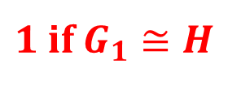


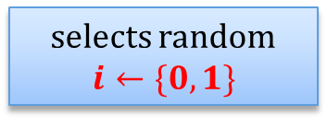
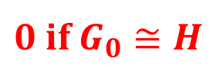



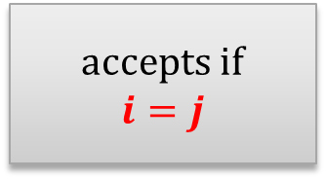
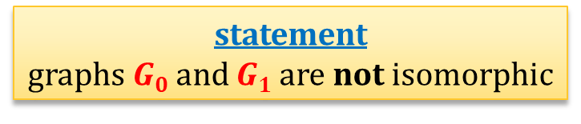




An interactive proof of graph non-isomorphism
statement
graphs $G0$ and $G1$are not isomorphic
prover
verifier
iterate $n$ times:
selects random $$i←\{0,1\}$$
$$H :=π(G_{i})$$
checks which is the case
sends
$$G0$$
accepts if
$$i=j$$
$$G1$$
$$≅$$
$$≅$$
$$\{$$
$0$ if $G_{0}≅H$
$$j ≔$$
$1$ if $G_{1}≅H$
$$H$$
this technique is called “amplification”

Slide 20
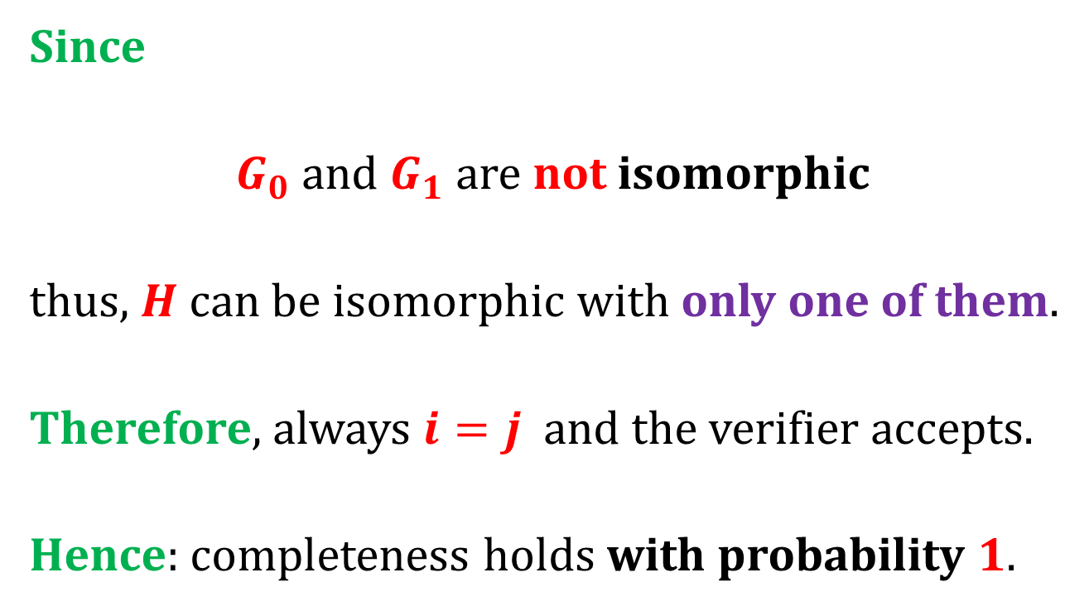
Completeness
Since
$G_{0}$and $G_{1}$ are not isomorphic
thus, $H$ can be isomorphic with only one of them.
Therefore, always $i=j$ and the verifier accepts.
Hence: completeness holds with probability $1$.

Slide 21
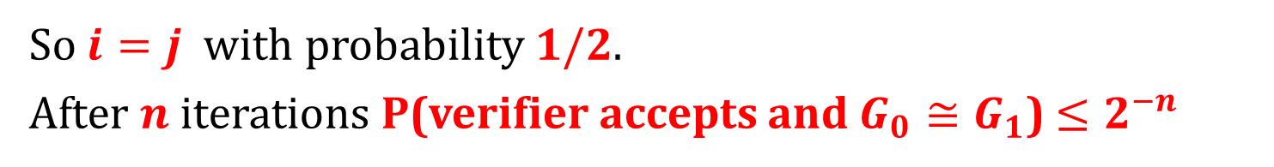




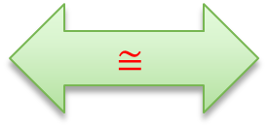


Soundness
Suppose $G_{0}≅G_{1}$. Then $G_{0}≅H≅ G_{1}$
$$≅$$
$$G_{0}$$
$$G_{1}$$
$$≅$$
$$≅$$
$$H$$
So $i=j$ with probability $1/2$.
After $n$iterations P(verifier accepts and $G_{0}≅G_{1}$) $≤2^{−n}$
“soundness error”: $2^{−n}$

Slide 22
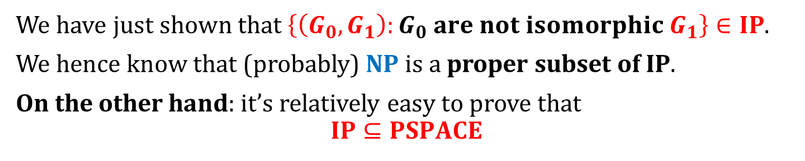


The situation
We have just shown that $\left\{\left(G_{0},G_{1}\right):G_{0} are not isomorphic G_{1}\right\}∈IP$.
We hence know that (probably) NP is a proper subset of IP.
On the other hand: it’s relatively easy to prove that
$$IP⊆PSPACE$$
P
$$≠$$
NP
$$≠$$
IP
?
PSPACE
For a while the other direction (“$PSPACE⊆IP$”) was an open problem.

Slide 23

A celebrated result
$$PSPACE⊆IP$$
IP = PSPACE
[Adi Shamir “IP=PSPACE”, FOCS 1990, J. ACM 39(4): 869-877 (1992)]
(building on work of several other researchers, see Laszlo Babai “E-mail and the unexpected power of interaction”)
Main strategy: reduction from the Quantified Boolean Formula Problem using an “arithmetization” technique.

Slide 24
Tremendous impact on CS
Interactive proofs have many different variants.
Most important for cryptography:
Zero-Knowledge Protocols
(we will talk about it in a moment).
One important generalization:
Probabilistically-Checkable Proofs
(PCPs).

Slide 25
Plan
Interactive Proofs
Zero-Knowledge Proofs
introduction and definitions
protocol for graph isomorphism
protocol for quadratic residuosity
protocol for any NP language
Zero-Knowledge Proofs of Knowledge
Non-Interactive Zero-Knowledge
Applications

Slide 26
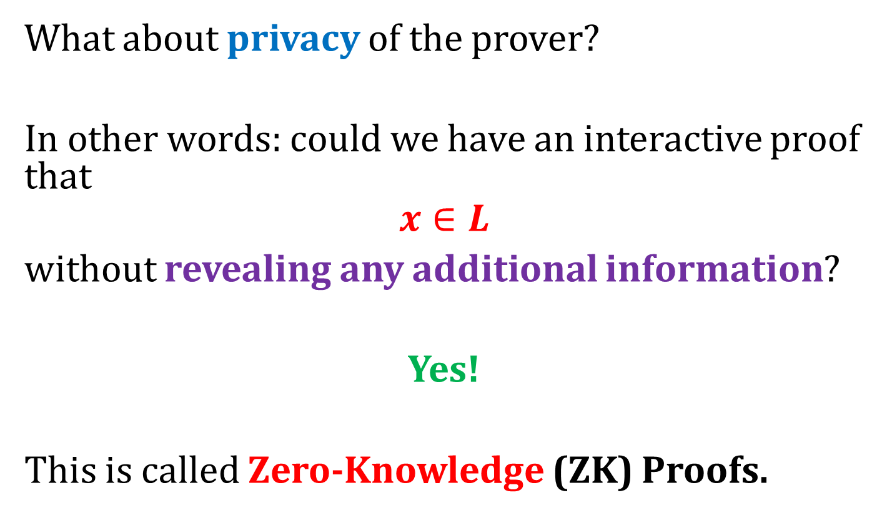
Adding cryptography to the picture
What about privacy of the prover?
In other words: could we have an interactive proof that
$$x∈L$$
without revealing any additional information?
Yes!
This is called Zero-Knowledge (ZK) Proofs.

Slide 27



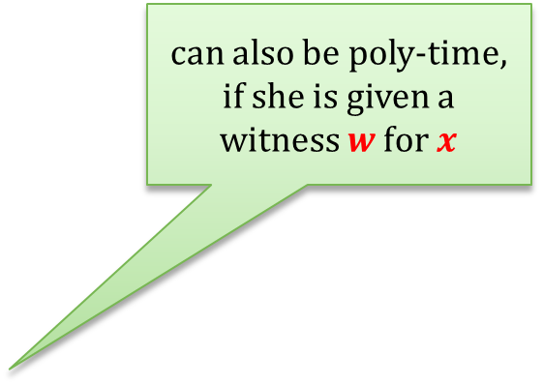
The general picture
$L∈NP$ – some language (usually not in $P$)
$$x∈L$$
can also be poly-time, if she is given a witness $w$ for $x$
$$x∈L$$
accept
infinitely-powerful prover
poly-time verifier
reject
The main properties:
completeness,
soundness,
zero-knowledge
(if $x∉L$)
as before
new

Slide 28

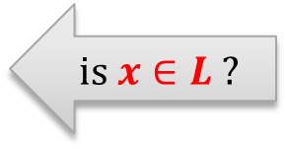

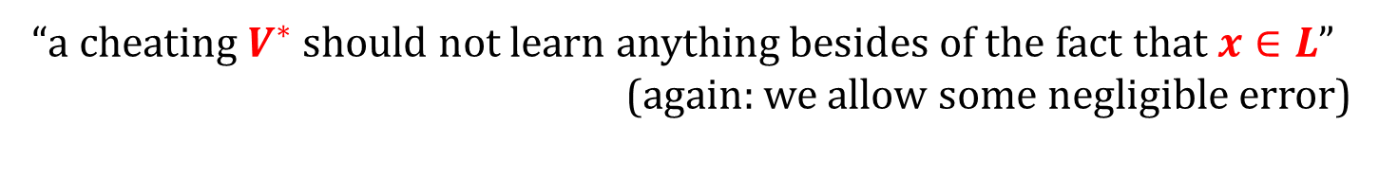
Zero Knowledge
The only thing that the verifier should learn is that $x∈L$
$$x∈L$$
is $x∈L$?
prover
verifier
YES!
verifier
“a cheating $V^{∗}$ should not learn anything besides of the fact that $x∈L$”
(again: we allow some negligible error)

Slide 29
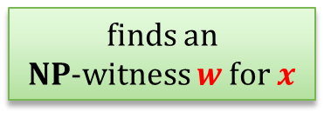


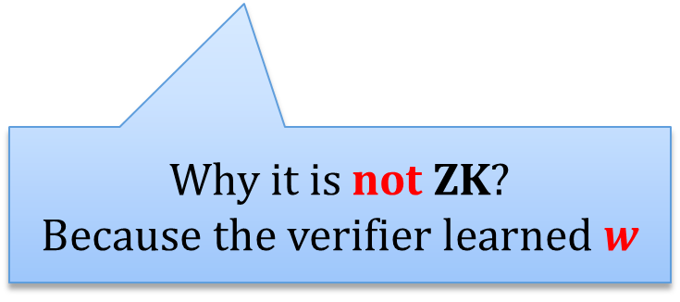


An example of a protocol that is not Zero Knowledge
$L$ – some NP language
$$x∈L$$
$$x∈L$$
finds an
NP-witness $w$ for $x$
$$w$$
can verify if $x∈L$
prover
verifier
Why it is not ZK?
Because the verifier learned $w$

Slide 30



More notation
$View(P,V,x)$ – a random variable denoting the
“view of $V$”,
that is:
the random input of $V$ and the input $x$,
the transcript of the communication.
$$x∈L$$
randomness
$View(P,V,x)$:
verifier

Slide 31


“a cheating $V^{∗}$ should not learn anything besides of the fact that $x∈L$”
“What a cheating $V^{∗}$ can learn can be simulated without interacting with $P$”
In this lecture: we focus on a simpler notion, namely:
Honest-Verifier Zero Knowledge

Slide 32











Main idea: simulation
$$∀$$
$$x∈L$$
$$x∈L$$
$$x∈L$$
$$x∈L$$
$$∃$$
simulator $S$
verifier $V$
prover
view of the simulator
$$≈$$
view of the verifier
“indistinguishable”

Slide 33






Indistinguishability of random variables
$$∀$$
Cannot distinguish $A$ from $B$.
$D$ is poly-time $→$ computational indistinguishability
$D$ is unbounded $→$
negligible advantage allowed $→$ statistical indistinguishability
no advantage allowed $→$ perfect indistinguishability
$$A$$
$$B$$
distinguisher
$$D$$

Slide 34



Formally
Let $α={\left\{A\left(x\right)\right\}}_{x∈L}$ and $β={\left\{B\left(x\right)\right\}}_{x∈L}$ be two sets of distributions.
$α$ and $β$ are computationally indistinguishable if for every poly-time $D$ there exists a negligible function $ε$ such that for every $x∈L$
$\left|P\left(D\left(x,A\left(x\right)\right)=1\right)−P\left(D\left(x,B\left(x\right)\right)=1\right)\right|≤ε(\left|x\right|)$ $(∗)$
$α$ and $β$ are statistically indistinguishable if $(∗)$holds also for infinitely powerful $D$.
$α$ and $β$ are perfectly indistinguishable if $(∗)$ holds also for infinitely powerful $D$, and $ε=0$.

Slide 35

Honest-Verifier Zero Knowledge
Definition (a bit more formally) There exists an (expected) poly-time machine $S$ such that
${\left\{View\left(P,V,x\right)\right\}}_{x∈L}$
is computationally indistinguishable from ${\left\{S\left(x\right)\right\}}_{x∈L}$
This is a definition of a computational zero-knowledge.
By changing the “computational indistinguishability” into
“statistical indistinguishability” we get a statistical zero-knowledge
“perfect indistinguishability” we get a perfect zero-knowledge

Slide 36
Plan
Interactive Proofs
Zero-Knowledge Proofs
introduction and definitions
protocol for graph isomorphism
protocol for quadratic residuosity
protocol for any NP language
Zero-Knowledge Proofs of Knowledge
Non-Interactive Zero-Knowledge
Applications

Slide 37




A zero-knowledge proof of graph isomorphism – a wrong solution
statement
graphs $G0$ and $G1$are isomorphic
prover
verifier
$$φ$$
computes the isomorphism $φ$ between
$G0$ and $G1$
checks if $φ$ is an isomorphism between
$G0$ and $G1$

Slide 38













A zero-knowledge proof of graph isomorphism
statement
graphs $G0$ and $G1$are isomorphic
prover
verifier
iterate $n$ times:
$$H :=π(G1)$$
selects a random permutation $π$
a random $i∈\{0,1\}$
an isomorphism between $H$ and $Gi$
accepts only if the answer is correct
Note:
Prover does not need to be infinitely powerful, if he knows the isomorphism isomorphism $φ$ between $G0$ and $Gi$.
if $i=1$ then he just sends $π$
if $i=0$ then he sends $π · φ$
$$G0$$
$$φ$$
$$G1$$
$$π · φ$$
$$π$$
$$H$$

Slide 39










Why is this a zero-knowledge proof system?
Completeness: trivial
Soundness: Suppose $G0$ and $G1$ are not isomorphic
$$G0$$
$$φ$$
$$G1$$
$$π · φ$$
$$π$$
$$H$$
Then, at least one of the following has to hold:
$G0$and $H$ are not isomorphic
$H$ and $G1$are not isomorphic
probability that a verifier rejects is at least $1/2$.
Since the protocol is repeated $n$ times, the probability that the verifier rejects is at least $1−{\left(\frac{1}{2}\right)}^{n}$.
Setting $n :=|G0|+|G1|$we are done!

Slide 40


Zero-knowledge?
Intuitively, the zero-knowledge property comes from the fact that:
The only thing that verifier learns is:
a permutation between $H$ and $G0$ or $G1$
where
graph $H$ is random graph isomorphic to $G0$ (and isomorphic to $G1$).
(In fact: we can show that this is a perfect zero knowledge proof system.)
To prove it we need to construct the simulator $S$
(for simplicity we do it for $n≔1$).

Slide 41






statement: graphs $G0$ and $G1$are isomorphic
simulator $S$
Select a random permutation $π$
Select a random bit $i←\{0,1\}$
Output:
$$\left(G_{0},G_{1}\right),i$$
and
$$(H,i,π)$$
input
random input
$$H :=π(Gi)$$
$$i$$
The running time is obviously polynomial.
$$π$$

Slide 42




Perfect indistinguishability of the distributions
uniform in the class of graphs isomorphic with $G0$ and $G1$
$$H :=π(Gi)$$
$$i$$
$$π$$
QED

Slide 43
Plan
Interactive Proofs
Zero-Knowledge Proofs
introduction and definitions
protocol for graph isomorphism
protocol for quadratic residuosity
protocol for any NP language
Zero-Knowledge Proofs of Knowledge
Non-Interactive Zero-Knowledge
Applications

Slide 44

Example
We show a zero-knowledge proof that some$x$is a quadratic residue modulo $N$.
How does it work?
Similar to the proof that two graphs are isomorphic!

Slide 45






Main idea
$G0$ is isomorphic with $H$
$H$ is isomorphic with $G1$
$G0$ is isomorphic with $G1$
$v$ is a QR
$v·x$is a QR
$x$is a QR

Slide 46









RSA modulus $N$, statement: ${x∈Z}_{N}^{+}$ in $QRN$
$y$ such that
$$y2 = x mod N$$
iterate $n$ times:
chose a random
$$u←Z_{N}^{∗}$$
$$v ≔u2 mod N$$
random bit $i←\{0,1\}$
$$w :=u⋅yi mod N$$
accept if
$$w2=v·x^{i}(mod N)$$
$=u$ if $i=0$
$=u⋅y$ if $i=1$

Slide 47







Why is this a zero-knowledge proof system?
$y$ such that
$$y2 = x mod N$$
chose a random
$$u←Z_{N}^{∗}$$
$$v ≔u2 mod N$$
random bit $i←\{0,1\}$
$$w :=u⋅yi mod N$$
accept if
$$w2=v·x^{i}(mod N)$$
1. Completeness:
$$w^{2}={\left(u⋅y^{i}\right)}^{2}$$
$$=u^{2}⋅{\left(y^{2}\right)}^{i}$$
$$=v⋅x^{i}$$

Slide 48

$y$ such that
$$y2 = x mod N$$
chose a random
$$u←Z_{N}^{∗}$$
$$v ≔u2 mod N$$
random bit $i←\{0,1\}$
$$w :=u⋅yi mod N$$
accept if
$$w2=v·x^{i}(mod N)$$
2. Soundness: suppose that $x ∉QRN$
Then
if $v$ is a $QRN$ then the cheating prover gets caught when $i=1$ since we cannot have
QR · QNR = QR
if $v$ is a $QNRN$ the cheating prover gets caught when $i=0$.
So, the prover can cheat with probability at most $1/2$ (in each iteration of the protocol).

Slide 49



$y$ such that
$$y2 = x mod N$$
chose a random
$$u←Z_{N}^{∗}$$
$$v ≔u2 mod N$$
random bit $i←\{0,1\}$
$$w :=u⋅yi mod N$$
accept if
$$w2=v·x^{i}(mod N)$$
3. Zero-knowledge (intuition)
The only information that the verifier gets is:
$$v := u2$$
and
$w≔u$if $i=0$, or
$w≔u·y$ if $i=1$.
This obviously gives him no information on $y$
This also gives him no information on $y$, since $y$ is “encrypted” with $u$

Slide 50
Plan
Interactive Proofs
Zero-Knowledge Proofs
introduction and definitions
protocol for graph isomorphism
protocol for quadratic residuosity
protocol for any NP language
Zero-Knowledge Proofs of Knowledge
Non-Interactive Zero-Knowledge
Applications

Slide 51

What is provable in NP?
Theorem [Goldreich, Micali, Wigderson, 1986]
Assume that the one-way functions exist.
Then, every language $L∈NP$ has a computational zero-knowledge proof system.
How to prove it?
It is enough to show it for one NP-complete problem!

Slide 52



Take the following NP-complete problem: Hamiltonian graphs
Example of a Hamiltonian cycle:
Hamiltonian graph – a graph that has a Hamiltonian cycle
$$L := \{G : G is Hamiltonian\}$$

Slide 53




How to construct a ZK proof that a graph $G$is Hamiltonian?
Of course:
sending the Hamiltonian cycle in a graph $G$ to the verifier doesn’t work.
$H$ is Hamiltonian
iff
$G$ is Hamiltonian
Idea:
We permute the graph $G$ randomly – let $H$ be the permuted graph.
Then we prove that
$H$ is Hamiltonian,
$H$ is a permutation of $G$.

Slide 54




The first idea:
statement
graph $G$ is Hamiltonian
prover
random bit $i∈\{0,1\}$
verifier
chooses a random permutation $π$
and sets
$H≔π(G)$
if $i=0$sends $π$
otherwise sends a Hamiltonian cycle in $H$
Problem: Prover can choose his response depending on $i$.

Slide 55

Solution: use commitments
Remember, that we assumed that the one-way functions exist, so we are “allowed” to use commitments!
Assume the vertices of the graph are natural numbers $\{1,…,n\}$.
How to commit to a permutation of a graph?
Represent it as a string
How to commit to a graph?
Represent it as an adjacency matrix,
and commit to each bit in the matrix separately.

Slide 56




Example
graph $H$:
$$M={\left\{M_{ij}\right\}}_{i,j∈\{A,…,B\}}$$
 | A | B | C | D | E
A | 0 | 1 | 1 | 1 | 0
B | 1 | 0 | 1 | 0 | 1
C | 1 | 1 | 0 | 1 | 1
D | 1 | 0 | 1 | 0 | 1
E | 0 | 1 | 1 | 1 | 0
C
B
E
D
A
to commit to $H$:
for $i=A,…,E$
for $j=A,…,E$
$$Commit(M_{ij})$$

Slide 57








statement: graph $G$ is Hamiltonian
iterate $n$ times:
prover
commit to $π$
commit to every bit $M_{ij}$
verifier
chooses a random permutation $π$
and sets
$$H :=π(G)$$
random bit $i∈\{0,1\}$
if $i=0$:
open all the commitments
check if everything was done correctly
open only the commitments to the edges that represent a Hamiltonian cycle in $H$
if $i=1$:
check if it is indeed a Hamiltonian cycle
verifier accepts only if all commitments were open correctly and all checks are ok

Slide 58
Example of a Hamiltonian graph
1
2
4
5
3
1
2
 | A | B | C | D | E
A | 0 | 1 | 1 | 1 | 0
B | 1 | 0 | 1 | 0 | 1
C | 1 | 1 | 0 | 1 | 1
D | 1 | 0 | 1 | 0 | 1
E | 0 | 1 | 1 | 1 | 0
C
B
E
D
A
1
4
2
4
5
5
3
3

Slide 59



Example of a “permuted graph”
 | A | B | C | D | E
A | 0 | 1 | 1 | 1 | 0
B | 1 | 0 | 1 | 0 | 1
C | 1 | 1 | 0 | 1 | 1
D | 1 | 0 | 1 | 0 | 1
E | 0 | 1 | 1 | 1 | 0
 | $$π(B)$$ | $$π(C)$$ | $$π(D)$$ | $$π(E)$$ | $$π(A)$$
$$π(B)$$ | 0 | 1 | 0 | 1 | 1
$$π(C)$$ | 1 | 0 | 1 | 1 | 1
$$π(D)$$ | 0 | 1 | 0 | 1 | 1
$$π(E)$$ | 1 | 1 | 1 | 0 | 0
$$π(A)$$ | 1 | 1 | 1 | 0 | 0
$π$
$$π\left(A\right)=E,π\left(B\right)=A,π\left(C\right)=B,π\left(D\right)=C,π\left(E\right)=D$$
Case $0$:
open everything but don’t show the Hamiltonian cycle

Slide 60


Case $1$
Open only the Hamiltonian cycle
 | $$π(B)$$ | $$π(C)$$ | $$π(D)$$ | $$π(E)$$ | $$π(A)$$
$$π(B)$$ | 0 | 1 | 0 | 1 | 1
$$π(C)$$ | 1 | 0 | 1 | 1 | 1
$$π(D)$$ | 0 | 1 | 0 | 1 | 1
$$π(E)$$ | 1 | 1 | 1 | 0 | 0
$$π(A)$$ | 1 | 1 | 1 | 0 | 0
1
1
1
1
1

Slide 61

Why is it a ZK proof?
Completeness: trivial
Soundness: If $G$ is not Hamiltonian, then either
$H$ is not Hamiltonian or $π$ is not a permutation.
Therefore, to cheat with probability higher than $1/2$ the prover needs to break the binding property of the commitment scheme.
If we use the commitment scheme of Naor, this probability is negligible, even against an infinitely-powerful adversary
Since the protocol is repeated $n$ times, the probability that the verifier rejects is at least
$1 −{\left(\frac{1}{2}\right)}^{n}$.

Slide 62





Zero-Knowledge - intuition
“a cheating $V$ should not learn anything besides of the fact that $x∈L$”
if $i=0$
if $i=1$
$P$ “opens everything”, so $V$ just learns a randomly permuted graph $G$.
$P$ “opens only the Hamiltonian cycle”, so $V$ just learns a randomly permuted cycle of vertices
Note, that this gives us only computational indistinguishability.
This is because the commitment scheme is only computationally binding.

Slide 63

Observation
The honest prover doesn’t need to be infinitely powerful, if he receives the NP-witness as an additional input!
Corollary
“Everything that is provable is provable in Zero Knowledge!”

Slide 64
Plan
Interactive Proofs
Zero-Knowledge Proofs
Zero-Knowledge Proofs of Knowledge
introduction
Schnorr’s protocol for discrete log
Non-Interactive Zero-Knowledge
Applications

Slide 65
Observation
Intuitively, in some of our proofs the prover also showed that she knows the witness.
This is called a Zero-Knowledge Proof of Knowledge.
It can be defined formally!

Slide 66







Recall the ZK proof for QR
$y$ such that
$$y2 = x mod N$$
RSA modulus $N$, statement: ${x∈Z}_{N}^{+}$ in $QRN$
chose a random
$$u←Z_{N}^{∗}$$
$$v ≔u2 mod N$$
random bit $i←\{0,1\}$
$$w :=u⋅yi mod N$$
accept if
$$w2=v·x^{i}(mod N)$$

Slide 67

Observation
The prover has to “be ready” to respond to both $i≔\{0,1\}$.
That is: he has to “know”:
$\sqrt{v}$ and $\sqrt{xv}$
Hence, he “knows”
$\frac{\sqrt{xv}}{\sqrt{v}}=\sqrt{x}$
But what does it mean that a machine “knows some value”?

Slide 68

“Knowledge extractor”
prover
who may be cheating
but manages to convince the verfier
knowledge extractor
plays the role of the verifier
but can rewind the prover
a simplification for this lecture:
this happens with probability 1

Slide 69





Example for the QR protocol
$$v ≔u2 mod N$$
$i≔0$
$$w$$
rewind
knowledge extractor
$i≔1$
$$\hat{w}$$

Slide 70

Note
Since the verifier convinces the prover, we have:
$$w2=v$$
and
$$\hat{w}2=v·x$$
Thus, the extractor can compute: $y≔ \frac{\hat{w}}{w}$ and
$$y^{2}=x.$$
Therefore he “extracts” the knowledge of the witness from the verifier.

Slide 71



Informal definitions
$(P, V)$ is an interactive proof of knowledge for a relation $R$ if it satisfies
completeness
and
knowledge-soundness
as before
there exists a knowledge extractor that
from every
prover $P^{∗}$ who convinces the verifier on input $x$
extracts $w$ such that $R\left(w,x\right)=true$
$(P, V)$ is a zero-knowledge proof of knowledge for a relation $R$ if it is additionally zero-knowledge.

Slide 72
Plan
Interactive Proofs
Zero-Knowledge Proofs
Zero-Knowledge Proofs of Knowledge
introduction
Schnorr’s protocol for discrete log
Non-Interactive Zero-Knowledge
Applications

Slide 73

An observation
Proofs of knowledge also make sense for “trivial languages”.
For example, consider a cyclic group $G$, its generator $g$, and the following statements:
for $y∈G$there exists $x$ such that $g^{x}=y$,
for $y∈G$verifier knows $x$ such that $g^{x}=y$
this is trivially always true
this may sometimes be false

Slide 74

Schnorr’s protocol for discrete log
$G$ – a group with prime order $q$ and generator $g$.
statement:
prover knows $x$ such that $g^{x}=y$
In other words, the relation is defined as $R ≔ \left\{\left(x,y\right):g^{x}=y\right\}.$

Slide 75










The Schnorr’s protocol
$G$ – group, $q=|G|$
$g$ – generator
knows $x$
knows
$$y :=gx$$
prover
verifier
$$k←Z_{q}$$
$$I≔g^{k}$$
$$I$$
$$r←Z_{q}$$
$$r$$
$$s≔rx+k mod q$$
$$s$$
output yes iff
$$g^{s}⋅y^{−r}=I$$

Slide 76
Fact
Schnorr’s protocol is an Honest-Verifier Zero-Knowledge Proof of Knowledge of discrete logarithm.
Proof:
We need to show
completeness
knowledge-soundness
honest-verifier zero knowledge
Schnorr’s protocol is believed to be also Zero-Knowledge, but nobody can prove it (from standard assumptions).

Slide 77









Why is this protocol complete?
$$y :=gx$$
$$k←Z_{q}$$
$$I≔g^{k}$$
$$I$$
$$r←Z_{q}$$
$$r$$
$$s≔rx+k mod q$$
$$s$$
output yes iff
$$g^{s}⋅y^{−r}=I$$
$$g^{s}⋅y^{−r}=g^{rx+k}⋅{\left(g^{x}\right)}^{−r}$$
$$=g^{rx+k}⋅g^{−rx}$$
$$=g^{k}$$
$=I$

Slide 78









Knowledge soundness
knowledge extractor
$$I$$
prover
$$r_{0}$$
$$r_{0}←Z_{q}$$
$$s_{0}$$
knows $s_{0}$
such that
$$g^{s_{0}}⋅y^{−r_{0}}=I$$
rewind
$$r_{1}$$
$$r_{1}←Z_{q}$$
$$s_{1}$$
knows $s_{1}$
such that
$$g^{s_{1}}⋅y^{−r_{1}}=I$$

Slide 79




We now have
$g^{s_{0}}⋅y^{−r_{0}}=I=g^{s_{1}}⋅y^{−r_{1}}$.
Hence
$$y^{r_{1}−r_{0}}=g^{s_{1}−s_{0}}$$
so
$$y=g^{\frac{{s_{1}−s}_{0}}{r_{1}−r_{0}}}$$
witness $$x=log_{g}y$$
note: with overwhelming probability
$$r_{0}≠r_{1}$$
So, we extracted the witness!
Note: in the full proof we would also need to consider the case when the malicious prover succeeds with probability $<1$.

Slide 80

For ZK: look at the verifier’s views:
$(I,r,s)$
where
$I=g^{k}$ where $k←Z_{q}$
$r←Z_{q}$
$s≔rx+k mod q$
We now show how to simulate them without knowing $x$.

Slide 81




How to simulate?
note: this works only because $r$ cannot depend on $I$
(“honest verifier”)
first sample $r,s←Z_{q}$ and
then compute $I$as
$$I=g^{s}{⋅y}^{−r}$$
Why is the distribution the same?
this is computed
this is sampled
$${I≔g}^{k}$$
$$r$$
$$s$$
this is sampled
this is computed
such that
$$s≔rx+k mod q$$
It’s the same!

Slide 82

Note the difference
The simulator can produce tuples $(I,r,s)$ with the right distribution
if he “starts from $(r,s)$”
but he cannot do it
if he has to “start from $I$” and sampling $r$ is out of his control.

Slide 83
Plan
Interactive Proofs
Zero-Knowledge Proofs
Zero-Knowledge Proofs of Knowledge
Non-Interactive Zero-Knowledge
introduction
signature schemes from ZK Proofs of Knowledge
Applications

Slide 84





Non-interactive zero-knowledge proofs (NIZKs)
$$x∈L$$
$$x∈L$$
$$π$$
prover computes a proof $π$
everybody can verify the proof
Note: we will work in non-standard models, so $π$ is not an NP-witness.

Slide 85

How to construct NIZKs
convert standard ZK to NIZK using Fiat-Shamir Transform ($≈$ Random Oracle Model)
can also be constructed just by assuming a Common Reference String
Exists for all languages in NP!
(everything efficiently provable can be proven using NIZK)

Slide 86





Fiat-Shamir transform: main idea
Suppose we have an Interactive Proof system of this form:
has no secret (is “public coin”)
$$I$$
random $r$
prover
verifier
$$s≔P(I,r)$$
technical assumption:
$I$ is “reasonably long”, say:
$\left|I\right|=Ω(n)$
compute some value $V(r,s)$
and accept iff $V(r,s)=I$.

Slide 87







Main idea: simulate the verifier “in the head:
Let $H:{\left\{0,1\right\}}^{∗}→{\left\{0,1\right\}}^{|r|}$ be a hash function
the verifier is “simulated using $H$“
$$I$$
$$r=H(I)$$
$$r$$
$$s$$
output
$π≔ (I,s)$

Slide 88




Why does it work?
Suppose $H$ is modelled as a Random Oracle:
$$I$$
$$r≔H(I)$$
a completely random function
$$H :{\left\{0,1\right\}}^{∗}→{\left\{0,1\right\}}^{|r|}$$
Then it is basically the same as using the real verifier!

Slide 89





Pictorially
$$I$$
$$r≔H(I)$$
$$s$$
$$H :{\left\{0,1\right\}}^{∗}→{\left\{0,1\right\}}^{|r|}$$
output
$π≔ (I,s)$

Slide 90

More formally
To $compute NIZK$for $x$:
use the Prover to sample $I$
compute $r≔H(I)$
compute $s≔ P(I,r)$
output $π≔ (I,s)$
To verify if $(I,s)$ is a $NIZK$proof for $x$:
compute $r≔H(I)$
accept if $V(r,s)=I$

Slide 91

Some remarks
it only works if $r$ is long and uniformly random
but: works also for the Honest-Verifier ZK
can be extended to multiple rounds
Important: always remember to include all the variables when computing the hash.
(see: the recent “Frozen Heart” vulnerability
https://blog.trailofbits.com/2022/04/13/part-1-coordinated-disclosure-of-vulnerabilities-affecting-girault-bulletproofs-and-plonk/)

Slide 92
Plan
Interactive Proofs
Zero-Knowledge Proofs
Zero-Knowledge Proofs of Knowledge
Non-Interactive Zero-Knowledge
introduction
signature schemes from ZK Proofs of Knowledge
Applications

Slide 93





Idea (wrong)
For example: $Gen(1n)$ run GenG to obtain $G,g$ and $q.$ Then: $x←Zq$and $y:=gx$ and:
$pk ≔(G,g,q,y)$.
$sk ≔(G,g,q,x)$.
Suppose we have some relation $R$ and an algorithm $Gen$that samples pairs
$\left(sk,pk\right)$
such that it’s hard to compute $sk$ from $pk$.
Design a signature scheme as follows:
$Gen$: is the key generation algorithm
to sign a message $m$ the signer “proofs knowledge” of $sk$
to verify the signature the verifier checks the proof
witness
statement
$$Sign_{sk}\left(m\right)≔π\left(sk\right)$$
makes no sense: the signature needs to be “bound” to $m$
$m$

Slide 94








Better idea:
Suppose NIZK is constructed as before:
the verifier is “simulated using $H$“
make $r$ dependent also on $m$
$$I$$
$$r=H(I,m)$$
$$r$$
$$s$$
output
$π≔ (I,s)$
Intuition: the prover is now proving the knowledge of the witness in a way that depends on $m$

Slide 95


Pictorially
fresh $r$for every $m$
$$I$$
$$r≔H(I,m)$$
$$s$$
$$H :{\left\{0,1\right\}}^{∗}→{\left\{0,1\right\}}^{|r|}$$
output
$π≔ (I,s)$

Slide 96



How does it look now
equivalently:
$$Sign_{sk}\left(m\right)≔$$
use the Prover to sample $I$
compute $r≔H(I,m)$
compute $s≔ P(I,r)$
output $(I,s)$
Vrf$y_{pk}\left(m,\left(I,s\right)\right)≔$
compute $r≔H(I)$
accept if $V(r,s)=I$
$$Sign_{sk}\left(m\right)≔$$
use the Prover to sample $I$
compute $r≔H(I,m)$
compute $s≔ P(I,r)$
output $(r,s)$
$$\text{Vrf}y_{pk}\left(m,\left(r,s\right)\right)≔$$
compute $I≔V(r,s)$
accept if $r= H\left(I,m\right)$
equivalently: accept if $r= H\left(V(r,s),m\right)$

Slide 97
Remember the Schnorr’s signatures?
They are simply:
Schnorr’s ZK proof of knowledge converted to a signature scheme using the Fiat-Shamir transform!
Let’s look at them again…

Slide 98



Schnorr’s signature scheme
$Gen(1n)$ run GenG to obtain $G,g$ and $q$ (assume $q$is prime). Then, choose $x←Zq$and computes $y:=gx$.
The public key $pk$is $(G,g,q,y)$.
The private key $sk$is $(G,g,q,x)$.
$$Sign\left(sk,m\right):$$
choose uniform $k←Z_{q}$ and let ${I≔g}^{k}$
compute $r≔H(I,m)$
compute $s≔rx+k mod q$
output $(r,s)$
$$Vrfy\left(pk,m,\left(r,s\right)\right):$$
output yes if $r=H\left(g^{s}⋅y^{−r},m\right) \text{.}$

Slide 99
Plan
Interactive Proofs
Zero-Knowledge Proofs
Zero-Knowledge Proofs of Knowledge
Non-Interactive Zero-Knowledge
Applications

Slide 100

Initial vision for applications of ZK
Example:
Alice has a document (signed by some public authority) saying:
“Alice was born on DD-MM-YYYY”.
She can now prove in zero-knowledge that
she is at least $18$ years old (without revealing her exact age)
Not very convincing for practitioners (“we can do it more efficiently with trusted hardware”)

Slide 101
Another natural application
Proving that your program “behaves well” without revealing the details.
(no need for external auditor)
Also remained mostly theoretical…

Slide 102
Applications within cryptography
A theoretical application:
designing CCA-secure encryption (use NIZK to prove the “knowledge of a ciphertext”)
A more practical one:
converting passively-secure to actively-secure MPCs (see next lecture)

Slide 103

Everything changed with this

Slide 104
A very popular tool in this space: ZK-SNARKS
for some applications ZK is not needed
short proofs
Zero-Knowledge Succinct Non-Interactive Argument of Knowledge
secure only against computationally bounded provers
verification time measured in milliseconds, proof fits on a QR code
Eli Ben-Sasson, et al. SNARKs for C: Verifying Program Executions Succinctly and in Zero Knowledge
Survey: https://www.di.ens.fr/~nitulesc/files/Survey-SNARKs.pdf
One problem with initial SNARKs: required “trusted setup” (“toxic waste”)

Slide 105


The first spectacular application
“Privacy-protecting digital currency”
“Trusted setup” was done using MPCs (see next lecture) in a “Parameter Generation Ceremony”

Slide 106
Several blockchain applications
Blockchain 2.0 – a large computing platform maintained in a distributed way via a “consensus algorithm”.
executing programs is slow and expensive
SNARKs allow to execute code privately and succinctly prove correctness!

Slide 107

A slide from a talk by Eli Ben-Sasson (Starkware)

Slide 108
©2026 by Stefan Dziembowski. Permission to make digital or hard copies of part or all of this material is currently granted without fee provided that copies are made only for personal or classroom use, are not distributed for profit or commercial advantage, and that new copies bear this notice and the full citation.

