Slide 1

Chapter 6 A Brush-up on Number Theory and Algebra
Stefan Dziembowski www.crypto.edu.pl/Dziembowski University of Warsaw

Slide 2
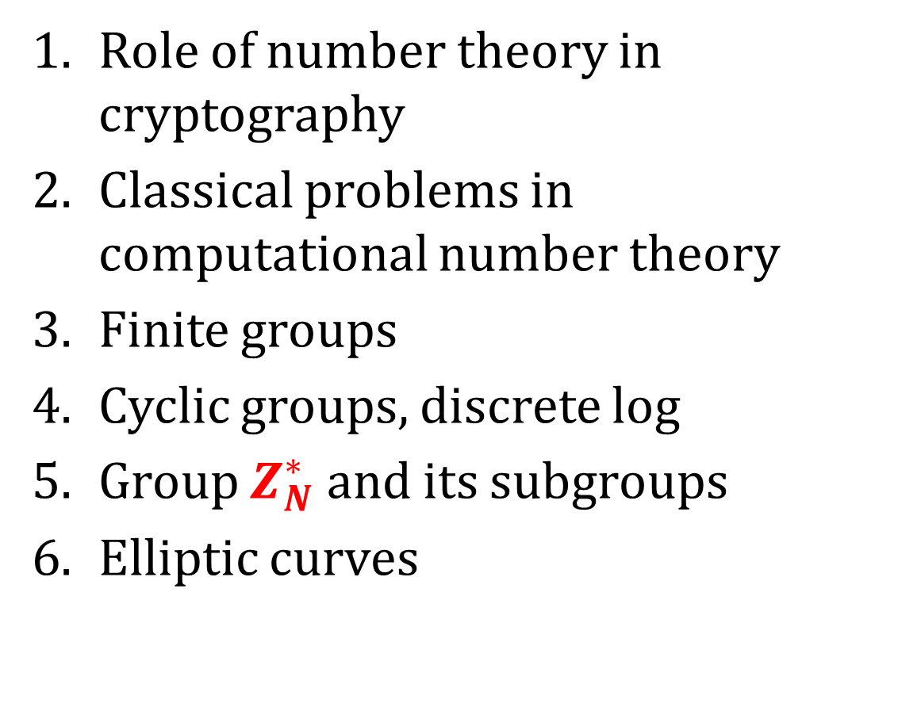
Plan
Role of number theory in cryptography
Classical problems in computational number theory
Finite groups
Cyclic groups, discrete log
Group $Z_{N}^{∗}$ and its subgroups
Elliptic curves

Slide 3
Number theory in cryptography - advantages
security can (in principle) be based on famous mathematical conjectures,
the constructions have a “mathematical structure”, this allows us to create more advanced constructions (public key encryption, digital signature schemes, and many others...).
the constructions have a natural security parameter (hence they can be “scaled”).
Additional advantage
a practical application of an area that was never believed to be practical... (a wonderful argument for all theoreticians!)

Slide 4
Number theory in cryptography - disadvantages
cryptography based on number theory is much less efficient!
the number-theoretic “structure” may help the cryptanalyst...

Slide 5
Number theory as a source of hard problems
In this lecture we will look at some basic number-theoretic problems,
identifying those that may be useful in cryptography.

Slide 6
Plan
Role of number theory in cryptography
Classical problems in computational number theory
Finite groups
Cyclic groups, discrete log
Group $Z_{N}^{∗}$ and its subgroups
Elliptic curves

Slide 7
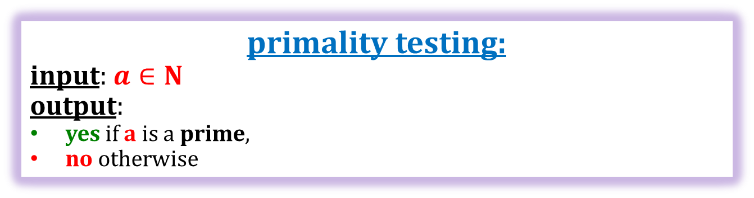
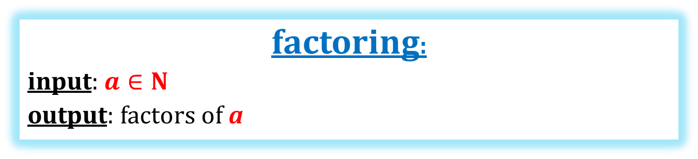
Famous algorithmic problems in number theory
primality testing:
input: $a∈N$
output:
yes if a is a prime,
no otherwise
this problem is
computationally easy
factoring:
input: $a∈N$
output: factors of a
this problem is believed to be computationally hard if a is a product of two long random primes p and q, of equal length.

Slide 8

Primality testing
x – the number that we want to test
Sieve of Eratosthenes (ca. 240 BC): takes $\sqrt{x}$ steps, which is exponential in |x| = log₂ x
Miller-Rabin test (late 1970s) is probabilistic:
if x is prime it always outputs yes
if x is composite it outputs yes with probability at most ¼.
Probability is taken only over the internal randomness of the algorithm, so we can iterate!
The error goes to zero exponentially fast.
This algorithm is fast and practical!
Deterministic algorithm of Agrawal et al. (2002) polynomial but very inefficient in practice

Slide 9
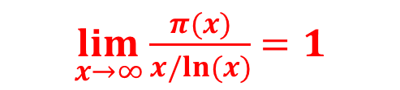
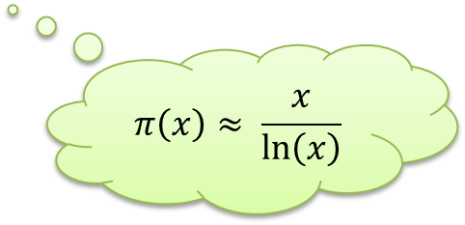
How to select a random prime of length n?
Select a random number x and test if it is prime.
Prime Number Theorem
Let
π(x) := number of n’s such that n ∈ {1,...,x} and n is prime
Then
$\lim_{x→∞}⁡\frac{π(x)}{x/ln⁡(x)}$ $=1$
$$π\left(x\right)≈ \frac{x}{\ln\left(x\right)}$$
For example, if x = 2¹⁰⁰⁰ then
π(x)/x ≈ 0.0014
Hence, the set of primes is “dense”.

Slide 10
Factoring is believed to be hard!
Factoring assumption.
Take random primes p and q of length n.
Set N = pq.
No polynomial-time algorithm that is given N can find p and q in with a non-negligible probability.
Factoring is a subject of very intensive research.
Currently |N|=2048 is believed to be a safe choice.

Slide 11
So we have a one-way function!
f(p,q) = pq is one-way.
(assuming the factoring assumption holds).
Using the theoretical results [HILL99] this is enough to construct secure encryption schemes.
It turns out that we can do much better:
based on the number theory we can construct efficient schemes,
that have some very nice additional properties (public key cryptography!)
But how to do it?
We need to some more maths...

Slide 12
Notation
Suppose a and b are integers, such that a ≠ 0
a | b:
a divides b, or
a is a divisor of b, or
a is a factor of b (if a ≠ 1 then a is a non-trivial factor of b)
gcd(a,b) = “the greatest common divisor of a and b”
lcm(a,b) = “the least common multiple of a and b”
If gcd(a,b) = 1 then we say that
a and b are relatively prime.

Slide 13
Facts about gcd(a,b)
Let a and b be positive integers.
There always exist integers X and Y such that
Xa + Yb = gcd (a,b)
Moreover
X, Y, and gcd(a,b) can be computed using the extended Euclidian algorithm.

Slide 14
Plan
Role of number theory in cryptography
Classical problems in computational number theory
Finite groups
Cyclic groups, discrete log
Group $Z_{N}^{∗}$ and its subgroups
Elliptic curves

Slide 15
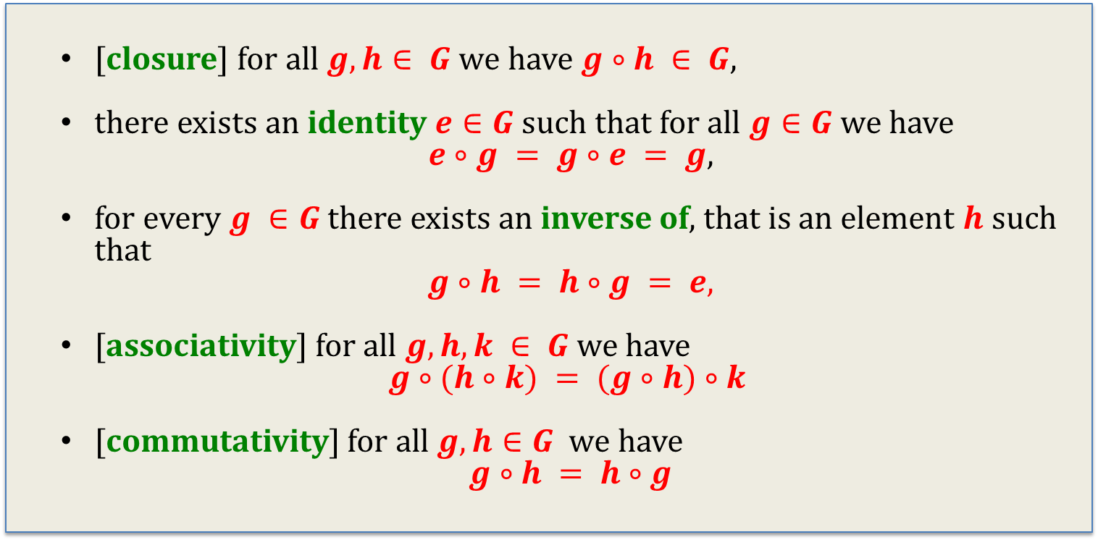
Groups
A group is a set $G$ along with a binary operation $∘$ such that:
[closure] for all $g,h∈ G$we have $g∘h ∈ G$,
there exists an identity $e∈G$such that for all $g∈G$we have
$e∘g = g∘e = g$,
for every $g ∈G$there exists an inverse of, that is an element $h$ such that
$$g∘h = h∘g = e,$$
[associativity] for all $g,h,k ∈ G$we have
$$g∘(h∘k) = (g∘h)∘k$$
[commutativity] for all $g,h∈G$we have
$$g∘h = h∘g$$
if this holds, the group is called abelian

Slide 16
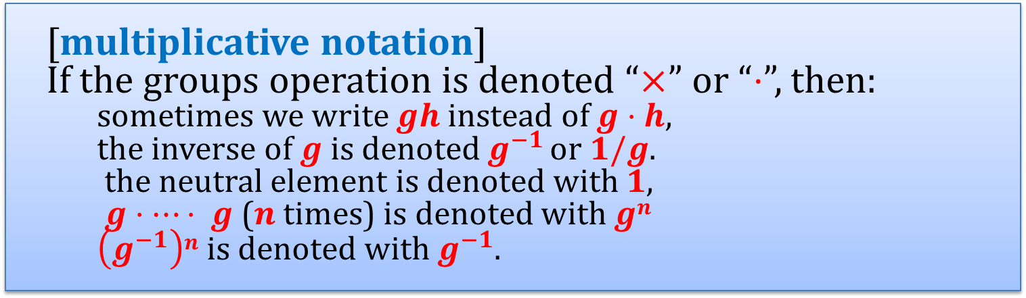
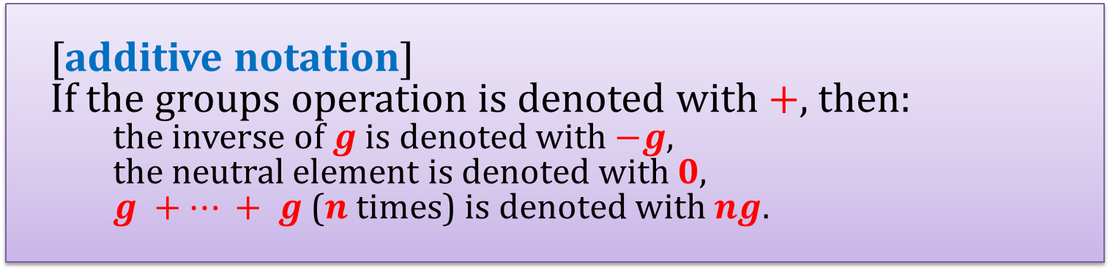
Additive/multiplicative notation
Convention:
[additive notation] If the groups operation is denoted with $+$, then:
the inverse of $g$ is denoted with $−g$,
the neutral element is denoted with $0$,
$g +⋯ + g$($n$ times) is denoted with $ng$.
[multiplicative notation] If the groups operation is denoted “$×$” or “$⋅$”, then:
sometimes we write $gh$ instead of $g⋅h$,
the inverse of $g$ is denoted $g^{−1 }$or $1/g$.
the neutral element is denoted with $1$,
$g⋅⋯⋅ g$($n$times) is denoted with $gn$
$\left(g^{−1}\right)n$is denoted with $g^{−1}$.

Slide 17
Subgroups
A group G is a subgroup of H if
G is a subset of H,
the group operation ○ is the same as in H

Slide 18

A cross product of groups
(G,○) and (H,□) – groups
Define a group (G × H, •) as follows:
the elements of G × H are pairs (g,h), where $g∈G$and $h∈H$.
(g,h) • (g’,h’) = (g ○ g’, h □ h’).
It is easy to verify that it is a group.

Slide 19
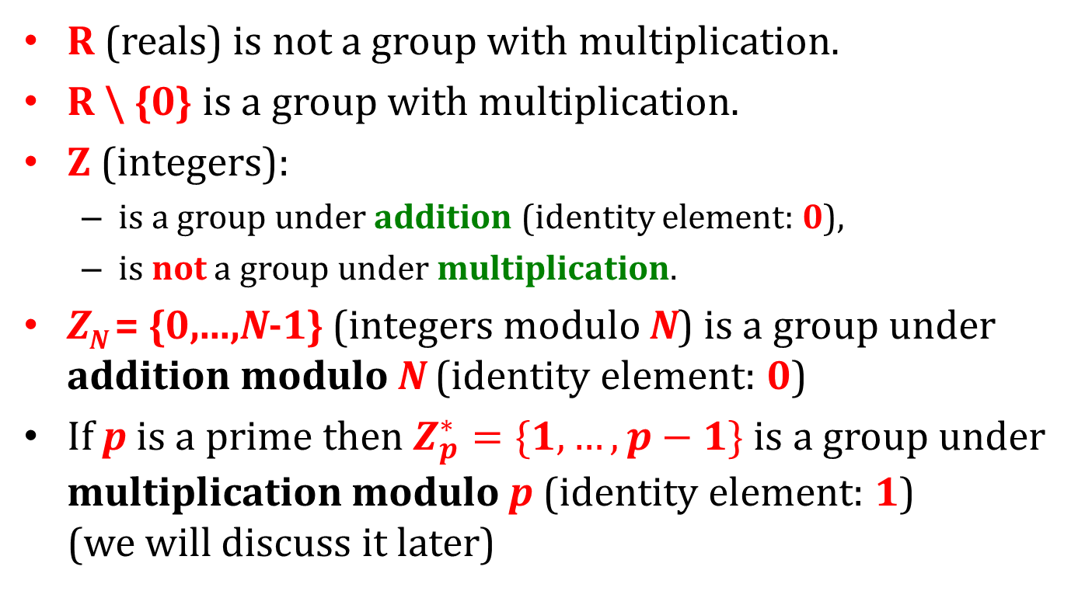
Examples of groups
R (reals) is not a group with multiplication.
R \ {0} is a group with multiplication.
Z (integers):
is a group under addition (identity element: 0),
is not a group under multiplication.
Z_{N} = {0,...,N-1} (integers modulo N) is a group under addition modulo N (identity element: 0)
If p is a prime then $Z_{p}^{∗}=\{1,…,p−1\}$ is a group under multiplication modulo p (identity element: 1) (we will discuss it later)

Slide 20
Z_{N} is a group under addition. Is it also a group under multiplication?
No: 0 doesn’t have an inverse.
What about other elements of Z_{N}?
Example N = 12.
 | 0 | 1 | 2 | 3 | 4 | 5 | 6 | 7 | 8 | 9 | 10 | 11
0 | 0 | 0 | 0 | 0 | 0 | 0 | 0 | 0 | 0 | 0 | 0 | 0
1 | 0 | 1 | 2 | 3 | 4 | 5 | 6 | 7 | 8 | 9 | 10 | 11
2 | 0 | 2 | 4 | 6 | 8 | 10 | 0 | 2 | 4 | 6 | 8 | 10
3 | 0 | 3 | 6 | 9 | 0 | 3 | 6 | 9 | 0 | 3 | 6 | 9
4 | 0 | 4 | 8 | 0 | 4 | 8 | 0 | 4 | 8 | 0 | 4 | 8
5 | 0 | 5 | 10 | 3 | 8 | 1 | 6 | 11 | 4 | 9 | 2 | 7
6 | 0 | 6 | 0 | 6 | 0 | 6 | 0 | 6 | 0 | 6 | 0 | 6
7 | 0 | 7 | 2 | 9 | 4 | 11 | 6 | 1 | 8 | 3 | 10 | 5
8 | 0 | 8 | 4 | 0 | 8 | 4 | 0 | 8 | 4 | 0 | 8 | 4
9 | 0 | 9 | 6 | 3 | 0 | 9 | 6 | 3 | 0 | 9 | 6 | 3
10 | 0 | 10 | 8 | 6 | 4 | 2 | 0 | 10 | 8 | 6 | 4 | 2
11 | 0 | 11 | 10 | 9 | 8 | 7 | 6 | 5 | 4 | 3 | 2 | 1
Only: 1,5,7,11 have an inverse!
Why?
Because they are relatively prime to 12.

Slide 21
Observation
If gcd(a,n) > 1 then for every integer b we have
ab mod n ≠ 1.
Proof
Suppose for the sake of contradiction that ab mod n = 1.
Hence we have:
ab = nk + 1
↓
ab - nk = 1
Since gcd(a,n) divides both ab and nk it also divides ab – nk.
Thus gcd(a,n) has to divide 1. Contradiction.
QED

Slide 22


$$Z_{N}^{∗}$$
Define $Z_{N}^{∗}$ $=\{a∈Z_{N}:gcd\left(a,N\right)=1\}$.
Then $Z_{N}^{∗}$ is an abelian group under multiplication modulo N.
Proof
First observe that $Z_{N}^{∗}$ is closed under multiplication modulo N.
This is because is a and b are relatively prime to N, then ab is also relatively prime to N.
Associativity and commutativity are trivial.
1 is the identity element.
It remains to show that for every $a∈Z_{N}^{∗}$ there exist $b∈Z_{N}^{∗}$ that is an inverse of a modulo N.
We say that b is an inverse of a modulo N if:
a · b = 1 mod N

Slide 23
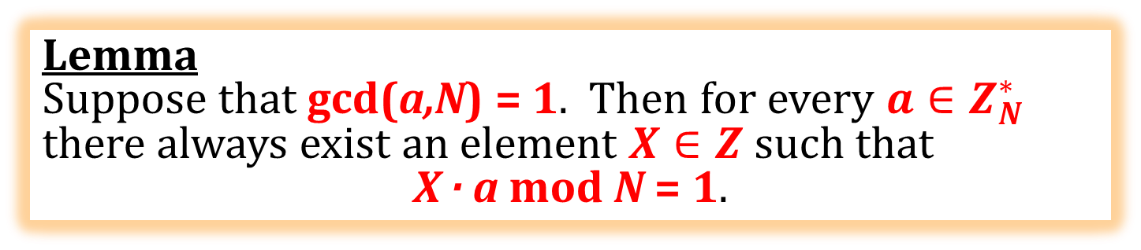
Lemma
Suppose that gcd(a,N) = 1. Then for every ${a∈Z}_{N}^{∗}$ there always exist an element $X∈Z$such that
X · a mod N = 1.
Proof Since gcd(a,N) = 1 there always exist integers X and Y such that
Xa + YN = 1.
Therefore Xa = 1 (mod N).
QED
Observation Such an X can be efficiently computed (using the extended Euclidian algorithm).

Slide 24
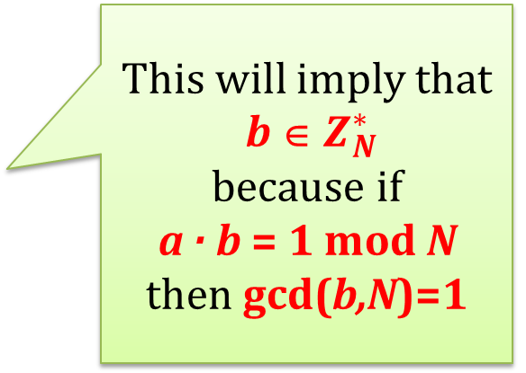
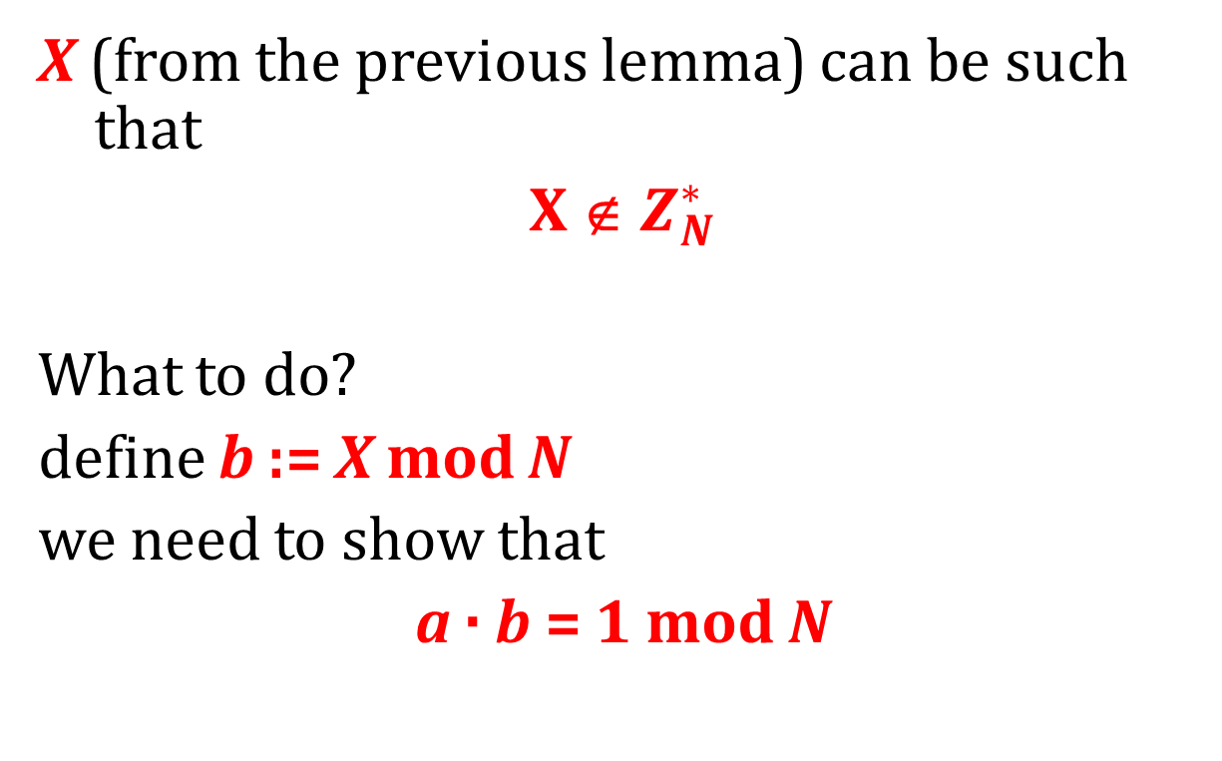
What remains?
X (from the previous lemma) can be such that
X ∉ $Z_{N}^{∗}$
What to do?
define b := X mod N
we need to show that
a · b = 1 mod N
This will imply that
b ∈ $Z_{N}^{∗}$
because if
a · b = 1 mod N
then gcd(b,N)=1

Slide 25
If
b := X mod N
then b = X + tN
So
a b = a · (X + tN)
= aX + atN
= 1 (mod N)
Hence we are done!
Remember that X is such that
aX mod N = 1.

Slide 26
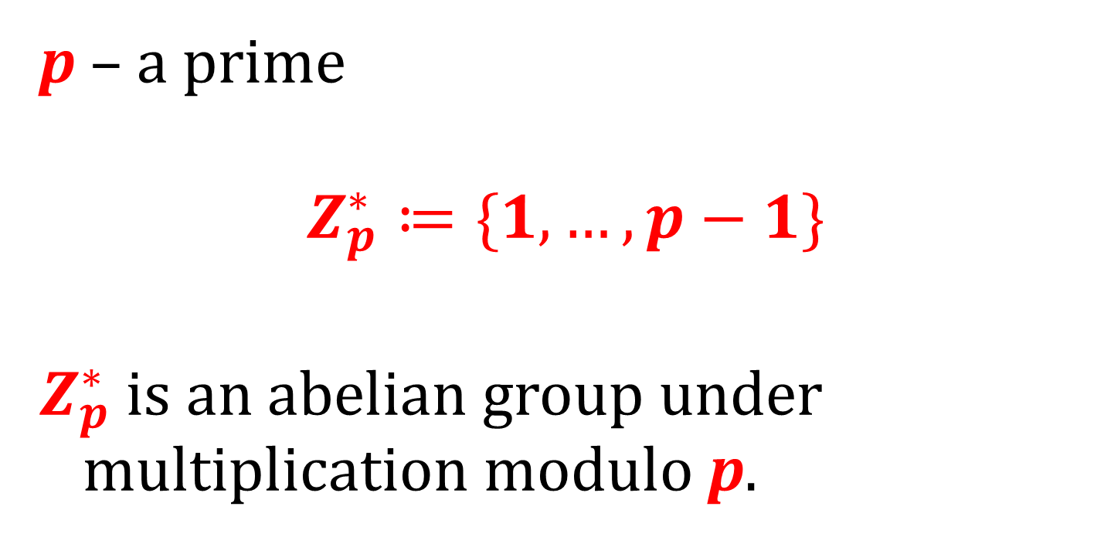
An example
p – a prime
$$Z_{p}^{∗}≔\{1,…,p−1\}$$
$Z_{p}^{∗}$ is an abelian group under multiplication modulo p.

Slide 27

A simple observation
For every $a,b,c∈G$. If
ac = bc
then
a = b.

Slide 28

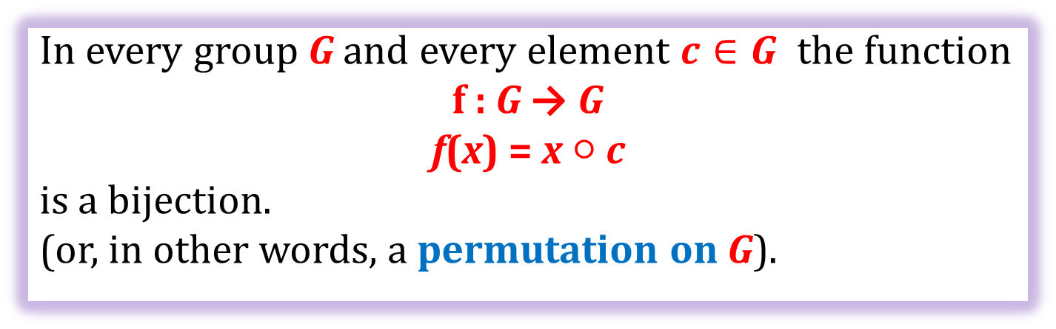
Corollary
In every group G and every element $c∈G$ the function
f : G → G
f(x) = x ○ c
is a bijection.
(or, in other words, a permutation on G).
x | 1 | 2 | 3 | 4 | 5 | 6 | 7 | 8 | 9 | 10
f(x) | 5 | 10 | 4 | 9 | 3 | 8 | 2 | 7 | 1 | 6
f(x) = 5·x mod 11
Example: $Z_{11}^{∗}$
Permutations have cycles. Let’s look now at the cycles that contain 1!

Slide 29
Example: f(x) = 5·x mod 11
4 · 5 = 20 = 9 (mod 11)
9 · 5 = 45 = 1 (mod 11)
1
2
3
4
5
6
7
8
9
10
5 · 5 = 25 = 3 (mod 11)
1
5
3
9
4
3 · 5 = 15 = 4 (mod 11)
1 · 5 = 5 (mod 11)

Slide 30
Example: f(x) = 10·x mod 11
1
2
3
4
5
6
7
8
9
10
1
10

Slide 31
Example: f(x) = 2·x mod 11
1
2
3
4
5
6
7
8
9
10
1
2
4
8
5
10
9
7
3
6

Slide 32
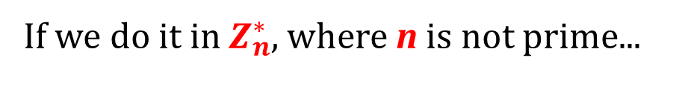
It has to be a cycle!
9
12
6
3
If we do it in $Z_{n}^{∗}$, where n is not prime...
1
for example: n = 15
g = 3
If n is a prime this cannot happen because f(x) = x · g mod n
is a permutation
so we cannot have
f(x₁) = f(x₂)
for x₁ ≠ x₂

Slide 33
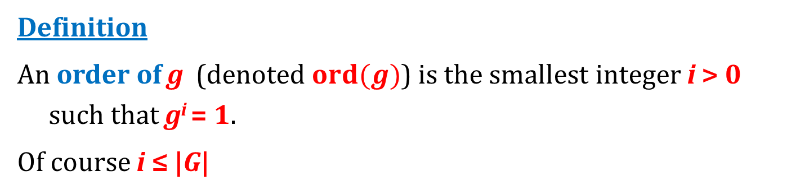
Order of an element
Definition
An order of g (denoted $ord(g)$) is the smallest integer i > 0 such that g^{i} = 1.
Of course i ≤ |G|
1
5
3
4
9
1
5
3
4
9
1
10
1
10
1
10
1
10
1
10
1
2
4
8
5
10
9
7
3
6
g = 5
order: 5
g = 10
order: 2
g = 2
order: 10

Slide 34
Look...
Let m := |$Z_{11}^{∗}$| = 10
1
5
3
4
9
1
5
3
4
9
1
10
1
10
1
10
1
10
1
10
1
2
4
8
5
10
9
7
3
6
g = 5
g = 10
g = 2
we will now show that it’s not a coincidence
Observe: in these examples
g^{m} = 1
the order of g divides the order of the group G.

Slide 35
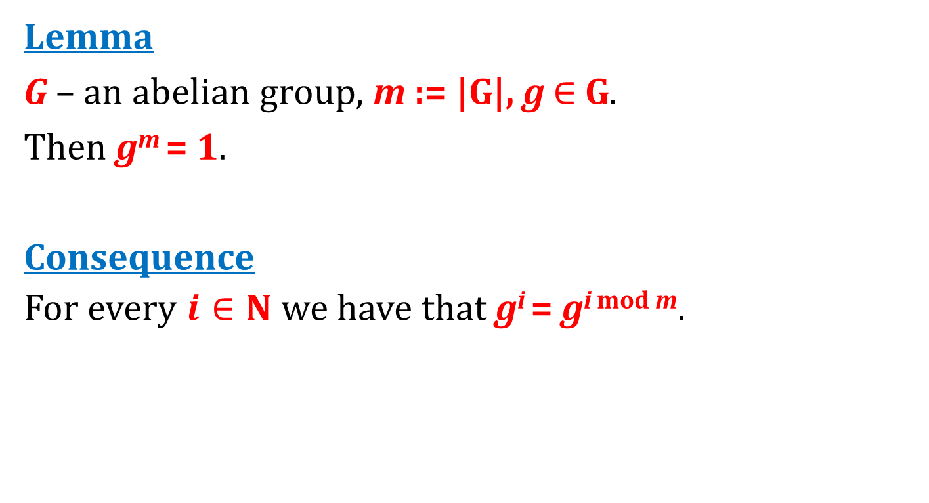
Standard facts
Lemma
G – an abelian group, m := |G|, g $∈$ G.
Then g^{m} = 1.
Consequence
For every $i∈N$ we have that g^{i} = g^{i mod m}.

Slide 36
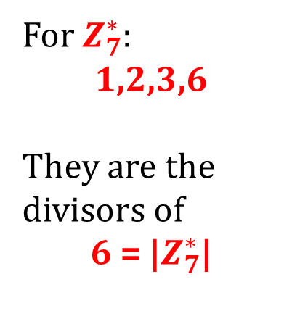
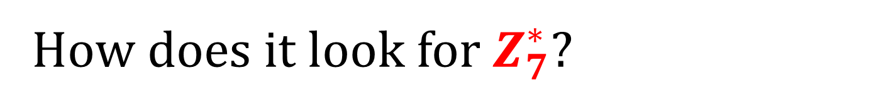
How does it look for $Z_{7}^{∗}$?
1
2
4
1
3
4
5
2
6
For $Z_{7}^{∗}$:
1,2,3,6
They are the divisors of
6 = |$Z_{7}^{∗}$|
g = 2
order: 3
g = 3
order: 6
g = 6
order: 2
g = 1
order: 1
1
6
1

Slide 37
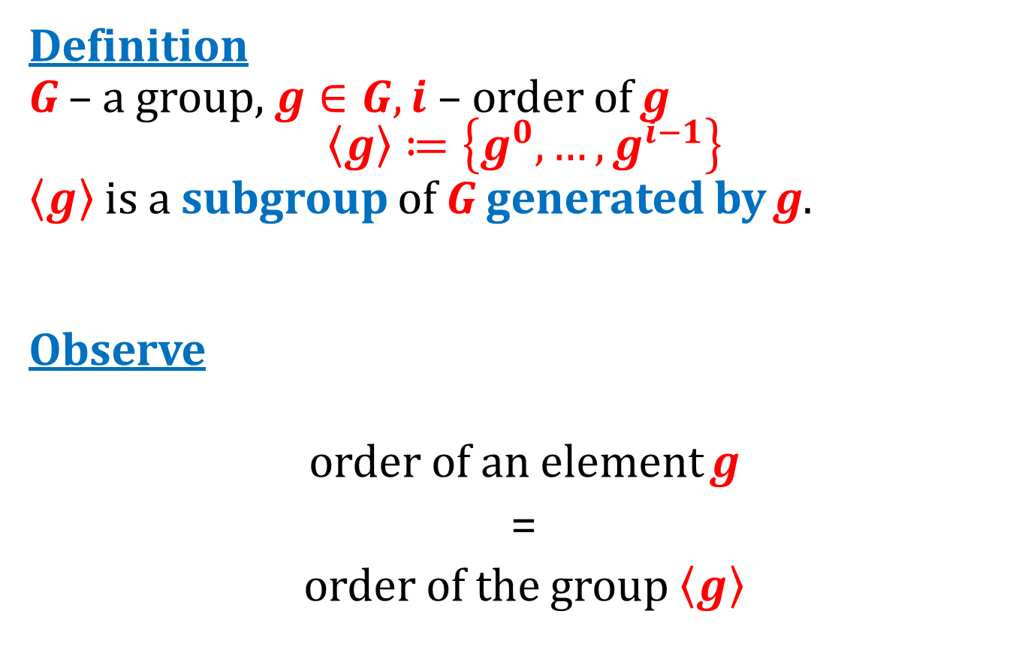
Generated subgroups
Definition
G – a group, $g∈G, i$ – order of g
$$〈g〉≔\left\{g^{0},…,g^{i−1}\right\}$$
$〈g〉$ is a subgroup of G generated by g.
Observe
order of an element g
=
order of the group $〈g〉$

Slide 38
We can now use the Lagrange's Theorem
Lagrange's Theorem
If H is a subgroup of G then
|H| divides |G|
So, that’s why the order of g divided the order of the group G.

Slide 39
Plan
Role of number theory in cryptography
Classical problems in computational number theory
Finite groups
Cyclic groups, discrete log
Group $Z_{N}^{∗}$ and its subgroups
Elliptic curves

Slide 40
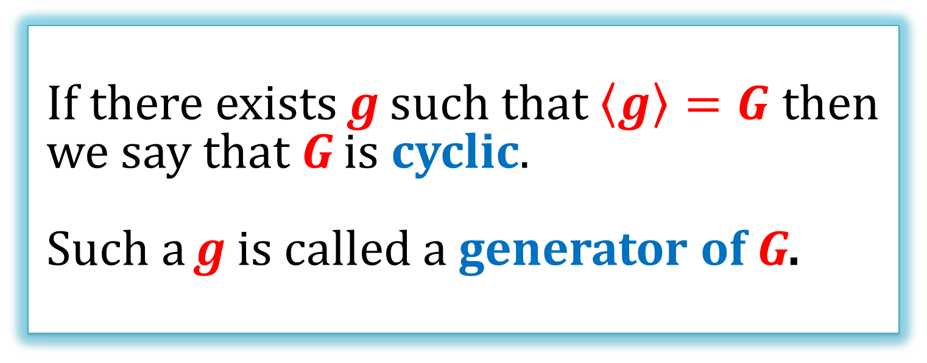
Cyclic groups
If there exists g such that $〈g〉=G$ then we say that G is cyclic.
Such a g is called a generator of G.

Slide 41
Example
1 is a generator of Z₁₀
0
1
2
3
4
5
6
9
7
8

Slide 42
Example
3 is a generator of Z₁₀
0
3
6
9
2
5
8
7
1
4

Slide 43
Example
2 is not a generator of Z₁₀
0
2
4
6
8
0
2
8
4
6

Slide 44
Observation
Every group G of a prime order is cyclic.
Every element g of G, except the identity is its generator.
Proof
The order of g has to divide p.
So, the only possible orders of g are 1 or p.
Only identity has order 1, so all the other elements have order p.
Trivial: x has “order 1” if x¹ = 1

Slide 45


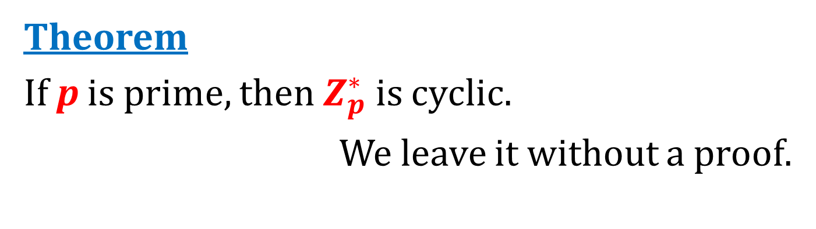
Another fact
Theorem
If p is prime, then $Z_{p}^{∗}$ is cyclic.
We leave it without a proof.
1
2
4
8
5
10
9
7
3
6
1
3
4
5
2
6
We verified that it is true for p=11 and p=7.
$$Z_{11}^{∗}$$ generator
g = 2
$Z_{7}^{∗}$ generator
g = 3

Slide 46
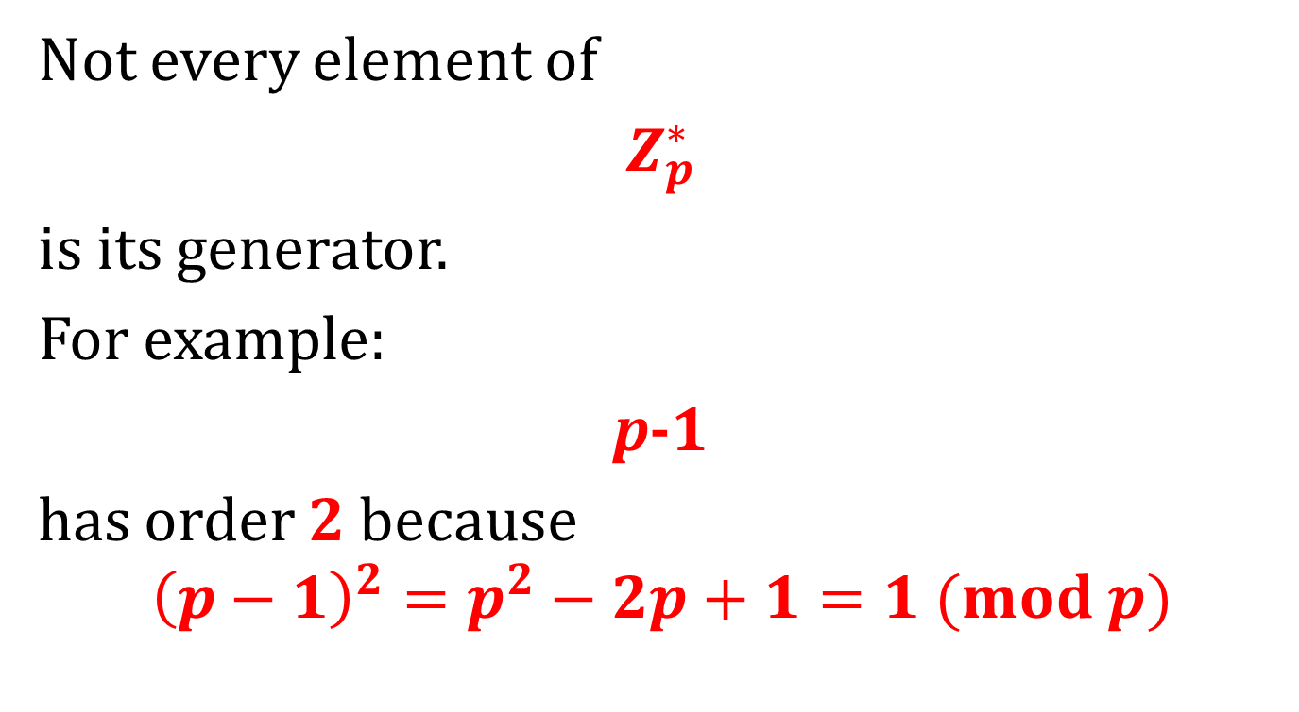
Of course:
Not every element of
$Z_{p}^{∗}$
is its generator.
For example:
p-1
has order 2 because
$${\left(p−1\right)}^{2}=p^{2}−2p+1=1 (mod p)$$

Slide 47
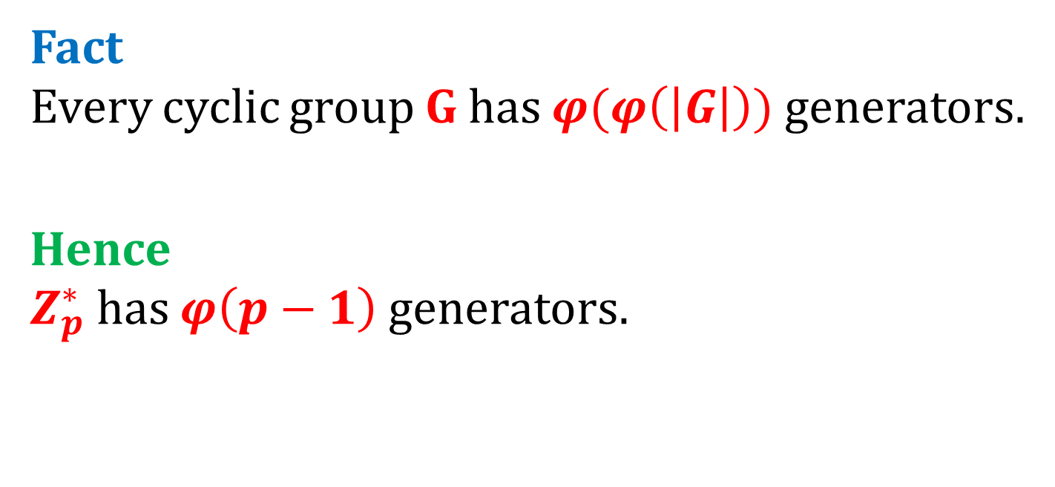
The number of generators
Euler’s function
Fact Every cyclic group G has $φ(φ\left(\left|G\right|\right))$ generators.
Hence $Z_{p}^{∗}$ has $φ\left(p−1\right)$ generators.

Slide 48
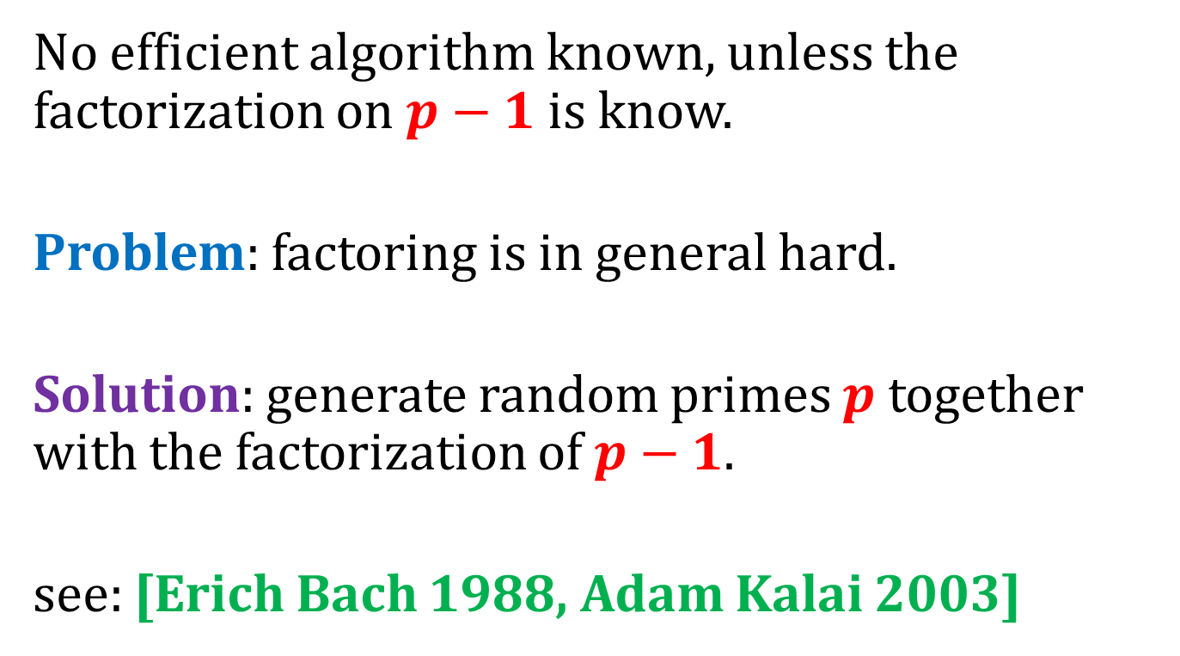

Finding generators of $Z_{p}^{∗}$
No efficient algorithm known, unless the factorization on $p−1$ is know.
Problem: factoring is in general hard.
Solution: generate random primes $p$ together with the factorization of $p−1$.
see: [Erich Bach 1988, Adam Kalai 2003]

Slide 49
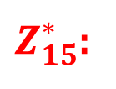
Example of a group that is not cyclic
$Z_{15}^{∗}$:
a
0 | 1 | 2 | 3 | 4 | 5 | 6 | 7 | 8 | 9 | 10 | 11 | 12 | 13 | 14
1
4
1
4
4
1
4
1
8
13
2
7
1
1
1
1
The maximal order is 4...

Slide 50
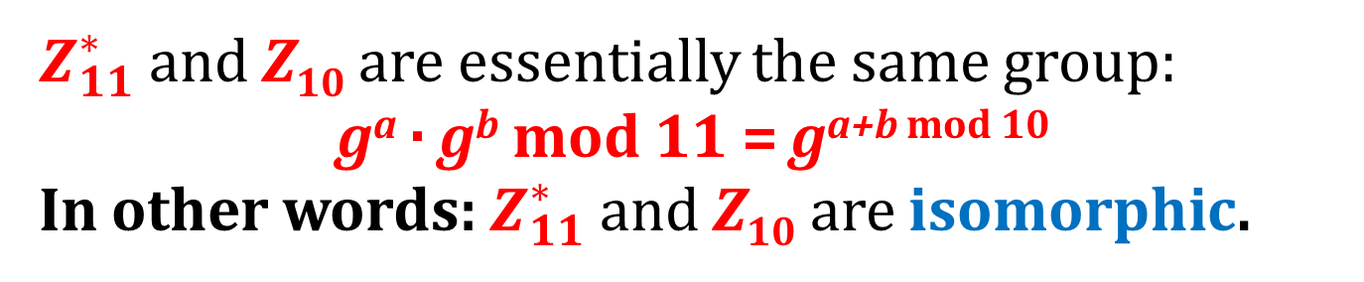
Look...
1
2
4
8
5
10
9
7
3
6
0
1
2
3
4
5
6
9
7
8
8 · 10 = 3
3 + 5 = 8
$Z_{11}^{∗}$ and Z₁₀ are essentially the same group:
gª · g^{b} mod 11 = g^{a+b mod 10}
In other words: $Z_{11}^{∗}$and Z₁₀ are isomorphic.

Slide 51
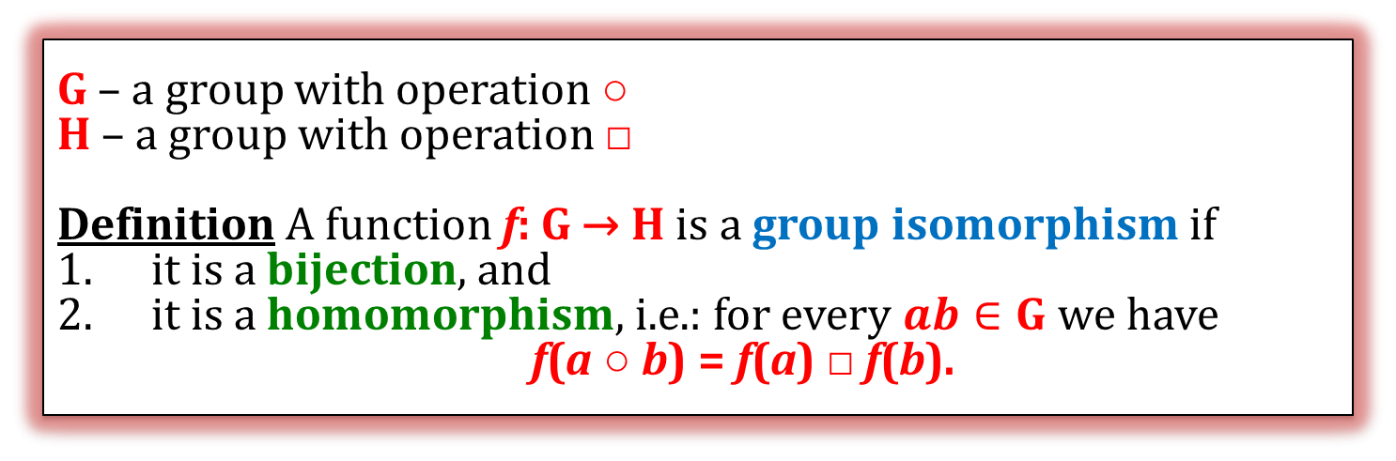
Group isomorphism
G – a group with operation ○
H – a group with operation □
Definition A function f: G → H is a group isomorphism if
it is a bijection, and
it is a homomorphism, i.e.: for every $ab∈G$ we have
f(a ○ b) = f(a) □ f(b).
(a,b)
○
a ○ b
f
f
f(a ○ b)
(f(a), f(b))
□
f(a) □ f(b)
these should be equal

Slide 52
Isomorphic groups
If there exists and isomorphism between G and H, we say that they are isomorphic.
Of course isomorphism is an equivalence relation.

Slide 53
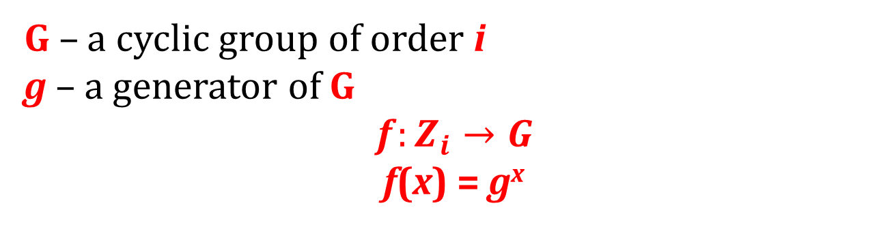
This is an isomorphism
G – a cyclic group of order i
g – a generator of G
$$f:Z_{i}→G$$ f(x) = g^{x}
0
i-1
1
2
3
4
5
⁶
g⁰
g^{i-1}
g¹
g²
g³
g⁴
g⁵
g⁶
f
. . .
. . .
G
Why? Because gª · g^{b} = g^{a+b mod i}

Slide 54
How to compute g^{x} for large x?
If the multiplication is easy then we can use the “square-and-multiply” method
Example
x in binary
1 | 1 | 0 | 1 | 0 | 1 | 1 | 0 | 1
compute by squaring from right to left
g²⁵⁶
g¹²⁸
g⁶⁴
g³²
g¹⁶
g⁸
g⁴
g²
g¹
g²⁵⁶ | g¹²⁸ |  | g³² |  | g⁸ | g⁴ |  | g¹
multiply
equals to g^{x}
g²⁵⁶ g¹²⁸ g³² g⁸ g⁴ g¹

Slide 55
What about the other direction?
(g – a generator)
It turns out the in many groups inverting
f(x) = g^{x}
is hard!

Slide 56
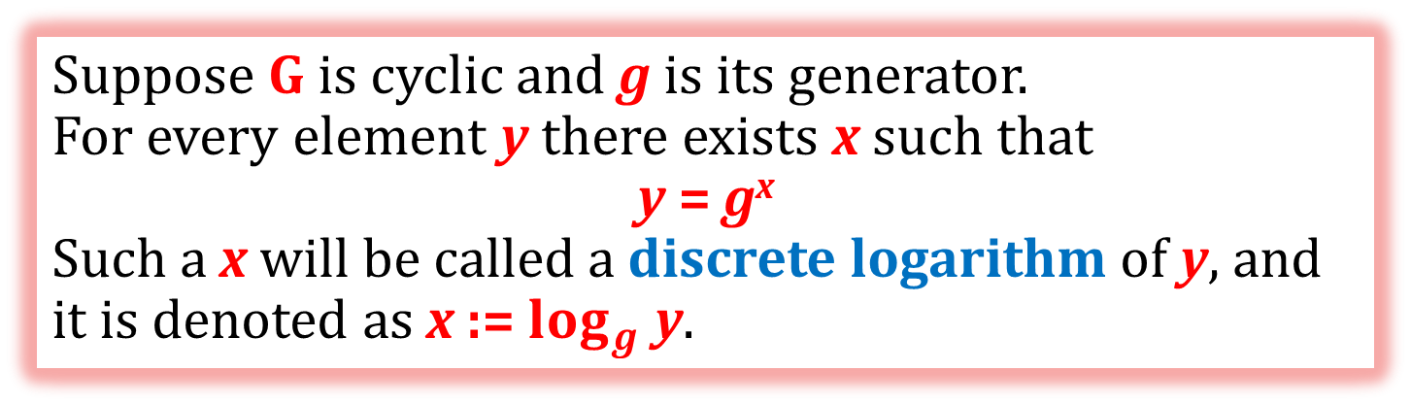
The discrete logarithm
Suppose G is cyclic and g is its generator.
For every element y there exists x such that
y = g^{x}
Such a x will be called a discrete logarithm of y, and it is denoted as x := $\log_{g}⁡$y.
In many groups computing a discrete log is believed to be hard.
Informally speaking:
f: {0,...,|G| - 1} → G defined as f(x) = g^{x} is believed to be a one-way function (in some groups).

Slide 57
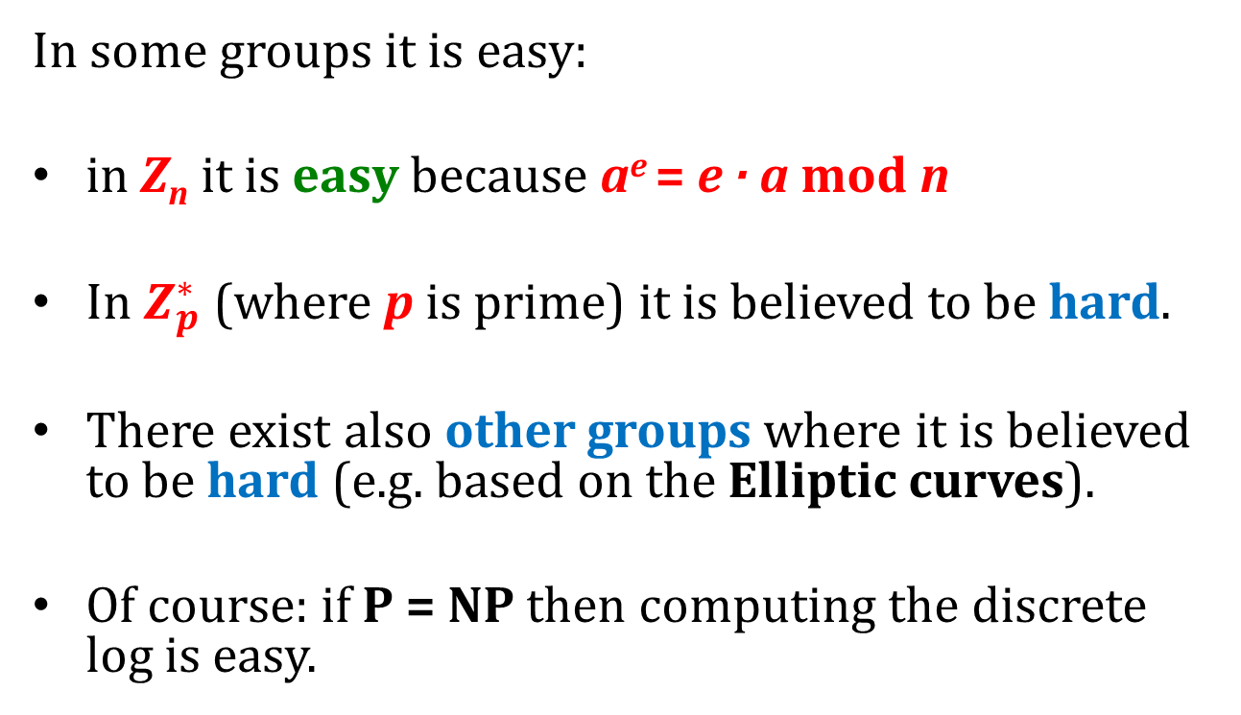
Hardness of the discrete log
In some groups it is easy:
in Z_{n} it is easy because a^{e} = e · a mod n
In $Z_{p}^{∗}$ (where p is prime) it is believed to be hard.
There exist also other groups where it is believed to be hard (e.g. based on the Elliptic curves).
Of course: if P = NP then computing the discrete log is easy.
(in the groups where the exponentiation is easy)

Slide 58
How to define formally “the discrete log assumption”
It needs to be defined for any parameter 1^{n}.
Therefore we need an algorithm H that
on input 1^{n}
outputs:
a description of a cyclic group G of order q, such that |q| = n,
a generator g of G.

Slide 59
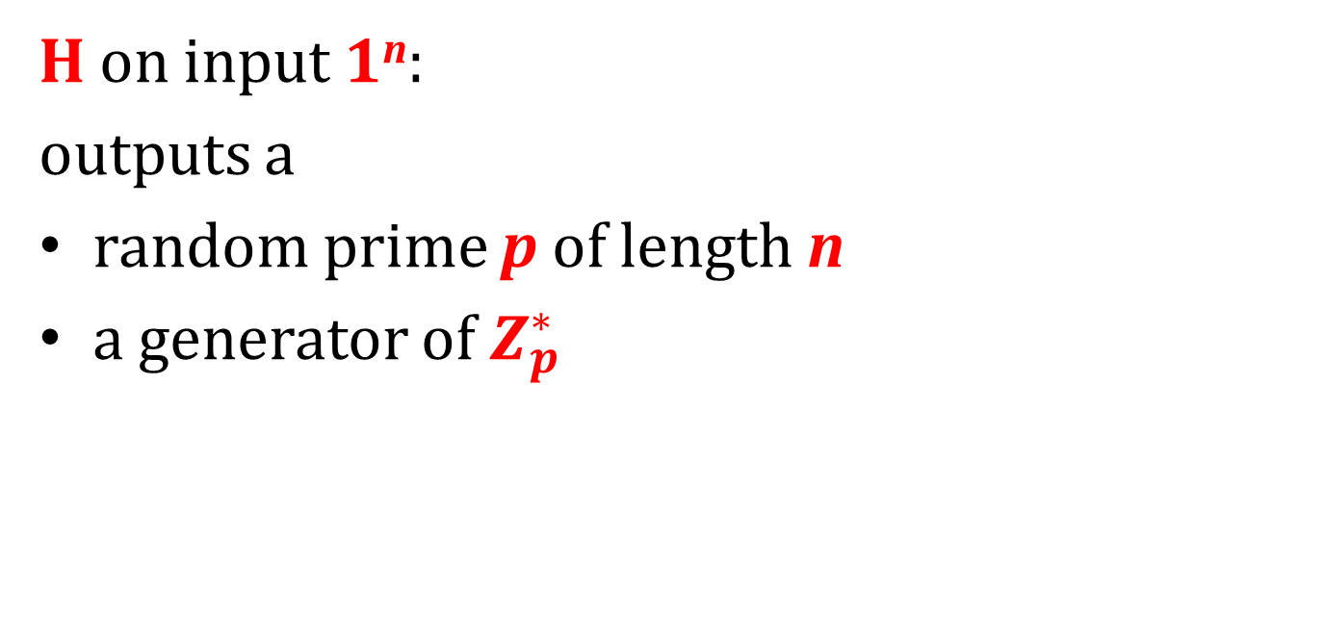
Example
H on input 1^{n}:
outputs a
random prime p of length n
a generator of $Z_{p}^{∗}$

Slide 60

The discrete log assumption
For every algorithm A consider the following experiment:
1^{n}
(G,g,y)
Let (G,g) be the output of H(1^{n}).
Select random y ← G.
algorithm A
output:
x
We say that a discrete logarithm problem is hard with respect to H if
$$∀$$
P(A outputs x such that g^{x} = y) is negligible in n
poly-time algorithm A

Slide 61
One way function?
This looks almost the same as saying that
f(x) = g^{x}
is a one-way function.
The only difference is that the function f depends on the group G that was chosen randomly.
We could formalize it, by defining:
“one-way function families”

Slide 62
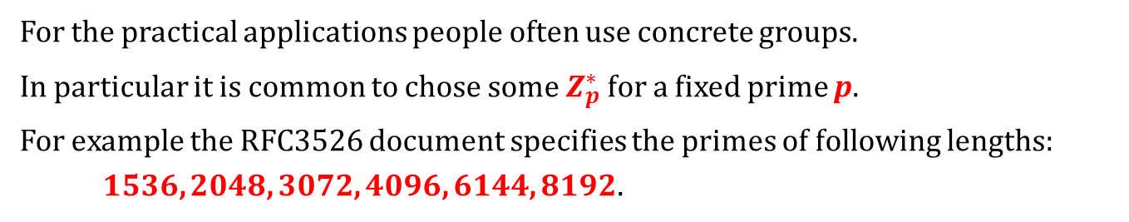
Concrete functions
For the practical applications people often use concrete groups.
In particular it is common to chose some $Z_{p}^{∗}$ for a fixed prime p.
For example the RFC3526 document specifies the primes of following lengths: 1536, 2048, 3072, 4096, 6144, 8192.
This is the 1536-bit prime:
FFFFFFFF FFFFFFFF C90FDAA2 2168C234 C4C6628B 80DC1CD1 29024E08 8A67CC74 020BBEA6 3B139B22 514A0879 8E3404DD EF9519B3 CD3A431B 302B0A6D F25F1437 4FE1356D 6D51C245 E485B576 625E7EC6 F44C42E9 A637ED6B 0BFF5CB6 F406B7ED EE386BFB 5A899FA5 AE9F2411 7C4B1FE6 49286651 ECE45B3D C2007CB8 A163BF05 98DA4836 1C55D39A 69163FA8 FD24CF5F 83655D23 DCA3AD96 1C62F356 208552BB 9ED52907 7096966D 670C354E 4ABC9804 F1746C08 CA237327 FFFFFFFF FFFFFFFF. the generator is: 2.

Slide 63
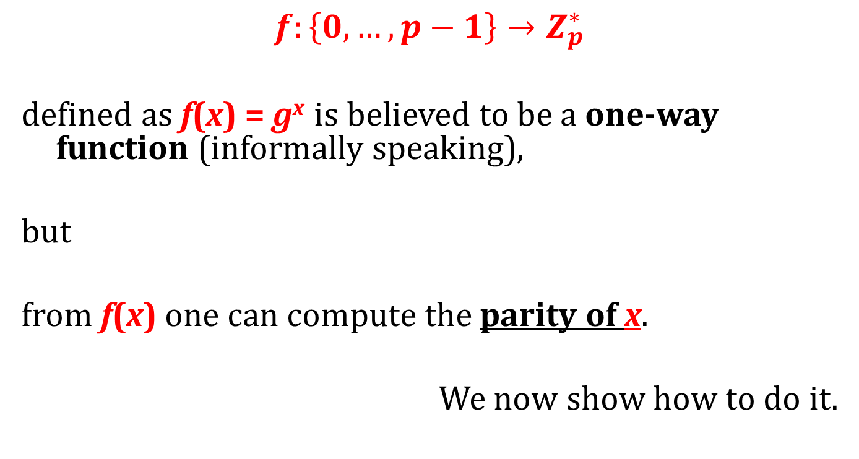
A problem
$$f:\left\{0,…,p−1\right\}→Z_{p}^{∗}$$
defined as f(x) = g^{x} is believed to be a one-way function (informally speaking),
but
from f(x) one can compute the parity of x.
We now show how to do it.

Slide 64
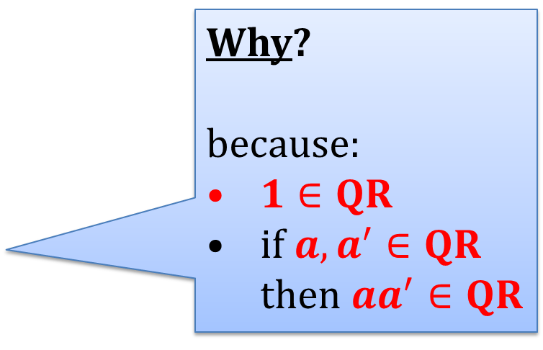
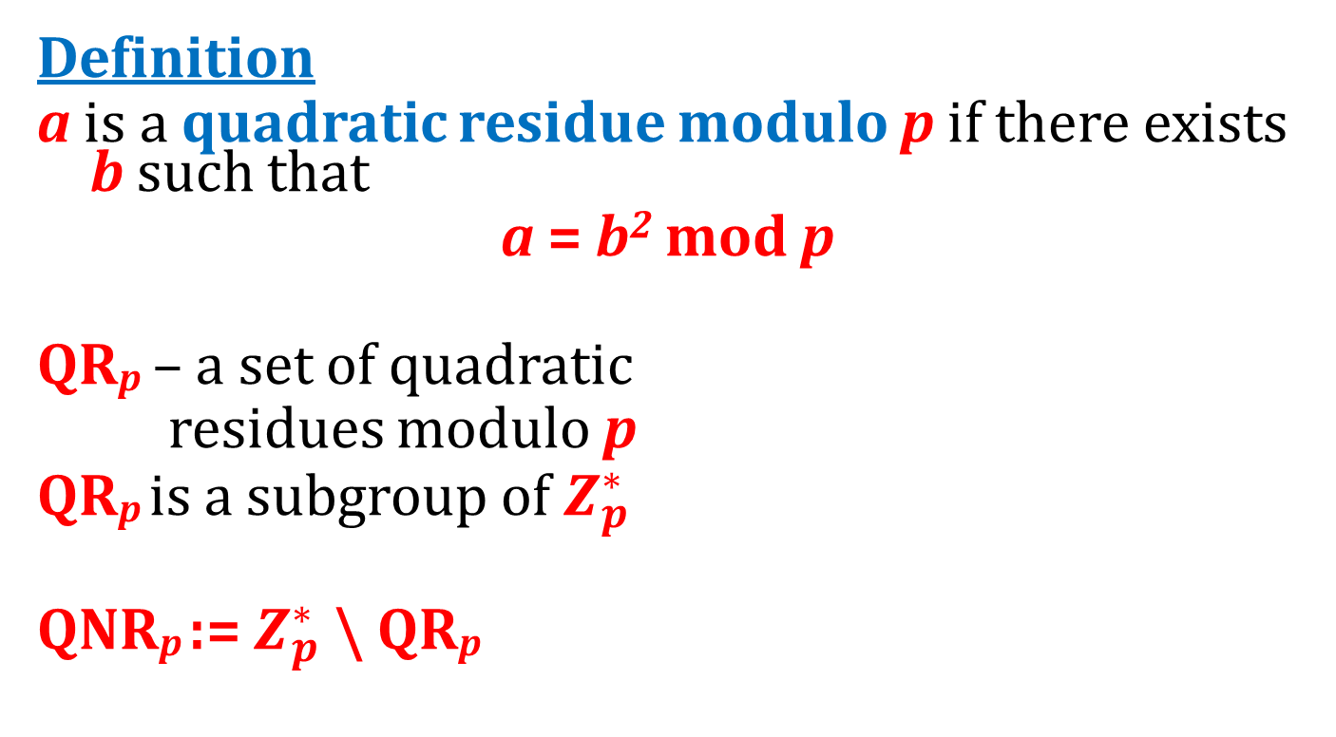
Quadratic Residues
Definition
a is a quadratic residue modulo p if there exists b such that
a = b² mod p
QR_{p} – a set of quadratic
residues modulo p
QR_{p} is a subgroup of $Z_{p}^{∗}$
QNR_{p} := $Z_{p}^{∗}$ \ QR_{p}
Why?
because:
$1∈QR$
if $a,a^{′}∈QR$ then $aa^{′}∈QR$
What is the size of QR_{p}?

Slide 65
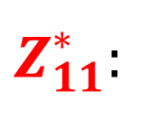
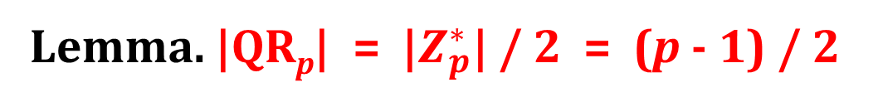
Example: QR₁₁
Observe:
(p – x)² = p² - 2px + x²
= x² mod p
$Z_{11}^{∗}$:
f(x) = x²
1
2
3
QR₁₁:
4
5
3
5
9
4
1
6
7
8
9
10
Lemma. |QR_{p}| = |$Z_{p}^{∗}$| / 2 = (p - 1) / 2

Slide 66
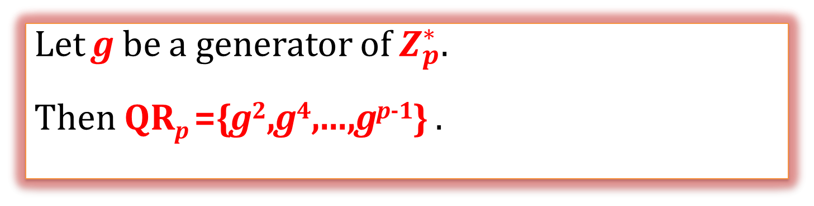
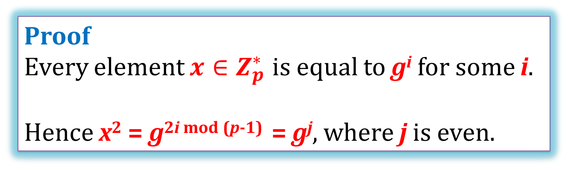
A proof that |QR_{p}| = (p - 1) / 2
Observation
Let g be a generator of $Z_{p}^{∗}$.
Then QR_{p} ={g²,g⁴,...,g^{p-1}} .
Proof
Every element ${x∈Z}_{p}^{∗}$ is equal to g^{i} for some i.
Hence x² = g^{2i mod (p-1)} = g^{j}, where j is even.

Slide 67
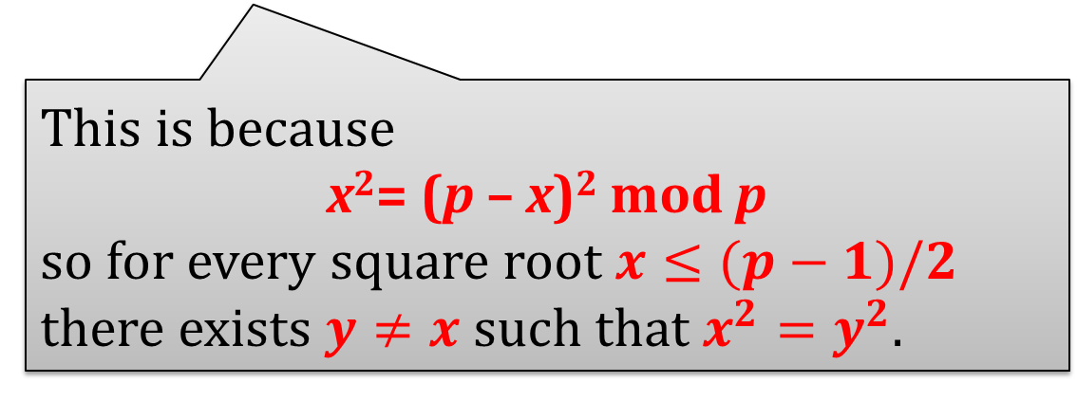
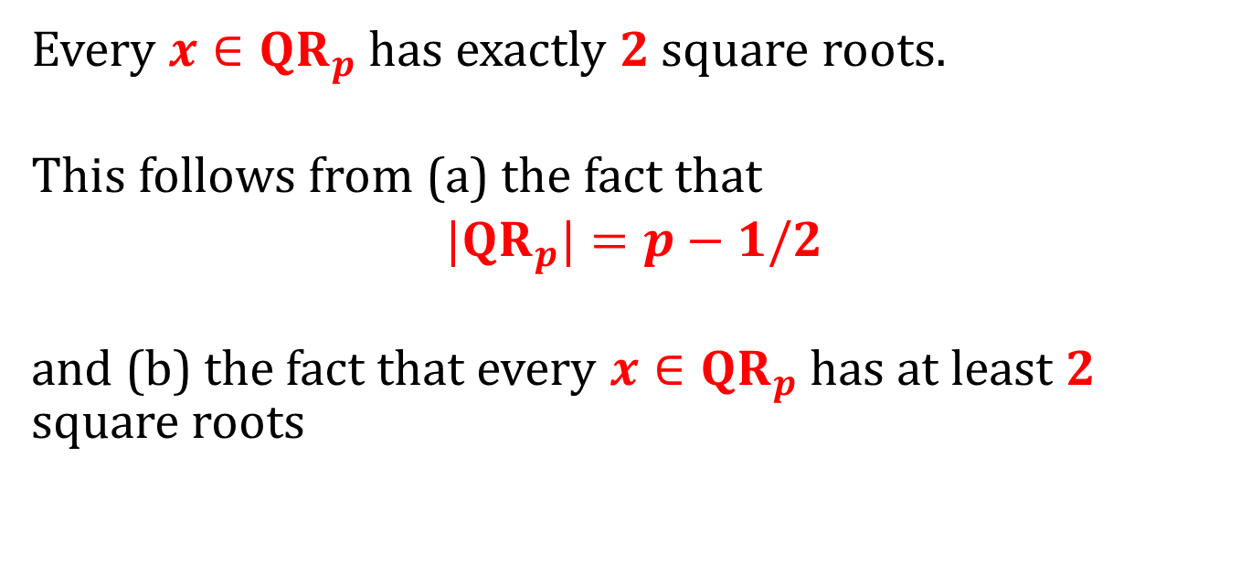

Another simple fact
Every $x∈{QR}_{p}$ has exactly 2 square roots.
This follows from (a) the fact that
${|QR}_{p}|=p−1/2$
and (b) the fact that every $x∈{QR}_{p}$ has at least 2 square roots
This is because
x²= (p – x)² mod p
so for every square root $x≤(p−1)/2$ there exists $y≠x$ such that $x^{2}=y^{2}$.

Slide 68
Example: QR₁₁ = {1,4,5,9,3}
1
2
4
8
5
10
9
7
3
6

Slide 69


Is it easy to test if $a∈QR_{p}$?
Yes!
Observation
$a∈QR_{p}$iff a^{(p-1)/2} = 1 (mod p)
Proof
(→)
If $a∈QR_{p}$ then a = g^{2i}.
Hence
a^{(p-1)/2}
=
(g^{2i})^{(p-1)/2}
=
g^{i(p-1)} = 1.

Slide 70
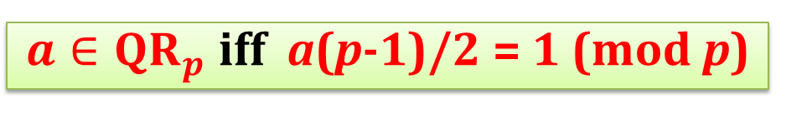
$a∈QR_{p}$ iff a(p-1)/2 = 1 (mod p)
(←)
Suppose a is not a quadratic residue.
Then a = g^{2i+1}. Hence
a^{(p-1)/2}
= (g^{2i+1})^{(p-1)/2}
= g^{i(p-1)} · g^{(p-1)/2}
= g^{(p-1)/2}
which cannot be equal to 1 since g is a generator.
QED

Slide 71
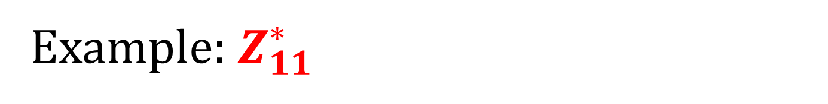
Example: $Z_{11}^{∗}$
(11 – 1)/2 = 5
1
2
4
8
5
10
9
7
3
6
1
10
1
10
1
10
1
10
1
10
f(x) = x⁵
1
-1
1
-1
1
-1
1
-1
1
-1
another way to look at it:
Not a coincidence:
(x^{(p-1)/2})² = 1 implies that x=±1

Slide 72

Hence we get a problem:
g – a generator of $Z_{p}^{∗}$
f: {0,...,p - 1} → $Z_{p}^{∗}$ defined as f(x) = g^{x} is a one-way function, but
from f(x) one can compute the parity of x
(by checking if $f\left(x\right)∈QR$)...
For some applications this is not good.
(but sometimes people don’t care)

Slide 73

What to do?
Instead of working in $Z_{p}^{∗}$ work in its subgroup: QR_{p}
How to find a generator of QR_{p}?
Choose p that is a strong prime, that is:
p = 2q + 1, with q prime.
Hence QR_{p} has a prime order (q).
Every element (except of 1) of a group of a prime order is its generator!
Therefore: every element of QR_{p} is a generator. Nice...

Slide 74

Example
11 is a strong prime (because 5 is a prime)
1
2
4
8
5
10
9
7
3
6
1
4
5
9
3
$$Z_{11}^{∗}$$
QR₁₁

Slide 75

How to compute square roots modulo a prime p?
We show it only for p = 3 (mod 4) (for p = 1 (mod 4) this fact also holds, but the algorithm and the proof are more complicated).
How to compute square root of x in reals?
One method: compute x^{½}
Problem “½” doesn’t make sense in $Z_{n}^{∗}$...

Slide 76


Hence: order of QR_{p}
is equal to (p-1)/2 = (4m+2)/2 = 2m + 1
Write p = 4m + 3.
Fact $\sqrt{x}=x^{m+1}$
Proof:
x^{2m+1} is equal to 1 because of this
(x^{m+1})²
= x^{2(m+1)}
= x^{2m+1+1}
= x^{2m+1} $⋅$ x¹
= x¹

Slide 77
Plan
Role of number theory in cryptography
Classical problems in computational number theory
Finite groups
Cyclic groups, discrete log
Group $Z_{N}^{∗}$ and its subgroups
Elliptic curves

Slide 78

Chinese Remainder Theorem (CRT)
Let N = pq, where p and q are two distinct primes.
Define: f(x) := (x mod p, x mod q)
Chinese Remainder Theorem (CRT):
f is an isomorphism between
Z_{N} and $Z_{p}×Z_{q}$
$Z_{N}^{∗}$ and $Z_{p}^{∗}×Z_{q}^{∗}$
To prove it we need to show that
f is a homorphism .
between Z_{N} and $Z_{p}×Z_{q}$, and
between $Z_{N}^{∗}$ and $Z_{p}^{∗}×Z_{q}^{∗}$.
f is a bijection:
between Z_{N} and $Z_{p}×Z_{q}$, and
between $Z_{N}^{∗}$ and $Z_{p}^{∗}×Z_{q}^{∗}$.

Slide 79

$f:Z_{N}→Z_{p}×Z_{q}$ is a homomorphism
Proof:
f(a + b)
=
(a + b mod p, a + b mod q)
=
(((a mod p) + (b mod p)) mod p, ((a mod q) + (b mod q)) mod q)
=
(a mod p, a mod q) + (b mod p, b mod q)
=
f(a) + f(b)

Slide 80

$f:Z_{N}^{∗}→Z_{p}^{∗}×Z_{q}^{∗}$ is a homomorphism
Proof:
f(a · b)
=
(a · b mod p, a · b mod q)
=
(((a mod p) · (b mod p)) mod p, ((a mod q) · (b mod q)) mod q)
=
(a mod p, a mod q) · (b mod p, b mod q)
=
f(a) · f(b)

Slide 81
An example
Z₁₅:
i
0 | 1 | 2 | 3 | 4 | 5 | 6 | 7 | 8 | 9 | 10 | 11 | 12 | 13 | 14
i mod 5
0 | 1 | 2 | 3 | 4 | 0 | 1 | 2 | 3 | 4 | 0 | 1 | 2 | 3 | 4
i mod 3
0 | 1 | 2 | 0 | 1 | 2 | 0 | 1 | 2 | 0 | 1 | 2 | 3 | 1 | 2
i mod 5
0 1 2 3 4
0
1
2
3
0
6
12
9
i mod 3
10
1
7
13
4
5
11
2
8
14

Slide 82
By the way: it’s not always like this!
Consider p = 4 and q = 6:
Z₂₄:
i mod 6
 | 0 | 1 | 2 | 3 | 4 | 5
0 | 0,12 |  | 8,20 |  | 4,16
1 |  | 1,13 |  | 9,21 |  | 5,17
2 | 6,18 |  | 2,14 |  | 10,22
3 |  | 7,19 |  | 3,15 |  | 11,23
i mod 4

Slide 83


If p and q are distinct primes then $f:Z_{N}→Z_{p}×Z_{q}$ is a bijection
f(x) := (x mod p, x mod q)
because p and q are distinct primes
Proof:
We first show that it is injective.
If f(i) = f(j) then
i mod p = j mod p → p divides i-j
and i mod q = j mod q → q divides i-j
Since |Z_{N}| = N = pq = |Z_{p} $×$ Z_{q}| we are done!
N=pq divides i-j
i = j mod N

Slide 84





$f:Z_{N}^{∗}→Z_{p}^{∗}×Z_{q}^{∗}$ is also a bijection
Since we have shown that f is injective it is enough to show that
$$\left|Z_{N}^{∗}\right|=\left|Z_{p}^{∗}\right|×|Z_{q}^{∗}|$$
= (p-1)(q-1)
$$Z_{5}^{∗}$$
Look at Z₁₅:
0 1 2 3 4
0
0
6
12
3
9
$$Z_{3}^{∗}$$
1
10
1
7
13
4
$$Z_{15}^{∗}$$
2
5
11
2
8
14

Slide 85


N = pq
Which elements of Z_{N} are not in $Z_{N}^{∗}$?
0
multiples of p: {p,...,(q-1)p} (there are q-1 of them)
multiples of q: {q,...,(p-1)q} (there are p-1 of them).
Summing it up: 1 + (q - 1) + (p - 1) = q + p -1
These sets are disjoint since p and q are distinct primes
= pq - p - q + 1 = (p - 1)(q - 1)
So $Z_{N}^{∗}$ has pq - (q + p - 1) elements.
QED

Slide 86


How does it look for large p and q?
Z_{N}
mod p
$$Z_{N}^{∗}$$
mod q
technical assumption: p ≠ q
we will often forget to mention it
(since for large p and q the probability that this p = q is negligible)
pq is called RSA modulus $Z_{N}^{∗}$ is called an RSA group

Slide 87
Fact
(f(x) := (x mod p, x mod q))
f is easy to compute (this is trivial)
f⁻¹ is also easy to compute (this is also a simple fact)

Slide 88
The inverse of f(x) := (x mod p, x mod q)
Let
c₁ := (q mod p)⁻¹ mod p
c₂ := (p mod q)⁻¹ mod q
Then
g(y₁,y₂) := (q c₁ y₁ + p c₂ y₂) mod pq
is the inverse of f.
(exercise)

Slide 89

By the way
Remember that we observed that $Z_{15}^{∗}$ is not cyclic?
Now we know why:
a^{x} mod pq = 1
iff
a^{x} mod p = 1 and a^{x} mod q = 1
iff
x | p - 1 and x | q - 1
iff
x | lcm(p-1,q-1)
for p=3 and q=5 it is equal to:
lcm(2,4) = 4

Slide 90

More general version of CRT
p₁,..., p_{n} – such that for every i and j we have
gcd(p_{i},p_{j})
Define
f(x) := (x mod p₁,..., x mod p_{n})
Let M =$p_{1}⋅⋯⋅p_{n}$ . Then foollowing f is an isomorphism
$$f:Z_{M}→Z_{p_{1}}×⋯×Z_{p_{n}}$$
and
$$f:Z_{M}^{∗}→Z_{p_{1}}^{∗}×⋯×Z_{p_{n}}^{∗}$$
Moreover f and f⁻¹ can be computed efficiently.

Slide 91

Euler’s φ function
Define
φ(N) = |$Z_{N}^{∗}$| = |{$a∈Z_{N}$: gcd(a,N) = 1}|.
Euler’s theorem:
For every $a∈Z_{N}^{∗}$ we have a^{φ(N)} = 1 mod N.
(trivially follows from the fact that for every $g∈G$ we have g^{|G|} = 1).
Special case (“Fermat's little theorem”)
For every prime p and every $a∈\{1,…,p−1\}$ we have
a^{p-1} = 1 mod N.

Slide 92
How to compute φ(N), where N = pq?
Of course if p and q are known then it is easy to compute φ(N), since
φ(N) = (p-1)(q-1).
Hence, computing φ(N) cannot be harder than factoring.
Fact
Computing φ(N) is as hard as factoring N.

Slide 93
Computing φ(N) is as hard as factoring N.
Suppose we can compute φ(N). We know that
(1)
(p-1)(q-1) | = | φ(N)
pq | = | N
(2)
It is a system of 2 equations with 2 unknowns (p and q).
We can solve it:
(2)
p = N/q
(N/q - 1)(q - 1) = φ(N)
it is a quadratic equation so we can solve it (in R)
(1)
q² + (φ(N) – N – 1)q + N = 0

Slide 94

Which problems are easy and which are hard in $Z_{N}^{∗}$ (N = pq)?
multiplying elements?
easy!
finding inverse?
easy! (Euclidean algorithm)
computing φ(N) ?
hard! - as hard as factoring N
raising an element to power e (for a large e)?
easy!
computing eth root (for a large e)?

Slide 95


Computing eth roots modulo N
In other words, we want to invert a function:
${f:Z}_{N}^{∗}→Z_{N}^{∗}$
defined as
f(x) = x^{e} mod N.
This is possible only if f is a permutation.
Lemma f is a permutation if and only if gcd(e, φ(N)) = 1.
In other words: $e∈Z_{φ\left(N\right)}^{∗}$ (note: a “new” group!)

Slide 96

“f(x) = x^{e} mod N is a permutation if and only if gcd(e, φ(N)) = 1.”
1.
f(x) = x^{e} mod N is a permutation
gcd(e, φ(N)) = 1
Let d be an inverse of e in $Z_{φ(N)}^{∗}$. That is:
d is such that d · e = 1 mod φ(N).
Then:
f ^{d}(x)
= (x^{e})^{d}
= x^{ed}
= x^{ed mod φ(N)}
= x¹
2.
f(x) = x^{e} mod N is a permutation
gcd(e, φ(N)) = 1
[exercise]

Slide 97

Computing eth root – easy, or hard?
Suppose gcd(e, φ(N)) = 1
We have shown that the function
f(x) = x^{e} mod N (defined over $Z_{N}^{∗}$)
has an inverse
f⁻¹(x) = x^{d} mod N, where d is an inverse of e in $Z_{φ\left(N\right)}^{∗}$
Moral:
If we know φ(N) we can compute the roots efficiently.
What if we don’t know φ(N)?

Slide 98

Can we compute the eth root if we do not know φ(N)?
It is conjectured to be hard.
This conjecture is called an RSA assumption. More precisely:
RSA assumption
For any randomized polynomial time algorithm A we have:
P(y^{e} = x mod N : y := A(x,N,e)) is negligible
where N = pq where p and q are random primes such that |p| = |q|, and x is a random element of $Z_{N}^{∗}$, and e is random element of $Z_{φ(N)}^{∗}$

Slide 99
What can be shown?
Does the RSA assumption follow from the assumption that factoring is hard?
We don’t know...
What can be shown is that
computing d from e is not easier
than factoring N.

Slide 100


f(x) = x^{e}
$$Z_{N}^{∗}$$
easy
$$Z_{N}^{∗}$$
easy (if you know p,q)
believed to be hard (otherwise)
Functions like this are called trap-door one-way permutations.
f is called an RSA function and is extremely important.

Slide 101

Outlook
N – a product of two large primes
factoring N
is hard
computing eth roots in$Z_{N}^{∗}$ is hard
computing φ(N)
hard
P ≠ NP
computing d from e
is hard

Slide 102
Square roots modulo N=pq
So, far we discussed a problem of computing the eth root modulo N.
What about the case when e = 2?
Clearly gcd(2,φ(N)) ≠ 1, so f(x) = x² is not a bijection.
Question
Which elements have a square root modulo N?

Slide 103



Quadratic Residues modulo pq
$Z_{15}^{∗}$:
a
0 | 1 | 2 | 3 | 4 | 5 | 6 | 7 | 8 | 9 | 10 | 11 | 12 | 13 | 14
a²
0 | 1 | 4 | 3 | 1 | 5 | 6 | 4 | 4 | 9 | 10 | 1 | 12 | 4 | 1
$QR_{15}$:
1 | 4
Observation: every quadratic residue modulo 15 has exactly 4 square roots, and hence |$QR_{15}$| = |$Z_{15}^{∗}$| / 4.

Slide 104





A lemma about QRs modulo pq
Fact: For N=pq we have |$QR_{N}$| = |$Z_{N}^{∗}$| / 4.
Proof:
$$x∈QR_{N}$$
iff
x = a² mod N, for some a
iff (by CRT)
x = a² mod p and x = a² mod q
iff
x mod p $∈$ $QR_{p}$ and x mod q $∈$ $QR_{q}$
$Z_{N}^{∗}$:
$$QR_{q}$$
mod q
$$QR_{p}$$
$$QR_{N}$$
mod p

Slide 105




QRs modulo pq – an example
1² mod 5
4² mod 5
$$QR_{5}$$
2² mod 5
3² mod 5
Z₁₅:
0 1 2 3 4
0
1
2
0
6
12
3
9
$$QR_{3}$$
10
1
7
13
4
5
11
2
8
14
1² mod 3
2² mod 3
$$QR_{15}$$
$$Z_{15}^{∗}$$

Slide 106

Every x $∈$ QR_{N} has exactly 4 square roots
More precisely, every z = x² has the square roots x₊₊ and x₊₋, x₋₊, x₋₋ such that:
x₊₊= x (mod p) and x₊₊ = x (mod q)
x₊₋= x (mod p) and x₊₋ = -x(mod q)
x₋₊ = -x (mod p) and x₋₊ = x (mod q)
x₋₋ = -x(mod p) and x₋₋ = -x (mod q)
equals to x
equals to -x

Slide 107






Jacobi Symbol
+ 1 if $x∈QR_{p}$
for any prime p define J_{p}(x) :=
- 1 otherwise
for N=pq define J_{N}(x) := J_{p}(x) · J_{q}(x)
$$QR_{p}$$
mod p
J_{N}(x) :=
$$QR_{q}$$
$$QR_{N}$$
+1 | -1
-1 | +1
mod q
It is a subgroup of $Z_{N}^{∗}$
$$Z_{N}^{+}≔\{x:J_{n}\left(x\right)=+1\}$$
Jacobi symbol can be computed efficiently! (even in p and q are unknown)

Slide 108

Algorithmic questions about QR
Suppose N=pq
Is it easy to test membership in $QR_{N}$?
Fact: if one knows p and q – yes!
What if one doesn’t know p and q?
Because:
testing membership modulo a prime is easy
the “CRT function”
f(x) := (x mod p, x mod q)
can be efficiently computed in both directions

Slide 109









Quadratic Residuosity Assumption
${a∈Z}_{N}^{+}$
↓
$Z_{N}^{∗}$:
$$QR_{p}$$
$$QNR_{p}$$
?
$$QR_{q}$$
$$QR_{N}$$
$$Q{NR}_{p}$$
Q(N,a) = 1 if $a∈QR_{N}$
0 otherwise
Quadratic Residuosity Assumption (QRA):
For a random ${a∈Z}_{N}^{+}$ it is computationally hard to determine if $a∈QR_{N}$.
Formally: for every polynomial-time probabilistic algorithm D the value:
|P(D(N,a) = Q(N,a)) – ½|
(where ${a←Z}_{N}^{+}$) is negligible.

Slide 110
So, how to compute a square root of $x∈QR_{N}$ ?
Fact
Let N be a random RSA modulus.
The problem of computing square roots (modulo N) of random elements in QR_{N} is poly-time equivalent to the problem of factoring N.
Proof
We need to show that:
(1)
one can factor N in poly-time
one can compute square roots modulo N
(2)

Slide 111
(1)
one can compute square roots modulo N
one can factor N in poly-time
This follows from the fact that computing square roots modulo a prime p is easy.
f(x) = (x mod p, x mod q) – the “CRT function”
Let
(a,b) = f(x)
Compute α and β such that
α² = a mod p
β² = a mod q
Output
f⁻¹(α,β)
f⁻¹ (-α,β)
f⁻¹ (α,-β)
f⁻¹ (-α,-β)
x

Slide 112
one can compute square roots modulo N
one can factor N in poly-time
(2)
Suppose we have an algorithm B that computes the square roots.
We construct an algorithm A that factors N.
N
A
B
select a random x
set z := x² mod N
if y = x or y = -x (mod N) then go to 1
otherwise output
gcd(N, x – y)
z
y

Slide 113
To complete the proof we show that:
the probability that y = x or y = -x is equal to 1/2,
If y ≠ x and y ≠ -x then
gcd(N, x – y) > 1.

Slide 114
“the probability π that y = x or y = -x is equal to 1/2”
Recall that every z = x² has the square roots x₊₊ and x₊₋, x₋₊, x₋₋ such that:
x₊₊= x (mod p) and x₊₊ = x (mod q)
x₊₋= x (mod p) and x₊₋ = -x(mod q)
x₋₊ = -x (mod p) and x₋₊ = x (mod q)
x₋₋ = -x(mod p) and x₋₋ = -x (mod q)
equals to x
equals to -x

Slide 115

If we are unlucky it always happens that:
$$Z_{N}^{∗}$$
z = x²
x
B
x₋₊
y = x
x₊₋
x₋₋

Slide 116
Or:
$$Z_{N}^{∗}$$
z = x²
x
B
x₋₊
x₊₋
y = x₋₋
x₋₋

Slide 117
Observation
$$Z_{N}^{∗}$$
z = x²
Since x is chosen randomly each
x₊₊, x₊₋, x₋₊, x₋₋ is chosen with the same probability
x
B
x₋₊
x₊₋
Therefore the probability π is equal to 1/2.
x₋₋

Slide 118
“Suppose that y ≠ x and y ≠ -x. Then gcd(N, x – y) > 1”
We know that y is such that
y = x (mod p) and y = -x (mod q)
(the other case is symmetric)
Hence y ≠ x mod N, and therefore y - x ≠ 0 mod N.
On the other hand:
y - x = 0 mod p
Therefore
gcd(N, y - x) = p.
QED

Slide 119

Outlook
Groups that we have seen:
$Z_{p}^{∗}$
$Z_{N}^{∗}$ for N = pq
subgroups: QR_{p} and QR_{N}
hard problem:
discrete log
hard problem:
computing the eth root

Slide 120
Other interesting groups
multiplicative groups of a field GF(2^{p}),
groups based on the elliptic curves
advantage:
much smaller key size in practive
we will now talk about it now

Slide 121
Plan
Role of number theory in cryptography
Classical problems in computational number theory
Finite groups
Cyclic groups, discrete log
Group $Z_{N}^{∗}$ and its subgroups
Elliptic curves

Slide 122

Elliptic curves over the reals
Let a,b $∈$ R be two numbers such that
4a³ + 27b² ≠ 0
A non-singular elliptic curve is a set E of solutions (x,y) $∈$ R² to the equation
y² = x³ + ax + b
together with a special point O called the point in infinity.

Slide 123

Example y² = 4x³ - 4x + 4

Slide 124
An abelian group over an elliptic curve
E – elliptic curve
(E,+) – a group
neutral element: O
inverse of P = (x,y): P = (x,-y)
.
P
.
-P

Slide 125

“Addition”
Suppose P,Q$∈$ E \ {O} where P=(x₁,y₁) and Q=(x₂,y₂). Consider the following cases:
x₁ ≠ x₂
x₁ = x₂ and y₁ = -y₂
x₁ = x₂ and y₁ = y₂

Slide 126
Case 1: x₁≠x₂
P=(x₁,y₁) and Q=(x₂,y₂)
L – line through P and Q
Fact
L intersects E in exactly one point R = (x₃,y₃).
where:
x₃ = λ² - x₁ - x₂
y₃ = λ(x₁ - x₃) - y₁
and
λ = (y₂ - y₁)/(x₂ - x₁)
L
.
Q
R
.
.
P
.
P + Q = -R

Slide 127
Case 2: x₁ = x₂ and y₁ = -y₂
P=(x₁,y₁) and Q=(x₂,y₂)
P + Q = O
.
P
.
Q

Slide 128

Case 3: x₁ = x₂ and y₁ = y₂
P=(x₁,y₁) and Q=(x₂,y₂)
L – line tangent to E at point R
Fact
L intersects E in exactly one point R = (x₃,y₃).
where:
x₃ = λ² - x₁ - x₂
y₃ = λ(x₁ - x₃) - y₁
and
λ = (3$x_{1}^{2}$ y₂ + a)/(2y₁)
P=Q
.
.
R
.
P + Q = -R

Slide 129
How to prove that this is a group?
Easy to see:
addition is closed on the set E
addition is commutative
O is an identity
every point has an inverse
What remains is associativity (exercise).

Slide 130
How to use these groups in cryptography?
Instead of the reals use some finite field.
For example Z_{p}, where p is prime.
All the formulas remain the same!

Slide 131
Example
x | x³ + x + 6 mod 11 | quadratic residue? | y
0 | 6 | no
1 | 8 | no
2 | 5 | yes | 4,7
3 | 3 | yes | 5,6
4 | 8 | no
5 | 4 | yes | 2,9
6 | 8 | no
7 | 4 | yes | 2,9
8 | 9 | yes | 3,8
9 | 7 | no
10 | 4 | yes | 2,9

Slide 132
Hasse’s Theorem
Let E be an elliptic curve defined over Z_{p} where p > 3 is prime.
Then:
$$p+1−2\sqrt{p}≤\left|E\right|≤p+1+2\sqrt{p}$$

Slide 133
How to use the elliptic curves in cryptography?
(E,+) - elliptic curve
Sometimes (E,+) is cyclic or it contains a large cyclic subgroup (E’,+).
There are examples of such (E,+) or (E’,+) where the discrete-log problem is believed to be computationally hard!

Slide 134
©2025 by Stefan Dziembowski. Permission to make digital or hard copies of part or all of this material is currently granted without fee provided that copies are made only for personal or classroom use, are not distributed for profit or commercial advantage, and that new copies bear this notice and the full citation.

