Slide 1

Chapter 2
Symmetric Encryption
Stefan Dziembowski
www.crypto.edu.pl/Dziembowski
University of Warsaw

Slide 2
Plan
Computational definitions of security
If semantically-secure encryption exists, then P ≠ NP
A proof that “the PRGs imply secure encryption”
Theoretical constructions of PRGs
Stream ciphers
Pseudorandom functions and permutations
Block ciphers
Practical considerations

Slide 3
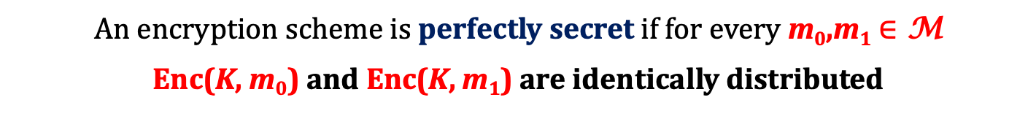
How to change the security definition?
we will require that m₀,m₁ are chosen by a poly-time adversary
An encryption scheme is perfectly secret if for every m₀,m₁ $∈$ M
Enc(K, m₀) and Enc(K, m₁) are identically distributed
we will require that no poly-time adversary can distinguish
Enc(K, m₀) from Enc(K, m₁)

Slide 4


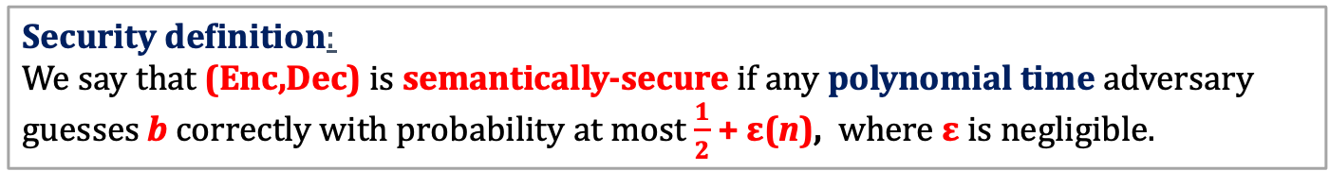
A game
(Enc,Dec) – an encryption scheme
security parameter
1^{n}
adversary
(polynomial-time probabilistic Turing machine)
oracle
chooses m₀,m₁ such that
|m₀|=|m₁|
m₀,m₁
selects k randomly from {0,1}^{n}
chooses a random b = 0,1
calculates
c := Enc(k,m_{b})
has to guess b
c
Alternative name: has indistinguishable encryptions in the presence of an eavesdropper
Security definition:
We say that (Enc,Dec) is semantically-secure if any polynomial time adversary guesses b correctly with probability at most $\frac{1}{2}$ + ε(n), where ε is negligible.

Slide 5
Testing the definition
Suppose the adversary can compute k from Enc(k,m). Can he win the game?
YES!
Suppose the adversary can compute some bit of m from Enc(k,m). Can he win the game?
YES!

Slide 6
Multiple messages
In real-life applications we need to encrypt multiple messages with one key.
The adversary may learn something about the key by looking at
ciphertexts c₁,...,c_{t} of
some messages m₁,...,m_{t}.
How are these messages chosen?
let’s say: the adversary can choose them!
(good tradition: be as pessimistic as possible)

Slide 7

A real-life example
Example: routing
k
Enc_{k}(m)
k
m

Slide 8



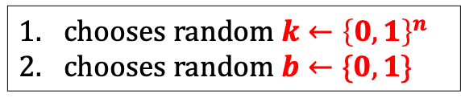



A chosen-plaintext attack (CPA)
security parameter
1^{n}
chooses random $k←{\left\{0,1\right\}}^{n}$
chooses random $b←\{0,1\}$
chooses $m_{1}^{′}$
$$m_{1}^{′}$$
c₁ = Enc(k,$m_{1}^{′}$)
oracle
. . .
chooses $m_{t}^{′}$
$$m_{t}^{′}$$
challenge phase:
c_{t} = Enc(${k,m}_{t}^{′}$)
chooses m₀,m₁
m₀,m₁
c = Enc(k,m_{b})
the interaction continues . . .
has to guess b

Slide 9
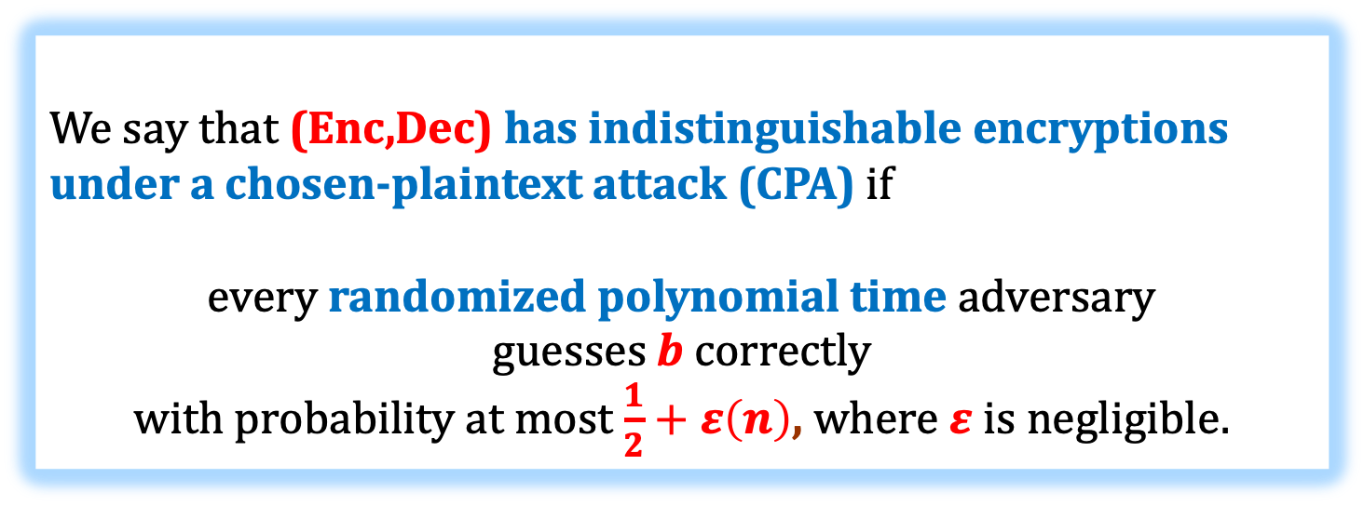
CPA-security
We will sometimes say: IND-CPA-secure
Security definition
We say that (Enc,Dec) has indistinguishable encryptions under a chosen-plaintext attack (CPA) if
every randomized polynomial time adversary
guesses b correctly
with probability at most $\frac{1}{2}+ε\left(n\right)$, where $ε$ is negligible.

Slide 10
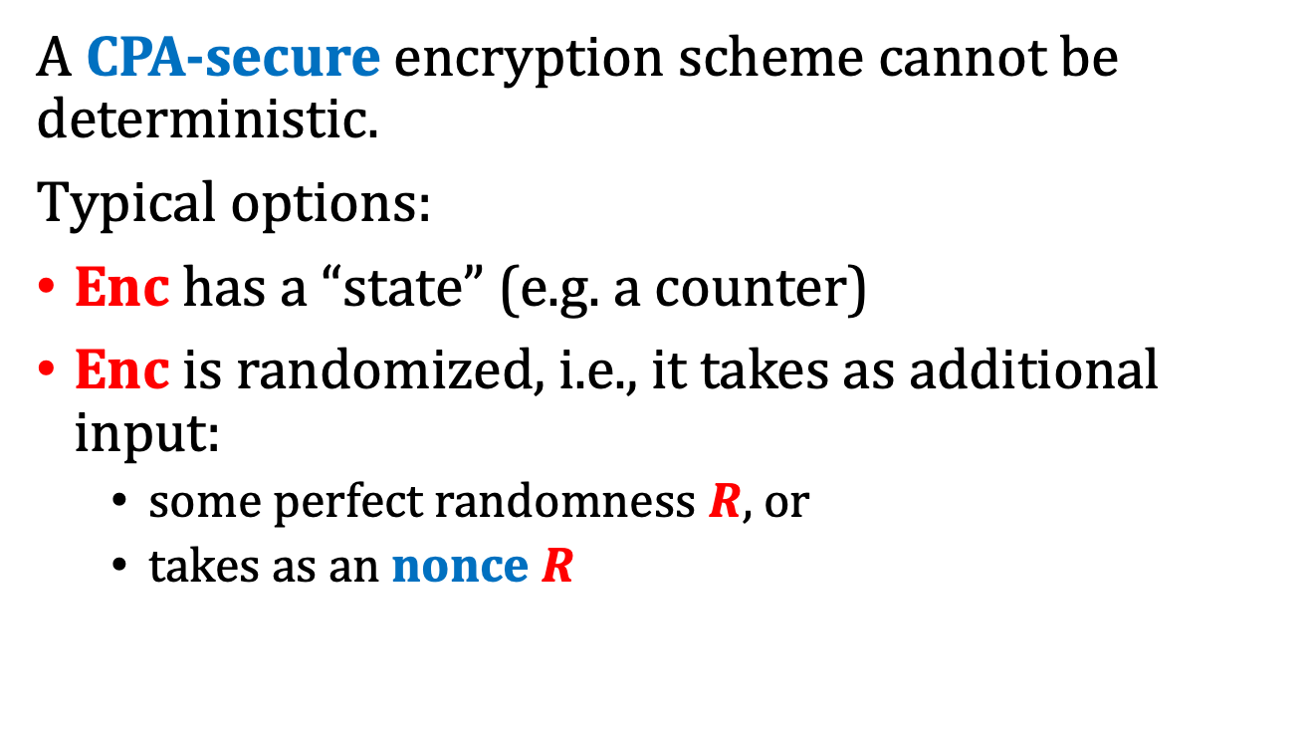
Observation
A CPA-secure encryption scheme cannot be deterministic.
Typical options:
Enc has a “state” (e.g. a counter)
Enc is randomized, i.e., it takes as additional input:
  some perfect randomness $R$, or
  takes as an nonce $R$
weaker requirement
nonce = “number used once”

Slide 11
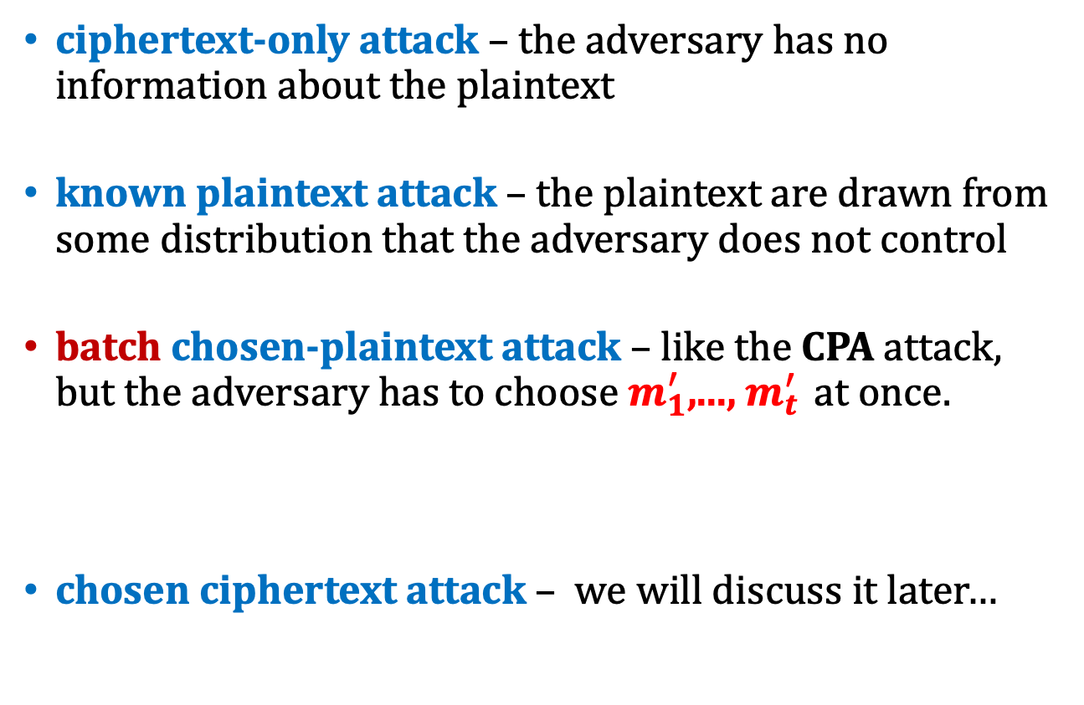
Other attacks known in the literature
strong weak
ciphertext-only attack – the adversary has no information about the plaintext
known plaintext attack – the plaintext are drawn from some distribution that the adversary does not control
batch chosen-plaintext attack – like the CPA attack, but the adversary has to choose $m_{1}^{′}$,..., $m_{t}^{′}$ at once.
chosen ciphertext attack – we will discuss it later…
(“our” CPA-attack is also called the “adaptive CPA-attack”)

Slide 12
Plan
Computational definitions of security
If semantically-secure encryption exists, then P ≠ NP
A proof that “the PRGs imply secure encryption”
Theoretical constructions of PRGs
Stream ciphers
Pseudorandom functions and permutations
Block ciphers
Practical considerations

Slide 13
Is it possible to prove security?
Bad news:
Theorem
If semantically-secure encryption exists
(with |k| < |m| )
then
P ≠ NP
Intuition: if P = NP then the adversary can guess the key...
(formal proof – exercises)

Slide 14
Moral:
“If P=NP, then the semantically-secure encryption is broken”
Is it 100% true?
Not really...
This is because even if P=NP we do not know what are the constants.
Maybe P=NP in a very “inefficient way”...

Slide 15
To prove security of a cryptographic scheme we need to show
a lower bound on the computational complexity of some problem.
In the “asymptotic setting” that would mean that
at least
we show that P ≠ NP.
Does the implication in the other direction hold?
(that is: does P ≠ NP imply anything for cryptography?)
No! (at least as far as we know)
Therefore
proving that an encryption scheme is secure is probably much harder than proving that P ≠ NP.

Slide 16

What can we prove?
We can prove conditional results.
That is, we can show theorems of a type:
Suppose that some “computational
assumption A”
holds
Suppose that some
scheme Y is secure
then scheme X is secure.
then scheme X is secure.

Slide 17
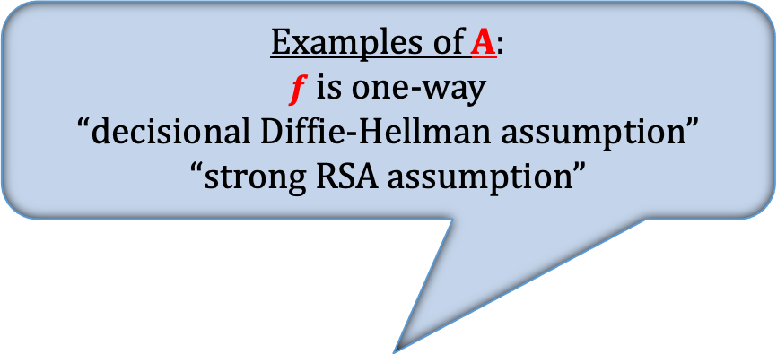
Research program in cryptography
Base the security of cryptographic schemes on a small number of well-specified “computational assumptions”.
Examples of A:
$f$ is one-way
“decisional Diffie-Hellman assumption”
“strong RSA assumption”
in this we
have to
“believe”
Some “computational
assumption A”
holds
interesting only if this is “far from trivial”
the rest is
provable
then scheme X is secure.

Slide 18
Example
Suppose that G is a “cryptographic pseudorandom generator”
we can construct a secure encryption scheme based on G

Slide 19
A natural question
What is “the minimal assumption” needed for cryptography?
Answer: existence one-way functions.
We introduce them now.

Slide 20
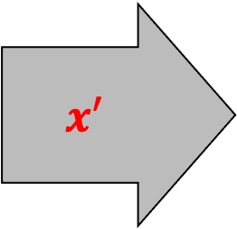
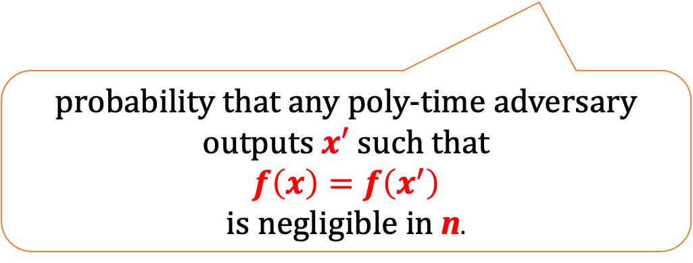
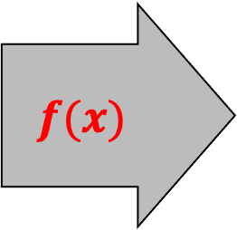
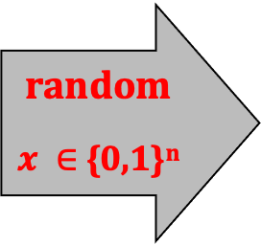
One-way functions
A function
f : {0,1}* → {0,1} *
is one-way if it is: (1) poly-time computable, and (2) “hard to invert it”.
random
$x ∈$ {0,1}^{n}
f
$$f(x)$$
$$x′$$
probability that any poly-time adversary
outputs $x′$ such that
$$f\left(x\right)=f\left(x^{′}\right)$$
is negligible in n.

Slide 21
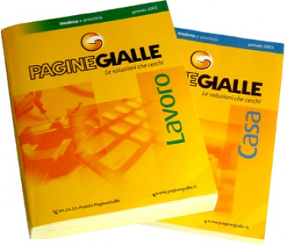
A real-life analogue: phone book
A function:
people → numbers
is “one way”.

Slide 22
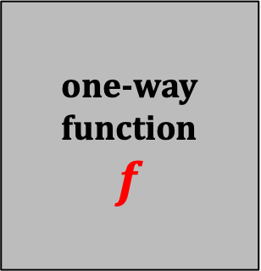


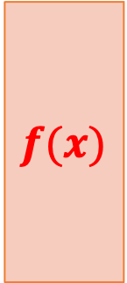
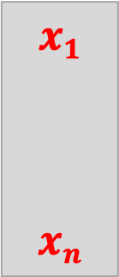
One way functions do not “hide all the input”
Example:
$$x1$$
$$xn$$
one-way function
$$f$$
$$f(x)$$
$$x_{n+1}$$
$$x_{n+1}$$
$f’(x1,…,x_{n+1}) := f(x1,…,xn) || x_{n+1 }$is also a one-way function

Slide 23
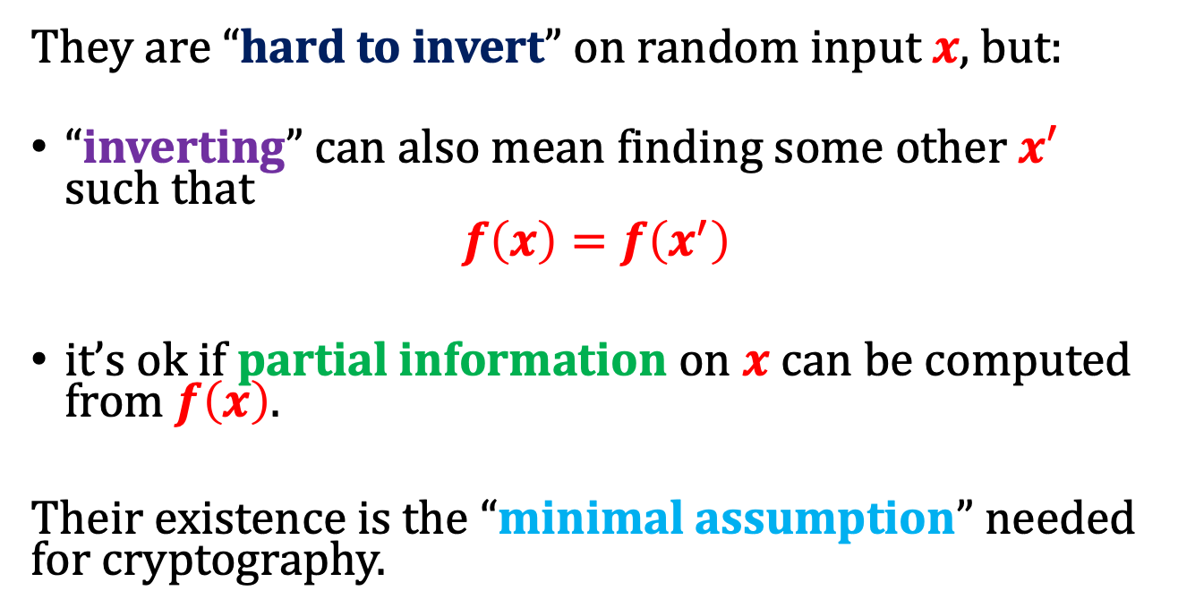
One way-functions – main properties
They are “hard to invert” on random input $x$, but:
“inverting” can also mean finding some other $x′$ such that
$$f\left(x\right)=f\left(x^{′}\right)$$
it’s ok if partial information on $x$can be computed from $f\left(x\right)$.
Their existence is the “minimal assumption” needed for cryptography.

Slide 24
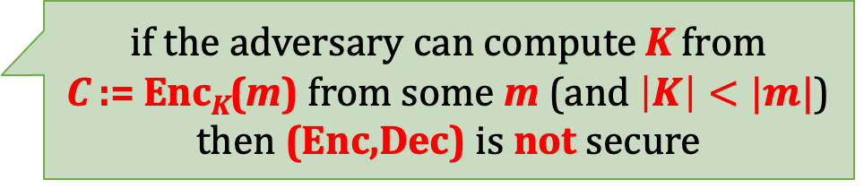
Why “minimal assumption?
Recall the following idea from the previous lecture:
(m – a message)
the key K is chosen uniformly at random
C := Enc_{K}(m) is given to the adversary
An idea
“The adversary should not be able to compute K.”
Observation: it’s not a sufficient condition for security.
But it is necessary.
Moral: f defined as f(K) := Enc_{K}(m) has to be one-way.
if the adversary can compute K from
C := Enc_{K}(m) from some m (and $\left|K\right|<|m|$) then (Enc,Dec) is not secure

Slide 25
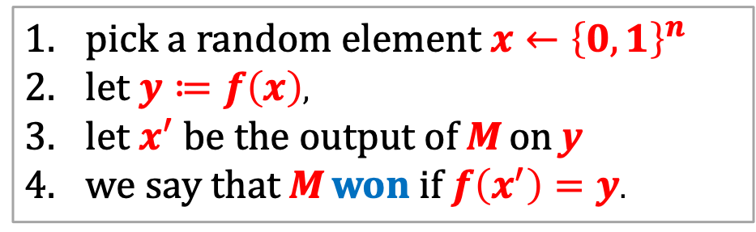

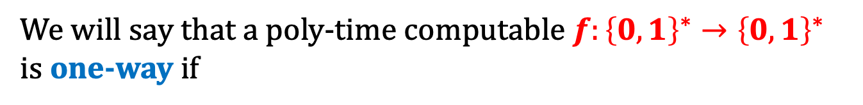
One-way functions more formally
experiment (machine M, function f)
pick a random element $x←{\left\{0,1\right\}}^{n}$
let $y≔f\left(x\right)$,
let $x^{′}$ be the output of M on y
we say that M won if $f\left(x^{′}\right)=y$.
We will say that a poly-time computable $f:{\left\{0,1\right\}}^{∗}→{\left\{0,1\right\}}^{∗}$ is one-way if
$$∀$$
P (M wins) is negligible
polynomial-time
Turing Machine M

Slide 26
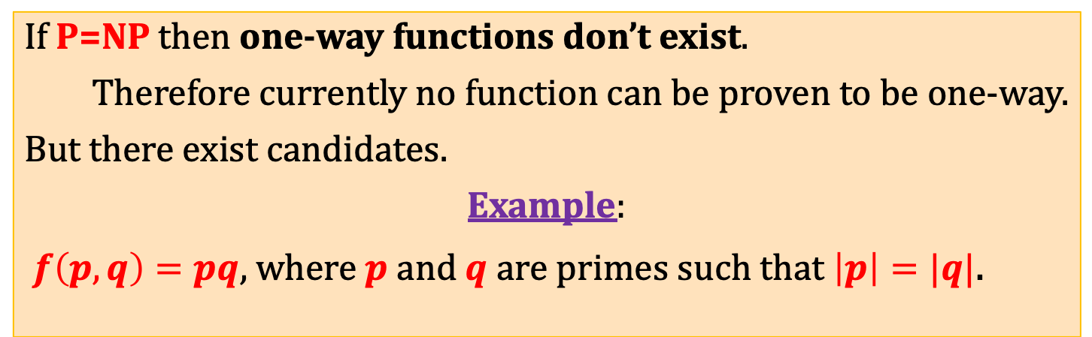
Example of a (candidate for) a one-way function
If P=NP then one-way functions don’t exist.
Therefore currently no function can be proven to be one-way.
But there exist candidates.
Example:
$f\left(p,q\right)=pq$, where $p$ and $q$are primes such that $\left|p\right|=|q|$.
this function is defined on
primes × primes,
not on
{0,1}*
but it’s just a technicality

Slide 27
Plan
Computational definitions of security
If semantically-secure encryption exists, then P ≠ NP
A proof that “the PRGs imply secure encryption”
Theoretical constructions of PRGs
Stream ciphers
Pseudorandom functions and permutations
Block ciphers
Practical considerations

Slide 28
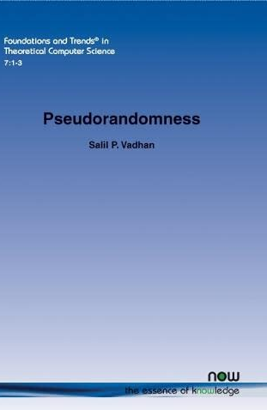
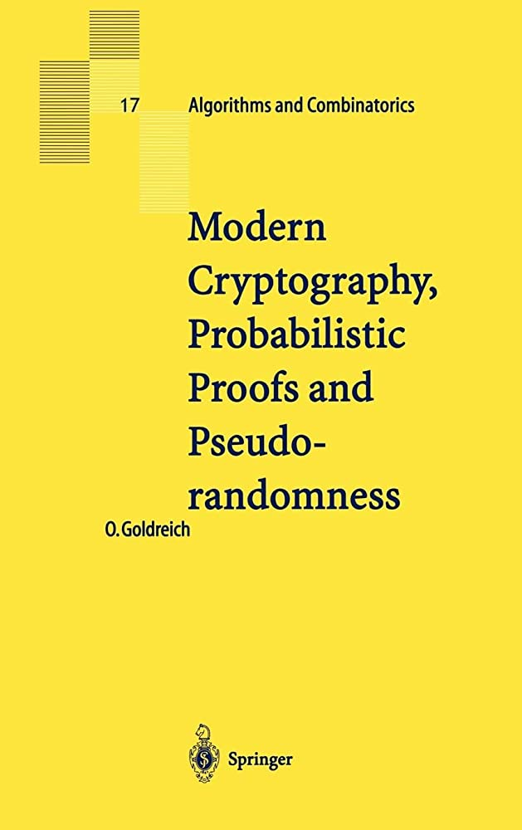
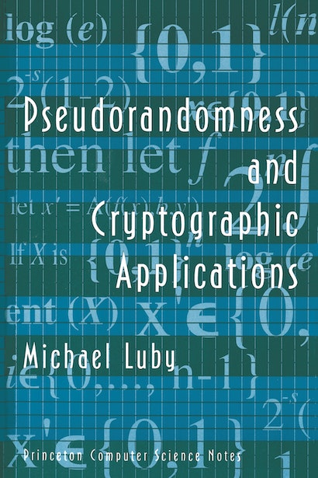
Our tool: pseudorandomness
An important topic on its own.
Applications outside of cryptography (e.g.: derandomization of randomized algorithms).

Slide 29


Intution
Randomness depends on the “power of an observer”.
Think of a coin-toss:
An observer that can record and process coin behavior can predict the outcome

Slide 30

Pseudorandom generators
“seed”
G(s)
s
n
$$ℓ(n)$$
“expansion
factor”
Definition
l – polynomial such that always l(n) > n
An algorithm G : {0,1}* → {0,1}* is called a pseudorandom generator (PRG) if
for every n
and for every s such that |s| = n
we have
|G(s)| = l(n).
and for a random s the value G(s) “looks random”.
this has to be formalized

Slide 31
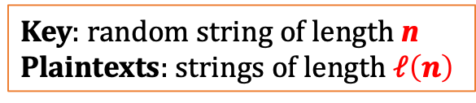
Idea
for a moment just consider a single message case
Use PRGs to “shorten” the key in the one time pad
Key: random string of length n
Plaintexts: strings of length $ℓ\left(n\right)$
xor
G(s)
m
m
xor
G(s)
Enc(s,m)
s
G(s)
c
c
xor
G(s)
s
Dec(s,c)
If we use a “normal PRG” – this idea doesn’t work
We have to use the cryptographic PRGs.

Slide 32
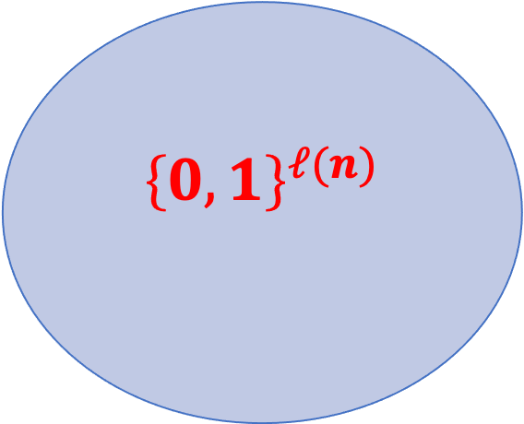
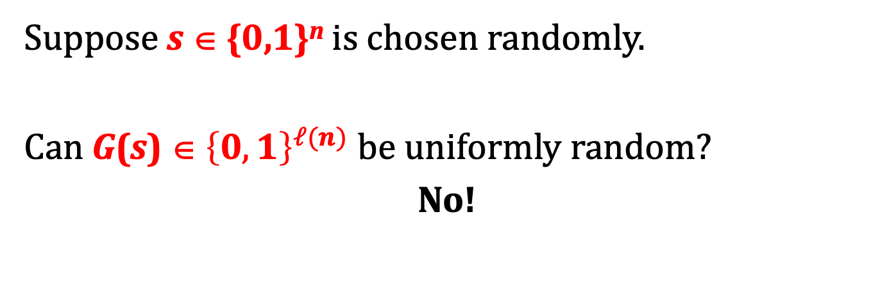
“Looks random”
Suppose s ∈ {0,1}^{n} is chosen randomly.
Can G(s) ∈ ${\left\{0,1\right\}}^{ℓ(n)}$ be uniformly random?
No!
$${\left\{0,1\right\}}^{ℓ(n)}$$
{0,1}^{n}
G({0,1}^{n})

Slide 33
“Looks random”
What does it mean?
Non-cryptographic applications:
should pass some statistical tests.
Cryptography:
should pass all polynomial-time tests.

Slide 34
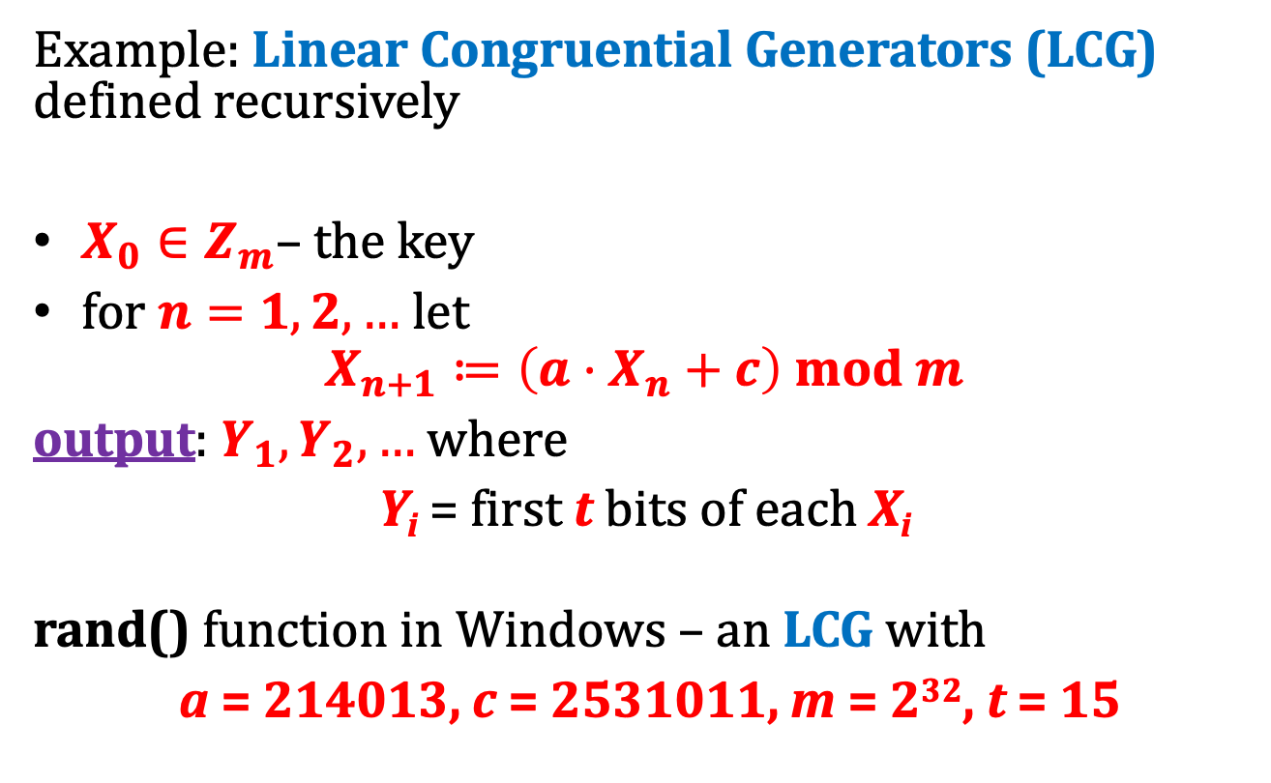
Non-cryptographic PRGs
Example: Linear Congruential Generators (LCG) defined recursively
$X_{0}∈Z_{m}$– the key
for $n=1,2,…$let
$$X_{n+1}≔\left(a⋅X_{n}+c\right) mod m$$
output: $Y_{1},Y_{2},…$ where
Y_{i} = first t bits of each X_{i}
rand() function in Windows – an LCG with
a = 214013, c = 2531011, m = 2³², t = 15

Slide 35

How to break an LRS
Y₁
Y₂
…
Y_{n}
X₀
Solve linear equations with “partial knowledge” (because you only know first t bits)
See:
G. Argyros and A. Kiayias: I Forgot Your Password: Randomness Attacks Against PHP Applications, USENIX Security '12
(successful attacks on password-recovery mechanisms in PHP)

Slide 36
PRG – main idea of the definition
scenario 0
a random string R
outputs:
b ∈{0,1}
should not be able to distinguish...
scenario 1
a probabilistic polynomial-time distinguisher D
G(S)
Notes:
hardness vs. randomness

Slide 37
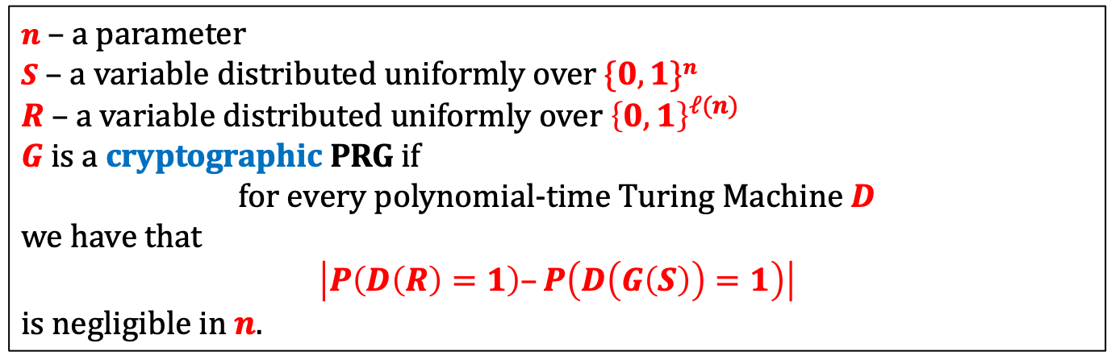



Cryptographic PRG
outputs:
a random string R
$0$ if he thinks it’s R
or
$G(S)$ (where $S$ random)
1 if he thinks it’s $G(S)$
Should not be able to distinguish...
Definition
$n$ – a parameter
$S$ – a variable distributed uniformly over $\{0,1\}n$
$R$ – a variable distributed uniformly over ${\left\{0,1\right\}}^{ℓ(n)}$
$G$is a cryptographic PRG if
for every polynomial-time Turing Machine $D$
we have that
$\left|P\left(D\left(R\right)=1\right)–P\left(D\left(G\left(S\right)\right)=1\right)\right|$
is negligible in $n$.

Slide 38
Constructions
There exists constructions of cryptographic pseudorandom-generators, that are conjectured to be secure.
We will discuss them later...

Slide 39
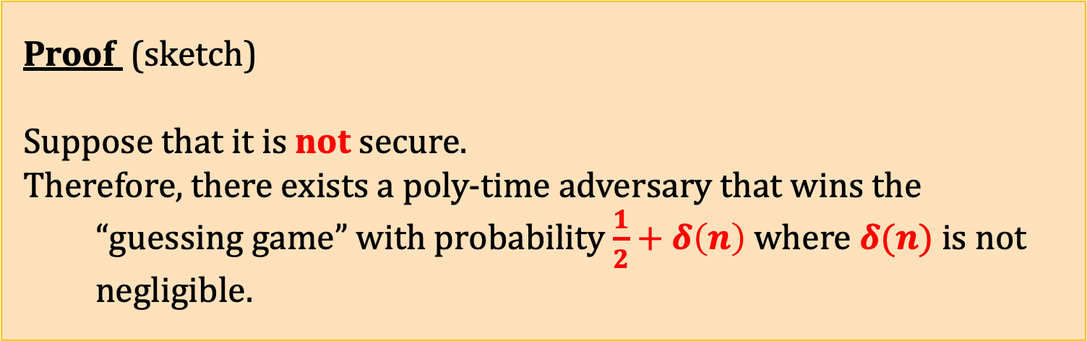
Theorem
(for simplicity consider only the single message case)
xor
If G is a cryptographic PRG then the encryption scheme constructed before is semantically secure.
G(s)
m
m
xor
G(s)
s
cryptographic PRGs
exist
CPA-secure encryption
exists
Proof (sketch)
Suppose that it is not secure.
Therefore, there exists a poly-time adversary that wins the “guessing game” with probability $\frac{1}{2}+δ\left(n\right)$ where $δ(n)$ is not negligible.

Slide 40


x
simulates
chooses $m_{0},m_{1}$
$$m_{0},m_{1}$$
b = 0,1 random
c := x xor m_{b}
tries to guess b
c
If the adversary guessed b correctly
otherwise
output 1:
“x is pseudorandom”.
output 0:
“x is random”.

Slide 41


“scenario 0”: x is a random string
x
simulates
chooses $m_{0},m_{1}$
$$m_{0},m_{1}$$
b = 0,1 random
c := x xor m_{b}
tries to guess b
c
If the adversary guessed b correctly
otherwise
prob. $\frac{1}{2}$
prob. $\frac{1}{2}$
output 1:
“x is pseudorandom”.
output 0:
“x is random”.

Slide 42


“scenario 1”: x = G(S)
x
simulates
chooses $m_{0},m_{1}$
$$m_{0},m_{1}$$
b = 0,1 random
c := x xor m_{b}
tries to guess b
c
If the adversary guessed b correctly
otherwise
prob. $\frac{1}{2}+δ(n)$
prob. $\frac{1}{2}−δ(n)$
output 1:
“x is pseudorandom”.
output 0:
“x is random”.

Slide 43

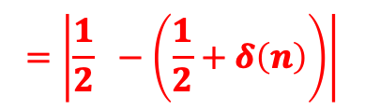



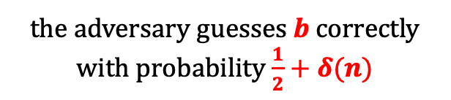
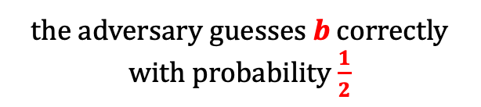




Hence
$x$ is a random string $R$
$x=G(S)$
the adversary guesses b correctly with probability $\frac{1}{2}$
the adversary guesses b correctly with probability $\frac{1}{2}+δ(n)$
prob.$\frac{1}{2}$
prob.$\frac{1}{2}$
prob.$\frac{1}{2}+δ(n)$
prob.$\frac{1}{2}−δ(n)$
outputs:
1
0
1
0
$$=\left|\frac{1}{2} −\left(\frac{1}{2}+δ\left(n\right)\right)\right|$$
$$|P\left(D\left(R\right)=1\right)−P(D\left(G\left(S\right)\right)=1|$$
$$=\left|δ\left(n\right)\right|$$
Since δ is not negligible G cannot be a cryptographic PRG.

Slide 44
The complexity
The distinguisher
simply simulated
one execution of the adversary
against the oracle .
Hence he works in polynomial time.
QED

Slide 45
Moral
it can be extended to CPA-security
cryptographic PRGs
exist
semantically-secure encryption
exists
To construct secure encryption it suffices to construct a secure PRG.
Moreover, we can also state the following:
Informal remark. The reduction is tight.

Slide 46
A question
What if the distinguisher
needed to simulate
1000 executions of the adversary
?
An (informal) answer
Then, the encryption scheme would be “1000 times less secure” than the pseudorandom generator.
Why?
To achieve the same result
needs to work 1000 times
more than
.

Slide 47
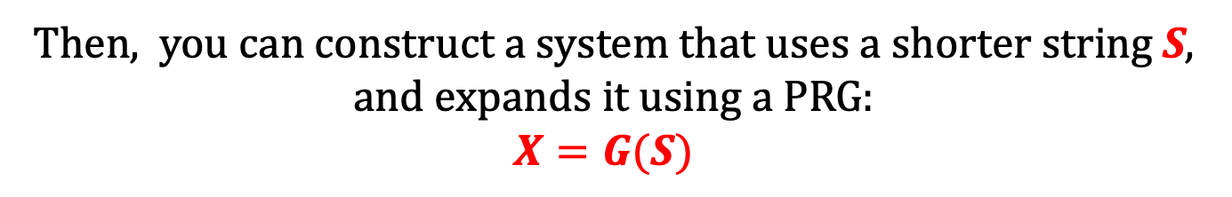
General rule
Take a secure system that uses some long secret string X.
secret string X
Then, you can construct a system that uses a shorter string S,
and expands it using a PRG:
$$X=G(S)$$
secret string S
G
“pseudorandom” string X

Slide 48
Constructions of PRGs
A theoretical result
a PRG can be constructed from any one-way function
(very elegant, impractical, inefficient)
Based on hardness of some
particular computational problems
For example
[Blum, Blum, Shub. A Simple Unpredictable Pseudo-Random Number Generator]
(elegant, more efficient, still rather impractical)
“Stream ciphers”
ugly, very efficient, widely used in practice
Examples: RC4, Trivium, SOSEMANUK,...

Slide 49
Plan
Computational definitions of security
If semantically-secure encryption exists, then P ≠ NP
A proof that “the PRGs imply secure encryption”
Theoretical constructions of PRGs
Stream ciphers
Pseudorandom functions and permutations
Block ciphers
Practical considerations

Slide 50
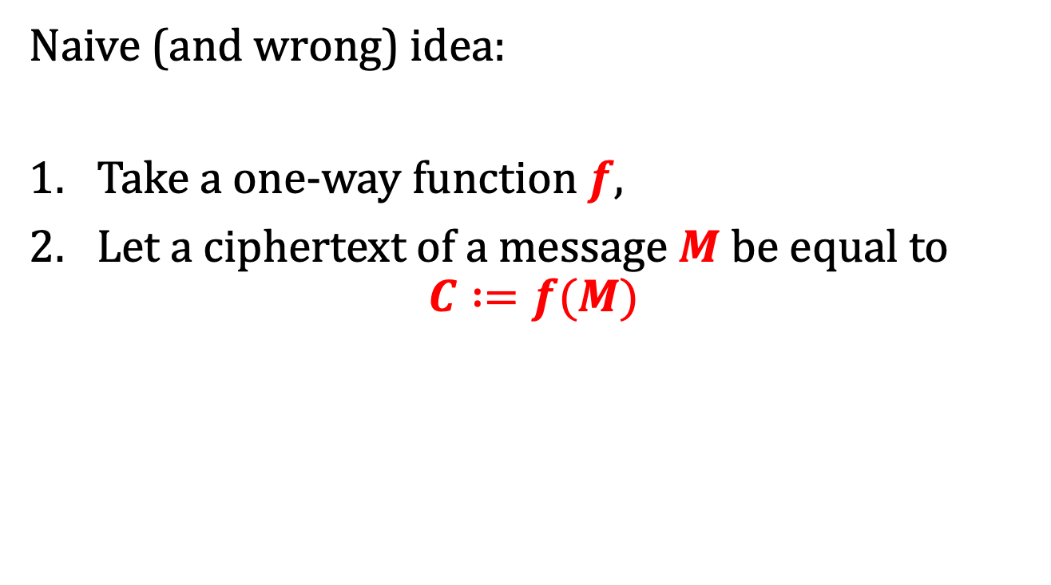
How to encrypt with one-way functions?
Naive (and wrong) idea:
Take a one-way function $f$,
Let a ciphertext of a message $M$ be equal to
$$C :=f(M)$$
where is the key?
not all the input is hidden...
how to decrypt?

Slide 51
One of the most fundamental results in symmetric cryptography
[Håstad, Impagliazzo, Levin, Luby A Pseudorandom Generator from any One-way Function]:
“a PRG can be constructed from any one-way function”
one-way functions
exist
cryptographic PRGs
exist
CPA-secure encryption
exists

Slide 52
Why is this result so important?
It connects two types of hardness:
hardness of guessing some value
hardness of distinguishing two experiments
K ?
?
experiment
0
experiment
1

Slide 53

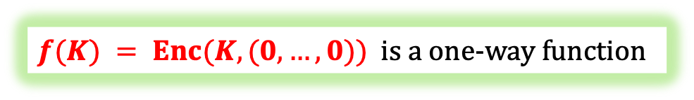
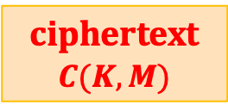
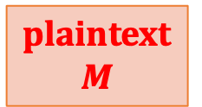
The implication also holds in the other direction
semantically-secure encryption exists
one-way functions
exist
Enc
plaintext $M$
ciphertext
$$C(K,M)$$
key
$$K$$
$f(K) = Enc(K,(0,…,0))$is a one-way function

Slide 54
“Minicrypt”
P ≠ NP
?
open problem
(most likely: no implication)
one-way functions
exist
CPA and semantically-secure
encryptions existaboth
cryptographic PRGs
exist
The “world” where the one-way functions exist
is called “minicrypt”.

Slide 55
Plan
Computational definitions of security
If semantically-secure encryption exists, then P ≠ NP
A proof that “the PRGs imply secure encryption”
Theoretical constructions of PRGs
Stream ciphers
Pseudorandom functions and permutations
Block ciphers
Practical considerations

Slide 56


Stream ciphers
The pseudorandom generators used in practice are called stream ciphers
$$s$$
$$s$$
. . .
They are called like this because their output is an “infinite” stream of bits.

Slide 57


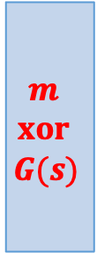



How to encrypt multiple messages using pseudorandom generators?
$$xor$$
$$G(s)$$
$$m$$
$$m$$
$$xor$$
$$G(s)$$
$$Enc(s,m)$$
$$s$$
Of course we cannot just reuse the same seed
(remember the problem with the one-time pad?)
It is not just a theoretical problem!

Slide 58






Misuse of RC4 in Microsoft Office
[Hongjun Wu 2005]
RC4 – a popular PRG/“stream cipher” (now broken)
“Microsoft Strong Cryptographic Provider”
(encryption in Word and Excel, Office 2003)
The key s is a function of a password and an initialization vector.
These values do not change between the different versions of the document!
Suppose Alice and Bob work together on some document:
$$Enc(s,m)$$
$$Enc(s,m’)$$
The adversary can compute $m xor m’$

Slide 59
What to do?
There are two solutions:
The synchronized mode
The unsynchronized mode

Slide 60











How to encrypt several messages
$G:\{0,1\}n → \{0,1\}very large$– a PRG.
this can be proven to be CPA-secure
divide $G(s)$ in blocks:
$$s$$
$G$is computed “on fly”
. . .
$$G(s)$$
$$m0$$
$$m1$$
$$m2$$
$$m3$$
xor
$$c0$$
$$c1$$
$$c2$$
$$c3$$

Slide 61





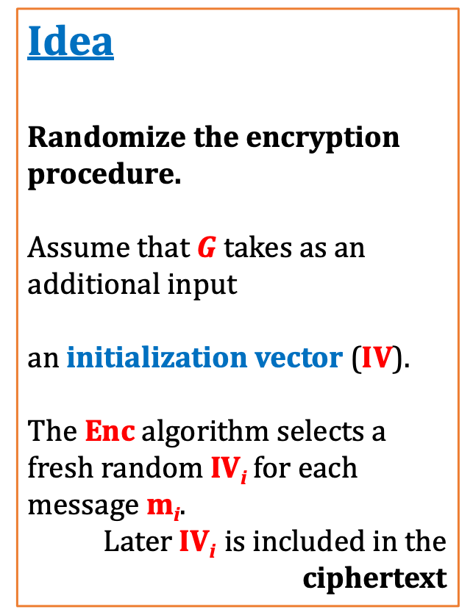


Unsynchronized mode
Idea
Randomize the encryption procedure.
Assume that $G$takes as an additional input
an initialization vector ($IV$).
The Enc algorithm selects a fresh random IV_{i} for each message m_{i}.
Later IV_{i} is included in the ciphertext
weaker version: a nonce
$$IVi$$
$$s$$
$$G(IVi,s)$$
$$mi$$
xor
$$IVi$$
$$G(IVi,s)$$
$$Enc(s,m_{i})$$

Slide 62
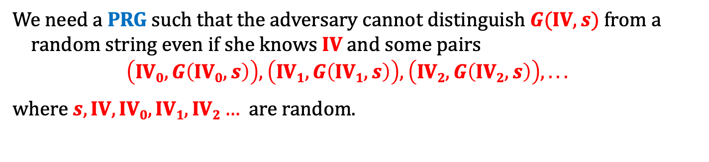



We need an “augmented” PRG
We need a PRG such that the adversary cannot distinguish $G(\text{IV},s)$ from a random string even if she knows IV and some pairs
$$\left(\text{IV}0,G\left(\text{IV}0,s\right)\right), \left(\text{IV}1,G\left(\text{IV}1,s\right)\right), \left(\text{IV}2,G\left(\text{IV}2,s\right)\right), . . .$$
where $s,\text{IV},\text{IV}0,\text{IV}1,\text{IV}2…$are random.
with a non-negligible advantage
IV
s
G
$$G(\text{IV},s)$$
$$R$$
or
?
$$IV$$
$$\left(\text{IV}0,G\left(\text{IV}0,s\right)\right), \left(\text{IV}1,G\left(\text{IV}1,s\right)\right), \left(\text{IV}2,G\left(\text{IV}2,s\right)\right), . . .$$

Slide 63
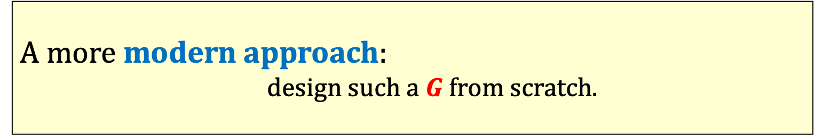
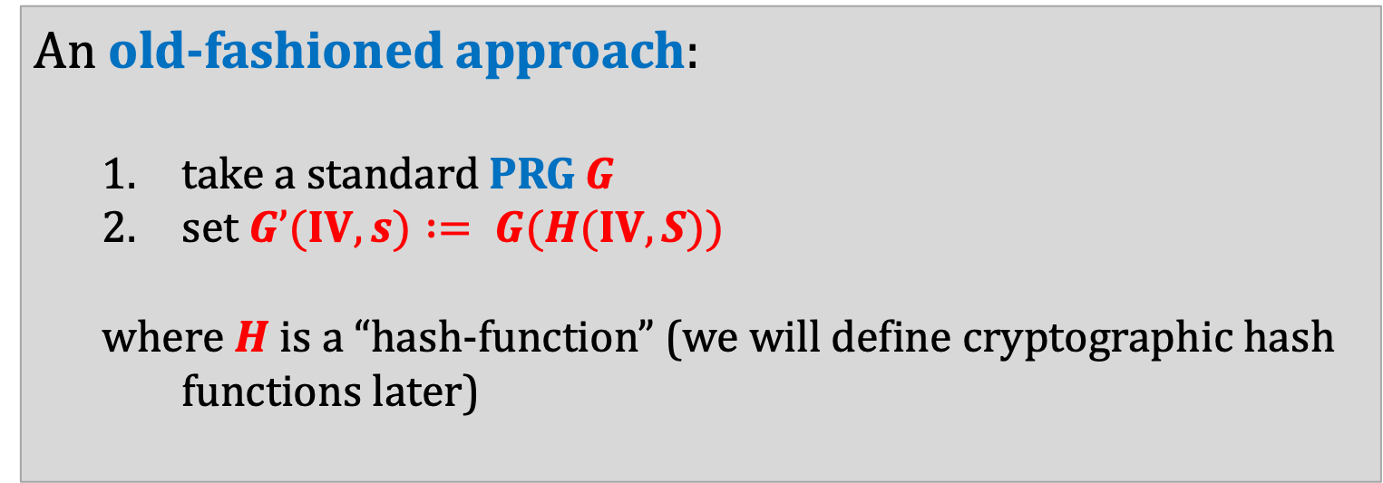
How to construct such a PRG?
An old-fashioned approach:
  take a standard PRG G
  set $G’(IV,s) := G(H(IV,S))$
  where $H$ is a “hash-function” (we will define cryptographic hash functions later)
often:
just concatenate
IV and S
A more modern approach:
  design such a $G$ from scratch.

Slide 64
Popular historical stream ciphers
Based on the linear feedback shift registers:
A5/1 and A5/2 (used in GSM)
Ross Anderson:
Content Scramble System (CSS) encryption
Other:
RC4
completely broken
"there was a terrific row between the NATO signal intelligence agencies in the mid 1980s over whether GSM encryption should be strong or not. The Germans said it should be, as they shared a long border with the Warsaw Pact; but the other countries didn't feel this way, and the algorithm as now fielded is a French design."
completely broken
very popular in the past, now broken

Slide 65
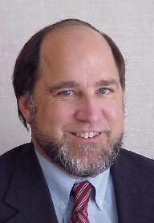
RC4
Designed by Ron Rivest (RSA Security)
in 1987.
RC4 = “Rivest Cipher 4”, or “Ron's Code 4”.
Trade secret, but in September 1994 its
description leaked to the internet.
For legal reasons sometimes it is called: "ARCFOUR" or "ARC4“.
Used in WEP and WPA and TLS.
Very efficient and simple, but has serious security flaws

Slide 66



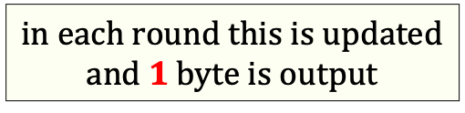

RC4 – an overview
note: no IV
$$|k| = 40 – 256 bits$$
key $k$
key-scheduling
algorithm
(KSA)
indices
i
j
array $S$
$$|S| = 256 bytes$$
in each round this is updated
and $1$ byte is output
(this is called a “pseudo-random generation algorithm (PRGA)”)

Slide 67
RC4
KSA
for i from 0 to 255
  S[i] := i
end
for j := 0 for i from 0 to 255
  j := (j + S[i] + key[i mod 256]) mod 256
  swap(S[i],S[j])
endfor
don’t read it!
PRGA
i := 0
j := 0
while GeneratingOutput:
  i := (i + 1) mod 256
  j := (j + S[i]) mod 256
  swap(S[i],S[j])
  output S[(S[i] + S[j]) mod 256]
endwhile

Slide 68
Problems with RC4
Doesn’t have a separate IV.
It was discovered that some bytes of the output are biased.
[Mantin, Shamir, 2001]
First few bytes of output sometimes leak some information about the key
[Fluhrer, Mantin and Shamir, 2001]
Recommendation: discard the first 768-3072 bytes.
Other weaknesses are also known...

Slide 69
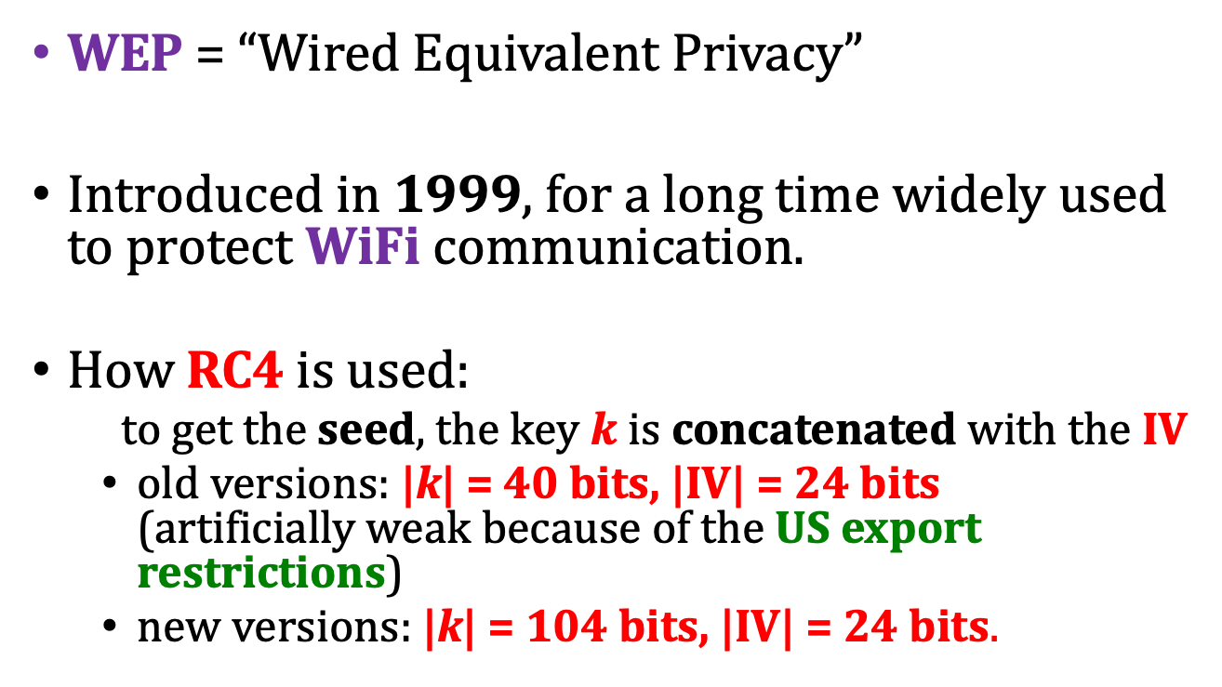
Use of RC4 in WEP
WEP = “Wired Equivalent Privacy”
Introduced in 1999, for a long time widely used to protect WiFi communication.
How RC4 is used:
  to get the seed, the key $k$ is concatenated with the IV
  old versions: |k| = 40 bits, |IV| = 24 bits
  (artificially weak because of the US export restrictions)
  new versions: |k| = 104 bits, |IV| = 24 bits.

Slide 70
RC4 in WEP – problems with the key length
|k| = 40 bits is not enough:
can be cracked using a brute-force attack
IV is changed for each packet.
Hence |IV| = 24 bits is also not enough:
  assume that each packet has length 1500 bytes,
  with 5Mbps bandwidth the set of all possible IVs will be exhausted in half a day
Some implementations reset IV := 0 after each restart – this makes things even worse.
see Nikita Borisov, Ian Goldberg, David Wagner (2001). "Intercepting Mobile Communications: The Insecurity of 802.11"

Slide 71
RC4 in WEP – the weak IVs
[Fluhrer, Mantin and Shamir, 2001]
(we mentioned this attack already)
For so-called “weak IVs” the key stream reveals some information about the key.
In response the vendors started to “filter” the weak IVs.
But then new weak IVs were discovered.
[see e.g. Bittau, Handley, Lackey The final nail in WEP's coffin.]

Slide 72
Another attack
“RC4 NOMORE” (www.rc4nomore.com)
[Vanhoef and Piessens, USENIX Security 2015]
Conclusion: RC4 should not be used in real life.

Slide 73
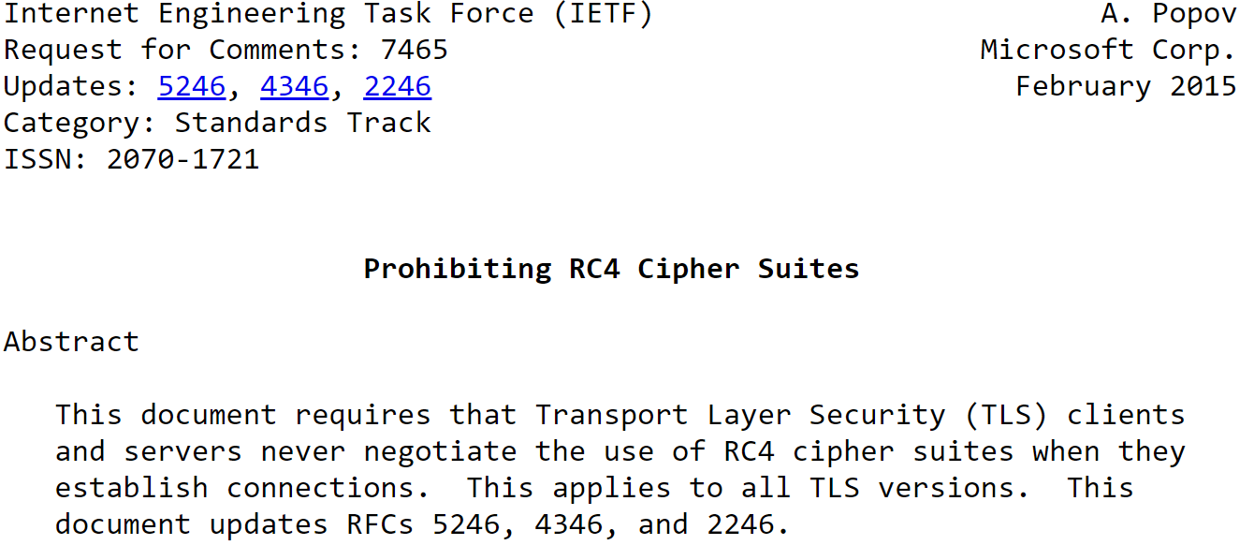
RC4 forbidden in TLS

Slide 74
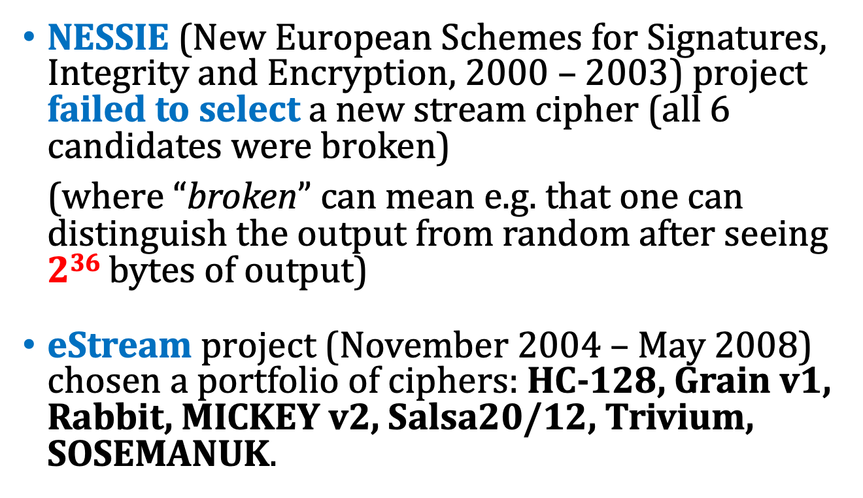
Competitions for new stream ciphers
NESSIE (New European Schemes for Signatures, Integrity and Encryption, 2000 – 2003) project failed to select a new stream cipher (all 6 candidates were broken)
(where “broken” can mean e.g. that one can distinguish the output from random after seeing $236$ bytes of output)
eStream project (November 2004 – May 2008) chosen a portfolio of ciphers: HC-128, Grain v1, Rabbit, MICKEY v2, Salsa20/12, Trivium, SOSEMANUK.

Slide 75
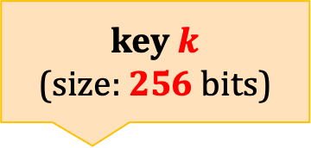
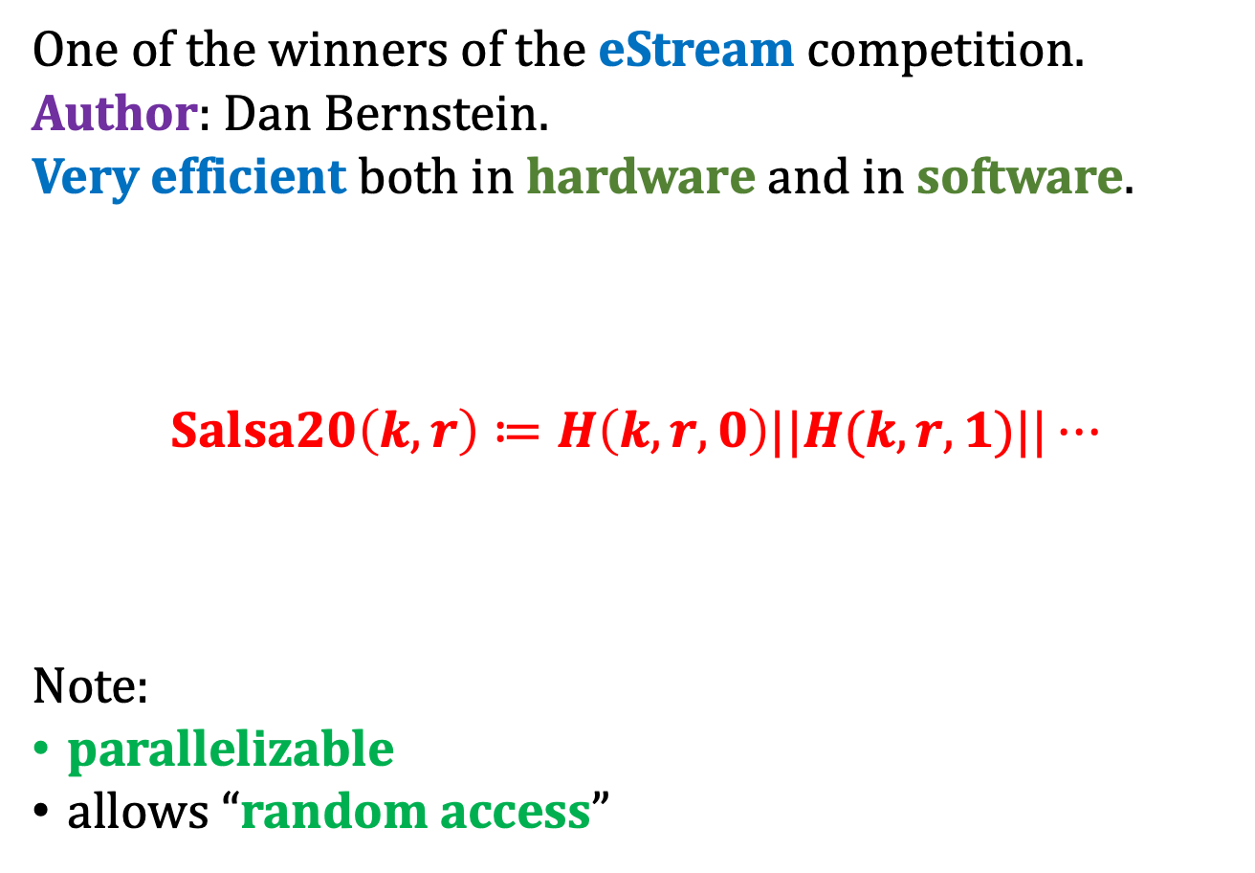
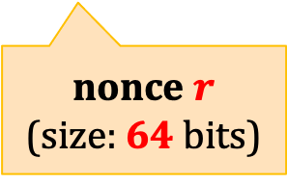
Salsa 20
One of the winners of the eStream competition.
Author: Dan Bernstein.
Very efficient both in hardware and in software.
$Salsa20\left(k,r\right)≔H\left(k,r,0\right)||H(k,r,1)||⋯$
Note:
parallelizable
allows “random access”
key $k$
(size: 256 bits)
nonce $r$
(size: 64 bits)

Slide 76





How is H defined?
word (32 bit) addition
$$H\left(k,r,i\right)$$
some function $h$
bits from $k,r$, and $i$
64 bytes
h
h
. . .
$$⊞$$
$10$ rounds

Slide 77
Is there an alternative to the stream ciphers?
Yes!
the block ciphers

Slide 78
Plan
Computational definitions of security
If semantically-secure encryption exists, then P ≠ NP
A proof that “the PRGs imply secure encryption”
Theoretical constructions of PRGs
Stream ciphers
Pseudorandom functions and permutations
Block ciphers
Practical considerations

Slide 79




A common way of constructing “ciphers”
A cipher is just “a deterministic box that encrypts”.
$$F_{k}(m)$$
$$k$$
$$F_{k}$$
$$m$$
Name: block ciphers
Examples: DES, AES,…
Warning: not a good way to encrypt “directly”

Slide 80




How to model them formally?
$$F_{k}(m)$$
$$k$$
$$F_{k}$$
$$m$$
block cipher ≈ “a deterministic box that behaves randomly”.
≈ a pseudorandom permutation

Slide 81











Random permutations
A box with a “random function”
that Alice and Bob can query
$$x$$
$$x’$$
$$F(x)$$
$$F(x’)$$
$$y$$
A random function
$$F:\left\{0,1\right\}m→\{0,1\}m$$
$$y’$$
$$F^{−1}(y)$$
$$F^{−1}(y′)$$
. . .
. . .
suppose $F$ is a bijection
In other words: it is a permutation on $\{0,1\}m$

Slide 82

Note
We consider permutations on $\{0,1\}m$, not on $\{1,…,m\}$
Example:
0 | 0 | 0
0 | 0 | 0
0 | 0 | 1
0 | 0 | 1
0 | 1 | 0
0 | 1 | 0
0 | 1 | 1
0 | 1 | 1
1 | 0 | 0
1 | 0 | 0
1 | 0 | 1
1 | 0 | 1
1 | 1 | 0
1 | 1 | 0
1 | 1 | 1
1 | 1 | 1

Slide 83




Can this box be simulated in real life?
Naive solution:
Select a random permutation $F:\{0,1\}m → \{0,1\}m$and give it to both parties.
$$F: \{0,1\}m → \{0,1\}m$$
$$F: \{0,1\}m → \{0,1\}m$$
Problem:
The number of possible permutations is $(2m)!$

Slide 84

That’s why pseudorandom
One cannot describe a random permutation
$$F:\{0,1\}m → \{0,1\}m$$
in a short space.
But we can describe a permutation that
“behaves almost random”
Terminology
pseudorandom permutations (in theory)
block ciphers (in practice)

Slide 85







Keyed permutations
For a partial function
$$F:{\left\{0,1\right\}}^{∗} × {\left\{0,1\right\}}^{∗}→ {\left\{0,1\right\}}^{∗}$$
let $Fk(m)$ denote $F(k,m)$.
$$F_{k}(m)$$
$$k$$
$$F_{k}$$
A keyed-permutation is a function
$F:{\left\{0,1\right\}}^{∗} × {\left\{0,1\right\}}^{∗}→ {\left\{0,1\right\}}^{∗}$ such that
for every $k$function $Fk$is a permutation on some $\{0,1\}n$
for every $k$ functions $Fk$ and $F_{k}^{−1}$ are poly-time computable.
$$m$$
$n$ is a function of $|k|$
for simplicity assume: $n = |k|$

Slide 86

Pseudorandom permutations
Intuition:
A keyed permutation $F$ is pseudorandom if it cannot be distinguished from a completely random permutation.
This has to be formalized

Slide 87











Scenario $0$
security parameter
$$1n$$
distinguisher $D$
oracle
chooses a random $k∈\{0,1\}n$.
$$m1∈\{0,1\}n$$
$$Fk(m1)$$
$$m_{2}∈\{0,1\}n$$
$$Fk(m2)$$
. . .
$$mt∈\{0,1\}n$$
$$Fk(mt)$$
outputs $b∈\{0,1\}$

Slide 88






Scenario $1$
security parameter
$$1n$$
oracle
chooses a random permutation
$$F :\{0,1\}n→ \{0,1\}n$$
distinguisher $D$
$$m1∈\{0,1\}n$$
$$F(m1)$$
$$m_{2}∈\{0,1\}n$$
$$F(m2)$$
. . .
$$mt∈\{0,1\}n$$
This of course cannot be done efficiently, but it doesn’t matter
$$F(mt)$$
outputs $b∈\{0,1\}$

Slide 89


Pseudorandom permutations – the definition
We say that a keyed-permutation $F:\{0,{1\}}^{∗}× {\left\{0,1\right\}}^{∗}→ {\left\{0,1\right\}}^{∗}$is a pseudorandom permutation (PRP) if
any polynomial-time randomized distinguisher $D$
cannot distinguish scenario $0$ from scenario $1$ with
a non-negligible advantage.
That is:
$$\left|P\left(D outputs “1” in scenario 0\right)− P\left(D outputs “1” in scenario 1\right)\right|$$
is negligible in $n$.

Slide 90





Strong pseudorandom permutations
Suppose we allow the distinguisher to additionally ask the oracle for inverting $F$:
distinguisher $D$
$$ci∈\{0,1\}n$$
oracle selects a random
$k∈\{0,1\}n$.
$$F_{k}^{−1}(ci)$$
Then we get a definition of a strong pseudorandom permutation.

Slide 91

PRFs vs PRP
If we drop the assumption that
$Fk$has to be a permutation
we obtain an object called
a “pseudorandom function (PRF)”.
The security definition doesn’t change.
In fact those two objects are indistinguishable for a polynomial-time adversary.

Slide 92




Terminology
Before we had:
stream ciphers ≈ pseudorandom generators
Similarly:
block ciphers ≈ pseudorandom permutations
“ciphertext”
$$F(m)$$
this terminology is a bit confusing
$$k$$
$$F$$
“block”
“plaintext”
$$m$$

Slide 93









Another way to look at the stream ciphers :
$m$ is a parameter
give me block $1$
$$GK(1)∈\{0,1\}m$$
give me block $2$
$$GK$$
$$GK(2)∈\{0,1\}m$$
give me block $3$
$$GK(3)∈ \{0,1\}m$$
. . .
. . .
Requiremenent:
$$G_{K}\left(1\right),G_{K}\left(2\right),G_{K}\left(3\right),…$$
has to “look random” if is $K$ random and secret.

Slide 94









Block ciphers:
$m$ is a parameter
give me block $x1  \{0,1\}m$
$$FK(x1)  \{0,1\}m$$
give me block $x2  \{0,1\}m$
$$FK$$
$$FK(x2)  \{0,1\}m$$
give me block $x3  \{0,1\}m$
$$FK(x3)  \{0,1\}m$$
. . .
. . .
for $x1,x2,x3…$chosen adversarily
Requiremenent:
$$F_{K}\left(x_{1}\right),F_{K}\left(x_{2}\right),F_{K}\left(x_{3}\right),…$$
has to “look random” if is $K$ random and secret.

Slide 95














An additional property of the block ciphers
give me block $x1$
$$FK(x1)$$
give me block $x2$
$$FK$$
$$FK(x2)$$
give me block $x3$
$$FK(x3)$$
invert $FK(x1)$
$$x1$$
invert $FK(x2)$
$$FK$$
$$x2$$
invert $FK(x3)$
$$x3$$

Slide 96
Popular block ciphers
A great design.
The only practical weakness: short key.
Can be broken by a brute-force attack.
 | key length | block length
DES (1976) (Data Encryption Standard) | 56 | 64
IDEA (1991) (International Data Encryption Algorithm) | 128 | 64
AES (1998) (Advanced Encryption Standard) | 128, 192 or 256 | 128
Other: Blowfish, Twofish, Serpent,...

Slide 97






How to encrypt using the block ciphers?
A naive (wrong) idea: Encrypt short blocks:
plaintext $m$
key $k$
encryption $Fk$
ciphertext $c$
key $k$
decryption $F_{k}^{−1}$
plaintext $m$
Problems:
the messages have to be short
it is deterministic and has no state, so it cannot be CPA-secure.

Slide 98
Plan
Computational definitions of security
If semantically-secure encryption exists, then P ≠ NP
A proof that “the PRGs imply secure encryption”
Theoretical constructions of PRGs
Stream ciphers
Pseudorandom functions and permutations
Block ciphers
  Modes of operation
  Popular construction paradigms
  Cascade ciphers
Practical considerations

Slide 99
Block cipher modes of operation
Block ciphers cannot be used directly for encryption.
They are always used in some “modes of operation”
Electronic Codebook (ECB) mode ← not secure,
Cipher-Block Chaining (CBC) mode,
Output Feedback (OFB) mode,
Counter (CTR) mode,
. . .

Slide 100





















Electronic Codebook mode
plaintext
encryption:
. . .
block 1
block 2
block 3
block $t$
$$Fk$$
$$Fk$$
$$Fk$$
$$Fk$$
block $1$
block $2$
block $3$
block $t$
ciphertext
decryption:
block $1$
block $2$
block $3$
block $t$
. . .
$$F_{k}^{−1}$$
$$F_{k}^{−1}$$
$$F_{k}^{−1}$$
$$F_{k}^{−1}$$
block $1$
block $2$
block $2$
block $t$
plaintext

Slide 101


This mode was used in the past.
It is not secure, and should not be used.
Example:
ECB
© wikipedia

Slide 102












Cipher-Block Chaining (CBC)
encryption:
plaintext
block $1$
block $2$
block $3$
. . .
block $t$
xor
xor
xor
xor
$$Fk$$
$$Fk$$
$$Fk$$
$$Fk$$
random
initial
value
block $1$
block $2$
block $3$
block $t$
ciphertext

Slide 103












Cipher-Block Chaining (CBC)
decryption:
ciphertext
initial
value
block $1$
block $2$
block $3$
. . .
block $t$
$$F_{k}^{−1}$$
$$F_{k}^{−1}$$
$$F_{k}^{−1}$$
$$F_{k}^{−1}$$
xor
xor
xor
xor
block $1$
block $2$
block $3$
block $t$
plaintext

Slide 104



CBC mode – properties
Error in block $ci$ affects
only $ci$ and $c_{i+1}$.
So, errors don’t propagate (This mode is self-synchronizing)
Error propagation?
Can encryption be parallelized?
No
Can decryption be parallelized?
Yes
What if one bit of plaintext is changed?
Everything needs to be recomputed
(not so good e.g. for disc encryption)

Slide 105



CBC mode is secure
Theorem. If $F$ is a PRP then $F$-CBC is secure.
[M. Bellare, A. Desai, E. Jokipii and P. Rogaway 1997]
In the proof one can assume that $Fk$ is a completely random function.
(If CBC behaves differently on a pseudorandom function, then one could construct a distiguisher.)
plaintext
plaintext
CBC
CBC
. . .
. . .
$$Fk$$
$$Fk$$
random
random
ciphertext
ciphertext

Slide 106













How to convert a pseudorandom permutation into a pseudorandom generator?
0000001
$$0000002$$
$$0000003$$
$$0000004$$
a seed
$$k$$
$$Fk$$
. . .
$$Fk$$
$$Fk$$
$$Fk$$
block $1$
block $2$
block $3$
block $4$
a pseudorandom stream
$$G(k) := Fk(1) || Fk(2) || Fk(3) || ···$$
Essentially, this is called a “counter mode” (CTR).

Slide 107
How to “randomize” this?
take some random IV
IV+1
IV+2
IV+3
IV+4
a seed
$$k$$
$$Fk$$
. . .
$$Fk$$
$$Fk$$
$$Fk$$
block 1
block 2
block 3
block 4
a pseudorandom stream
$$G(k,IV) := Fk(IV + 1) || Fk(IV + 2) || Fk(IV + 3) || ···$$
Note:
We have to be sure that IV + i never repeats.
This is why it is bad if the block length is too small (like in DES).

Slide 108

CTR mode – properties
Error in block $ci$ affects only $ci$.
(But this mode is not self-synchronizing)
Error propagation?
Can encryption be parallelized?
Yes
Can decryption be parallelized?
Yes
What if one bit of plaintext is changed?
Only one block needs to be recomputed

Slide 109
One more member of minicrypt!
pseudorandom
functions/permutations
exist
using “modes of operation”
this can also be proven
secure encryption
exist
this we already knew
one-way functions
exist

Slide 110


There are many constructions of block ciphers that are believed to be secure
Why do we believe it?
Someone important say “it is secure”.
(But is he honest?)
Many people tried to break it and they failed...

Slide 111
Plan
Computational definitions of security
If semantically-secure encryption exists, then P ≠ NP
A proof that “the PRGs imply secure encryption”
Theoretical constructions of PRGs
Stream ciphers
Pseudorandom functions and permutations
Block ciphers
  Modes of operation
  Popular construction paradigms
  Cascade ciphers
Practical considerations

Slide 112
Block ciphers – typical requirements
security: ideally the best attack should be the brute force key search.
efficiency when implemented on:
  8 bit microcontrollers and smart cards with limited memory
  tablets, phones, palmtops,
  PCs, workstations, servers,
  dedicated hardware (ASICs, FPGAs) – here we might require speeds up to gigabits/second
key agility – changing the key can be done very efficiently

Slide 113
Block ciphers – more “informal” requirements
simplicity – advantages:
  easier to implement
  more confidence that there is no backdoor
symmetry (repeating patterns):
  smaller circuits (in hardware)
  easier to program (in software).

Slide 114
Block ciphers –advanced security requirements
resistance to the side-channel attacks,
resistance to the key-related attacks.

Slide 115













A very popular paradigm: iterated ciphers
$R:{\left\{0,1\right\}}^{a}×{\left\{0,1\right\}}^{m }→{\left\{0,1\right\}}^{m}$ – a round function
Typically we write the first argument in a subscript.
$$m$$
subkeys:
input $M_{0}$
$$a$$
key $k$
rounds
$$k1$$
$$M_{1}=R_{k_{1}}\left(M_{0}\right)$$
$$k2$$
$$M_{2}=R_{k_{2}}\left(M_{1}\right)$$
Note: since we use the same $R$ in each round, we get:
symmetry
flexibility in the number of rounds (useful for analysis)
key
schedule
. . .
. . .
$$kn$$
$$M_{n}=R_{k_{n}}\left(M_{n−1}\right)$$
output $M_{n}$

Slide 116
Popular types of iterated ciphers
Feistel ciphers
Substitution-permutation networks
Lai-Massey ciphers

Slide 117
Plan
Computational definitions of security
If semantically-secure encryption exists, then P ≠ NP
A proof that “the PRGs imply secure encryption”
Theoretical constructions of PRGs
Stream ciphers
Pseudorandom functions and permutations
Block ciphers
  Modes of operation
  Popular construction paradigms
    Feistel ciphers
    Substitution-permutation networks
  Cascade ciphers
Practical considerations

Slide 118

Feistel ciphers
Invented by Horst Feistel (1915-1990) in 1970s while working at IBM.
First used in Lucifer. Most famous use: Data Encryption Standard (DES).
Other ciphers that use it:
Blowfish, Camellia, CAST-128, FEAL, GOST 28147-89, ICE, KASUMI, LOKI97, MARS, MAGENTA, MISTY1, RC5, Simon, TEA, Twofish, XTEA,...

Slide 119
DES (Digital Encryption Standard)
Key length:
  effective: 56 bits
  formally: 64 bits (8 bits for checking parity).
Block length: 64 bits

Slide 120
History of DES
First version designed by IBM in 1973-74, based on a Lucifer cipher (by Horst Feistel).
National Security Agency (NSA) played some role in the design of DES.
Made public in 1975.
Approved as a US federal standard in November 1976.

Slide 121

Criticism of DES
The key is to short (only 56 bits).
Unclear role of NSA in the design
  hidden backdoor?
  $256$ : feasible for NSA, infeasible for the others
  (in the 1970s)?

Slide 122
Security of DES
The main weakness is the short key (brute-force attacks are possible).
Also the block length is too small.
Apart from this – a very secure design:
after almost 5 decades still the most practical attack is brute-force!
The only attacks so far:
differential cryptanalysis
linear cryptanalysis
are rather theoretical

Slide 123
The role of NSA
The United States Senate Select Committee on Intelligence (1978):
"In the development of DES, NSA convinced IBM that a reduced key size was sufficient; indirectly assisted in the development of the S-box structures; and certified that the final DES algorithm was, to the best of their knowledge, free from any statistical or mathematical weakness.”
"NSA did not tamper with the design of the algorithm in any way. IBM invented and designed the algorithm, made all pertinent decisions regarding it, and concurred that the agreed upon key size was more than adequate for all commercial applications for which the DES was intended."

Slide 124
Brute-force attacks on DES
1977
Diffie and Hellman proposed a machine costing 20 million $ breaking DES in 1 day.
1993
Wiener proposed a machine costing 1 million $ breaking DES in 7 hours.
1997
DESCHALL Project broke a “DES Challenge” (published by RSA) in 96 days using idle cycles of thousands of computers across the Internet.
1998
a DES-cracker was built by the Electronic Frontier Foundation (EFF), at the cost of approximately 250,000$
2000s
COPACOBANA (the Cost-Optimized Parallel COde Breaker) breaks DES in 1 week and costs 10,000$

Slide 125


DES-cracker
COPACOBANA

Slide 126




Theoretical attacks on DES – differential cryptoanalysis
Biham and Shamir (late 1980s):
differential cryptoanalysis
They show how to break DES using a chosen-plaintext attack.
$247$ times
plaintext
DES_{k}
ciphertext
$$k$$
Not very practical...

Slide 127
Differential cryptoanalysis – an interesting observation
A small change in the design of DES would make the differential cryptanalysis much more sucesfull.
Moral
NSA and IBM knew it!

Slide 128

"After discussions with NSA, it was decided that disclosure of the design considerations would reveal the technique of differential cryptanalysis, a powerful technique that could be used against many ciphers. This in turn would weaken the competitive advantage the United States enjoyed over other countries in the field of cryptography.”
Don Coppersmith, IBM
see: Coppersmith, Don (May 1994). "The Data Encryption Standard (DES) and its strength against attacks" (PDF). IBM Journal of Research and Development 38 (3): 243. http://www.research.ibm.com/journal/rd/383/coppersmith.pdf.

Slide 129

Theoretical attacks on DES – linear cryptoanalysis
Matsui (early 1990s):
linear cryptoanalysis
uses a known-plaintext attack
$243$ (plaintext, ciphertext) pairs
this means:
the adversary doesn’t need to choose the plaintexts
Let’s now discuss in detail how DES is built.

Slide 130
















subkeys:
$$m/2$$
$$m/2$$
Feistel
network
$$L0$$
$$R0$$
$$k1$$
$$f$$
$$k$$
$$L1$$
$$R1$$
$$k2$$
$$f$$
$n$ “Feistel rounds”
key
schedule
. . .
. . .
$$kn$$
$$f$$
here no twist
$$Ln$$
$$Rn$$

Slide 131








A nice propery of Feistel rounds
Even if $f$is not easily invertible, each round can be easily inverted!
$$Li$$
$$Ri$$
$$f$$
$$L_{i+1}:= Ri$$
$$R_{i+1}:= L_{i} xor f(Ri)$$
inversion:
$$f$$
$$(L_{i} xor f (Ri)) xor f(L_{i+1})$$
$$Ri$$
=
$$Li$$

Slide 132






















Hence: the Feistel network can be “inverted”!
Example: 3 round Feistel network
$$L0$$
$$R0$$
$$L3$$
$$R3$$
$$f1$$
$$f3$$
$$L1$$
$$R1$$
$$L2$$
$$R2$$
$$f2$$
$$f2$$
$$L2$$
$$R2$$
$$L1$$
$$R1$$
$$f3$$
$$f1$$
$$L3$$
$$R3$$
$$L0$$
$$R0$$

Slide 133



Without a “twist” in the last round:
$$L0$$
$$R0$$
$$L3$$
$$R3$$
$$f1$$
$$f3$$
$$L1$$
$$R1$$
$$L2$$
$$R2$$
$$f2$$
$$f2$$
$$L2$$
$$R2$$
$$L1$$
$$R1$$
$$f3$$
$$f1$$
$$L3$$
$$R3$$
$$L0$$
$$R0$$

Slide 134






How to decrypt?
Reverse the key schedule (note: symmetry)!
$$L0$$
$$R0$$
$$kn$$
$$f$$
key $k$
$$L1$$
$$R1$$
$k_{n−1}$
$$f$$
key
schedule
$$. . .$$
$$. . .$$
$$k1$$
$$f$$
$$Ln$$
$$Rn$$

Slide 135

Feistel networks are also studied by the theoreticians
Suppose $f$is a pseudorandom function, and we use it to construct a Feistel network.
Then:
the $3$-round Feistel network is a pseudorandom permutation,
the $4$-round Feistel network is a strong pseudorandom permutation.
see M. Luby and C. Rackoff. "How to Construct Pseudorandom Permutations and Pseudorandom Functions." In SIAM J. Comput., vol. 17, 1988, pp. 373-386.

Slide 136

How is the Feistel network used in DES?
The following needs to be described:
The concrete parameters
The key schedule algorithm.
The functions $f$.

Slide 137


DES:
$64$ bits
input
initial permutation (IP)
key $k$
“Feistel network”
16 rounds
56 bits
final permutation (IP⁻¹)
output

Slide 138
DES – the conclusion
The design of DES is extremally good.
The only weaknesses: short key and block.
Enormous impact on research in cryptography!

Slide 139
One practical weakness of Feistel networks
Only half of the message is processed at one time.
Question: Is there any alternative construction that does not have this problem?
Yes! (substitution-permutation networks)

Slide 140
Plan
Computational definitions of security
If semantically-secure encryption exists, then P ≠ NP
A proof that “the PRGs imply secure encryption”
Theoretical constructions of PRGs
Stream ciphers
Pseudorandom functions and permutations
Block ciphers
  Modes of operation
  Popular construction paradigms
    Feistel ciphers
    Substitution-permutation networks
  Cascade ciphers
Practical considerations

Slide 141

Substitution-permutation networks
Based on the ideas of Claude Shannon (1916– 2001) from 1949.
Used in AES (Rijndael), 3-Way, SAFER, SHARK, Square...

Slide 142


Advanced Encryption Standard (AES)
Competition for AES announced in January 1997 by the US National Institute of Standards and Technology (NIST)
15 ciphers submitted
5 finalists: MARS, RC6, Rijndael, Serpent, and Twofish
October 2, 2000: Rijandel selected as the winner.
November 26, 2001: AES becomes an official standard.
Authors : Vincent Rijmen, Joan Daemen (from Belgium)
Key sizes: 128, 192 or 256 bit, block size: 128 bits

Slide 143











Substitution-permutation networks
input $M_{0}$
$$k0$$
AddRoundKey
$$k$$
$$F$$
$$k1$$
AddRoundKey
key
schedule
$$…$$
$$F$$
...
$$F$$
$$kn$$
AddRoundKey
simply:
AddRoundKey($k,M$) = $k⊕M$
output $M_{n}$

Slide 144


















To invert: invert the order and apply $F^{−1}$ instead of $F$.
input $M_{0}$
output $M_{0}$
$$k0$$
AddRoundKey
AddRoundKey
$$k0$$
$$F$$
$$F^{−1}$$
$$k1$$
AddRoundKey
AddRoundKey
$$k1$$
$$…$$
$$F$$
$$F^{−1}$$
$$…$$
$$…$$
$$…$$
$$F$$
$$F^{−1}$$
$$kn$$
AddRoundKey
AddRoundKey
$$kn$$
output $M_{n}$
input $M_{n}$

Slide 145






A construction of $F$
$$M$$
transformation $T$
substitution
$$X$$
permutation $π$ on bits
permutation
$$M′$$

Slide 146













How to construct $F^{−1}$?
$$F$$
$$F^{−1}$$
$$M$$
$$M$$
transformation $T$
transformation $T^{−1}$
$$X$$
$$X$$
permutation $π$ on bits
permutation $π^{−1}$ on bits
$$M′$$
$$M′$$

Slide 147







Transformation $T$ in AES
In AES $M$ is represented as a $4×4$-matrix of bytes.
a byte ($A_{ij}∈{\left\{0,1\right\}}^{8}$)
$$M$$
$$A_{00}$$ | $$A_{01}$$ | $$A_{02}$$ | $$A_{03}$$
$$A_{10}$$ | $$A_{11}$$ | $$A_{12}$$ | $$A_{13}$$
$$A_{20}$$ | $$A_{21}$$ | $$A_{22}$$ | $$A_{23}$$
$$A_{30}$$ | $$A_{31}$$ | $$A_{32}$$ | $$A_{33}$$
$$X$$
SubBytes
ShiftRows
MixColumns
$4×4×8=128$bits

Slide 148
Main challenge
SubBytes
ShiftRows
MixColumns
This transformation needs to be invertible...
On the other hand: it cannot be “too simple”.
AES idea: use finite field algebra.

Slide 149

Groups
A group is a set $G$ along with a binary operation $∘$ such that:
[closure] for all $g,h∈ G$we have $g∘h ∈ G$,
there exists an identity $e∈G$such that for all $g∈G$we have
$e∘g = g∘e = g$,
for every $g ∈G$there exists an inverse of, that is an element $h$ such that
$$g∘h = h∘g = e,$$
[associativity] for all $g,h,k ∈ G$we have
$$g∘(h∘k) = (g∘h)∘k$$
[commutativity] for all $g,h∈G$we have
$$g∘h = h∘g$$
if this holds, the group is called abelian

Slide 150


Additive/multiplicative notation
Convention:
[additive notation]
If the groups operation is denoted with $+$, then:
  the inverse of $g$ is denoted with $−g$,
  the neutral element is denoted with $0$,
  $g +⋯ + g$($n$ times) is denoted with $ng$.
[multiplicative notation]
If the groups operation is denoted “$×$” or “$⋅$”, then:
  sometimes we write $gh$ instead of $g⋅h$,
  the inverse of $g$ is denoted $g^{−1 }$or $1/g$.
  the neutral element is denoted with $1$,
  $g⋅⋯⋅ g$($n$times) is denoted with $gn$
  $\left(g^{−1}\right)n$is denoted with $g^{−1}$.

Slide 151

Fields
$(F,+,×)$ is a field if
$(F,+)$ is an additive group with neutral element $0$
$(F∖\left\{0\right\}, ×)$ is a multiplicative group
Distributivity of multiplication over addition:
  for all $a,b,c∈F$, we have
  $$a×\left(b+c\right)=a×b+a×c$$

Slide 152

How to define a “field over bytes”?
A very simple additive group over ${\left\{0,1\right\}}^{n}$:
$$({\left\{0,1\right\}}^{n},+)$$
where
$$\left(a_{1},…,a_{n}\right)+\left(b_{1},…,b_{n}\right)=\left(a_{1}⊕b_{1},…,a_{n}⊕b_{n}\right)$$
Extremely efficient to implement.
xor

Slide 153


How to extend $\left({\left\{0,1\right\}}^{n},+\right)$ to a field?
“Galois fields” $GF(2^{n})$:
Represent each $\left(a_{0},…,a_{n−1}\right)∈{\left\{0,1\right\}}^{n}$ as a polynomial $A$ over $Z_{2}$ of degree $n−1$.
$$A\left(x\right)=a_{0}+a_{1}x+⋯+a_{n−1}x^{n−1 }$$
Note: if $(b_{0},…,b_{n−1})$ is represented as a polynomial $B\left(x\right)=b_{0}+b_{1}x+⋯+b_{n−1}x^{n−1}$, then
$$\left(A+B\right)\left(x\right)=\sum_{i=0}^{n−1}{\left(a_{i}+b_{i}\right)⋅x^{i}} (mod 2)$$
Observe: this is the same as the xor operation on bits.

Slide 154

How to multiply?
Suppose:
$$A\left(x\right)=a_{0}+a_{1}x+⋯+a_{n−1}x^{n−1 }$$
$B\left(x\right)=b_{0}+b_{1}x+⋯+b_{n−1}x^{n−1}$.
Then $A×B$ is a polynomial of max degree $2n−2$.
How to reduce this degree?
Take an irreducible polynomial $p$ of degree $n$, and compute
$$C=A⋅B (mod p)$$
Then $C$ is a polynomial of degree $n−1$.
Write $C\left(x\right)=c_{0}+c_{1}x+⋯+c_{n−1 }x^{n−1}$.
Define: $\left(a_{0},…,a_{n−1}\right)×\left(b_{0},…,b_{n−1}\right)=(c_{0},…,c_{n−1})$
Fact from algebra: this defines a field.
do not exits non-constant polynomials $q_{0},q_{1}$ such that $p=q_{0}⋅q_{1}$

Slide 155

AES field
AES uses $GF(2^{8})$, where the polynomial $p$ is defined as
$$p\left(x\right)=1+x+x^{3}+x^{4}+x^{8}$$

Slide 156



First step of SubBytes
SubBytes
ShiftRows
MixColumns
$$A_{00}$$ | $$A_{01}$$ | $$A_{02}$$ | $$A_{03}$$
$$A_{10}$$ | $$A_{11}$$ | $$A_{12}$$ | $$A_{13}$$
$$A_{20}$$ | $$A_{21}$$ | $$A_{22}$$ | $$A_{23}$$
$$A_{30}$$ | $$A_{31}$$ | $$A_{32}$$ | $$A_{33}$$
$$A_{00}^{−1}$$ | $$A_{01}^{−1}$$ | $$A_{02}^{−1}$$ | $$A_{03}^{−1}$$
$$A_{10}^{−1}$$ | $$A_{11}^{−1}$$ | $$A_{12}^{−1}$$ | $$A_{13}^{−1}$$
$$A_{20}^{−1}$$ | $$A_{21}^{−1}$$ | $$A_{22}^{−1}$$ | $$A_{23}^{1}$$
$$A_{30}^{−1}$$ | $$A_{31}^{−1}$$ | $$A_{32}^{−1}$$ | $$A_{33}^{−1}$$
Invert every $A_{ij}$ (in the multiplicative group of $GF(2^{n})$).
Convention: $0^{−1}=0$.

Slide 157





Another observation
We can look at $Z_{2}^{n}$ as a linear space.
AES defines the following affine transformation:
$$φ\left(x_{1},…,x_{8}\right)≔$$
1 | 0 | 0 | 0 | 1 | 1 | 1 | 1
1 | 1 | 0 | 0 | 0 | 1 | 1 | 1
1 | 1 | 1 | 0 | 0 | 0 | 1 | 1
1 | 1 | 1 | 1 | 0 | 0 | 0 | 1
1 | 1 | 1 | 1 | 1 | 0 | 0 | 0
0 | 1 | 1 | 1 | 1 | 1 | 0 | 0
0 | 0 | 1 | 1 | 1 | 1 | 1 | 0
0 | 0 | 0 | 1 | 1 | 1 | 1 | 1
$$x_{1}$$
$$x_{2}$$
$$x_{3}$$
$$x_{4}$$
$$x_{5}$$
$$x_{6}$$
$$x_{7}$$
$$x_{8}$$
1
1
0
0
0
1
1
0
$$∗$$
$$+$$
Advantage: SubBytes is not an operation only in $GF\left(2^{n}\right)$.
The constant vector is chosen in such a way that there are no
  fixpoints $φ\left(X\right)=X$
  anti-fixpoints $φ\left(X\right)=\overline{X}$
$φ$ is invertible.

Slide 158




Complete SubBytes
SubBytes
ShiftRows
MixColumns
$$A_{00}$$ | $$A_{01}$$ | $$A_{02}$$ | $$A_{03}$$
$$A_{10}$$ | $$A_{11}$$ | $$A_{12}$$ | $$A_{13}$$
$$A_{20}$$ | $$A_{21}$$ | $$A_{22}$$ | $$A_{23}$$
$$A_{30}$$ | $$A_{31}$$ | $$A_{32}$$ | $$A_{33}$$
$$A_{00}^{−1}$$ | $$A_{01}^{−1}$$ | $$A_{02}^{−1}$$ | $$A_{03}^{−1}$$
$$A_{10}^{−1}$$ | $$A_{11}^{−1}$$ | $$A_{12}^{−1}$$ | $$A_{13}^{−1}$$
$$A_{20}^{−1}$$ | $$A_{21}^{−1}$$ | $$A_{22}^{−1}$$ | $$A_{23}^{1}$$
$$A_{30}^{−1}$$ | $$A_{31}^{−1}$$ | $$A_{32}^{−1}$$ | $$A_{33}^{−1}$$
$${φ(A}_{00}^{−1})$$ | $${φ(A}_{01}^{−1})$$ | $${φ(A}_{02}^{−1})$$ | $${φ(A}_{03}^{−1})$$
$${φ(A}_{10}^{−1})$$ | $${φ(A}_{11}^{−1})$$ | $${φ(A}_{12}^{−1})$$ | $${φ(A}_{13}^{−1})$$
$${φ(A}_{20}^{−1})$$ | $${φ(A}_{21}^{−1})$$ | $${φ(A}_{22}^{−1})$$ | $${φ(A}_{23}^{−1})$$
$${φ(A}_{30}^{−1})$$ | $${φ(A}_{31}^{−1})$$ | $${φ(A}_{32}^{−1})$$ | $${φ(A}_{33}^{−1})$$
Observe that
$$A_{ij}↦A_{ij}^{−1}↦φ(A_{ij}^{−1})$$
is invertible (since $A_{ij}↦A_{ij}^{−1}$ and $φ$ are invertible)

Slide 159


ShiftRows
SubBytes
ShiftRows
MixColumns
Cyclic shifts of rows:
$$B_{00}$$ | $$B_{01}$$ | $$B_{02}$$ | $$B_{03}$$
$$B_{10}$$ | $$B_{11}$$ | $$B_{12}$$ | $$B_{13}$$
$$B_{20}$$ | $$B_{21}$$ | $$B_{22}$$ | $$B_{23}$$
$$B_{30}$$ | $$B_{31}$$ | $$B_{32}$$ | $$B_{33}$$
$$B_{00}$$ | $$B_{01}$$ | $$B_{02}$$ | $$B_{03}$$
$$B_{11}$$ | $$B_{12}$$ | $$B_{13}$$ | $$B_{10}$$
$$B_{22}$$ | $$B_{23}$$ | $$B_{20}$$ | $$B_{21}$$
$$B_{33}$$ | $$B_{30}$$ | $$B_{31}$$ | $$B_{32}$$
shift 1 cell left
shift 2 cells left
shift 3 cells left
Clearly: ShiftRows is invertible.

Slide 160








MixColumns
SubBytes
ShiftRows
MixColumns
$$C_{00}$$ | $$C_{01}$$ | $$C_{02}$$ | $$C_{03}$$
$$C_{10}$$ | $$C_{11}$$ | $$C_{12}$$ | $$C_{13}$$
$$C_{20}$$ | $$C_{21}$$ | $$C_{22}$$ | $$C_{23}$$
$$C_{30}$$ | $$C_{31}$$ | $$C_{32}$$ | $$C_{33}$$
$${C′}_{00}$$ | $${C′}_{01}$$ | $${C′}_{02}$$ | $${C′}_{03}$$
$${C′}_{10}$$ | $${C′}_{11}$$ | $${C′}_{12}$$ | $${C′}_{13}$$
$${C′}_{20}$$ | $${C′}_{21}$$ | $${C′}_{22}$$ | $${C′}_{23}$$
$${C′}_{30}$$ | $${C′}_{31}$$ | $${C′}_{32}$$ | $${C′}_{33}$$
Multiply every column by a matrix $M$ (in $GF(2^{8})$):
$M$:
2 | 3 | 1 | 1
1 | 2 | 3 | 1
1 | 1 | 2 | 3
3 | 1 | 1 | 2
$$C_{02}$$
$$C_{12}$$
$$C_{22}$$
$$C_{32}$$
$${C′}_{02}$$
$${C′}_{12}$$
$${C′}_{22}$$
$${C′}_{32}$$
bytes treated as polynomial coefficients
$$∗$$
$=:$
Clearly $M$ is invertible, so the whole operation also is.

Slide 161

AES construction – more details
Concrete parameters:
  key size: 128, 192 or 256 bit,
  block size: 128 bits
We omit the description of the key schedule.
Security:
best known attack: biclique attacks [Bogdanov, Khovratovich, and Rechberger, 2013]:
AES-128 complexity $2^{126.1}$,
AES-192 complexity $2^{189.7}$,
AES-256 complexity $2^{254.4}$.

Slide 162
Plan
Computational definitions of security
If semantically-secure encryption exists, then P ≠ NP
A proof that “the PRGs imply secure encryption”
Theoretical constructions of PRGs
Stream ciphers
Pseudorandom functions and permutations
Block ciphers
  Modes of operation
  Popular construction paradigms
  Cascade ciphers
Practical considerations

Slide 163

An idea
The main problem of DES is the short key!
Maybe we could increase the length of the key?
But how to do it?
Idea: cascade the ciphers!
We now describe it in an abstract way (for any block cipher $F$)

Slide 164








How to increase the key size?
Cascade encryption.
For example, double encryption is defined as:
$$F’_{(k,k^{′})}(x) := Fk’(Fk(x))$$
$$F$$
$$F$$
$$x$$
$$Fk(x)$$
$$Fk’(Fk(x))$$
$$k$$
$$k’$$
Does it work?
Double encryption – not really...
Triple encryption is much better!

Slide 165


Double encryption
$n$ = block length = key length
Double encryption can be broken using
  time $O\left(2n\right)$,
  space $O(2n)$,
  and $3$(plaintext,ciphertext) pairs.
The attack is called “meet in the middle”.

Slide 166

















Meet-in-the middle attack – the idea
Goal: Given $(x,y)$find $(k,k’)$such that $y = Fk’\left(F_{k}\left(x\right)\right)$
$$m = 2n$$
$$F_{k_{1}}(x)$$
$$F_{k_{1}}^{−1}(y)$$
$$k1$$
$$k1$$
$$F_{k_{2}}(x)$$
$$F_{k_{2}}^{−1}(y)$$
$$k2$$
just find a pair of equal values
$Fk(x)$and $F_{k′}^{−1}(y)$
$$k2$$
. . .
. . .
$$x$$
$$y$$
$$km$$
How?
sort both lists!
$$km$$
$$F_{k_{m}}(x)$$
$$F_{k_{m}}^{−1}(y)$$

Slide 167

Meet-in-the middle attack – the algorithm
Goal: Given $(x,y)$ find $(k,k’)$such that $y=Fk’(Fk (x))$.
Algorithm:
For each $k$ compute $z=Fk(x)$and store $(z,k)$in a list $L$.
For each $k$ compute $z=F_{k}^{−1}(y)$and store $(z,k’)$in a list $L’$.
Sort L and $L’$by their first components.
Let S denote the list of all pairs all pairs $(k,k’)$such that for some $z$ we have
$(z,k)∈L$and $(z,k’)∈L’$.
Output $S$.

Slide 168



Meet-in-the middle attack – analysis [1/2]
Suppose: $n$ = block length = key length, $x$ and $y$ are fixed
$$P (a random pair \left(k,k’\right) satisfies y=Fk’(Fk(x)))≈2^{−n}$$
The number of all pairs $(k,k’)$is equal to $22n$. Therefore
$E(|S|) ≈ 2^{2^{n}} · 2^{−n }= 2n$.
why?
because
$$Fk’(Fk(x))$$
can take
$$2n$$
values
So we have around $2n$ “candidates” for the correct pair $(k,k’)$.
How to eliminate the “false positives”?
For each “positive” check it against another pair $(x’,y’)$.

Slide 169



Meet-in-the middle attack – analysis [2/2]
The probability that $(k,k’)$is a false positive for $(x,y)$and for $(x’,y’)$is around
$2^{−n} · 2^{−n} = 2^{−2n}$.
Hence, the expected number of “false positives” is around
$$22n · 2^{−2n} = 1$$
An additional pair $(x’’,y’’)$allows to eliminate the false positive.

Slide 170












A much better idea: triple encryption
$$F_{{(k}_{1},k_{2},k_{3})}\left(x\right)≔F_{k_{3}}\left(F_{k_{2}}^{−1}\left(F_{k_{1}}\left(x\right)\right)\right)$$
$$F$$
$$F$$
$$F$$
$$x$$
$$F_{k_{1}}\left(x\right)$$
$$F_{k_{2}}^{−1}\left(F_{k_{1}}\left(x\right)\right)$$
$$F_{k_{3}}\left(F_{k_{2}}^{−1}\left(F_{k_{1}}\left(x\right)\right)\right)$$
$$k1$$
$$k2$$
$$k3$$
Sometimes $k1=k3$.

Slide 171
Triple DES (3DES) is a standard cipher.
Disadvantages:
rather slow,
small block size.

Slide 172
Plan
Computational definitions of security
If semantically-secure encryption exists, then P ≠ NP
A proof that “the PRGs imply secure encryption”
Theoretical constructions of PRGs
Stream ciphers
Pseudorandom functions and permutations
Block ciphers
Practical considerations

Slide 173
Benchmarks
Algorithm | MiB/Second | Cycles Per Byte
Salsa20 | 643 | 2.7
Sosemanuk | 727 | 2.4
AES/CTR (128-bit key) | 139 | 12.6
AES/CTR (192-bit key) | 113 | 15.4
AES/CTR (256-bit key) | 96 | 18.2
AES/CBC (128-bit key) | 109 | 16
AES/CBC (192-bit key) | 92 | 18.9
AES/CBC (256-bit key) | 80 | 21.7
DES/CTR | 32 | 54.7
DES-EDE3/CTR | 13 | 134.5
stream
block
Source: www.cryptopp.com/benchmarks.html
All algorithms coded in C++, compiled with Microsoft Visual C++ 2005 SP1 (whole program optimization, optimize for speed), and ran on an Intel Core 2 1.83 GHz processor under Windows Vista in 32-bit mode.

Slide 174

Hardware implementations of AES
(taken from J Daemen, V Rijmen The design of Rijndael, 2001):
Example of a hardware record:

Slide 175
Stream ciphers vs. block ciphers
Stream ciphers are a bit more efficient.
But they appear to be “less secure”.
It is easier to misuse them (use the same stream twice).
If you encrypt a stream of data, you can always use a block cipher in a CTR mode.
Probably at the moment block ciphers are a better choice for most of the applications.

Slide 176
©2026 by Stefan Dziembowski. Permission to make digital or hard copies of part or all of this material is currently granted without fee provided that copies are made only for personal or classroom use, are not distributed for profit or commercial advantage, and that new copies bear this notice and the full citation.

