Slide 1
Kafka Project
Sebastian Dziura

Slide 2
Setting up environment
Run Docker image with PySpark
Download Kafka
Download and configure Cassandra
Download cassandra-driver to use in Python
pip install cassandra-driver
Run Zookeeper
bin/zookeeper-server-start.sh config/zookeeper.properties
Run Kafka server
bin/kafka-server-start.sh config/server.properties
Run Cassandra
bin/cassandra

Slide 3
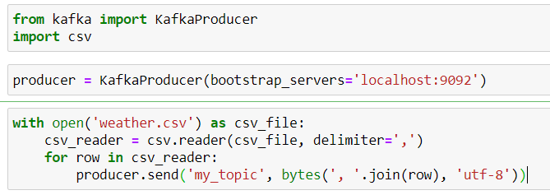
Producer
Producer is a short program for sending data to Kafka topic. The program consists:
Initiating the instance of KafkaProducer with a given bootstrap server where it can find topic
Reading csv file, dividing it into rows and sending one row at the time to topic as bytes.

Slide 4
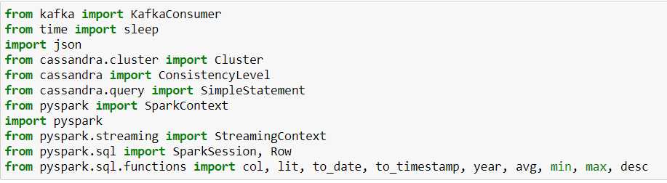
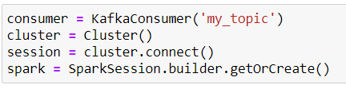
Consumer
Consumer is a program for collecting data from Kafka topic .
List of imported libraries
Initiating KafkaConsmuer with the name of the topic we want to connect to
Connecting to Cassandra database
Initiating SparkSession for using DataFrame Later

Slide 5
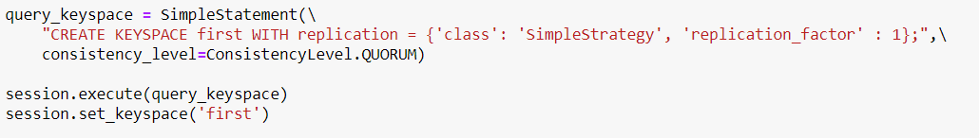
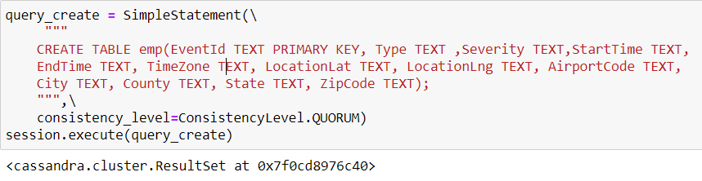
Consumer
Creating query in CQL language that Cassandra database is using. Query was to create a KeySpace named „first”. It was executed and later the keyspace was set as the default for the session.
CQL query for creating a table.

Slide 6
Consumer
Setting schema for DataFrame and N variable to specify the numer of demanded number of top results.

Slide 7
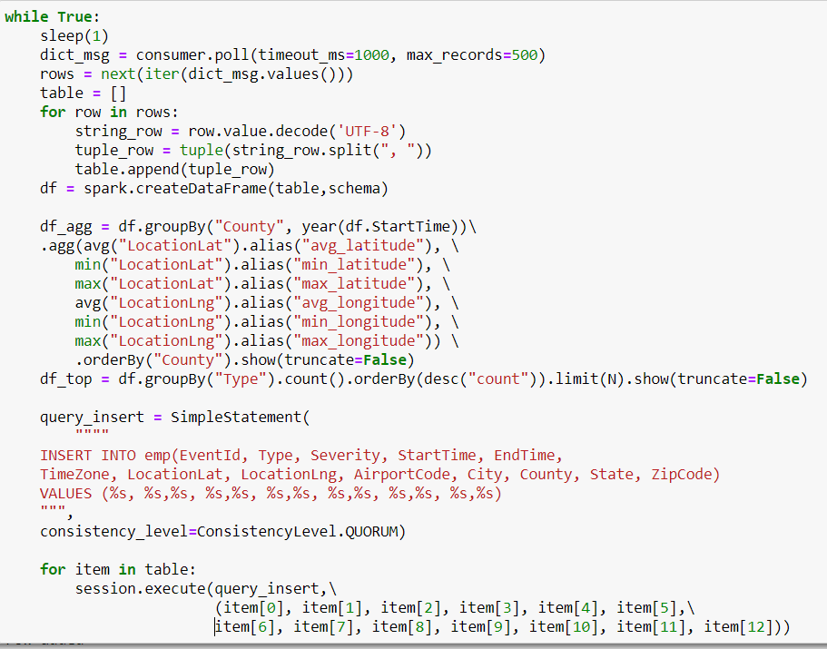
Consumer
It is the main loop of the program.
Waititng 1 sec in each iteration as a fixed window.
Consumer.poll pulls messages currently waiting in the topic.
Decoding each row of the downloaded data and putting all to the tuple list.
Making DataFrame from tuple list and schema.
Aggregating, grouping, ordering and showing data from the current window.
Showing top N most popular Type attributes in the current window.
Preparing CQL query for insterting data.
Executing query with data collected in the current window.

Slide 8
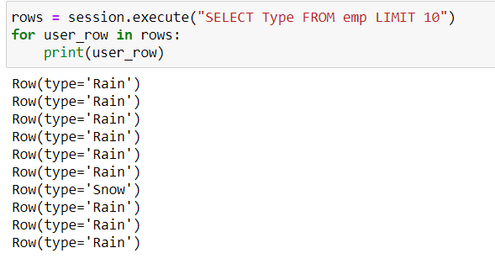
Consumer
Checking if data was sent to the Cassandra database.

Slide 9
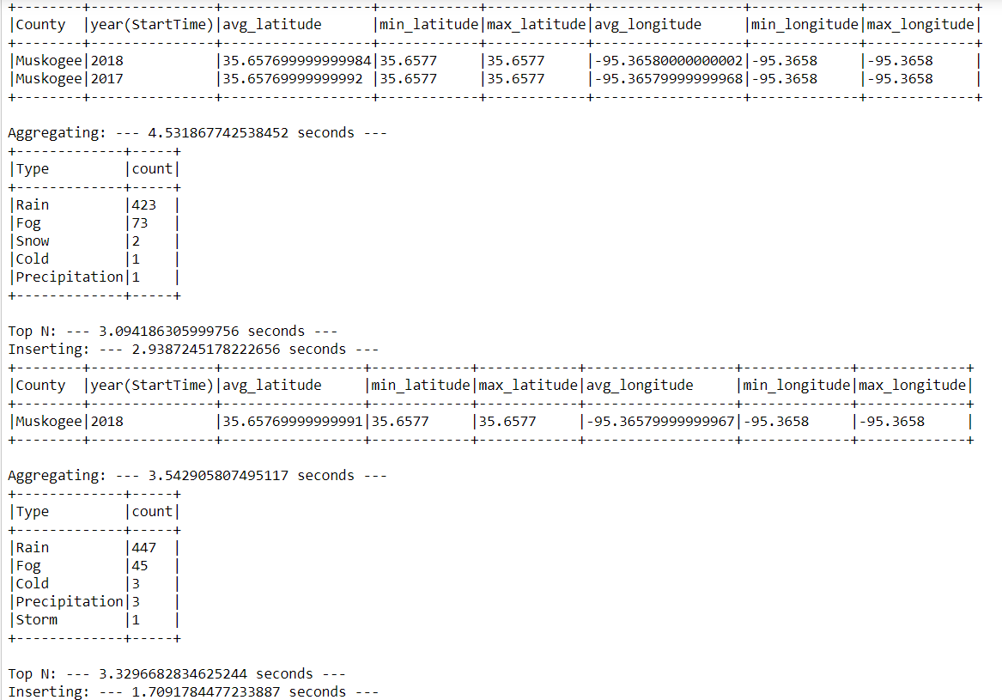
Results
Results for 2 iterations of main loop of program with amount of time that took for each of essential processes.
Looking at this performance, it can be concluded that window with time 1 sec doesnt make for this program at this machine.

