Slide 1
Apache Spark Application
Sebastian Dziura

Slide 2
Data
For the project I used dataset about weather events in United States (645 MB) that consisted following columns:
EventId,
Type,
Severity,
StartTime,
EndTime,
TimeZone,
LocationLat,
LocationLng,
AirportCode,
City,
County,
State,
ZipCode
Attributes marked with yellow colour are the ones used during analyze.

Slide 3


Implemantiation
Project was implemented in Docker container, containing PySpark with all dependencies and Jupyter Notebook.

Slide 4
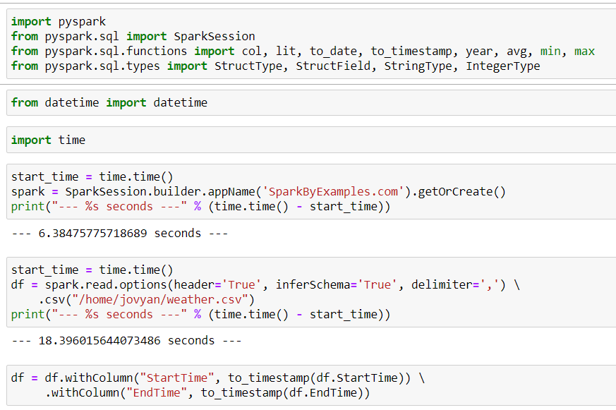
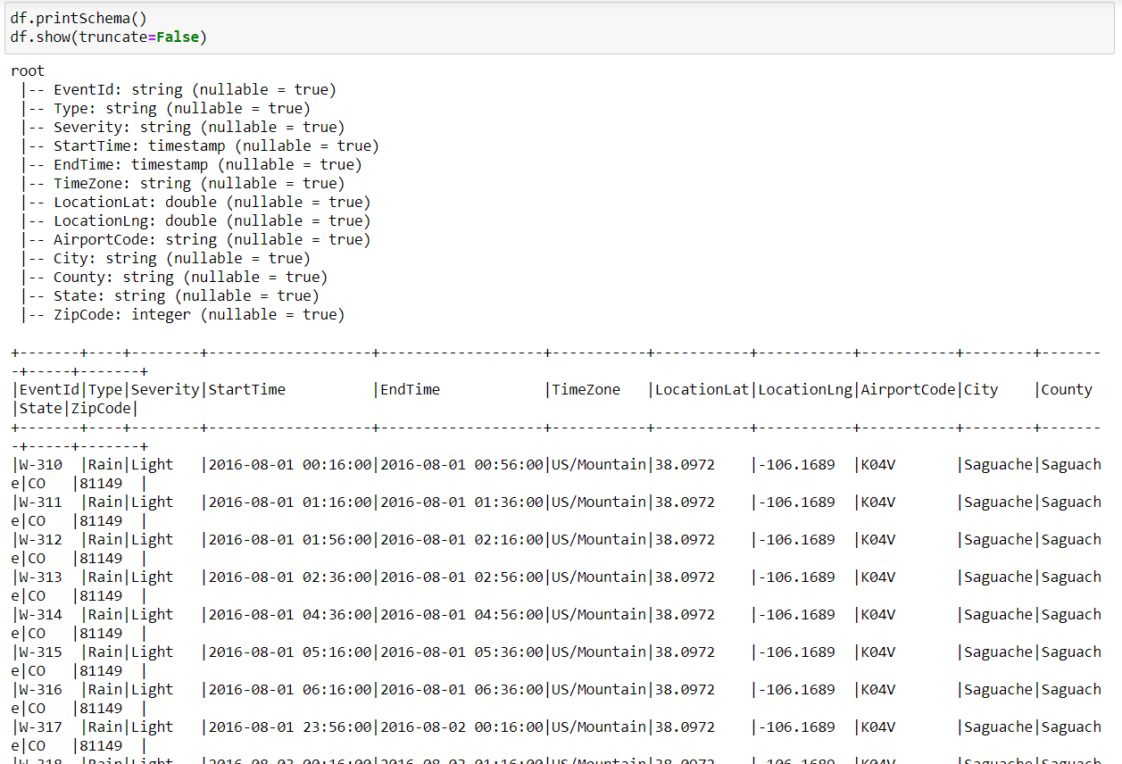
Loading data
Preparing dataset for analyze by:
importing frameworks,
Creating SparkSession (~6 sec),
loading data into dataframe (~18 sec),
modyfying time data type.
Printing schema and table of dataframe to check if it is corect.

Slide 5
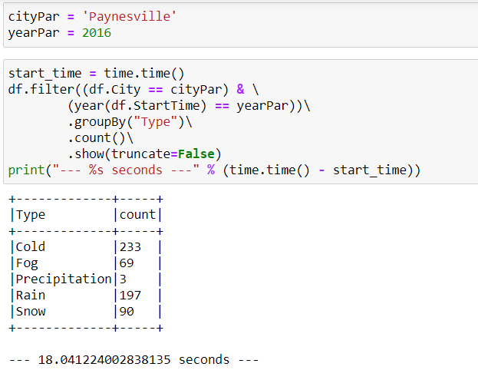
Analyze
Filtering data to find out how many times each type of weather event happend in Paynesville in 2016.
(~18 sec)

Slide 6
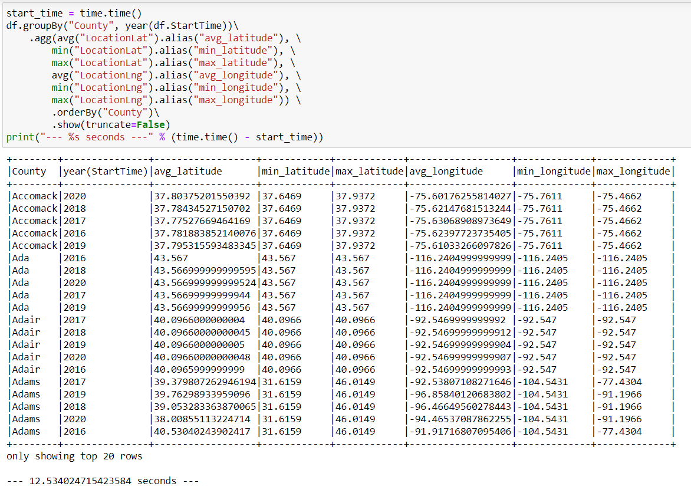
Analyze
Grouping data by County and Year.
Aggregating Latitude and Longitude attributes to find their average, minimum and maximum value fro each group.
Received geographical location where the data comes from in each county, in each year can be used to find climate and understand better weather events for these counties.
(~12 sec)

