Slide 1
Comparison of VCF files comparing tools
Autor: Sebastian Dziura
Notes:
My name is Sebastian Dziura,
The title of my project is „”

Slide 2
Content
Introduction
Tools
Tests
Results
Conclusions
Notes:
Presentation will start from introduction, to show a background of the project and explain some of the key words.
Then I will talk about tools that have been compared in the project.
Next step will consist some information about performed tests,
Data so the VCF files compared by tools,
Platform where the tests have been performed
and how the tests output had been analysed
The last two steps : are the results of the tests and conclusions taken from these results.

Slide 3
Introduction
Aim
To compare two tools, which are used for comparing VCF files.
To give opinion about solutions used by these tools.
To perform tests and interprate results.
Notes:
Intruduction will start with the aim of the project. So the aim is :
[1][2] it’s because these tools use different way to compare files and I will say more about it later [3]

Slide 4
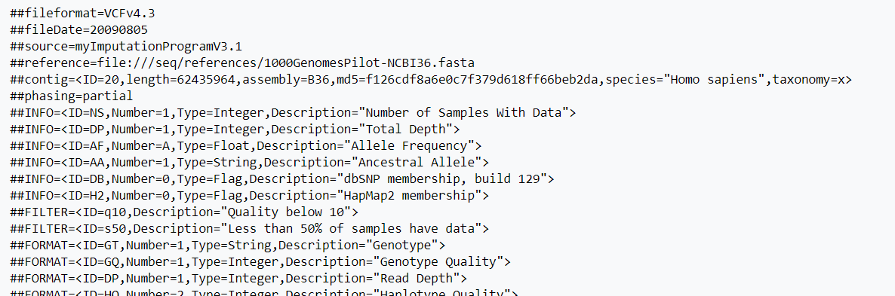
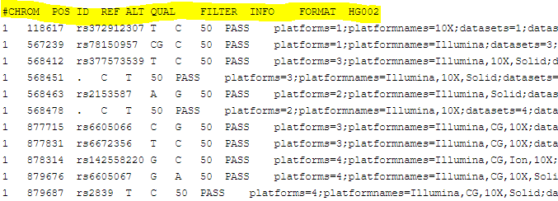
Introduction
VCF (Variant Call Format)
Metadata
Proper data
Notes:
I need to say a word about VCF files. VCF stands for Variant Call Format.
What are Variants?
More than 99% of DNA is a same for whole human popluation. The parts that makes us different from eachother are called Variants.
VCF is file that stores information about variants. The file is divided in 2 parts.
First one, consists metadata with information about the file. Those lines start with double hash.
Second part consists a data about each variant. Information are divided into colums, which are labaled by the header line that starts with single hash. I marked this line with yellow colour. Here we can find information like from which chromosome the variant is, what is its position, what was a base in refference, altarnative base and many other.

Slide 5
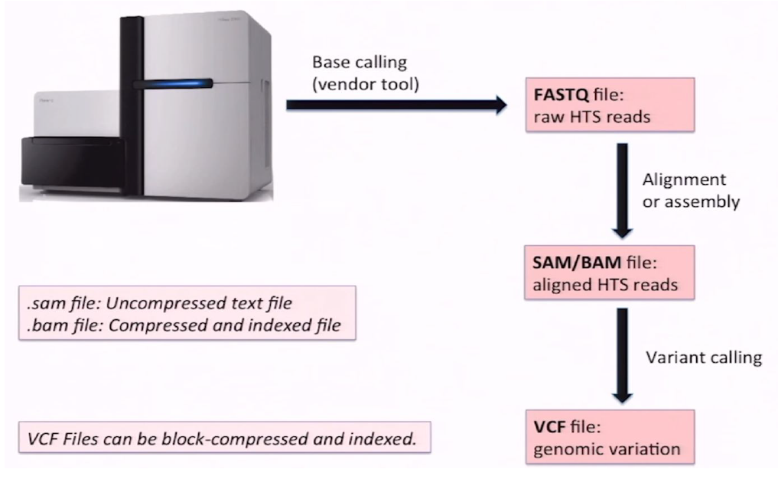
Introduction
(Source – Presentation from lesson 2)
Notes:
How to get those files with variants.
First we need to use this machine called DNA sequencer to read bases from fragments of DNA sample.
Then we get FASTQ file with fragments of our sequence. These fragments are later put together by alignment or assembly.
Ready sequence is saved in SAM or BAM file, which we use for variant calling that gives us VCF file with variants.

Slide 6
Tools
BCFtools isec
RTG tools vcfeval
Simple tool
Creates intersections, unions and complements
Compare corresponding records
Sophisticated tool
Performs variant comparison at the haplotype level
Uses refference sequence to deal wtih differences in variant representation
Notes:
As we already have VCF files, let’s now check the tools used for comparing them.
First of them is BCFtools Isec. It is a simple tool. It takes two VCF files and directly compare variants at their coresponding positions.
Second is, RTG tools vcfeval. It takes more sophisticated approach. It compares variants at haplotype level, that is, it determines whether the genotypes asserted in the VCFs under comparison result in the same genomic sequence when applied to the reference genome. It should deal better with differenes in representation or more complex situations.

Slide 7
Tests
TEST I
TEST II
VCF from GIAB
Two of the AshkenazimTrio
Baseline: HG003_NA24149_father
Called: HG002_NA24385_son
VCF from different callers
Both called from the same sample
Baseline: NA12878_HG001 from GIAB
Called: NA12878_HG001 from Platinum Genomes
Notes:
To check that, two tests have been performed.
In first one, samples to compare were taken from GIAB. It were samples from father and son, from Ashkanazim Trio. Beacuse of this relation, expected results of True positives should be around 50%.
In Second test, one sample was from GIAB and second one was from Platinum Genomes. In this case these were variants called from the same sample, but different callers. It means that even though results should be similiar, they might have some differences especially beacuse of different representation.

Slide 8
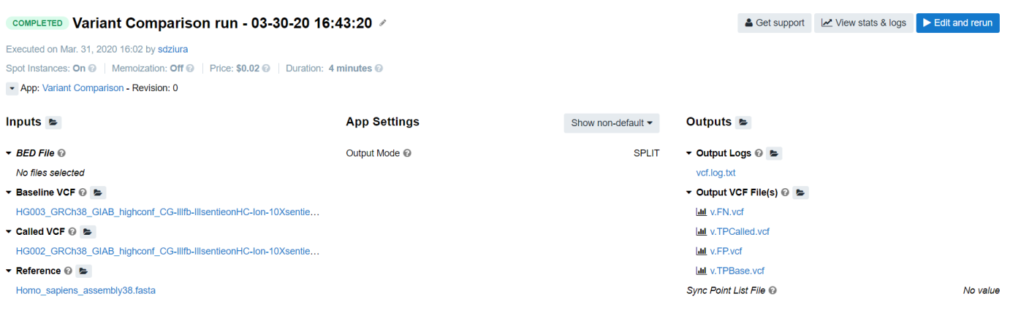
Tests - platform
CGC Platform
Notes:
To perform tests, I used CGC Platform where access was shared to me by Seven bridges genomics company. Platform consists many tools, including the ones that are compared in this project. As it is shown on a slide, Platform allows users to use tools in a very easy way. Just need to choose the input files and enter the right settings for the task.

Slide 9
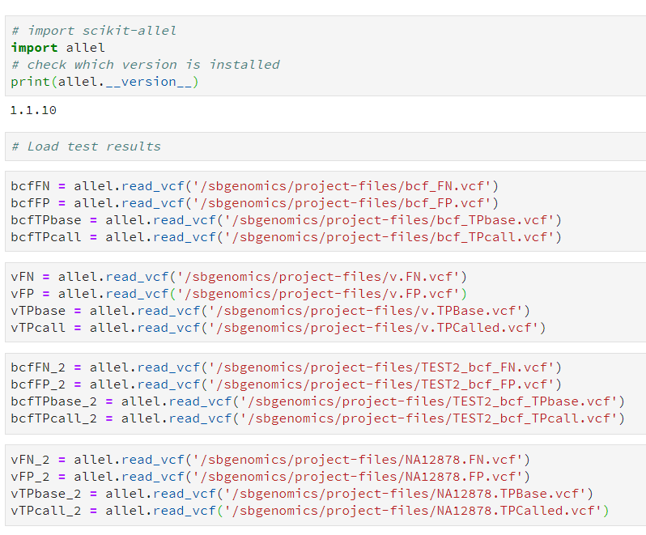
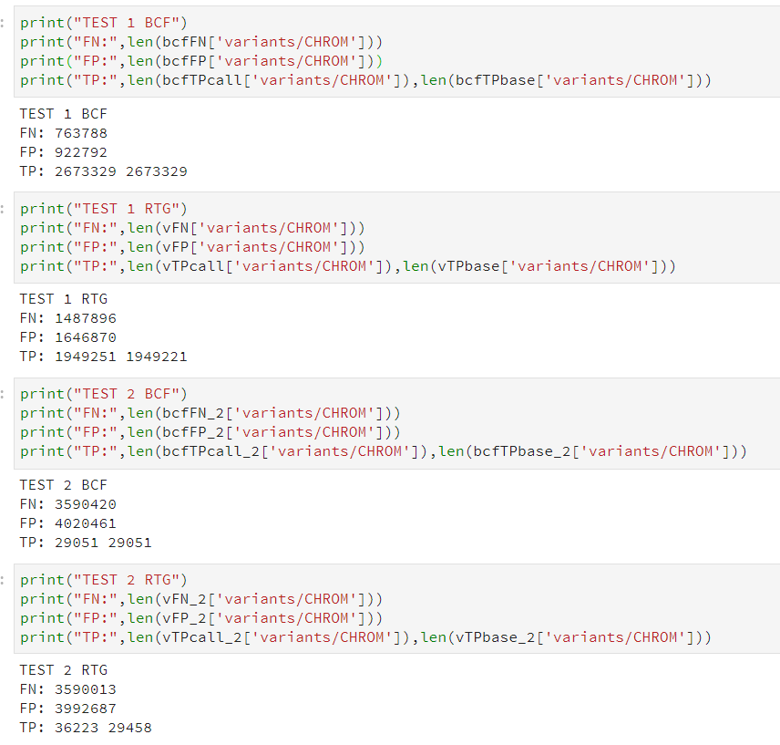
Tests – analysis
Python Jupyter Notebook
Notes:
At platform there is also posibillity to anlyze results in Jupyter Notebook. I read the output files using „allel” library and checked the length of .columns in each file which is equal to number of TPs, FPs and FNs

Slide 10
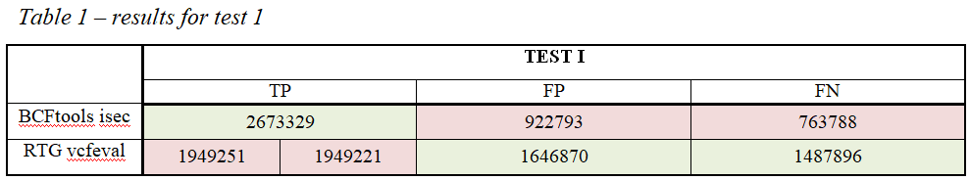
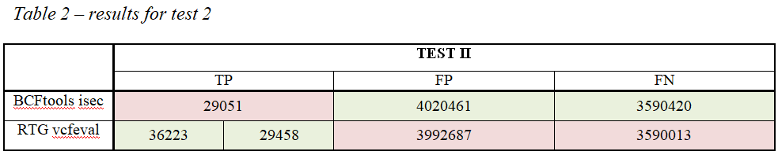
Results
Notes:
Results are presented in these tables. Cells of tools which got bigger number of partucular results are marked with green, smaller with red.
In the first test where fathers and sons samples were compared, there was more TPs when using BCFtools isec. Here 50% of TPs was expected and both tools had more than that. However RTG vcfeval was closer to that.
In the second test there weren’t many TPs found, although the same sample was used for variant calling. Still better results were achieved again by RTG vcfeval.

Slide 11
Conclusions
RTG tool vcfeval works better in situations where:
compared samples are in parent-child relation,
compared are sequences from same sample produced by different callers.
Notes:
From the comparison of tools, according to description and tests results, we can conclude that RTG tools really works better than BCFtools in both situations. Either the parent- child pair of sequences were compared and sequences called from same sample but different callers.

Slide 12
Thank you for listening

