Slide 1


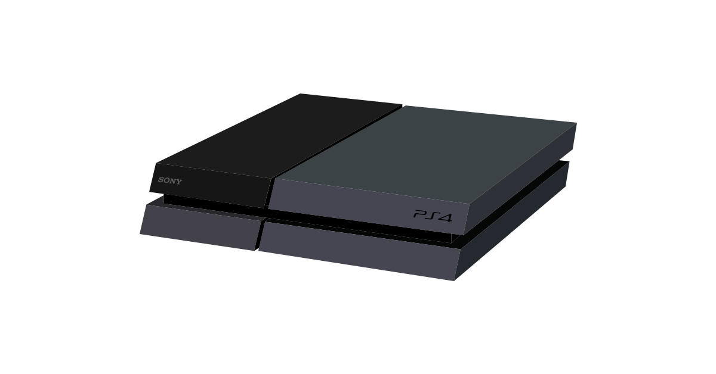



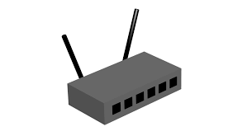

Wi-Fi
Inferring state machines of Tunneled Direct-Link Setup, Sébastiaan Versteeg
Notes:
Normal Wi-Fi network with a lot of devices, connecting them all together providing access to the internet.

Slide 2
Tunneled Direct-Link Setup
Inferring state machines of Tunneled Direct-Link Setup, Sébastiaan Versteeg
Notes:
TDLS sets up a direct link between two of the devices to lighten the load on the access point

Slide 3
Model learning
Create hypothesis
Check hypothesis
Learner
System Under Learning (SUL)
Input
Output
Counter example
Inferred state model
Inferring state machines of Tunneled Direct-Link Setup, Sébastiaan Versteeg
Notes:
How do we check the handshake?
Using model learning.
Learner can send and receive messages to the SUL
Learner tries to establish a hypothesis using the L* algorithm. Learner checks algorithm using randomwords.
Counter example? Create new hypothesis and reset.
Eventually the learner will output a model
that represents the SUL

Slide 4
Result
Inferring state machines of Tunneled Direct-Link Setup, Sébastiaan Versteeg
Notes:
The resulting state machine with all transitions. Exactly as we expected.

