Slide 1
Inferring state machines of Tunneled Direct-Link Setup Bachelor Thesis Presentation 23 January 2019
Author:
Sébastiaan Versteeg
hello@sebastiaan.app
First supervisor/assessor:
dr. ir. Joeri de Ruiter
joeri@cs.ru.nl
Second assessor:
dr. ir. Erik Poll
erikpoll@cs.ru.nl

Slide 2
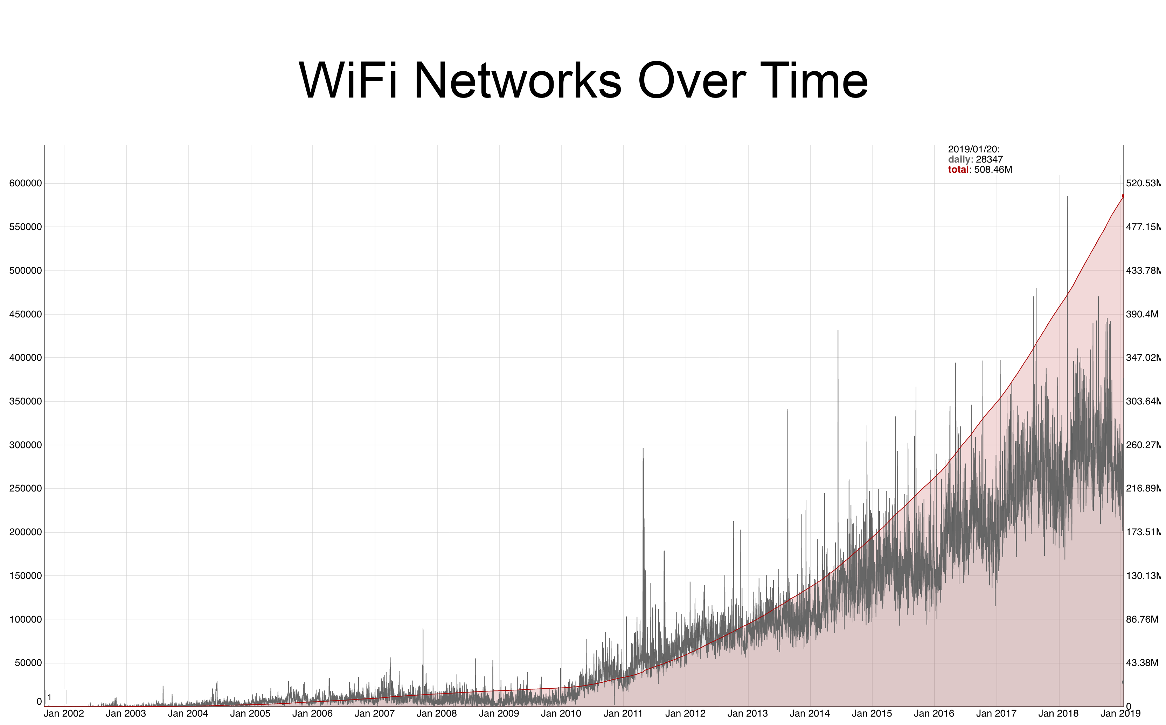
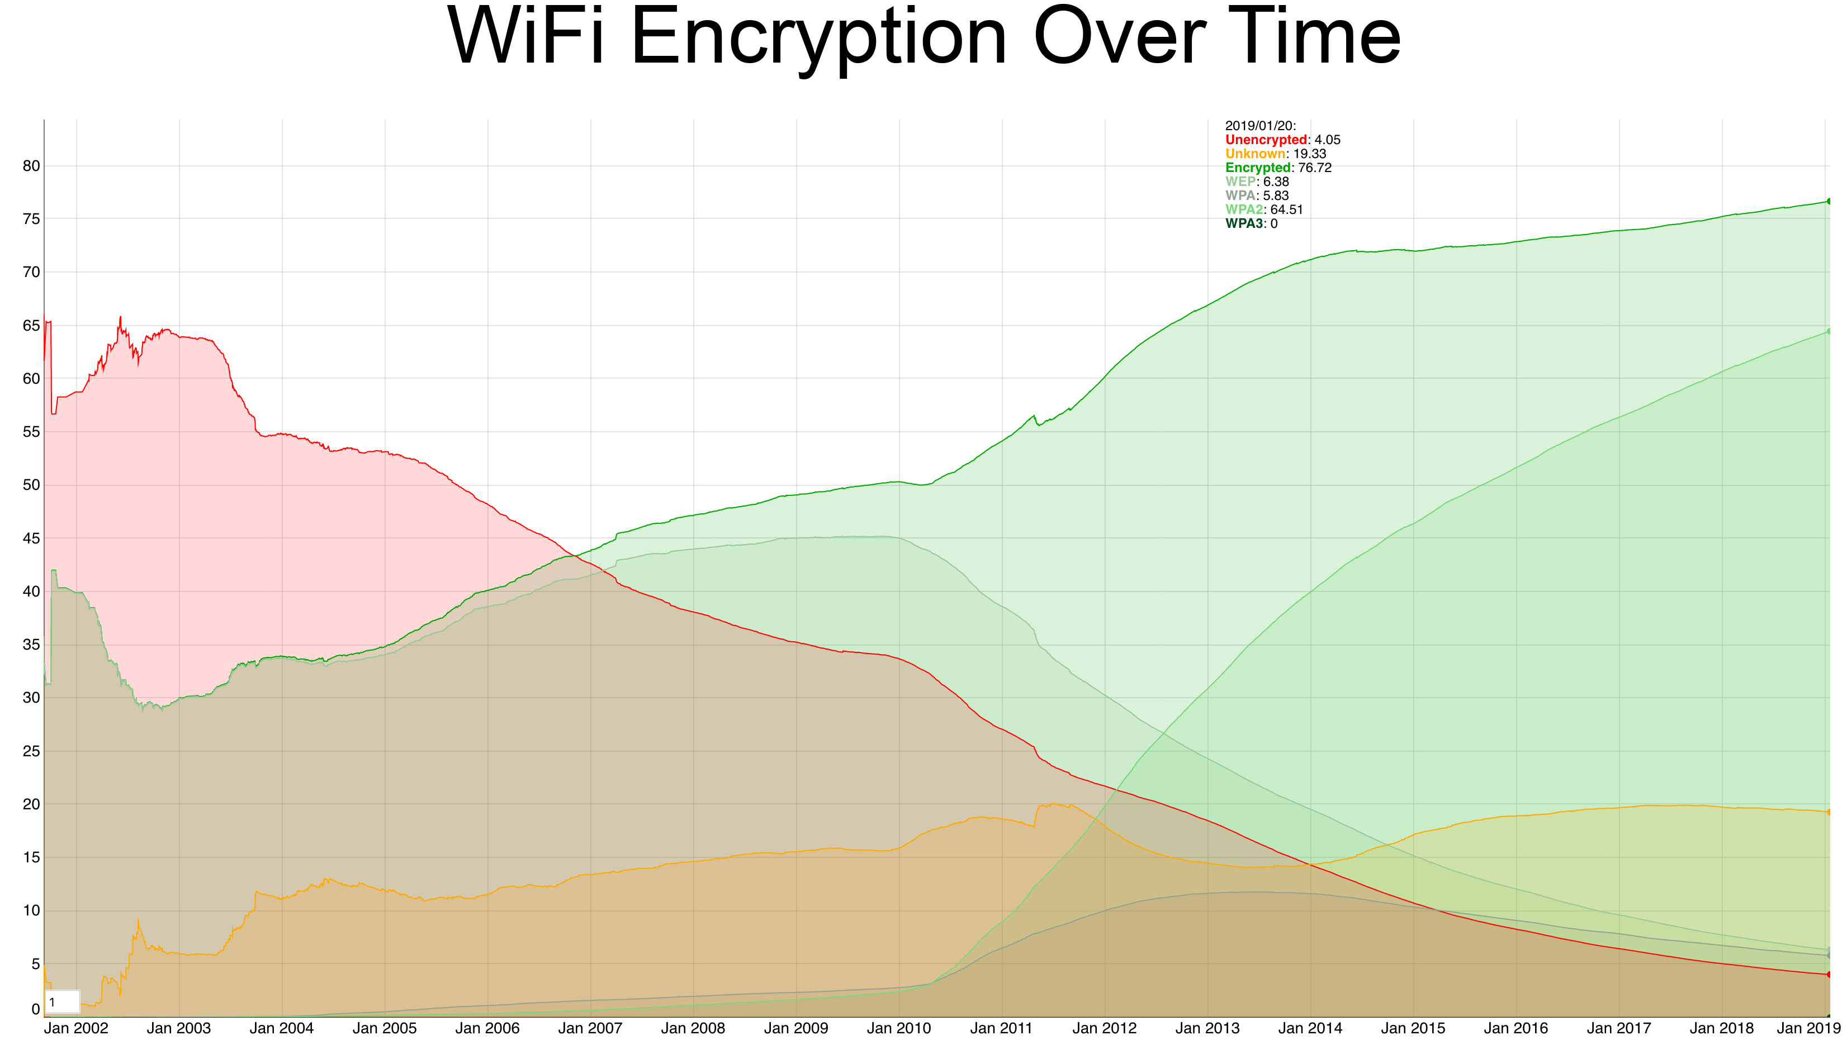
Introduction
Source: WiGle.net
Source: WiGle.net
Every user relies on reliable security mechanisms!
Notes:
The past years we have seen a massive increase in the use of Wi-Fi. These networks are encrypted to provide confidentiality, users should be able to rely on the security mechanisms.
Why is this relevant? TDLS is part of the Wi-Fi specification

Slide 3






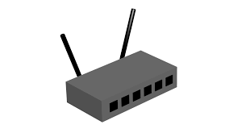

Wi-Fi
Notes:
Normal Wi-Fi network with a lot of devices, connecting them all together providing access to the internet.

Slide 4
Tunneled Direct-Link Setup
Notes:
TDLS sets up a direct link between two of the devices to lighten the load on the access point

Slide 5
Wi-Fi: 4-Way Handshake
Tunneled Direct-Link Setup: TDLS PeerKey (TPK)
Notes:
Both negotiate a key to protect data frame, our research focuses on TPK. The 4-way handshake provides security for the links to the access point.

Slide 6
Tunneled Direct-Link Setup: TDLS PeerKey (TPK)
MIC = AES-HMAC(message, (ANonce, SNonce, MAC_{I}, MAC_{R}))
Notes:
The TPK handshake utilizes AES to calculate the MIC to confirm the connection and provide confidentiality over the link.
Messages protected since link with AP is protected.

Slide 7
Model learning
Create hypothesis: L*
Check hypothesis:
randomwords
Learner
System Under Learning (SUL)
Input
Output
Counter example:
Reset
Inferred state model
Notes:
How do we check the handshake?
Using model learning.
Learner can send and receive messages to the SUL
Learner tries to establish a hypothesis using the L* algorithm. Learner checks algorithm using randomwords.
Counter example? Create new hypothesis and reset.
Eventually the learner will output a model
that represents the SUL

Slide 8
Learning TDLS
Learner:
StateLearner
Mapper
System Under Learning (SUL):
TDLS
Implementation
Input
Input
Output
Output
Inferred state model
Abstract token
TDLS Packet
Notes:
Learn TDLS:
Implemented mapper
Mapper can convert tokens to packets
Response packets converted to tokens

Slide 9
Challenges building the mapper
Checking if the TDLS connection succeeded
Ping a program on the interfaces connected to the SUL
Try a TDLS channel switch
Handling error messages
Retransmissions
We assume that after a happy flow the connection is successful.
Notes:
Building the mapper, most challenging
- Check connection
- Error messages
- Retransmissions
Happy flow

Slide 10
Setup
Learner: StateLearner + LearnLib
Mapper: Python script communicating with sockets and interfaces using Scapy
Virtual interfaces and access point: hostapd
TDLS Implementation: wpa_supplicant
Notes:
All together our learning setup together with our mapper and other tools can be visualised as follows.
Write TDLS implementation from scratch
Using wpa_supplicant test code to setup virtual interfaces
wpa_supplicant = implementation for wpa/tdls on most linux systems + whole android

Slide 11
Result
Notes:
The resulting state machine with all transitions. Exactly as we expected.

Slide 12
Conclusions
We can infer a state machine of a TDLS implementation
Inferring state machines improves our knowledge of a protocol
TDLS can be implemented using only Python, Scapy and crypto tools
Notes:
- Our code is able to infer a state machine of TDLS
- Improved knowledge about how TDLS works
- Simple tools to do the job

Slide 13
Future work
Current limitations:
Assumptions made in the mapper
Ignoring error messages, only well formatted packets
Tested on virtual setup
Possible improvements:
Fuzzing messages
Malformed message as input
Use real hardware
Implement a ping to confirm a successful TDLS setup

Slide 14
Questions?
Inferring state machines of Tunneled Direct-Link Setup 23 January 2019 Sébastiaan Versteeg hello@sebastiaan.app

