Slide 1
Title: Integrating the MPU6050 IMU Sensor in Autonomous Vehicle
Subtopics: Basics, Purpose, Data, and Implementation

Slide 2
Introduction to IMU Sensors
What is an IMU?
  An Inertial Measurement Unit (IMU) is a device that measures and reports a vehicle's specific force, angular rate, and sometimes magnetic field.
  IMUs are widely used in applications where orientation, velocity, and position are needed, such as robotics, drones, mobile phones, and autonomous vehicles.

Slide 3
Basic Functionality of an IMU:
  An IMU typically contains multiple sensors:
    Accelerometer: Measures linear acceleration in 3 axes (x, y, z).
    Gyroscope: Measures rotational velocity around 3 axes (roll, pitch, yaw).

Slide 4
Overview of the MPU6050 IMU Sensor
MPU6050 Specifications:
  Manufactured by InvenSense.
  Combines a 3-axis accelerometer and a 3-axis gyroscope in a single chip.
  Data Interface: I2C, making it easy to interface with microcontrollers like Arduino and Raspberry Pi.
  Range:
    Accelerometer: Selectable ranges of ±2g, ±4g, ±8g, and ±16g.
    Gyroscope: Selectable ranges of ±250, ±500, ±1000, and ±2000 degrees/second.
Purpose of MPU6050:
  Provides information about the vehicle’s orientation and movement, which can be used for localization and navigation.

Slide 5
Data Provided by the MPU6050
Accelerometer Data:
  Measures linear acceleration along the x, y, and z axes.
  Used to detect changes in speed and can infer orientation (e.g., tilt) relative to gravity.
Gyroscope Data:
  Measures angular velocity around the x, y, and z axes.
  Helps to track the rotation of the vehicle, providing insights into changes in direction.
Sample Data Format:
Example values from the IMU might look like this:
  Accelerometer: Ax = 0.5g, Ay = 0.1g, Az = 9.8g (where g is gravity)
  Gyroscope: Gx = 30°/s, Gy = 0°/s, Gz = -15°/s

Slide 6
How the IMU Helps in Our Autonomous Car Project
Primary Purposes:
  Orientation Tracking: Provides data to determine the car's tilt and rotation, helping with stable movement and correct alignment on the path.
  Acceleration Measurement: Detects changes in the car’s speed, which can be useful for controlling the vehicle smoothly.
  Assists in Localization: The IMU can work with other sensors (like LiDAR) to estimate the car’s position more accurately, especially in cases of short-term drift correction.
Why Use IMU Along with LiDAR:
  LiDAR is excellent for creating maps and detecting obstacles, but it may have limitations in tracking subtle orientation changes.
  The IMU compensates for short-term orientation changes, especially in low-speed situations where LiDAR data may not be precise enough for fine adjustments.

Slide 7
Integrating the MPU6050 into the Project
Hardware Setup:
  Connection to Microcontroller: The MPU6050 communicates via I2C.
  Wiring:
    VCC to 3.3V or 5V (based on microcontroller’s voltage level).
    GND to GND.
    SCL and SDA to respective I2C pins on the microcontroller (e.g., A4 and A5 on Arduino).
  Placement on the Vehicle: Mount the MPU6050 in a stable position near the center of the vehicle to minimize vibrations and ensure accurate readings.
Software Integration:
  Arduino Code: Using an MPU6050 library (e.g., Adafruit or Jeff Rowberg’s MPU6050 library) to initialize and read data from the sensor.
ROS2 Integration:
The IMU data can be published to a ROS2 topic (e.g., /imu/data).
ROS2 nodes can then subscribe to this topic for orientation and motion data, which helps with localization and navigation.

Slide 8
Data Flow in the System
Step-by-Step Data Flow:
Data Collection: MPU6050 reads linear acceleration and angular velocity.
2. Preprocessing on Arduino: Basic filtering (if any) and formatting data.
3. Data Transmission to Raspberry Pi (RP4): Arduino sends data over I2C or serial to RP4.
4. ROS2 Node Publishes IMU Data: A ROS2 node on RP4 reads the data and publishes it to /imu/data.
5. Data Fusion and Usage:
The robot_localization package combines IMU data with other sensor data (like LiDAR) to estimate position and orientation.
Navigation and Control Nodes use this information to adjust the car’s path and maintain stability.

Slide 9
Important Concepts for Working with IMU Data:
1. Noise and Drift:
  IMU sensors can be noisy and subject to drift over time, especially in low-cost sensors like the MPU6050.
  Solution: Use filtering techniques such as the Complementary Filter or Kalman Filter (provided by ROS2 packages like robot_localization) to fuse IMU data with other sensors and reduce drift.
2. Sensor Calibration:
Accelerometer Calibration: Ensures that the IMU’s readings are accurate for each axis. A common method involves placing the sensor in different orientations and adjusting for gravity.
Gyroscope Calibration: Corrects for any inherent bias in the gyroscope readings to prevent drift.
3. Coordinate Frames and Transformation:
The data from the IMU needs to be correctly oriented with respect to the car’s frame of reference (base_link). ROS2 uses tf2 (transformation) to manage coordinate frames and ensure that IMU data aligns with other sensor data.

Slide 10
Implementation Challenges and Solutions
Challenge: Managing IMU Drift
  Solution: Combine IMU data with other sources, like LiDAR, using robot_localization for more accurate state estimation.
Challenge: Processing IMU Data in Real-Time
  Solution: Preprocess data on Arduino to reduce computational load on RP4 and only send essential information.
Challenge: Ensuring Stable Mounting
  Solution: Mount the IMU near the center of mass and use damping materials if necessary to reduce vibrations.

Slide 11
Conclusion and Next Steps
Summary:
  The MPU6050 provides essential orientation and acceleration data that improves localization and stability in our autonomous car project.
  By integrating this data with other sensors, the car can more accurately navigate the environment.
Next Steps:
  Implement the IMU data publishing node on RP4.
  Test data fusion with robot_localization to verify the effectiveness of IMU in localization.
  Fine-tune the IMU data usage based on initial testing and project needs.

Slide 12
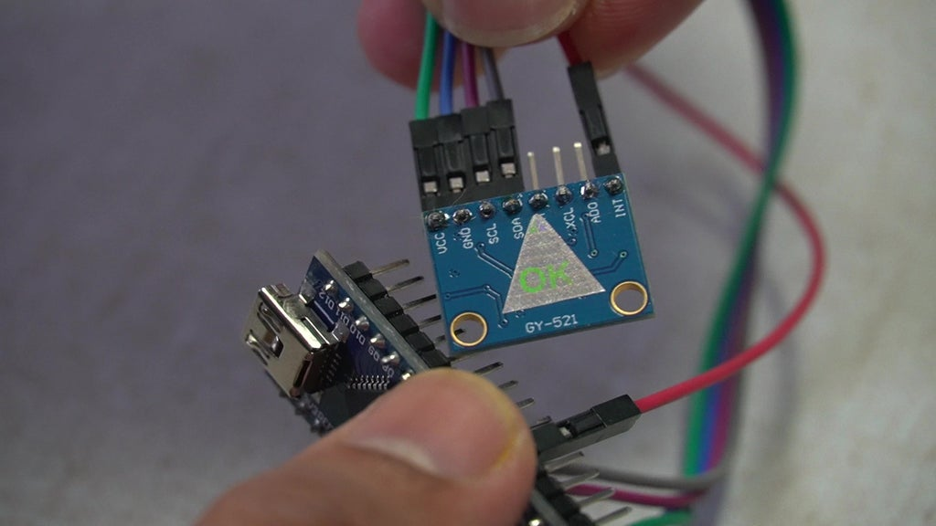
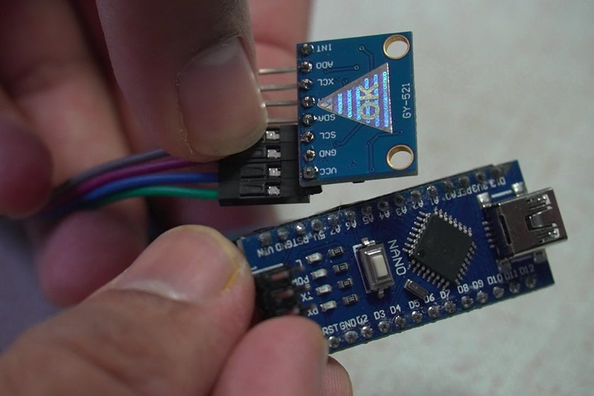
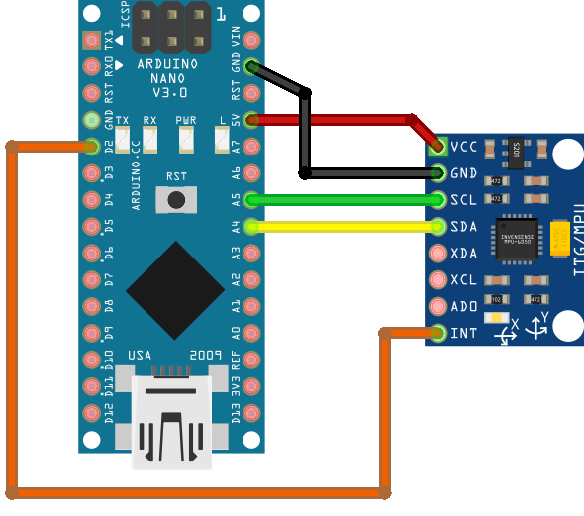

Slide 13
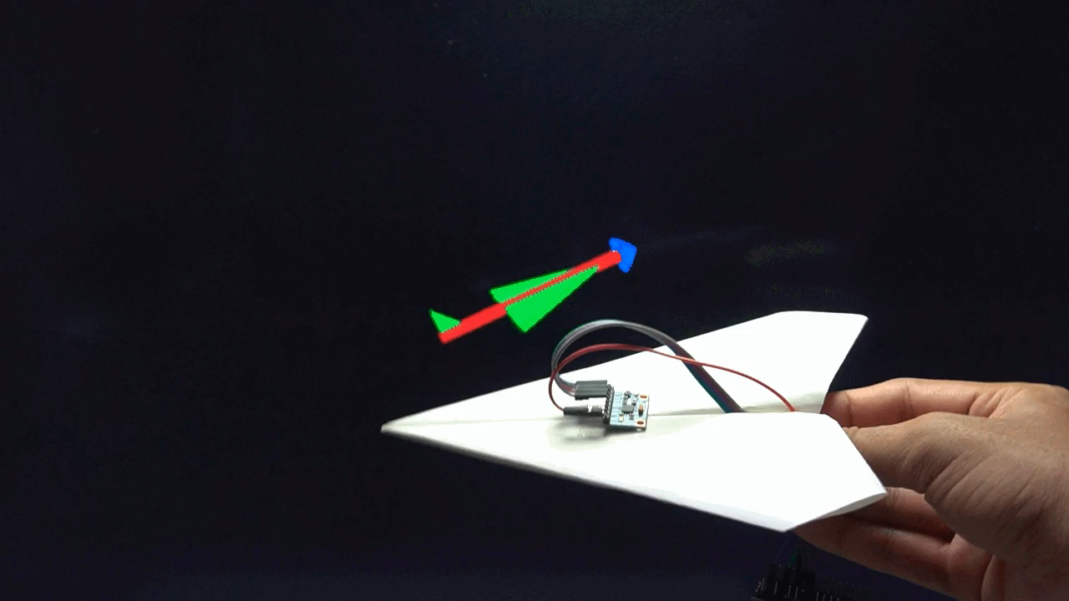

Slide 14
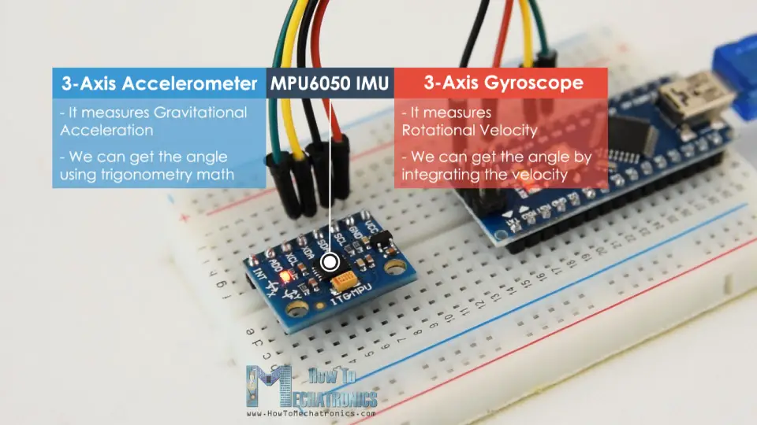

Slide 15
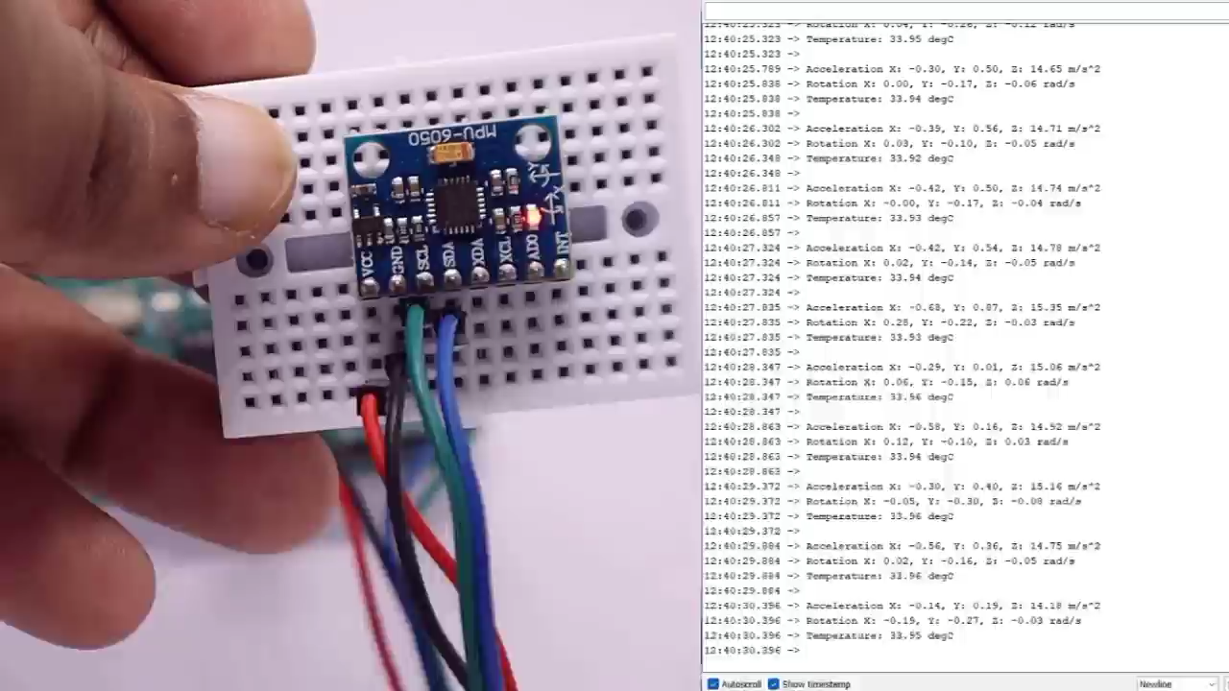

Slide 16
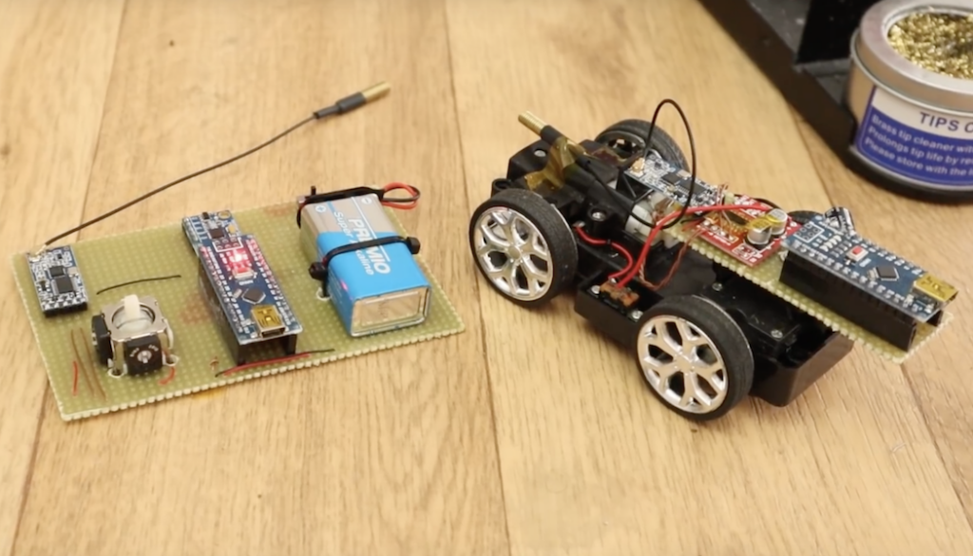
Augment RC vehicle control with an IMU-based transmitter
https://blog.arduino.cc/2018/10/02/augment-rc-vehicle-control-with-an-imu-based-transmitter/

Slide 17
Demo created (by me) for IMU sensor where fake value is published in the topic /data/imu
https://vimeo.com/1028156074

Slide 18
IMU setup in hardware
Components Needed
IMU Sensor (e.g., MPU6050)
Microcontroller (e.g., Arduino) to read data from the IMU
Main Computer (e.g., Raspberry Pi 4 running ROS2)
Connecting Wires for I2C connection
Power Supply for the Arduino (often powered through USB from the Pi)
Wiring Connections (for MPU6050)
If you’re using an MPU6050, it typically communicates over I2C. Here’s how to wire it:
VCC to 5V on the Arduino (or 3.3V if required by your IMU version).
GND to GND on the Arduino.
SCL (Serial Clock) to A5 (Arduino UNO) or designated SCL pin on other models.
SDA (Serial Data) to A4 (Arduino UNO) or designated SDA pin on other models.
This setup will allow the Arduino to communicate with the IMU over I2C.
1

Slide 19
IMU setup in hardware
Programming the Arduino to Read IMU Data
Next, program the Arduino to read data from the IMU and send it over serial to the Raspberry Pi.
Step 1: Install the MPU6050 Library
In the Arduino IDE:
Go to Sketch -> Include Library -> Manage Libraries…
Search for "MPU6050" and install a library like MPU6050 by Electronic Cats or MPU6050 by Jeff Rowberg.
Explanation of Code:
Acceleration and Gyroscope Data: Reads and prints accelerometer and gyroscope values to the serial output.
Serial Print Format: Data is output in a simple format that’s easy to parse in ROS2.
Upload this code to your Arduino.
2

Slide 20
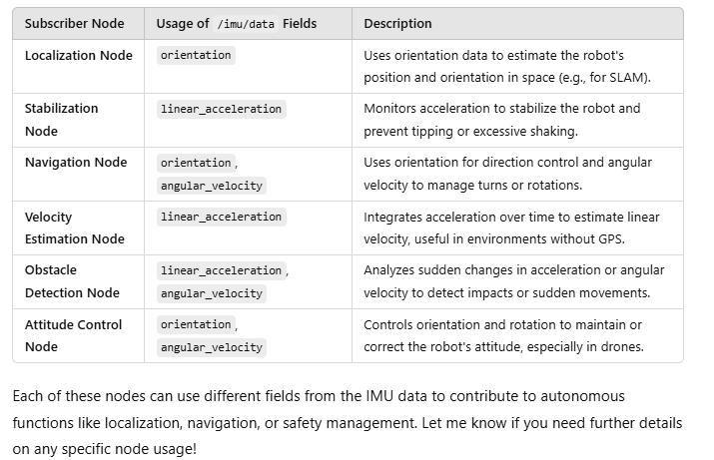
Imu_publisher
/imu/data
Imu_sub

Slide 21
References
https://howtomechatronics.com/tutorials/arduino/arduino-and-mpu6050-accelerometer-and-gyroscope-tutorial/
https://www.instructables.com/MPU-6050-Teapot-Project/
ChatGPT
https://circuitdigest.com/microcontroller-projects/interfacing-mpu6050-module-with-arduino

Slide 22
Controller

Slide 23
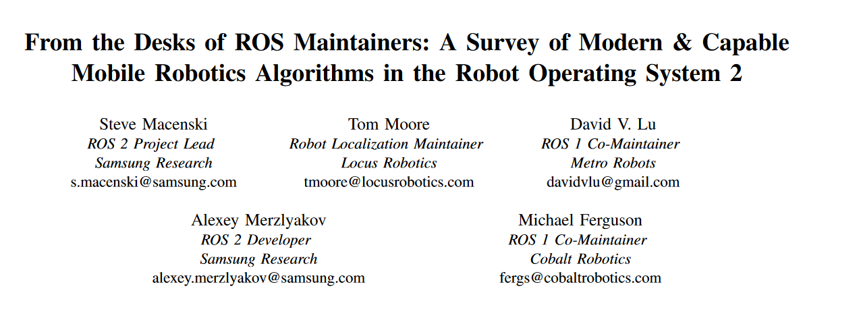
This survey includes overviews, analysis, and unique expert insight into
the algorithms and capabilities, new and old. We discuss and
compare current research products with historically robust
methods. Brief benchmarking within provides metrics for the
first time for the new key methods.
https://arxiv.org/pdf/2307.15236

Slide 24
Points of consideration

Slide 25
Refer notes:16

Slide 26
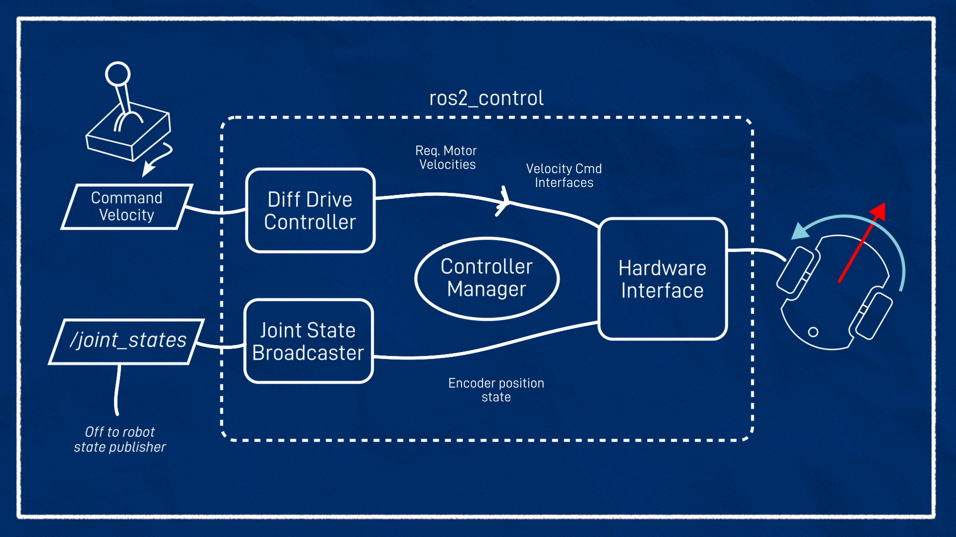
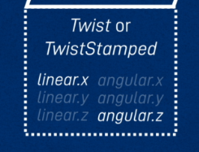
Customize for use case,
Articulated robotics tutorial
https://articulatedrobotics.xyz/tutorials/mobile-robot/applications/ros2_control-real/

Slide 27
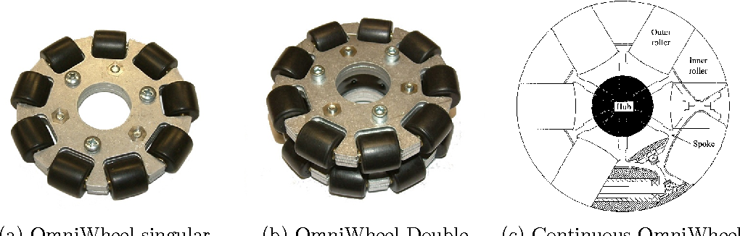
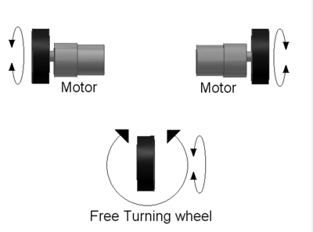
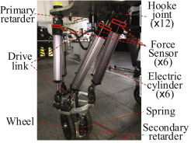
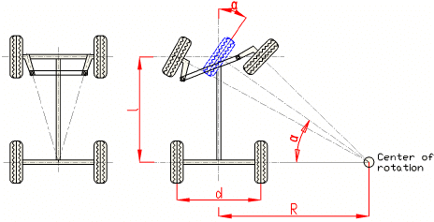
https://en.wikipedia.org/wiki/Differential_wheeled_robot
Ackermann mobile robot chassis with independent rear wheel drives - Scientific Figure on ResearchGate. Available from: https://www.researchgate.net/figure/Ackermann-steering-principle_fig2_224184352 [accessed 21 Nov 2024]
Notes:
https://www.sciencedirect.com/science/article/pii/S0957415820300684
Here’s a quick overview of the supported platform types:
Differential:
Vehicles with two independently driven wheels (e.g., robots like TurtleBot). Steering is achieved by varying wheel speeds.
Omnidirectional:
Vehicles with specialized wheels (e.g., Mecanum or Omni-wheels) that allow movement in any direction without changing orientation.
Ackermann:
Vehicles with car-like steering geometry, where front wheels turn at different angles, commonly used in autonomous cars.
Legged:
Robots with legs (e.g., quadrupeds like Spot or bipedal robots), designed for uneven terrains and complex mobility.

Slide 28
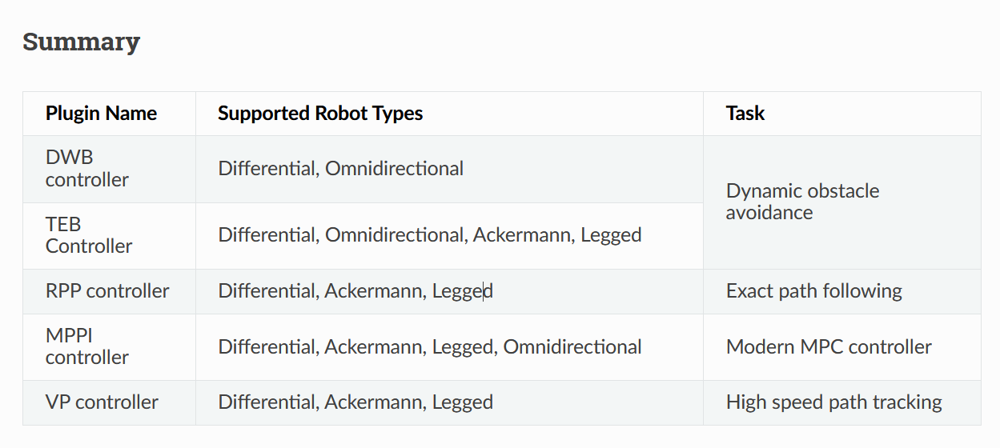
Differential types of control mechanism based on the vehicle driving system
https://docs.nav2.org/setup_guides/algorithm/select_algorithm.html#select-algorithm

Slide 29
Demo of controllers:
Implementation on Ackermann based drive in gazebo
(Maybe) for differential drive [turtlebot3], aim is to provide workflow schema
From the construct

Slide 30
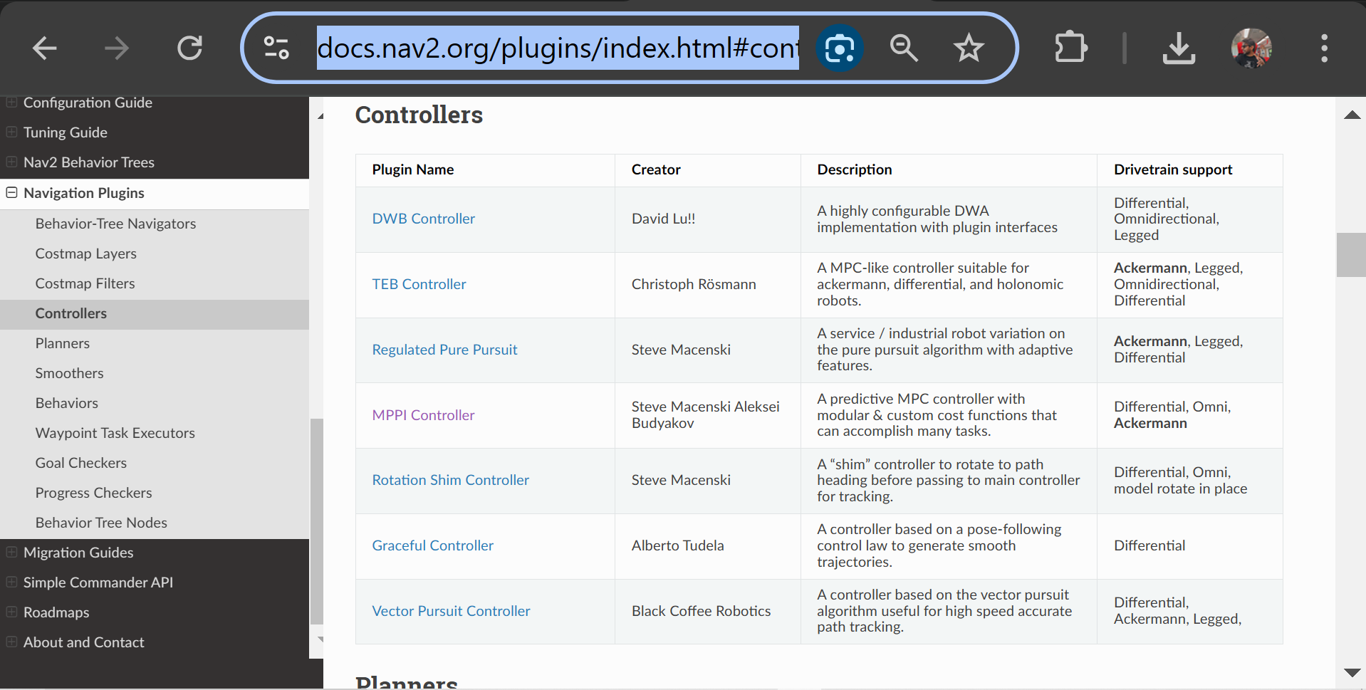
https://docs.nav2.org/plugins/index.html#controllers

Slide 31
Ros2_control

Slide 32
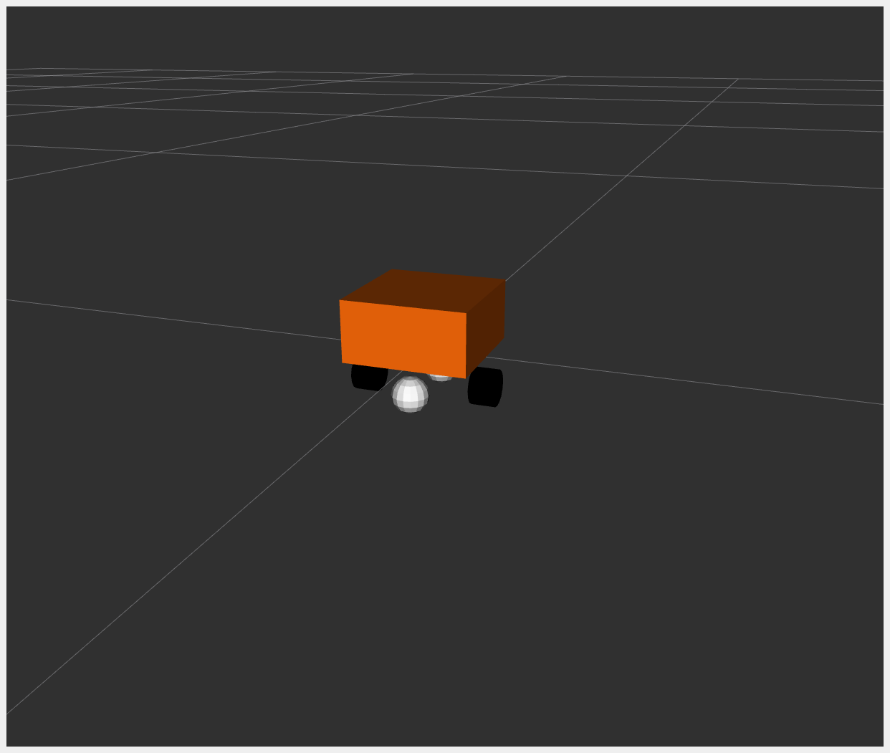
https://control.ros.org/master/doc/ros2_control_demos/example_2/doc/userdoc.html
Diffbot

Slide 33
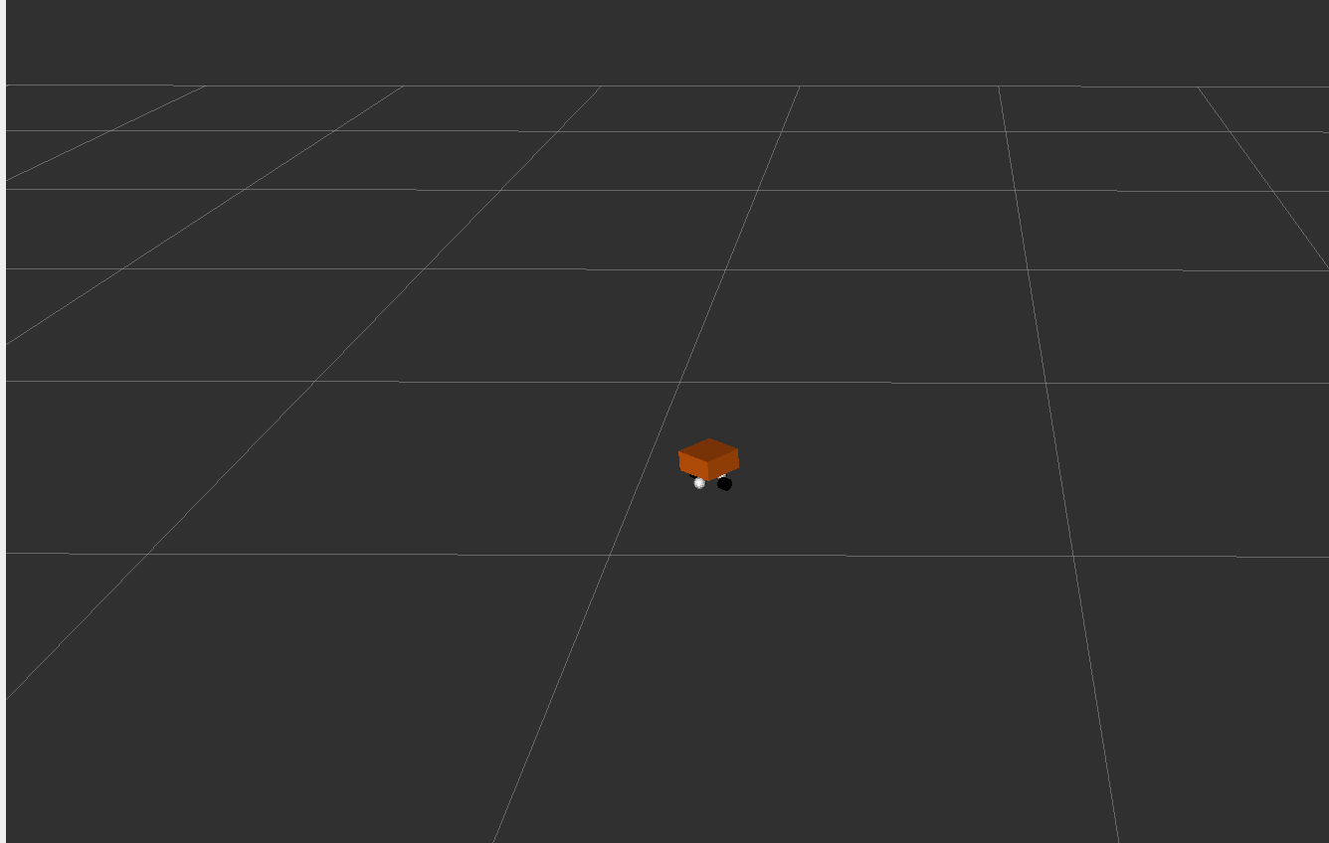

Changing parameters
diffbot_controllers.yaml file and adjust parameters like wheel_radius, wheel_separation, or velocity limits.
diff_drive_controller:
type: diff_drive_controller/DiffDriveController
parameters:
wheel_radius: 0.2 # Change the wheel size
wheel_separation: 0.6 # Increase the distance between wheels
linear.x.max_velocity: 1.5 # Modify maximum speed
angular.z.max_velocity: 0.8
Right
wrong
$ ros2 topic pub --rate 10 /cmd_vel geometry_msgs/msg/TwistStamped "twist: linear: x: 0.7 y: 0.0 z: 0.0 angular: x: 0.0 y: 0.0 z: 1.0
$ ros2 topic pub /cmd_vel geometry_msgs/msg/Twist "linear: x: 1.0 y: 0.0 z: 0.0angular: x: 0.0 y: 0.0 z: 0.5

Slide 34
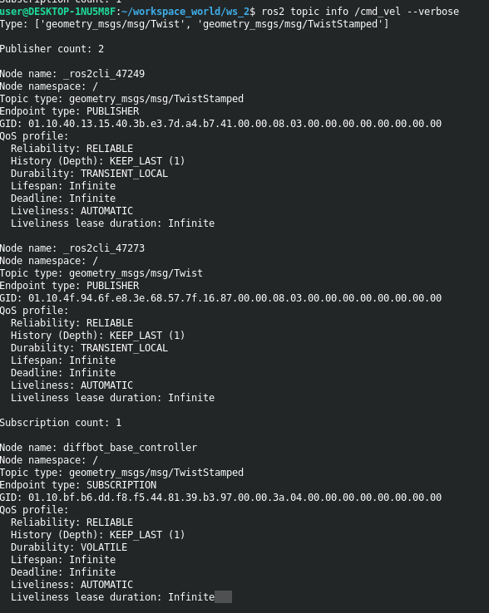
Troubleshoot: check subscriber subscribes to which “type” of topic

Slide 35
Further, if..
Optional Exploration
Advanced Features:
Interested in:
  Visual odometry or SLAM for localization.
  Obstacle avoidance or dynamic path planning.
Not interested in:
  Multi-robot coordination or communication.

Slide 36
1. Additional Information Required
To fully define your URDF/Xacro, I need the following:
Chassis Dimensions:
  Length, width, and height of the chassis.
Wheel Mounting:
  Is the axle of the wheel centered or offset vertically on the chassis?
Weight Distribution (Optional):
  Approximate weight or center of gravity if available (can be added later for physics simulation in Gazebo).
Steering Details:
  Is the steering mechanism Ackermann-based with a single-point turn axis, or does it have any unique features?
  Do you want to model only the front wheels turning or simulate virtual rear-wheel steering?
2. What You’ve Already Provided
Wheelbase: 55.8 cm
Track Width: 40.8 cm
Wheel Diameter: 20 cm
Steering Offset: 12 cm from the front wheel axis

Slide 37
Key Components of a Hardware Interface
Command Interfaces:
Define what type of commands the hardware can accept (e.g., set position, velocity, or effort).
Examples:
position for a servo motor to set its angle.
velocity for a DC motor to set its speed.
effort for force/torque-based control.
State Interfaces:
Define what states the hardware reports back (e.g., current position, velocity, or effort).
These are read by the read() method in the hardware interface plugin.
Claimed Interfaces:
A controller claims one or more command interfaces to manage specific hardware (e.g., a joint).

Slide 38
ROS Developers Open Class n.186: Understand Ackermann
ROS Developers Open Class n.196: How to create Web Dashboards for ROS 2

Slide 39
https://youtu.be/bQgAIV3eHbg?si=A3iqi5qmgtID3G__
https://youtu.be/LvBjVmZxxDA?si=XPYen7uNuu0KzYwN
https://youtu.be/YSlRPh-N0Fs?si=48WRin4L3DRD3iFt
https://youtu.be/RrFcKgJUK54?si=P6bpAIUSQgPZbJFv
https://youtu.be/xBhYHOSxMOk?si=hYWWMXaDafRX4sKn
https://youtu.be/3RPaWrOGYPU?si=XJftufjk2KPCL87T
https://youtu.be/vzxGgf9Jn3c?si=_mjBgf0v9Z9ISZq0
https://youtu.be/vzxGgf9Jn3c?si=_mjBgf0v9Z9ISZq0
https://youtu.be/9AsDmPJWcnQ?si=eO0iY6R3SN7i3wmP

Slide 40
Aim : make hardware interface for driving the steering vehicle, front :servo, back differential
Protocol
ros2_control overview - personal
Writing a URDF - done
Writing a hardware interface - done
Writing a controller – Ackermann

Slide 41
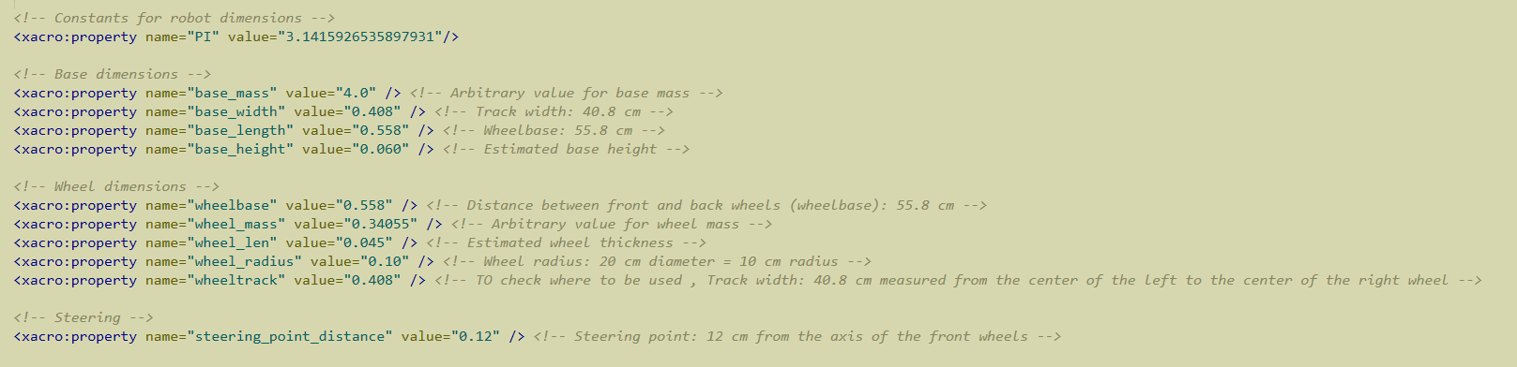
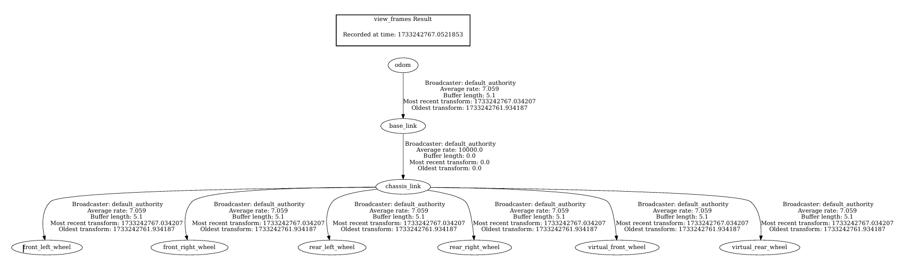
ros2 launch ros2_control_demo_example_11 carlikebot.launch.py remap_odometry_tf:=true

Slide 42
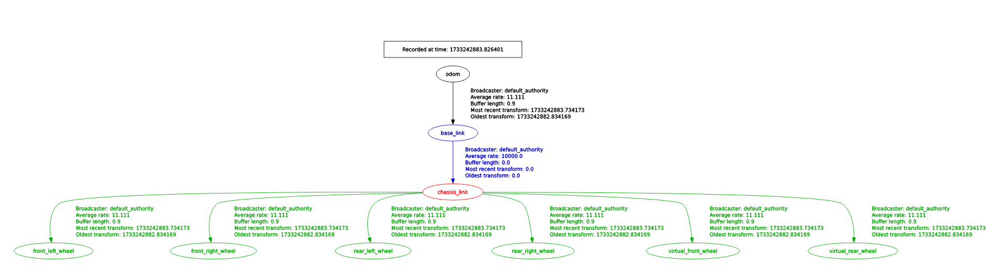
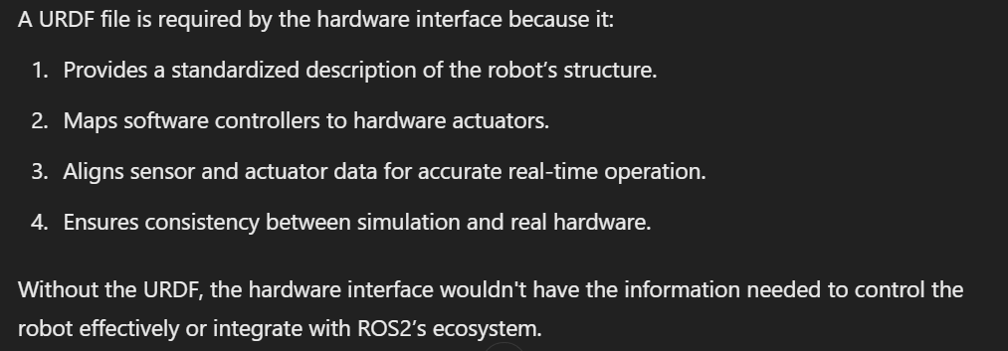
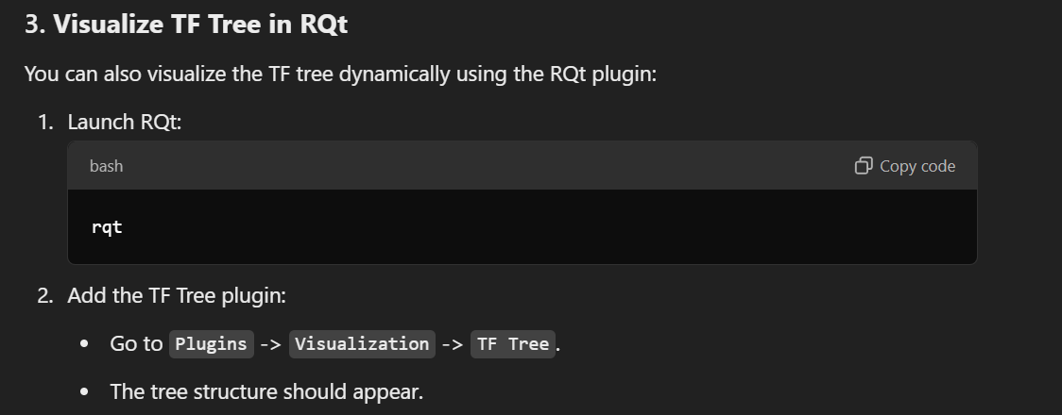
rqt
Why urdf file is required to work on real robot for Hardware interface?
How to use rqt for TF?

Slide 43
Do we need 4-wheel differential drive or two rear wheel differential drive in URDF?
<!-- virtual rear wheel -->
<link name="${prefix}virtual_rear_wheel">
<visual>
<origin xyz="0 0 0" rpy="${PI/2} 0 ${PI/2}"/>
<geometry>
<cylinder length="0.01" radius="${wheel_radius}"/>
</geometry>
<material name="invisible"/>
</visual>
</link>
<joint name="${prefix}virtual_rear_wheel_joint" type="continuous">
<parent link="${prefix}chassis_link"/>
<child link="${prefix}virtual_rear_wheel"/>
<origin xyz="-${wheelbase/2} 0 -${base_height/2}" rpy="0 0 ${PI/2}"/>
<axis xyz="1 0 0"/>
<limit effort="100.0" velocity="100.0"/>
<dynamics damping="0.2"/>
</joint>
Same for front wheel
<link name="${prefix}rear_right_wheel"> <!--collision, visual, inertial,-->
---
---
.
.
.
.
.
<joint name="${prefix}rear_right_wheel_joint" type="continuous">
<parent link="${prefix}chassis_link"/>
<child link="${prefix}rear_right_wheel"/>
<origin xyz="-${wheelbase/2} ${base_width/2} -${base_height/2}" rpy="0 0 ${PI/2}"/>
<axis xyz="1 0 0"/>
<limit effort="100.0" velocity="100.0"/>
<dynamics damping="0.2"/>
<mimic joint="${prefix}virtual_rear_wheel_joint" multiplier="1.0" offset="0.0"/>
</joint>
Same for front wheel

Slide 44
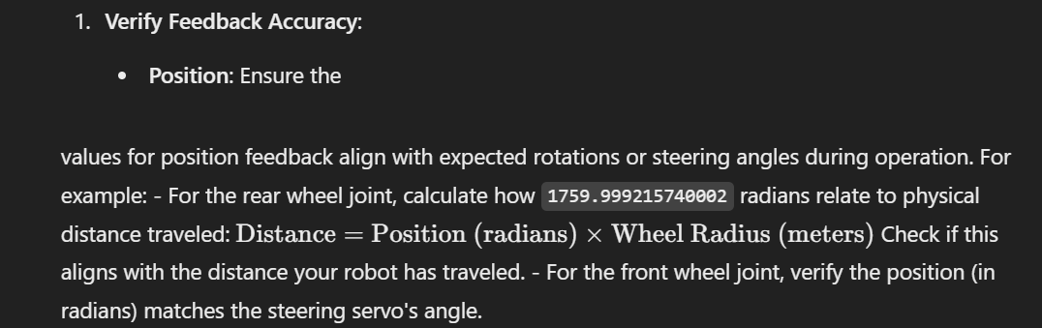
Test Compatibility
Launch the URDF in RViz:
  Ensure the TF tree and joint states are correctly structured. – done
  Expectation: true
Simulate Hardware Commands:
  Publish velocity commands to virtual_rear_wheel_joint.
ros2 topic pub --rate 10 /virtual_rear_wheel_joint/command std_msgs/msg/Float64 "{data: 1.0}"
  Publish position commands to virtual_front_wheel_joint.
ros2 topic pub --rate 10 /virtual_front_wheel_joint/command std_msgs/msg/Float64 "{data: 0.5}"
Run Your Hardware Interface:
  Confirm it maps the single motor outputs to the corresponding URDF joints.
graph TD
odom --> base_link
base_link --> chassis_link
chassis_link --> virtual_rear_wheel
chassis_link --> virtual_front_wheel
chassis_link --> rear_left_wheel
chassis_link --> rear_right_wheel
chassis_link --> front_left_wheel
chassis_link --> front_right_wheel
virtual_rear_wheel --> rear_left_wheel
virtual_rear_wheel --> rear_right_wheel
virtual_front_wheel --> front_left_wheel
virtual_front_wheel --> front_right_wheel
Possible things to be done for later:
Transforms:
The transform rates (average rate ~7 Hz) seem low. Ideally, the transform broadcaster should be running at a higher rate (e.g., 50–100 Hz) for real-time performance.
If your motor driver or hardware interface is responsible for publishing the transforms, ensure the update rate is sufficient.
- Nan values published from : ros2 topic echo /joint_states , are fine and can be ignored
Odometry Integration:
If you’re using odometry, ensure the rear wheel joint's position and velocity data are correctly translated into the robot's pose updates.

Slide 45
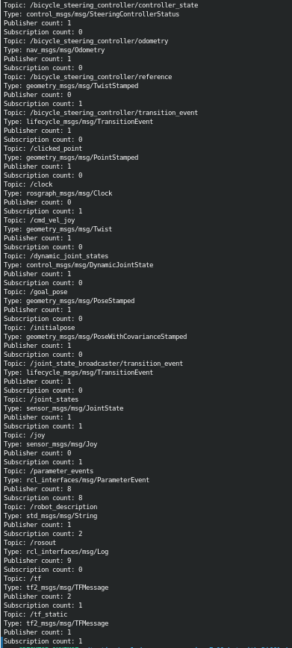
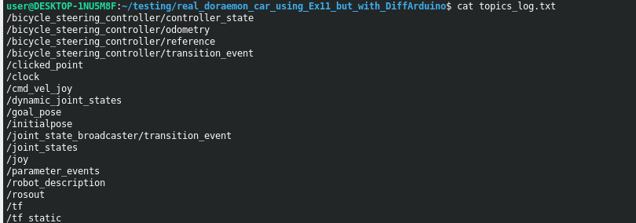
ros2 topic list > topics_log.txt
for topic in $(ros2 topic list); do
echo "Topic: $topic" >> topics_log.txt
ros2 topic info $topic >> topics_log.txt
done

Slide 46
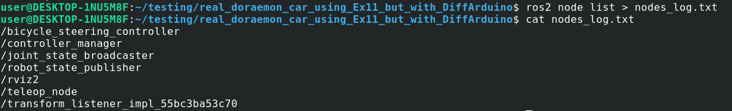

Slide 47
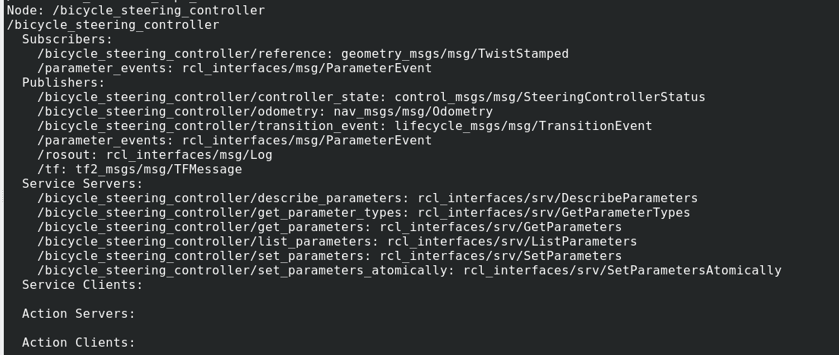

Slide 48
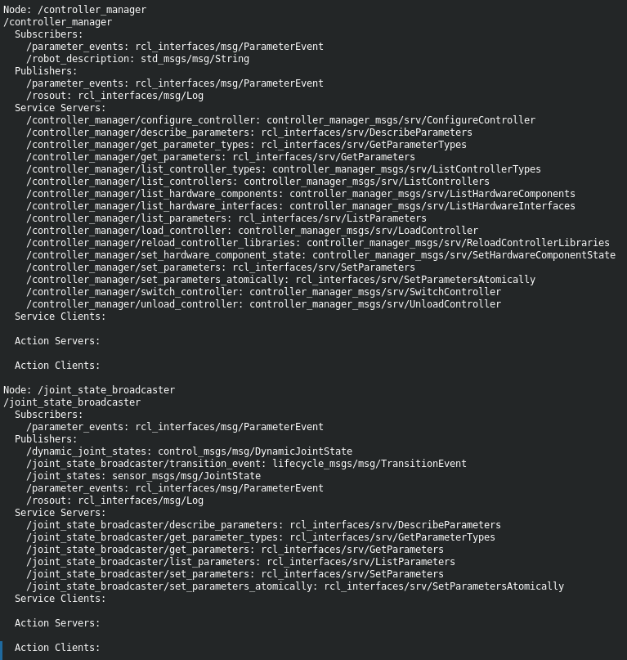
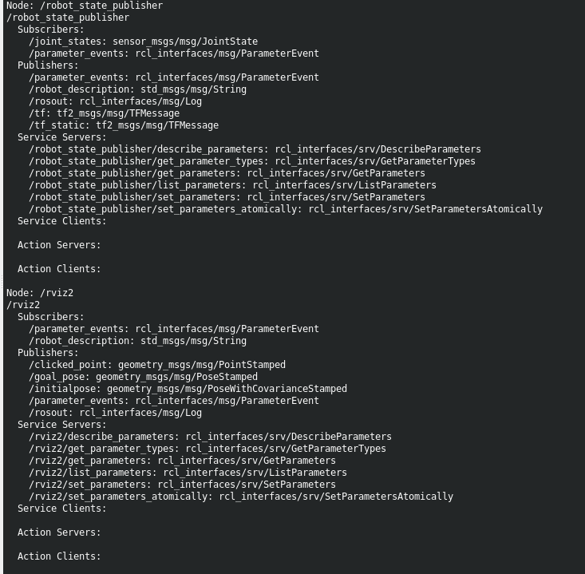

Slide 49
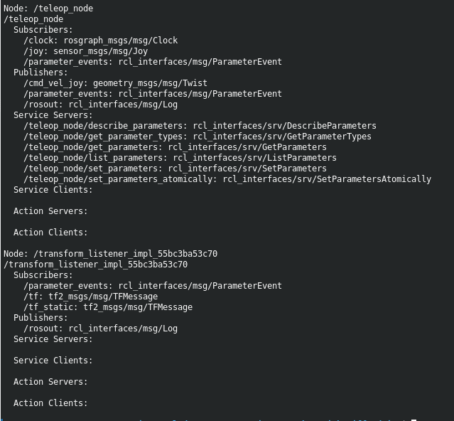
for node in $(ros2 node list); do
echo "Node: $node" >> nodes_log.txt
ros2 node info $node >> nodes_log.txt
done

Slide 50
Why Transmission Link
<transmission name="rear_wheel_transmission">
<type>transmission_interface/SimpleTransmission</type>
<joint name="virtual_rear_wheel_joint">
<hardwareInterface>hardware_interface/VelocityJointInterface</hardwareInterface>
</joint>
<actuator name="rear_motor">
<mechanicalReduction>1.0</mechanicalReduction>
</actuator>
</transmission>
https://gist.github.com/guptaaditya746/12faa1e4b2a089830b9f08c93ce8a3c0

Slide 51
IMU sensor hardware interface
The IMU sensor hardware interface plays an essential role in providing feedback to improve odometry, navigation, and control. In your case:
Add IMU state interfaces to your hardware interface for ros2_control.
Publish IMU data to /imu/data or /joint_states.
Use IMU data for odometry fusion or directly in control loops.

Slide 52
Export interfaces:Define command and state interfaces for each joint (e.g., position for steering, velocity for traction).
Steering Joint:
Command Interface: hardware_interface::HW_IF_POSITION
State Interface: hardware_interface::HW_IF_POSITION
Traction Joint (Drive)
Command Interface: hardware_interface::HW_IF_VELOCITY
State Interfaces: hardware_interface::HW_IF_VELOCITY, hardware_interface::HW_IF_POSITION
T
S

Slide 53
Velocity of PWM
https://docs.arduino.cc/tutorials/generic/secrets-of-arduino-pwm/
https://gist.github.com/guptaaditya746/8988a5a89d5e0d7e05d9adc8fce3b3ef

Slide 54
Step 8: Test in Small Steps
Initialization:
  Ensure the hardware initializes without errors (e.g., proper communication setup).
State Reading:
  Verify sensor values are correctly read and published to the ROS2 topics.
Command Writing:
  Send commands manually to test motor and servo responses.
Step 10: Debug and Optimize
Check for communication latency or hardware bottlenecks.
Optimize scaling factors and conversions to ensure smooth control.
Step 9: Integration Testing
Test the complete loop:
  Commands issued from ROS2 -> Hardware interface -> Motors/servo.
  Sensor feedback -> Hardware interface -> ROS2 topics.
Use Gazebo simulation as a baseline for comparison.

Slide 55
Arduino file : for sending and receiving commands over a serial connection.
A serial port is a serial communication interface through which information transfers in or out sequentially one bit at a time.
Checklist Before Using
Confirm Protocol Compatibility:
Ensure the Arduino firmware expects commands in the format used here (e.g., m 50 40\r for motor values).
Test Edge Cases:
Test what happens if the Arduino sends unexpected data or if the serial connection is interrupted.
Error Recovery:
Plan how your system will handle disconnections or unexpected failures (e.g., reconnect automatically or alert the user).
Performance:
Ensure the serial communication speed (baud rate) and timeout are adequate for your real-time requirements.
Integration with ROS 2:
Make sure this class integrates seamlessly with the ROS 2 lifecycle and threading model if used in a node.

Slide 56
Bottle neck writing cmake file and launch file, urdf also (but I guess, we can work with the present one from example 11)

Slide 57
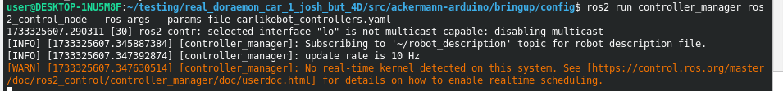
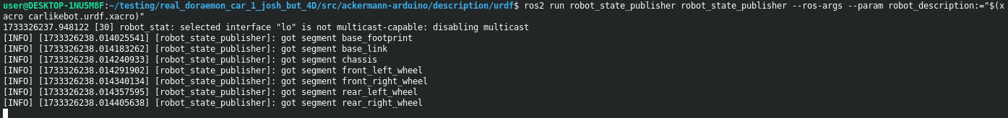
Ros2 terms:
https://gist.github.com/guptaaditya746/351cf1849f8d0ed402d22de734500635

Slide 58
Ackermann _arduino
Ex-11
<!-- Constants for robot dimensions -->
<xacro:property name="PI" value="3.1415926535897931"/>
<xacro:property name="base_mass" value="4.0" /> <!-- arbitrary value for base mass -->
<xacro:property name="base_width" value="0.260" />
<xacro:property name="base_length" value="0.525" />
<xacro:property name="base_height" value="0.060" />
<xacro:property name="wheelbase" value="0.325" />
<xacro:property name="wheel_mass" value="0.34055" /> <!-- arbitrary value for wheel mass -->
<xacro:property name="wheel_len" value="0.045" />
<xacro:property name="wheel_radius" value="0.05" />
<!-- <xacro:property name="wheeltrack" value="" -->
<!-- VARIABLES-->
<xacro:property name="chassis_length" value="0.27" />
<xacro:property name="chassis_width" value="0.1205" />
<xacro:property name="base_mass" value="4.0" /> <!-- arbitrary value for base mass -->
<xacro:property name="chassis_to_back_wheels_distance" value="0.048" />
<xacro:property name="chassis_mass" value="1.1" />
<xacro:property name="wheel_track" value="0.175" />
<xacro:property name="front_wheel_track" value="0.11" />
<xacro:property name="wheel_radius" value="0.0368" />
<xacro:property name="wheel_length" value="0.0295" />
<xacro:property name="wheel_mass" value="0.05" />
<xacro:property name="wheel_base" value="0.172" />
<xacro:property name="PI" value="3.1415926535897931"/>
<xacro:property name="base_height" value="0.060" />
<xacro:property name="base_width" value="0.260" />

Slide 59
Is your urdf.xacro is correct compiled?
xacro <path_to_your_file>.urdf.xacro
xacro <path_to_your_file>.urdf.xacro > robot.urdf
ros2 run robot_state_publisher robot_state_publisher --ros-args --param robot_description:="$(xacro <path_to_your_file>.urdf.xacro)"
ros2 run tf2_tools view_frames
check_urdf robot.urdf
https://gist.github.com/guptaaditya746/846bfce443cd08531eaf0e56b417efce

Slide 60
<param name="front_wheel_joint_name">virtual_front_wheel_joint</param>
<param name="rear_wheel_joint_name">virtual_rear_wheel_joint</param>
<param name="front_left_wheel_name">front_left_wheel_joint</param>
<param name="front_right_wheel_name">front_right_wheel_joint</param>
<param name="rear_left_wheel_name">rear_left_wheel_joint</param>
<param name="rear_right_wheel_name">rear_right_wheel_joint</param>

Slide 61
<joint name="${prefix}virtual_front_wheel_joint">
<command_interface name="position"/>
<state_interface name="position"/>
</joint>
<joint name="${prefix}virtual_rear_wheel_joint">
<command_interface name="velocity"/>
<state_interface name="velocity"/>
<state_interface name="position"/>
</joint>
<joint name="${prefix}front_right_wheel_joint">
<command_interface name="position" />
<state_interface name="position" />
</joint>
<joint name="${prefix}front_left_wheel_joint">
<command_interface name="position" />
<state_interface name="position" />
</joint>
<joint name="${prefix}rear_right_wheel_joint">
<command_interface name="velocity" />
<state_interface name="velocity" />
<state_interface name="position" />
</joint>
<joint name="${prefix}rear_left_wheel_joint">
<command_interface name="velocity" />
<state_interface name="velocity" />
<state_interface name="position" />
</joint>

Slide 62
private: ArduinoComms comms_; Config cfg_; Wheel wheel_l_; Wheel wheel_r_;};
private:
ArduinoComms comms_;
Config cfg_;
Wheel rear_left_wheel_;
Wheel rear_right_wheel_;
ServoSteering steering_;
};

Slide 63
File built now
URDF/Xacro file publishes correct joint states.
Test Controller Integration
Test Commands
Check if your hardware interface is correctly responding to commands and updating state interfaces
Test Hardware Communication

Slide 64
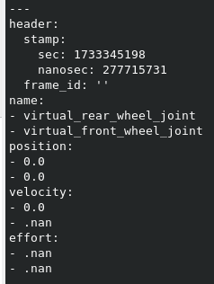
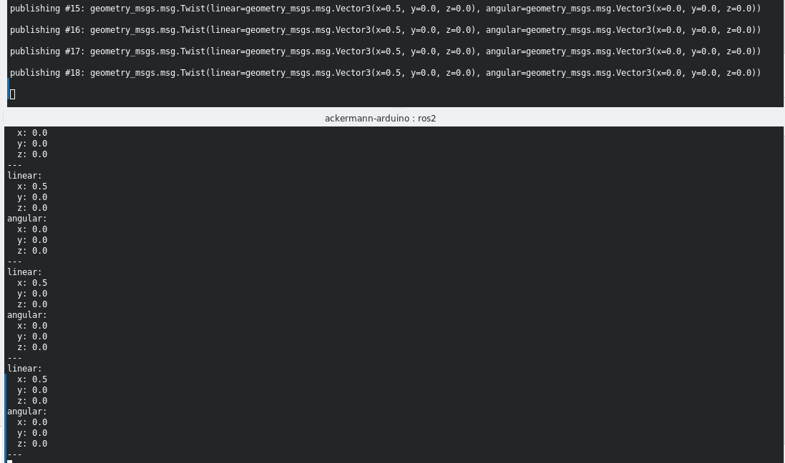
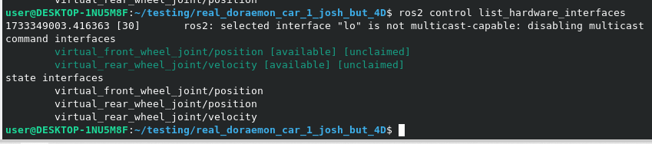
ros2 topic echo /joint_states
ros2 topic echo /cmd_vel

Slide 65
What i am doing right now? Dec,9
Implementing global map using NAV2
The things I require to start with, static map and its config file. The current location of bot using ACML. Publishing msg in /goal topic.
Deciding the algo for finding shortest path and comparing it. And at last, visualizing it on rviz, eg: path planned , robot pose, static map.
https://gist.github.com/guptaaditya746/4c2ee3906f23b3e4fa77c0bb0c073aef

Slide 66
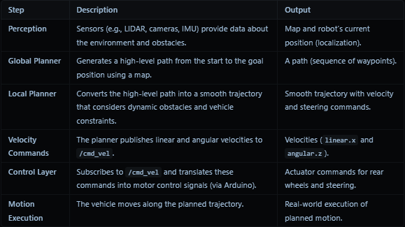
Where we are ? Dec,9
Workflow
Done
Next
Partially Done (steer left)
Things left but important to do:
1. Learning about how “bicycle controller”, tech. detail.
2. Modifying Arduino code for steering wheel.
3. Setup of car, for driving in the room
4. Encoder through color sensor

Slide 67
Continue global palnner
header:
stamp:
sec: 1734569470
nanosec: 234567
frame_id: "map"
pose:
position:
x: 2.0
y: 3.0
z: 0.0
orientation:
x: 0.0
y: 0.0
z: 0.707
w: 0.707
Local Planning , /plan, dynamic obs, bot current vel to local vel
Global planning, /amcl_pose, /goal_pose, /map to /plan
Goal setting, /goal_pose to Poststamped msg
Localization-ACML, /scan and /odom to /amcl_pose
Map loading, .pgm to /map

Slide 68
Map loading, .pgm to /map
validate YAML file using yamllint
yamllint /home/user/turtlebot3_ws/src/turtlebot3/turtlebot3_navigation2/map/map.yaml
ros2 run nav2_map_server map_server --ros-args --param map:=/home/user/turtlebot3_ws/src/turtlebot3/turtlebot3_navigation2/map/map.yaml
Node map_server activate
ros2 lifecycle get /map_server
ros2 lifecycle set /map_server configure
ros2 lifecycle set /map_server activate

Slide 69
Localization-ACML, /scan and /odom to /amcl_pose
Loading acml node: ros2 run nav2_amcl amcl --ros-args --param use_sim_time:=false
Configure and activate node
Publish initial location
ros2 topic pub /initialpose geometry_msgs/PoseWithCovarianceStamped ………………………
echo /amcl_pose
Combine into launch file

Slide 70
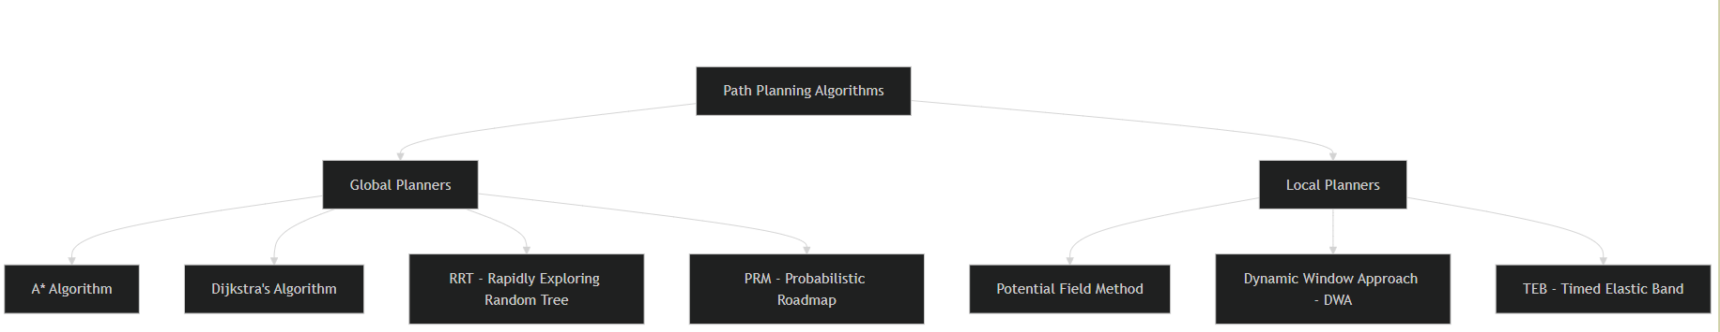

Slide 71
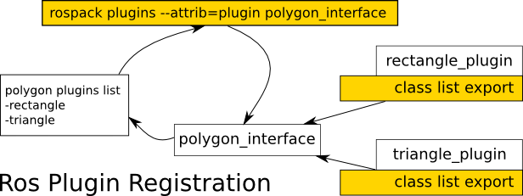
How plugin works ? Pluginlib helps in loading of plugin in dynamic time
Pkg and xml
Pkg and xml

Slide 72
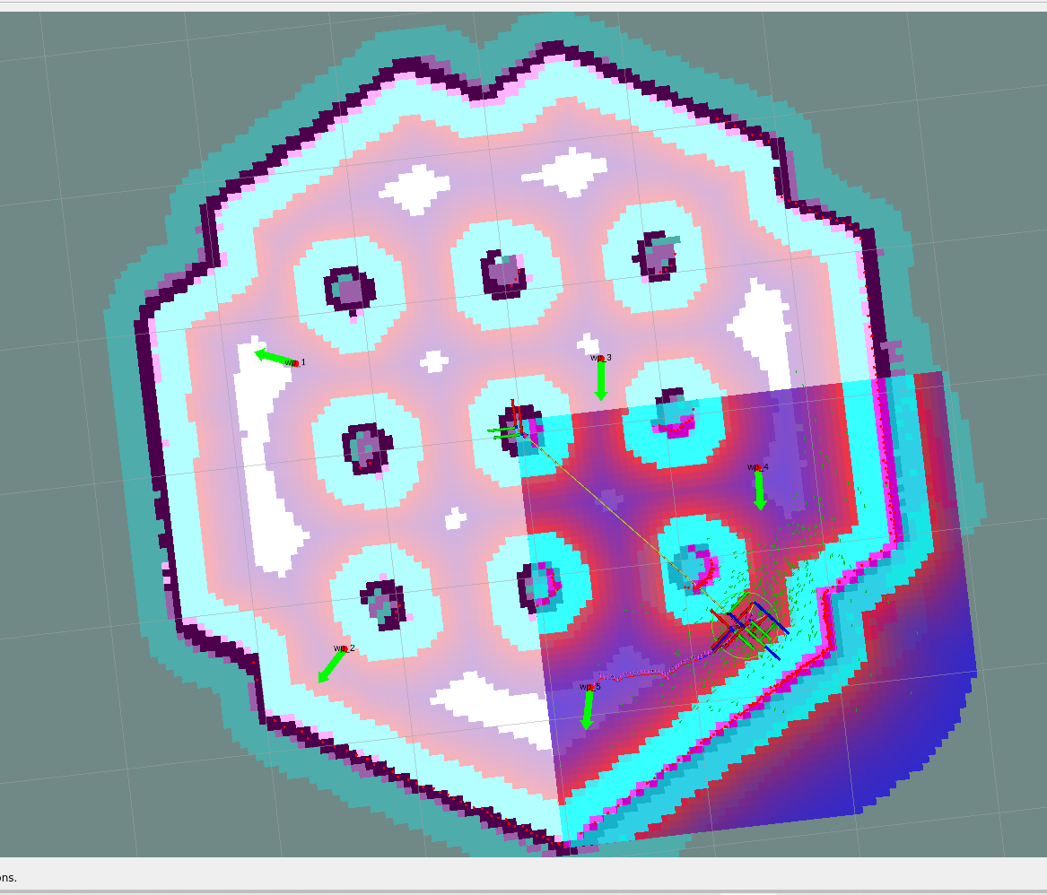
https://gist.github.com/guptaaditya746/bea450c848ff6da121f5a58bc81f5212
Log files

Slide 73
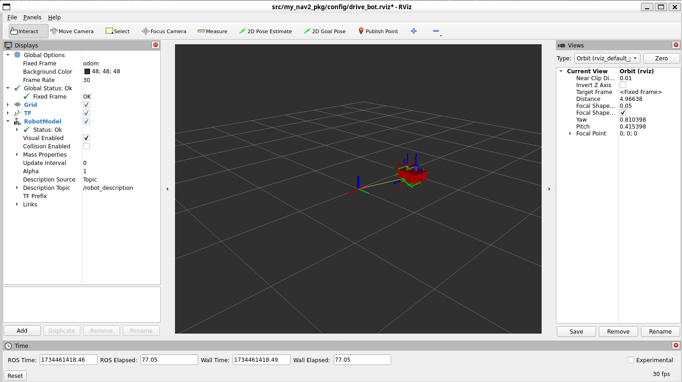
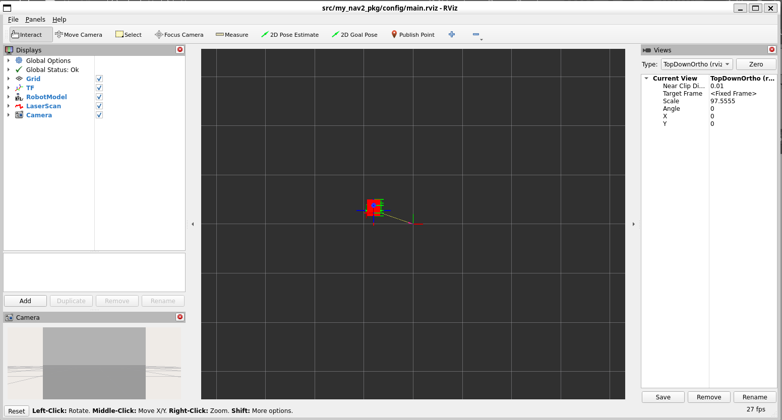

Slide 74
Purpose of rsp.launch.py is to just load state publisher tf, no rviz.

Slide 75
map --> odom --> base_link --> sensor frames (e.g., lidar, imu, camera)
\
--> footprint
Structure of Nav2 Logs
Nav2 logs provide messages from its nodes during a navigation session. The key components generating logs are:
Map Server: Provides the map to the global costmap.
AMCL: Localizes the robot on the map using LIDAR data.
Planner Server: Computes the global path.
Controller Server: Generates local commands for the robot to follow the path.
BT Navigator: Coordinates planning and execution using a Behavior Tree.
Lifecycle Manager: Manages the lifecycle of the above nodes.

Slide 76
Final work layout

Slide 77
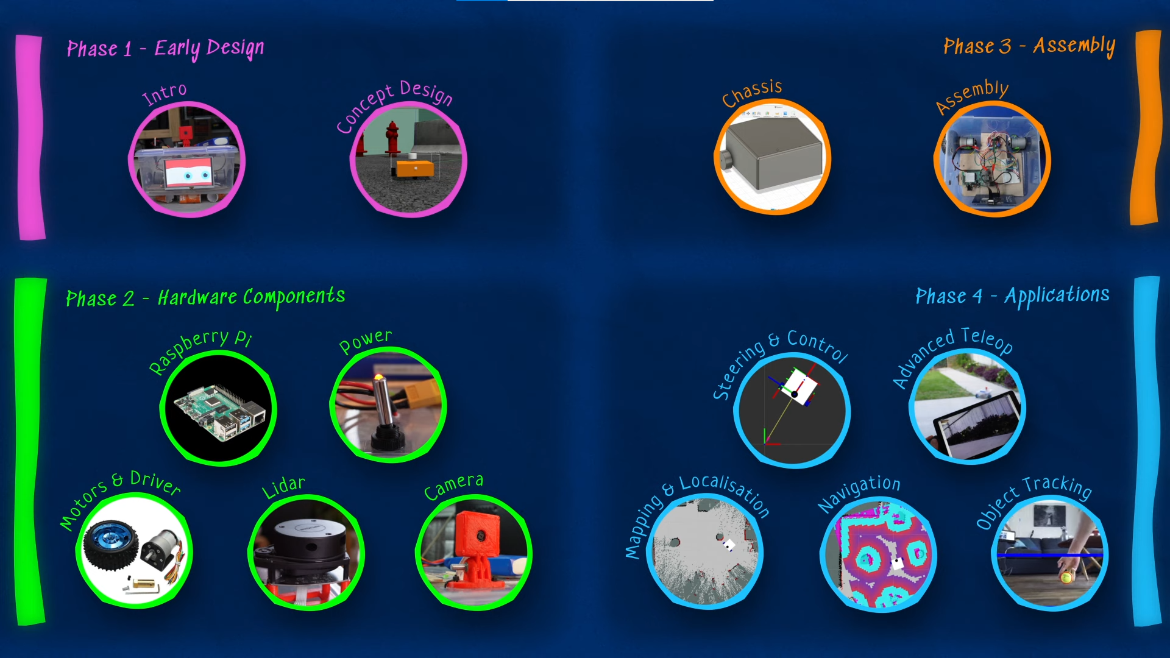

Slide 81
Component | X (Forward/Backward) | Y (Left/Right) | Z (Up/Down)
Base Center (Origin) | 0 | 0 | 0 (ground level)
Rear Left Wheel | 0 | +track_width/2 = 250mm | wheel_radius = 90
Rear Right Wheel | 0 | -track_width/2 = -250 mm | wheel_radius
Front Left Wheel | +wheelbase = 590.5 mm | +track_width/2 | wheel_radius
Front Right Wheel | +wheelbase | -track_width/2 | wheel_radius
Steering Link | +wheelbase | 0 | 0 (ground level)
LiDAR Sensor | -36.024 | 0 | 77.736 cm
IMU Sensor | 94.8 | 35.076 | 0
Battery | Center of mounting area | Center of mounting | Mounting height above base
Steering Color Sensor | 189.6 cm | 0 | 86.268 cm
Odom color Sensor | 63.83 cm | - 200 cm | 63.28 cm
Camera | As per mounting position | As per mounting | Vertical distance from base top

