Slide 1
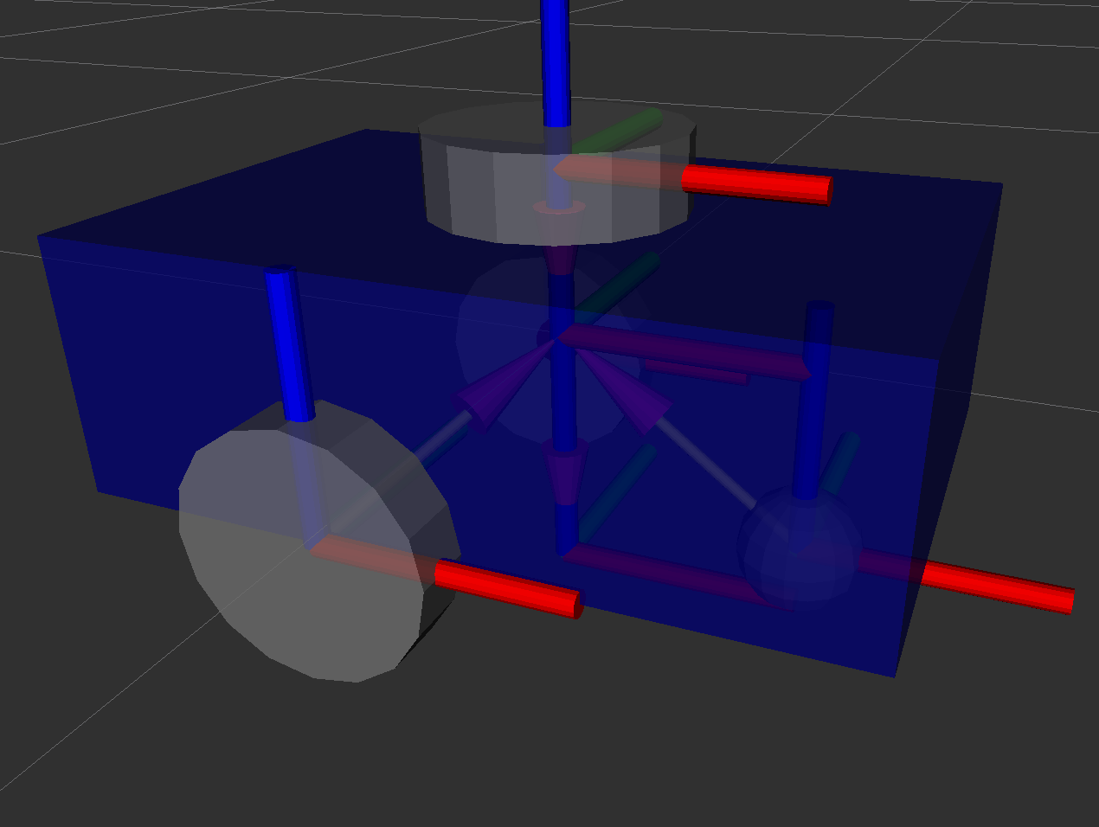

Slide 2
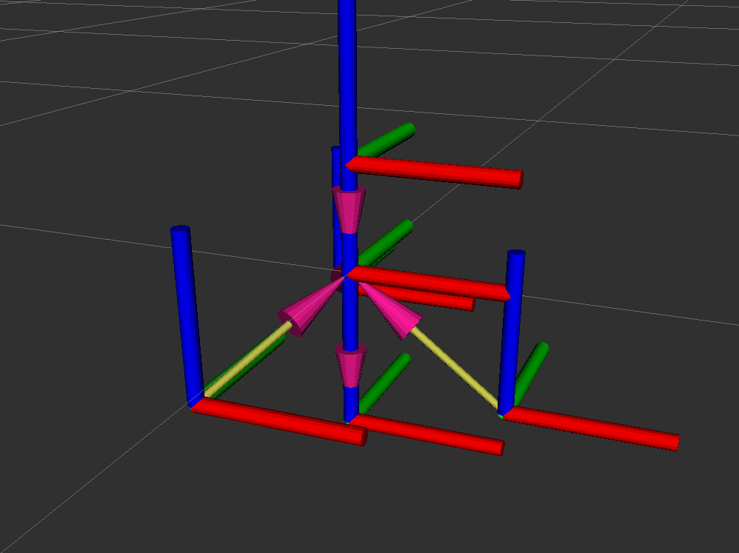
Origin and transformation

Slide 3
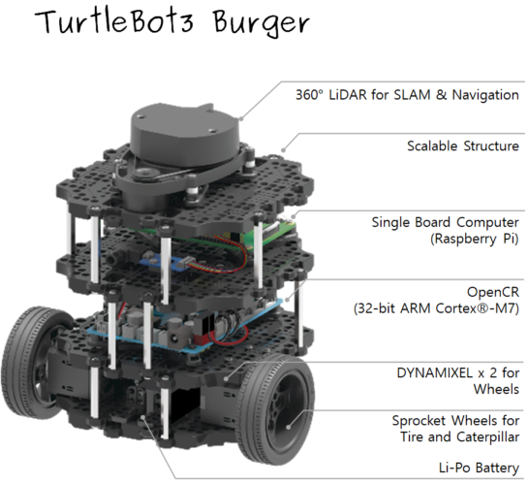
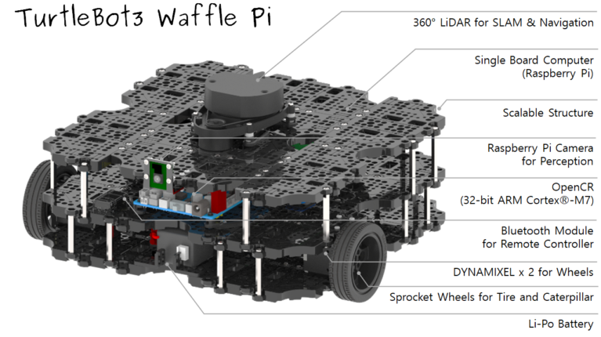
Aditya look into this documentation together with yt channel for follow through and implementation
https://emanual.robotis.com/docs/en/platform/turtlebot3/features/

Slide 4
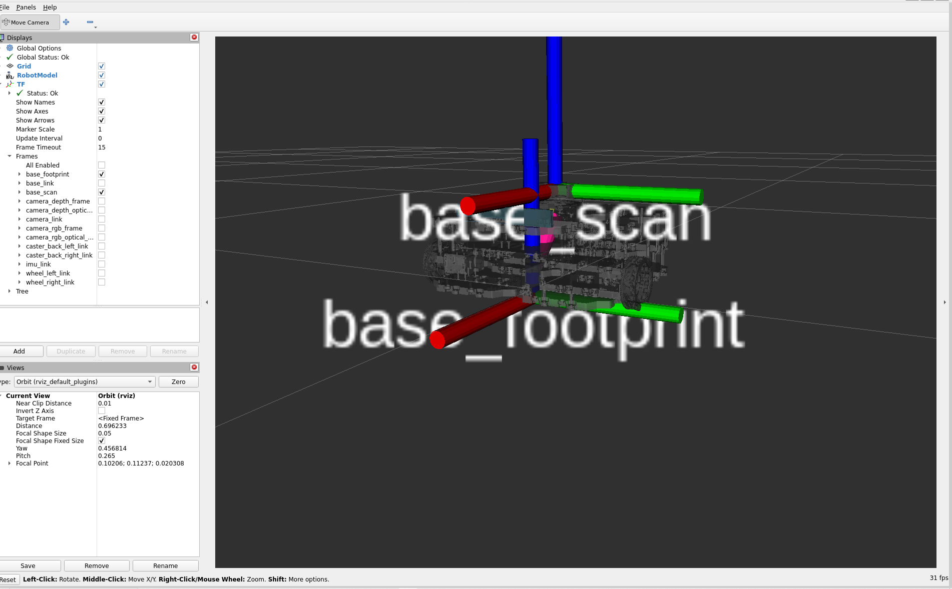
Notes:
ros2 launch urdf_tutorial display.launch.py model:=/opt/ros/humble/share/turtlebot3_description/urdf/turtlebot3_waffle.urdf

Slide 5
nav_msgs/odometry
how to implement this , let's say I have a toy car, and odometer sensor
How to create ros package?
The nav_msgs/Odometry message type in ROS (Robot Operating System) is commonly used to publish information about a robot’s position, orientation, and velocity within a given frame of reference.
Message published in YAML format
https://codefile.io/f/PtFTq7b3pa
Notes:
nav_msgs/odometry

