Slide 1
Machine Learning
Assignment #4
Predictive Maintenance by SVM

Slide 2
Paper Presentation
論文清單: [授課教材]-[Paper Presentation]-Paper.zip
報告時間: 6/7、6/14
報告方式
每四人為一組 (此分組亦為Final Project分組)
每組12分鐘報告、3分鐘問答
報告登記
E-Course討論區登記報告日期、順序、組別成員、論文名稱
5/29(二)13:00開放E-Course討論區登記，First Come First Serve!
報告當天請印出一份論文紙本給老師

Slide 3
Predictive Maintenance
Predictive maintenance techniques are designed to help anticipate equipment failures to allow for advance scheduling of corrective maintenance, thereby preventing unexpected equipment downtime, improving service quality for customers, and also reducing the additional cost caused by over-maintenance in preventative maintenance policies.
Many types of equipment—e.g., automated teller machines (ATMs), information technology equipment, medical devices, etc.—track run-time status by generating system messages, error events, and log files, which can be used to predict impending failures.

Slide 4
Data Description
Observation Window/ Prediction Window
Different data-sets with different Observation- and Prediction-Window sizes are provided:
OW: [1, 2, 4, 8, 16] days;
PW: [1, 2] days.
Feature (27 types of errors in total)
26 frequent errors have been selected to be relevant, these errors are represented by their Error ID;
All other (infrequent) relevant errors are grouped as rare errors. They are grouped under Error ID 1;
For each error, three different statistic has been provided:
The amount of errors;
The mean interval of the errors (vMean);
The standard deviation of the interval of the errors (vStd).
Label
FALSE: the machine is OK in that day;
TRUE: machine break down for some reasons in that day.

Slide 5
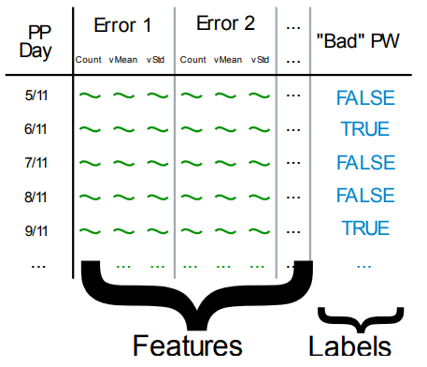
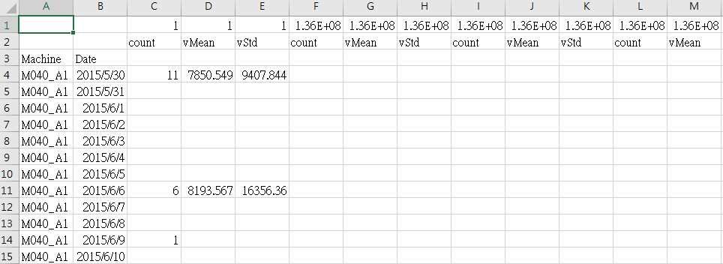
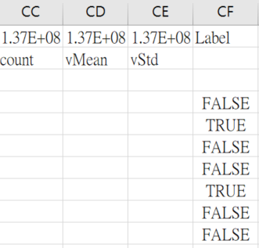
Predictive Maintenance by SVM
Feature
1. Count: The amount of errors
2. vMean: The mean interval of the errors
3. vStd: The standard deviation of the interval of the errors
Label
True: the machine is OK in that day
False: machine break down for some reasons in that day

Slide 6
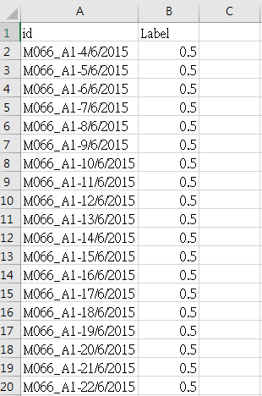
Prediction Results
submission_sample.csv
Your submission is probability of failure from your model
submission format:
5 datasets have different label size.(due to different OW size)
個別上傳OW=1、2、4、8、16, PW=1和OW=1、2、4、8、16, PW=2
的預測結果

Slide 7
The Dataset of Predictive Maintenance
Dataset can be downloaded at:
Nexperia Predictive Maintenance Full 1
https://www.kaggle.com/c/nexperia-predictive-maintenance-full-1/data
Nexperia Predictive Maintenance Full 2
https://www.kaggle.com/c/nexperia-predictive-maintenance-full-2

Slide 8
Assignment #4
Download SVM Tools.
https://www.csie.ntu.edu.tw/~cjlin/libsvm/
Study functions and parameter settings of SVM
Train your model on Predictive Maintenance Dataset.
Upload your testing results (.csv) to E-Course:
Submit two text files and your code to E-Course
Readme – How to run your code
Report
Method description & parameter settings
Experimental results – accuracy for different ow & pw
Discussion of difficulty or problem encountered
Deadline: 05/30(Wed) 11:59p.m

