Slide 1
Urinary bladder tumer

Slide 2
ILOs:
- Classify renal tumors.
- Outline renal cell carcinoma features.
- Outline nephroblastoma features.
- Classify bladder tumors.
- Describe transitional cell carcinoma.
- Describe squamous cell carcinoma.

Slide 3
Classification of Renal Tumours:
Benign: Adenoma, Oncocytoma
Malignant: Adenocarcinoma (RCC)
Renal pelvis: Transitional cell tumors
Embryonal: Wilms’ Tumor
Non-epithelial: Angiomyolipoma
Miscellaneous & Metastatic tumors

Slide 4
Renal Cell Carcinoma (RCC):
Adenocarcinoma from tubular epithelium
80–85% of renal cancers
2–3% of adult cancers
Peak incidence: 6th–7th decade
Male predominance (2:1)
RCC Risk Factors:
Tobacco
Asbestos & cadmium exposure
Hypertension
Cystic kidney disease
Obesity & estrogen therapy
Hereditary (5% of cases)

Slide 5
RCC Classification:
Clear cell (most common)
Papillary
Chromophobe
Granular cell
Sarcomatoid
Collecting duct type

Slide 6
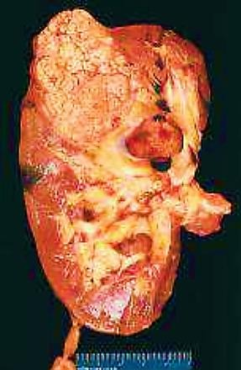
Gross Picture of RCC:
Solitary, unilateral, often upper pole
Large, golden yellow, circumscribed
Papillary type: multifocal, bilateral
Areas of necrosis, cysts, hemorrhage
Tumor thrombus in renal vein

Slide 7
Microscopic Picture of RCC:
Clear cell type (70%): clear cytoplasm
Papillary type (15%): papillary pattern
Chromophobe type (5%): mixed cells
Perinuclear halo in chromophobe
Clinical Picture of RCC:
Gross hematuria
Palpable abdominal mass
Paraneoplastic syndromes:
Polycythemia, hypercalcemia
Hypertension, hormonal effects

Slide 8
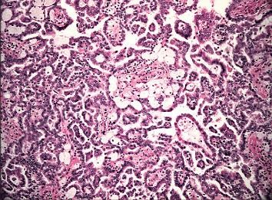
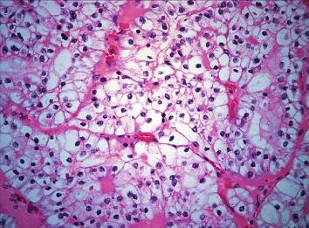
RCC
Papillary type
Clear cell type

Slide 9
Nephroblastoma (Wilms’ Tumor):
Embryonic tumor from renal components
Most common abdominal malignancy in kids
Age: 1–6 years
Equal sex incidence
Gross Picture of Wilms’ Tumor:
Large, spheroidal, replaces kidney
Usually solitary & unilateral
5–10% bilateral
Fish flesh-like cut surface
Necrosis, hemorrhage, myxomatous areas

Slide 10
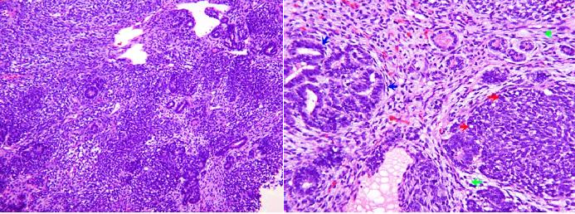
Microscopic Picture of Wilms’:
Triphasic: epithelial & mesenchymal
Blastemal cells (small, round to spindled)
Abortive tubules & glomerular structures
Clinical Picture of Wilms’ Tumor:
Palpable abdominal mass in child
Hematuria, pain, fever, hypertension
Rapid spread via blood → lungs

Slide 11
Classification of Bladder Tumors:
Benign: Villous/inverted papilloma
Mesenchymal: Fibroma, Leiomyoma
Malignant: Carcinoma, Sarcoma
Carcinosarcoma, Lymphoma
Secondary tumors

Slide 12
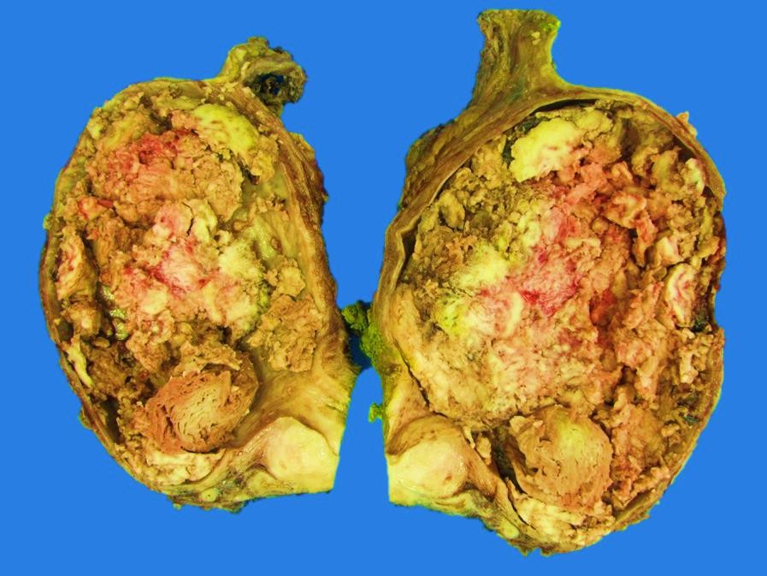
Bladder Carcinoma Risk Factors:
Schistosomiasis (common in Egypt)
Industrial chemicals (aniline, rubber)
Local lesions (diverticulum, stones)
Smoking (2–3× risk)
Gross Picture of Bladder Carcinoma:
Papillary (common in non-bilharzial)
Non-papillary: polypoid, ulcerative
Infiltrative or combined patterns

Slide 13
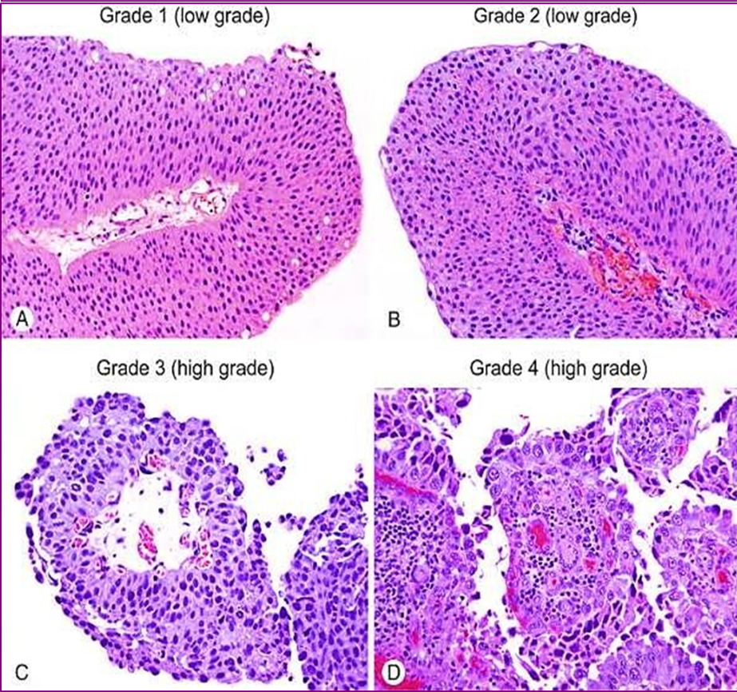
Microscopic Picture – TCC:
Papillary pattern: exophytic villi
Covered by malignant urothelial cells
Non-papillary: solid, invasive
Usually high grade

Slide 14
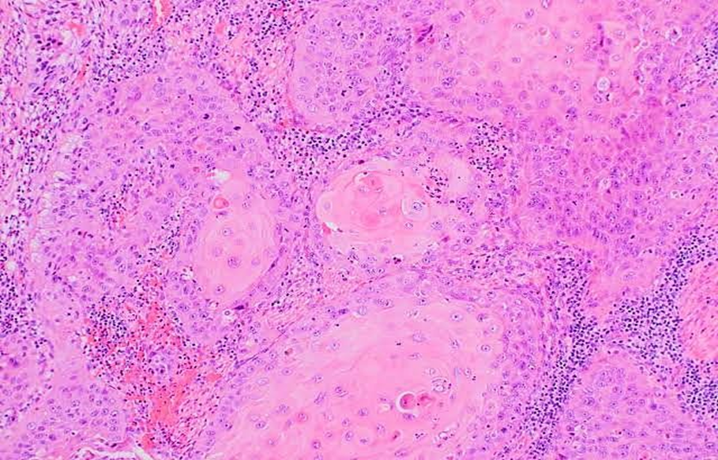
Microscopic Picture – SCC:
Infiltrative squamous carcinoma
Often arises from bilharzial cystitis
Grading based on keratin pearl formation

Slide 15
Stages of Bladder Carcinoma:
In situ → Stage I (urothelium)
Stage II (lamina propria)
Stage III (muscle)
Stage IV (serosa/fat/metastasis)
Effects & Complications of Bladder Cancer:
Spread: direct, lymphatic, hematogenous
Urinary obstruction → renal failure
Infection: cystitis, pyelonephritis
Hematuria, fistula formation

