Slide 1
2012-09-13: 2nd Team Meeting
Agenda

Slide 2
Agenda
One Minute Round Retrospective
Team & Vehicle Name
Introduction of our guest
1st week’s progress / subject
Schedule Estimations and Planning
Tasks for next week

Slide 3
Agenda
One Minute Round Retrospective
Team & Vehicle Name
Introduction of our guest
1st week’s progress / subject
Schedule Estimations and Planning
Tasks for next week

Slide 4
Agenda
One Minute Round Retrospective
Team & Vehicle Name
Introduction of our guest
1st week’s progress / subject
Schedule Estimations and Planning
Tasks for next week

Slide 5

Team & Vehicle Name

Slide 6
Agenda
One Minute Round Retrospective
Team & Vehicle Name
Introduction of our guest
1st week’s progress / subject
Schedule Estimations and Planning
Tasks for next week

Slide 7
Agenda
One Minute Round Retrospective
Team & Vehicle Name
Introduction of our guest
1st week’s progress / subject
Schedule Estimations and Planning
Tasks for next week

Slide 8
1st week’s progress
Integration & Testing
  Anna & Paschalis

Slide 9
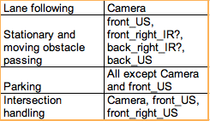
Sensors
Integration & Testing
The advised sensor setup covers all the scenarios of the Rules & Regulation document.

Slide 10
Integration & Testing
Test Scenarios
Preliminary test scenario catalogue:
Test battery capability
Lights
Sensors
Camera
Steering
Motor (acceleration & speed)

Slide 11
Integration & Testing
Track Layout
Main parts of track:
Straight line (with parking spots)
Curve (with detachable lanes)
Intersection
Boxes
Suggestion: draw each part of the track on a different piece of pond liner, so we can combine them.

Slide 12
Integration & Testing
Risks & Difficulties
Sensor layout provided might not represent the perfect positioning, but it is easy to adjust while testing on real vehicle.
Preliminary we can only test battery with basic functionality (without algorithms).
The white tape might have different shade and different size from lines on the competition.
It is hard to predict how pond liner is going to act while testing.

Slide 13
1st week’s progress
Integration & Testing
  Anna & Paschalis
Lane Following Algorithm
  Munir & Sofia

Slide 14
Keep in Mind
Lane Following Algorithm
Start: Press button on the vehicle
Drive: As fast as possible on the right lane
Constants:
Road width = 820mm
Closest curve’s inner radius >=1000mm
Distance between dotted lines = 200mm
Length of dotted lines = 200mm
Width of (dotted & side) lines = 20mm
Starting / Stopping line width = 40mm
Maximum length of broken line (NOT intersections) = 1000mm
(at most 2 lines/time)
Maximum length of broken line (intersections) = 1820mm (middle line)
= 1400mm (side lines ---
Is the 20mm width of middle line recognizable? )

Slide 15
Concept
Lane Following Algorithm
Input data: Output data:
Image from camera for parking:
distance of car from the right side lane for intersections:
identification of intersection line
Computations:
Image processing computations:
2 or 3 line recognition
curve’s inner radius
intersection line
General computations:
Calculate if our car is on the road
Calculate distance of car from the right side lane
Calculate maximum applicable speed according to the curves of the road
Calculate acceleration / decelerations according to the curves of the road
Calculations regarding the right to left transformation of lanes’ identification,
when changing line to avoid an obstacle.

Slide 16
…continue
Lane Following Algorithm
Scenarios:
There are all lines on the road
There is one 1 missing line
The road is straight
The car has gone out of the road
There is a turn on the road (open/close curve)
The road is straight → the car accelerates
The road turns → the car decelerates properly
Test Cases:
Strait road with only one line (2 or 3 cases)
Car decelerates enough so that it stays in the road (open / close curve).
Car decelerates – break lights work properly
Open curve – car’s side or/and middle lines missing.
The car get’s out of the road.
Car reaction when other white objects are out of the lane.

Slide 17
Difficulties & Risks
Lane Following Algorithm
Difficulties
Find all critical aspects that could lead our car out of the road.
Identification of tricky factors that could confuse Meili (e.x. shade of the white lines)
Differences between the simulator and the real behavior of Meili.
The car get’s out of the road –will it manage to get into the road again?
Risks
Dependency of all algorithms to the lane following algorithm
Integration with “Stationary & Moving Obstacle Passing Algorithm” and “Intersection Handling Algorithm”
Differences between the development - competition conditions.
There are 2 missing lines
Reliability on assumptions / simplifications:
No more than one of the lines will be missing

Slide 18
1st week’s progress
Integration & Testing
  Anna & Paschalis
Lane Following Algorithm
  Munir & Sofia
Stationary & Moving Obstacle Passing Algorithm
  Anna & Munir

Slide 19
Stationary & Moving Obstacle Passing Algorithm
Inputs:
Front US: to recognise the obstacle and specify the distance.
Front right IR or back right IR: to recognise when the obstacle.
The concept can be tested in modeling SW or on the vehicle.

Slide 20
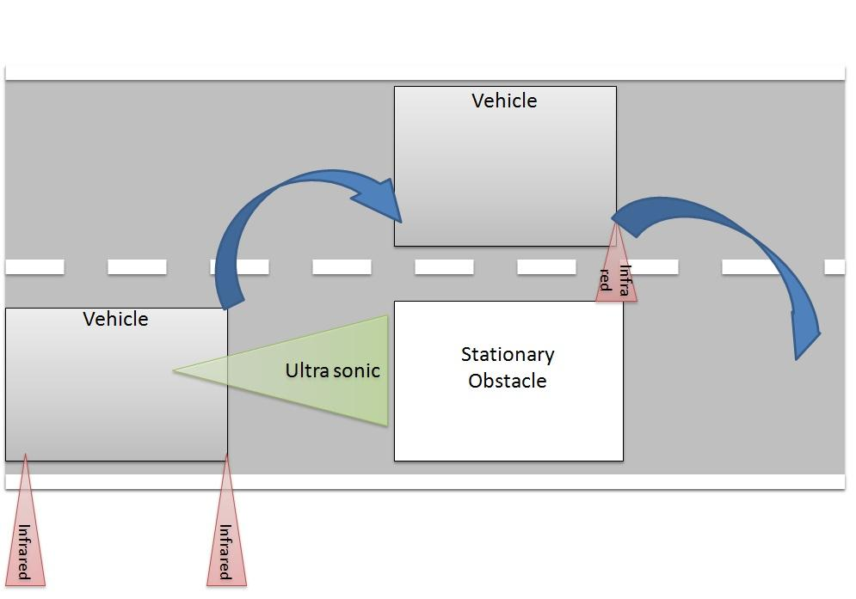
Test Concept
Stationary & Moving Obstacle Passing Algorithm

Slide 21
Scenarios
Stationary & Moving Obstacle Passing Algorithm
Getting distance between objects
When it reaches to the shortest distance b/n the objects
action will be
    Slow speed
    Flash light
    Pass the stationary obstacle

Slide 22
Risks and Difficulties
Stationary & Moving Obstacle Passing Algorithm
Dynamic obstacle
  Calculating the distance between the moving objects
  Predict the speed of the other objects

Slide 23
1st week’s progress
Integration & Testing
  Anna & Paschalis
Lane Following Algorithm
  Munir & Sofia
Stationary & Moving Obstacle Passing Algorithm
  Anna & Munir
Intersection Handling Algorithm
  Sofia & Paschalis

Slide 24
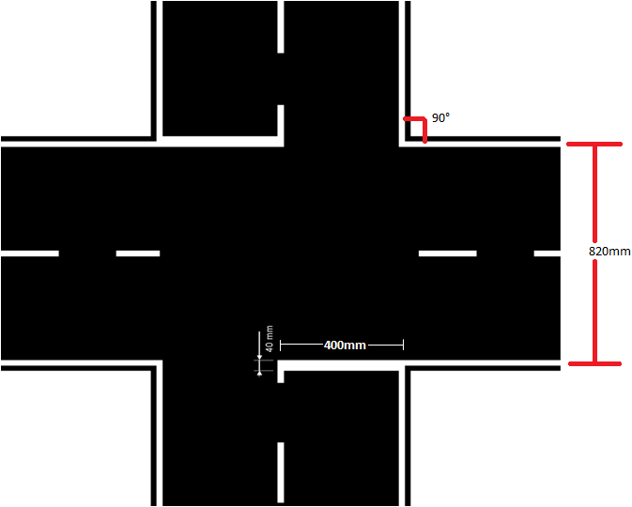
Keep in Mind
Intersection Handling Algorithm

Slide 25
Concept/Results
Intersection Handling Algorithm
Inputs:
Camera: Presence of an intersection line and distance from it.
Front-Right Ultra Sonic Sensor & Front Ultra Sonic Sensor : Distance of moving object in relation to our vehicle.
Speedometer : Vehicle speed.
Computations:
Using our speed and the distance from the intersection line we should calculate the deceleration needed to stop no more that 15cm before the line and not after it.
A two seconds stop that is needed when reaching an intersection line.
The distance of the moving object from the furthest left point of the intersection line.
Stop procedure:
When intersection line is detected, decelerate turning brake lights on and stopping at the intersection line.
Start procedure:
Cross the intersection (after 2 sec) if no moving obstacle is detected or if the time to reach the other end is less than the time the moving obstacle needs to approach the intersection(max moving obstacle speed 0,6m/s).

Slide 26
Intersection Handling Algorithm
Assumptions & Simplifications
We can assume that no moving obstacle will come from the left side of an intersection.
Apart from the distance we do not have to take the path of the moving obstacle into consideration
Our vehicle only moves straight ahead.
Difficulties/Risks
Lane detection, intersection handling and stationary & moving obstacle passing algorithms might have intercommunication difficulties.
Multiple sensors input data. Front-right sensor data first and then front sensor data.

Slide 27
Test Cases & Scenarios
Intersection Handling Algorithm
The vehicle detects the intersection line and stops.
The vehicle detects the intersection line, stops for 2 seconds and then crosses the intersection.
The vehicle detects the intersection line, stops for 2 seconds, detects far away a moving obstacle and crosses the intersection without waiting.
The vehicle detects the intersection line, stops for 2 seconds, detects a moving object and waits for it to move straight ahead before crossing the intersection.
The vehicle detects the intersection line, stops for 2 seconds, detects a moving object and waits for it to turn left before crossing the intersection.
The vehicle detects the intersection line, stops for 2 seconds, detects a moving object and waits for it to turn right before crossing the intersection. The vehicle should pass control to the obstacle passing algorithm in order to overtake the moving obstacle.

Slide 28
1st week’s progress
Integration & Testing
  Anna & Paschalis
Lane Following Algorithm
  Munir & Sofia
Stationary & Moving Obstacle Passing Algorithm
  Anna & Munir
Intersection Handling Algorithm
  Sofia & Paschalis
Parking Algorithm
  Mahsa & Ehsan

Slide 29
Parking Algorithm
Input data:
input data from all sensors at the right for detecting the obstacles
input data from camera in order to detect the distance to the street line at the right of the car
Output data:
output data in parking is not about sensors and it is just shows the states of the car that is parked

Slide 30
Parking Algorithm
Computations
Computation from sensors:
front sensor: detect first obstacle and second obstacle
rear right :detect the corner of the parking
distance between two obstacles :
connect to odometer and calculate distance with multiply time and speed
and detect parking space
**Mieli should be connected to odometer during parking time

Slide 31
Parking Algorithm
Test Cases
Case 1:
Place a car/object next to our car. Make sure that is aligned correctly.
Run the car. By default, it will park itself if the distance threshold is met.
Case 2:
Place some cars/objects in a line and put them apart by some distance. If
there’s not enough space for the car to park, it will proceed forward. When
the distance threshold is met (enough space), the car will parallel park.
Case 3:
When there’s no obstacle / reference for the sensor, the car will start
doing the pre defined movements by itself.

Slide 32
Scenario:
The car is moving and just recognizing obstacles that are in its way.
It will recognize the first obstacle. (It is not enough for detect parking space and it should recognize the second obstacle as well.)
Now, the parking space is detected.
Parking system will be implemented on the system.

Slide 33
1st week’s progress
Integration & Testing
  Anna & Paschalis
Lane Following Algorithm
  Munir & Sofia
Stationary & Moving Obstacle Passing Algorithm
  Anna & Munir
Intersection Handling Algorithm
  Sofia & Paschalis
Parking Algorithm
  Mahsa & Ehsan
Hardware
  Mahsa & Ehsan

Slide 34
Hardware
Range finder (ultrasound) SRF08
Power: 5 V, 3-15 mA
Analog gain: 94-1025 (32 steps)
Interface: I ² C
Range finder GP2D120 (Infra-red, Analog)
Supply voltage: VCC −0.3 to +7
Output terminal voltage: Vo −0.3 to Vcc +0.3

Slide 35
Hardware
9 Degrees of Freedom - Razor IMU
  ADXL345 - 13-bit resolution, ±16g, triple-axis accelerometer
  HMC5883L - triple-axis, digital magnetometer
  ITG-3200 - triple-axis digital-output gyroscope
Outputs of all sensors processed by on-board ATmega328
and sent out via a serial stream
  Autorun feature and help menu integrated into the example firmware
  Output pins match up with FTDI Basic Breakout, Bluetooth Mate, XBee Explorer
  3.5-16VDC input

Slide 36
Hardware
Test plan for overriding the software control by the
RC-unit:
Test case 1: Emergency situation listener,
Precondition 1: Vehicle is driving in the route
Precondition 2: Emergency situation listener is called
Expected result 1: Vehicle should be stopped immidiately
Expected result 2: RC Light flashes with frequency of 1 Hz

Slide 37
Test case 2: Driving speed at RC mode,
Precondition 1: Emergency situation listener is called
Expected result 1: The vehicle should drive with speed of 0.3 m/s
Test case 3: Functions at RC mode,
Precondition 1: Emergency situation listener is called
Expected result 1: All functions except driving forward and backward and steering should be disabled.

Slide 38
Agenda
One Minute Round Retrospective
Team & Vehicle Name
Introduction of our guest
1st week’s progress / subject
Schedule Estimations and Planning
Tasks for next week

Slide 39
Schedule Estimations and planning
Integration & Testing
Beginning of next week agree on naming conventions and first draft of architecture.
Integration should start as soon as first prototypes of the algorithms are done.
Creating of the track should begin as soon as materials have arrived.
Preliminary test scenarios should be done as soon as vehicle is assembled.
Intersection Handling Algorithm
Understand the problem and define the basic functionality of the algorithm.
Based on the input data create the code for the computations.
Test the algorithm after each iteration.
Test the algorithm on Meili
Integration with other algorithms.

Slide 40
…continue
Lane Following Algorithm
Task 1: Create Algorithms
  Image Processing
  Lane Following
  Calculate acceleration / deceleration
  Calculate car’s position on the road
Task 2: Coding
Task 3: Test in simulator
Task 4: Integration of all algorithms – related to the rest of algorithms
Task 5: Test on Meili – Meili should feel ready to learn how to walk! :-)
Task 6: Apply improvements

Slide 41
…continue
Stationary & Moving Obstacle Passing Algorithm
Task | Description | who | Time
1 | Get familiar with simulator
2 | Getting Input data from US and IR
3 | Develop for dynamic obstacle passing using - Ultrasonic + IR
4 | Integrating both the stationary and dynamic obstacle

Slide 42
Agenda
One Minute Round Retrospective
Team & Vehicle Name
Introduction of our guest
1st week’s progress / subject
Schedule Estimations and Planning
Tasks for next week

Slide 43
Tasks for next week
Familiarize with the provided software tools.
  Think of very simple scenarios tasks to try on the simulator. Set goals and try to get them
Search to find what already exists. Look for Open source codes doing what we want to do.
  Look in openCV for robotics or in ROS framework ect
Start practicing / remembering C++
Meet and discuss some basic aspects regarding our architecture. Focus on the dependences. Who needs the inputs we get as outputs?
Prepare a more consistent presentation after collaboration (not each team separately) & try to prepare for asking questions than only presenting our progress.

Slide 44
Thank you.

