Slide 1

Twister Design and Proposal Document
ISYS2089 – 2011C
Assignment A2

Slide 2
Team’s Members:
<Phan Thanh San> (<s3342133>)
<Vuong Do Thanh Huy> (<s3342135>)
<Luong Duc Tu> (<s3343706>)
Date: December 23th 2011

Slide 3
1. Introduction
TTC software is copyrighted under GPL – the GNU General Public License v3.0.
This is an open-source software → free.
Instead of paying fee, users should give feedback about the system.
Even though the software is free, security is tight.
The software is easy-to-use with a friendly interface.

Slide 4
Problems which might occur:
Constraint 1
Constraint 2
Constraint 3
Constraint 4
Constraint 5
Constraint 6
Constraint 7
Constraint 8
Constraint 9
Constraint 10

Slide 5
2. Design
Using cloud-computing technique → not require good computer.
Requiring both side contacts (client-database).
→client computer only requires running browser
→server client uses LAMPP pack on Linus-based server or WAMPP package on Windows-based server.
Medium-sized company is recommended to have a silver-package service from Amazon capable for 200 users.

Slide 6
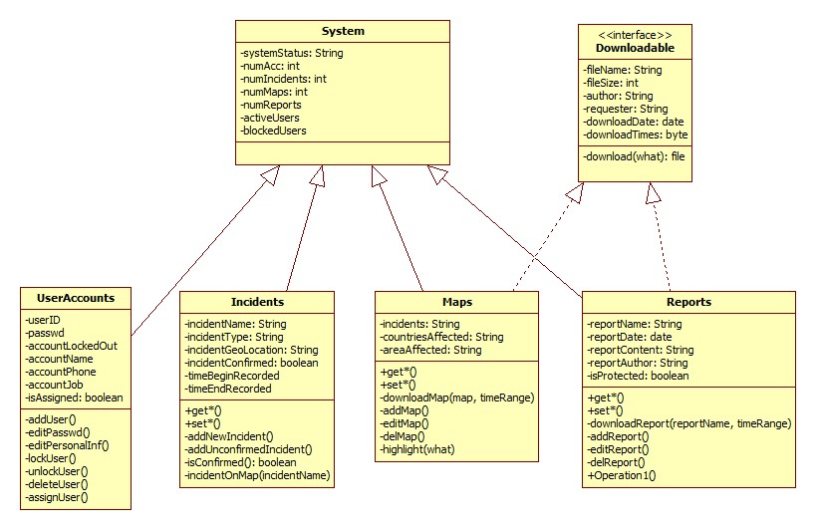
2.1. Class Diagrams
Class Diagram No 0

Slide 7
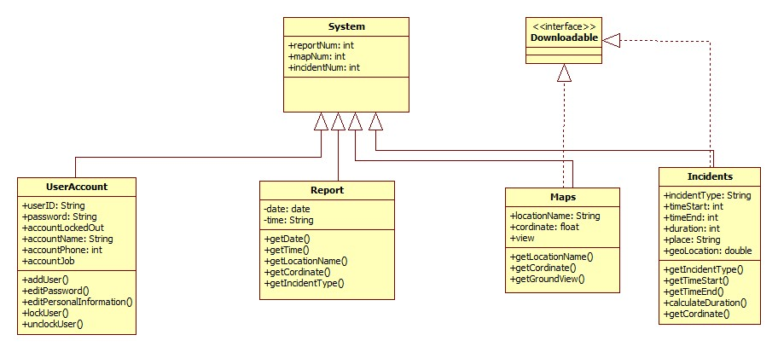
Class Diagram No 1

Slide 8
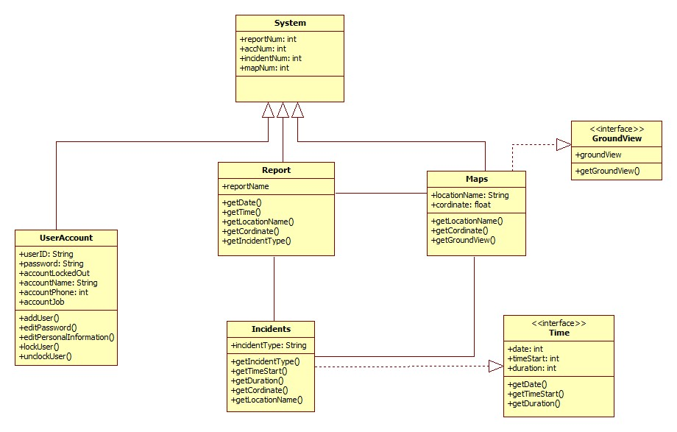
Class Diagram No 2

Slide 9
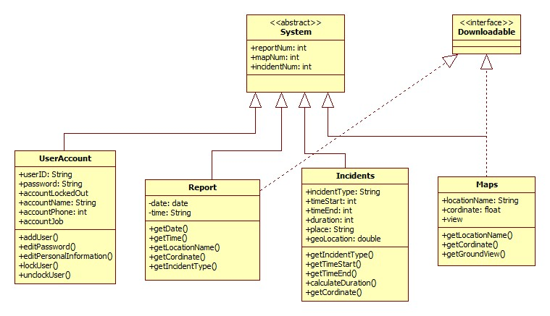
Class Diagram No 3

Slide 10
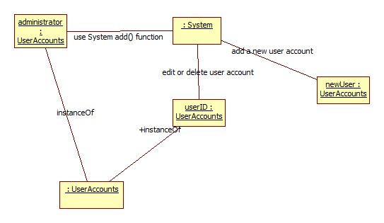
2.1. Object Diagrams
ObjectDiagram1 Description:
When adding/editing/deleting a user account, 3 objects are presented in the system at that time: the Administrator use the system functions to create newUser or edit/delete the userID.

Slide 11
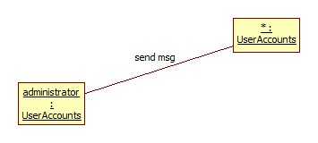
ObjectDiagram2 Description:
When sending message to user accounts, 2 objects are presented in the system at that time: the Administrator and all other user accounts.

Slide 12
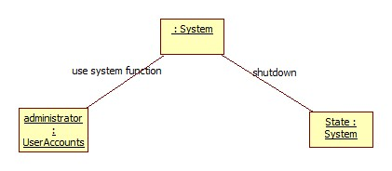
ObjectDiagram3 Description:
When shutting down the system, 2 objects are presented in the system at that time: the Administrator use the system function to bring the System State down.

Slide 13
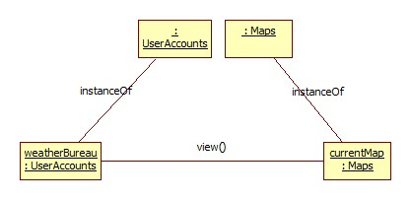
ObjectDiagram4 Description:
When viewing the map, 2 objects are presented in the system at that time: the weatherBureau use the function view() to access the currentMap object.

Slide 14
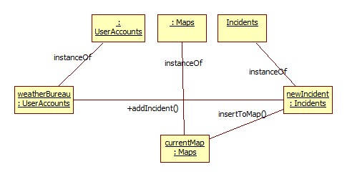
ObjectDiagram5 Description:
When adding a new incident, 3 objects are presented in the system at that time: the weatherBureau adds newIncident to the currentMap.

Slide 15
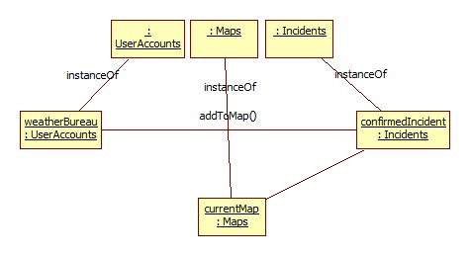
ObjectDiagram6 Description:
When adding a confirmed incident, 3 objects are presented in the system at that time: the weatherBureau adds confirmedIncident to the currentMap.

Slide 16
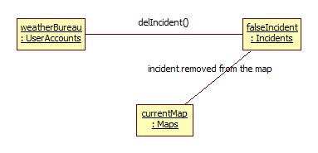
ObjectDiagram7 Description:
When deleting a false incident, 3 objects are presented in the system at that time: the weatherBureau deletes falseIncident in currentMap.

Slide 17
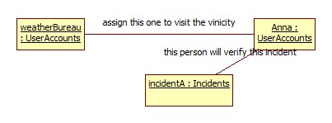
ObjectDiagram8 Description:
When assigning a staff to go verifying an incident, 3 objects are presented in the system at that time: the weatherBureau assigns Anna for the incidentA.

Slide 18
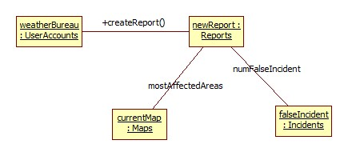
ObjectDiagram9 Description:
When creating a report, 4 objects are presented in the system at that time: the weatherBureau creates a newReport using data from currentMap and falseIncident.

Slide 19
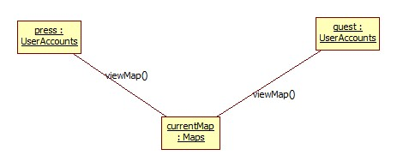
ObjectDiagram10 Description:
When viewing current map, 2-3 objects are presented in the system at that time: either the press or guest accesses the currentMap.

Slide 20
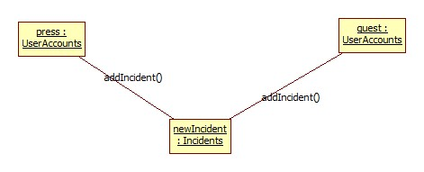
ObjectDiagram11 Description:
When adding a new incident, 2-3 objects are presented in the system at that time: either press or guest adds a newIncident.

Slide 21

ObjectDiagram12 Description:
When downloading map, 2 objects are presented in the system at that time: the press downloads the map.

Slide 22

ObjectDiagram13 Description:
When downloading report, 2 objects are presented in the system at that time: the press downloads the report.

Slide 23

ObjectDiagram14 Description:
When voting, 2 objects are presented in the system at that time: the guest and the being-voted incident.

Slide 24
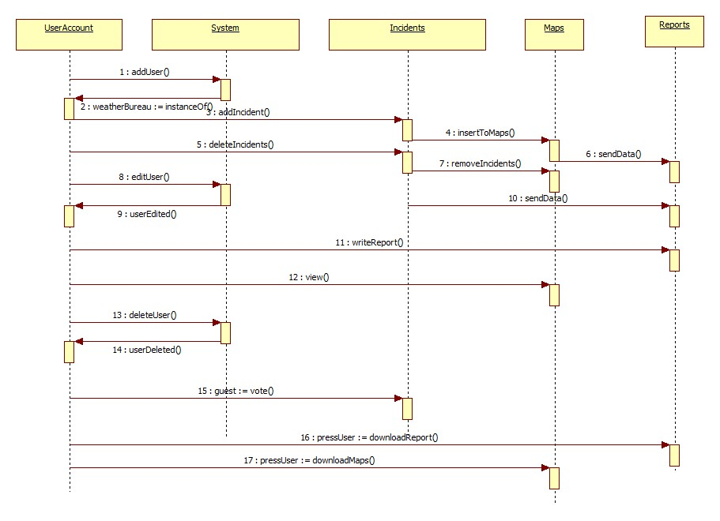
2.3. Sequence Diagrams

Slide 25
3. Management
3.1. Quality Assurance and Risk
Quality Assurance:
In this section, we will set up an SQA (Software Quality Assurance) to assist coders and developers in ensuring the quality of the system.
Evaluations
Audits and reviews
Standards applicable
Procedures for error tracking/reporting
Documents produced by SQA group
Feedback provided to project team

Slide 26
Risk Management:
Resources risks: 1. A: Funding Resources
1. B: Human Resources
Business risks: 2. A: not profitable 2. B: funding not stable
Technical risks: 3. A: connection loss 3. B: false information about incidents 3. C: the expanse of database is over the server’s memory 3. D: system not exactly all the time 3. E: transportation’s dependency risk

Slide 27
3.2. Test Plan

Slide 28
4. Schedule, Project & Cost Estimation
4.1. Schedule
4.2. Cost Estimate

Slide 29
5. Summary
TTC Software is free and has multiple functions dealing with recording and tracking natural disaster.
It also provides free-update patch to ensure safety in need and security for users.
However, it is required for users to pay service fees for co-operate provider as well as maintain fees.
In short, by choosing TTC Software, users’ desire can be fulfill in all aspect.

Slide 30
6. Reference List
Ken Schwaber 2011, “SCRUM Development Process”, Lecture notes, <scrum.pdf>.
SQAtester 2011, viewed 22nd Dec 2011, <SQAtester.com >.
Controlchaos, 2011, viewed 22nd Dec 2011, <www.controlchaos.com>.
Focustesting, 2011, viewed 22nd Dec 2011, <www.focustesting.com>.

Slide 31
Constraint 1:
Problem:
In case of completely loss of electricity, Internet, mobile/landline phone. How to send data back to the system?
Solution:
Using satellite connection.
Using the satellite service, TTC software can verify the incident, collect data using satellite and send it back to the user.

Slide 32
Constraint 2:
Problem:
In case datacenter where database is located is destroyed. How to keep the system running to update the incident information?
Solution:
Backup data to many datacenters.
The administrator has full control over these datacenters.
The system itself is redundantly programmed.
Cloud computing service from providers for backup purpose.

Slide 33
Constraint 3:
Problem:
In case of loss of admin password. How to recover?
Solution:
Multiple levels security: 2 different passwords, finger scanning, OTP (one-time password). If the hacker wants to take changes to the system, he must pass all of these levels.
Recovering the whole system should only take about 12 hours.

Slide 34
Constraint 4:
Problem:
A guess user try to poison the database by fake voting: vote a lot for a particular incident.
Solution:
Detecting IP address of voting. If the fake vote founded, the IP will be blocked from voting temporarily or permanently.

Slide 35
Constraint 5:
Problem:
A hacker is trying to flood our database system by sending a huge amount of requests reporting incidents.
Solution:
The database system is designed with algorithms to detect flooding request, by default.

Slide 36
Constraint 6:
Problem:
There might be problems related to the voting system since different person hold different idea as well as different point of view on a certain issues.
Solution:
Choose the best solution based on the most votes. This is installed by default.

Slide 37
Constraint 7:
Problem:
It might be impossible for the system to find and update incidents in time with the incident that is currently occurring due to the loss of connection.
Solution:
Build auto recorder point (small record machine) which cannot be damaged under any condition then place them in the different frequency to ensure the connection to sever will never be lost.

Slide 38
Constraint 8:
Problem:
Security is broken.
Solution:
2-level password and 1 secret question.
An e-mail account is also needed in case of recovering.

Slide 39
Constraint 9:
Problem:
The increase of software’s database can lead to long-awaiting time.
Solution:
Increasing the bandwidth is one of the solutions we recommend. This technique not only solves waiting time to load data, but also limit the deadlock situation.

Slide 40
Constraint 10:
Problem:
In case our database is damaged by the effects of natural incidents. We may lose all of our data.
Solution:
We recommend using cloud computing to resolve this problem. By saving data in a virtual database and update it every day, we can download it anytime we need.

