Slide 1
云作业平台项目汇报
周淳威 吴方诺 毛昊天 刘金珂
2021.1.8

Slide 2
目录 Contents
1
Demo
2
Infrastructure
3
Security
4
Engineering
5
Experience

Slide 3
Demo

Slide 4

Infrastructure
Nginx Ingress
Backend
HAProxy
Postgres
Cluster
Frontend
Kubernetes

Slide 5

Functionality: Tests
Backend Project
Testing with Django Testing Support
Mixed Unit Test and E2E Test style
Coverage: 98%
Frontend Project
Unit Test with Jest
E2E Test with Cypress
Ignore some too complex to test components in Unit Tests
E2E Tests cover all user interactions process in our app.

Slide 6
Availability: Kubernetes Cluster
Master
Worker-1
Worker-2
Control-Plane
Workers
Edge Router

Slide 7

Availability: Redundancy
Backend
Service
Frontend
Service

Slide 8
Security: Authentication
Session Authentication
Easy to implement
Well-supported
Heavy database pressure
Revocable
JWT Authentication
Database-free
Well performant
Unable to revoke

Slide 9

Security: Authentication
{username, password}
SessionID
Auth-related
Service
JWT Access Token
(10min TTL)
Users
JWT Access Token
(Latest)
JWT Access Token
(Latest)
SessionID
Other
Service
jwtMonitor

Slide 10


Security: Transport
Cert-manager
Cloud-native TLS cert management
Export as standard kubernetes.io/tls Secret
Automatically certs monitoring and renewing
Let’s Encrypt compatible

Slide 11

Security: Transport
Hosted under .dev TLD
Secure namespace
Automatically HSTS Preloading

Slide 12
Engineering
Engineering Practices
API Design
Github Actions CI
Ansible Automation
React Hooks and TypeScript

Slide 13
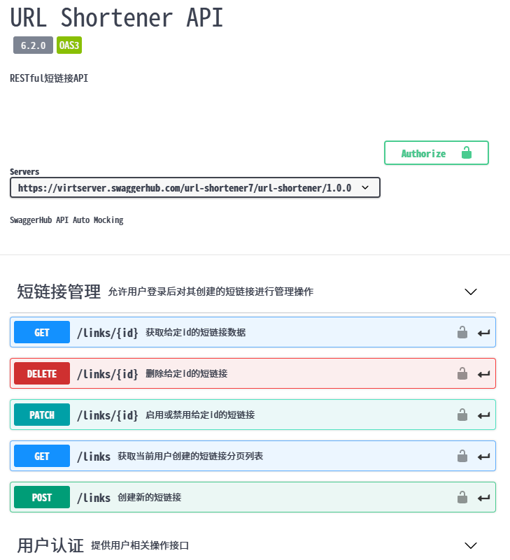

Engineering: API Design
Schema-First Approach:
Design and share API Specification with OpenAPI and Swagger
Design API Schema first before implementing an API

Slide 14

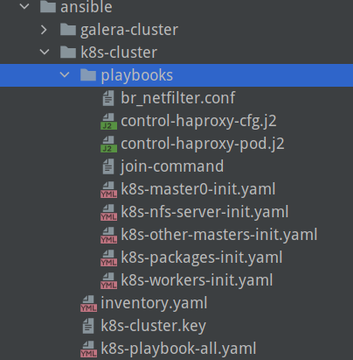
Engineering: Ansible Automation
Ansible
Extremely popular IT Automation tool
Developed series of playbooks for bring up a cluster by one key.

Slide 15
Thanks！

