Slide 1
Random Walks for Entity Linking And ASE for Knowledge Base Vertex Nomination

Slide 2
Entity Linking in Electronic Communications
Consider a corpus of Emails. (Enron Corpus)
From: Alice
To : Bob, Dave
Body: … Will Chris join the conference Call? …
Which Chris are they talking about:
Chris Poole, or
Chris Christie?

Slide 3
Weighted Random Walks for Entity Linking
Create a set of all entities in the enron corpus. An entity is an email-id, name tuple. Call it V
Let c_{a}^{b} be the number of times a emails b where a, b ∈V . Let E = { f(c_{a}^{b}) ∀ a,b ∈ V} where f is either Identity or Normalization.
If we know the participants in an email how do we find who they are emailing about.
For each participant perform K weighted random walks on G=(V, E) and count the number of times a node v ∈V is visited during each walk.
Return aggregated counts over participants

Slide 4
Results
Type | MRR | Accuracy
Best Single Feature in existing SOTA Baseline | 0.09 | 0.05
RW (NC_10_max) | 0.30 | 0.15
Type | MRR | Accuracy
Baseline (All Feature) | 0.79 | 0.73
Baseline + RW (NC_10_max) | 0.79 | 0.74

Slide 5
Adjacency Spectral Embedding for Vertex Nomination for Knowledge Base Population
The Problem
Some nodes in the graph belong to a class.
Which other nodes should belong to that class.
A Stochastic Block Model (SBM) is a model for community structure amongst vertices of a graph. ASE was developed to estimate of the parameters of a SBM.
The Idea
Assign embeddings/vectors to vertices. This step is unsupervised.
Given supervised data (tuples of vertex, class label) use the features to train a classifier.
Rank which other nodes should belong to the class based on a classifier that can also assign likelihoods.

Slide 6
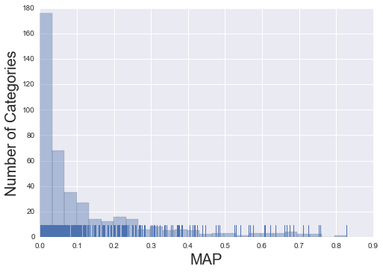
Results

Slide 7
Results
Categories with best performance
Category | Map
base.locations.states_and_provences | 0.83
base.aareas.schema.earth.sovereign_state | 0.76
base.schemastaging.govt_jurisdiction_extra | 0.75
tennis.tennis_player | 0.71
Notes:
0.8281951705693846
0.7565508160343571
0.7531602841164338
base.schemastaging.statistical_region_extra 0.7241609542214855
0.7100941066635618
location.country 0.6837965244296688
ice_hockey.hockey_player 0.6740644845282026
base.languagesfordomainnames.topic 0.6674792075926695

Slide 8
Results
Categories With “Bad” Performance?
military.military_commander, P@10=0.3, MAP= 0.06 Top 5 Returned Entities
Former Soviet leader Mikhail Gorbachev
France 's Napoleon Bonaparte
Laurent Kabila
President Slobodan Milosevic
King Hussein

Slide 9
Results
Categories With “Bad” Performance?
tv.tv_network, P@10=0.2, MAP= 0.06 Top 5 Returned Entities
Animal Planet
Fox
ABC
Modern Family
ABC Sports - ESPN

Slide 10
Results
Categories With “Bad” Performance?
american_football.football_coach, P@1 =0.0, P@10=0.3, MAP= 0.06 Top 5 Returned Entities
Coach Jim Schwartz
their new quarterback Donovan McNabb
the expected-to-retire Walter Jones
troubled running back Marshawn Lynch
Carroll

Slide 11
Odds and Ends
Hyper Parameters – The Devil in Details
Count Aggregation in random walks
Graph Creation.
The ASE dimensions.
The choice of classifier.
Future Work
Incorporating known edge and vertex attributes.
Improving evaluation data quality.
Comparing with existing KBC baselines.
Repo: Gitlab KBVN
Total | 1K
py | 520
sh/Makefile | 160
R | 467

