Slide 1
Entity Search By Example
Literature Review

Slide 2
Related Keywords
Information Retrieval
Collaborative Filtering
Learning to Rank
Document Routing
Vertex Nomination
Content Based Recommendation
Concept Expansion
Set/List Completion
Entity Retrieval
Expert Finding/Retrieval
Entity Ranking
Query by Entity Examples

Slide 3
Application

Slide 4
Entity Finding/Retrieval
When a Knowledge Base is not enough: QA over KB with external text data: Savenkov, Agichtein, SIGIR 2016
An Empirical Study of Learning to Rank For Entity Search, Jing Chen, Chen Yon Xiong, James Callan, SIGIR 2016
Entities are represented by multi field documents constructed from their RDF triples and field based text similarity features are extracted from query-entity pairs
Uses everything as features and beats everything else.
Latent Entity Space: A novel retrieval approach for entity bearing queries (2007), Xitong Liu, Hui Fang
Add features about entities and entity types that appear in a document, use the occurrence of an entity as a feature, similar to “wiki article feature” idea.
Entity Centric Information Retrieval, Xitong Liu, 2015, U Delaware
QBEES: Query by Entity Examples, CIKM 2013
Define Entity Similarity solely by structural features
Similar Entity Search by Example is an important task for retrieving info from semantic KBs
They grow a maximal subgraph that at least contains one other entity that is not in the set, and then iterate.

Slide 5
Entity Finding/Retrieval
Growing a List. Ben Letham, Cynthis Rudin, Katherine Heller, KDD 2013
Used Bayesian Sets and Crawling to find entities related to a topic
Markov Logic Sets, Neumann, Ahmadi, Kersting, AAAI 2011
Used Markov Logic Based Model
PageRank, PPR, Lifted Inference
Completing Lists of Entities. Adfre, Rijke
For evaluation purposes we make use of the lists and categories available in Wikipedia. Experimental results show that cluster-based contexts improve retrieval results.
“Tell Me More”, Finding Related Items from User Provided Feedback, Kniff, Lilkins, Coethals, 2012
Used Random Walks with Restart
Related Entity Finding by Unified Probabilistic Models, Fong, Si, 2013
Fielded Sequential Dependence Model for Ad Hoc Entity Retrieval in the Web of Data, Zhitsov, Kotov, Nikolaev, SIGIR 2015
Proximity Based Document Retrieval for Named Entity Retrieval, Petkova, Croft, 2007
Document driven Generative LM approach to rank named entities
An Active Learning Approach to Finding Related Items, Vickrey, Kipersztok, Koller (ACL 2015)
Active learning for set expansion for getting synonyms.
Used Negative Examples which most set expansion methods don’t use (it’s trivial to extend them)
Relevance and Ranking inOnline Dating Systems, SIGIR 2010

Slide 6
Datasets

Slide 7
Datasets and Toolkits
A Test Collection for Entity Search in DBPedia, Balog, NeuMayer, SIGIR 2013
Classification in Networked Data: A tookit and univariate case study

Slide 8
Concept/Set Expansion
Entity Set Expansion in Opinion Documents, Lei Zhong, Bing Liu, HT11
Employ Distributional Clues -> Bayesian Sets Entity Ranking and Feature Sparsity
Improve over Bsets by using feature weighting.
Distributional Similarity vs PU Learning for Entity Set, Li, Zhong, Liu, Ng, ACL 2010
Compare PU Learning with Bayesian Sets
On Demand Set Based Recommendation, RecSys 2010, Suhrid, Balakrishnan
They extend Bsets and apply MaxEnt and DML to this problem.
Concept Expansion using Web tables, Wang, Chak-He, Ganjam, Chen, Bernstein 2015
Given the name of an ad-hoc concept as well as a few seed entities belonging to the concept output all entities belonging to it.
More Like These: Growing Entity Classes From Seeds, Luis Sarmento, Jiijkoun, Rijke, Oliviera, CIKM 2007
We use distributional features to define a membership function that is used to rank candidate entities for inclusion in the set.

Slide 9
Related Paper Finding
On the recommendation of Citations for Research Papers, McNee, Riedl, GroupLens, (2000)
Used Collaborative Filtering
On this dataset, the method did not really work out
The paper was frank and showed that Google Scholar produced better results.
Google Scholar, Naïve Bayes and Basic Methods beat the pants off of collaborative filtering.
Beyond Keyword Search – Representation and Model for Personalization, Khalid El-Arini, Thesis 2013
Define a Researcher’s need for information as a set of papers instead of a keyword string

Slide 10
Expertise Retrieval / Expert Finding
TREC has enterprise tracks in 2008 and Entity tracks in 2009, 2010, 2011
The main tasks were the “TREC Entity List Completion Task”
The broad category of features used were
Language Models
Discriminative Models (Learning to Rank/Doc to relevance)
Voting Models
Graph Based Models

Slide 11
Expertise Retrieval / Expert Finding
Unsupervised, Efficient and Semantic Expertise Retrieval. Gysel, Rijke (WWW 2016)
P@noptic for Expertise Finding, Crasswell, 2001
Finding Similar Experts, Balog, Rijke, SIGIR 2007

Slide 12
Finding the Query By Examples
Discovering Nbhd Pattern Queries by Samples Answers in KBs
GQBE: Querying Knowledge Graphs by Example Entity Tuples
SPARQLByE: Querying RDF by example

Slide 13
Finding the Query By Examples
Theoretical Work
Learning Tree Patterns From Example Graphs, Sara Cohen, Yaacov, Weiss, (2015)
The complexity of Learning Tree Patterns from Example Graphs, TODS – Invited Paper from SIGMOD 2014
Reverse Engineering SPARQL Queries, User paper
A Statistical Learning Theory Framework for Supervised Pattern Discovery. Jonathan Huggins, Cynthia Rudin

Slide 14
Collective Classification
Collective Classification in Networked Data, Sen Namata, Bilgic, Getoor, Gallagher, (2008 AAAI)
A Study of Appraoches to Hypertext Categorization, 2002, Yiming Yang, Searn Slattery, Rayid Ghani JIIS

Slide 15
Sketch the papers together into 1 A4 sheet. 1.5 times of what we want to do for the thesis, no need to nail the outline completely.

Slide 16
A Test Collection for Entity Search in DBPedia

Slide 17
Luhn Revisited: Significant Words Language Models

Slide 18
Entity Linking in Queries: Tasks and Evaluation
t. Consider, as an illustrative example, the query “new york pizza manhattan.” It could be annotated, among others, as “[NEW YORK CITY] pizza [MANHATTAN]” or as “[NEW YORK-STYLE PIZZA][MANHATTAN],” and both would be correct (linked entities are in brackets). A cardinal question, then, is how should the inherent ambiguity of entity annotations in queries be handled? One line of prior work has dealt with this problem by adopting a retrieval-based approach: returning a ranked list of entities that are semantically related to the query [6, 27]. We refer to it as semantic mapping. The Entity Recognition and Disambiguation (ERD) Challenge [8] represents a different perspective by addressing the issue of ambiguity head-on: search queries can legitimately have more than a single interpretation. An interpretation is a set of entities, with non-overlapping mentions, that are semantically compatible with the query text [8]. We term this task interpretation finding. Both approaches have their place, but there is an important distinction to be made as they are designed to accomplish different tasks. Semantic mapping is a tool for aiding users with suggestions that could be beneficial for enhancing navigation or for contextualization. Interpretation finding is a means to machine-understanding of queries, which, in our opinion, is the ultimate goal of entity linking in queries.

Slide 19
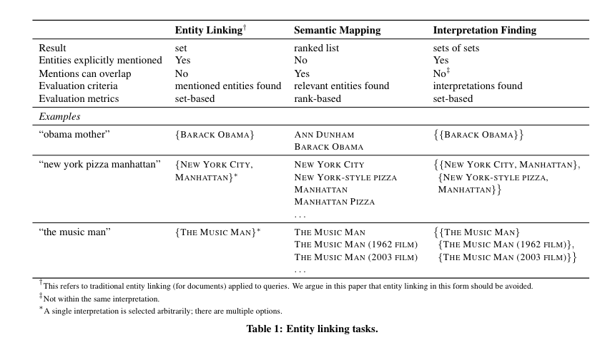

Slide 20
Ad-hoc Object Retrieval in the Web of Data
We define the ad-hoc object retrieval task for evaluating semantic search systems on the Web of Data. The task is based on answering arbitrary information needs related to particular aspects of objects, expressed in unconstrained natural language and resolved using a collection of structured data. We also explain the problems in mapping the current methodology for ad-hoc document retrieval to ad-hoc object retrieval.

Slide 21
It is common to call any information retrieval system a semantic search system if it performs the matching of queries and potential results at a conceptual level, i.e. by processing information beyond the surface forms of symbols. Unfortunately, this definition is hard to operationalize when it comes to semantic search evaluation, because it leaves open the type of queries processed by the system, the format of the content and the internal knowledge representation paradigm applied within the search system.

Slide 22
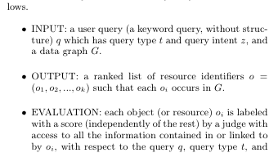

Slide 23
Related entity finding
Given an input entity, by its name and homepage, the type of the target entity, as well as the nature of their relation, described in free text, find related entities that are of target type, standing in the required relation to the input entity.

Slide 24
Plethora of Entity Retrieval Tasks: A Test Collection for Entity Search in DBpedia
INEX-XER: The INEX 2009 Entity Ranking track seeks a list of entities (e.g., “US presidents since 1960”), where entities are represented by their Wikipedia page [9].
TREC Entity: The related entity finding task at the TREC 2009 Entity track focuses on specific relationships between entities (e.g., “Airlines that currently use Boeing 747 planes”) and requests entity homepages from a Web corpus to be retrieved [1].
SemSearch ES: Queries in the ad-hoc entity search task at the 2010 and 2011 Semantic Search Challenge refer to one particular entity, albeit often an ambiguous one (e.g., “Ben Franklin,” which is both a person and a ship), by means of short keyword queries.
SemSearch LS: Using the same data collection as the ES task, the list search task at the 2011 Semantic Search Challenge targets a group of entities that match certain criteria (e.g., “Axis powers of World War II”) [4].
QALD-2: The Question Answering over Linked Data challenge aims to answer natural language questions (e.g., “Who is the mayor of Berlin?”) using Linked Data sources [14].
Notes:
I am doing combinations of INEX-XER and Semsearch LS, where I have both a keyword query and some examples and I am shooting for maximizing RECALL within the top 20.

Slide 25
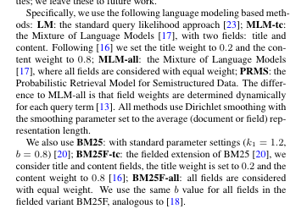

Slide 26
Example of usage of entity search
Consider a business analyst of a large corporation producing industrial goods who needs to determine potential customers (leads). This is usually an extremely time consuming task. Having an ECIR-system he might for instance simply query for all competing companies and retrieve the corresponding customers for each of them. There are many other usage

Slide 27
Related Entity Finding Vs Expertise Retrieval
The related entity finding problem is also related to the expert finding problem [18]. In fact, it can be regarded as a more general problem than expert finding [18], since the latter focuses only on a specific type of related entities (i.e., person), a specific type of input entities (i.e., expertise area) and a specific relation (i.e., expert of).

Slide 28
Query Expansion
Query expansion is a well known strategy to improve retrieval performance [33, 104, 114, 140]. A common strategy in most existing query expansion methods is termbased. Specifically, they use different strategies to select expansion terms from feedback documents, user feedback or external sources, and update the existing query through some re-weighting strategies. Zhai and Lafferty [159] proposed two different approaches (i.e. generative model and risk minimization) to estimate the query language model which fits the relevant documents best with collection background model. Instead of modeling the (pseudo-)relevant documents explicitly, Lavrenko and Croft [96] proposed to estimate relevance model from feedback documents in a more generalized way, and Lafferty and Zhai [93] developed an approach which uses Markov chains to estimate query models. Tan et al. [139] used a cluster-based method to select terms from documents, presented the terms to users for feedback, and used the selected terms to update query models. More recently, Weerkamp et al. [148] proposed a query-dependent expansion method that enables each query to have its own mixture of external collections for expansion. Lv and Zhai [105] presented a positional relevance model which leverages proximity and selects useful expansion terms based on their distance from query terms in feedback documents. Metzler and Croft [112] proposed a Markov random fields based query expansion technique which is capable of incorporating arbitrary features to model the term dependency for query expansion. Instead of selecting expansion terms from feedback documents, we study the feasibility of exploiting related entities and the relations among them for query expansion.

Slide 29
Liu et al. [101] explored how to leverage related entities of query and their relationship to perform query expansion based on both documents and DBpedia. I

Slide 30
Entity Retrieval via Entity Factoid Hierarchy
We propose that entity queries are generated via a two-step process: users first select entity facts that can distinguish target entities from the others; and then choose words to describe each selected fact. Based on this query generation paradigm, we propose a new entity representation model named as entity factoid hierarchy. An entity factoid hierarchy is a tree structure composed of factoid nodes. A factoid node describes one or more facts about the entity in different information granularities. The entity factoid hierarchy is constructed via a factor graph model, and the inference on the factor graph is achieved by a modified variant of Multiple-try Metropolis algorithm. Entity retrieval is performed by decomposing entity queries and computing the query likelihood on the entity factoid hierarchy. Using an array of benchmark datasets, we demonstrate that our proposed framework significantly improves the retrieval performance over existing models.

Slide 31
Entity Query Feature Expansion using Knowledge Base Links
Recent advances in automatic entity linking and knowledge base construction have resulted in entity annotations for document and query collections. For example, annotations of entities from large general purpose knowledge bases, such as Freebase and the Google Knowledge Graph. Understanding how to leverage these entity annotations of text to improve ad hoc document retrieval is an open research area. Query expansion is a commonly used technique to improve retrieval effectiveness. Most previous query expansion approaches focus on text, mainly using unigram concepts. In this paper, we propose a new technique, called entity query feature expansion (EQFE) which enriches the query with features from entities and their links to knowledge bases, including structured attributes and text. We experiment using both explicit query entity annotations and latent entities. We evaluate our technique on TREC text collections automatically annotated with knowledge base entity links, including the Google Freebase Annotations (FACC1) data. We find that entity-based feature expansion results in significant improvements in retrieval effectiveness over state-of-the-art text expansion approaches.

Slide 32
An Exploration of Entity Models, Collective Classification and Relation Description, KDD 2004
Hema Raghavan, James Allan and Andrew McCallum
Traditional information retrieval typically represents data using a bag of words; data mining typically uses a highly structured database representation. This paper explores the middle ground using a representation which we term entity models, in which questions about structured data may be posed and answered, but the complexities and task-specific restrictions of ontologies are avoided. An entity model is a language model or word distribution associated with an entity, such as a person, place or organization. Using these perentity language models, entities may be clustered, links may be detected or described with a short summary, entities may be collectively classified, and question answering may be performed. On a corpus of entities extracted from newswire and the Web, we group entities by profession with 90% accuracy, improve accuracy further on the task of classifying politicians as liberal or conservative using collective classification and conditional random fields, and answer questions about “who a person is” with mean reciprocal rank (MRR) of 0.52.

Slide 33
Model-based Feedback in the Language Modeling Approach to Information Retrieval Zhai, Lafferty, 2002
The language modeling approach to retrieval has been shown to perform well empirically. One advantage of this new approach is its statistical foundations. However, feedback, as one important component in a retrieval system, has only been dealt with heuristically in this new retrieval approach: the original query is usually literally expanded by adding additional terms to it. Such expansion-based feedback creates an inconsistent interpretation of the original and the expanded query. In this paper, we present a more principled approach to feedback in the language modeling approach. Specifically, we treat feedback as updating the query language model based on the extra evidence carried by the feedback documents. Such a model-based feedback strategy easily fits into an extension of the language modeling approach. We propose and evaluate two different approaches to updating a query language model based on feedback documents, one based on a generative probabilistic model of feedback documents and one based on minimization of the KL-divergence over feedback documents. Experiment results show that both approaches are effective and outperform the Rocchio feedback approach.

Slide 34
A generative model. Assuming a generative model, we estimate the query topic model using the observed feedback documents based upon a maximum likelihood or regularized maximum likelihood criterion. The particular generative model we consider here is a simple mixture model, using the collection language model as one component, and the query topic model as the other.
Divergence/risk minimization over feedback documents. Here, rather than maximizing likelihood we estimate the query model by minimizing the average KL-divergence between the model and the feedback documents

Slide 35
Learning Joint Query Interpretation and Response Ranking
Thanks to information extraction and semantic Web efforts, search on unstructured text is increasingly refined using semantic annotations and structured knowledge bases. However, most users cannot become familiar with the schema of knowledge bases and ask structured queries. Interpreting free-format queries into a more structured representation is of much current interest. The dominant paradigm is to segment or partition query tokens by purpose (references to types, entities, attribute names, attribute values, relations) and then launch the interpreted query on structured knowledge bases. Given that structured knowledge extraction is never complete, here we use a data representation that retains the unstructured text corpus, along with structured annotations (mentions of entities and relationships) on it. We propose two new, natural formulations for joint query interpretation and response ranking that exploit bidirectional flow of information between the knowledge base and the corpus. One, inspired by probabilistic language models, computes expected response scores over the uncertainties of query interpretation. The other is based on max-margin discriminative learning, with latent variables representing those uncertainties. In the context of typed entity search, both formulations bridge a considerable part of the accuracy gap between a generic query that does not constrain the type at all, and the upper bound where the “perfect” target entity type of each query is provided by humans. Our formulations are also superior to a two-stage approach of first choosing a target type using recent query type prediction techniques, and then launching a type-restricted entity search query.

Slide 36
Relationship Queries on Extended Knowledge Graphs Mohamed Yahya, Denilson Barbosa, Klaus Berberich, Qiuyue Wang, Gerhard Weikum WSDM 2016
Entity search over text corpora is not geared for relationship queries where answers are tuples of related entities and where a query often requires joining cues from multiple documents. With large knowledge graphs, structured querying on their relational facts is an alternative, but often suffers from poor recall because of mismatches between user queries and the knowledge graph or because of weakly populated relations. This paper presents the TriniT search engine for querying and ranking on extended knowledge graphs that combine relational facts with textual web contents. Our query language is designed on the paradigm of SPO triple patterns, but is more expressive, supporting textual phrases for each of the SPO arguments. We present a model for automatic query relaxation to compensate for mismatches between the data and a user's query. Query answers -- tuples of entities -- are ranked by a statistical language model. We present experiments with different benchmarks, including complex relationship queries, over a combination of the Yago knowledge graph and the entity-annotated ClueWeb'09 corpus.

Slide 37
Parameterized Fielded Term Dependence Models for Ad-hoc Entity Retrieval from Knowledge Graph
Accurate projection of terms in free-text queries onto structured entity representations is one of the fundamental problems in entity retrieval from knowledge graph. In this paper, we demonstrate that existing retrieval models for ad-hoc structured and unstructured document retrieval fall short of addressing this problem, due to their rigid assumptions. According to these assumptions, either all query concepts of the same type (unigrams and bigrams) are projected onto the fields of entity representations with identical weights or such projection is determined based only on one simple statistic, which makes it sensitive to data sparsity. To address this issue, we propose the Parametrized Fielded Sequential Dependence Model (PFSDM) and the Parametrized Fielded Full Dependence Model (PFFDM), two novel models for entity retrieval from knowledge graphs, which infer the user’s intent behind each individual query concept by dynamically estimating its projection onto the fields of structured entity representations based on a small number of statistical and linguistic features. Experimental results obtained on several publicly available benchmarks indicate that PFSDM and PFFDM consistently outperform state-of-the-art retrieval models for the task of entity retrieval from knowledge graph.

Slide 38
Recent studies [16, 22] indicate that more than 75% of queries issued to Web search systems aim at finding information about entities, which could be material objects or concepts that exist in the real world or fiction (e.g. people, products, scientific papers, colors). Most common information needs underlying this type of queries include finding a certain entity (e.g. “Einstein relativity theory”), a particular attribute or property of an entity (e.g. “Who founded Intel?”) or a list of entities satisfying a certain criteria (e.g. “Formula 1 drivers that won the Monaco Grand Prix”). Such information needs can be efficiently addressed by presenting the target entity or a list of entities, either directly as search results or in addition to the ranked list of documents. This scenario gives rise to the problem of ad-hoc entity retrieval from knowledge graph, when the output of retrieval models is a list of entities given their (potentially verbose) textual description.

Slide 39
Recent successes in the development of Web information extraction methods have resulted in the emergence of a number of large-scale publicly available and proprietary knowledge repositories, such as DBpedia1 , Freebase2 , Google’s Knowledge Graph and Microsoft’s Satori. All these repositories adopt a simple knowledge representation model based on subject-predicate-object triples that can be conceptualized as a directed labeled multi-graph (commonly referred to as a knowledge graph), in which the nodes correspond to entities and the edges denote typed relations between entities. This model makes knowledge graphs a natural choice for addressing different types of entity-centric information needs. However, since the structure of knowledge graphs has been optimized for automated reasoning and answering structured graph pattern queries, finding entities in knowledge graphs that conceptually match unstructured free-text queries presents certain challenges to existing retrieval models

Slide 40
Parameterized Fielded Term Dependence Models for Ad-hoc Entity Retrieval from Knowledge Graph
Accurate projection of terms in free-text queries onto structured entity representations is one of the fundamental problems in entity retrieval from knowledge graphs. In this paper, we demonstrate that existing retrieval models for ad-hoc structured and unstructured document retrieval fall short of addressing this problem, due to their rigid assumptions. According to these assumptions, either all query concepts of the same type (unigrams and bigrams) are projected onto the fields of entity representations with identical weights or such projection is determined based only on one simple statistic, which makes it sensitive to data sparsity. To address this issue, we propose the Parametrized Fielded Sequential Dependence Model (PFSDM) and the Parametrized Fielded Full Dependence Model (PFFDM), two novel models for entity retrieval from knowledge graphs, which infer the user's intent behind each individual query concept by dynamically estimating its projection onto the fields of structured entity representations based on a small number of statistical and linguistic features. Experimental results obtained on several publicly available benchmarks indicate that PFSDM and PFFDM consistently outperform state-of-the-art retrieval models for the task of entity retrieval from knowledge graph.

Slide 41
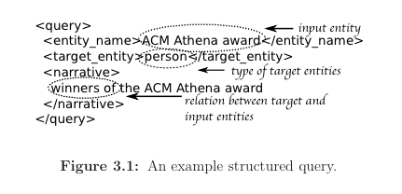
ENTITY CENTRIC INFORMATION RETRIEVAL
Entity Retrieval
award winners such as “Deborah Estrin”, “Shafi Goldwasser” and “Karen Sp¨arck Jones”
FINDING RELEVANT INFORMATION OF CERTAIN TYPES: Enterprise search users often look for relevant information other than documents. When formulating a keyword query, search users may specify not only what kind of information is relevant, i.e., content requirements, but also what type of information is desirable, i.e., type requirements. Without loss of generality, we assume that a query term describes either content or type requirement and we can represent a keyword query as Q = QC S QT , where QC is the set of query terms describing the content requirement and QT is the set of query terms describing the type requirement. Given a keyword query and an enterprise data collection, our goal is to retrieve information satisfying both requirements from the collection.

Slide 42
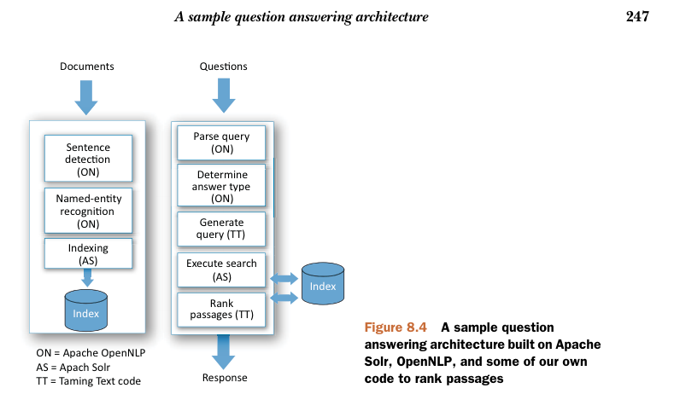
Taming Text: How to Find, Organize and manipulate it. By Grant Ingersoll et al.

Slide 43
Entity Based Feedback with Fusion
We found that good improvement is possible when we adding only a single organization, a single location, or a single person name. Details of these calibrations may be found in [McCabe00].
For example, query Ireland Peace Talks added the organization Sinn Fein, the person Jerry Adams, and the location Northern Ireland. Each of these improved the query effectiveness by over 100%. While more queries improved than degraded with each entity type, several queries degraded badly.
Names that were associated with more than the query topic were harmful.
For example, the query Estonian Economics selected the Estonian Prime Minister Mart Laar as the name to add. This degraded performance because the prime minister is in many documents having nothing to do with economics. In addition, ambiguous names were harmful. It turns out there are many individuals with the name Stirling. So that addition to the query Stirling Engine brought back documents about a California senator, a minister, etc

