Slide 1
Multi View Learning and Paraphrasing
Pushpendre Rastogi
Johns Hopkins University

Slide 2
Introduction
The problem
  Paraphrasing
    Lexical: Two words with the same meaning.
    Phrasal: Two strings of words with the same meaning.
    Syntactic: Strings of surface words and non-terminal categories that have the same meaning.
Step 1. Finding synonyms or Lexical paraphrases

Slide 3
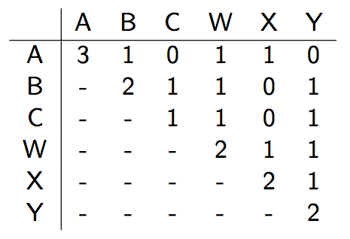
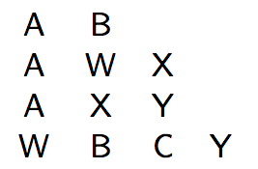
Data Source (1)
Monolingual - Lots of sentences, optionally pos-tagged, parsed
Top : Corpus
Right : Context Matrix, M

Slide 4
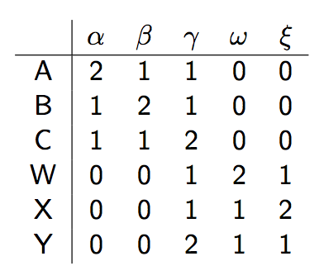
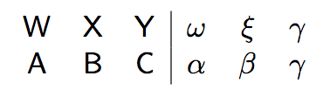
Data Source (2)
Bilingual – Lots of pairs of sentence, optionally word aligned
Top : Bilingual Corpus
Right : Context Matrix, B

Slide 5
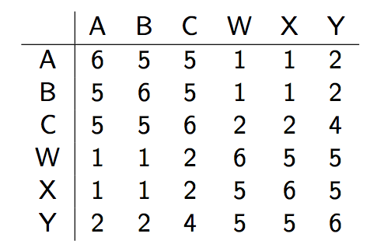
B*B^{T} =

Slide 6
Previous Approaches^{1,2}
Use only M
  DIRT-Discovery of Inference Rules from Text.
Use just B
  Paraphrasing with bilingual parallel corpora
Use both B and M
  Reranking bilingually extracted paraphrases using monolingual distributional similarity
  PPDB: The paraphrase database
^{1.} For this type of data, unsupervised, web scale ^{2.} Not exhaustive

Slide 7
Previous Approaches^{1,2}
Use only M
  DIRT-Discovery of Inference Rules from Text. (Distance metric over rows of M. Pro: Good quality. Cons: Sometimes thinks antonyms are similar)
Use just B
  Paraphrasing with bilingual parallel corpora (Threshold values in rows of B*B^{T}. Pro: Never confuses antonyms, Cons: Over-generates a lot.)
Use both B and M
  Reranking bilingually extracted paraphrases using monolingual distributional similarity (Generate suggestions from B*B^{T} but use Monolingual distance metric. The two views complement each other.)
  PPDB: The paraphrase database
^{1.} For this type of data, unsupervised, web scale ^{2.} List is not exhaustive

Slide 8
Multi-view Learning
Techniques for leveraging (more than ?) two views over data
Examples
  Unsupervised WSD rivaling supervised methods
    One sense per collocation
    One sense per discourse
  Co-Training, CoBoosting, Co-regularization
  Canonical Correlation Analysis (CCA)
    Multi view learning of word embeddings via CCA
    2 step CCA, A new spectral method for embeddings
  Probabilistic CCA, CCA is MLE over a certain graph under certain priors
    2 languages are better than one (for syntactic parsing)
    Learning Better monolingual models with unannotated bilingual text
  Neural Network and Multi-view Learning
    Improving word representation via Global Context and Multiple Word Prototypes
    Effective Bilingual Constraints for Semisupervised learning of NER

Slide 9
Multi-view Learning
Techniques for leveraging (more than ?) two views over data
Examples
  Unsupervised WSD rivaling supervised methods
    One sense per collocation
    One sense per discourse
  Co-Training, CoBoosting, Co-regularization
  Canonical Correlation Analysis (CCA)
    Multi view learning of word embeddings via CCA
    2 step CCA, A new spectral method for embeddings
  Probabilistic CCA, The solution to CCA is the MLE under a certain prior
    2 languages are better than one (for syntactic parsing)
    Learning Better monolingual models with unannotated bilingual text
  Neural Network and Multi-view Learning
    Improving word representation via Global Context and Multiple Word Prototypes
    Effective Bilingual Constraints for Semisupervised learning of NER

Slide 10
Preliminary Experiments
Compressing existing embeddings
  Incorporating supervised data
Incremental SVD

Slide 11
Extensions
Learning phrasal and syntactic paraphrases
Try the other variants of CCA
How to perform Semi supervised CCA

