Slide 1
Minwise Hashing and Efficient Search

Slide 2
Example Problem
Large scale search:
We have a query image
Want to search a giant database (internet) to find similar images
Fast
Accurate

Slide 3
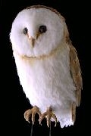
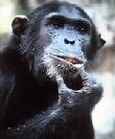


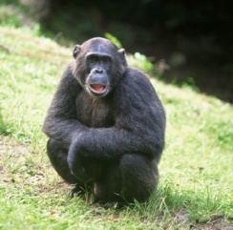
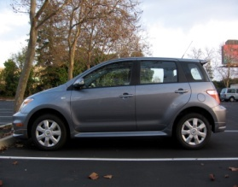
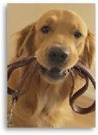
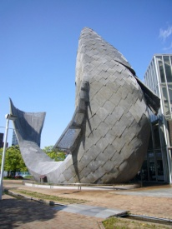
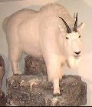
Large Scale Image Search in Database
Find similar images in a large database
Kristen Grauman et al

Slide 4
Large scale image search
Representation must fit in memory (disk too slow)
Facebook has ~10 billion images (10¹⁰)
PC has ~10 Gbytes of memory (10¹¹ bits)
→ Images are very high-dimensional objects.
Fergus et al

Slide 5
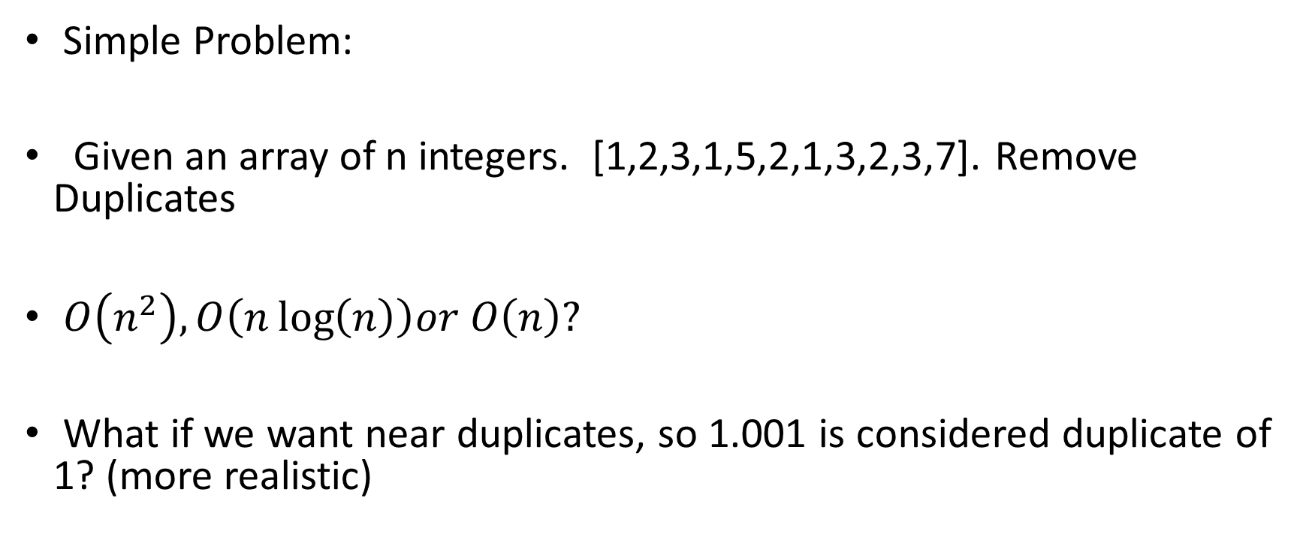
Solution: Hashing Algorithms
Simple Problem:
Given an array of n integers. [1,2,3,1,5,2,1,3,2,3,7]. Remove Duplicates
$O\left(n^{2}\right), O\left(n\log\left(n\right)\right)or O\left(n\right)?$
What if we want near duplicates, so 1.001 is considered duplicate of 1? (more realistic)

Slide 6
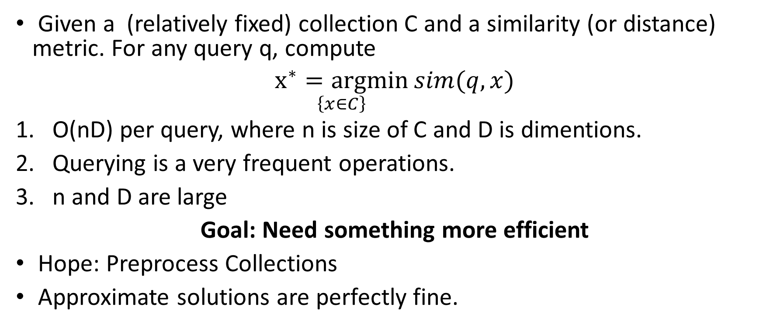
Similarity or Near-Neighbor Search
Given a (relatively fixed) collection C and a similarity (or distance) metric. For any query q, compute
$\underset{\left\{x∈C\right\}}{x^{∗}=argmin}{sim(q,x)}$
O(nD) per query, where n is size of C and D is dimentions.
Querying is a very frequent operations.
n and D are large
Goal: Need something more efficient
Hope: Preprocess Collections
Approximate solutions are perfectly fine.

Slide 7
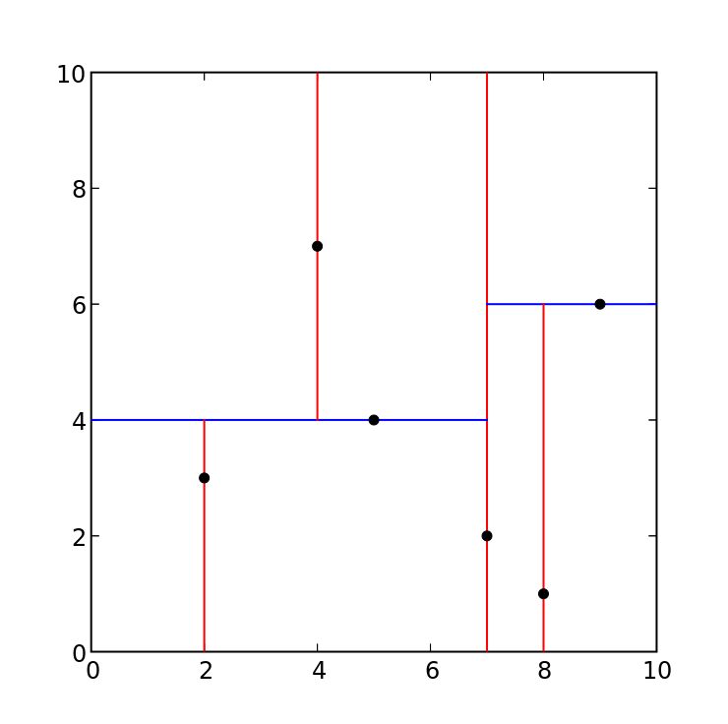
Space Partitioning Methods
Partition the space and organize database into trees
In high dimensions, space partitioning is
not at all efficient.
Even D > 10, leads to near exhaustive

Slide 8
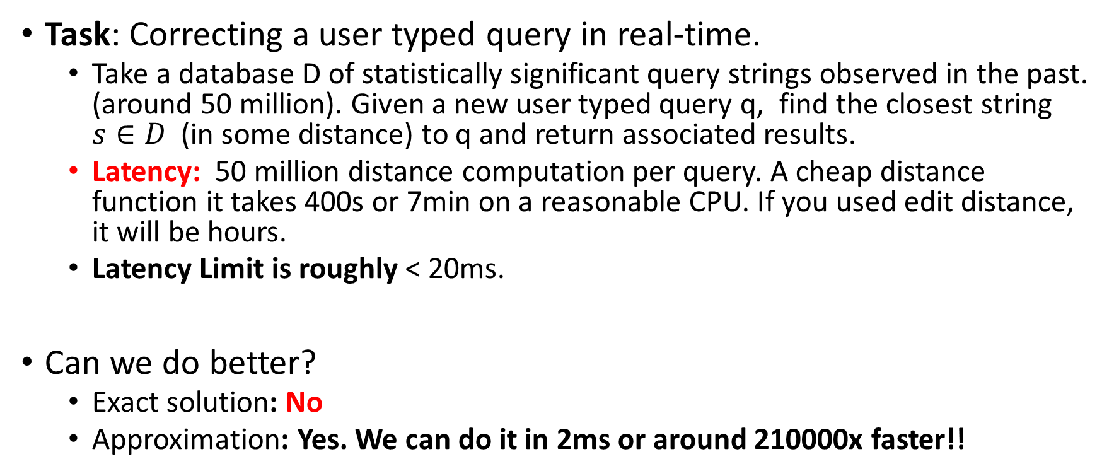
Motivating Problem: Search Engines
Task: Correcting a user typed query in real-time.
Take a database D of statistically significant query strings observed in the past. (around 50 million). Given a new user typed query q, find the closest string $s∈D$ (in some distance) to q and return associated results.
Latency: 50 million distance computation per query. A cheap distance function it takes 400s or 7min on a reasonable CPU. If you used edit distance, it will be hours.
Latency Limit is roughly < 20ms.
Can we do better?
Exact solution: No
Approximation: Yes. We can do it in 2ms or around 210000x faster!!

Slide 9
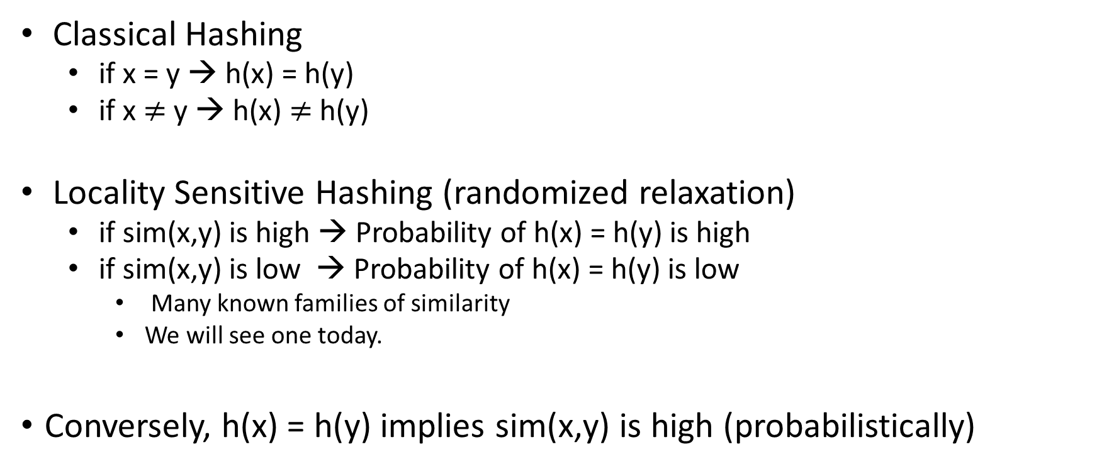
Locality Sensitive Hashing
Classical Hashing
if x = y → h(x) = h(y)
if x $≠$ y → h(x) $≠$h(y)
Locality Sensitive Hashing (randomized relaxation)
if sim(x,y) is high → Probability of h(x) = h(y) is high
if sim(x,y) is low → Probability of h(x) = h(y) is low
Many known families of similarity
We will see one today.
Conversely, h(x) = h(y) implies sim(x,y) is high (probabilistically)

Slide 10
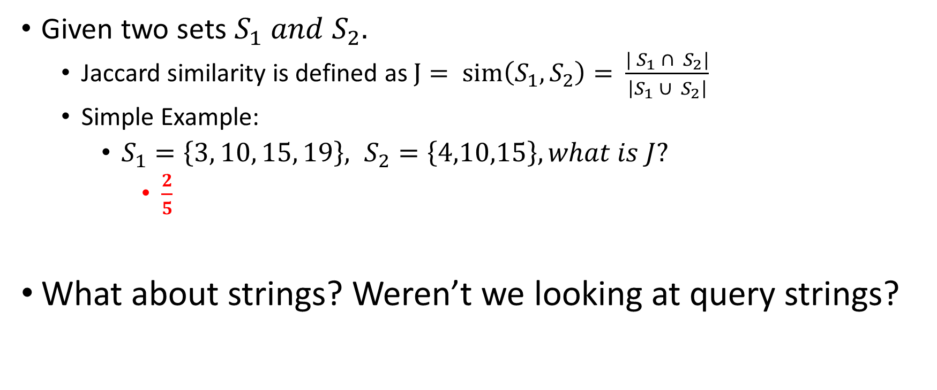

Our Notion of Similarity: Jaccard
Given two sets $S_{1} and S_{2}.$
Jaccard similarity is defined as $J= sim\left(S_{1}, S_{2}\right)=$ $\frac{{| S}_{1} ∩ S_{2}|}{\left|S_{1} ∪{ S}_{2}\right|}$
Simple Example:
$S_{1}=\left\{3, 10, 15, 19\right\}, S_{2}=\left\{4,10,15\right\}, what is J?$
$\frac{2}{5}$
What about strings? Weren’t we looking at query strings?
$$\left|S_{1}∩S_{2}\right|$$

Slide 11
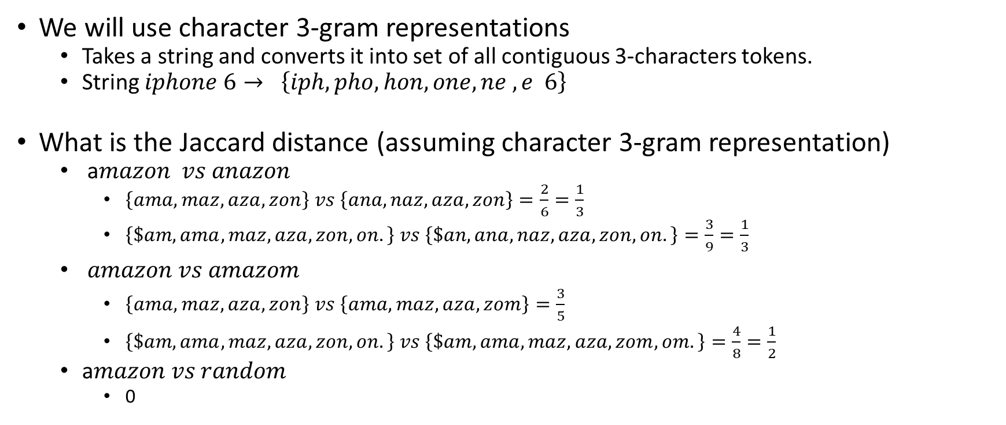
N-grams are set!
We will use character 3-gram representations
Takes a string and converts it into set of all contiguous 3-characters tokens.
String $iphone 6→ \left\{iph, pho, hon, one, ne ,e 6\right\}$
What is the Jaccard distance (assuming character 3-gram representation)
a$mazon vs anazon$
$\left\{ama, maz, aza, zon\right\} vs \left\{ana, naz, aza,zon\right\}=\frac{2}{6}=\frac{1}{3}$
$\left\{\$am, ama, maz, aza, zon, on.\right\} vs \left\{\$an, ana, naz, aza,zon, on.\right\}=\frac{3}{9}=\frac{1}{3}$
$amazon vs amazom$
$\left\{ama, maz, aza, zon\right\} vs \left\{ama, maz, aza,zom\right\}=\frac{3}{5}$
$\left\{\$am, ama, maz, aza, zon, on.\right\} vs \left\{\$am, ama, maz, aza,zom, om.\right\}=\frac{4}{8}=\frac{1}{2}$
a$mazon vs random$
0

Slide 12
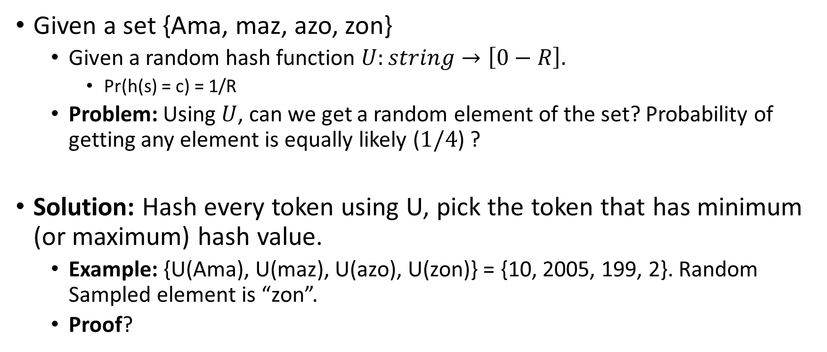
Random Sampling using universal hashing
Given a set {Ama, maz, azo, zon}
Given a random hash function $U:string→\left[0−R\right].$
Pr(h(s) = c) = 1/R
Problem: Using $U$, can we get a random element of the set? Probability of getting any element is equally likely ($1/4$) ?
Solution: Hash every token using U, pick the token that has minimum (or maximum) hash value.
Example: {U(Ama), U(maz), U(azo), U(zon)} = {10, 2005, 199, 2}. Random Sampled element is “zon”.
Proof?

Slide 13
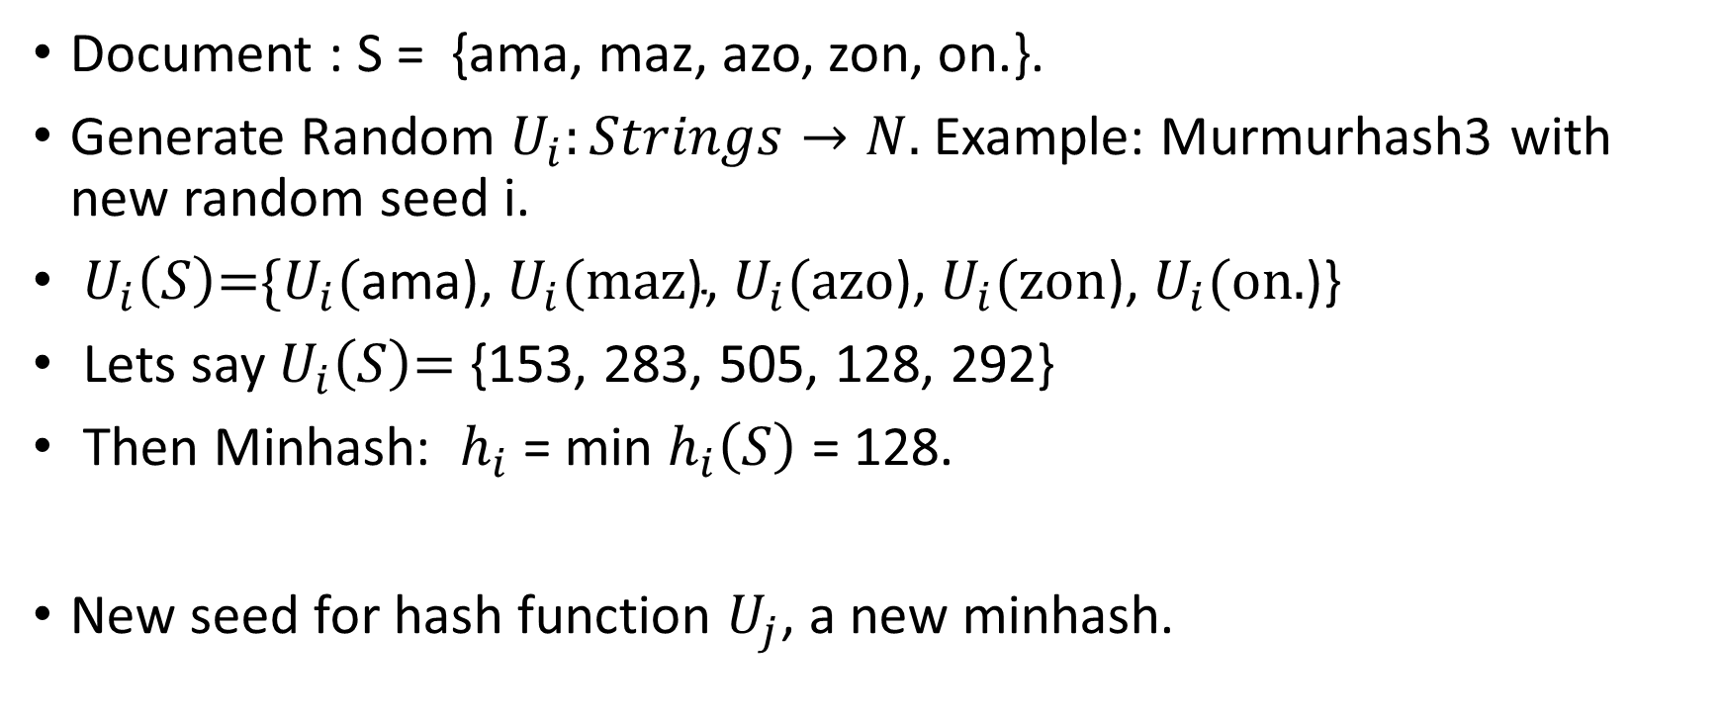
Minwise hashing (Minhash)
Document : S = {ama, maz, azo, zon, on.}.
Generate Random $U_{i}:Strings→N.$ Example: Murmurhash3 with new random seed i.
$U_{i}\left(S\right)\text{=\{}U_{i}\text{(}\text{ama}\text{),}{ U}_{i}\text{(}\text{maz}\text{),}{ U}_{i}\text{(}\text{azo}\text{),}{ U}_{i}\text{(}\text{zon}\text{),}{ U}_{i}\text{(}\text{on}\text{.}\text{)\}}$
Lets say $U_{i}\left(S\right)\text{=}$ {153, 283, 505, 128, 292}
Then Minhash: $h_{i}$ = min $h_{i}\left(S\right)$ = 128.
New seed for hash function $U_{j}$, a new minhash.

Slide 14

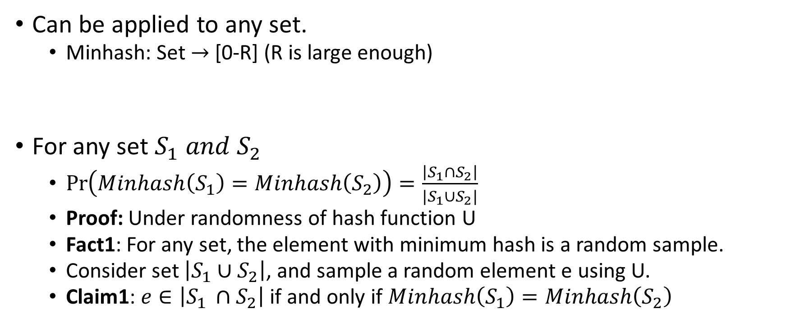
Properties of Minwise Hashing
Can be applied to any set.
Minhash: Set $→$[0-R] (R is large enough)
For any set $S_{1} and S_{2}$
$\operatorname{Pr}\left(Minhash\left(S_{1}\right)=Minhash\left(S_{2}\right)\right)=\frac{\left|S_{1}∩S_{2}\right|}{|S_{1}∪S_{2}|}$
Proof: Under randomness of hash function U
Fact1: For any set, the element with minimum hash is a random sample.
Consider set $\left|S_{1}∪S_{2}\right|$, and sample a random element e using U.
Claim1: $e∈\left|S_{1 }∩S_{2}\right|$if and only if $Minhash\left(S_{1}\right)=Minhash\left(S_{2}\right)$
$$\left|S_{1}∩S_{2}\right|$$

Slide 15
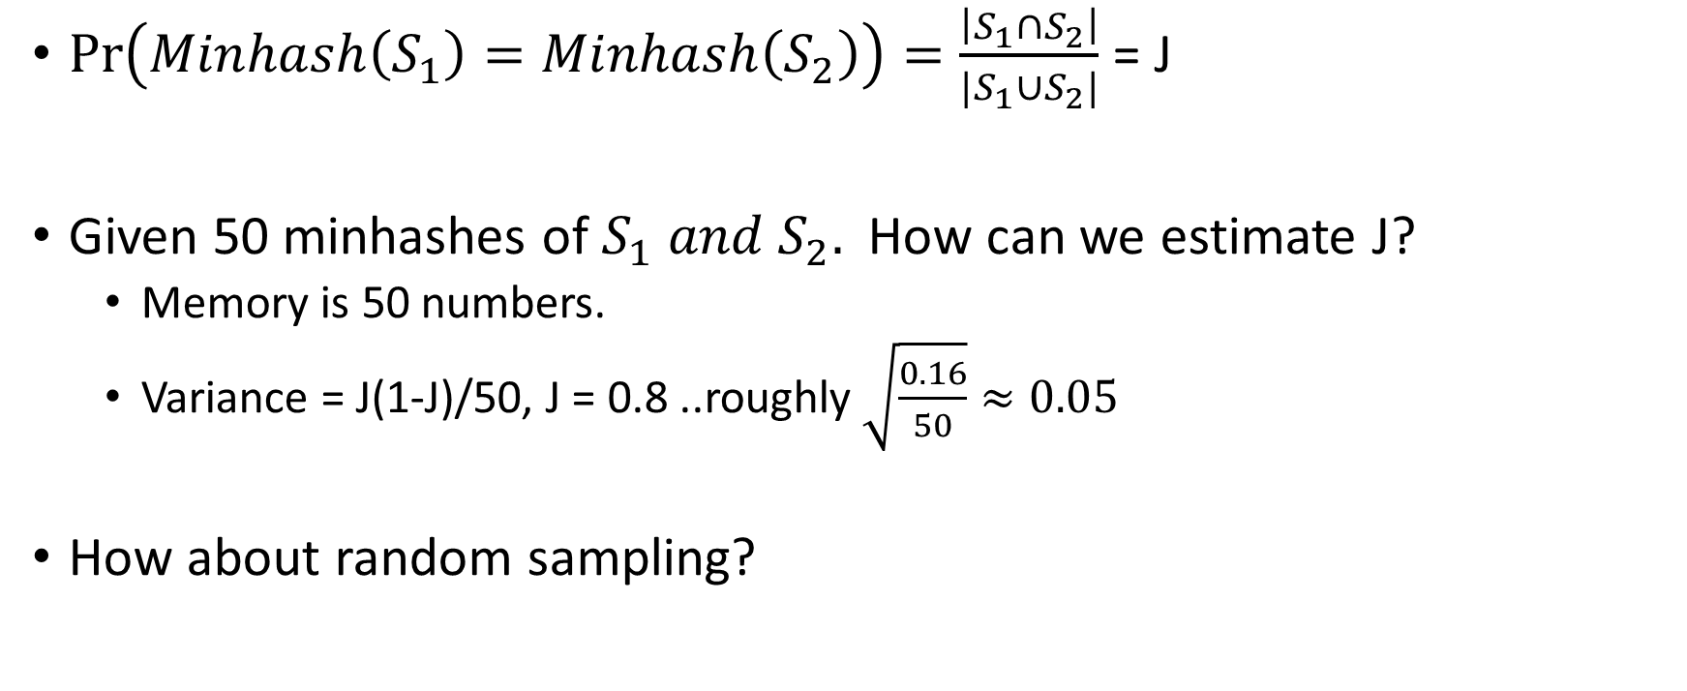
Estimate Similarity Efficiently
$\operatorname{Pr}\left(Minhash\left(S_{1}\right)=Minhash\left(S_{2}\right)\right)=\frac{\left|S_{1}∩S_{2}\right|}{|S_{1}∪S_{2}|}$ = J
Given 50 minhashes of $S_{1} and S_{2}.$ How can we estimate J?
Memory is 50 numbers.
Variance = J(1-J)/50, J = 0.8 ..roughly $\sqrt{\frac{0.16}{50}}≈0.05$
How about random sampling?

Slide 16
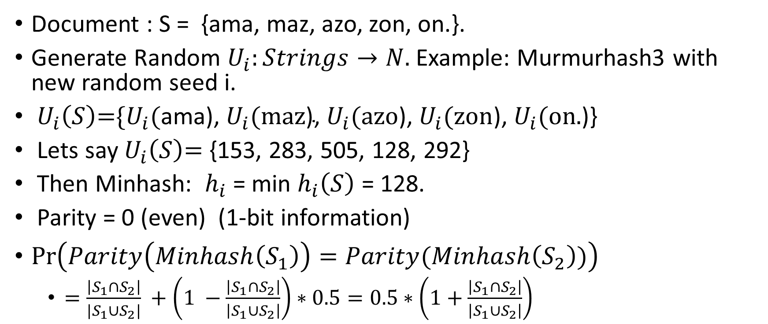
Parity of MinHash is good too
Document : S = {ama, maz, azo, zon, on.}.
Generate Random $U_{i}:Strings→N.$ Example: Murmurhash3 with new random seed i.
$U_{i}\left(S\right)\text{=\{}U_{i}\text{(}\text{ama}\text{),}{ U}_{i}\text{(}\text{maz}\text{),}{ U}_{i}\text{(}\text{azo}\text{),}{ U}_{i}\text{(}\text{zon}\text{),}{ U}_{i}\text{(}\text{on}\text{.}\text{)\}}$
Lets say $U_{i}\left(S\right)\text{=}$ {153, 283, 505, 128, 292}
Then Minhash: $h_{i}$ = min $h_{i}\left(S\right)$ = 128.
Parity = 0 (even) (1-bit information)
$\operatorname{Pr}\left(Parity\left(Minhash\left(S_{1}\right)\right)=Parity(Minhash\left(S_{2}\right))\right)$
$=\frac{\left|S_{1}∩S_{2}\right|}{|S_{1}∪S_{2}|} +\left(1 −\frac{\left|S_{1}∩S_{2}\right|}{\left|S_{1}∪S_{2}\right|}\right)∗0.5=0.5∗\left(1+\frac{\left|S_{1}∩S_{2}\right|}{\left|S_{1}∪S_{2}\right|}\right)$

Slide 17
Parity of Minhash: Compression
Given 50 parity of minhashes. How to estimate J?
Memory is 50 bits or < 7 bytes (2 integers)
Error for J = 0.8 is little worse than 0.05 (how to compute ?)
Only depends on similarity and not on how heavy the set is!!
Completely different tradeoff
Set can have 100, 1000 or 10,000 elements, but the storage cost is the same for similarity estimation.

Slide 18
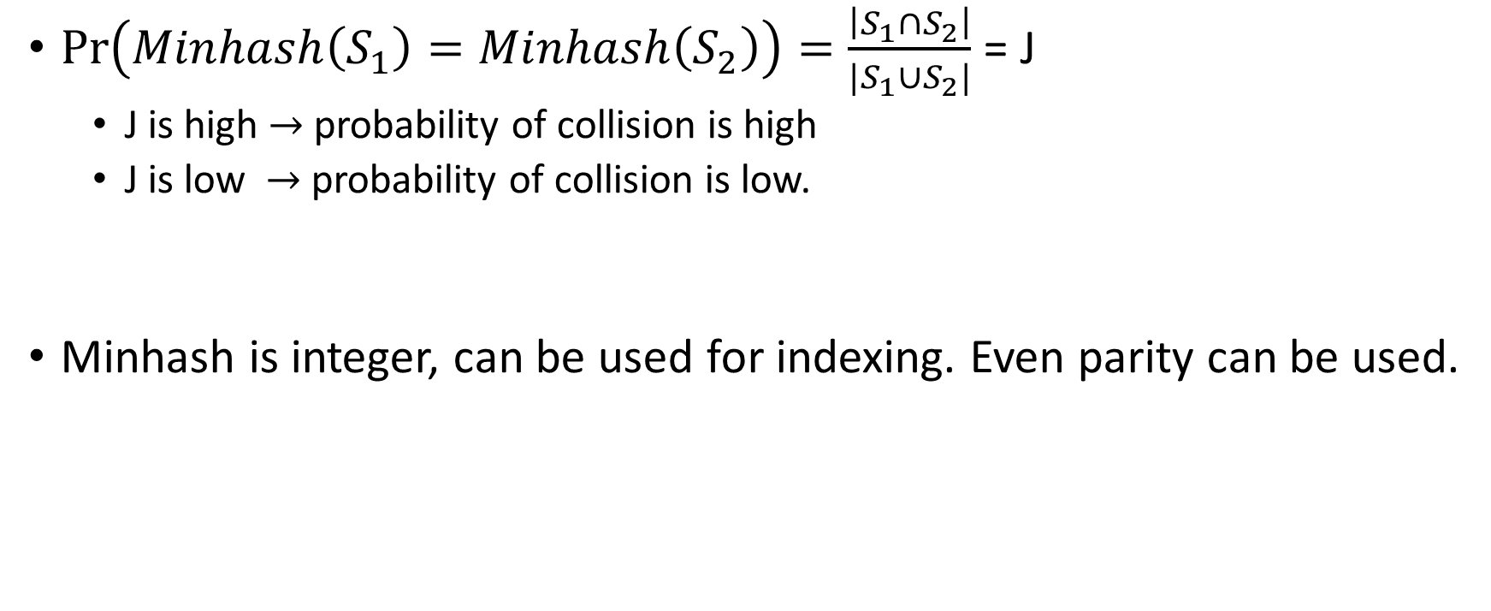
Minwise Hashing is Locality Sensitive
$\operatorname{Pr}\left(Minhash\left(S_{1}\right)=Minhash\left(S_{2}\right)\right)=\frac{\left|S_{1}∩S_{2}\right|}{|S_{1}∪S_{2}|}$ = J
J is high $→$ probability of collision is high
J is low $→$ probability of collision is low.
Minhash is integer, can be used for indexing. Even parity can be used.

Slide 19
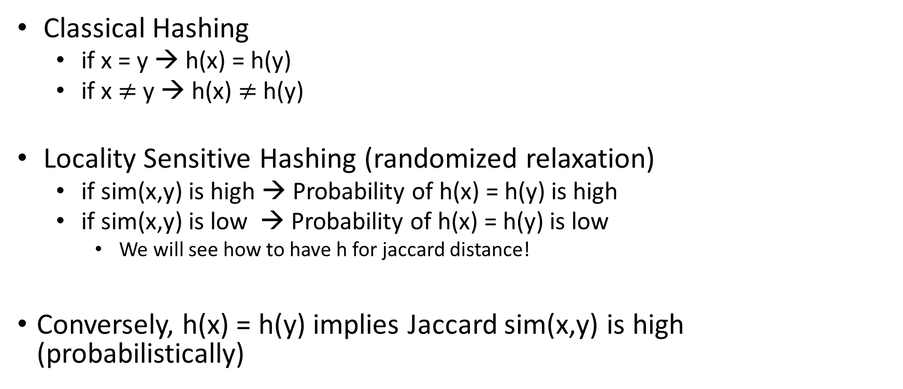
Locality Sensitive Hashing
Classical Hashing
if x = y → h(x) = h(y)
if x $≠$ y → h(x) $≠$h(y)
Locality Sensitive Hashing (randomized relaxation)
if sim(x,y) is high → Probability of h(x) = h(y) is high
if sim(x,y) is low → Probability of h(x) = h(y) is low
We will see how to have h for jaccard distance!
Conversely, h(x) = h(y) implies Jaccard sim(x,y) is high (probabilistically)

Slide 20
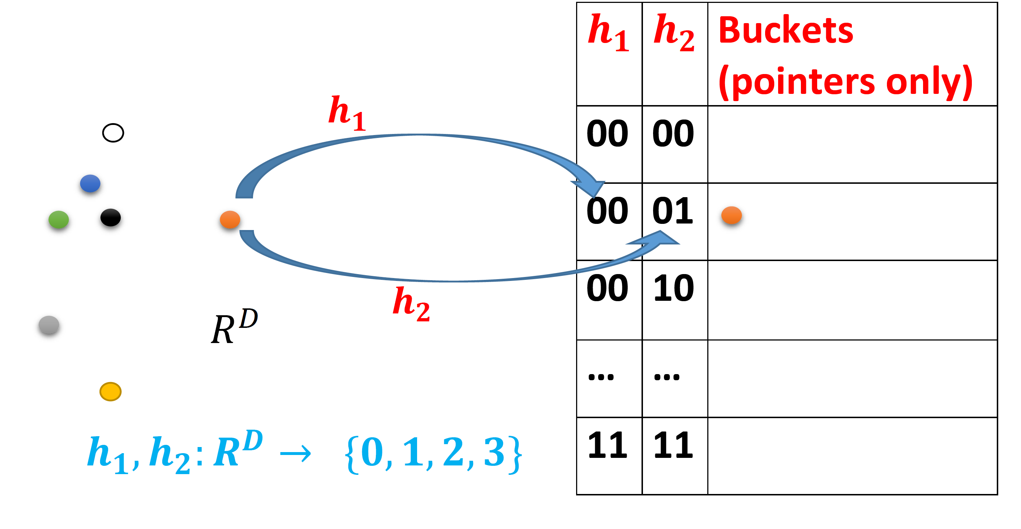
Why is it helpful in search?
Access to h(x) (with random seed), such that
h(x) = h(y) → Noisy indicator that Sim(x,y) is high.

Slide 21
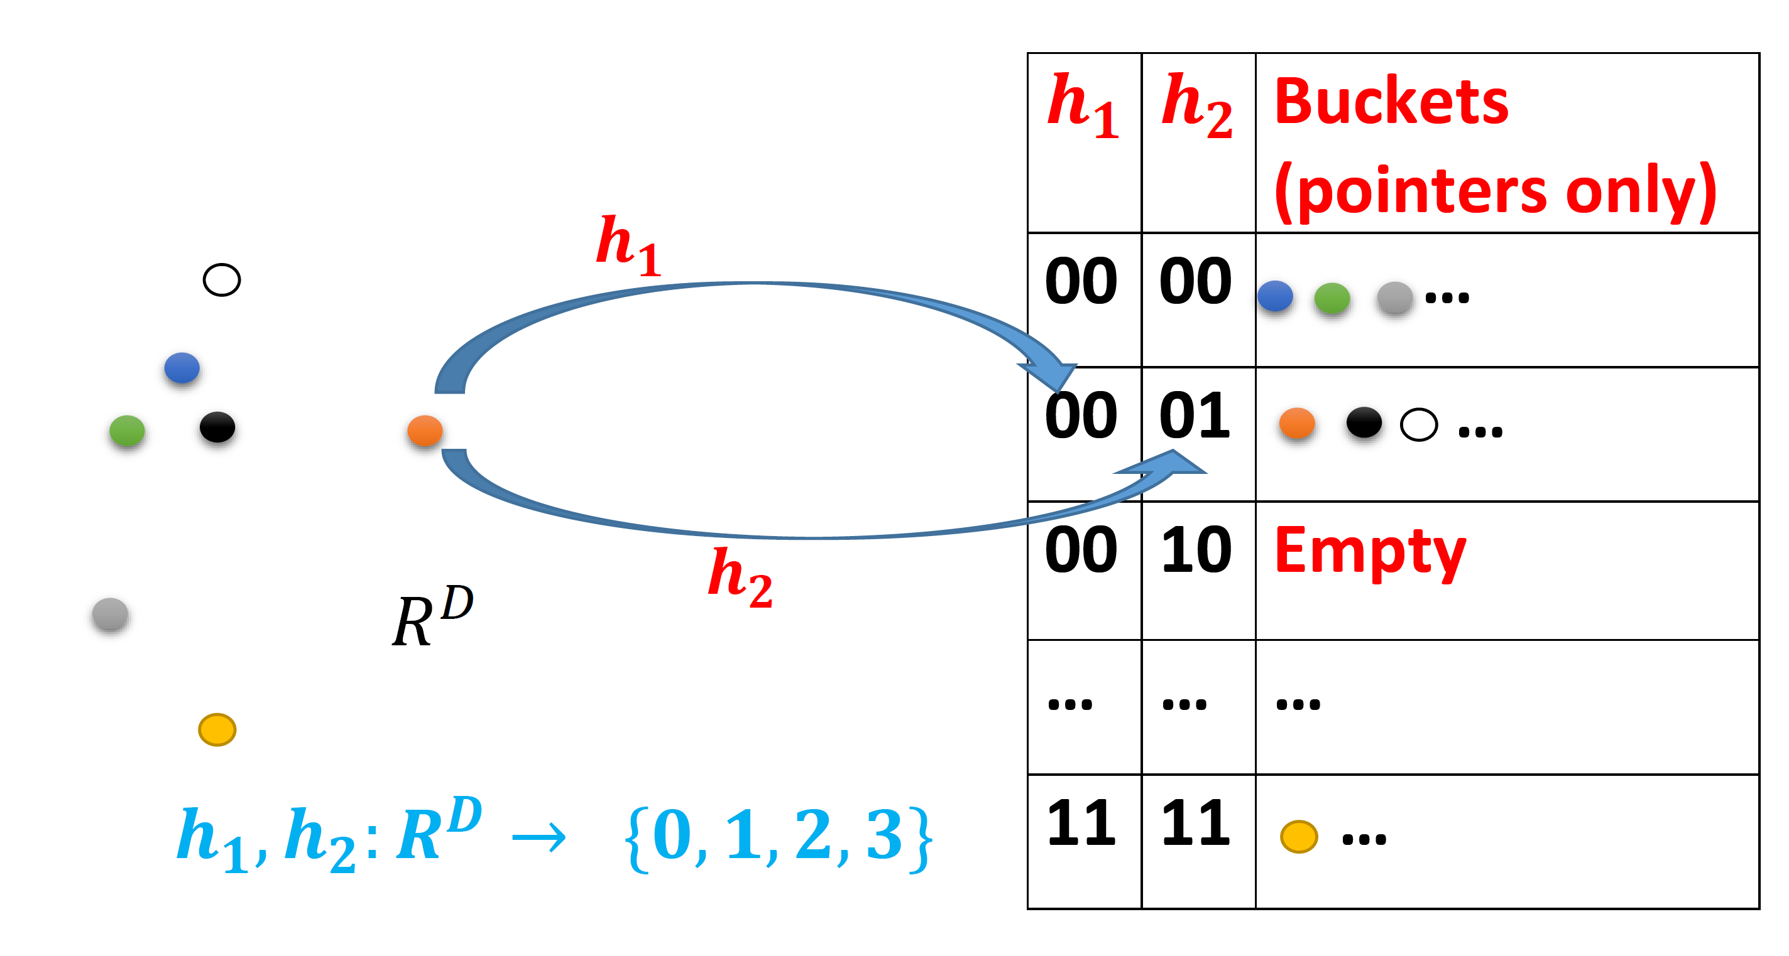
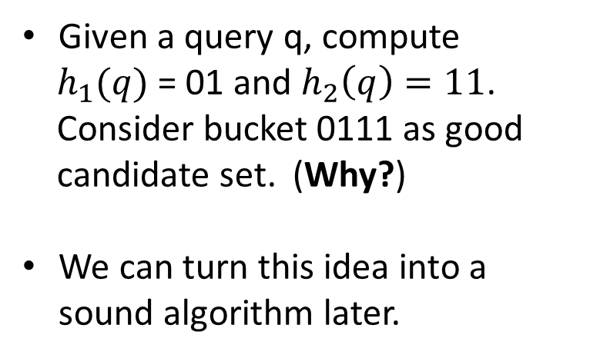
Why is it helpful in search?
Access to h(x) (with random seed), such that
h(x) = h(y) → Noisy indicator that Sim(x,y) is high.
Given a query q, compute
$h_{1}(q)$ = 01 and $h_{2}\left(q\right)=11$.
Consider bucket 0111 as good
candidate set. (Why?)
We can turn this idea into a sound algorithm later.

Slide 22
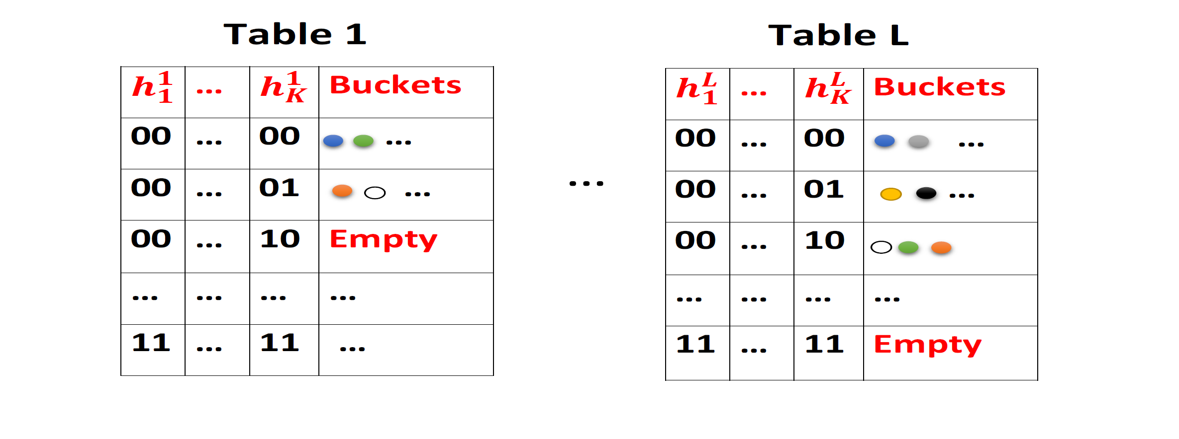
Create multiple independent Hash Tables
For every query, get the union of L buckets.
K controls the quality of bucket.
L controls failure probability.
Optimal choice of K and L is provably efficient.

Slide 23
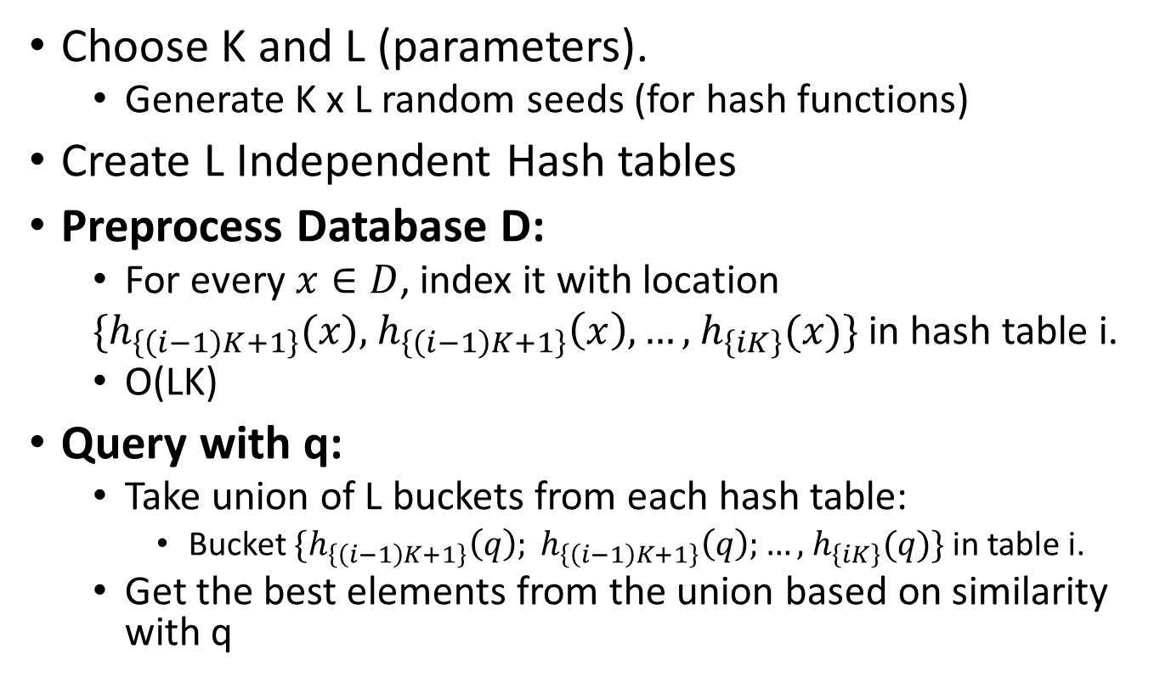
The LSH Algorithm
Choose K and L (parameters).
Generate K x L random seeds (for hash functions)
Create L Independent Hash tables
Preprocess Database D:
For every $x∈D$, index it with location
$\{h_{\left\{\left(i−1\right)K+1\right\}}(x),$ $h_{\left\{\left(i−1\right)K+1\right\}}\left(x\right),…,$ $h_{\left\{iK\right\}}(x)\}$in hash table i.
O(LK)
Query with q:
Take union of L buckets from each hash table:
Bucket $\{h_{\left\{\left(i−1\right)K+1\right\}}\left(q\right); h_{\left\{\left(i−1\right)K+1\right\}}\left(q\right);…,$ $h_{\left\{iK\right\}}(q)\}$ in table i.
Get the best elements from the union based on similarity with q

Slide 24
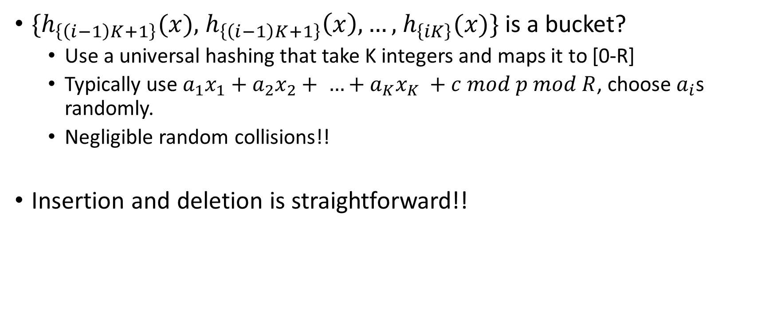
One implementation details
$\{h_{\left\{\left(i−1\right)K+1\right\}}(x),$ $h_{\left\{\left(i−1\right)K+1\right\}}\left(x\right),…,$ $h_{\left\{iK\right\}}(x)\}$ is a bucket?
Use a universal hashing that take K integers and maps it to [0-R]
Typically use $a_{1}x_{1}+a_{2}x_{2}+ …+a_{K}x_{K} +c mod p mod R$, choose $a_{i}$s randomly.
Negligible random collisions!!
Insertion and deletion is straightforward!!

Slide 25
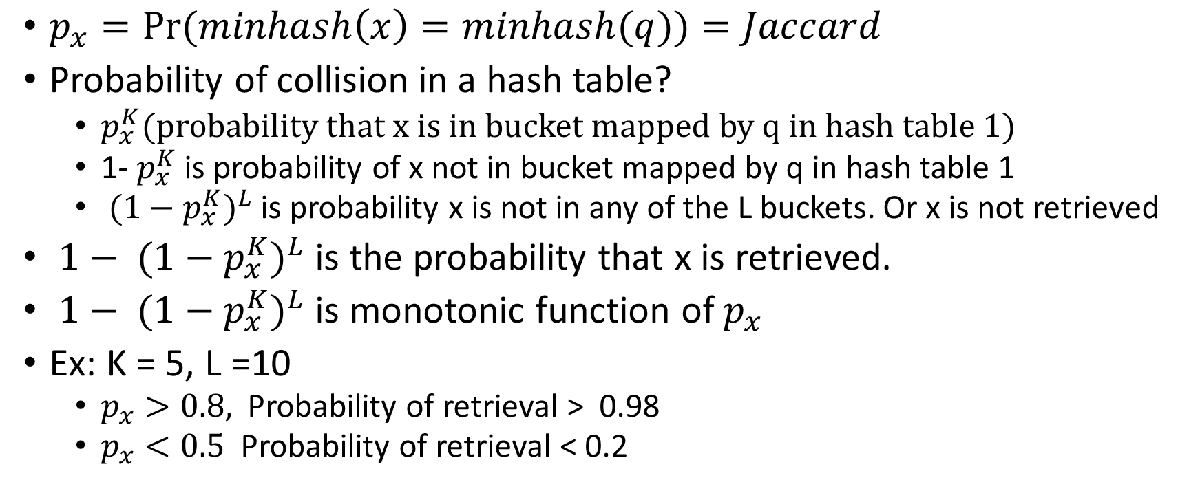
A bit of analysis
$p_{x}=\operatorname{Pr}{(minhash\left(x\right)=minhash(q))}=Jaccard$
Probability of collision in a hash table?
$p_{x}^{K}(probability that x is in bucket mapped by q in hash table 1)$
1- $p_{x}^{K}$ is probability of x not in bucket mapped by q in hash table 1
${ {(1−p}_{x}^{K})}^{L}$is probability x is not in any of the L buckets. Or x is not retrieved
${ {1− (1−p}_{x}^{K})}^{L}$ is the probability that x is retrieved.
${ {1− (1−p}_{x}^{K})}^{L}$ is monotonic function of $p_{x}$
Ex: K = 5, L =10
$p_{x}>0.8,$ Probability of retrieval > 0.98
$p_{x}<0.5$ Probability of retrieval < 0.2

Slide 26
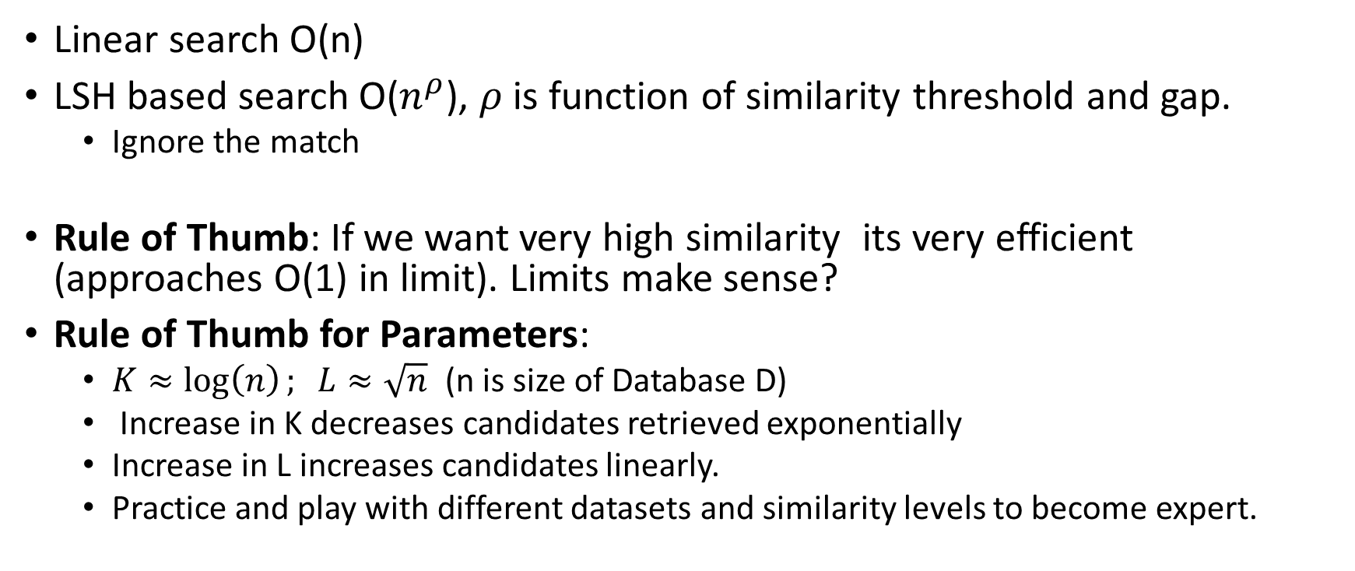
More Theory
Linear search O(n)
LSH based search O($n^{ρ}$), $ρ$ is function of similarity threshold and gap.
Ignore the match
Rule of Thumb: If we want very high similarity its very efficient (approaches O(1) in limit). Limits make sense?
Rule of Thumb for Parameters:
$K≈\log\left(n\right); L≈\sqrt{n}$ (n is size of Database D)
Increase in K decreases candidates retrieved exponentially
Increase in L increases candidates linearly.
Practice and play with different datasets and similarity levels to become expert.

