Slide 1
Diving Deeper into Chaining and Linear Probing
COMP 480/580

Slide 2
Announcements
Assignment 1 will be released today/Tomorrow and is, due 2 weeks from now, 24th Feb. Submission via Canvas.
11th is the deadline to pick project over final exams. Put your name in the spreadsheet. Names not in spreadsheet after 11th will be automatically assigned the finals.
All deadlines are 11:59pm CT on the given day.

Slide 3
TA and their office hours
Aditya Desai, ZhaoZhuo Xu, Emma Liu are the TAs
3 more office hours with TAs will be announced
In addition, the instructor (Anshu) will have office hours every Wednesday 12:00pm - 1pm

Slide 4
Projects and Scribes
Make a (commercial grade) Library of hashing and sketching algorithms on different platforms
GPU, multi-core, multi-node, multi-GPUs
Improve last year’s scribe.

Slide 5
In Person Class
Thoughts?

Slide 6
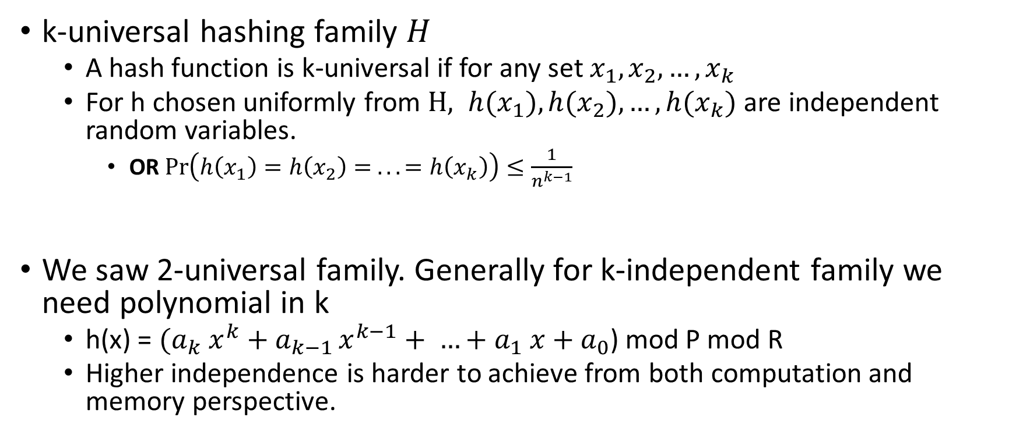
Refresher
k-universal hashing family $H$
A hash function is k-universal if for any set $x_{1}, x_{2}, …, x_{k}$
For h chosen uniformly from $H, {h(x}_{1}), {h(x}_{2}), …, {h(x}_{k})$ are independent random variables.
OR $\operatorname{Pr}\left(h\left(x_{1}\right)=h\left(x_{2}\right)= .. .=h\left(x_{k}\right)\right)≤\frac{1}{n^{k−1}}$
We saw 2-universal family. Generally for k-independent family we need polynomial in k
h(x) = ${(a}_{k} x^{k}+a_{k−1 }x^{k−1}+ …+a_{1} x+a_{0}$) mod P mod R
Higher independence is harder to achieve from both computation and memory perspective.

Slide 7
Separate Chaining.
key space = integers
TableSize = 10
h(K) = K mod 10
Insert: 7, 41,18, 17
0
1 | ptr
2
3
4
5
6
7 | ptr
8 | ptr
9
41
7
17
18

Slide 8
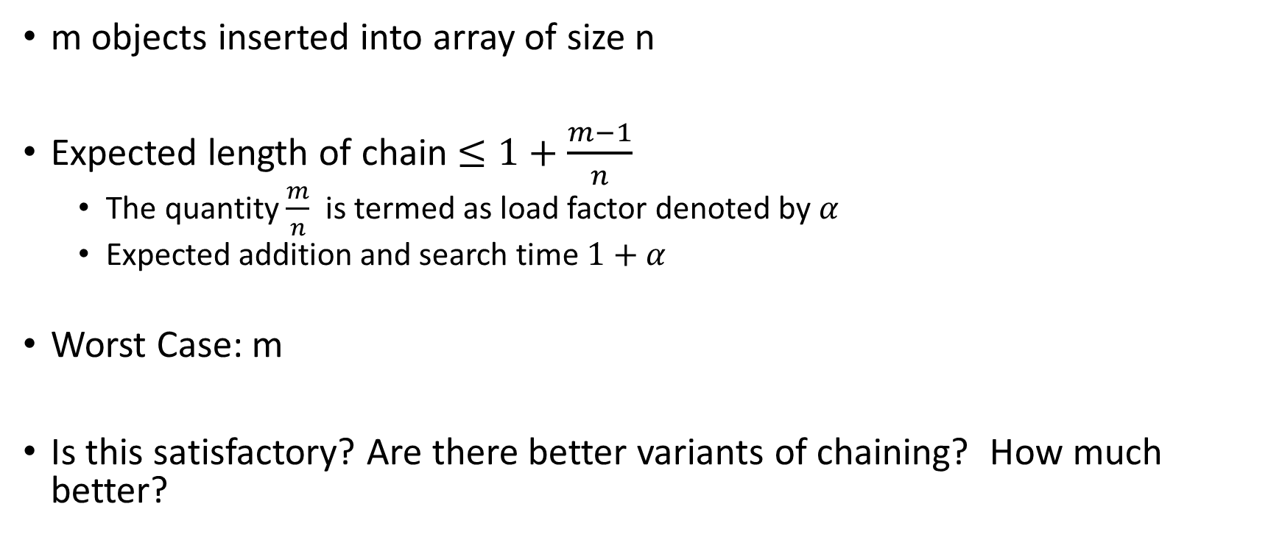
What we saw?
m objects inserted into array of size n
Expected length of chain $≤1+\frac{m−1}{n}$
The quantity $\frac{m}{n}$ is termed as load factor denoted by $α$
Expected addition and search time $1+α$
Worst Case: m
Is this satisfactory? Are there better variants of chaining? How much better?

Slide 9

What is a good running time?
Log(n).
Natural question: What is the probability that there exist a chain of size $≥log⁡(n)$ . More information than expected value!!

Slide 10
Counting and Approximations!
Theorem: For the special case with m=n, with probability at least 1-1/n, the longest list is O(ln n / ln ln n).
Proof:
Let X_{i,k}= Indicator of {key i hash to slot k}, Pr(X_{i,k}=1) = 1/n
The probability that a particular slot k receives >κ keys is (letting m=n)
(assuming lot if independence)
If we choose κ = 3 ln n / ln ln n, then κ! > n² and 1/κ! < 1/n².
Thus, the probability that any n slots receives >κ keys is < 1/n.

Slide 11
Better? (Power of two (multiple) choices)
Can we do better?
Use two hash functions, insert at the location with smaller chain.
Assignment: Using m=n slots, with probability at least 1-1/n, the longest list is O(log log n). Exponentially better!!
Template for Power of Two choices: Do independent things in parallel pick the best. (Bloom filters?)

Slide 12
Linear Probing
F(i) = i
Probe sequence:
0th probe = h(k) mod TableSize
1th probe = (h(k) + 1) mod TableSize
2th probe = (h(k) + 2) mod TableSize
. . .
i^{th} probe = (h(k) + i) mod TableSize
Notes:
Add a function of I to the original hash value to resolve the collision.
Primary clustering – we notice this effect in the previous slide.
Any key that hashes into the cluster 1) will require several attempts to resolve collision and 2) will then add to the cluster. (Both 1 and 2 are bad)

Slide 13
Probing or Open Addressing
Insert:
38
19
8
109
10
0 | 8
1 | 109
2 | 10
3
4
5
6
7
8 | 38
9 | 19
Linear Probing: after checking spot h(k), try spot h(k)+1, if that is full, try h(k)+2, then h(k)+3, etc.

Slide 14
Major Milestones of Linear Probing
In 1954, Gene Amdahl, Elaine McGraw, and Arthur Samuel invent linear probing as a subroutine for an assembler.
In 1962, Don Knuth, in his first ever analysis of an algorithm, proves that linear probing takes expected time O(1) for lookups if the hash function is truly random (n-wise independence).
In 2006, Anna Pagh et al. proved that 5-independent hash functions give expected constant-time lookups.
In 2007, Mitzenmacher and Vadhan proved that 2-independence will give expected O(1)-time lookups, assuming there’s some measure of randomness in the keys.

Slide 15
Linear Probing in Practice
In practice, linear probing is one of the fastest general-purpose hashing strategies available.
This is surprising – it was originally invented in 1954! It's pretty amazing that it still holds up so well.
Why is this?
Low memory overhead: just need an array and a hash function.
Excellent locality: when collisions occur, we only search in adjacent locations.
Great cache performance: a combination of the above two factors

Slide 16
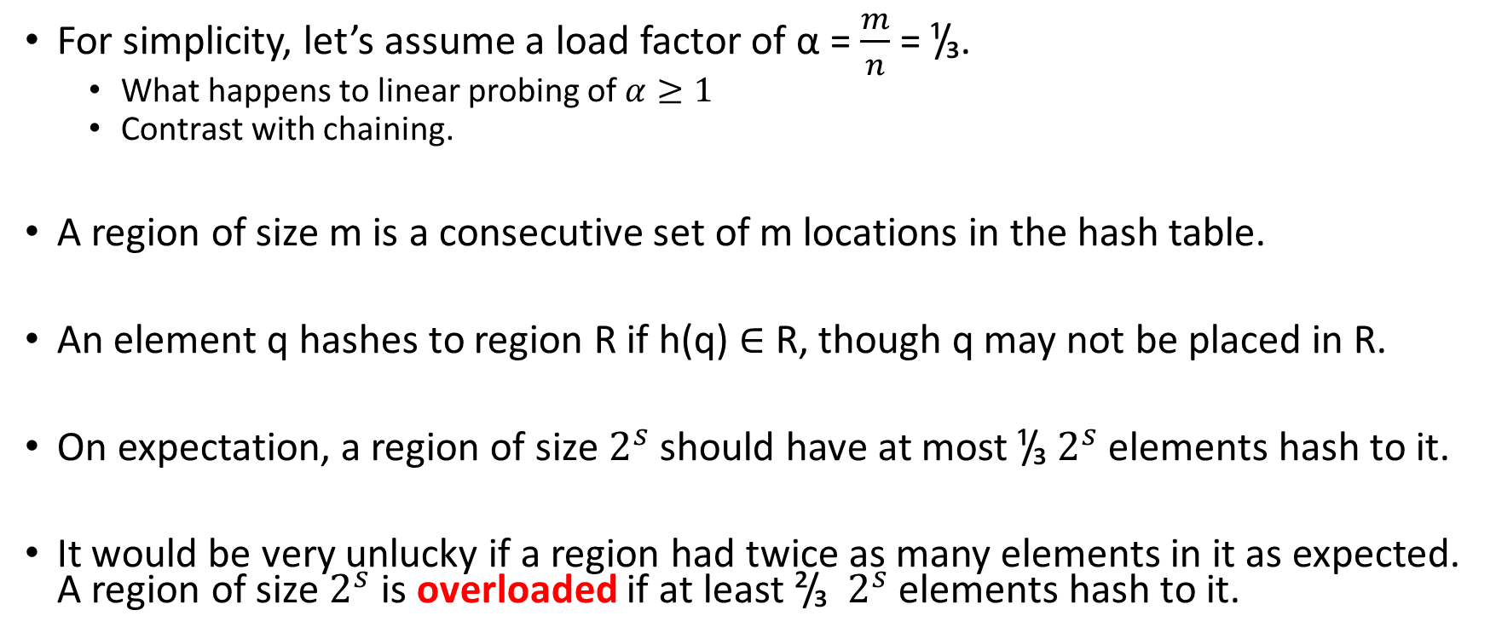
Analyze Expected cost of Linear Probing
For simplicity, let’s assume a load factor of α = $\frac{m}{n}$ = ¹/₃.
What happens to linear probing of $α≥1$
Contrast with chaining.
A region of size m is a consecutive set of m locations in the hash table.
An element q hashes to region R if h(q) ∈ R, though q may not be placed in R.
On expectation, a region of size $2^{s}$ should have at most ¹/₃ $2^{s}$ elements hash to it.
It would be very unlucky if a region had twice as many elements in it as expected. A region of size $2^{s}$ is overloaded if at least ²/₃ $2^{s}$ elements hash to it.

Slide 17
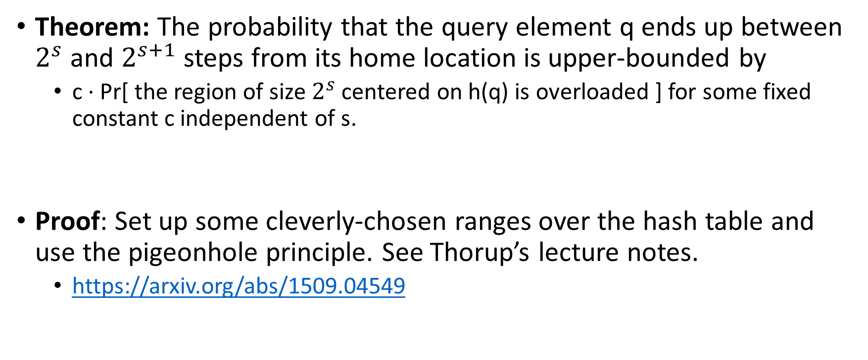
A Provable Fact
Theorem: The probability that the query element q ends up between $2^{s}$ and $2^{s+1}$ steps from its home location is upper-bounded by
c · Pr[ the region of size $2^{s}$ centered on h(q) is overloaded ] for some fixed constant c independent of s.
Proof: Set up some cleverly-chosen ranges over the hash table and use the pigeonhole principle. See Thorup’s lecture notes.
https://arxiv.org/abs/1509.04549

Slide 18
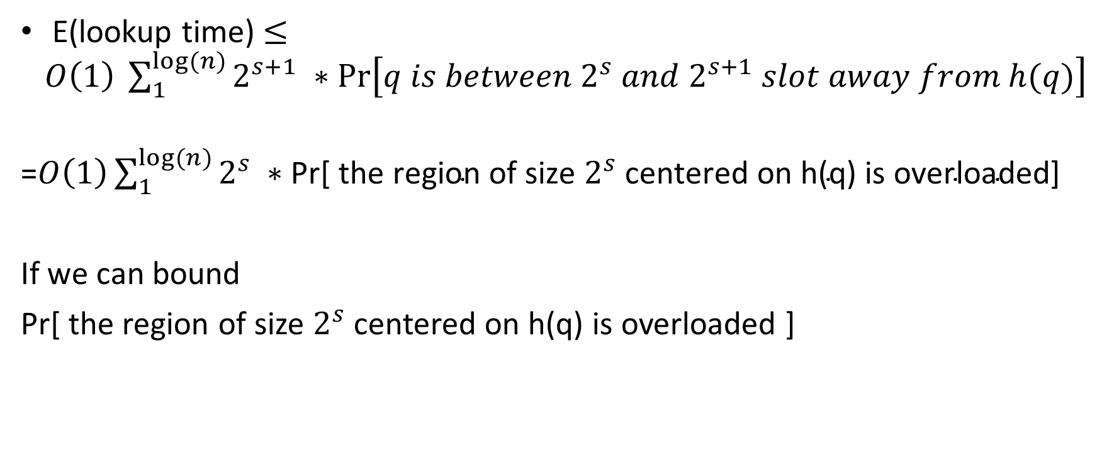
Overall we can write the expectation as
E(lookup time) $≤O\left(1\right) \sum_{1}^{log⁡(n)}{2^{s+1} ∗\operatorname{Pr}\left[q is between 2^{s} and 2^{s+1} slot away from h(q)\right]}$
=$O\left(1\right)\sum_{1}^{log⁡(n)}{2^{s} ∗\text{Pr}\text{[ }\text{the} \text{region} \text{of} \text{size} 2^{s} \text{centered} \text{on} \text{h}\text{(}\text{q}\text{) }\text{is} \text{overloaded}\text{]}}$
If we can bound
Pr[ the region of size $2^{s}$ centered on h(q) is overloaded ]

Slide 19
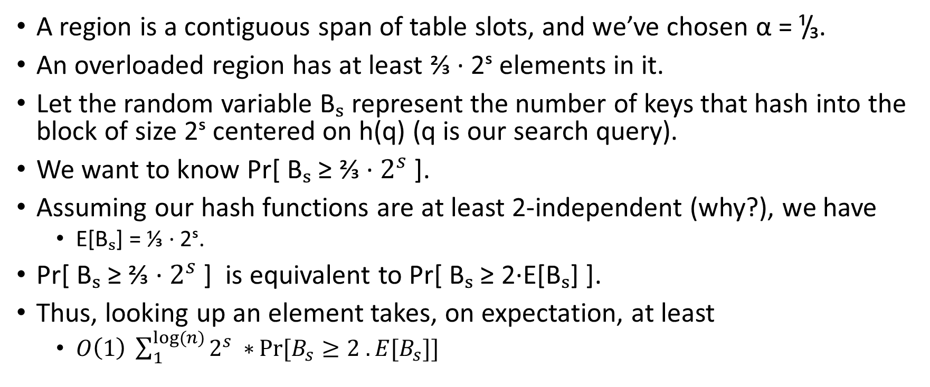
Recall
A region is a contiguous span of table slots, and we’ve chosen α = ¹/₃.
An overloaded region has at least ⅔ · 2ˢ elements in it.
Let the random variable Bₛ represent the number of keys that hash into the block of size 2ˢ centered on h(q) (q is our search query).
We want to know Pr[ Bₛ ≥ ⅔ · $2^{s}$ ].
Assuming our hash functions are at least 2-independent (why?), we have
E[Bₛ] = ⅓ · 2ˢ.
Pr[ Bₛ ≥ ⅔ · $2^{s}$ ] is equivalent to Pr[ Bₛ ≥ 2·E[Bₛ] ].
Thus, looking up an element takes, on expectation, at least
$O\left(1\right) \sum_{1}^{log⁡(n)}{2^{s} ∗}Pr⁡[B_{s}≥2 . E[B_{s}]]$

Slide 20
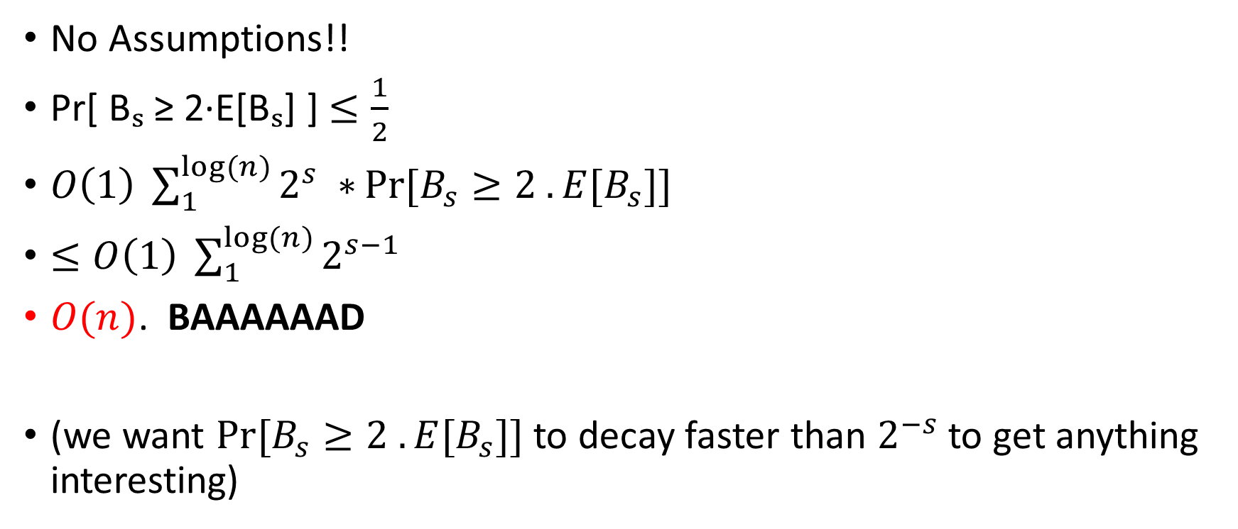
Apply Markov’s
No Assumptions!!
Pr[ Bₛ ≥ 2·E[Bₛ] ] $≤\frac{1}{2}$
$O\left(1\right) \sum_{1}^{log⁡(n)}{2^{s} ∗}Pr⁡[B_{s}≥2 . E[B_{s}]]$
$≤O\left(1\right) \sum_{1}^{log⁡(n)}{2^{s−1} }$
$O(n)$. BAAAAAAD
(we want $Pr⁡[B_{s}≥2 . E[B_{s}]]$ to decay faster than $2^{−s}$ to get anything interesting)

Slide 21
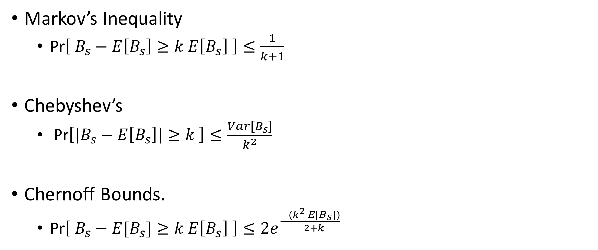
Concentration Inequalities (Last Class)
Markov’s Inequality
Pr$\left[ B_{s}−E\left[B_{s}\right]≥k E\left[B_{s}\right] \right]≤\frac{1}{k+1}$
Chebyshev’s
Pr$\left[|B_{s}−E\left[B_{s}\right]|≥k \right]≤\frac{Var\left[B_{s}\right]}{k^{2}}$
Chernoff Bounds.
Pr$\left[ B_{s}−E[B_{s}]≥k E\left[B_{s}\right] \right]≤2e^{−\frac{{(k}^{2} E[B_{s}])}{2+k} }$
A fair coin is tossed 200 times. How likely is it to observe at least 150 heads?
❖ Markov: ≤ 0.6666
❖ Chebyshev: ≤ 0.02
❖ Chernoff: ≤ 0.017

Slide 22
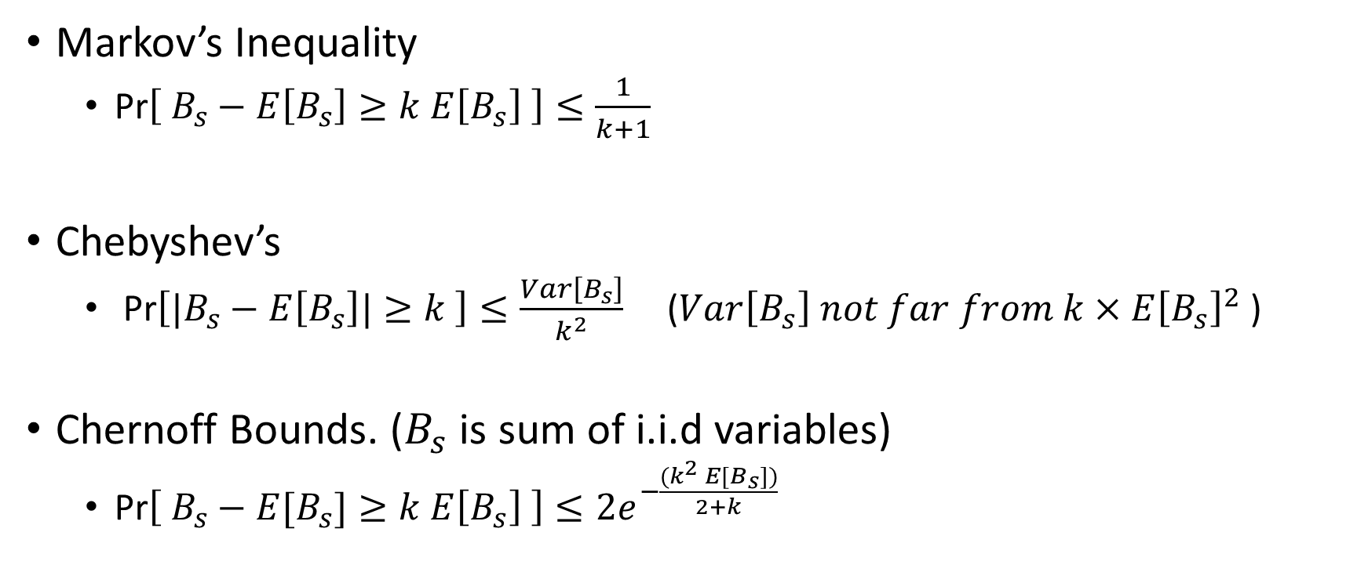
Concentration Inequalities (Last Class)
Markov’s Inequality
Pr$\left[ B_{s}−E\left[B_{s}\right]≥k E\left[B_{s}\right] \right]≤\frac{1}{k+1}$
Chebyshev’s
Pr$\left[|B_{s}−E\left[B_{s}\right]|≥k \right]≤\frac{Var\left[B_{s}\right]}{k^{2}}$ ($Var\left[B_{s}\right] not far from k×E{\left[B_{s}\right]}^{2}$ )
Chernoff Bounds. ($B_{s}$ is sum of i.i.d variables)
Pr$\left[ B_{s}−E[B_{s}]≥k E\left[B_{s}\right] \right]≤2e^{−\frac{{(k}^{2} E[B_{s}])}{2+k} }$
More Independence → More Resources in Hash Functions

Slide 23
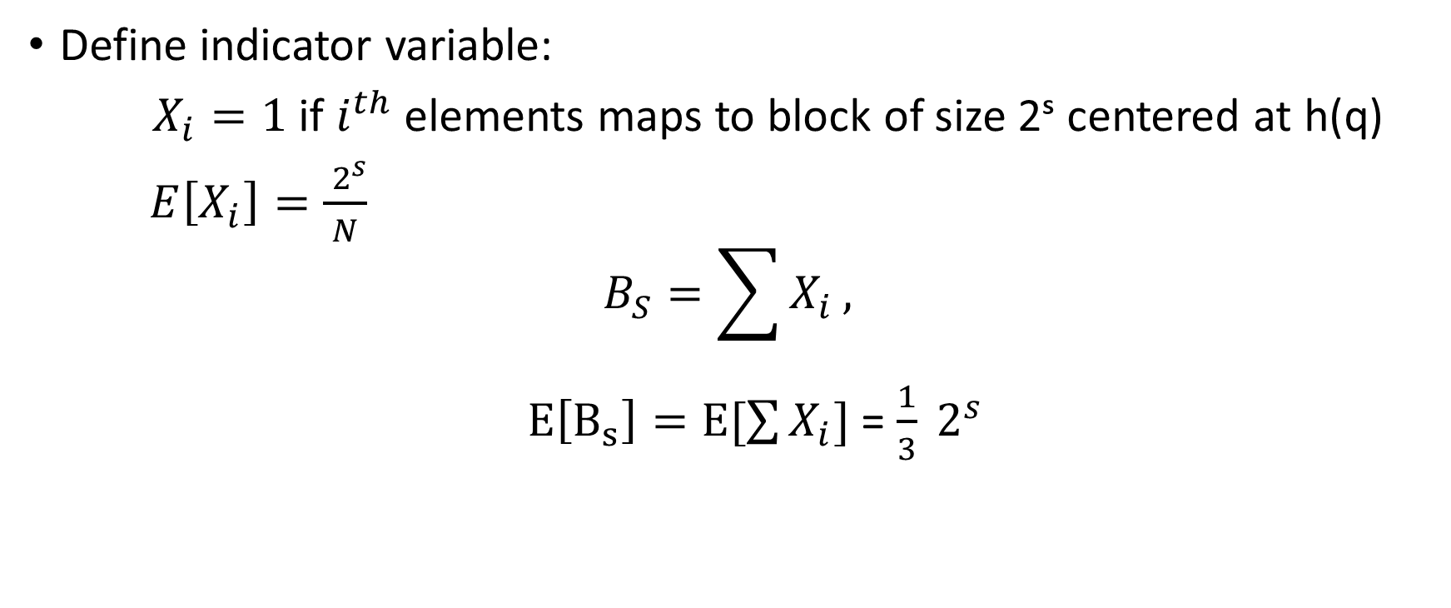
Can we bound the variance?
Define indicator variable:
$X_{i}=1$ if $i^{th}$ elements maps to block of size 2ˢ centered at h(q)
$E\left[X_{i}\right]=\frac{ 2^{s}}{N}$
$$B_{S}=\sum{X_{i}},$$
$E\left[B_{s}\right]=E[\sum{X_{i}}]$ = $\frac{1}{3} 2^{s}$

Slide 24
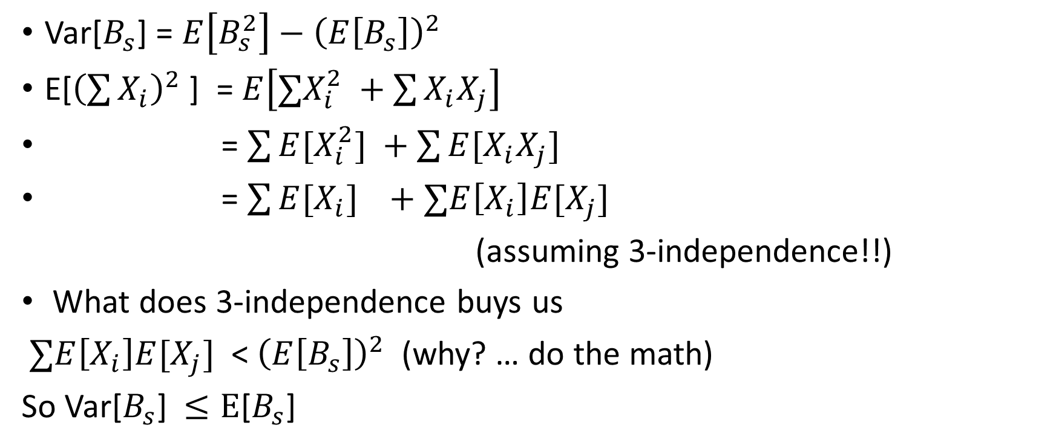
Variance
Var[$B_{s}$] = $E\left[B_{s}^{2}\right]−{\left(E\left[B_{s}\right]\right)}^{2}$
E[${\left(\sum{X_{i}}\right)}^{2}$] = $E\left[∑X_{i}^{2} +\sum{X_{i}X_{j}}\right]$
= $\sum{E[X_{i}^{2}]} +\sum{E[X_{i}X_{j}]}$
= $\sum{E[X_{i}]} +∑E\left[X_{i}\right]E[X_{j}]$
(assuming 3-independence!!)
What does 3-independence buys us
$∑E\left[X_{i}\right]E[X_{j}]$ < ${\left(E\left[B_{s}\right]\right)}^{2}$ (why? … do the math)
So Var[$B_{s}$] $≤E$[$B_{s}$]

Slide 25
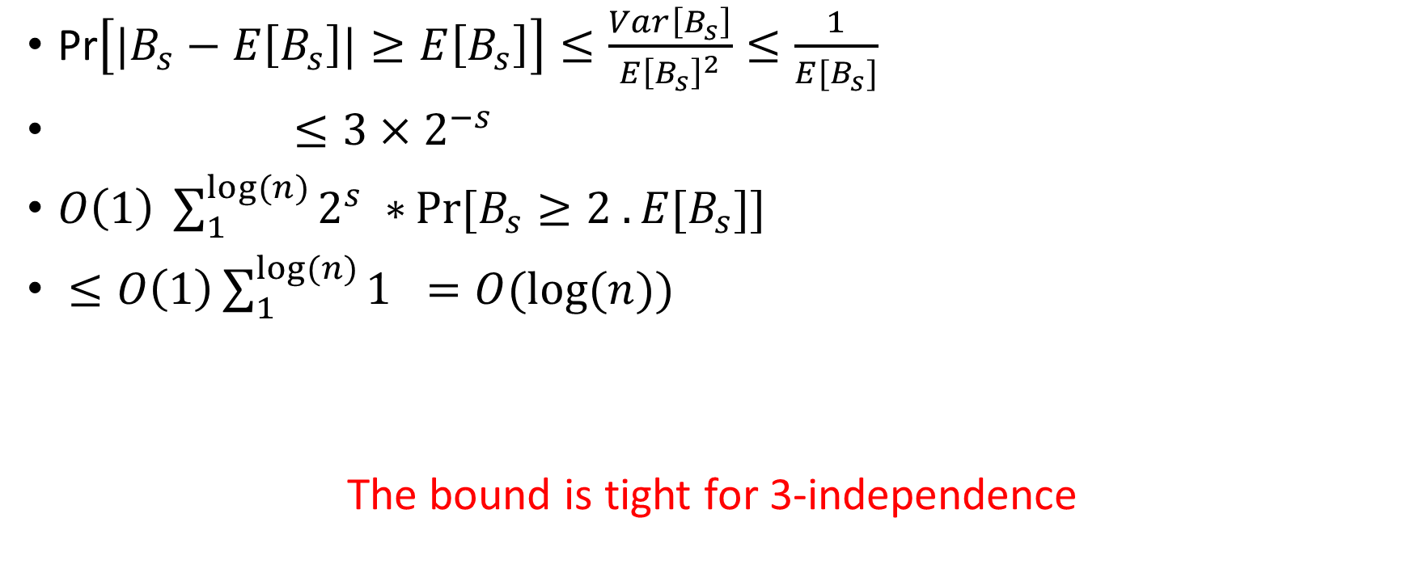
Pr$\left[|B_{s}−E\left[B_{s}\right]|≥E\left[B_{s}\right]\right]≤\frac{Var\left[B_{s}\right]}{{E\left[B_{s}\right]}^{2}}≤\frac{1}{E[B_{s}]}$
$≤3×2^{−s}$
$O\left(1\right) \sum_{1}^{log⁡(n)}{2^{s} ∗}Pr⁡[B_{s}≥2 . E[B_{s}]]$
$≤O\left(1\right)\sum_{1}^{log⁡(n)}{1 =O(log⁡(n))}$
The bound is tight for 3-independence

Slide 26

Going Beyond: 4th Moment Bound
Pr$\left[|B_{s}−E\left[B_{s}\right]|≥a \right]≤\frac{4^{th}Moment\left[B_{s}\right]}{a^{4}}$
Assignment: Prove that expected cost of linear probing is O(1) assuming 5-independence using the above 4th moment bounds.

Slide 27
In practice 2-independence suffice?
In 2007, Mitzenmacher and Vadhan proved that 2-independence will give expected O(1)-time lookups, assuming there’s some measure of randomness in the keys.
Assignment for Grads: Read this paper.

Slide 28
Cuckoo Hashing
Worst case of both chaining and probing is O(n). Expected is O(1).
Includes both insertion and searching.
Can we sacrifice insertions for worst case O(1) searching?
YES
Cuckoo Hashing

Slide 29
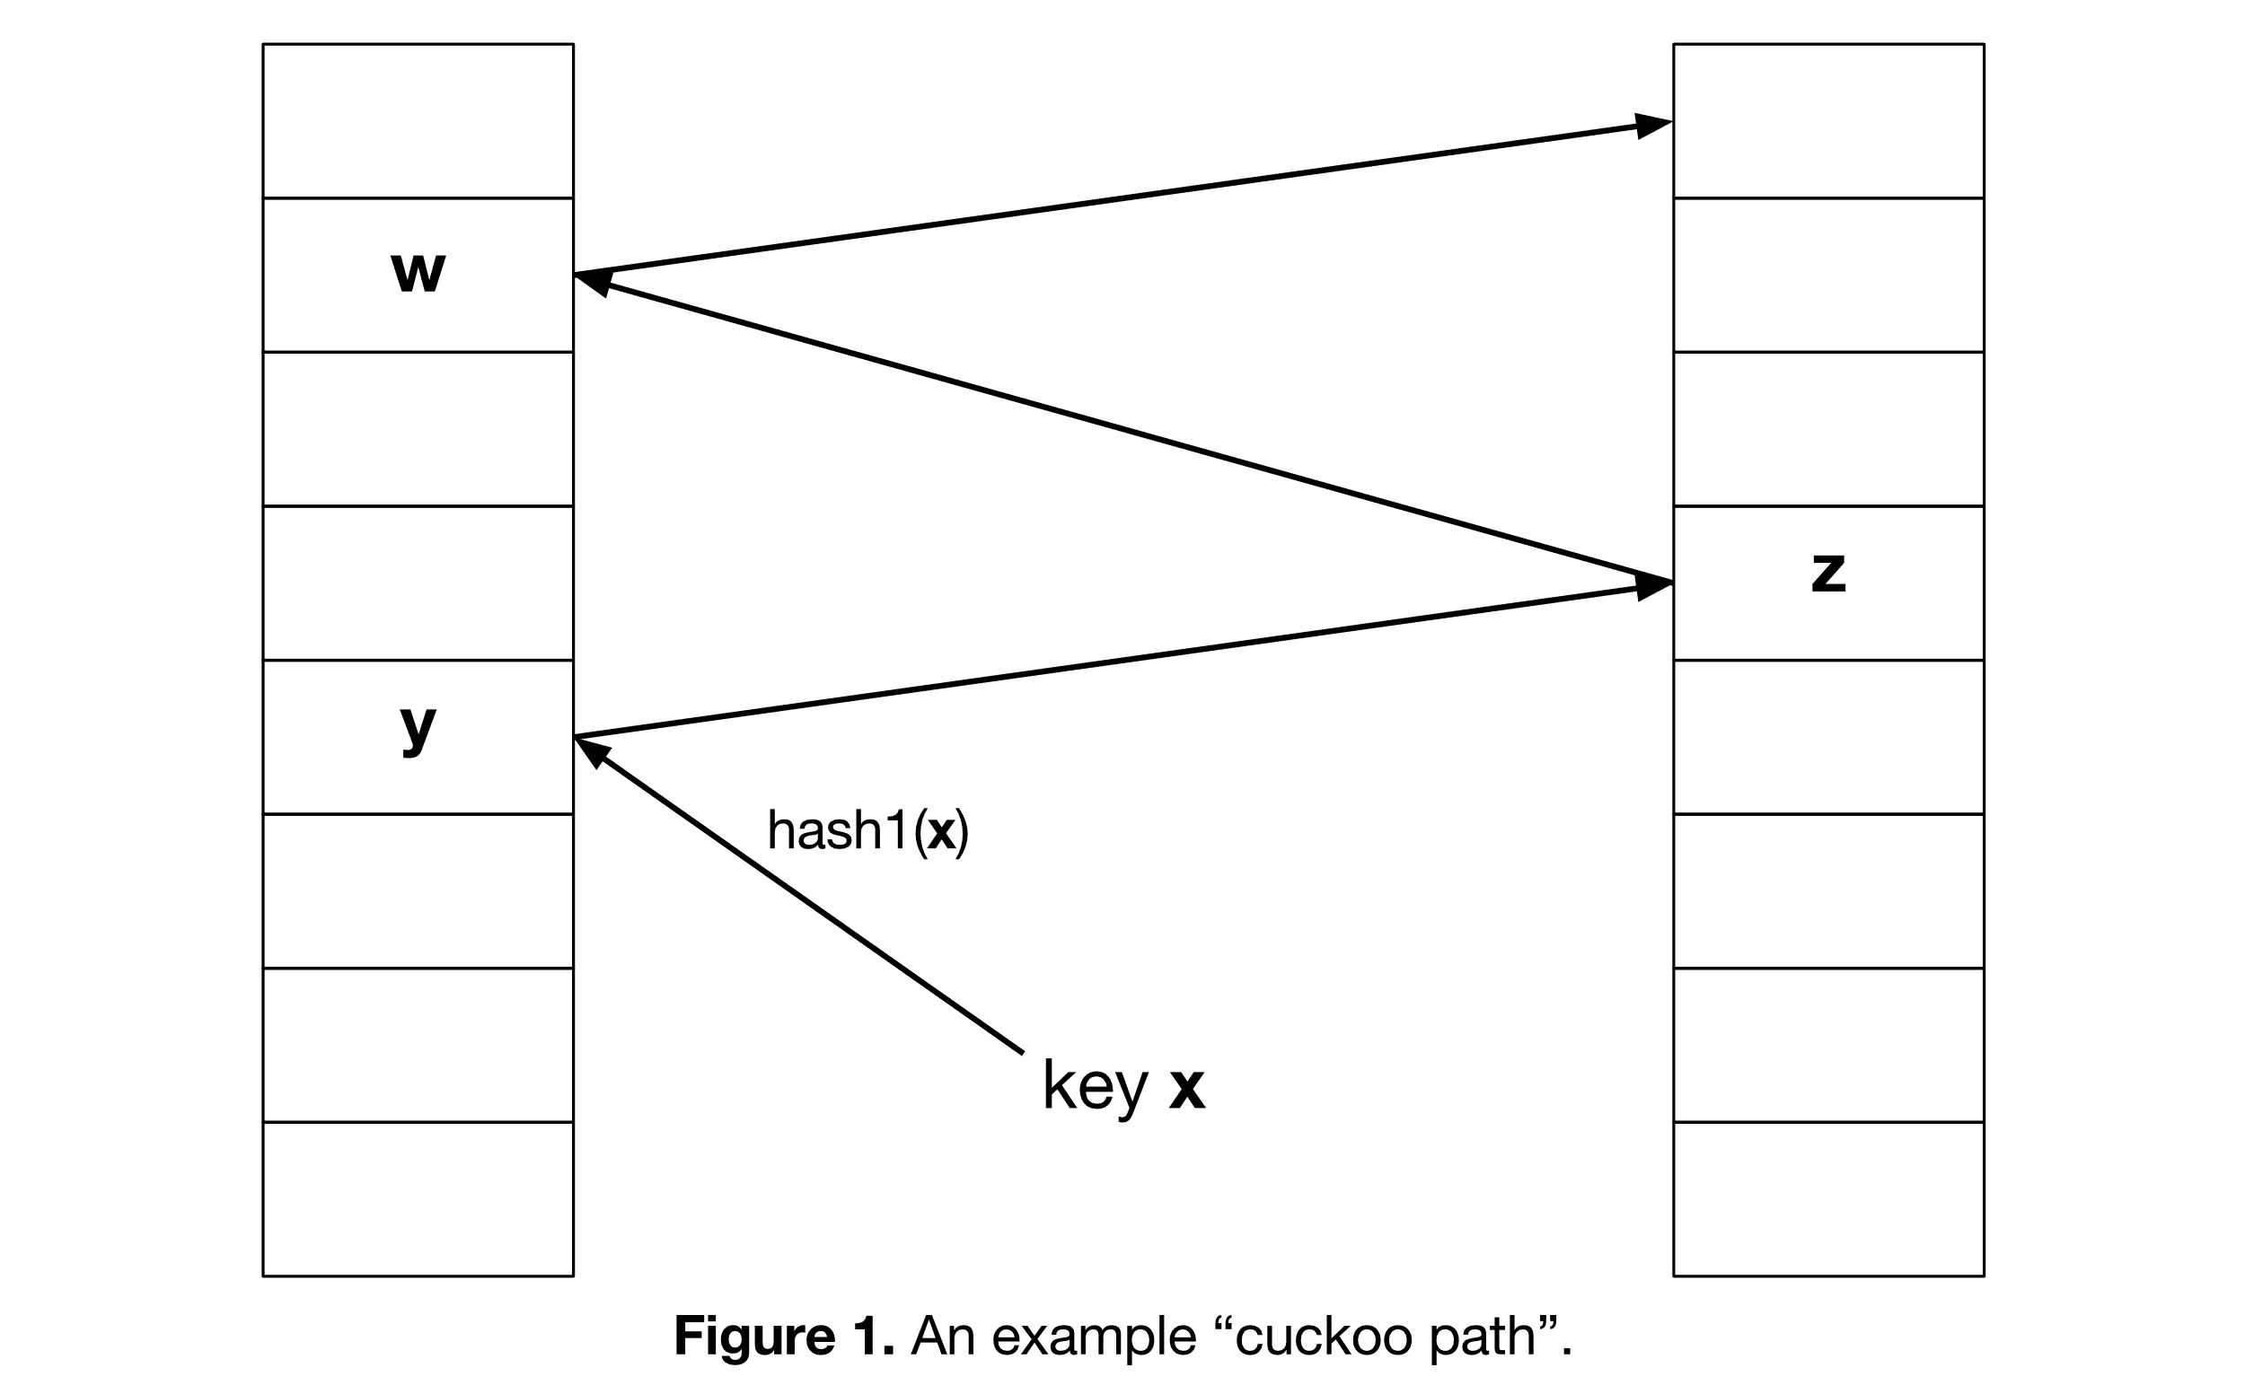

Slide 30
Cuckoo Hashing: Insertion Algorithm
To insert element x, call Insert(x, 1)
Insert(x, i):
1. Put x into location h_{i}(x) in T_{i}
2. If T_{i}[h_{i}(x)] was empty: return
3. If T_{i}[h_{i}(x)] contained element y: do Insert(y, 3–i)
Example:
To insert x:
Put in first location and displace residing element if needed
Put displaced element in its other location
Until finding a free spot
d
t
c
y
h₂(y) = h₂(a)
x
b
h₁(e) = h₁(a)
a
e
...
...
h₁(y)
z
T₁
T₂

Slide 31
Cuckoo Hashing: Insertion
What happens if we are not successful?
Unsuccessful stems from two reasons
Not enough space
The path goes into loops
Too long chains
Can detect both by a time limit.

Slide 32
Cuckoo Hashing: Deletion
Extremely simple:
2 tables: T₁ and T₂
2 hash functions: h₁ and h₂
As in Lookup:
Check in T₁ and T₂
Remove wherever found

Slide 33
In practice
In practice Cuckoo hashing is about 20-30% slower than linear probing which is the fastest of the common approaches.

