Slide 1
Introduction to Stream Computing and Reservoir Sampling

Slide 2
Data Streams
We do not know the entire data set in advance
Google queries
Twitter feeds
Internet traffic
Convenient to think of the data as infinite.

Slide 3
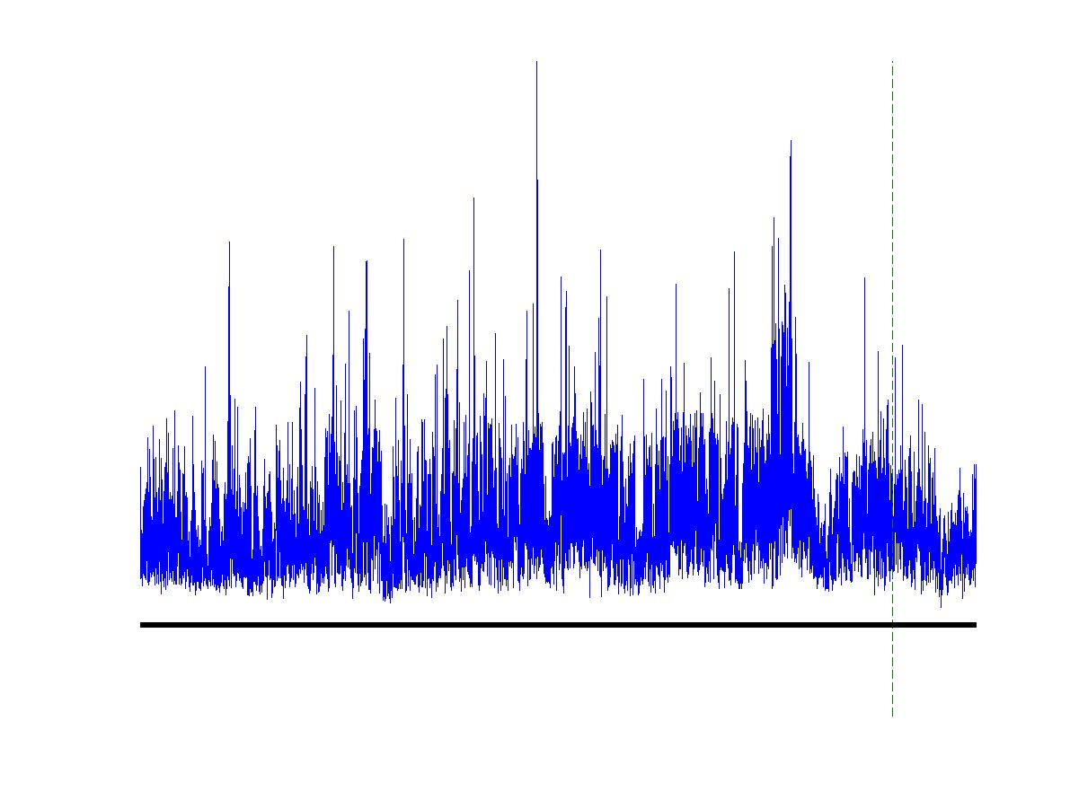
Contd..
Input data element enter one after another (i.e., in a stream).
Cannot store the entire stream accessibly
How do you make critical calculations about the stream using a limited amount of memory?

Slide 4
Applications
Mining query streams
Google wants to know what queries are more frequent today than yesterday
Mining click streams
Yahoo wants to know which of its pages are getting an unusual number of hits in the past hour
Mining social network news feeds
E.g., look for trending topics on Twitter, Facebook

Slide 5
Applications
Sensor Networks
Many sensors feeding into a central controller
Telephone call records
Data feeds into customer bills as well as settlements between telephone companies
IP packets monitored at a switch
Gather information for optimal routing
Detect denial-of-service attacks

Slide 6
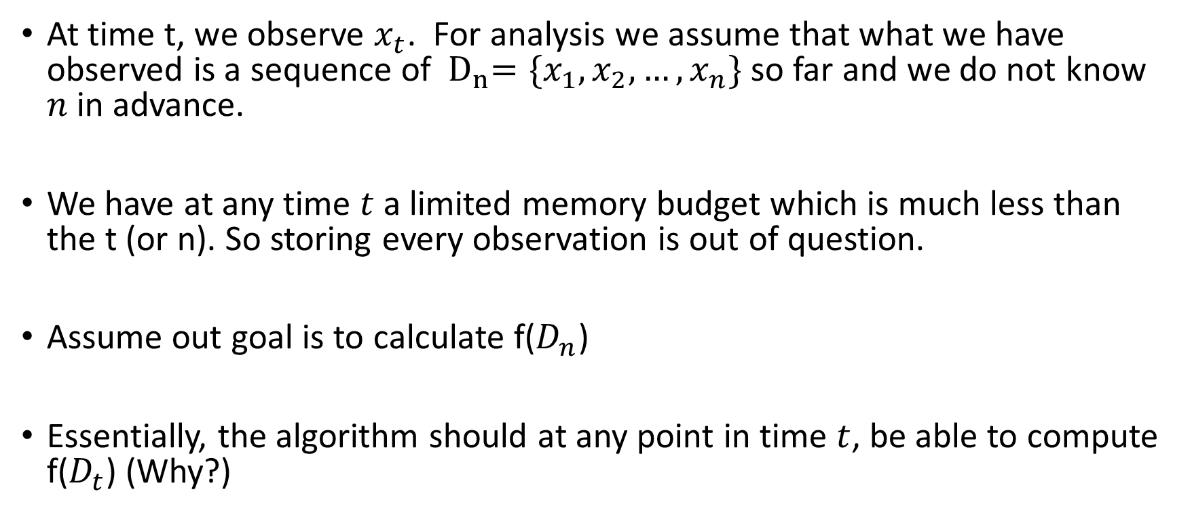
Formalization: One Pass Model
At time t, we observe $x_{t}$. For analysis we assume that what we have observed is a sequence of ${ D}_{n}=\{x_{1}, x_{2}, …, x_{n}\}$ so far and we do not know $n$ in advance.
We have at any time $t$a limited memory budget which is much less than the t (or n). So storing every observation is out of question.
Assume out goal is to calculate f($D_{n}$)
Essentially, the algorithm should at any point in time $t$, be able to compute f($D_{t}$) (Why?)

Slide 7
Basic Question: Sampling
If we get a representative sample of stream then we can do analysis on it.
Example: Find trending tweets from a large enough random sample of streams.
How to do sampling on a stream?

Slide 8
Sampling a Fraction
Sample a random sample of say 1/10 the total size?
How?
Generate a random number between [1-10] and if that number is 1, then use the sample.
Issues?
Size is unknown, so this can go unbounded.
How about sampling bias?

Slide 9
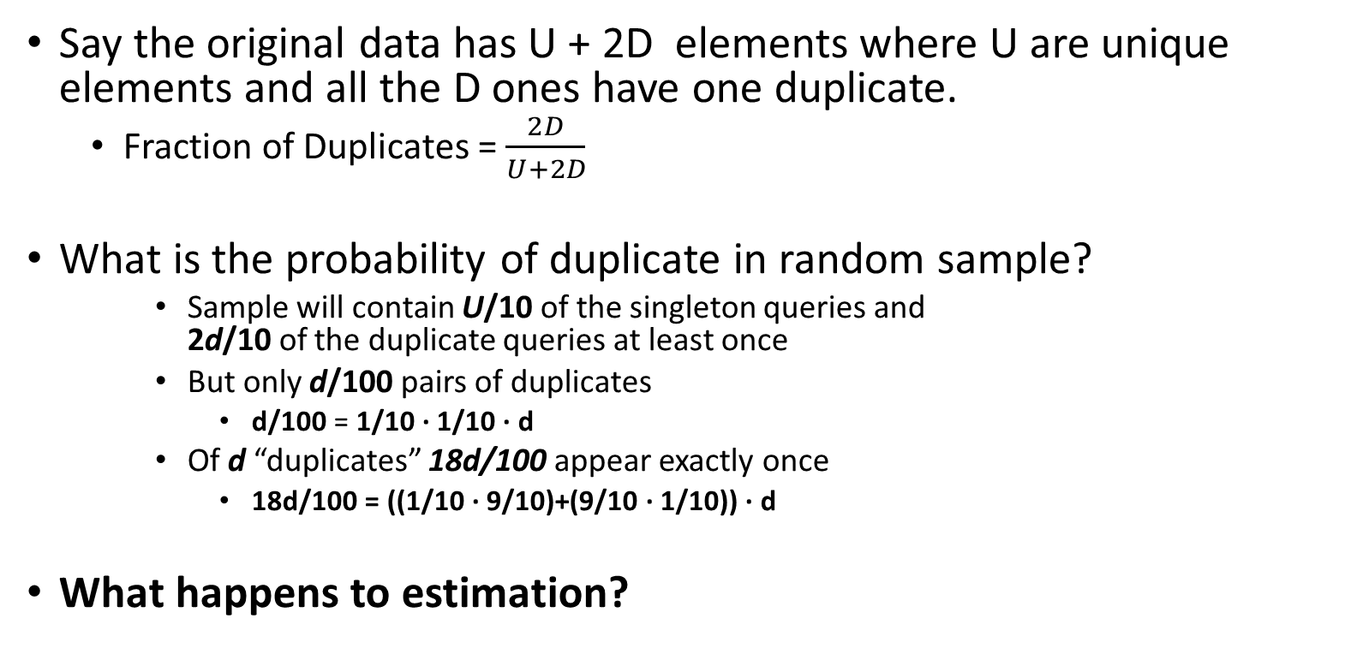
Fraction of duplicates in original vs sample?
Say the original data has U + 2D elements where U are unique elements and all the D ones have one duplicate.
Fraction of Duplicates = $\frac{2D}{U+2D}$
What is the probability of duplicate in random sample?
Sample will contain U/10 of the singleton queries and 2d/10 of the duplicate queries at least once
But only d/100 pairs of duplicates
d/100 = 1/10 ∙ 1/10 ∙ d
Of d “duplicates” 18d/100 appear exactly once
18d/100 = ((1/10 ∙ 9/10)+(9/10 ∙ 1/10)) ∙ d
What happens to estimation?

Slide 10
Fixed sample size
We want to sample s elements from the stream. When we stop at n elements, we should have
Every element has s/n probability of being sampled.
We have exactly s elements.
Can this be done?

Slide 11
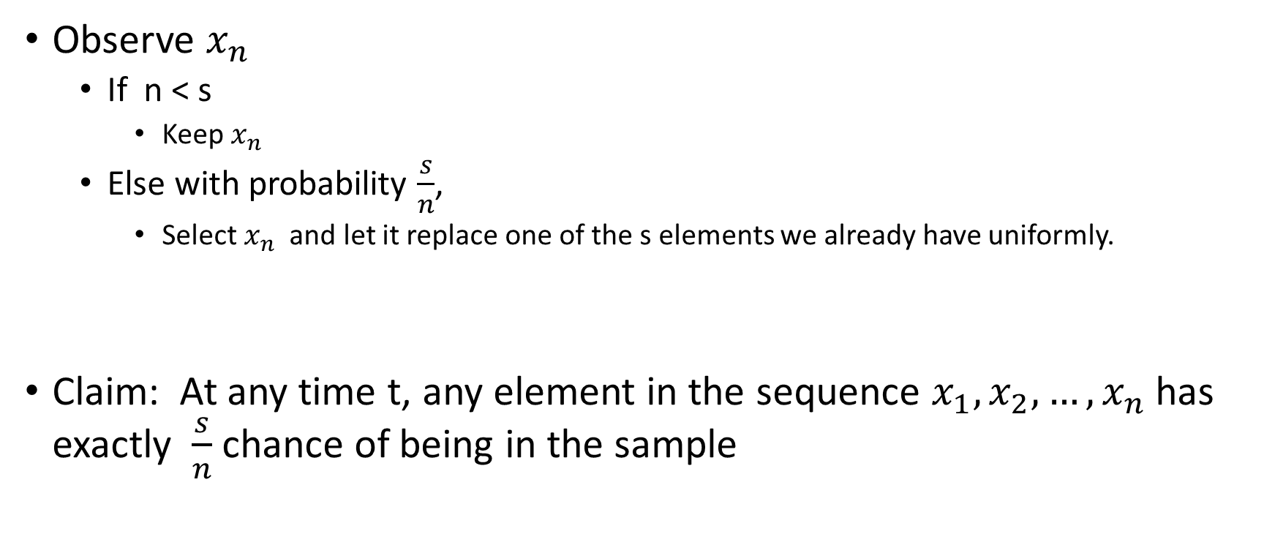
Reservoir Sampling of Size s
Observe $x_{n}$
If n < s
Keep $x_{n}$
Else with probability $\frac{s}{n}$,
Select $x_{n}$ and let it replace one of the s elements we already have uniformly.
Claim: At any time t, any element in the sequence $x_{1},x_{2}, …,x_{n}$has exactly $\frac{s}{n}$ chance of being in the sample

Slide 12
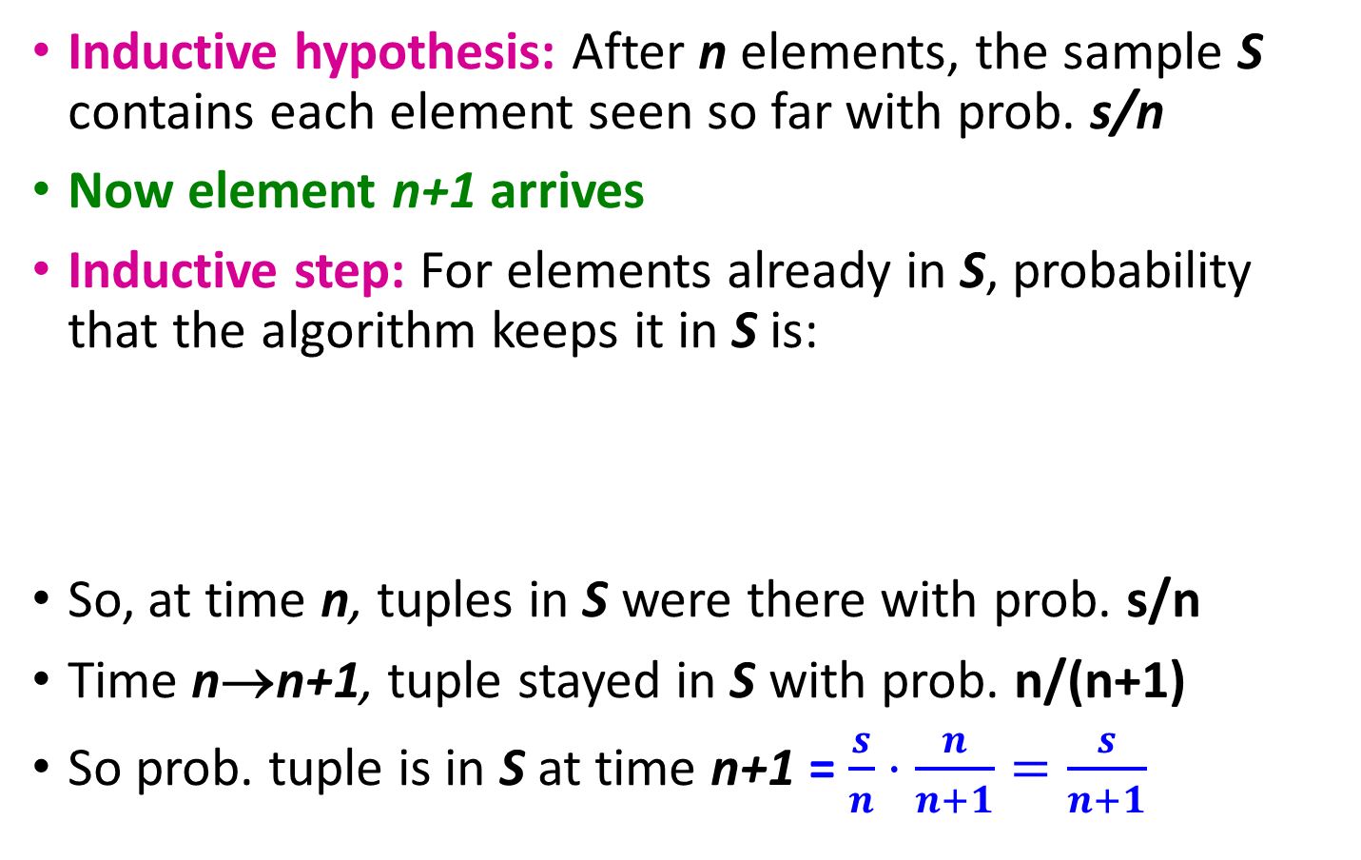
Proof: By Induction
Inductive hypothesis: After n elements, the sample S contains each element seen so far with prob. s/n
Now element n+1 arrives
Inductive step: For elements already in S, probability that the algorithm keeps it in S is:
So, at time n, tuples in S were there with prob. s/n
Time n→n+1, tuple stayed in S with prob. n/(n+1)
So prob. tuple is in S at time n+1 = $\frac{s}{n}⋅\frac{n}{n+1}=\frac{s}{n+1}$
Element n+1 discarded
Element n+1 not discarded
Element in the sample not picked

Slide 13
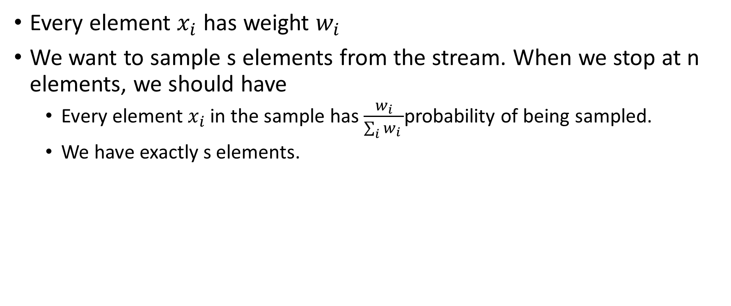
Weighted Reservoir sampling
Every element $x_{i}$ has weight $w_{i}$
We want to sample s elements from the stream. When we stop at n elements, we should have
Every element $x_{i}$ in the sample has $\frac{w_{i}}{\sum_{i}{w_{i} }}$probability of being sampled.
We have exactly s elements.

Slide 14

Attempt 1
Assume there are $w_{i}$ copies of $x_{i}$ anytime you observe $x_{i}$
Make sure $\sum_{i}{w_{i}}$ is big enough integer and every $w_{i}$ is an integer.
Issues?

Slide 15
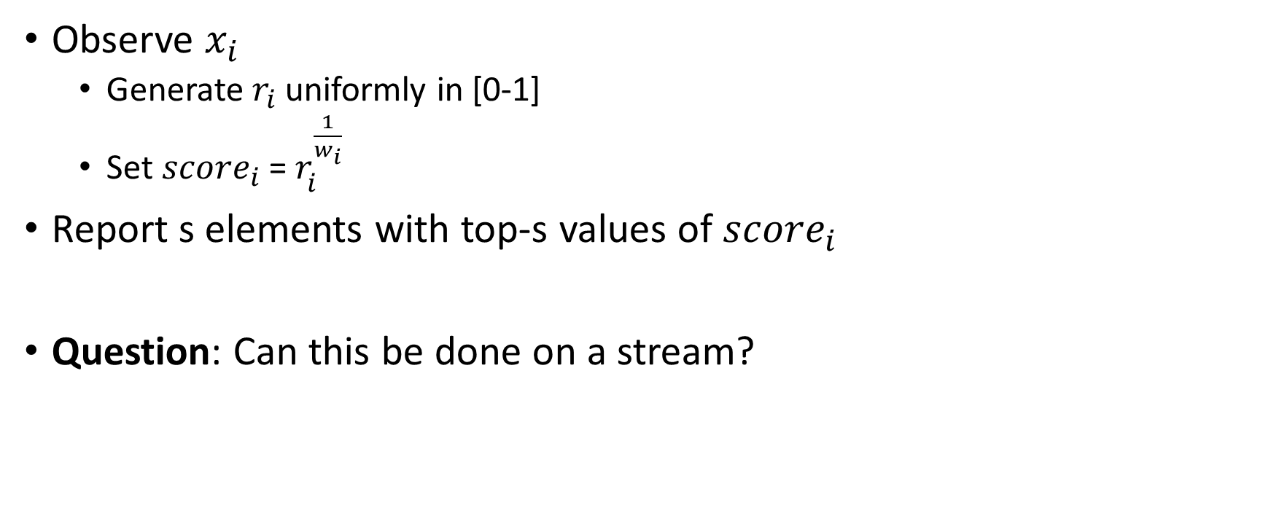
Solution: (Pavlos S Efraimidis and Paul G Spirakis in 2006)
Observe $x_{i}$
Generate $r_{i}$ uniformly in [0-1]
Set ${score}_{i}$ = $r_{i}^{\frac{1}{w_{i}}}$
Report s elements with top-s values of $score_{i}$
Question: Can this be done on a stream?

Slide 16
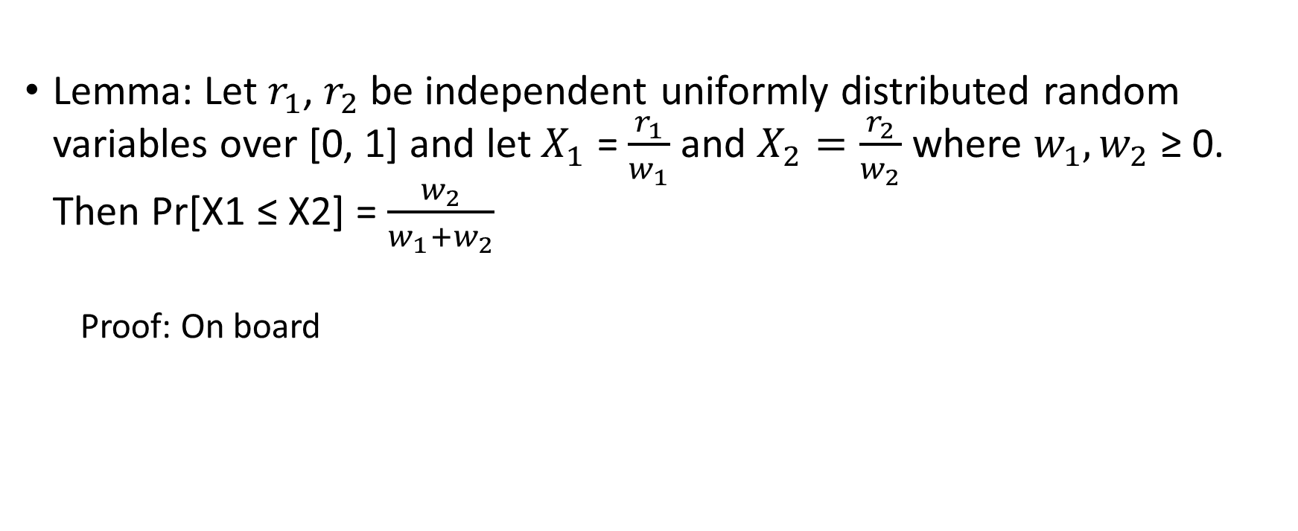
Why it works
Lemma: Let $r_{1}$, $r_{2}$ be independent uniformly distributed random variables over [0, 1] and let $X_{1}$ = $\frac{r_{1}}{w_{1}}$ and $X_{2}=\frac{r_{2}}{w_{2}}$ where $w_{1}, w_{2}$ ≥ 0. Then Pr[X1 ≤ X2] = $\frac{w_{2}}{w_{1}+w_{2}}$
Proof: On board

