Slide 1
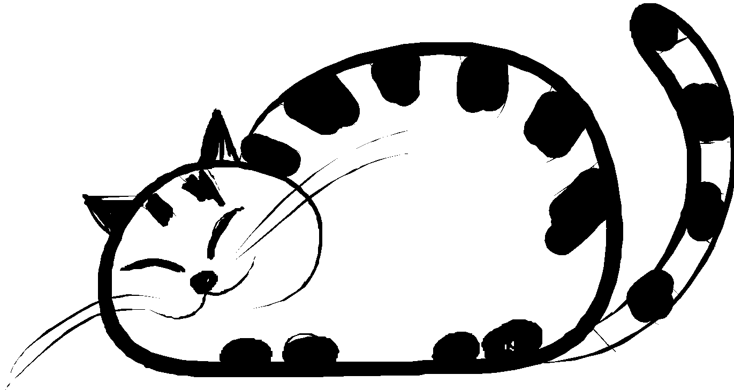
【Ucats】
A leisure game about cats.
Presented by: Cynthia(3312596), Eric(3315951) , Wendy(3317924)

Slide 2

【INTRODUCTION】

Slide 3
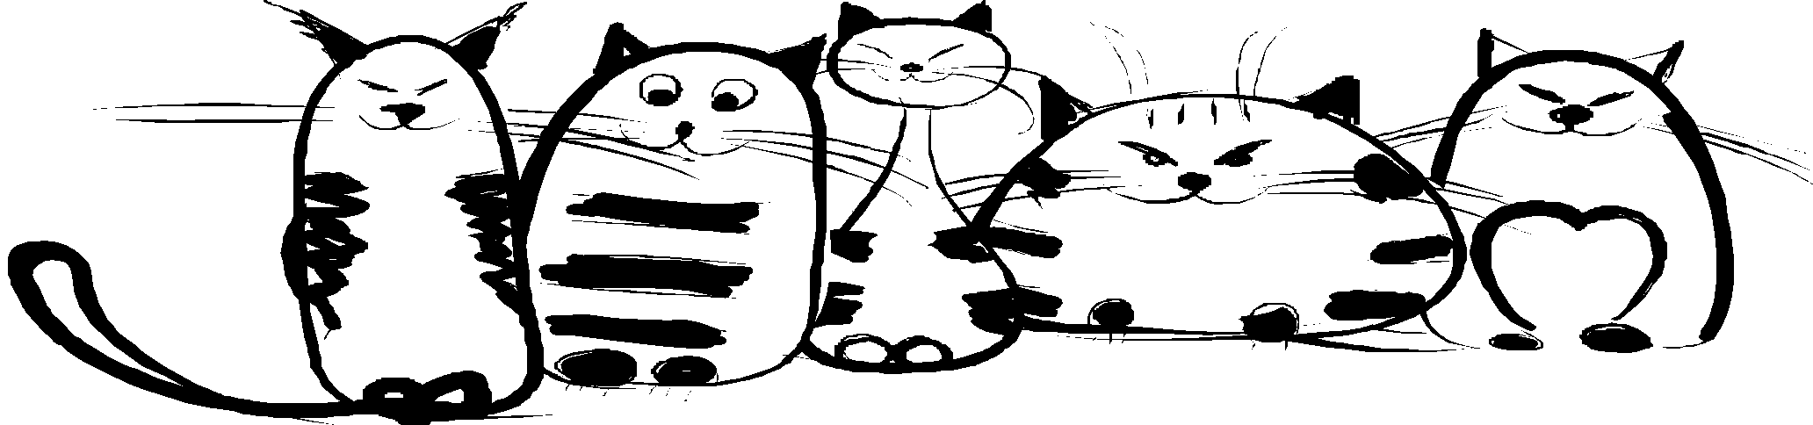
INTRODUCTION
1
2
RELAXING
PLAY ANYWHERE
Easy to play, best for cat lovers
It is an offline game, network connection is not required for normal playing

Slide 4
【SOLUTION
AND DESIGN】

Slide 5



RESOURCES
Xamarin
As programming tools
Krita
As photo editor
Just in Mind
As Prototype tools

Slide 6
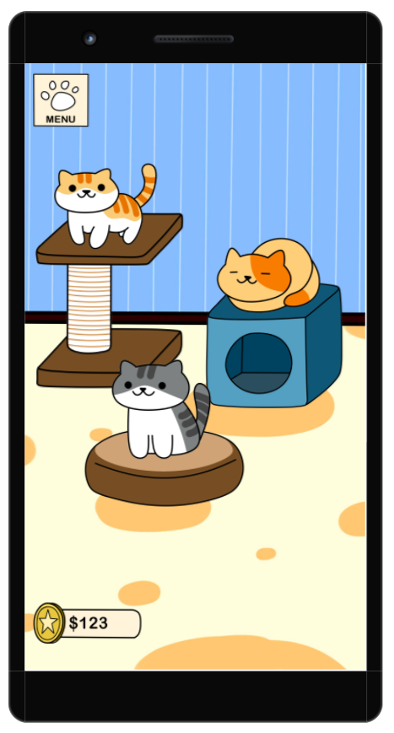
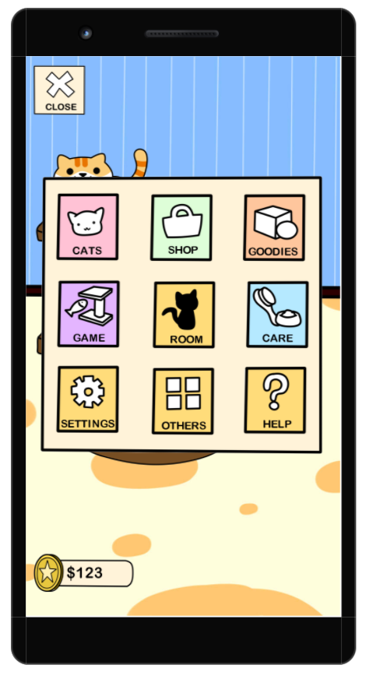


MAIN PAGE & MENU
Main Page
Room with adorable cats
Menu
All features at a glance.
You can buy new toys or wallpaper in the shop by using the coins

Slide 7
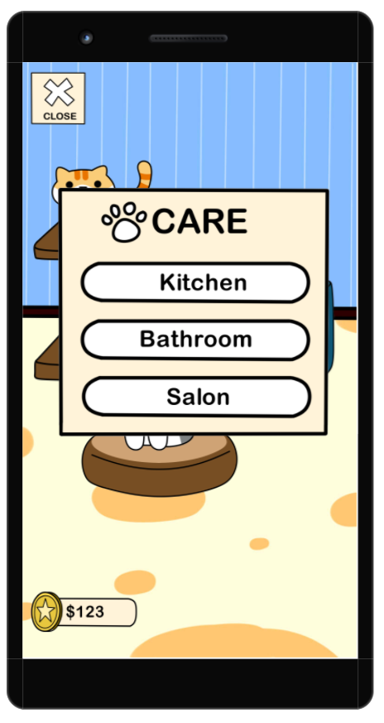
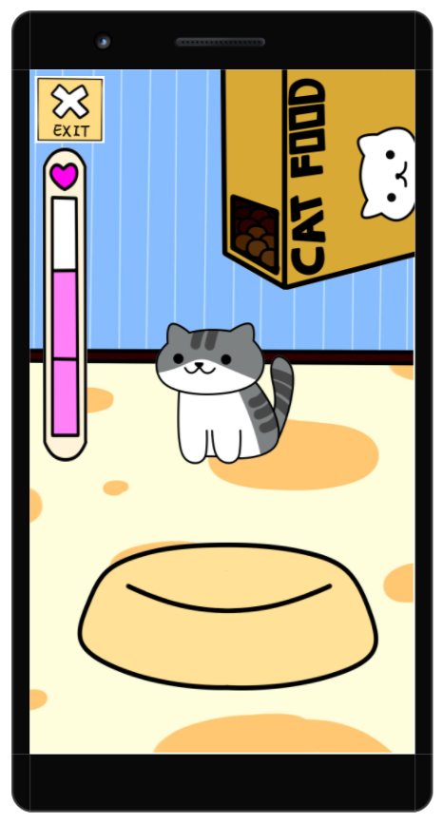


CARE
Care Menu
Makesure you take good care of your kitty
Kitchen
Shake the food and pour it out to feed the hungry kitty

Slide 8
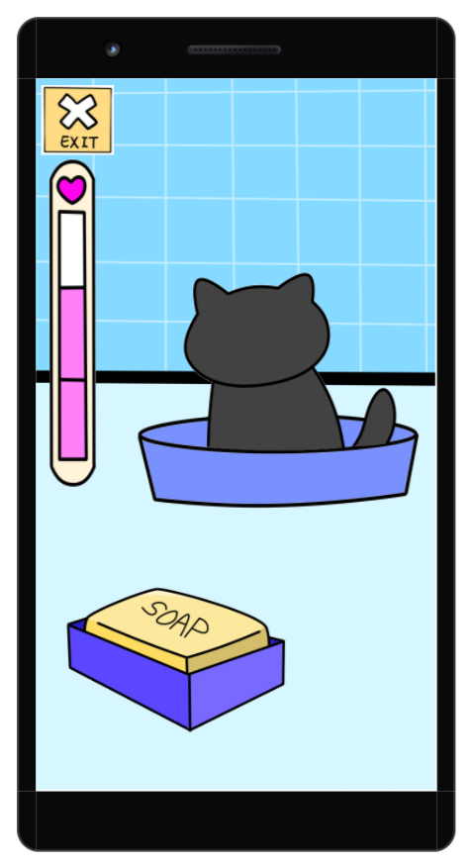
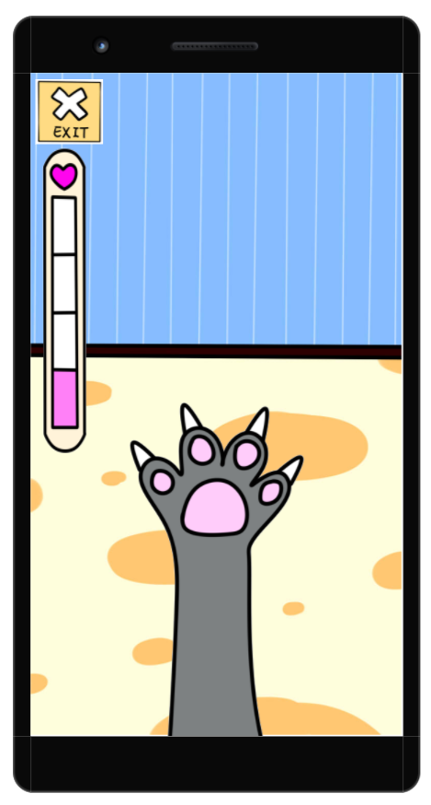



CARE
Bathroom
Use the soap to rub,
clean all the dirty things from kitty
Salon
Cut the over long nails so they won’t hurt themselves accidentally

Slide 9
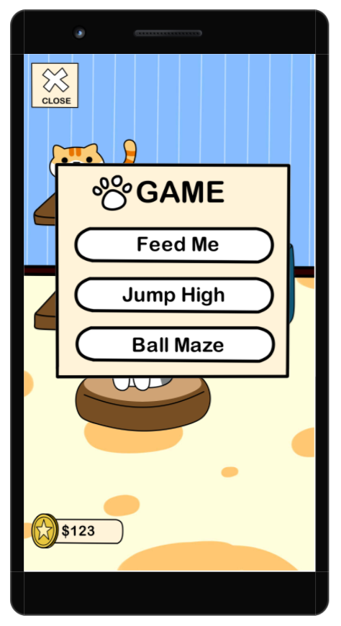
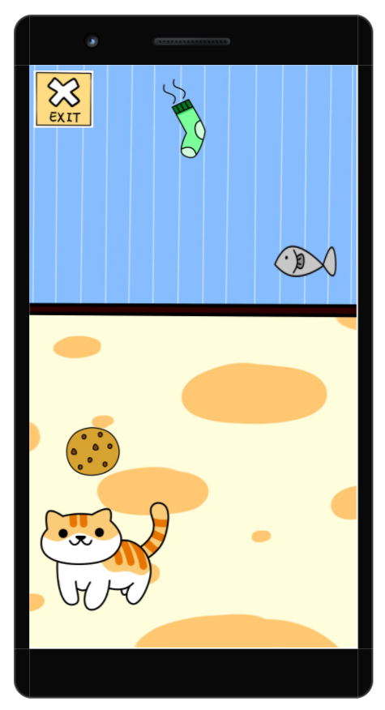

GAME
Game menu
Play the game with kitty
Feed Me
Control the cat to eat the snacks. Careful not to eat the bad things!

Slide 10
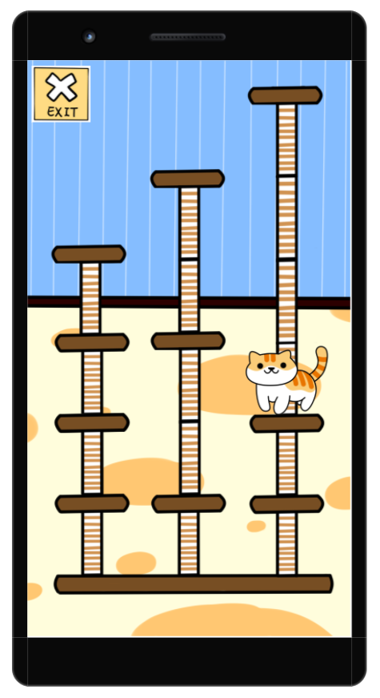
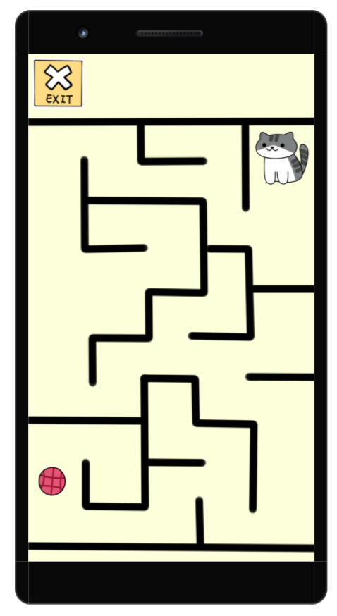

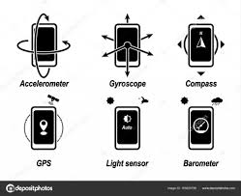
GAME
Jump High
Jump to the top and get the prizes! Tap left or right to climb up, make sure you jump the right way!
Ball Maze
The cat lost her ball, help her to find it back.

Slide 11
【BUSINESS MODEL】

Slide 12


BUSINESS MODEL
PURCHASE
The user can paid for ad-free or
game credits.
ADVERTISEMENT
Mobile advertisement,
for example watch short ad to get
some rewards

Slide 13
【POSSIBLE CHALLENGES】

Slide 14
POSSIBLE CHALLENGES
UGLY DESIGN
INSUFFICIENT SKILL
Since we are not art student, the artwork and animation may
not be as pretty as other.
But we will try to do our
best
Our skill may not enough to support us to achieve our goals.
But we will try to study more and work harder to overcome it

Slide 15
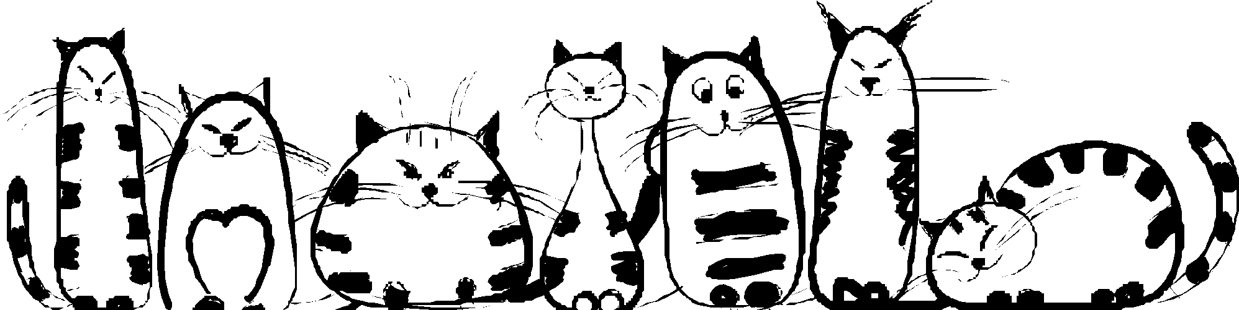
【Thanks for listening】

