Slide 1
LAMEN MICROFINANCE
Islamic Finance • Accounting • HR
Loan Management System
Product Overview
An end-to-end platform for Shariah-compliant microfinance: customer onboarding, Murabaha financing, disbursements and collections, full double-entry accounting, DAB regulatory reporting, and a complete HR module — plus a field officer mobile app.
April 2026

Slide 2
OPERATIONS
Customers, Loans & Daily Operations
From customer onboarding through Murabaha origination, disbursement and daily collections.

Slide 3
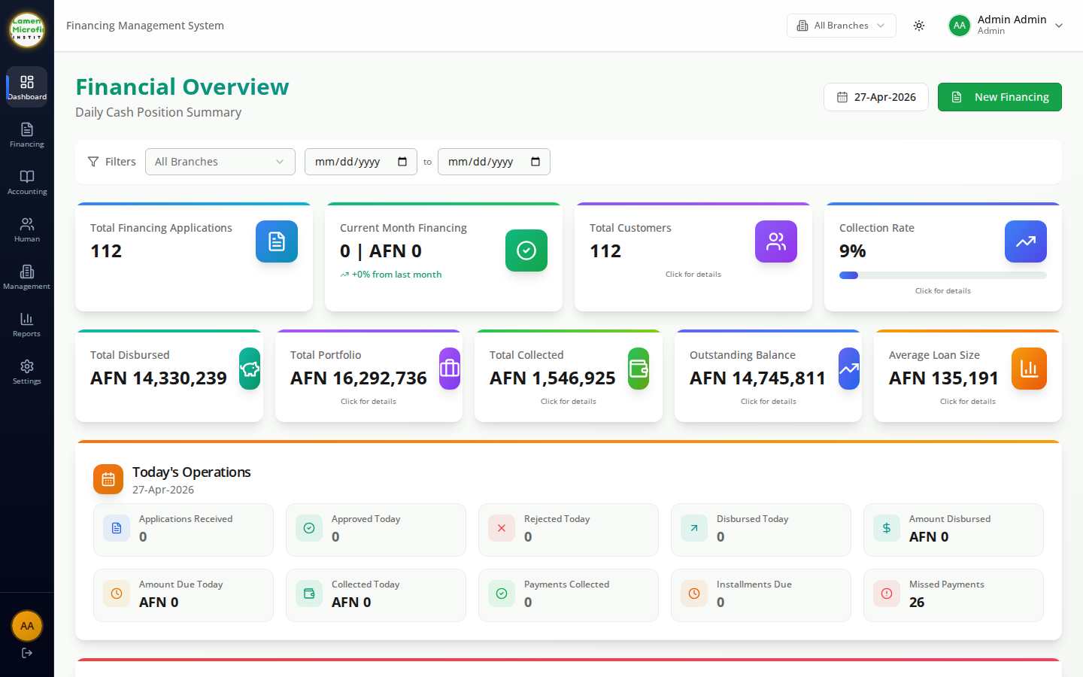
OPERATIONS
Operational Dashboard
WHAT THIS SCREEN DOES
Daily cash position with KPIs for portfolio, collections, disbursements and PAR.
Live tiles for applications received, approved, rejected and amounts disbursed today, plus installments due and missed.
Lamen Microfinance • Loan Management System

Slide 4
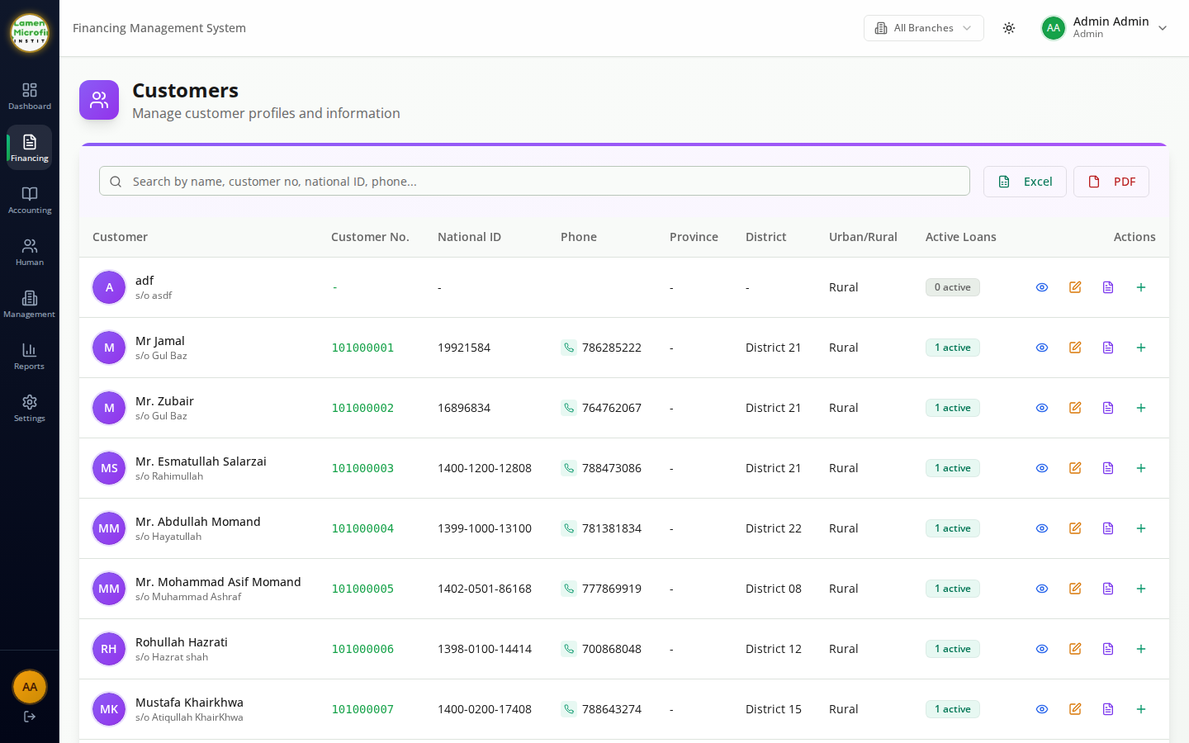
OPERATIONS
Customers
WHAT THIS SCREEN DOES
Master register of all customers with branch, sector, contact and KYC details.
Search, filter and drill into a customer to view their financing history and outstanding balances.
Lamen Microfinance • Loan Management System

Slide 5
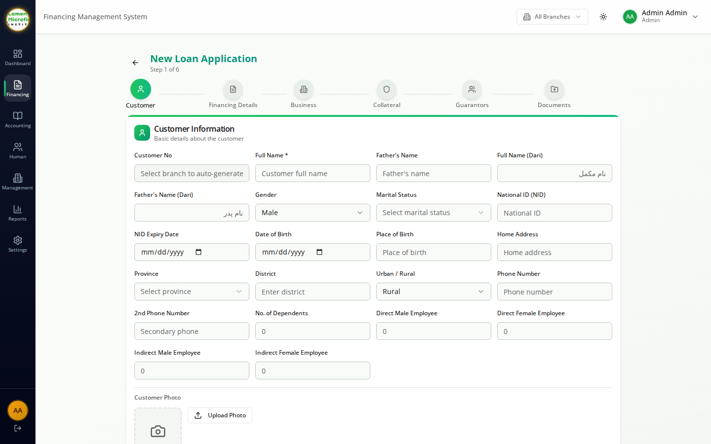
OPERATIONS
New Loan Application
WHAT THIS SCREEN DOES
Multi-step Murabaha application capturing customer, financing details, business profile, collateral, guarantors and documents.
Auto-generates the customer number and routes the file into the credit committee workflow.
Lamen Microfinance • Loan Management System

Slide 6
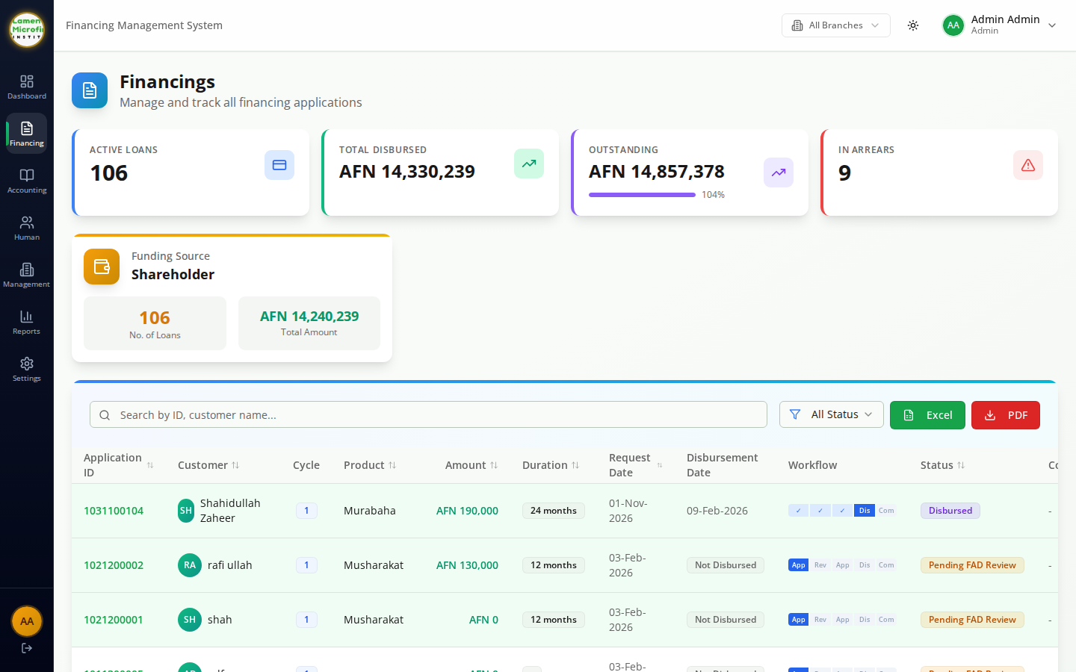
OPERATIONS
Loans / Financing Portfolio
WHAT THIS SCREEN DOES
Unified view of every Murabaha contract across all branches with status, principal, margin and outstanding balance.
Quick actions to open contracts, record events and export the active portfolio.
Lamen Microfinance • Loan Management System

Slide 7
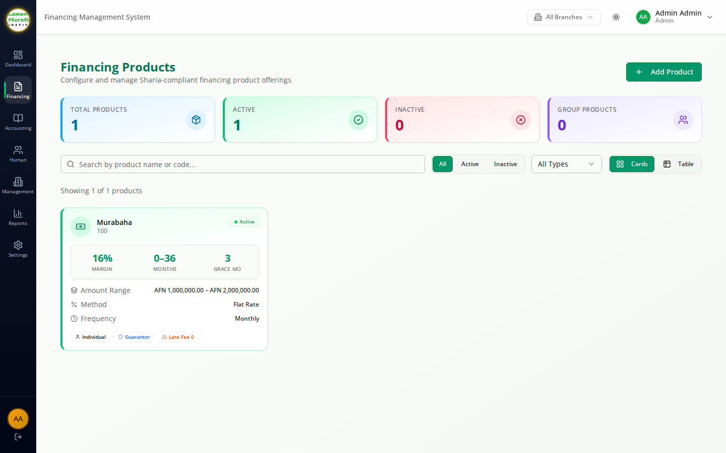
OPERATIONS
Financing Products
WHAT THIS SCREEN DOES
Configure the Murabaha product catalog — tenor, margin rate, repayment frequency and eligibility rules.
Used as the source of truth when officers create new applications.
Lamen Microfinance • Loan Management System

Slide 8
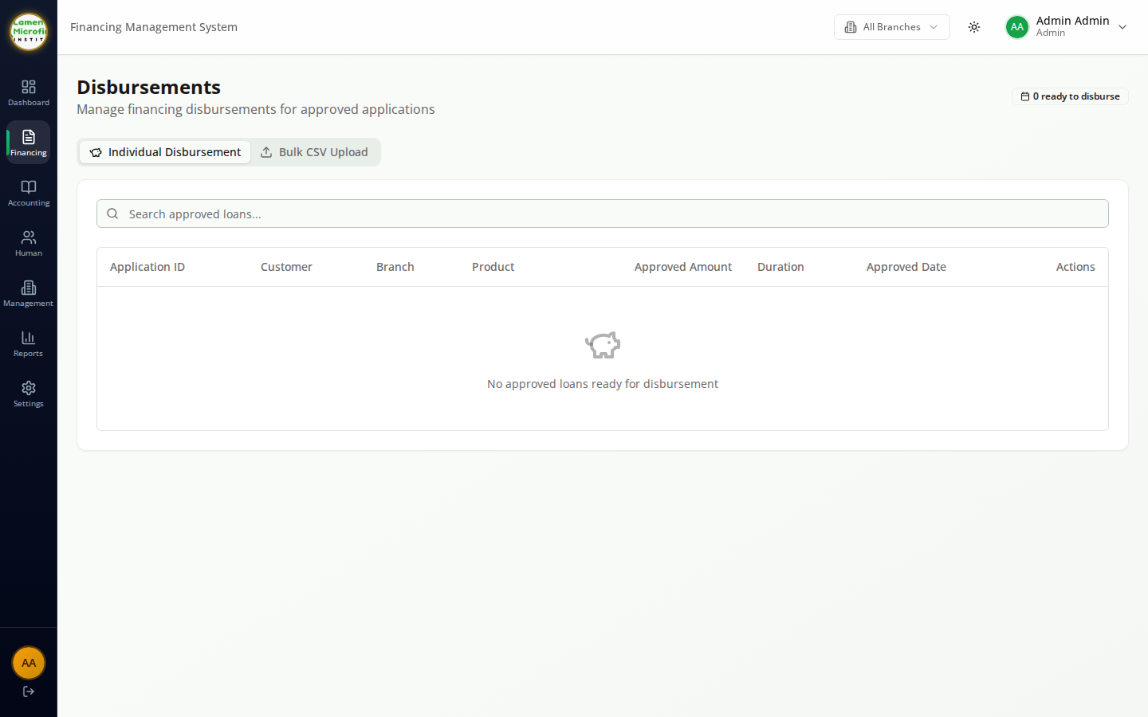
OPERATIONS
Disbursements Queue
WHAT THIS SCREEN DOES
Shows approved contracts waiting to be disbursed, with the amount, customer and target disbursement date.
Officers post the disbursement, which automatically books the matching journal entries and updates the portfolio.
Lamen Microfinance • Loan Management System

Slide 9
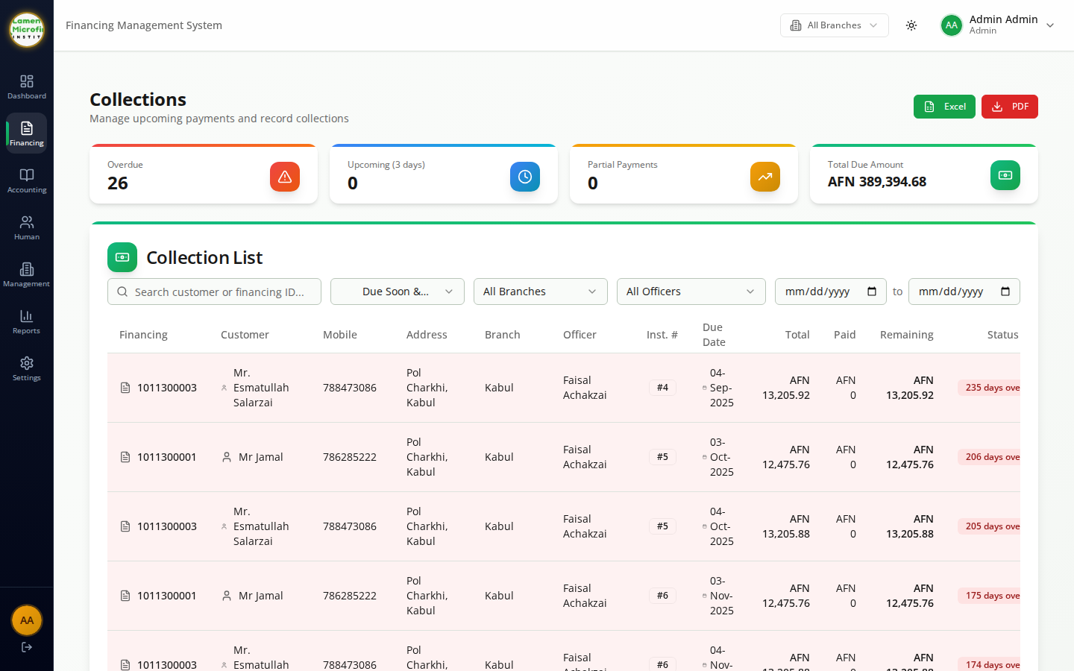
OPERATIONS
Collections
WHAT THIS SCREEN DOES
Daily collection workspace for officers — filter by branch and date to find installments due.
Record cash, bank and HQ collections in one click; amounts flow into the cash position and ledgers immediately.
Lamen Microfinance • Loan Management System

Slide 10
ACCOUNTING
Full Double-Entry Accounting
Chart of accounts, journals and the complete financial statement set.

Slide 11
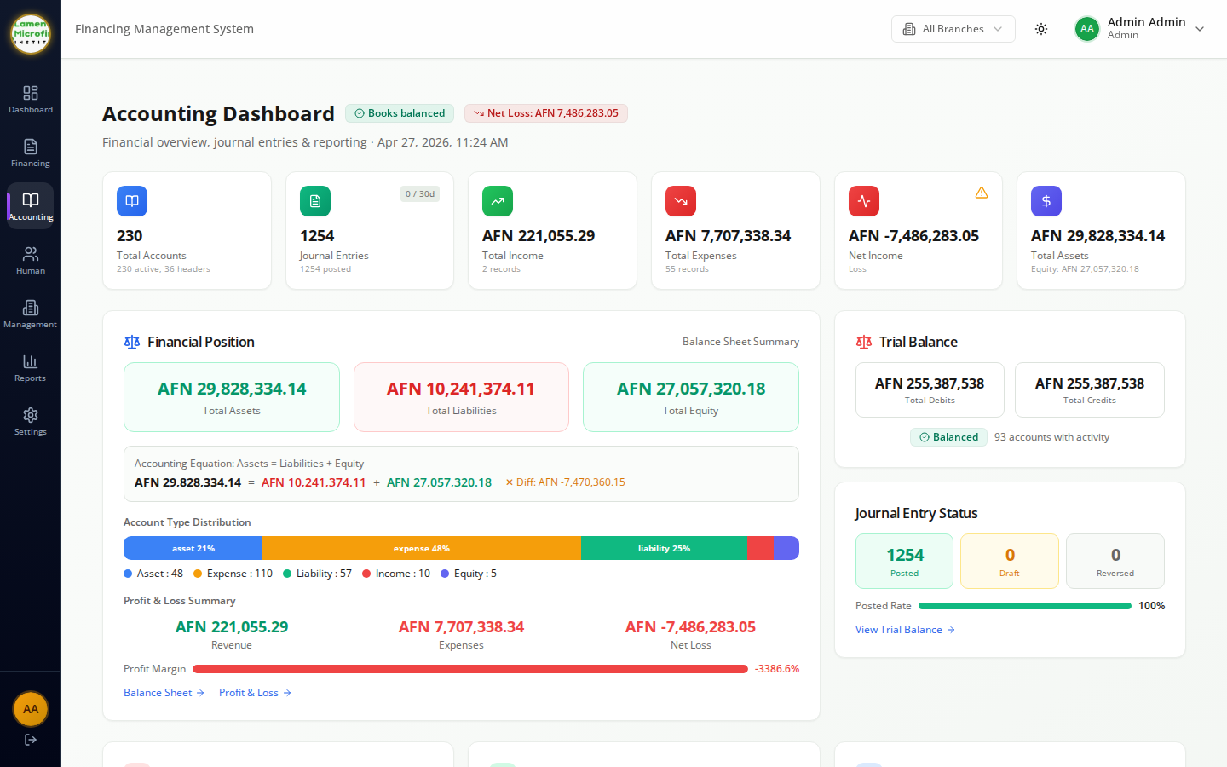
ACCOUNTING
Accounting Dashboard
WHAT THIS SCREEN DOES
At-a-glance view of total assets, liabilities, equity, revenue and expenses across the institution.
Drills into the underlying ledgers, journals and statements from a single entry point.
Lamen Microfinance • Loan Management System

Slide 12
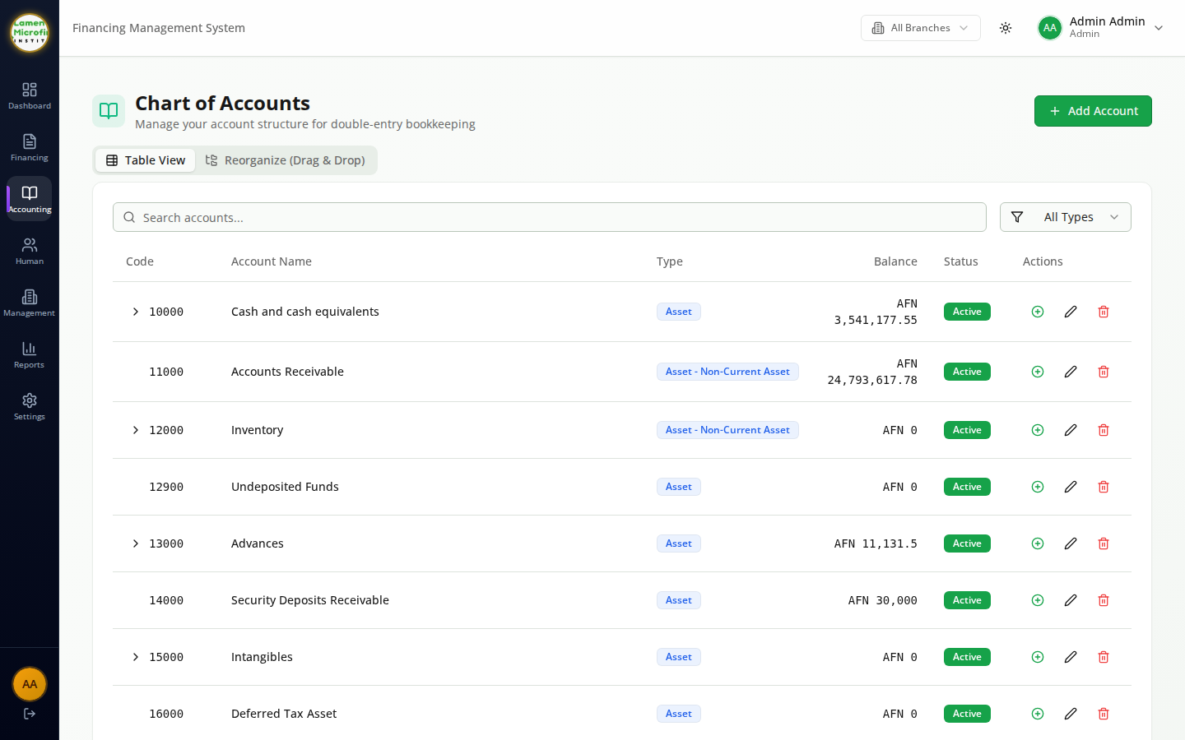
ACCOUNTING
Chart of Accounts
WHAT THIS SCREEN DOES
Hierarchical chart of accounts aligned to DAB and IFRS categories — assets, liabilities, equity, revenue, expense.
Add and reorganize accounts, control posting rules and view running balances per account.
Lamen Microfinance • Loan Management System

Slide 13
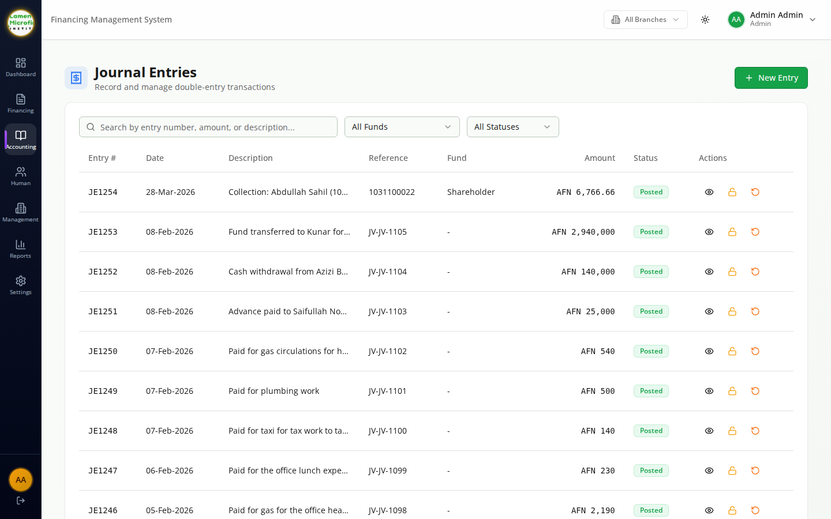
ACCOUNTING
Journal Entries
WHAT THIS SCREEN DOES
Capture and review every double-entry journal posted by the system or by accountants manually.
Search by date, account, reference or branch and export to Excel for reconciliation.
Lamen Microfinance • Loan Management System

Slide 14
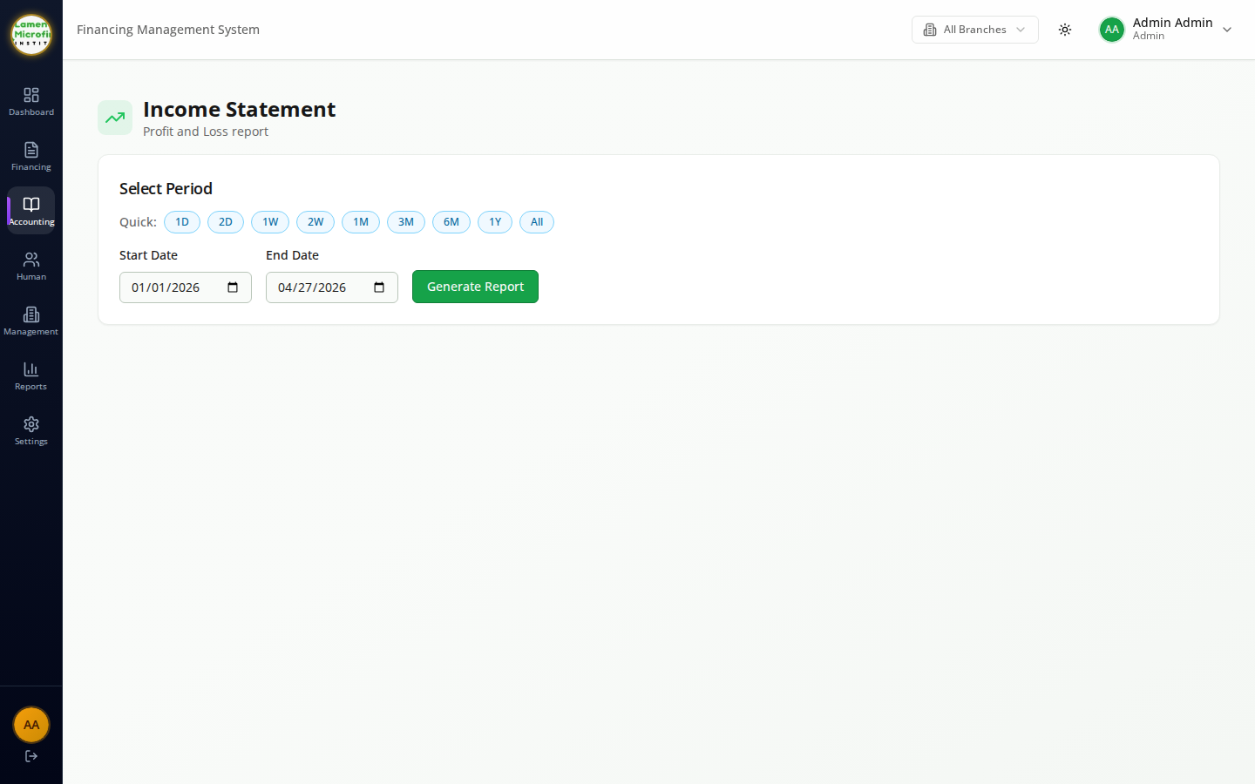
ACCOUNTING
Income Statement
WHAT THIS SCREEN DOES
Profit & loss for any period, with revenue, cost of financing and operating expenses broken down by category.
Compare across periods and branches to evaluate profitability.
Lamen Microfinance • Loan Management System

Slide 15
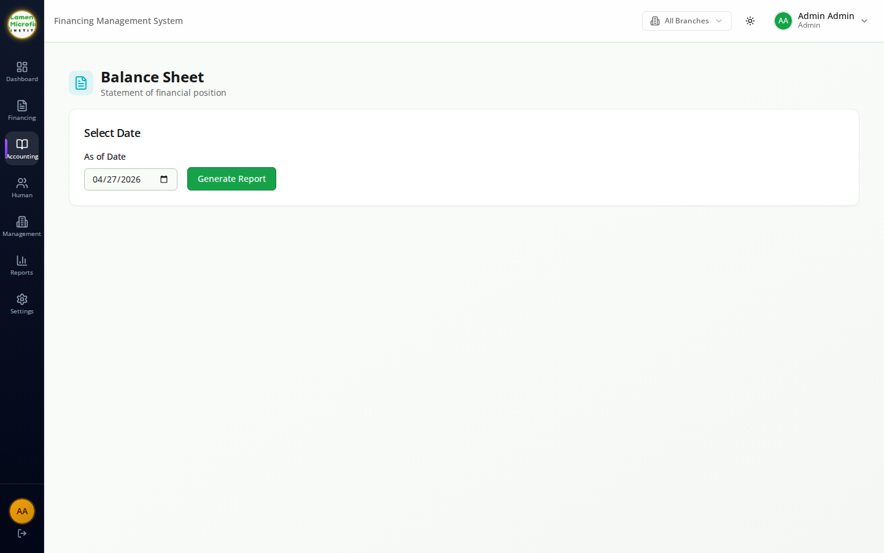
ACCOUNTING
Balance Sheet
WHAT THIS SCREEN DOES
Statement of financial position at a chosen reporting date.
Groups assets, liabilities and equity per IFRS and feeds directly into the DAB regulatory pack.
Lamen Microfinance • Loan Management System

Slide 16
REGULATORY
Regulatory Reporting
DAB-aligned regulatory reports generated from live ledger and portfolio data.

Slide 17
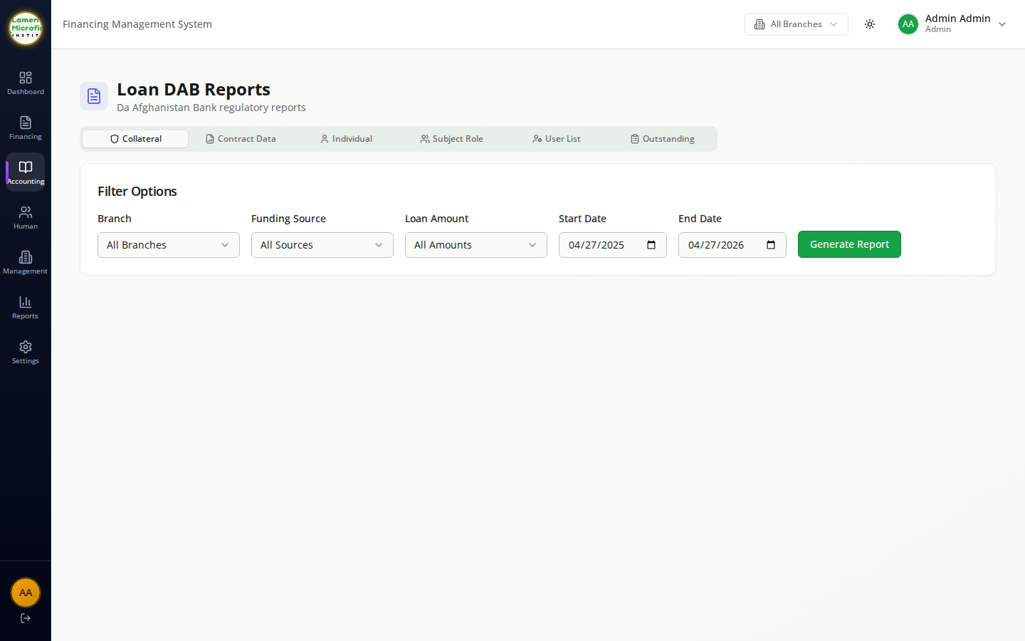
REGULATORY
DAB Regulatory Reports
WHAT THIS SCREEN DOES
One-click pack of the reports required by Da Afghanistan Bank for microfinance institutions.
Generates standardized exports for portfolio quality, classification, large transactions and prudential limits.
Lamen Microfinance • Loan Management System

Slide 18
HR
Human Resources
Employees, attendance, leave, payroll, recruitment and performance in one place.

Slide 19
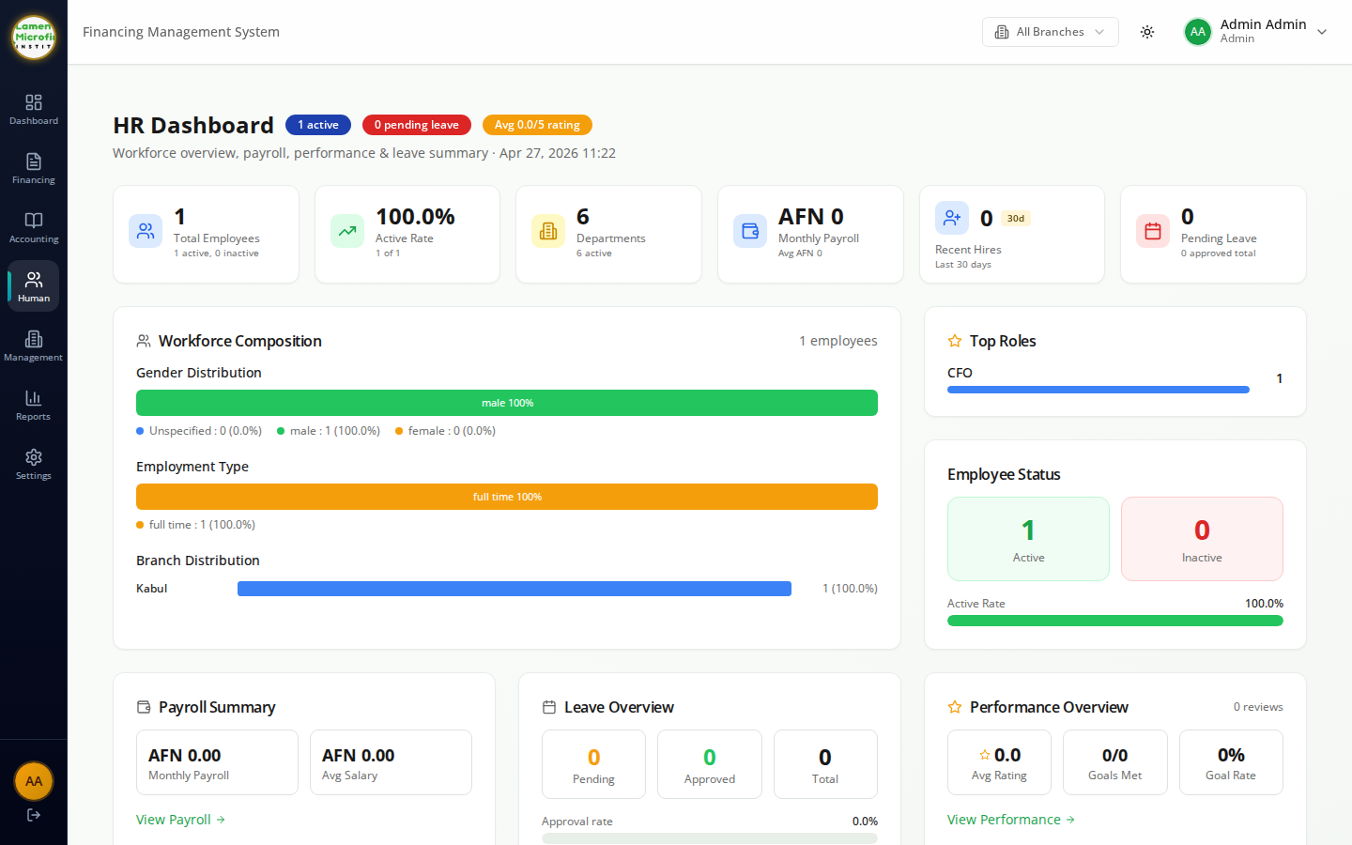
HR
HR Dashboard
WHAT THIS SCREEN DOES
Workforce overview — headcount, gender mix, employment type and branch distribution.
Summarizes payroll, leave and performance so HR can spot issues before they escalate.
Lamen Microfinance • Loan Management System

Slide 20
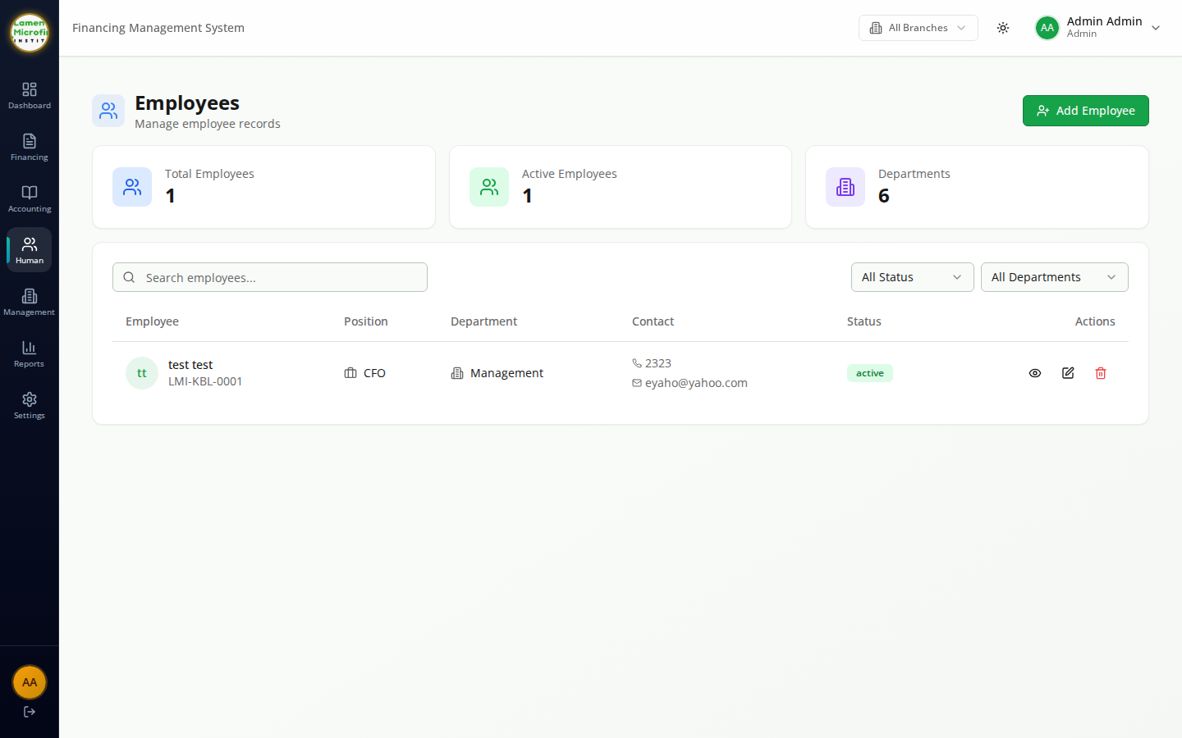
HR
Employees
WHAT THIS SCREEN DOES
Employee register with personal, contractual and compensation information.
Add new staff, edit profiles, attach documents and link employees to branches and positions.
Lamen Microfinance • Loan Management System

Slide 21
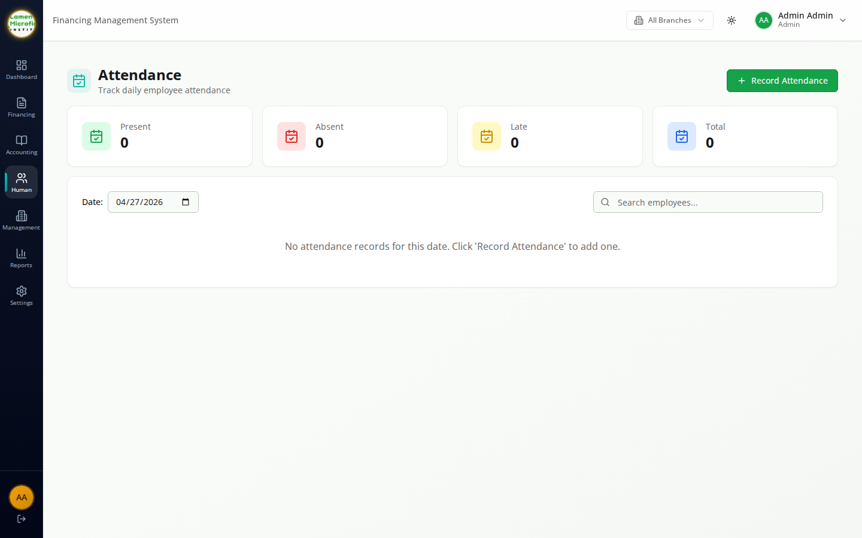
HR
Attendance
WHAT THIS SCREEN DOES
Daily attendance grid showing clock-in / clock-out, late arrivals and absences by branch.
Feeds straight into payroll calculations and leave balances.
Lamen Microfinance • Loan Management System

Slide 22
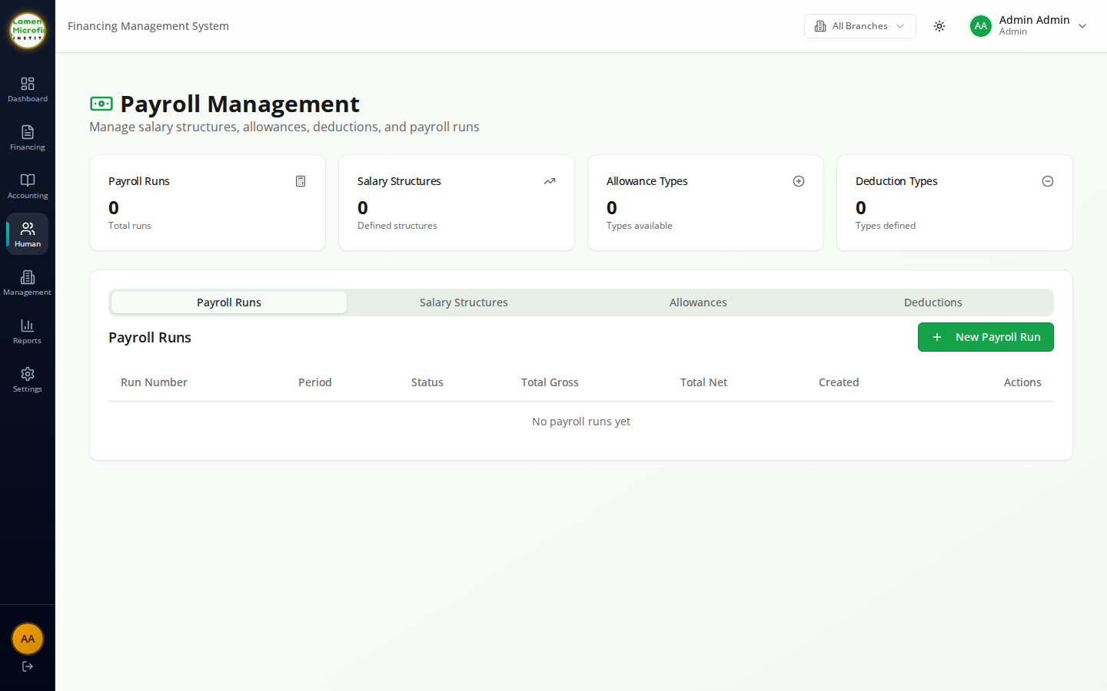
HR
Payroll
WHAT THIS SCREEN DOES
Run monthly payroll across branches with earnings, deductions and benefits.
Posts the payroll journal automatically and produces payslips ready to share.
Lamen Microfinance • Loan Management System

Slide 23
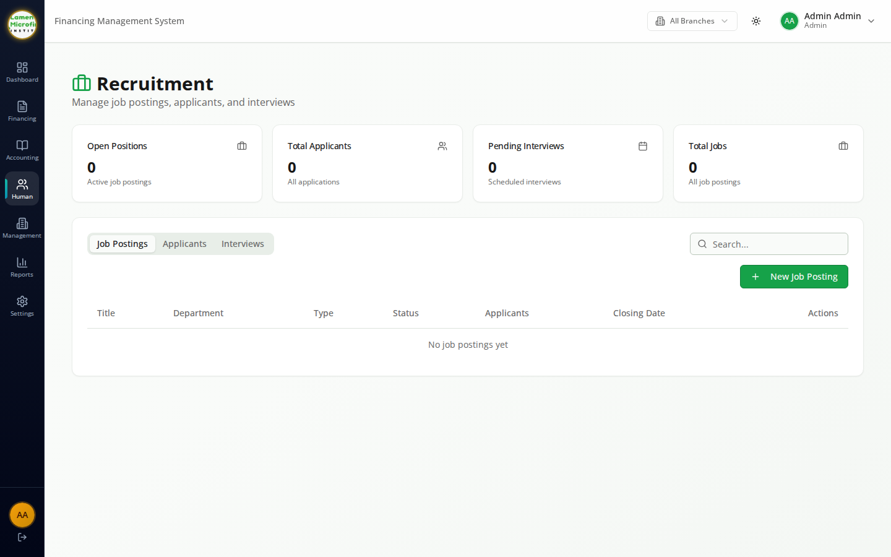
HR
Recruitment
WHAT THIS SCREEN DOES
Pipeline of open positions, candidates and interview stages.
Hire approved candidates straight into the employee module without rekeying data.
Lamen Microfinance • Loan Management System

Slide 24
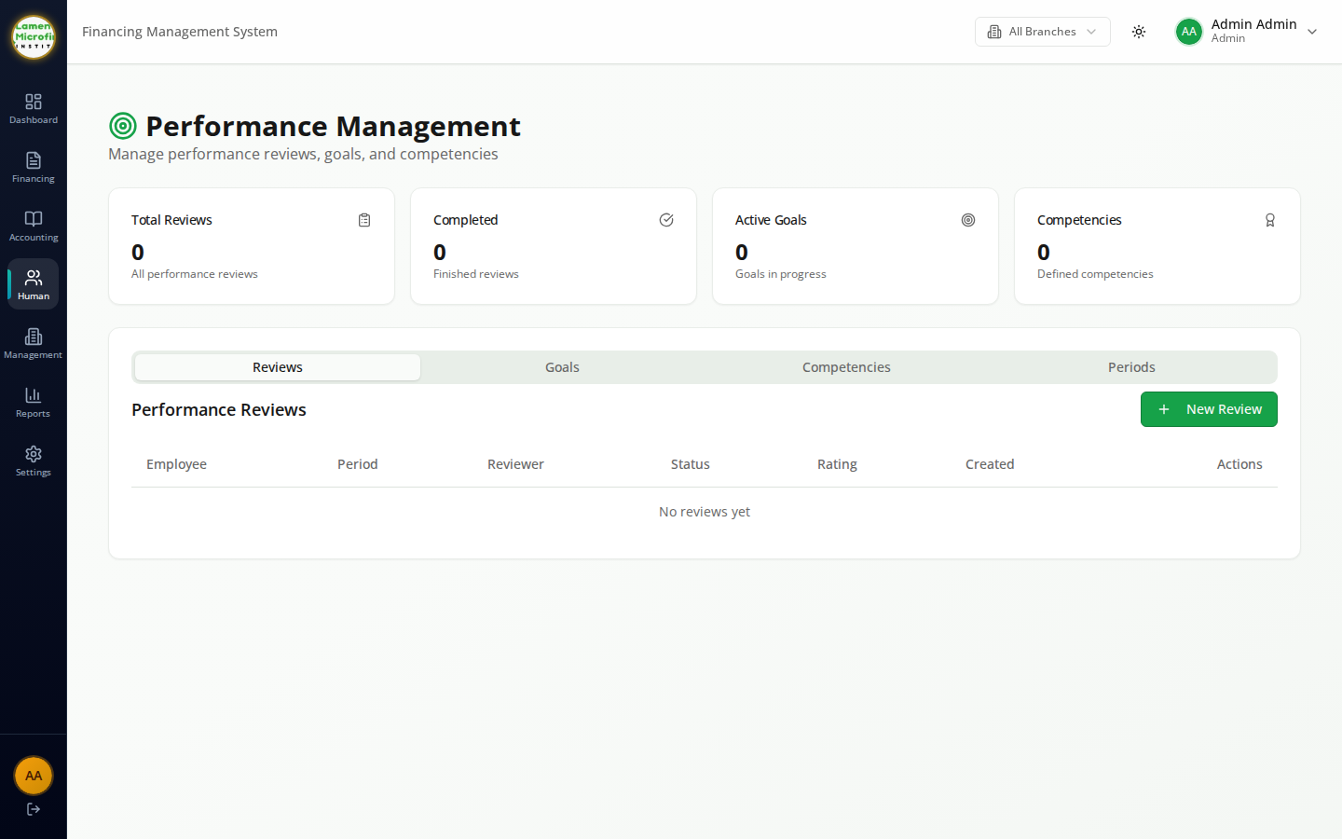
HR
Performance
WHAT THIS SCREEN DOES
Review cycles, goals and ratings per employee and department.
Surfaces ratings on the HR dashboard so management has a live view of workforce performance.
Lamen Microfinance • Loan Management System

Slide 25
ADMIN
Administration & Configuration
Branches, users, role-based permissions and activity logs that keep the institution running safely.

Slide 26
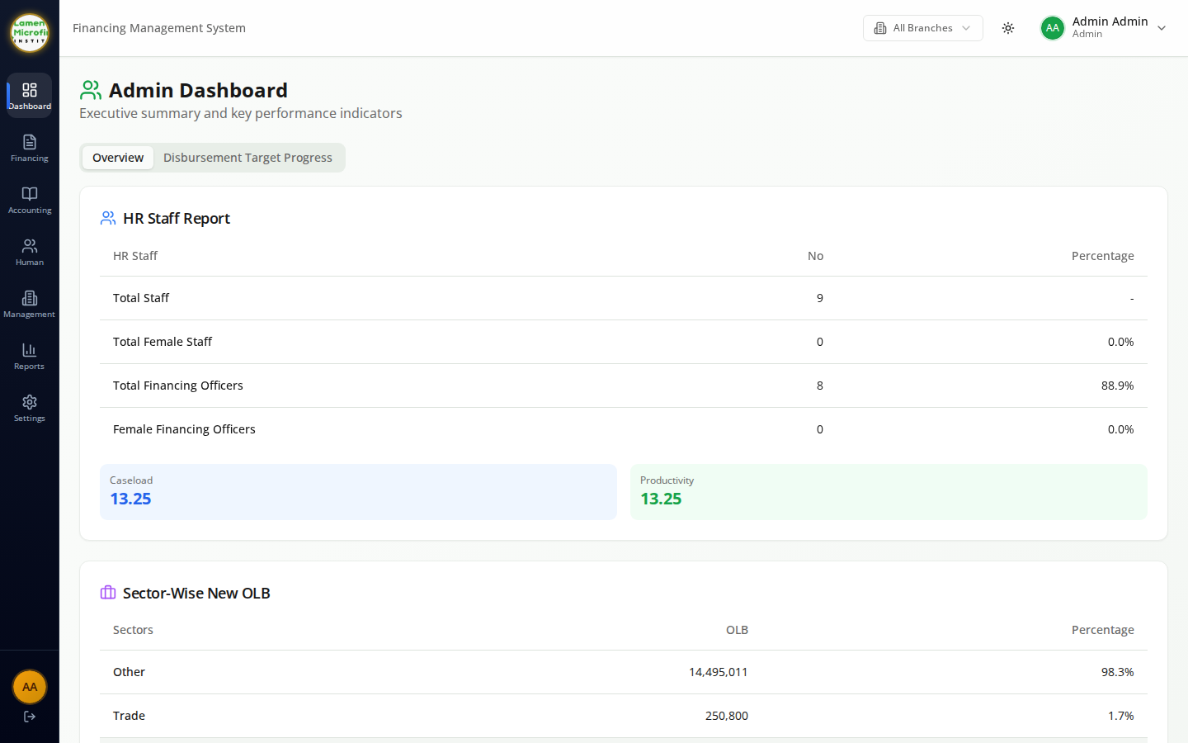
ADMIN
Admin Dashboard
WHAT THIS SCREEN DOES
Executive view combining HR staffing, sector exposure and branch productivity.
Includes disbursement target progress so management can track plan vs. actuals.
Lamen Microfinance • Loan Management System

Slide 27
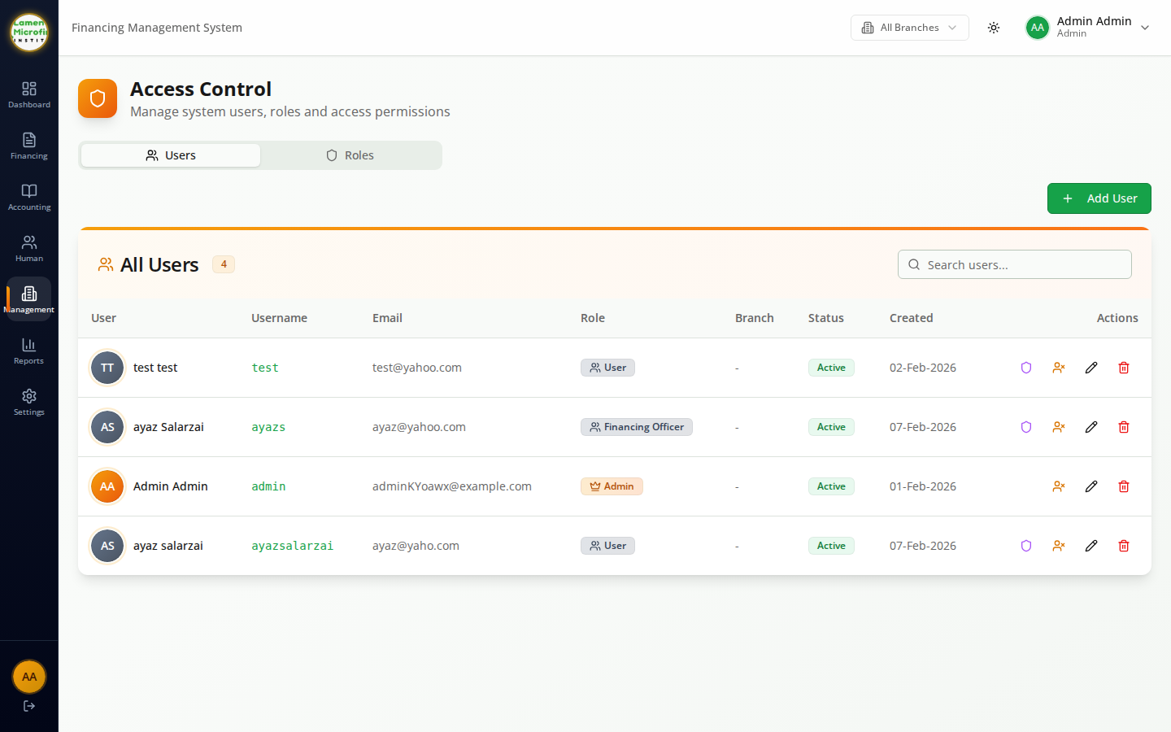
ADMIN
Users
WHAT THIS SCREEN DOES
Manage system users — create accounts, assign branches and reset passwords.
Activate or deactivate users without losing the audit trail of their actions.
Lamen Microfinance • Loan Management System

Slide 28
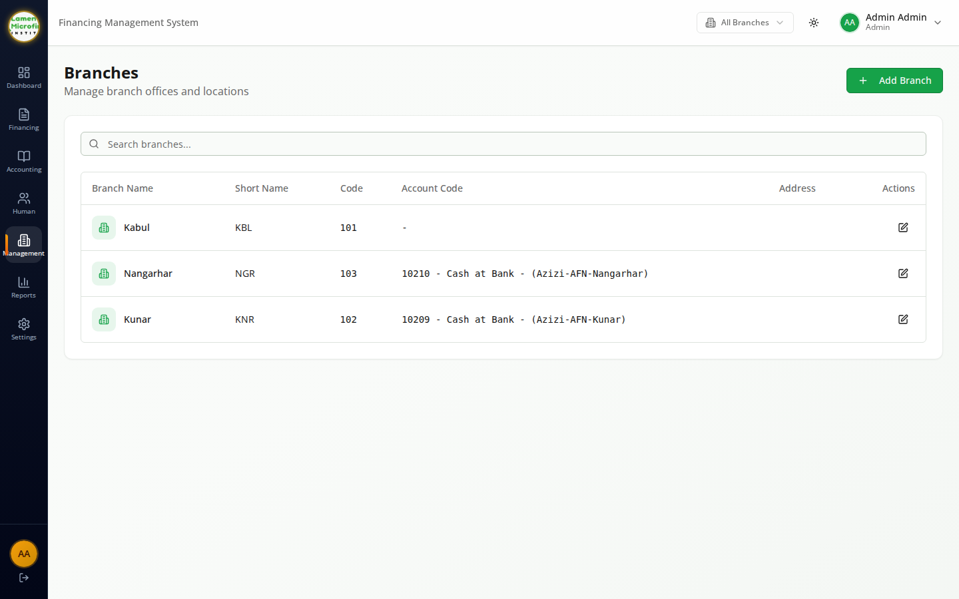
ADMIN
Branches
WHAT THIS SCREEN DOES
Maintain the institution's branch network — names, regions, codes and operational status.
Branch is a first-class dimension across loans, accounting, HR and reports.
Lamen Microfinance • Loan Management System

Slide 29
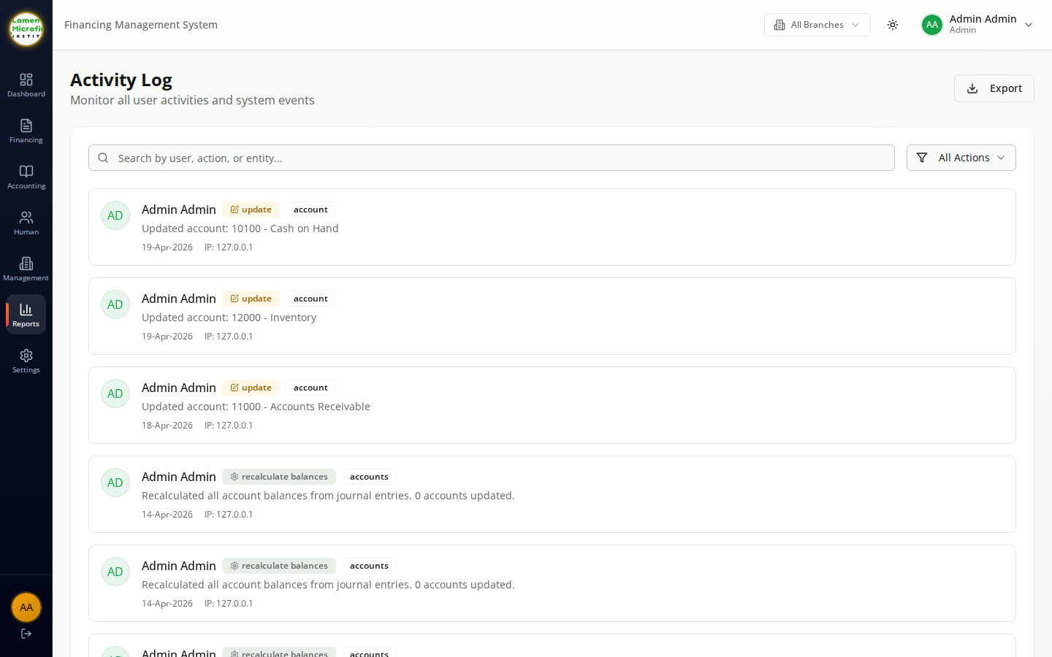
ADMIN
Activity Log
WHAT THIS SCREEN DOES
Full audit log of user actions across the platform with timestamps and source IP.
Filter by user, action or entity to investigate issues or satisfy compliance reviews.
Lamen Microfinance • Loan Management System

Slide 30
MOBILE
Field Officer Mobile App
Active financing, new applications and collections from any phone.

Slide 31
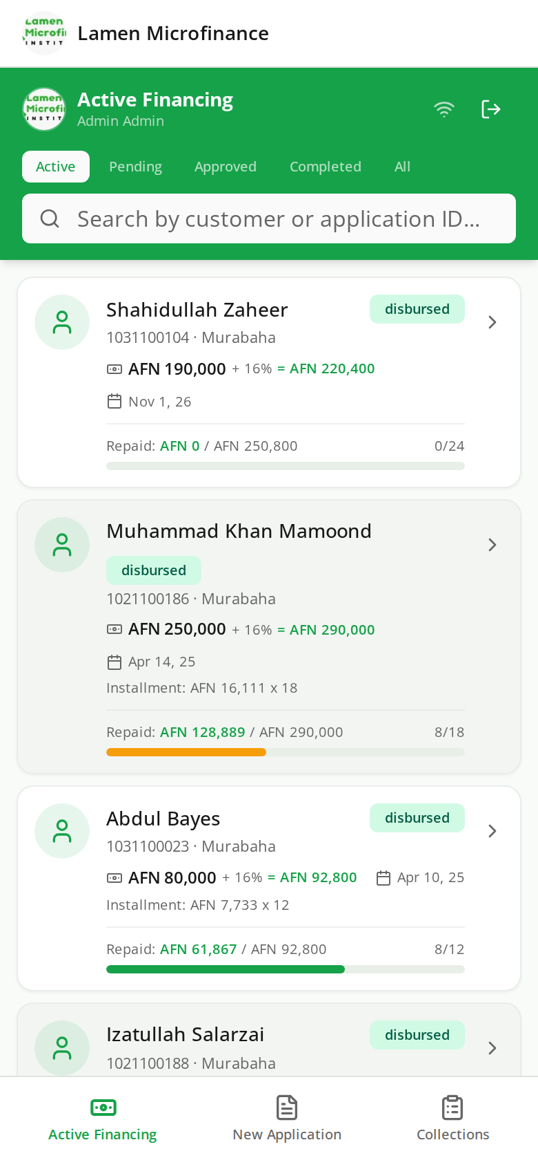
MOBILE
Mobile — Active Financing
WHAT THIS SCREEN DOES
Field officers see all active Murabaha contracts assigned to them with a quick repayment progress bar.
Tabs for Active, Pending, Approved, Completed and All make it easy to triage from the field.
Tap any customer to view their full contract details.
Lamen Microfinance • Field Officer Mobile App

Slide 32
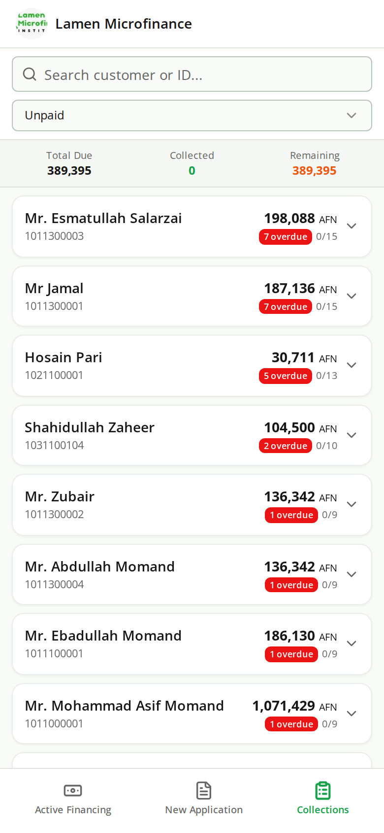
MOBILE
Mobile — Collections
WHAT THIS SCREEN DOES
Lists today's installments due so officers can confirm and record collections on the spot.
Recorded payments sync back into the collections, journal and dashboards in real time.
Lamen Microfinance • Field Officer Mobile App

Slide 33
ONE PLATFORM, FROM ONBOARDING TO REGULATORY REPORTING
Why Lamen Microfinance
Shariah-compliant Lifecycle
Built-in Accounting
Regulatory & Risk
End-to-end Murabaha origination: application, FAD review, risk & compliance, committee voting, disbursement, repayment scheduling and PAR tracking.
Full chart of accounts, journal entries, trial balance, income statement, balance sheet and cash flow — with branch-level dimensions.
DAB reports, loan classification, citizen balance statements, LCTR and a library of operational and shareholder reports out of the box.
HR & Workforce
Field Officer Mobile App
Branches, Roles & Permissions
Employees, departments, attendance, leave, payroll, recruitment, performance reviews and training in the same workspace.
Officers can review active financing, file new applications, and record collections from any phone — with the same auth and data model.
Multi-branch operation with granular page permissions, user management and an audit-friendly activity log.
Lamen Microfinance Loan Management System

