Slide 2
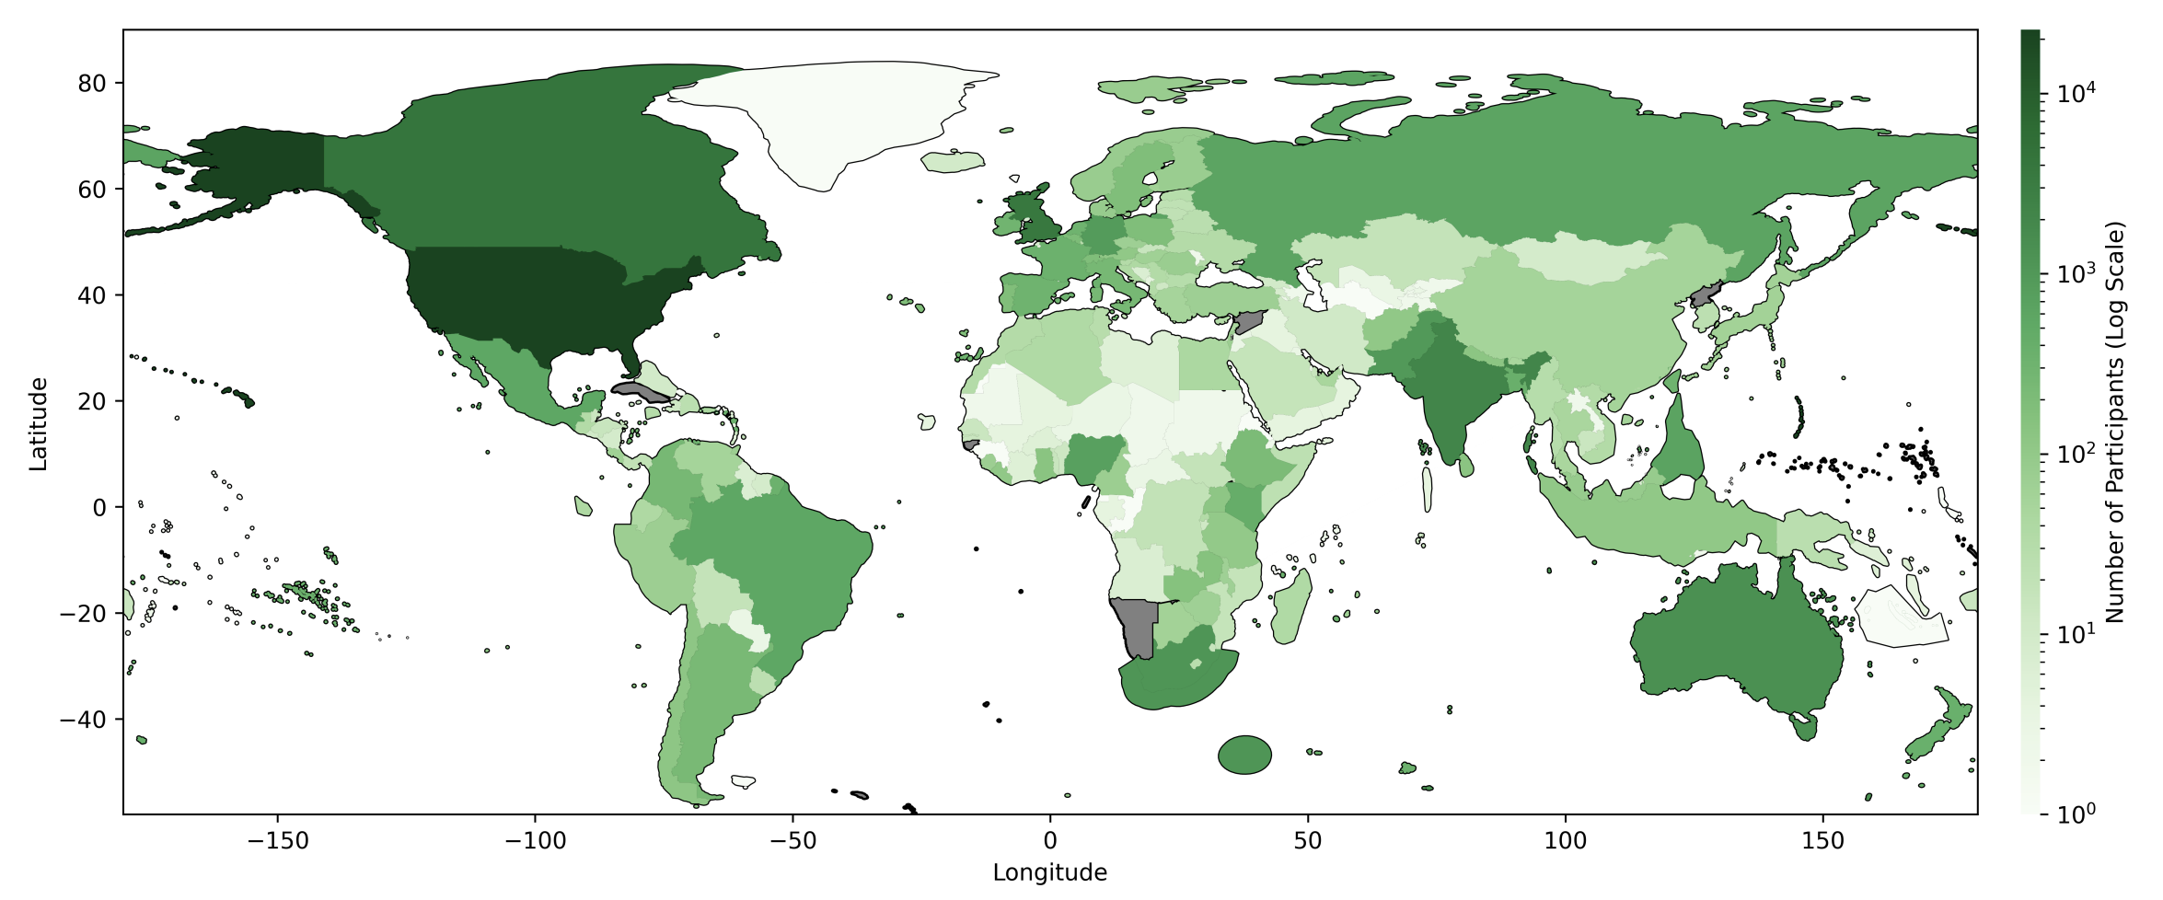
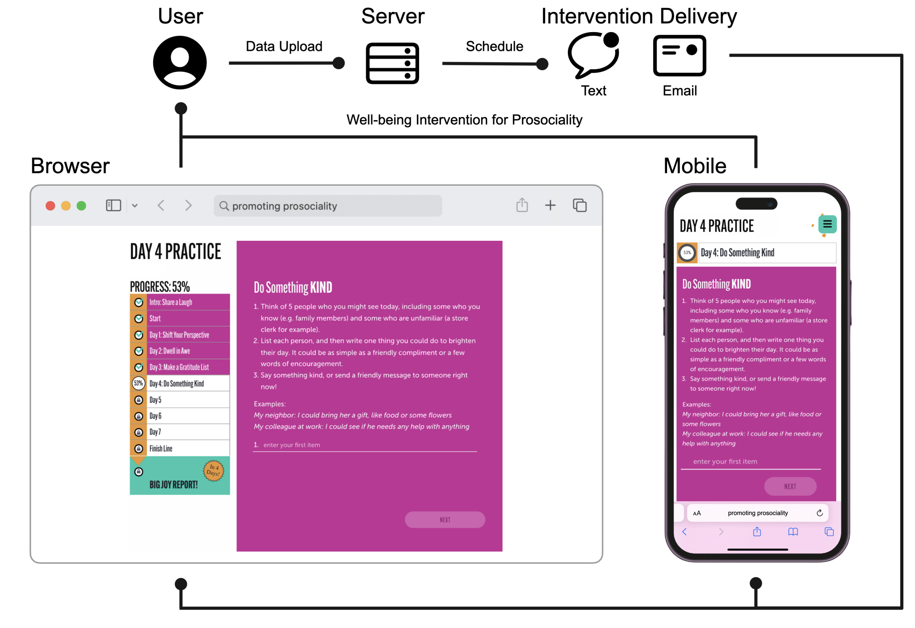

Slide 3
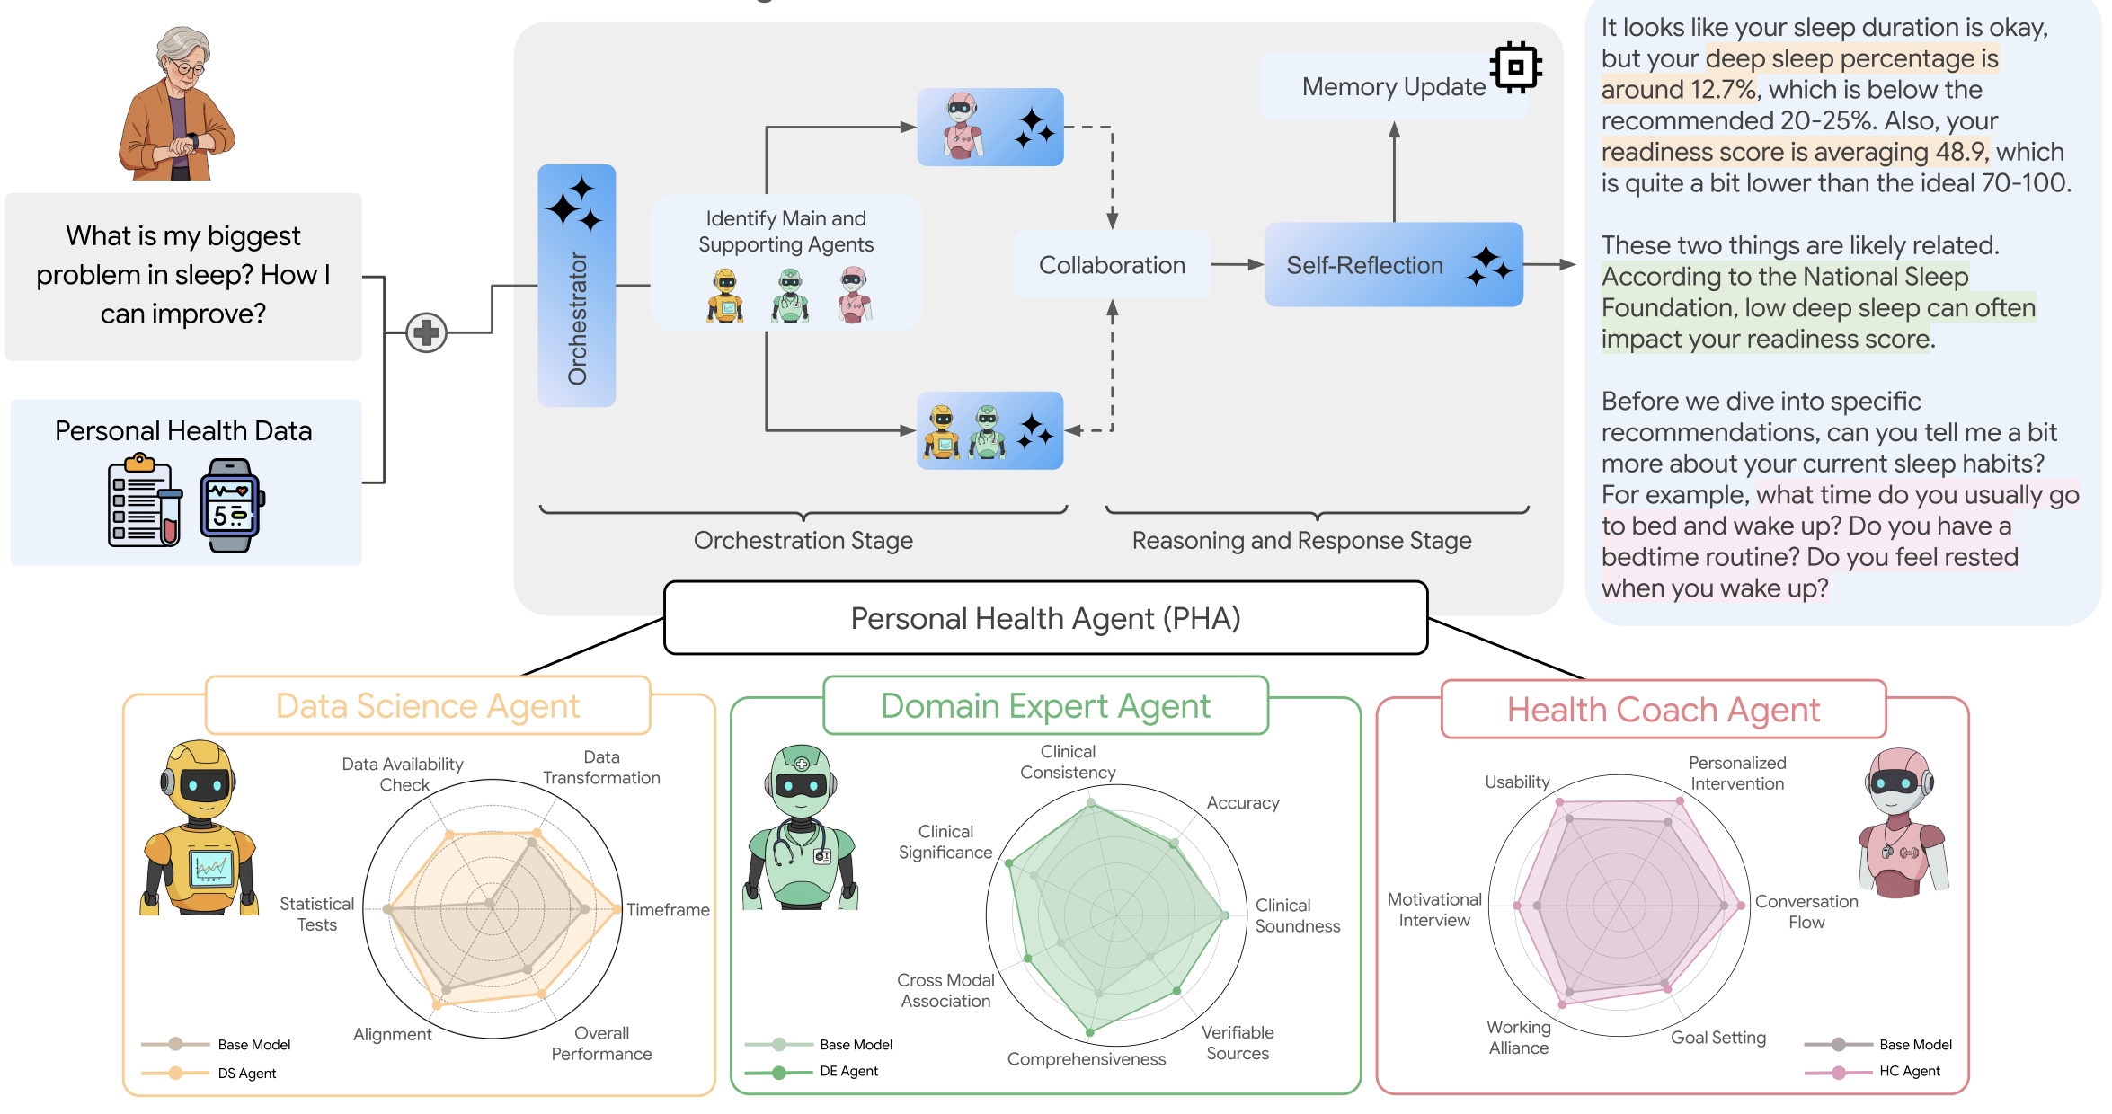

Slide 4
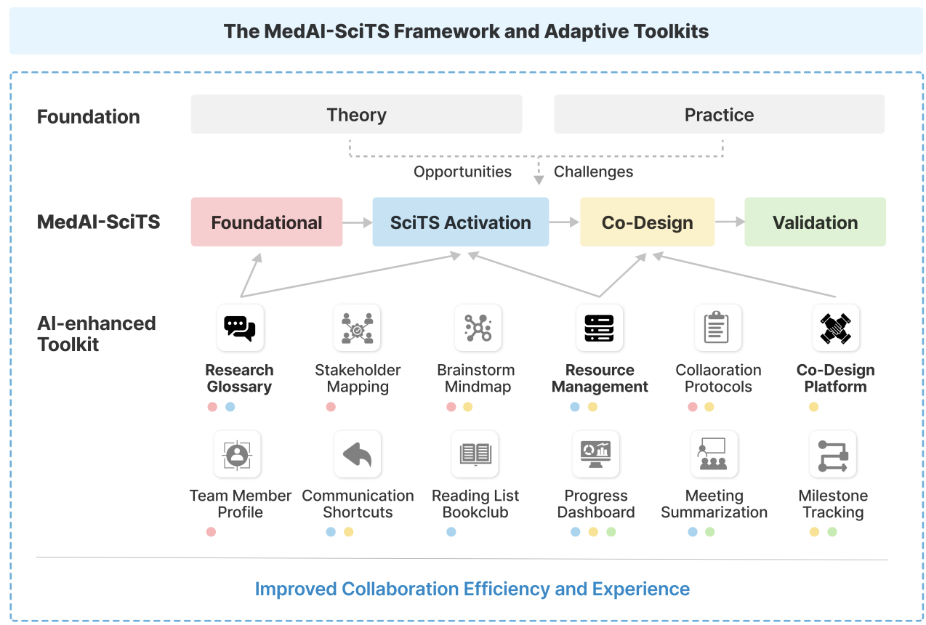

Slide 5
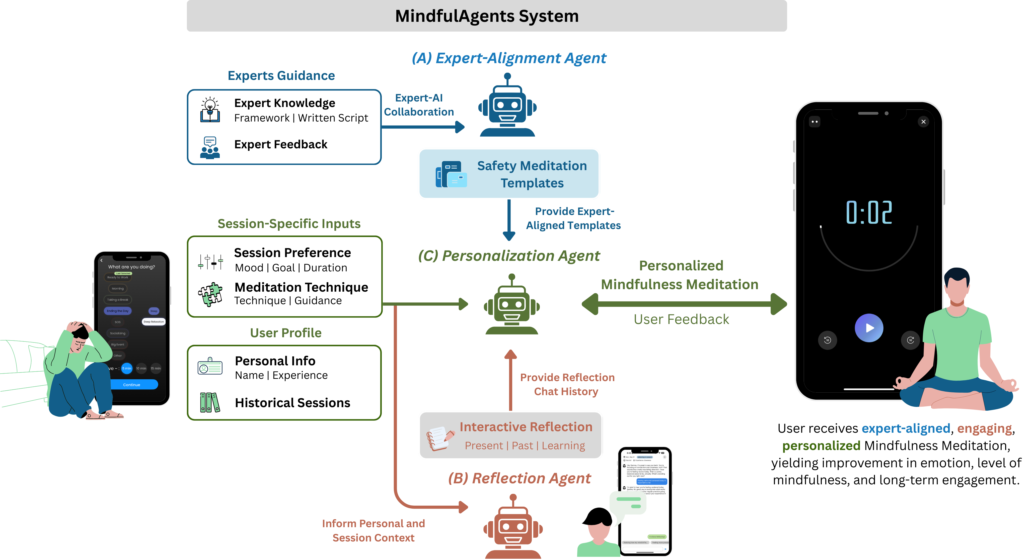

Slide 6
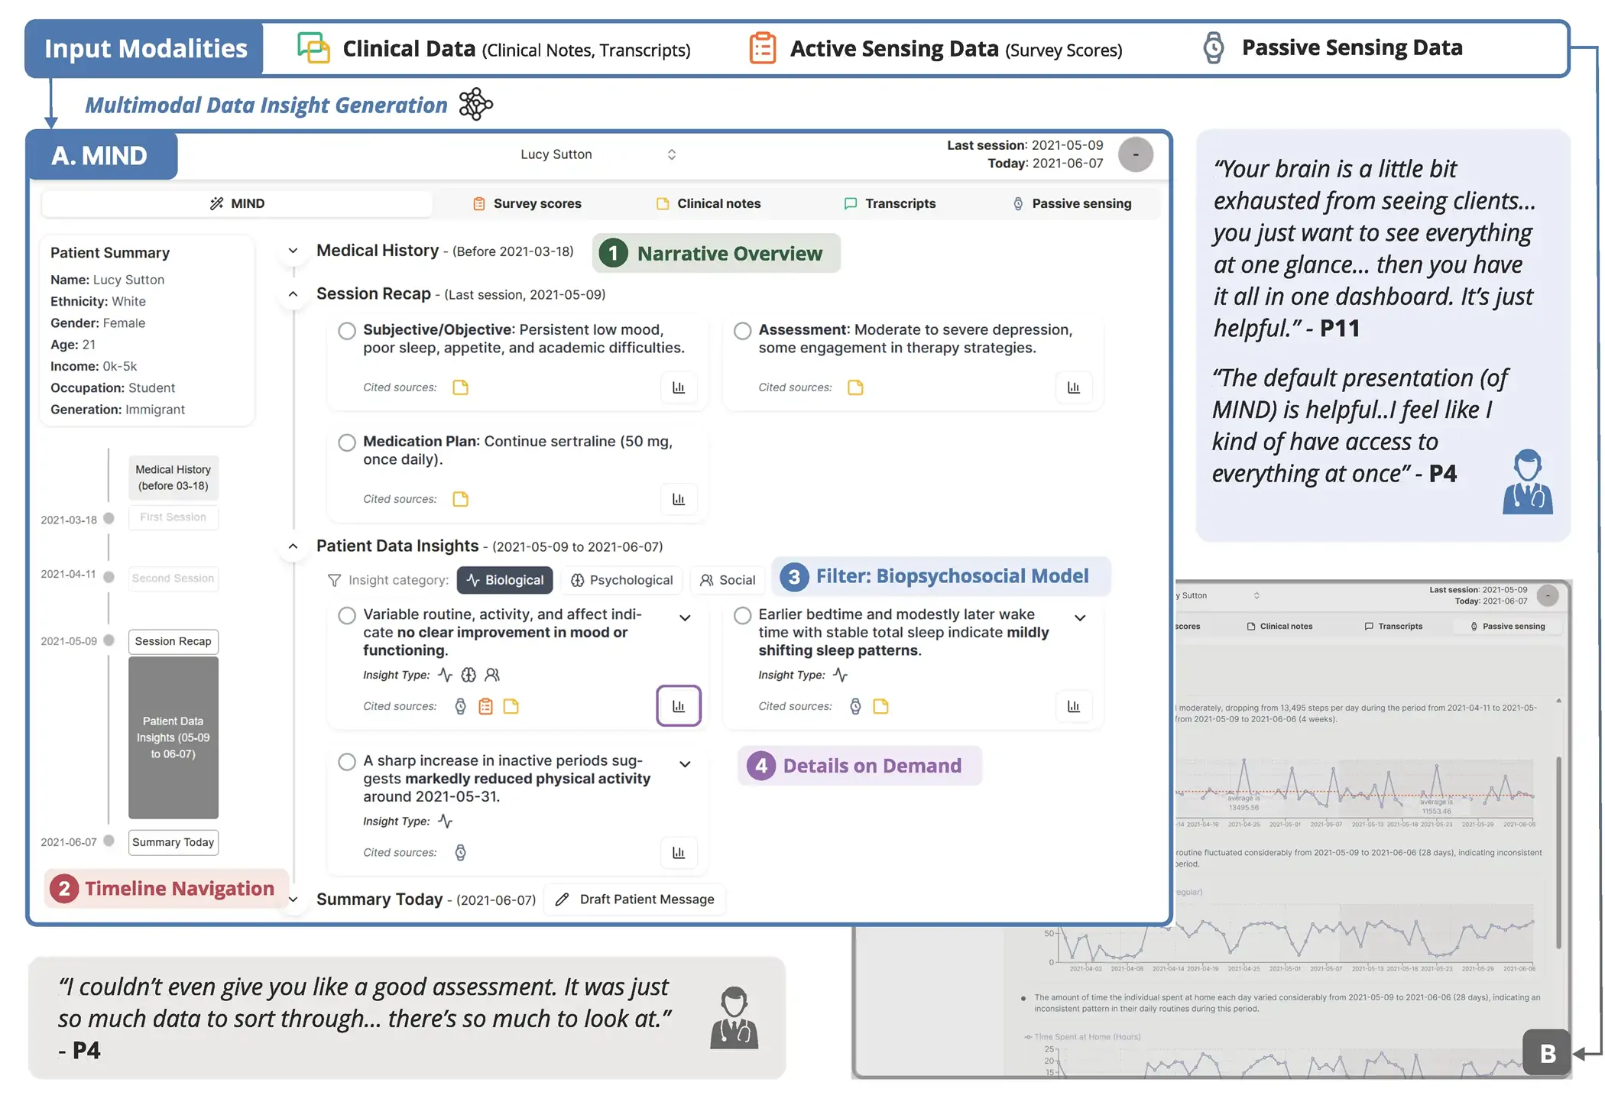

Slide 7
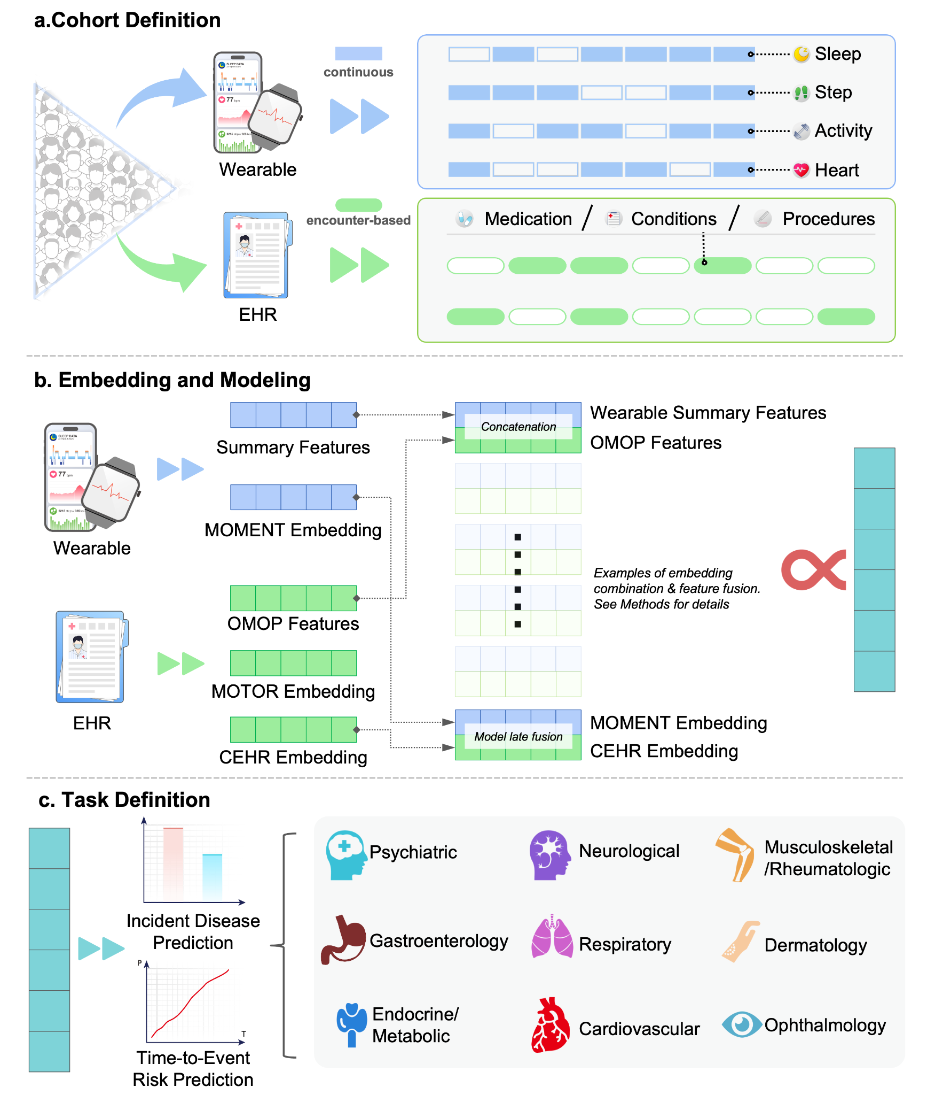

Slide 9
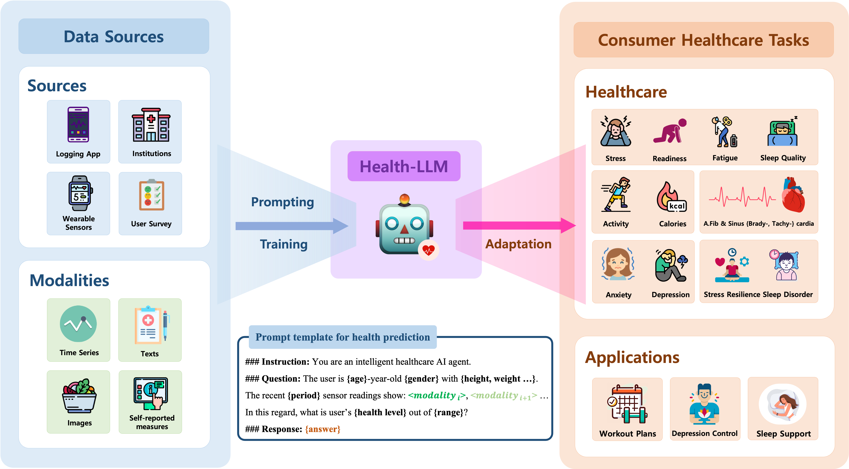

Slide 10



􀉪
􀉪
􀉪
􀉪
􀉪
􀉪
>10,000 Users
6 LLMs
Stress
Suicide
Zero-Shot
Depression
Few-Shot
6 Mental Health Tasks
Instruction-Finetuning

Slide 11
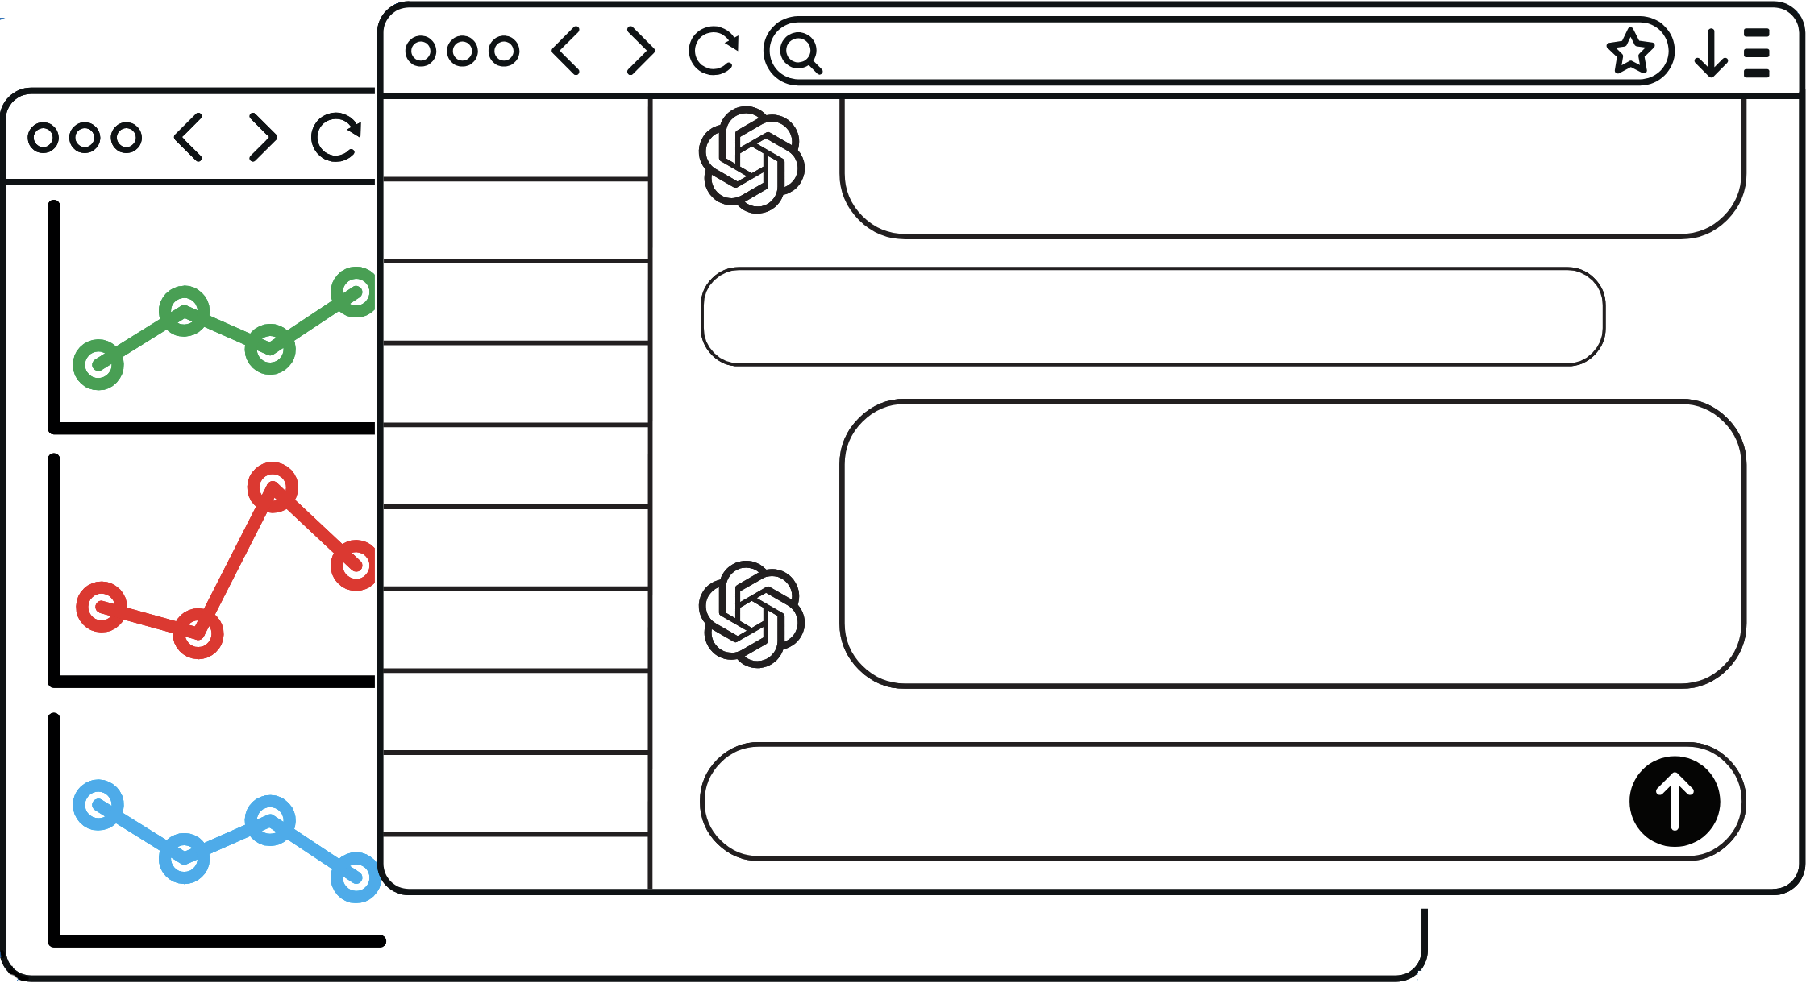

LLM-Powered Interpretation
for Wearable Data

Slide 12
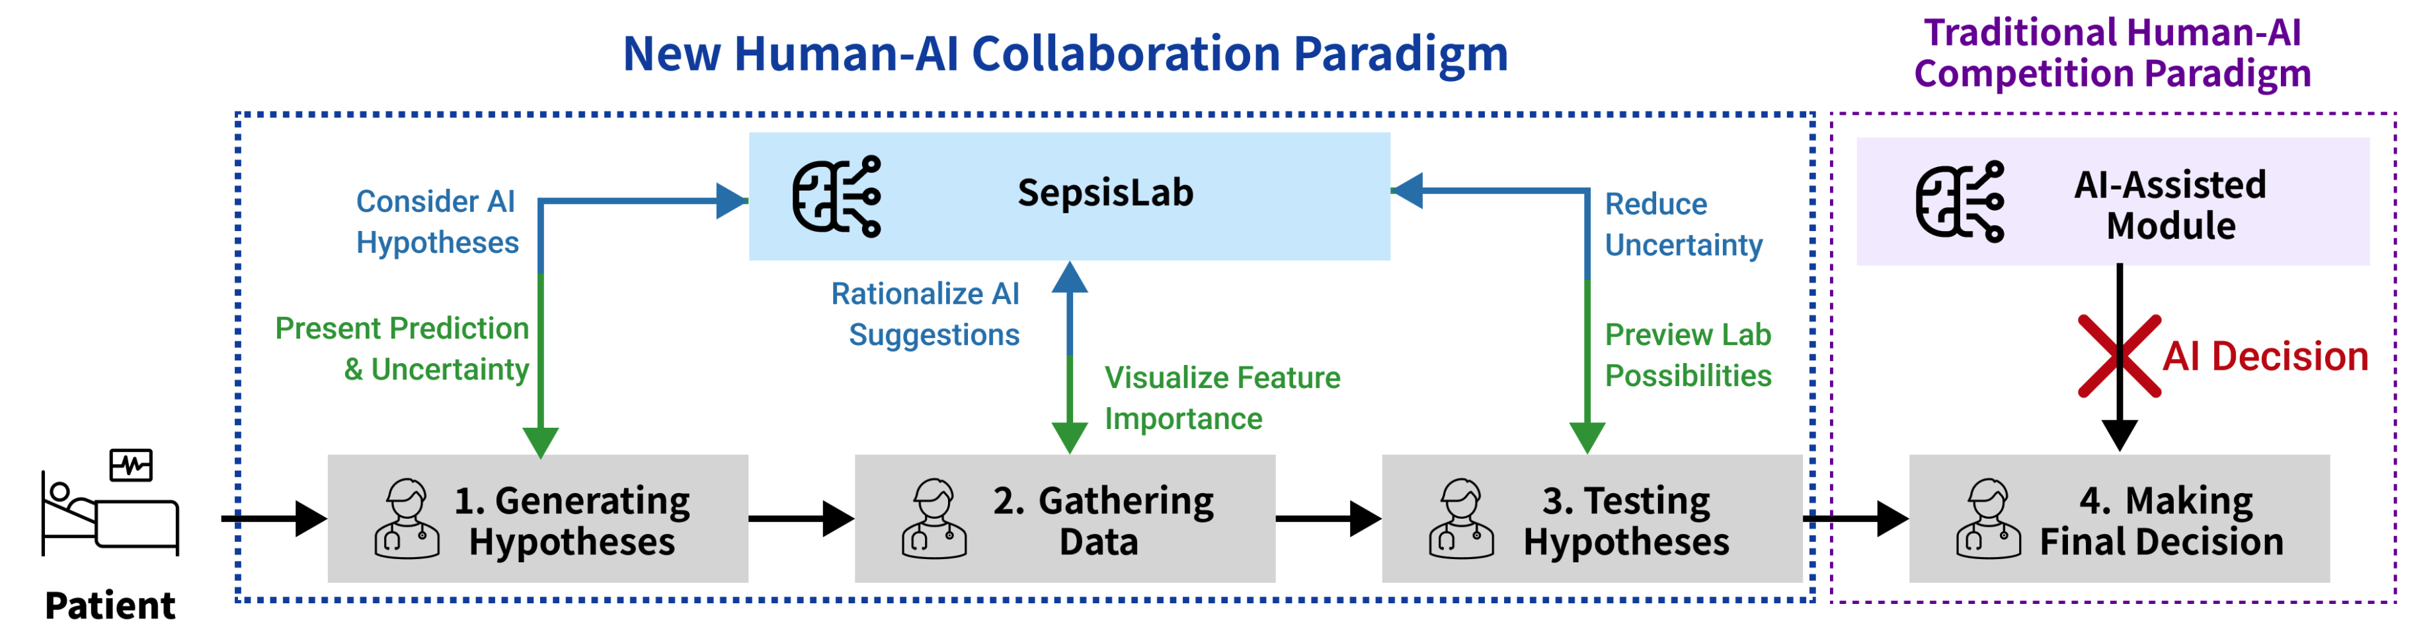
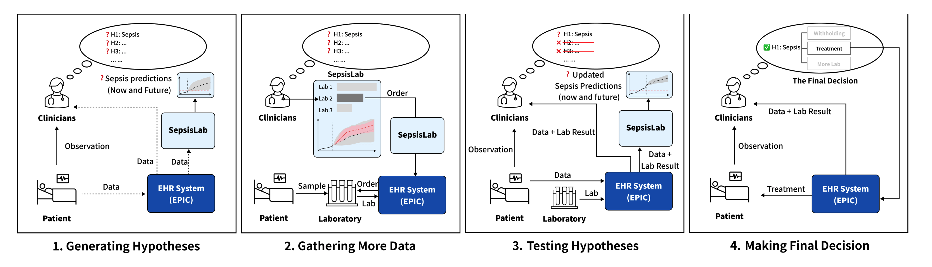

Slide 13


Slide 14
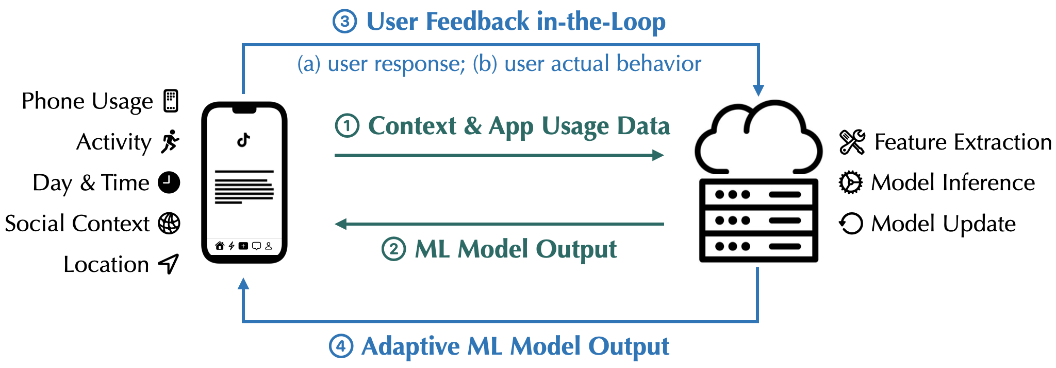
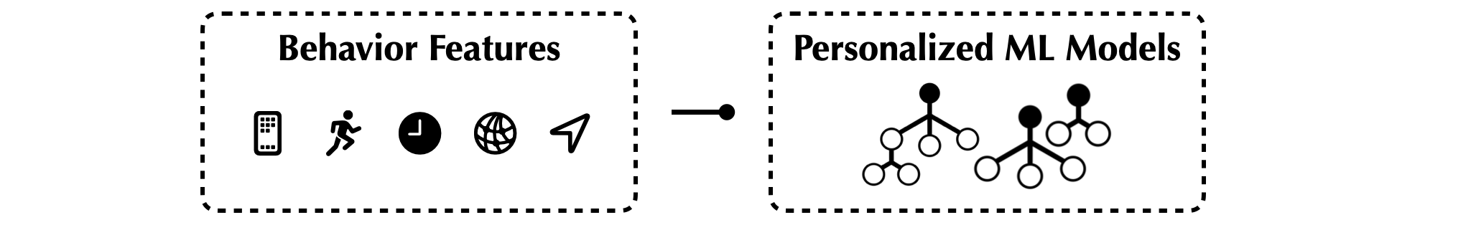
AI-Powered JITAI System for Phone Addiction
AI Evolving with Users in Longitudinal Deployment

Slide 15
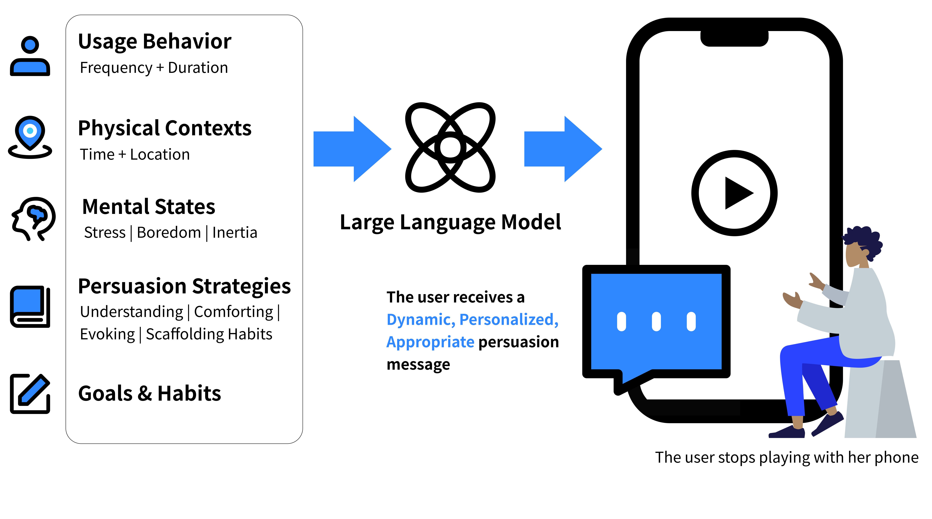
LLM-Powered Intervention for Phone Addiction

Slide 16
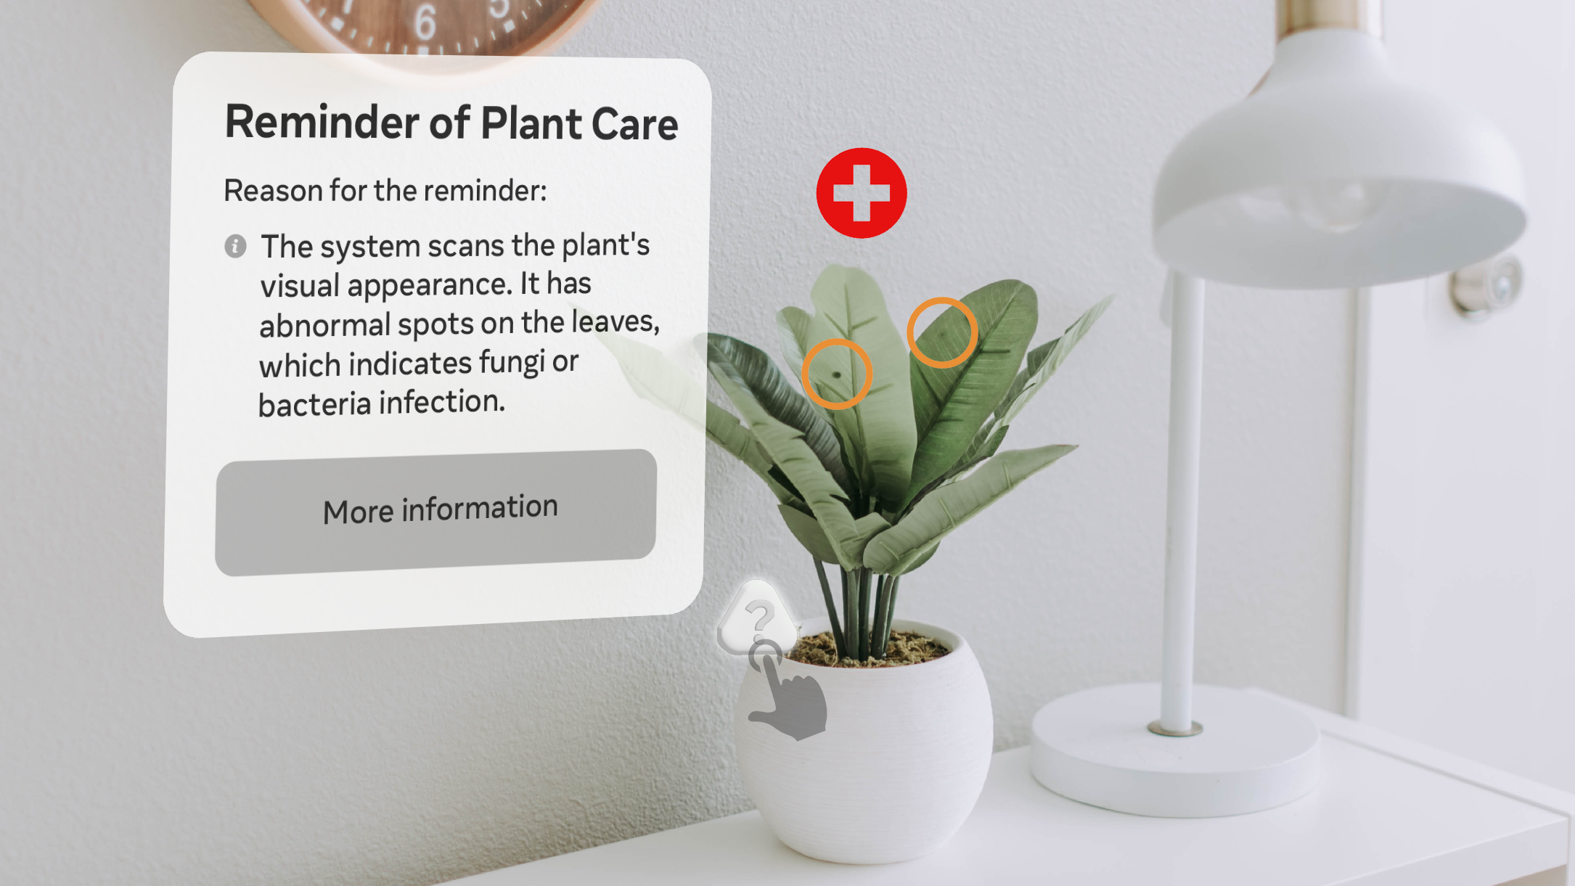

Slide 17
