Slide 1
National Cipher Challenge
A beginner’s guide to codes and ciphers
Part 3, the affine shift cipher

Slide 2
We have seen that the Caesar shift cipher is easy to break because it only has 26 keys. Inventing new ciphers is not easy, but maths can come to the rescue. To start we reformulate the Caesar shift using modular arithmetic.
Notes:
A modern cipher has two components, an algorithm and a key. For the Caesar shift the algorithm is “rotate the alphabet” and the key is the amount of rotation, measured by where the letter A moves to.

Slide 3
Arithmetic mod 26
Replace each letter by a number starting with A=1, B=2 and so on.
Choose a key as a number between 1 and 26.
Encrypt text by adding the key to each number from step 1.
Read off the cipher text by translating the new numbers back to letters using the encoding 1=A, 2=B, …

Slide 4
Hang on, that doesn’t work!
Suppose we choose the key k=8 and we want to encrypt the letter S
First we replace S by the number 19.
Then we add on 8 to get 27.
But there is no letter labelled 27, the biggest is 26 which stands for Z.

Slide 5
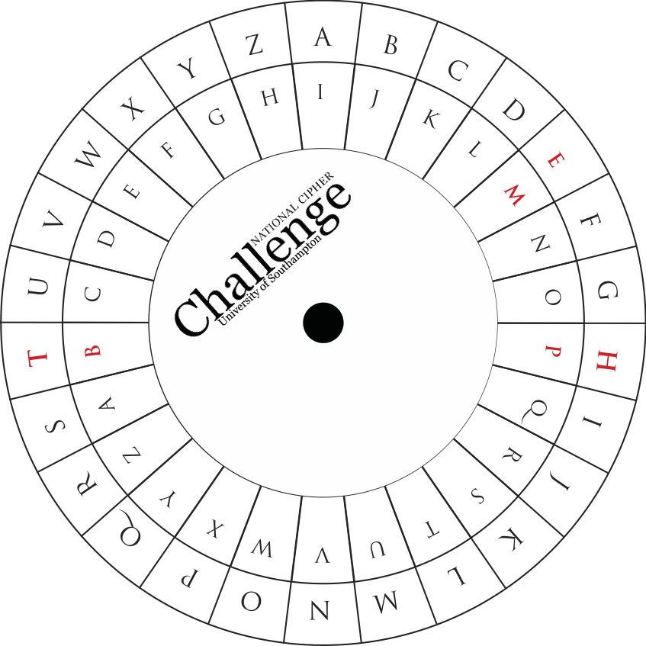
The cipher wheel suggests what we should do

Slide 6
The cipher wheel suggests what we should do
We wrap around the wheel. When we get to 27, that wraps back to 1 which represents the letter A.
So the letter S is encrypted as the letter A.
This should be familiar as the way we add hours on a 24 hour clock.
8 hours after 19:00 hours is 03:00 hours, not 27:00 hours. We just wrap around at 24. Similarly 8 hours after 11am can be described as 7pm, wrapping round at 12.

Slide 7
Modular arithmetic was invented by Karl Friedrich Gauss
1+2+3+…+100? That’s easy, it is 5050.
He was a child genius who reinvented mathematics as an adult, discovering new forms of geometry, inventing the normal distribution in statistics and revolutionizing number theory.
Notes:
There is a (probably apocryphal) story that when Gauss was 8 his class were challenged to add the numbers from 1 to 100. Gauss worked out the trick, pairing 1 with 100, 2 with 99 and so on to quickly give the correct answer 5050. The story might not be true, but he invented so many clever ideas it is at least believable.

Slide 8
The great thing is that we can multiply in clock arithmetic as well as add.
Example: Suppose it takes 25 minutes to mark an exam and a further 15 minutes to write up the marks list. If you have 38 scripts to mark and you start at 6pm, what time will you finish?
Notes:
38*25= 950=900+50 = 15 hours and 50 minutes, or 38*25 = 50 mod 60. 6+15=21=12+9 (or, in modular arithimetic 6+15=9 mod 12) so 15 hours after 6pm is 9am, and you will finish marking at 10 minutes to 10 in the morning. A further 15 minutes for the marks list takes you to 5 past 10 since 50+15=5 mod 60.

Slide 9
The affine shift cipher
Replace each letter by a number starting with A=1, B=2 and so on.
For the key, choose two numbers a, b between 1 and 26.
Encrypt text by multiplying each number from step 1 by a and adding b to each of the answers.
Read off the cipher text by translating the new numbers back to letters using the encoding 1=A, 2=B

Slide 10
Example
Choose a=3, b=7.
We will encrypt the word “Affine” using this key.
First replace A by 1, f by 6, i by 9, n by 14, e by 5.
Multiplying by 3 and adding 7 gives 10, 25, 25, 8, 23, 22 mod 26.
Which we convert to the letters:
J Y Y H W V
This is not a Caesar shift cipher because of the multiplication by 3.

Slide 11
How on earth can we crack that cipher?

Slide 12
What have we already learned about codebreaking?
Notes:
Good time to have a discussion around brute force and team work, and to remind them about frequency analysis

Slide 13
Let’s try to decipher the following affine shift cipher using intelligent brute force
kar karvez dh kavevnxa
Guessing that KAR = THE
THE karvez dh kavevnxa
So K= T, A=H and R=E
THE THEvez dh THvevnxa
Notes:
Modular inverses will be discussed in lesson plan 4, but here we will just use intelligent guessing.

Slide 14
But now we are stuck!
We can try guessing a bit more.
What six letter words start THE?
A Scrabble (or crossword) dictionary is really useful for this:
http://www.crosswordsolver.org

Slide 15
In computing this would be called
Using a lookup table

Slide 16
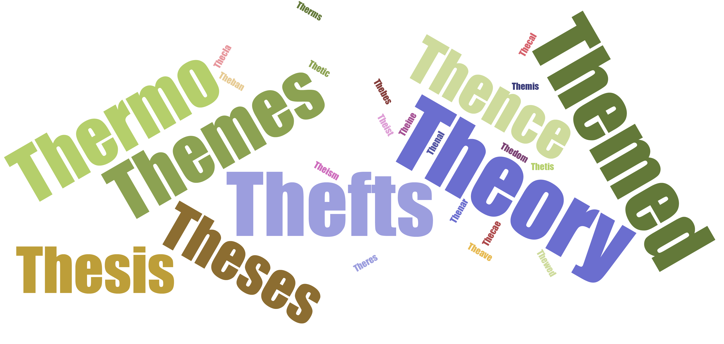
Looking up 6 letter words starting THE gives
Notes:
The smaller words in the word cloud are very rarely used. We can’t be certain they are wrong, but it is a good first guess.

Slide 17
We can rule out some of these
Notes:
We are working on the assumption that E is encrypted as R, so none of the words can have E in the last three letters. Similarly the last three letters must all be different.

Slide 18
This leaves us with a list of three possibilities
Thefts
Thermo
Theory

Slide 19
THE THEvez dh THvevnxa
Trying the word THEFTS would give us
V->F, E->T, Z->S
Which doesn’t work too well!
THE THEFTS dh THFTFnxa
Notes:
There is no word in English beginning THFTF.

Slide 20
THE THEvez dh THvevnxa
Trying the word THERMO would give us
V->R, E->M, Z->O
Which doesn’t work too well!
THE THERMO dh THRMRnxa
Notes:
There is no word in English beginning THRMR.

Slide 21
THE THEvez dh THvevnxa
Trying the word THEORY would give us
V->O, E->R, Z->Y
Which is much more promising!
THE THEORY dh THOROnxa
Notes:
There is a word in English beginning THORO, and the crossword dictionary comes to our aid once more! There is only one, and it is THOROUGH!

Slide 22
THE THEORY dh THOROUGH
Notes:
A smart guess would be that DH represents IS, to complete the decryption.

Slide 23
This text was encrypted using the affine shift x->3x+3.
THE THEORY IS THOROUGH
Notes:
This text was encrypted with the affine shift x->3x+3.

Slide 24
Next time: How we could have discovered this with less guesswork (and, even better, less work).

