Slide 1
National Cipher Challenge
A beginner’s guide to codes and ciphers
Part 4, breaking the affine shift cipher using modular inverses

Slide 2
Breaking a cipher is like solving an equation.
Notes:
A modern cipher has two components, an algorithm and a key. For the Caesar shift the algorithm is “rotate the alphabet” and the key is the amount of rotation, measured by where the letter A moves to.

Slide 3
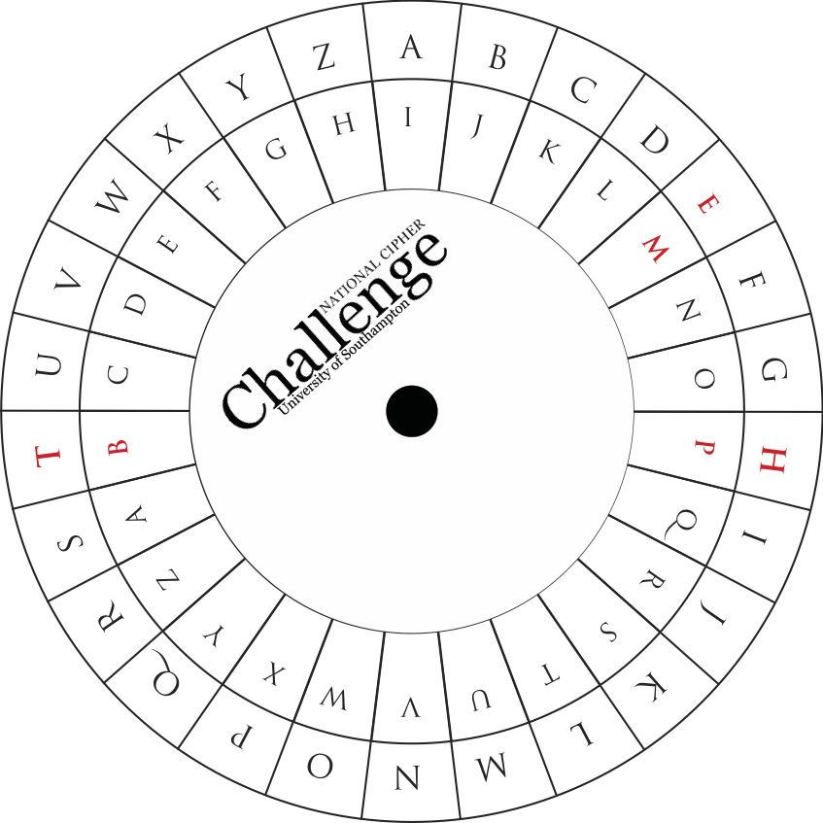
We can think of the Caesar shift cipher as “adding” in mod 26 arithmetic.

Slide 4
So decrypting is just like solving the equation y = x + b by rewriting it as y – b = x
Where:
x is the number representing the plain-text letter y is the number representing the encrypted letter b is the amount of the shift

Slide 5
Now let’s think about the affine shift cipher.

Slide 6
That can be written as x → ax + b so decrypting is just like solving the equation y = ax + b.

Slide 7
The first step in the solution is easy: x = ax + b so y – b = ax so y – b = x a

Slide 8
You can’t divide like this in modular arithmetic!
y – b = x a
You can add, subtract and multiply, but you can’t divide.

Slide 9
Let’s try an example to see what we should do
x → 3x + 5
A | B | C | D | E | F | G | H | I | J | K | L | M
H | K
N | O | P | Q | R | S | T | U | V | W | X | Y | Z
Notes:
Remind the class that we encode A as 1, B as 2 etc, then apply the affine shift x -> 3x +5 so 1 -> 3+5=8, 2->6+5=11 and so on, then we recode using letters so A->H, B-> K and so on. Point out that once you know where A goes then B goes three steps further round the wheel. Use the cipher wheel handout with blank inner wheel to implement the ciphers x -> 3x + 5.

Slide 10
Let’s try an example to see what we should do
x → 3x + 5
A | B | C | D | E | F | G | H | I | J | K | L | M
H | K | N | Q | T | W | Z | C | F | I | L | O | R
N | O | P | Q | R | S | T | U | V | W | X | Y | Z
U | X | A | D | G | J | M | P | S | V | Y | B | E

Slide 11
Notes:
Time to use the whiteboard: The letter I maps to F which in numerical terms tells us that 3*9 + 5 is congruent to 6 mod 26. subtracting 5 tells us that 3*9 is congruent to 1 mod 26, which it clearly is so “dividing by 3” is the same as “multiplying by 9” and that is how we solve the equation

Slide 12
So dividing by 3 is illegal, but multiplying by 9 has the same effect and is fine!
All we need to do to undo multiplication by a is to find a number d so that da is the same as 1 mod 26.
We usually denote d as a⁻¹

Slide 13
Here is a table for some of these magic inverses
1 | 2 | 3 | 4 | 5 | 6 | 7 | 8 | 9 | 10 | 11 | 12 | 13
1 |  | 9 |  | 21 |  | 15 |  | 3 |  | 19
14 | 15 | 16 | 17 | 18 | 19 | 20 | 21 | 22 | 23 | 24 | 25 | 26
 | 7 |  | 23 |  | 11 |  | 5 |  | 17 |  | 25
Notes:
If you want an activity for less able students this discussion of inverting mod 26 could be replaced by building cipher wheels to implement the encyption x->3x+b and the decryption x->9(x-b). Just fill in the blank inner wheels on a pair of cipher wheels with the letters C, F, I, (every third letter in turn until they are all used) and I, R, A (every ninth letter in turn) to get the wheels you need. You could discuss how technology enabled people to build better machines for enciphering and talk about the Enigma machine.

Slide 14
What about the gaps in this table? What happens if we try to build a cipher wheel for the affine shift x → 2x + 5 instead?
Notes:
As a class start to fill in the wheel with every other letter A, C, E, G, etc. Let them discover that half the letters appear twice and half don’t appear at all.
Discuss why this makes the shift x -> 2x useless as part of a cipher.

Slide 15
What other affine shifts don’t work?
Notes:
Discuss the fact that if a is even then you will always get the same behaviour as if a is 2, and that 13 is even worse. Discover the fact that divisors of 26 are the problem.
For a stronger group talk about common factors, the greatest common divisor and coprime numbers and explain that the transformations that can be used are x -> ax+b where a and 26 are coprime.
For more discussion: bigger alphabets, maybe including punctuation or numerals, would require a bigger modulus, but the same ideas work.

